Slide 1
Hilary Marland
This is your Warwick life…

Slide 2
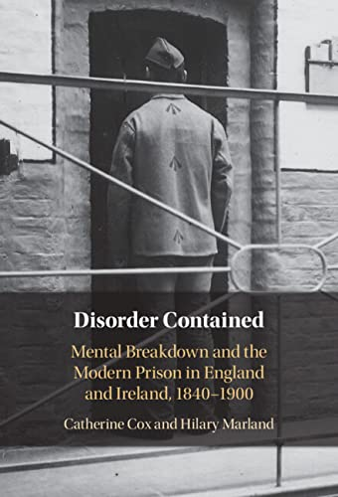
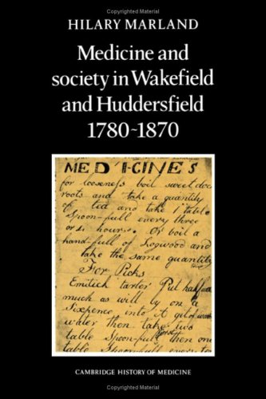
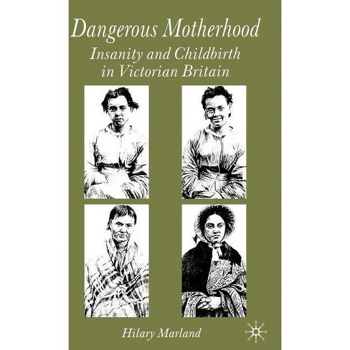
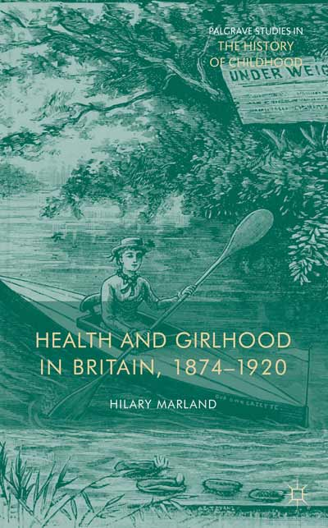
In Books…

Slide 3
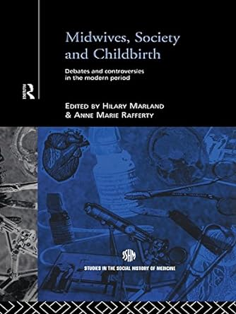
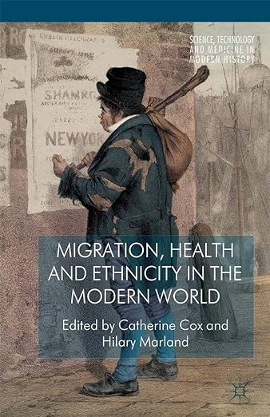
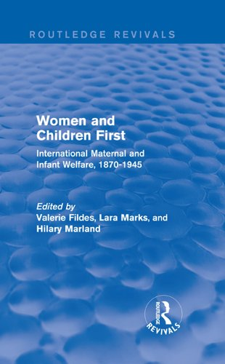
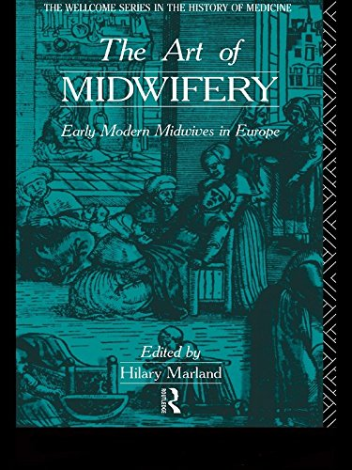
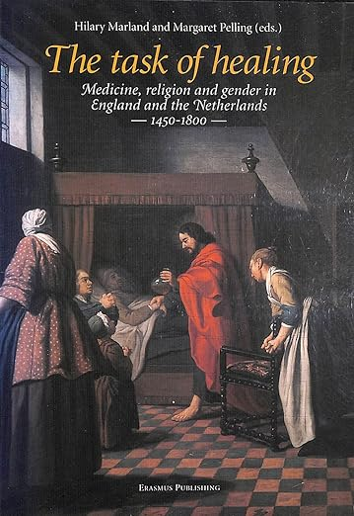
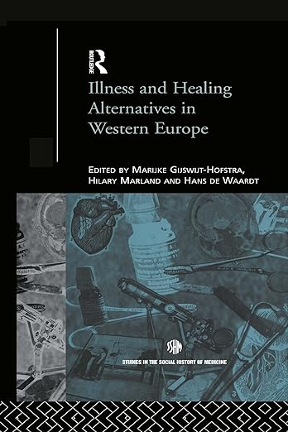
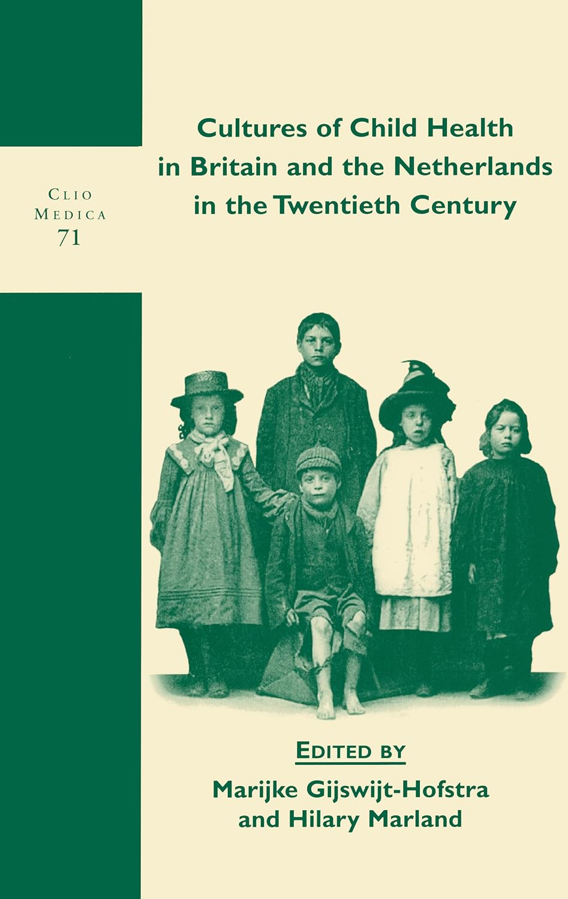
In Edited Volumes…

Slide 4
In Doctoral Students…
Cathy McClive, 'Bleeding Flowers and Waning Moons: A History of Menstruation in France, c.1495-1761' (completed 2004) Jane Adams, 'The Mixed Economy of Medical Services in Herefordshire c.1770-c.1850' (completed 2004) Vicky Long, 'Changing Public Representations of Mental Illness in Britain, 1870-1970' (completed 2004) Sheryl Root, 'Healing and Touch, c.1890-1950' (completed 2005) Lisa Petermann, 'The Development of Paediatrics in France and England, 1760-1883' (completed 2007) Kathryn Miele, 'Representing Empathy: The Defence of Vulnerable Bodies in Victorian Medical Culture' (completed 2008) Judith Lockhart, '"Truly a Hospital for Women": The Birmingham and Midland Hospital for Women, 1871-1948' (completed 2008) Brooke Whitelaw, 'Industry and the Interior Life: Work, Mental Health and Perceptions of Self in Britain, 1900-1951' (completed 2009) Sue Aspinall, 'Environmentalism in Representations of Women and Exercise in Britain 1880s to 1920s' (completed 2009) Gaby Robilliard, 'Midwives and Identity in Early Modern Germany' (completed 2010) | Stephen Soanes, 'Convalescence and the Public Asylum in England, 1918-39' (completed 2011) Emily Andrews, 'Old Age Mental Illness in Britain in the Nineteenth and Early Twentieth Century' (completed 2014) Josette Duncan, 'Medical Charities in Malta, Cyprus and the Ionian Islands in the Nineteenth and Early Twentieth Centuries' (completed 2014) Rebecca Noble, 'Madness and the Regulation of the Self in Bourbon Mexico’ (completed 2017) Jean Hwang, 'Women and Depression in Interwar Britain: Case Notes, Narratives and Experiences' (completed 2018) John Wilmott, 'Medical Dispensaries in Warwickshire: Their Place in Local Health Care, 1820-1880' (completed 2021) Sophie Greenway, 'Growing Well: Dirt and Health in the Home and Garden in Britain, 1930-1970' (completed 2022) Ute Oswald, 'Entertaining the Insane: Recreation in Nineteenth-Century British Asylums' (completed 2022) Louise Morgan, 'Eat Better, Not Less: Contextualising Clean Eating in Contemporary British History' (completed 2023)

Slide 5
In major funding…
2021 'The Last Taboo of Motherhood: Postnatal Mental Disorders in Twentieth-Century Britain’
£398,900
2014 Wellcome Senior Investigator Award, ‘Prisoners, Medical Care and Entitlement to Health in England and Ireland, 1850-2000’ (PI, with Dr Catherine Cox UCD) £536,532
2010 Wellcome Project Grant ‘Madness, Migration and the Irish in Lancashire, c.1850-1921’ (PI, with Dr Catherine Cox UCD) £78,286
2008 Wellcome Strategic Award, CHM Warwick (PI): ‘Situating Medicine: New Directions in the History of Medicine’ £811,542
2005 Wellcome Project Grant, ‘Healing Cultures and the Therapeutic Uses of Water in the English Midlands, 1840-1948’ (PI) £134,310
2004 Wellcome Project Grant, ‘Politics and Practices of Health in Work, 1915-1950’ (PI with Prof. Mathew Thomson) £125,712
2003 Wellcome Strategic Award, CHM Warwick (PI): ‘Cultures and Practices of Health’ £592,054
1996 Wellcome University Award: ‘Puerperal Insanity in the Nineteenth Century’ (Award Holder) £135,948
Total: £2,813,140 (Ker-Ching!)

Slide 6
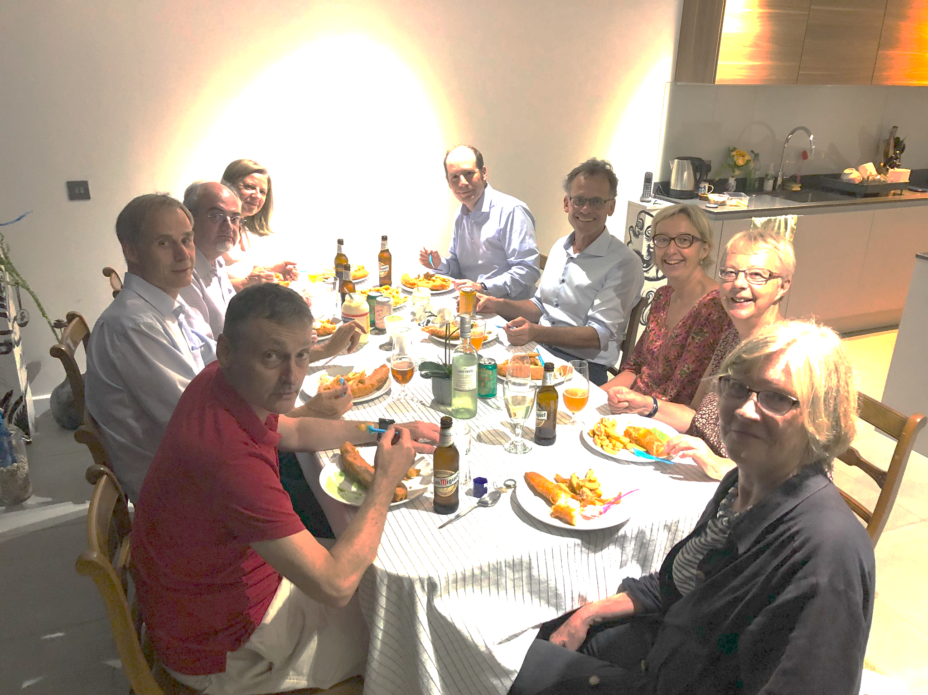
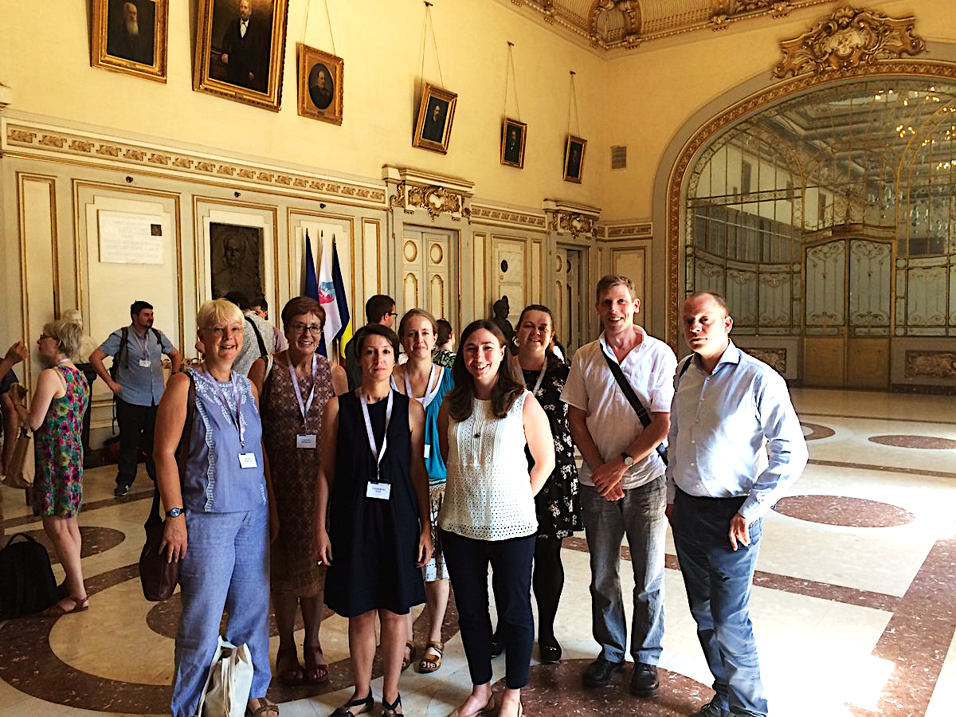
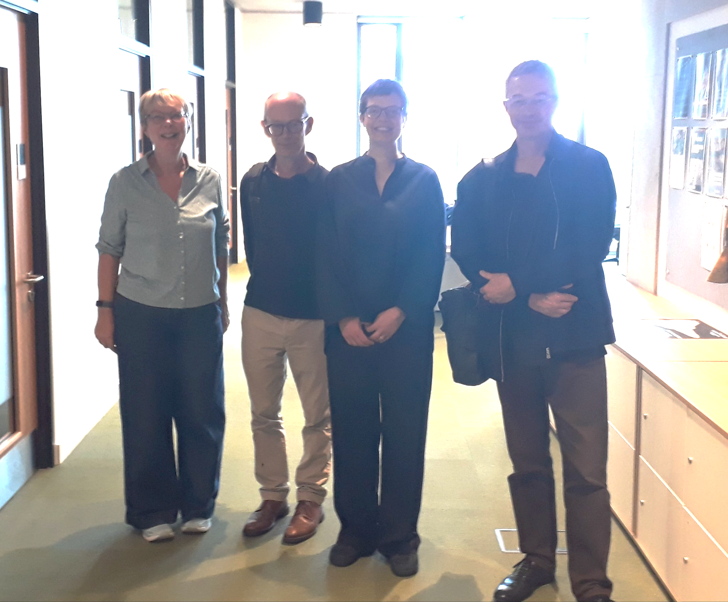
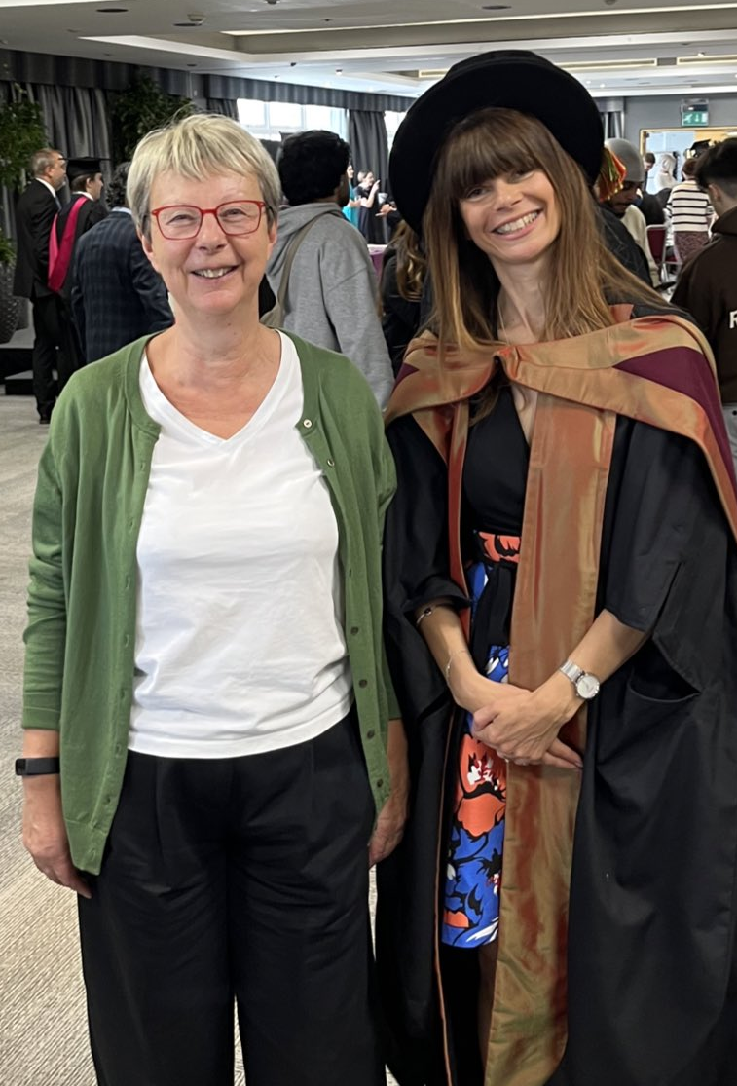
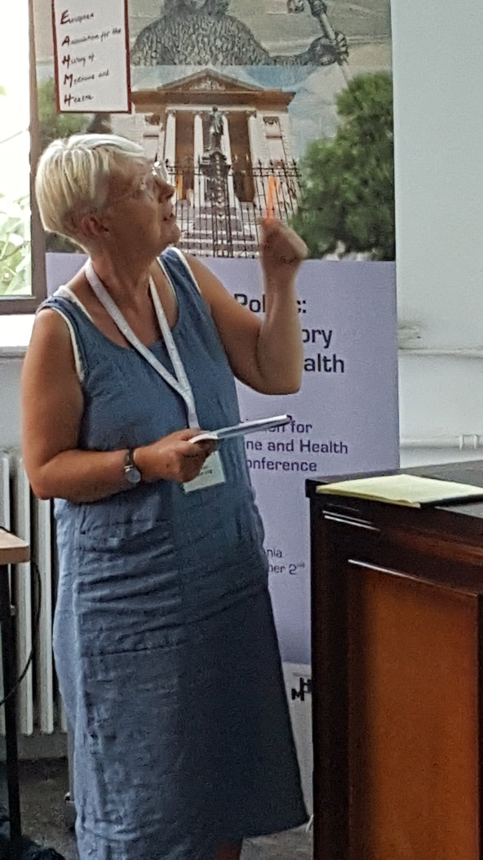
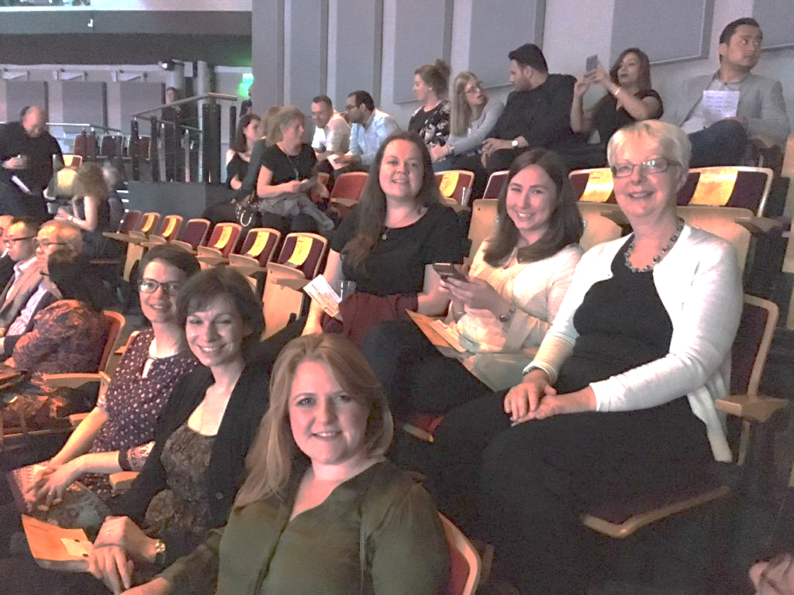
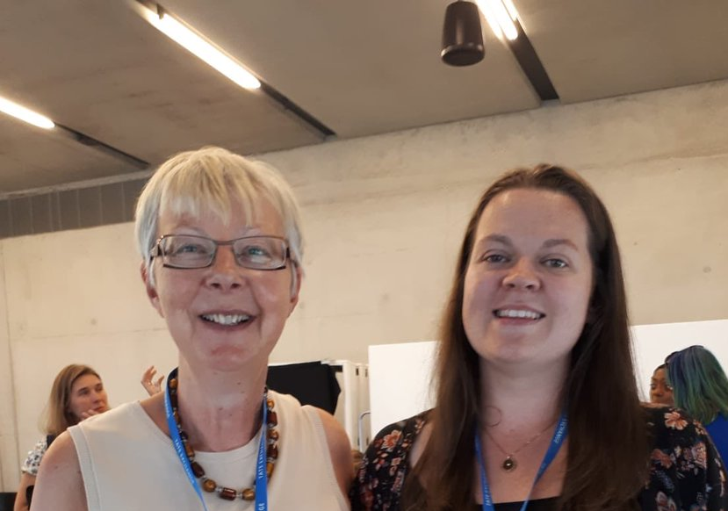
And beyond the ‘outputs’?

