Slide 1
Making of the Modern World:
Epidemics
Roberta Bivins
Office: H3.30
Email: r.bivins@warwick.ac.uk

Slide 2
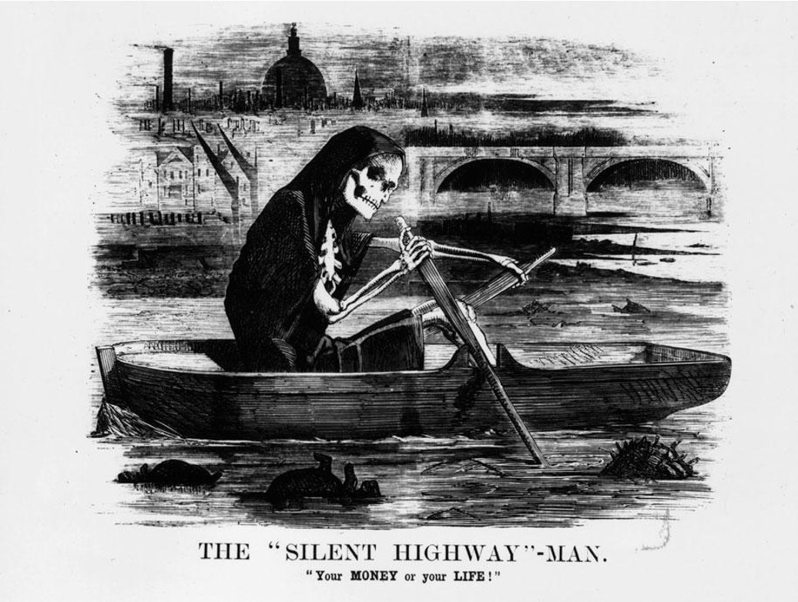
MMW Week 9: Epidemics
What does disease have to do with ‘Making the Modern World’, you ask?
Well… today we’ll discuss exactly that!
Historical precedents for unprecedented (Covid) times;
Constructing ‘the public’
Exploring the invention of ‘social and economic rights’
By the end of this week , you will be able to draw a direct connection between the UK’s Covid response and the political philosophies of 19th century Britain…

Slide 3
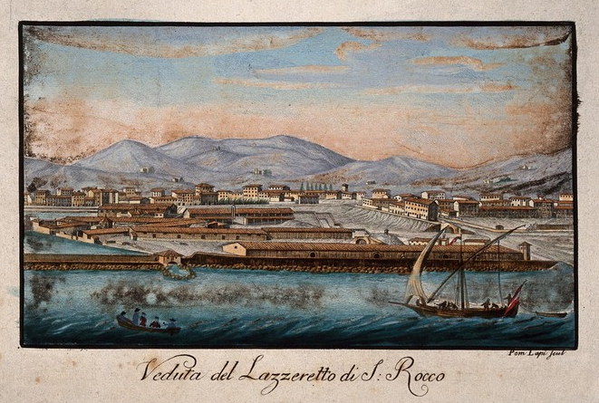
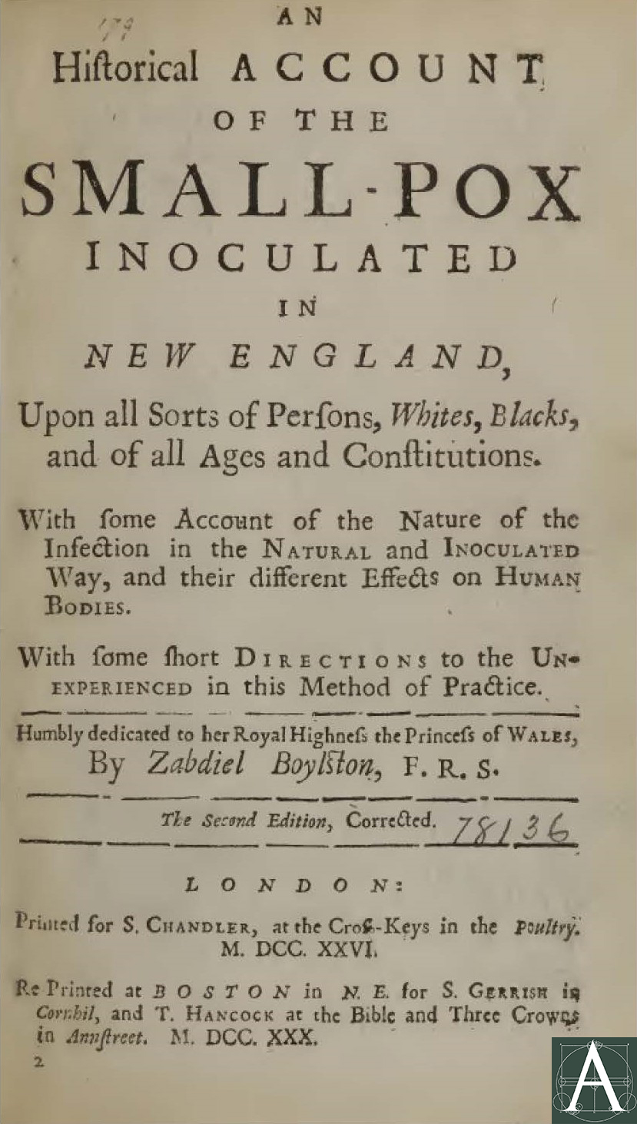
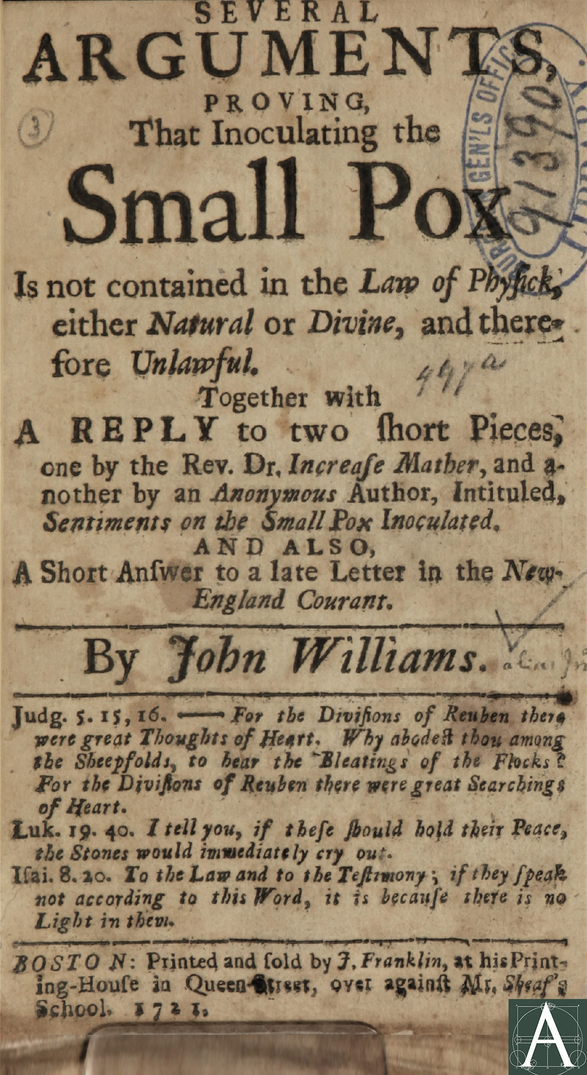
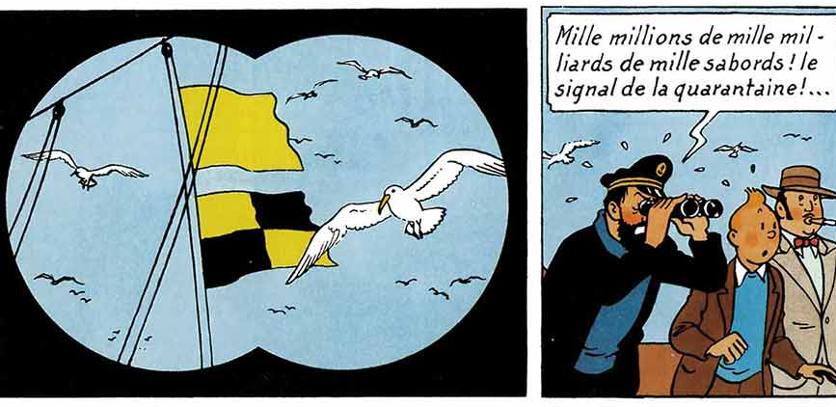
Early responses to epidemic disease
Notes:
For more on Smallpox debates in Boston, see: https://www.archipedianewengland.org/

Slide 4
What makes a modern ‘epidemic’? Counting and comprehending epidemic threats
William Farr, Report on the Mortality of Cholera in England, 1848-49 ... for H.M.S.O., 1852
Notes:
William Farr, Report on the mortality of cholera in England, 1848-49, London : Printed by W. Clowes ... for H.M.S.O., 1852
Covid deaths data from https://coronavirus.data.gov.uk/deaths

Slide 5
Free movement, free trade, and Britain’s ‘cholera years’, 1831-1866
Was cholera:
‘[O]ne of the most terrible pestilences which have ever devastated the earth … If this malady should really take root and spread in these islands, it is impossible to calculate the horror even of its probable financial results alone.’
Quarterly Review, 1832, vol 46, p 170
And for more on Cholera and its impact on the 19th century and beyond, see this readable account: https://sickcityproject.wordpress.com/2013/03/11/john-snow-and-cholera/
‘John Bull defending Britain against the invasion of cholera; comparing the Reform Bill to the cholera epidemic’. Coloured lithograph, O. Hodgson, London (10 Cloth Fair) c. 1832
© Wellcome Library no. 12236i
Notes:
Quotation from placard reproduced from Alan Bewell, Romanticism and Colonial Disease (London: Johns Hopkins University Press, 1999) p.253

Slide 6
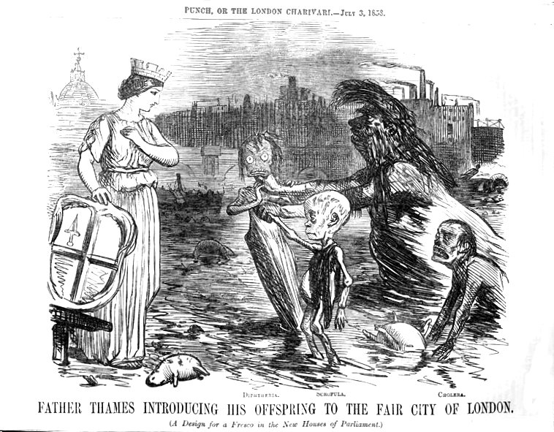
Free movement, free trade, and Britain’s ‘cholera years’, 1831-1866
Or was it:
‘Cholera humbug! – Inhabitants of Lambeth, be not imposed upon by the villainously false report that Asiatic Cholera has reached London. A set of half-starved doctors, apothecaries’ clerks, and jobbers in the parish funds, have endeavoured to frighten the nation into a lavish expenditure; with the Government they have succeeded in carrying a bill which will afford fine pickings. A ruinous system of taxation, starvation, and intemperance has long been carried on; … and disease is the natural result.’
Text of a placard displayed in Lambeth c 1831-2
John Leech: Father Thames Introducing His Offspring to the Fair City of London. (A Design for a Fresco in the New Houses of Parliament.) Punch, 3 July 1858
Notes:
Quotation from placard reproduced from Alan Bewell, Romanticism and Colonial Disease (London: Johns Hopkins University Press, 1999) p.253

Slide 7
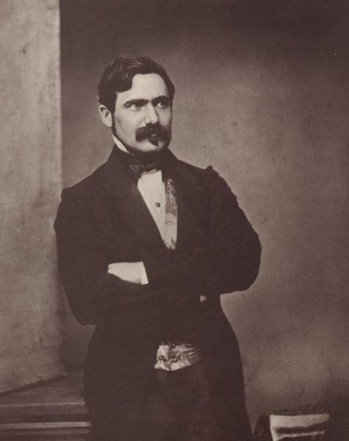
Epidemic scepticism and scientific disputes: not novel either!
Max Joseph von Pettenkofer (1818-1901), circa 1860 Wikimedia Commons (photographer: Franz Hanfstaengl)
‘Positively, we must find something; it won’t do to lose our Twenty guineas a day!’
Notes:
A London Board of Health hunting after cases like cholera. British Museum, Catalogue of political and personal satires, vol. 11, London 1954, no. 16963 Courtesy Wellcome Images.
For more on Max von Pettenkofer, see https://www.en.uni-muenchen.de/news/newsarchiv/2018/pettenkofer.html

Slide 8
But what does cholera have to do with the ‘Representation of the People Act’ 1832?
‘I am jealous of the Glory of this new-imported Nabob, from the Indian jungles, his Serene Blueness, Prince of Air…’ S.T. Coleridge, ‘Cholera Cured Beforehand’ 1832.
Image Description: John Bull grasps the blue shrouded 'cholera' round its neck brandishing a club inscribed: "Heart of oak" and saying: "Now you rascal where are you going to". It replies: "I am going back again" while reaching for a scroll under Bull inscribed: "Reform Bill". The fence through which it squeezes reads: "The wooden walls of England" and bears two signs: "Beware of the Bull" and "Board of Health”. © Wellcome Library no. 12236i
Notes:
Quotation from placard reproduced from Alan Bewell, Romanticism and Colonial Disease (London: Johns Hopkins University Press, 1999) p.253

Slide 9
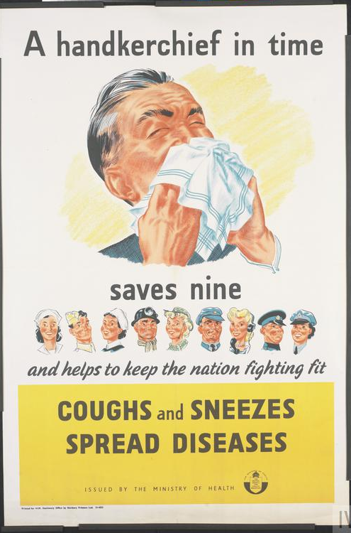
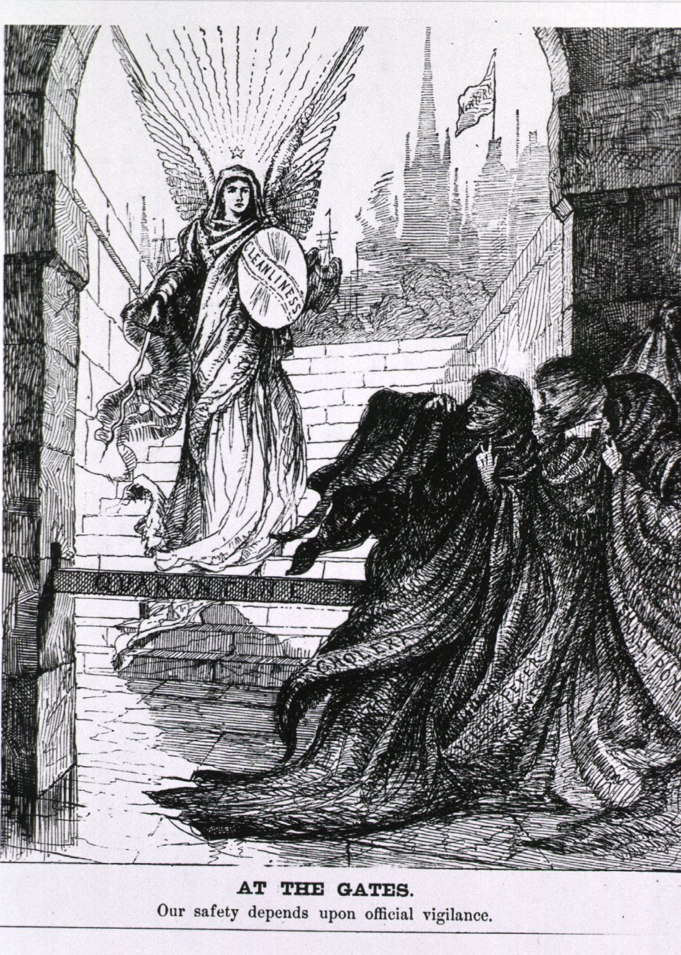
Who is responsible for health in epidemic times?
Individuals?
States?
‘A handkerchief in time saves nine and helps to keep the nation fighting fit COUGHS and SNEEZES SPREAD DISEASES ISSUED BY THE MINISTRY OF HEALTH THE MINISTRY OF HEALTH’ THE CENTRAL COUNCIL FOR HEALTH EDUCATION Printed for H.M. Stationery Office by Norbury Printers Ltd. 51-4253 Courtesy, Imperial War Museum.
‘At The Gates. Our safety depends upon official vigilance’, Harper’s Weekly, 1885, courtesy National Library of Medicine USA. For more, see https://www.nlm.nih.gov/exhibition/visualculture/introduction.html

Slide 10
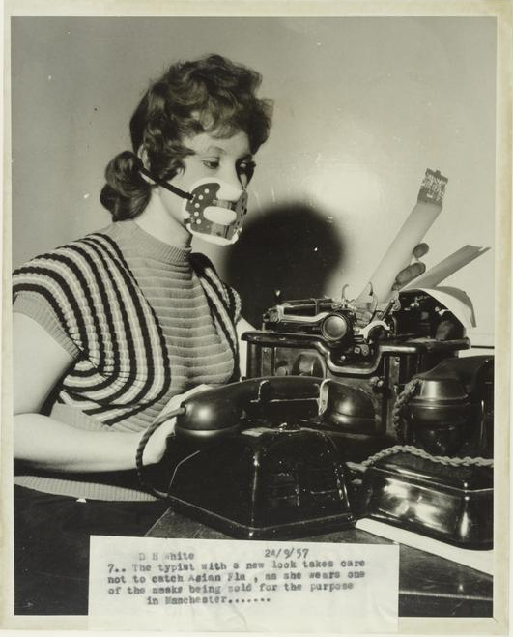
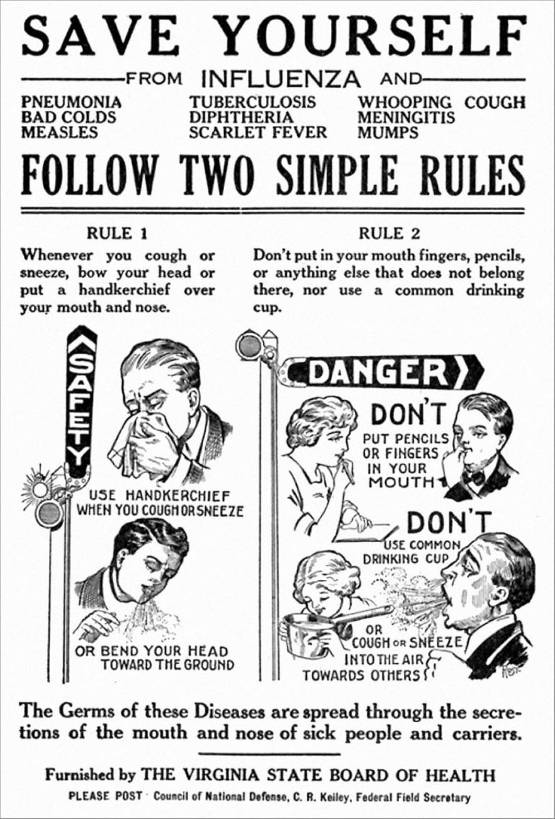
Epidemics and ‘the public’: Behaviour and blame in pandemic times
‘Responsibilization’ and Commodification in the ‘Age of Universal Contagion’
24 Sept. 1957: Daily Herald photograph by White showing a typist in Manchester wearing a mask designed to prevent catching Asian Flu.(c) Mirrorpix
Flyer warning about the spread of common infectious diseases made during the 1918 influenza epidemic. © US Library of Congress.
Notes:
Daily Herald Archive, National Science and Media Museum, object number 1983-5236/10427

Slide 11
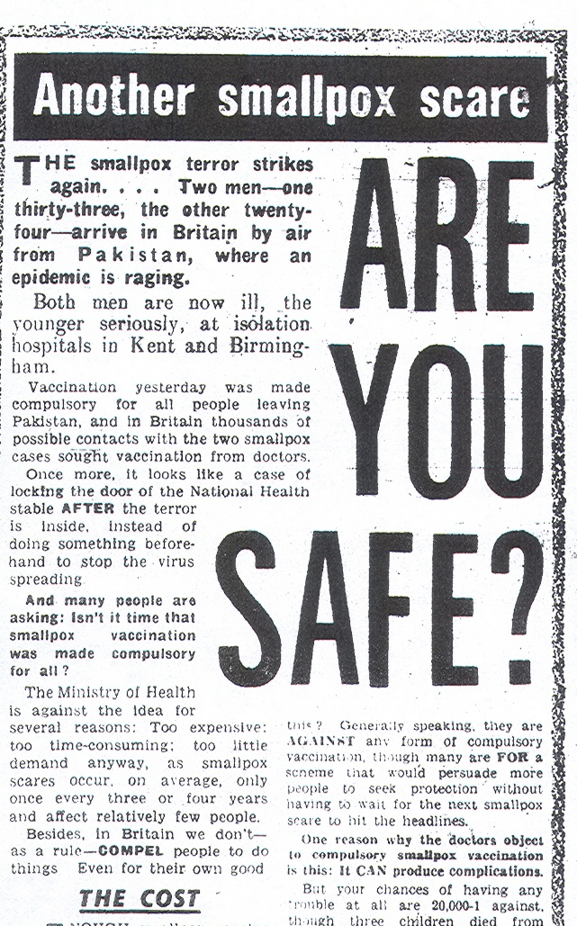
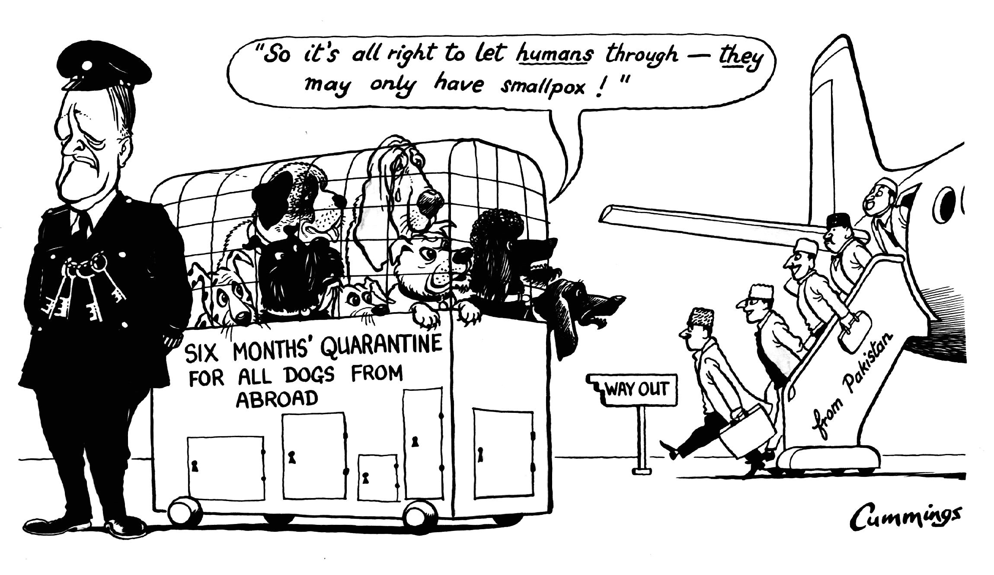
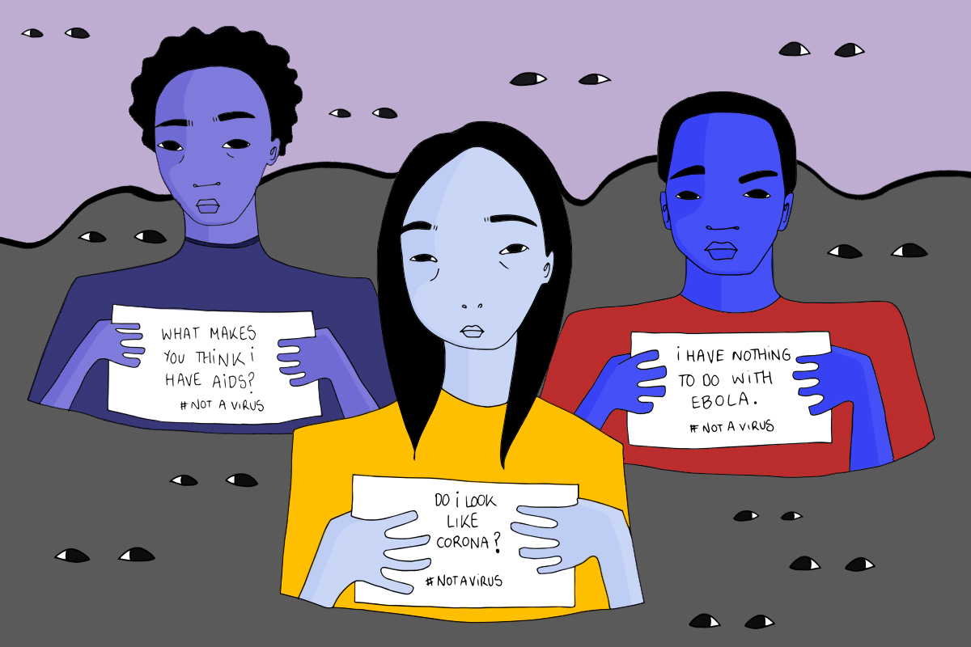
Who is (or isn’t) ‘the public’: what epidemics can tell us about race, rights, and ’imagined communities’
© Express Syndication Ltd., British Cartoon Archive, University of Kent, Michael Cummings, Daily Express, 17 Jan 1962
“CHECK! A foreigner brings smallpox into this country and a Ministry of Health spokesman admits that there is no check … against the terrible disease. Scandalous! A health check should be rigidly enforced, particularly when a person has come from an Eastern country.”
Daily Mirror, ‘Letters’ Jan 1 1962
© Aude Nasr #NotAVirus, https://gal-dem.com/racism-spreads-faster-than-most-epidemics/2 February 2020
Notes:
IMAGE FROM JAN 4 DAILY MIRROR
QUOTE FROM Daily Mirror letters, Jan 1

Slide 12
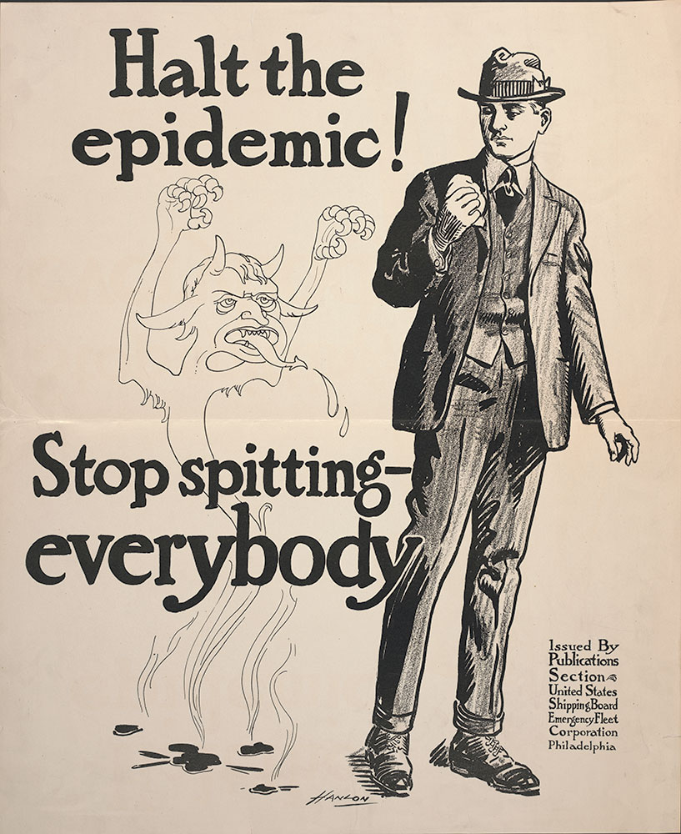
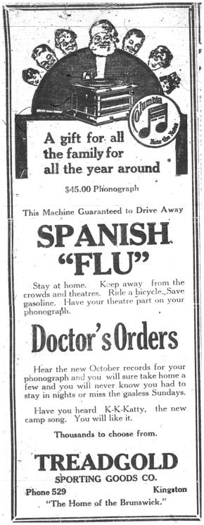
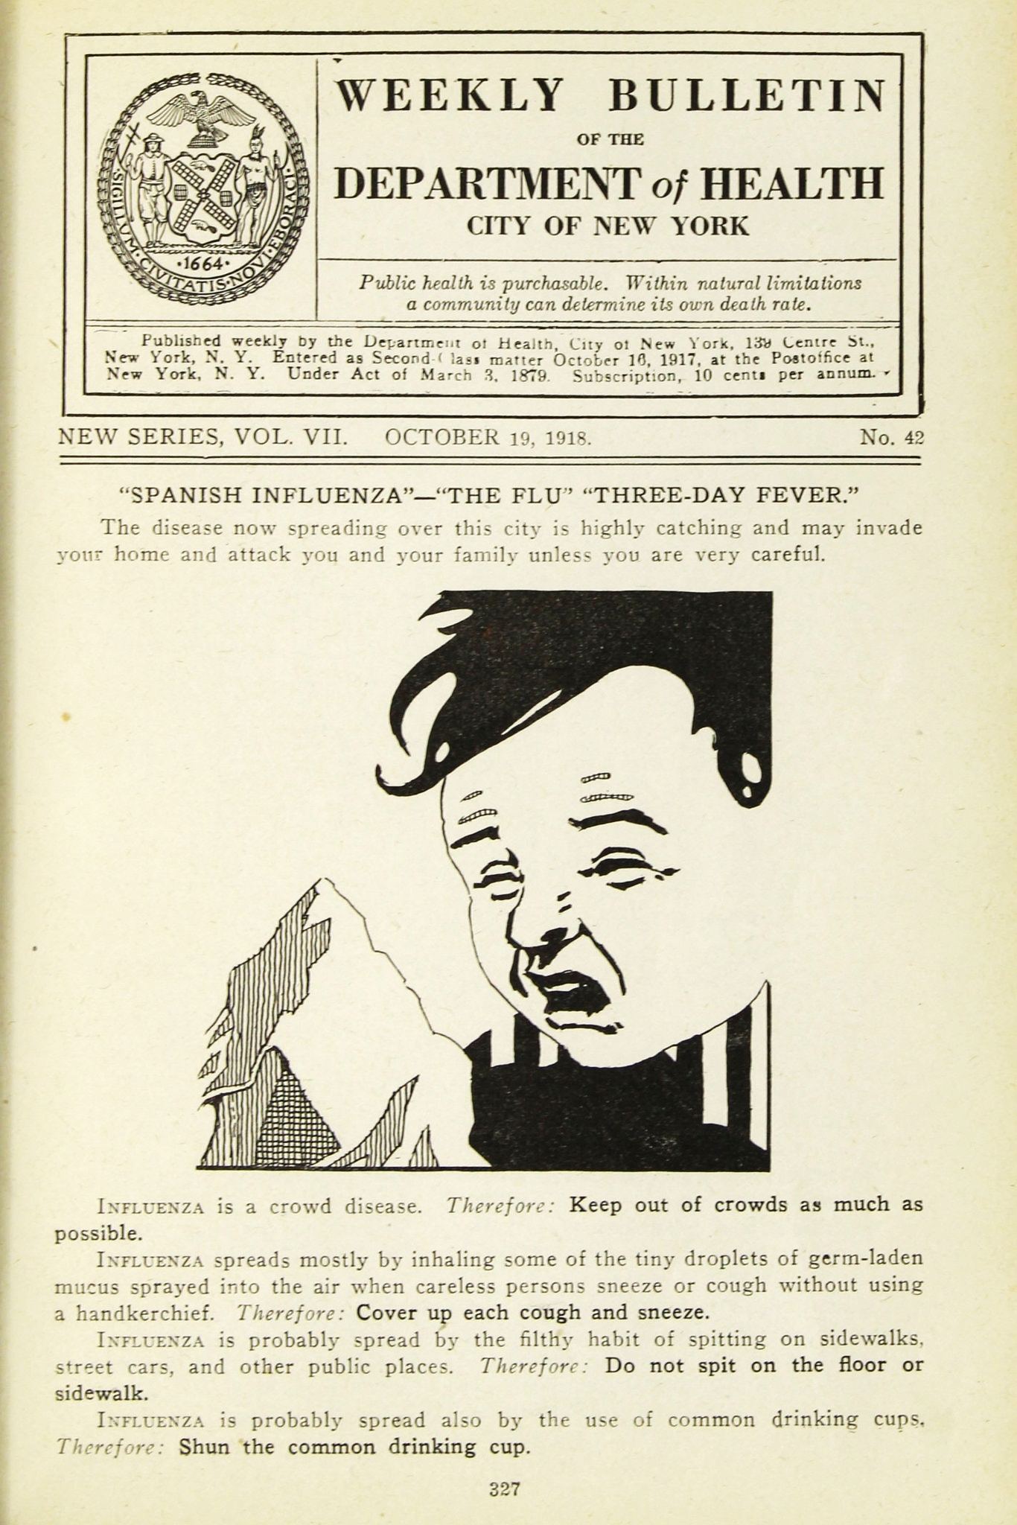
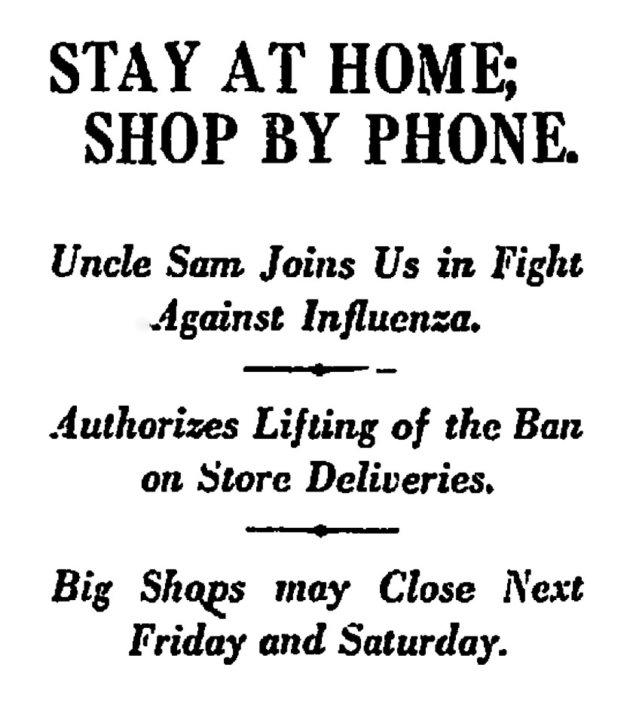
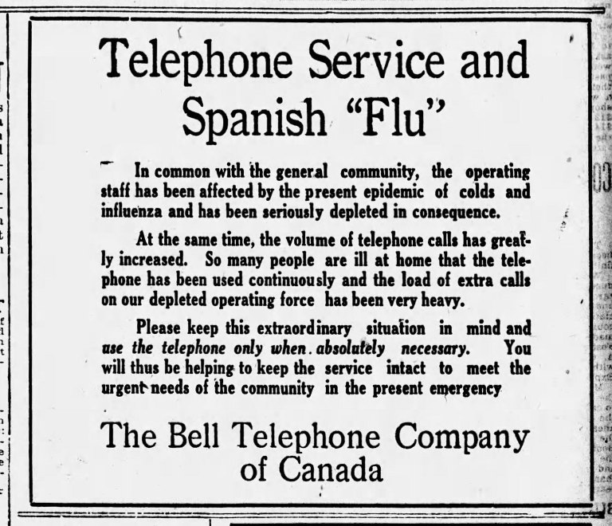
US Shipping Board Emergency Fleet Corporation - Publisher. (1918). Halt the epidemic! Stop spitting- everybody. Retrieved from https://libwww.freelibrary.org/digital/item/65051
A little something to think about for seminar… looking at all of these historical images, reflecting North American responses to the Spanish Flu pandemic of 1918-19, what looks familiar to you? Why might there be similarities, and what can they tell us? What is different?
LA Times, 1918
Columbia Records ad 1918 ©Museum of Healthcare
https://museumofhealthcare.wordpress.com/2017/05/19/the-infamous-spanish-influenza/
Ottawa Citizen, 15 Oct., 1918
© New York City Municipal Archives
Notes:
A clipping from The Ottawa Journal on Saturday, Oct. 19, 1918 found at https://kitchissippi.com/2020/04/05/quick-to-act-how-ottawa-quelled-the-spanish-flu-in-1918/

