Slide 1
History on the Move: How do we tell the story of migration?
Roberta Bivins
Department of History
University of Warwick
r.bivins@warwick.ac.uk

Slide 2
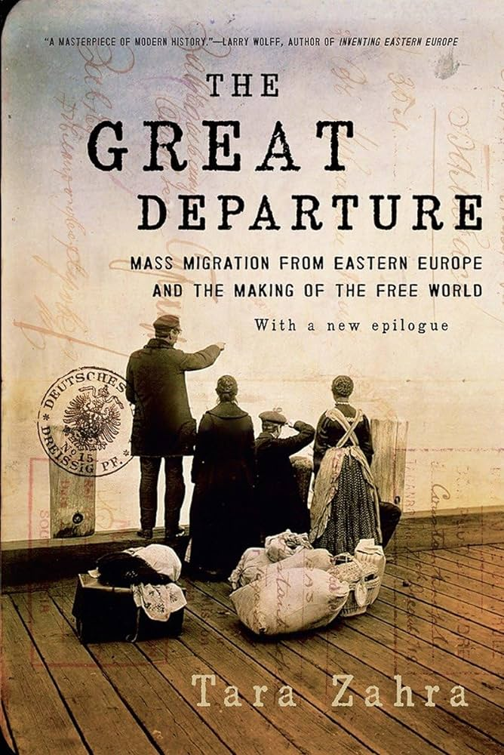


When you think about the history of migration…
What do you think it will look like?
Who does it discuss?
Where does the history happen?
When does it happen?
What stories would you want to hear or tell?
Do you want to read more (for fun) ? Try these books.

Slide 3
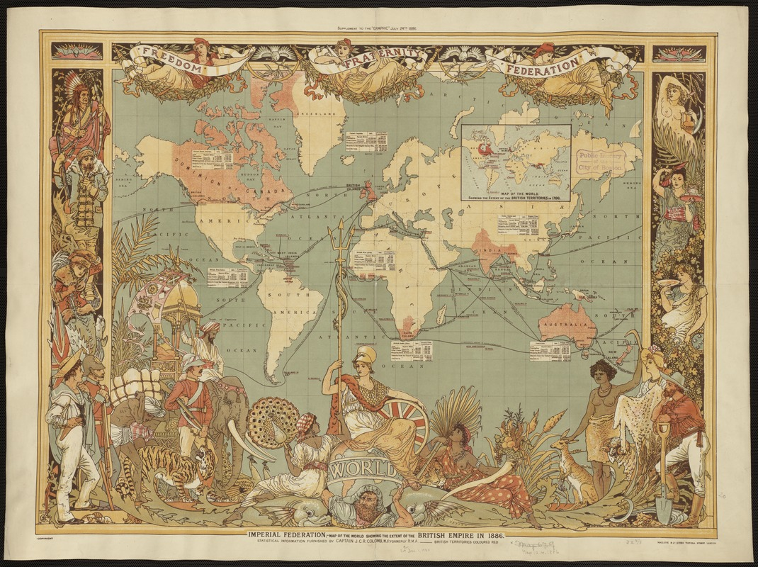
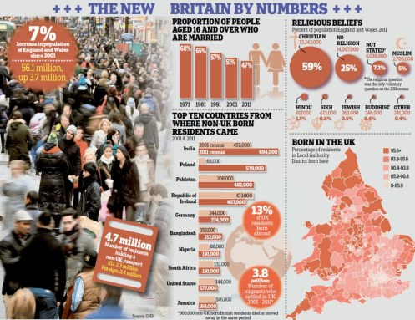
Migration-nation Britain?
Imperial Federation, map of the world showing the extent of the British Empire in 1886, published in The Graphic, a popular newspaper.
Daily Mail, 12 December 2012

Slide 4
How do historians write the history of migration in Britain?
Traditionally:
Parliamentary debates
Border and Census Data
Newspaper coverage
Legislation
Policy documents
Inclusively:
Visual representations – photos, film, television, cartoons
Oral history
Diaries/Memoirs/Letters
Community documents

Slide 5
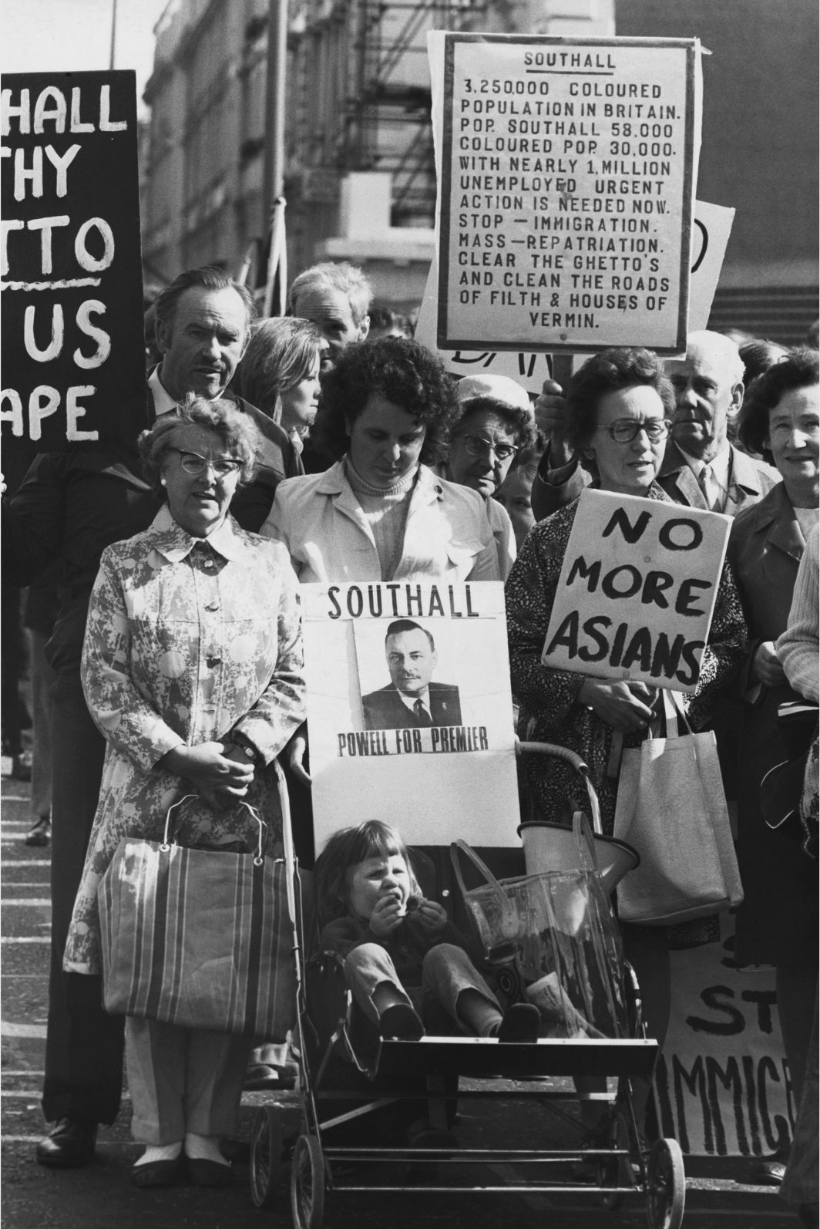
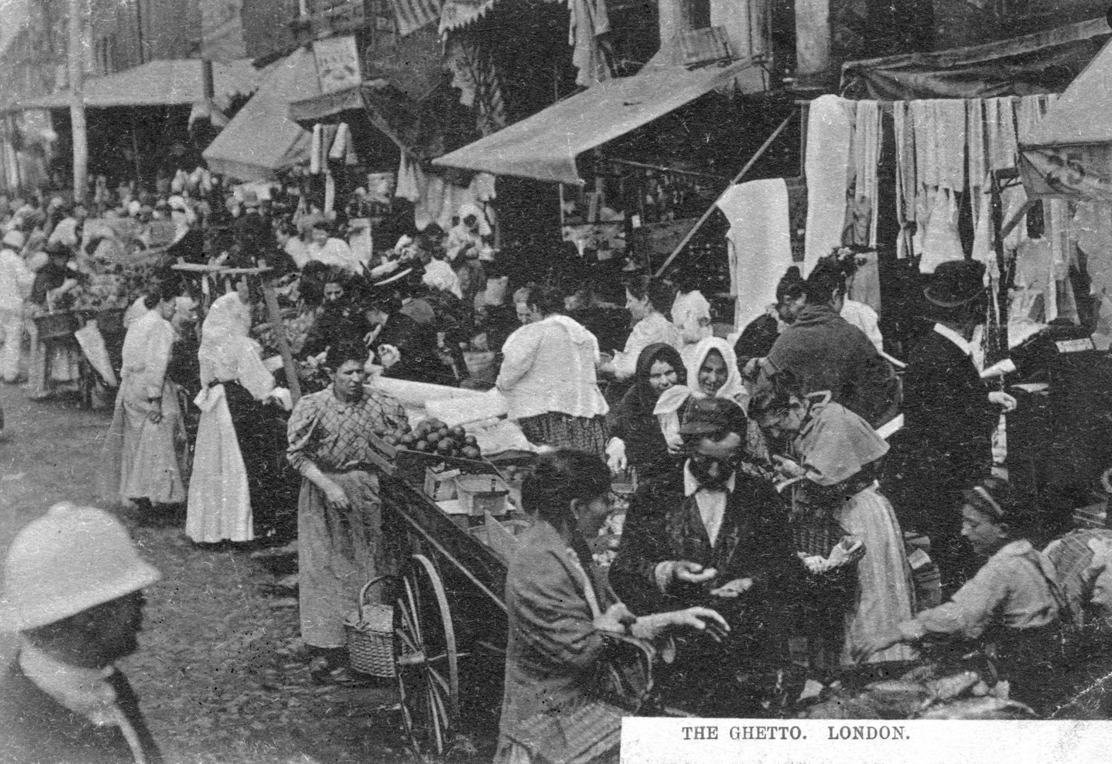
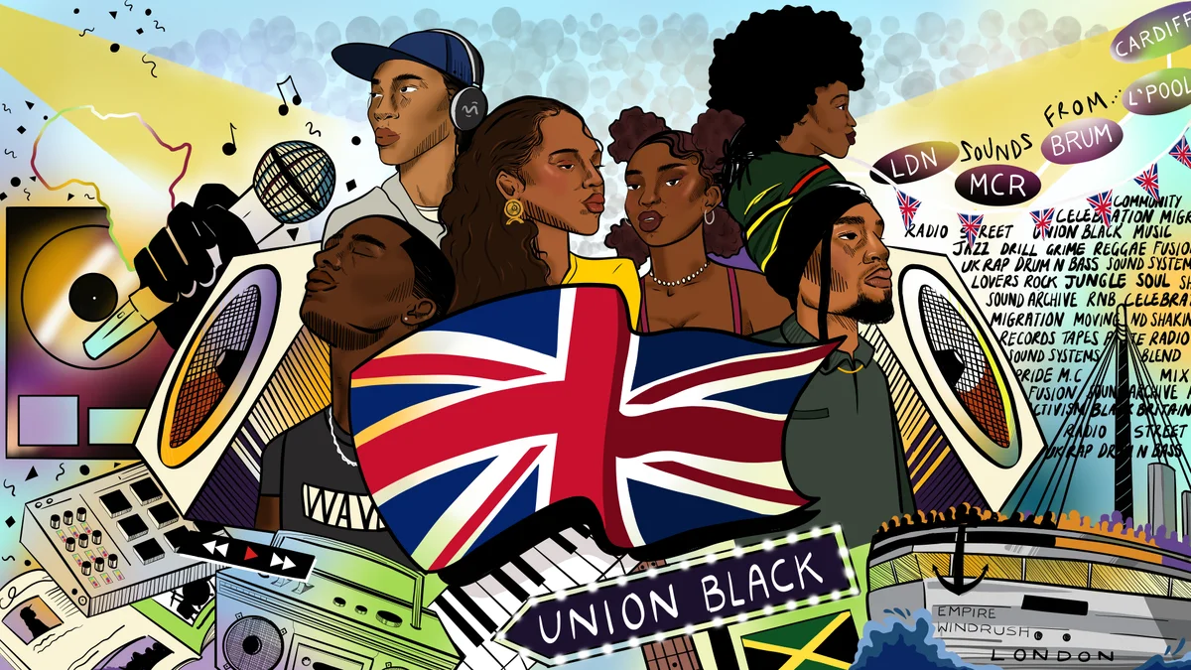
An estimated 150,000 Eastern European Jews settled in Britain between 1881 and 1914, in many cases after escaping persecution in pogroms across the Russian and Hapsburg empires. Credit...Jewish Chronicle/Heritage Images, via Getty Images

Slide 6
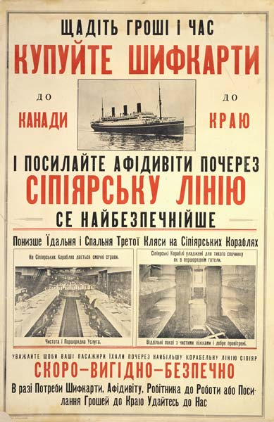
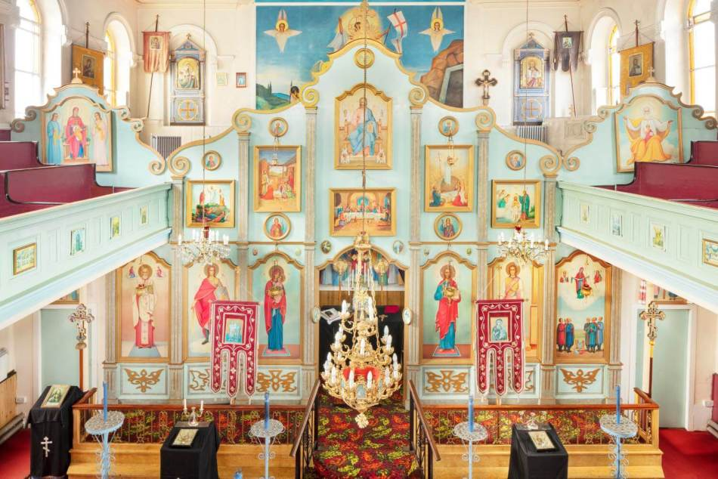
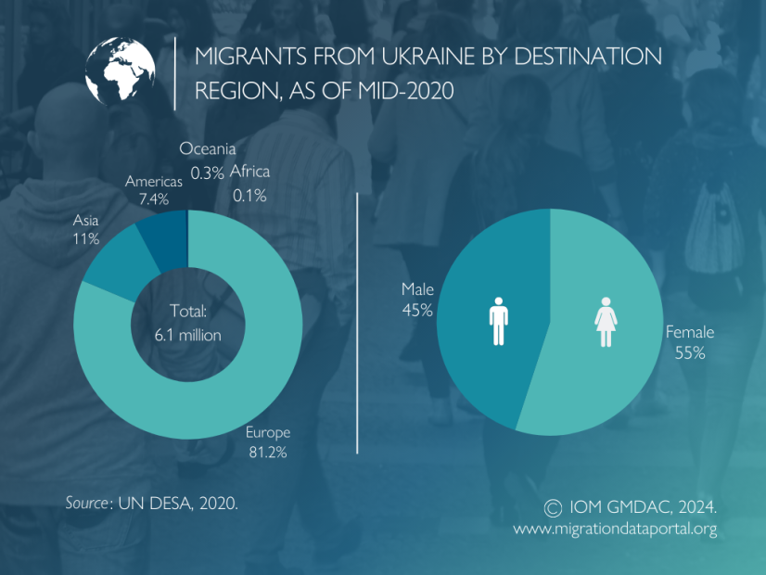
Tell me: What do histories of migration look like in Ukraine?
The iconostasis in St Mary Protectress Ukrainian Orthodox Church in Bradford, West Yorkshire. © Historic England Archive. View image DP371835.
Click for more data on migration and Ukraine today.
Poster published by the Canadian Pacific Railway between 1910 and 1930, advertising ocean passage to potential Ukrainian immigrants. Glenbow Museum Archives Poster-32
Notes:
https://heritagecalling.com/2023/05/10/a-history-of-ukrainians-in-england/

