Slide 1
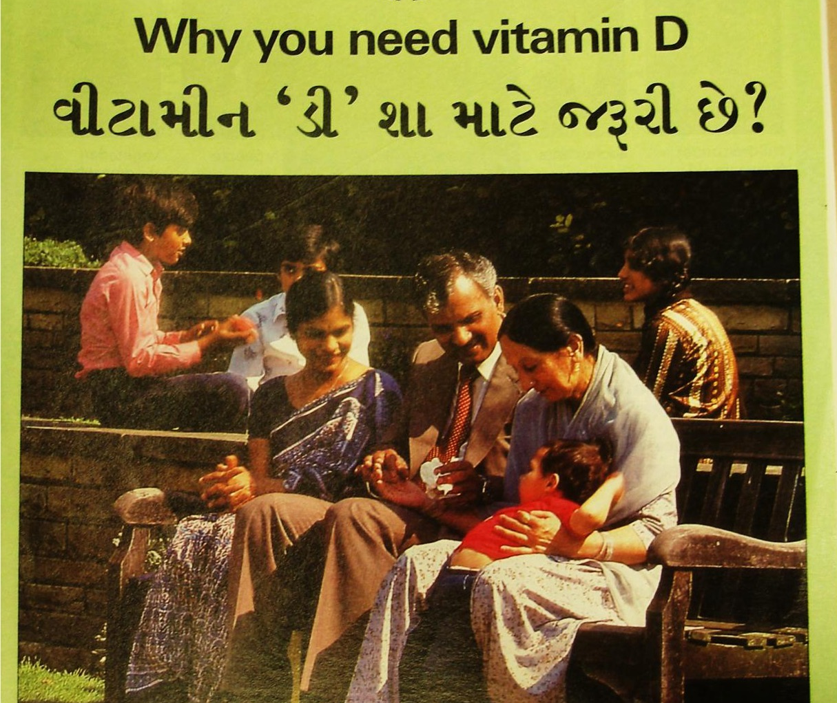
Choice vs Compulsion in Nutrition-focused Public health
Learning from the History of the ‘Education, Supplementation, or Fortification’ debate.
Roberta Bivins
Centre for the History of Medicine University of Warwick

Slide 2
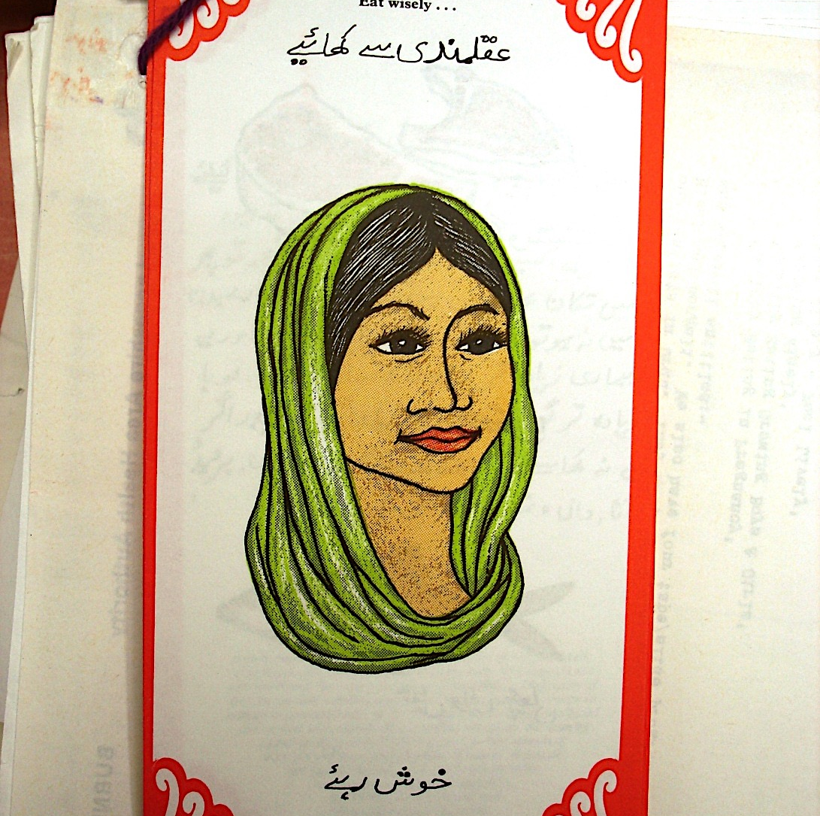

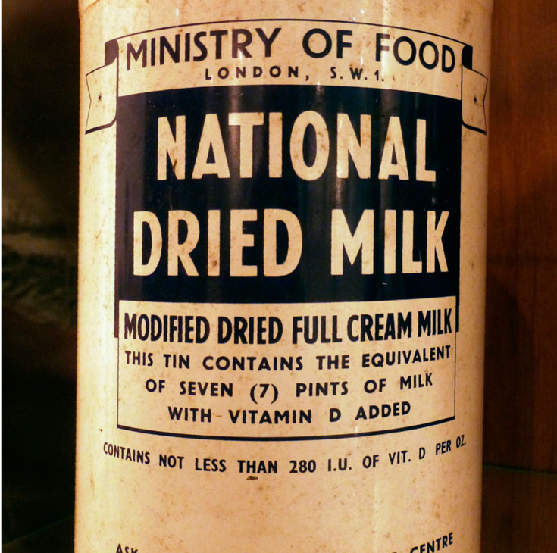
History as Laboratory
What ‘works’ to support improved nutrition for the most vulnerable?
Education and Advice
‘Universal’ messaging (Posters, print and broadcast media)
Education in school
Targeted messaging via culturally appropriate means
Provision of supplementation
On demand
Universal or targeted provision
Over the counter commercial availability
Food fortification
Mandated by the state
Recommended by the state
Marketed and provided from commercial suppliers
Notes:
Image one: https://www.nationalgeographic.com/magazine/article/race-genetics-science-Africa
Image 2: Vanity fair 2018

Slide 3
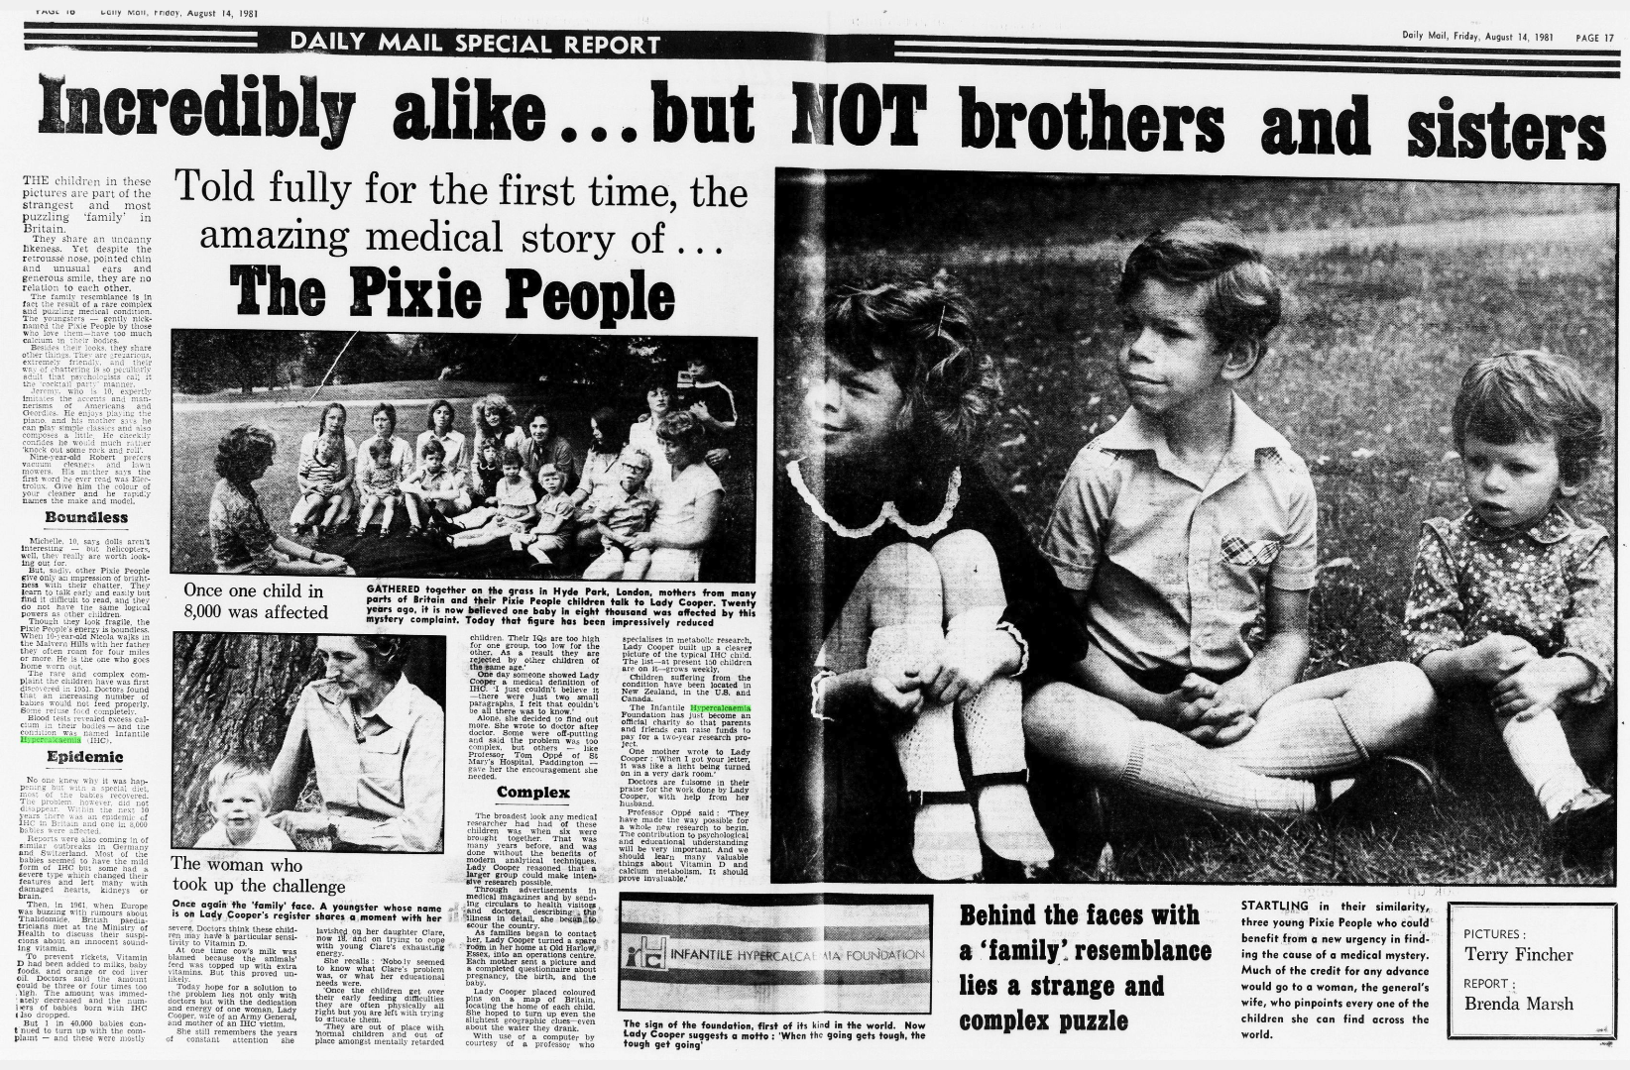
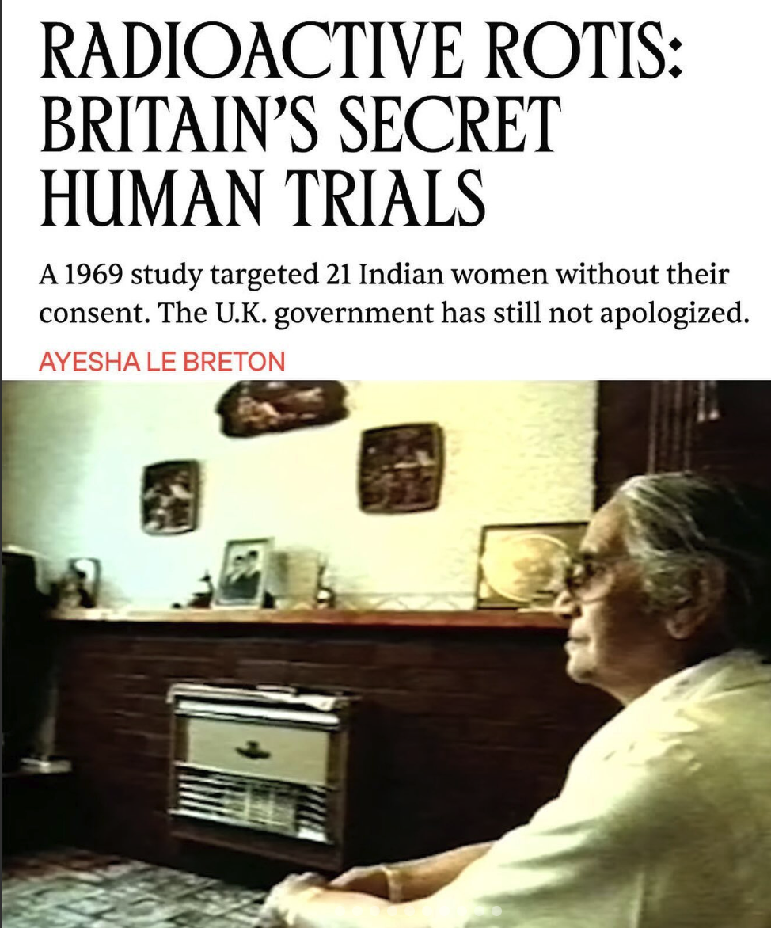
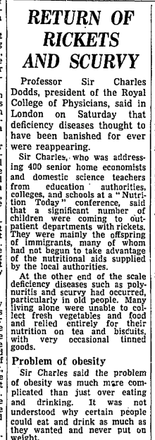

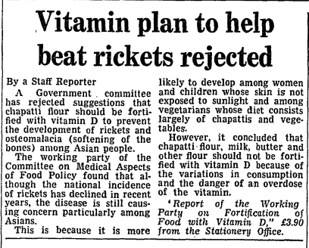
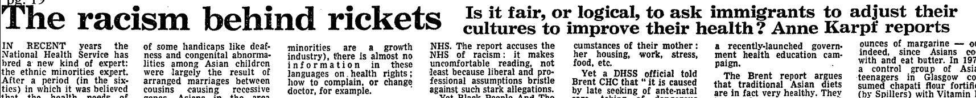
Constraints and Complications
Why NOT compel? What’s wrong with ‘choice’? Why won’t individuals adopt health-preserving behaviours?
Risks of Intervention
Mistrust, suspicion and historical misuse
Risks of Inaction

Slide 4
‘Asian Rickets’: Blaming ‘Cultural’ Difference
‘The solution lies in adequate education of Asian women immigrants firstly to speak English and secondly in the elements of child care in this climate.’
Lancet, 1963
‘Rickets had been almost completely eliminated from this country since the war … but rickets appeared again with people …who … had no idea of the uses of welfare foods.’
Guardian, 1965
‘the lack of sunshine in the UK is not … entirely at fault, so much as the dietary habits and social customs which prevent the necessary exposure to sunlight here as in their own countries.’
COMA(Nutrition) Panel on Child Nutrition, January 1976

Slide 5
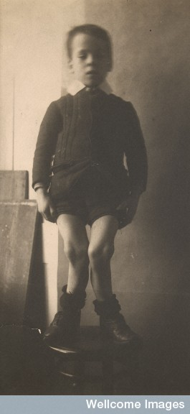

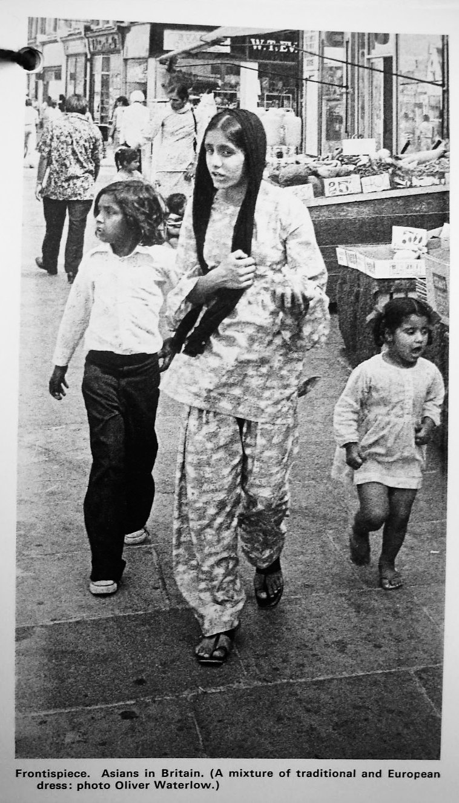
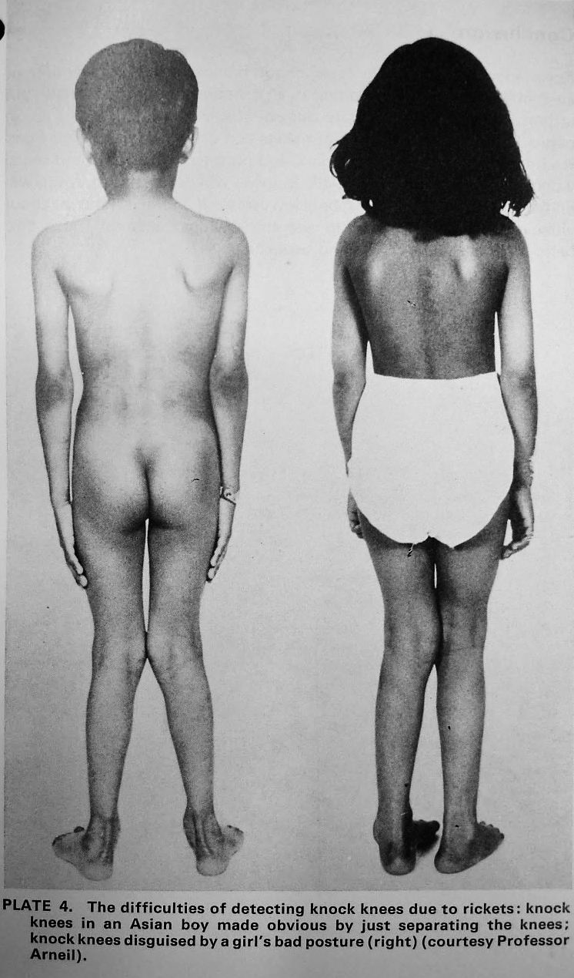
‘Blacking up’ the ‘British disease’

Slide 6
‘Asian Rickets’: Factors Identified by Migrants
‘The racial violence and panic are so high that the Immigrant adults or children, no one can come out in the park for fresh air or in the sun shine to have ultraviolet irradiation.’
‘overcrowding; damaged environment; no ventilation; no sun shine facilities; repeated attacks of infections.’
Dr Qudratul Islam to Minister Gerard Vaughan, 10 March 1981
© Getty Images

Slide 7
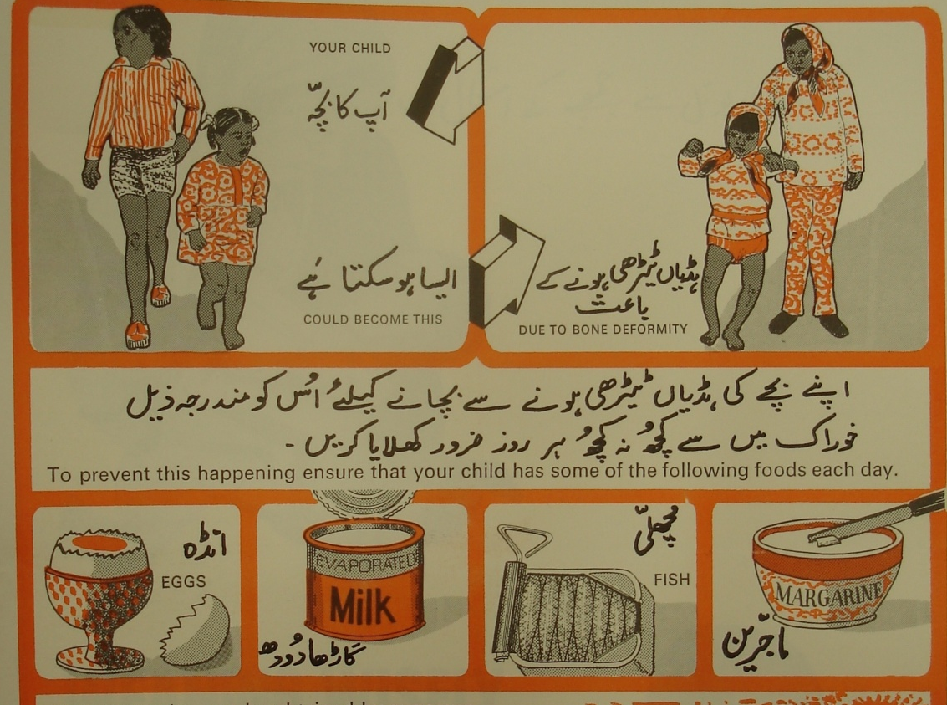
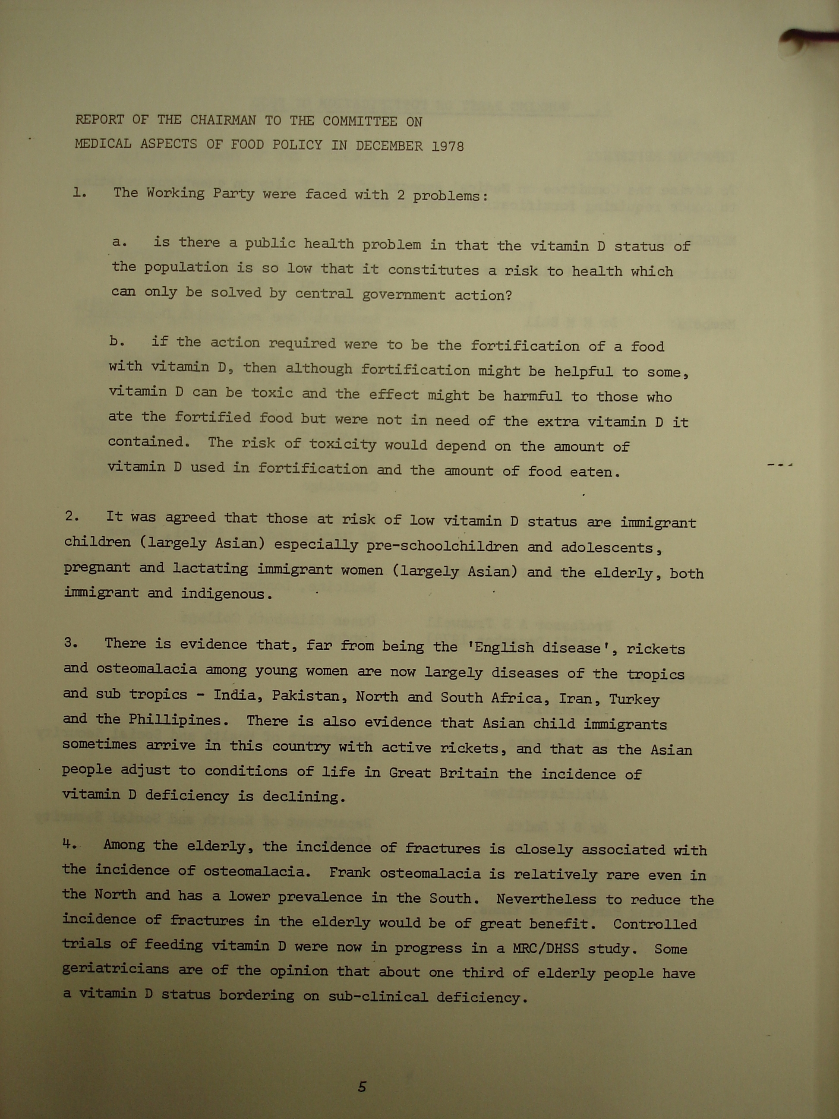
Stop Rickets!
Education, voluntary supplementation, but no fortification…
‘Poverty, social incompetence, and poor health, marching together’
‘A sign of social regression’
[A] good example of how the withdrawal of free vitamins affected health was the way in which the incidence of rickets had increased after the reduction of the Vitamin D content of welfare foods and the increased cost of National Dried Milk between 1956 and 1960. … Rickets was a disease that had disappeared, but it is now reappearing. …That is some indication of the long-term effects of the sort of policies that are crystallised in the [Education (Milk)] Bill.
Jimmy Hamilton Hansard, 14 July 1971
‘The reality is that our standards of nutrition are somewhat worse now than they were in the austerity of 1950. … (And our standards are generally some way below those of America and Russia.) Rickets, the most emotion-charged of all the symptoms of deprivation, is still found in Britain – mainly but not wholly in immigrant families.’
John Barry, Sunday Times, 6 August, 1967

Slide 8
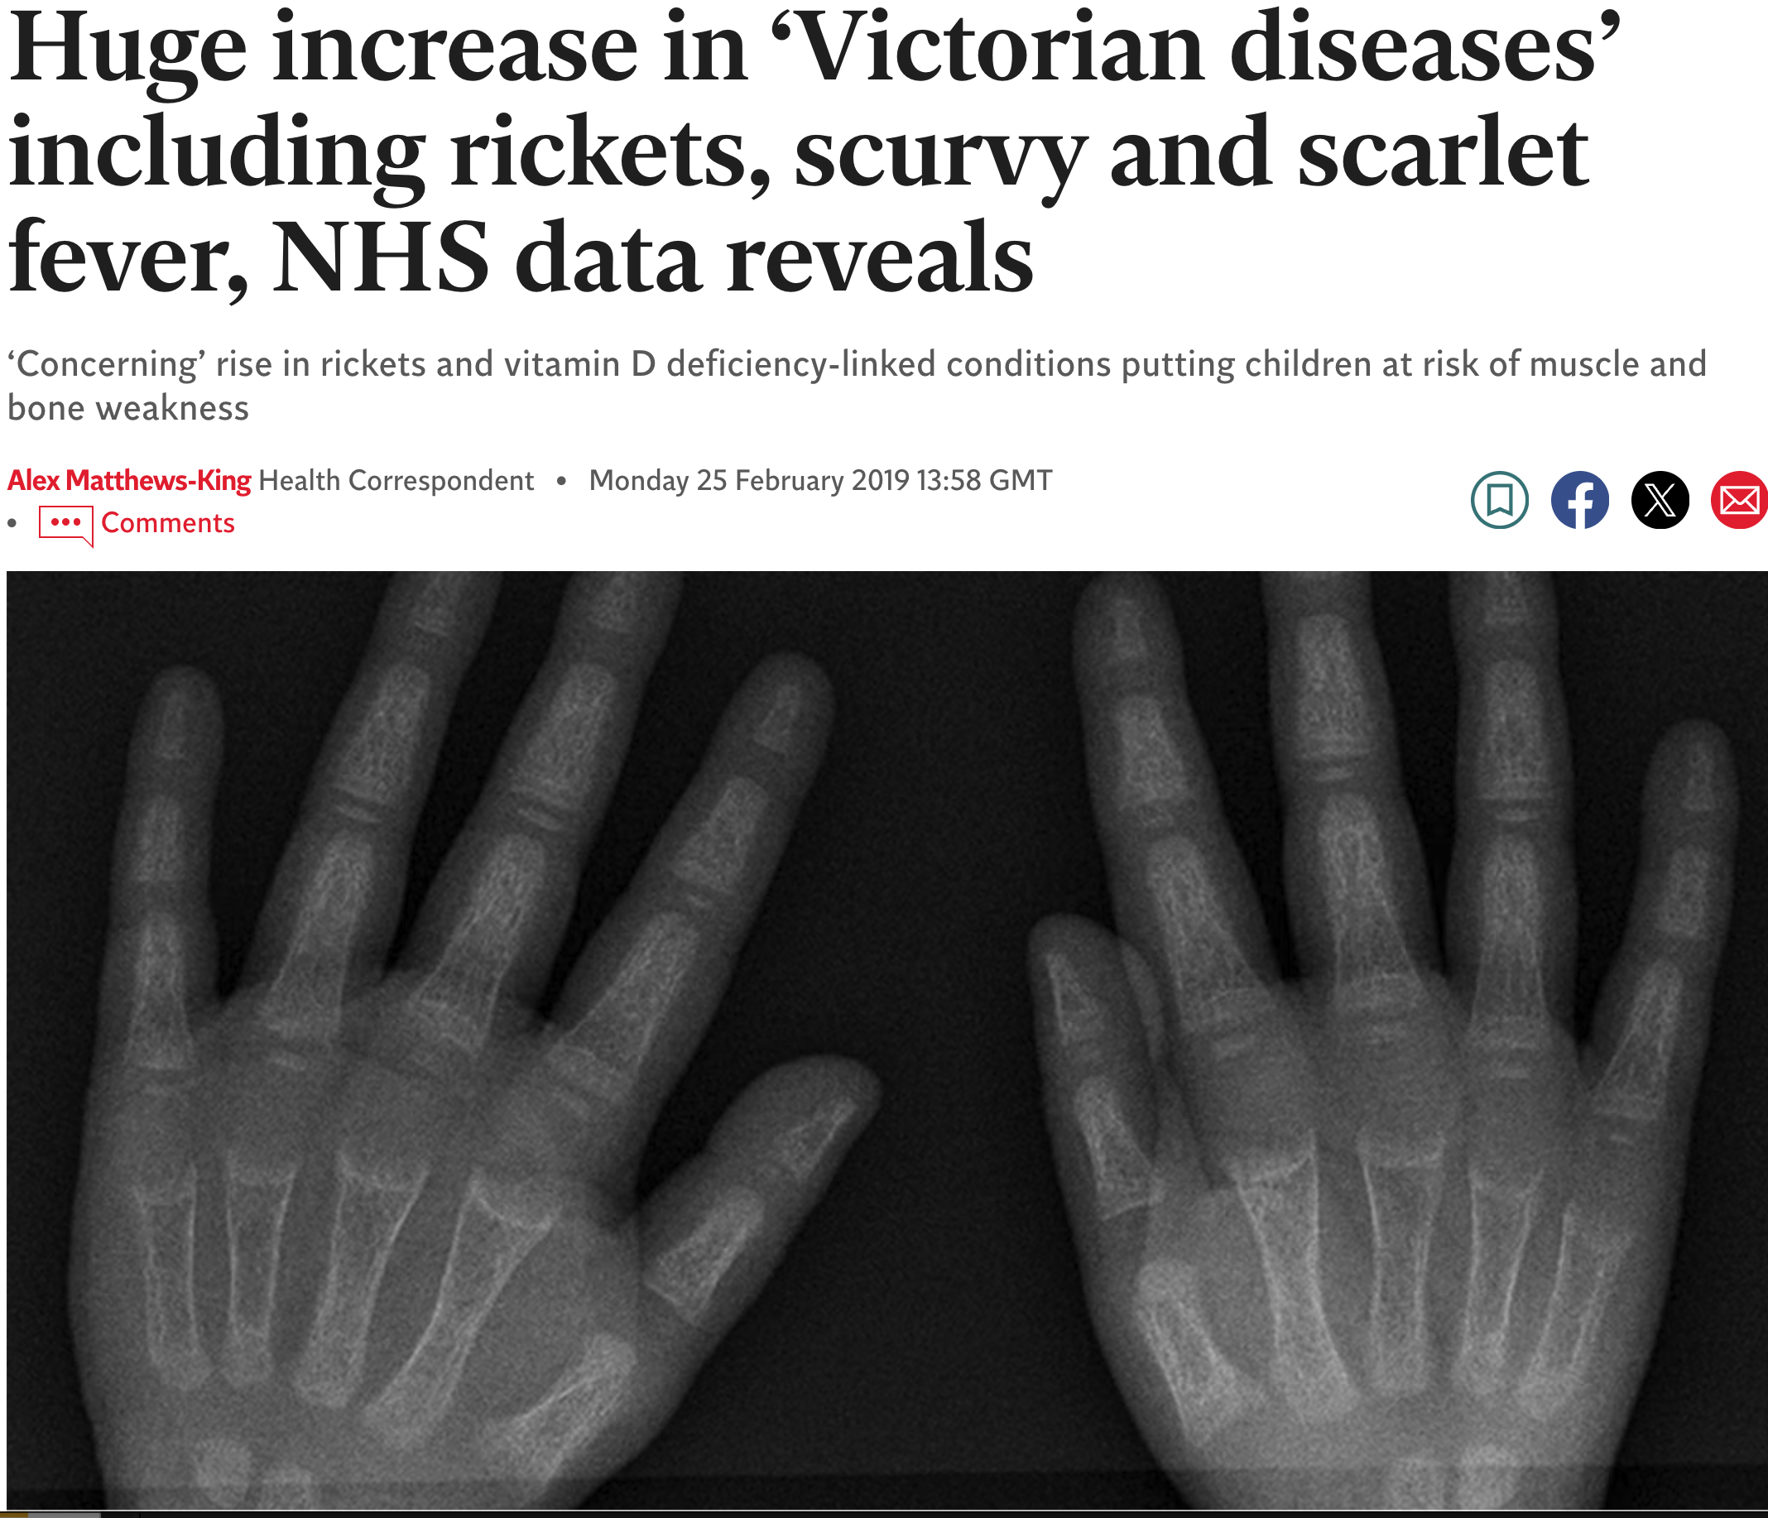
Results: Not perfect, not long-term… but enough?
‘The campaign, as well as proving effective in tackling a wholly preventable disease, has, to Dr Vaughan's delight, had some beneficial side effects. It has greatly improved links with the Asian community and, best of all these days, has not cost a lot of money. Apart from the communications link, which is proving valuable in helping improve race relations generally, one of the other reasons Dr Vaughan is carrying on with the scheme is that it has brought a lot of other illnesses to light, including active TB and various dietary and malnutrition problems.’
‘Smiles about rickets’ BMJ, Jan 1982
Notes:
Success stories are sufficiently rare these days not to allow even quite a little one to pass unremarked, and Dr Gerard Vaughan is enthusiastic about this one anyway. The "Stop Rickets" campaign, which the Minister of Health launched last year and was due to end in March… is to carry on and provides the story. Most people are probably unaware that it has been taking place because it has been aimed at the immigrant population, particularly the Asians, among whom rickets is prevalent. The campaign, as well as proving effective in tackling a wholly preventable disease, has, to Dr Vaughan's delight, had some beneficial side effects. It has greatly improved links with the Asian community and, best of all these days, has not cost a lot of money. … Of all the immigrant communities, the Asians tend to be the most isolated, partly because they cling to their traditional social habits, which means that women remain firmly within the family unit and simply do not know about diet deficiencies, and partly because of language problems. Rickets among the population generally was eradicated during the last war and to most people is a thing of the past. Dr Vaughan says that some of the health authority chairmen he has talked to insisted that they did not have it in their areas but when pressed to investigate came up with quite a different picture. In Sheffield, for instance, four general practitioners found 17 patients with rickets "just like that,“ and in Glasgow, where the disease was once commonplace, the Scottish Home and Health Department found that about one-third of Asian children were vulnerable. Apart from the communications link, which is proving valuable in helping improve race relations generally, one of the other reasons Dr Vaughan is carrying on with the scheme is that it has brought a lot of other illnesses to light, including active TB and various dietary and malnutrition problems. The trouble is that a diet suitable to the Indian subcontinent simply does not contain the vitamins and oils needed in Britain's climate, and the campaign helps people understand what changes they must make. Dr Vaughan's pleasure at the economical nature of it all stems from the fact that the first year's budget of £70 000 is not yet exhausted, and that, of course, makes getting next year's money to allow it to carry on rather easier.

Slide 9


Educational approaches: the obesity example
Winners and losers when ‘what is counted counts’
Balancing the risks and benefits of quantification in assessing and maintaining health
BMI: the risk of ‘simple measures’…
When bodies are not simple.
Notes:
https://www.newsweek.com/2017/05/19/obesity-childhood-obesity-body-mass-index-bmi-weight-weight-gain-health-595625.html
https://www.gov.uk/government/publications/health-matters-preventing-type-2-diabetes/health-matters-preventing-type-2-diabetes
https://evidence.nihr.ac.uk/alert/diabetes-prevention-should-start-at-different-bmi-for-each-ethnic-group/

Slide 10
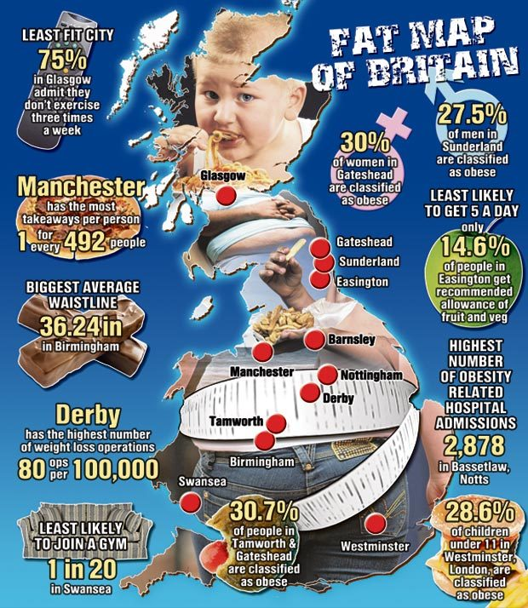
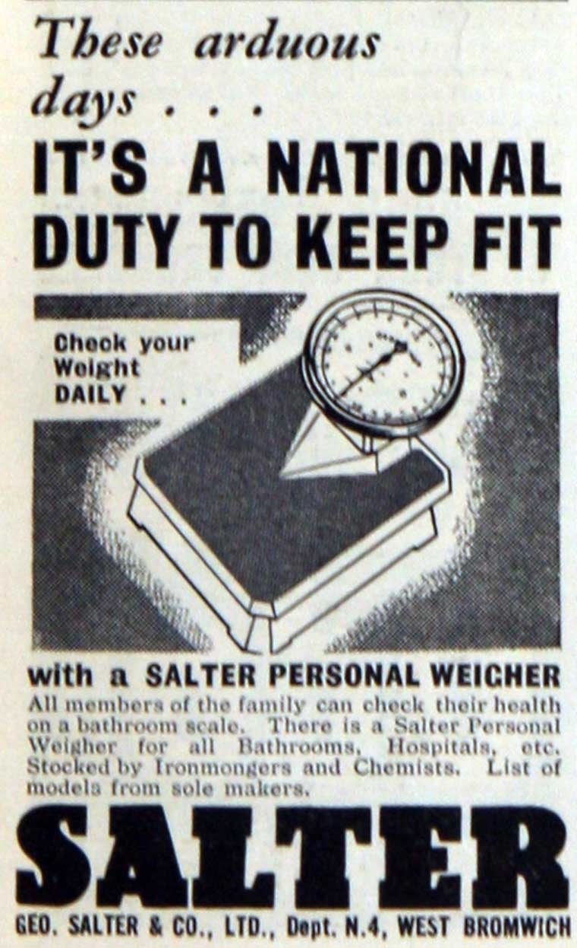
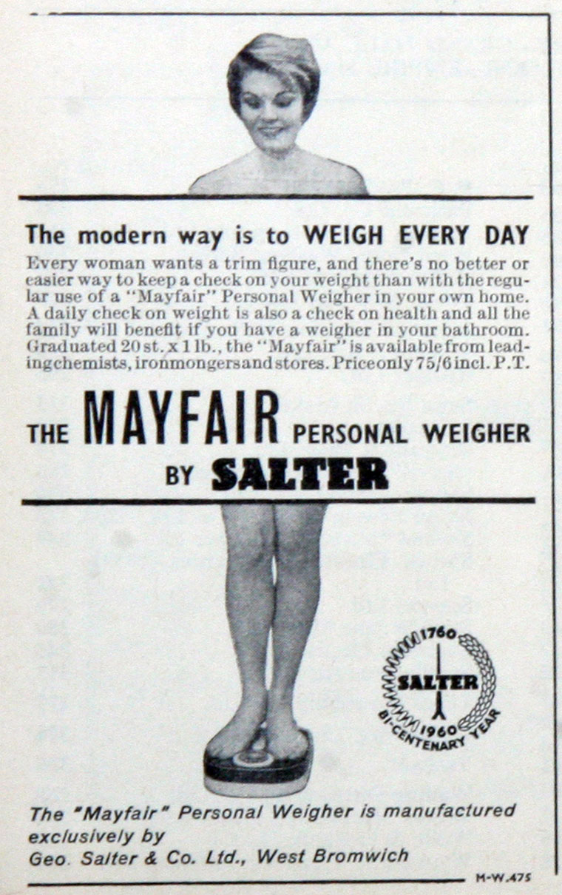
‘Why not?’ or ‘No weigh’! Cultures of quantification, cultures of stigma
Too fat, too lazy, or just too overwhelmed? When (commercial) health education
messages hit home but miss the point…
Notes:
Bertillonage, Craniometry, sphygmograph 1882, electrocardiograph 1913

Slide 11
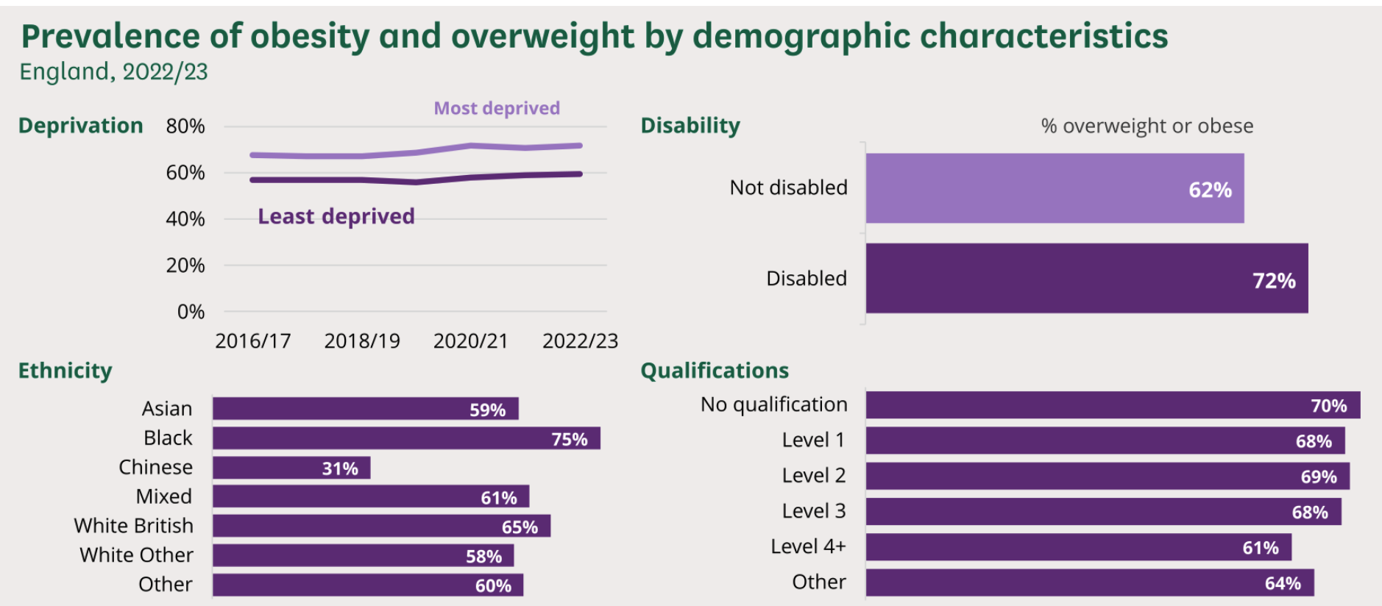
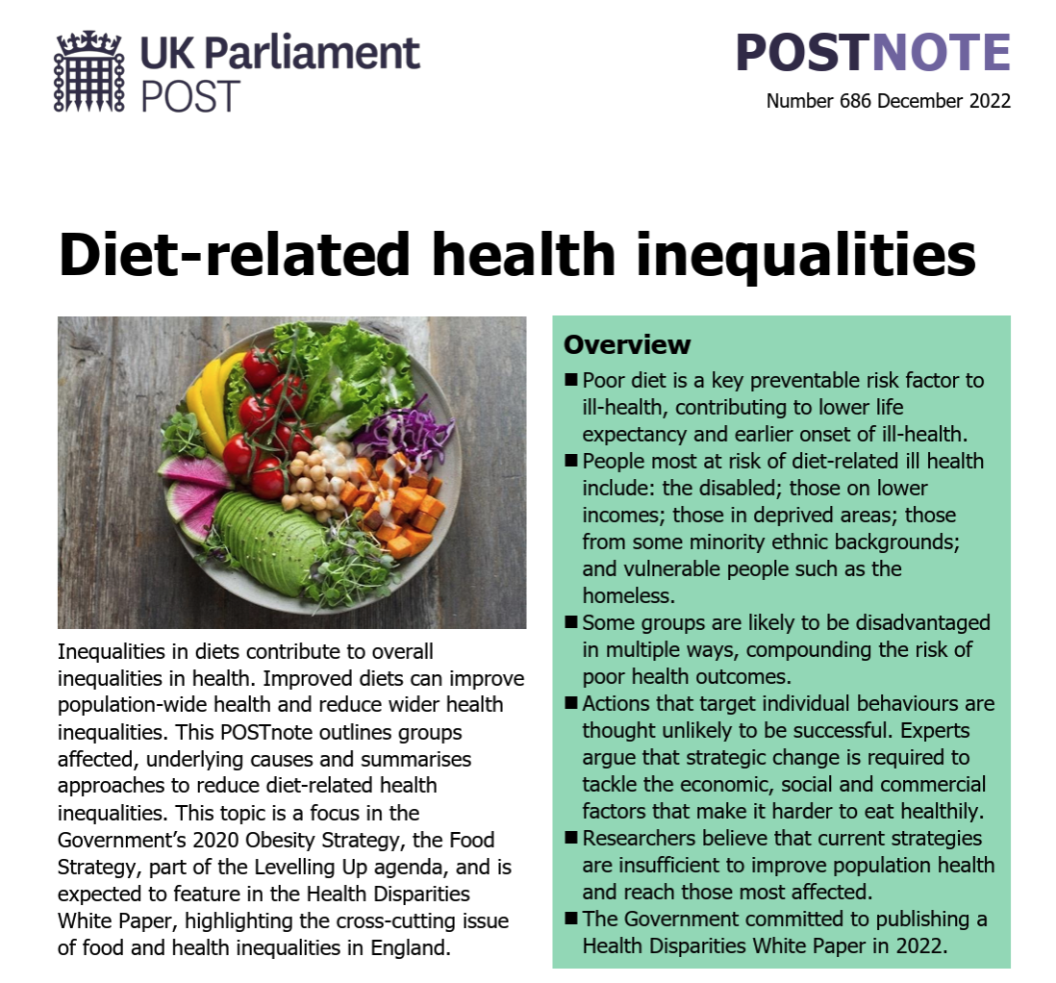
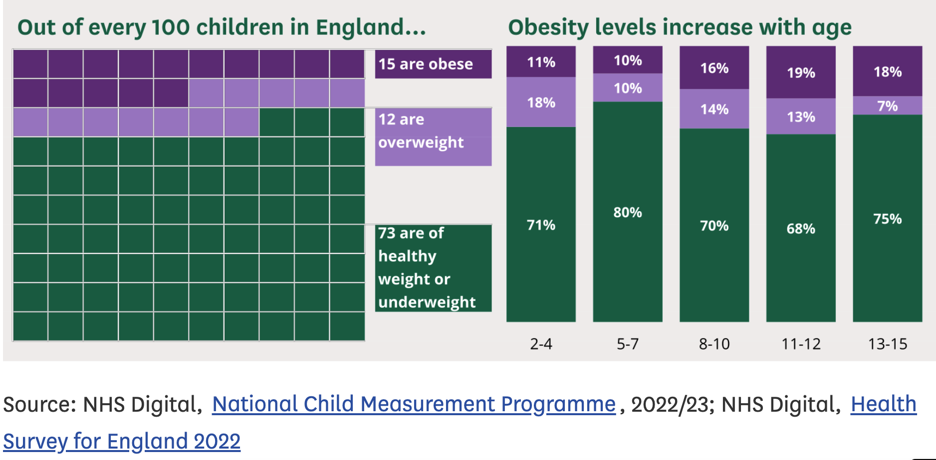
Hard to reach, hardly reached, or hard lives? Responding to ‘chosen’ failures in nutrition

Slide 12

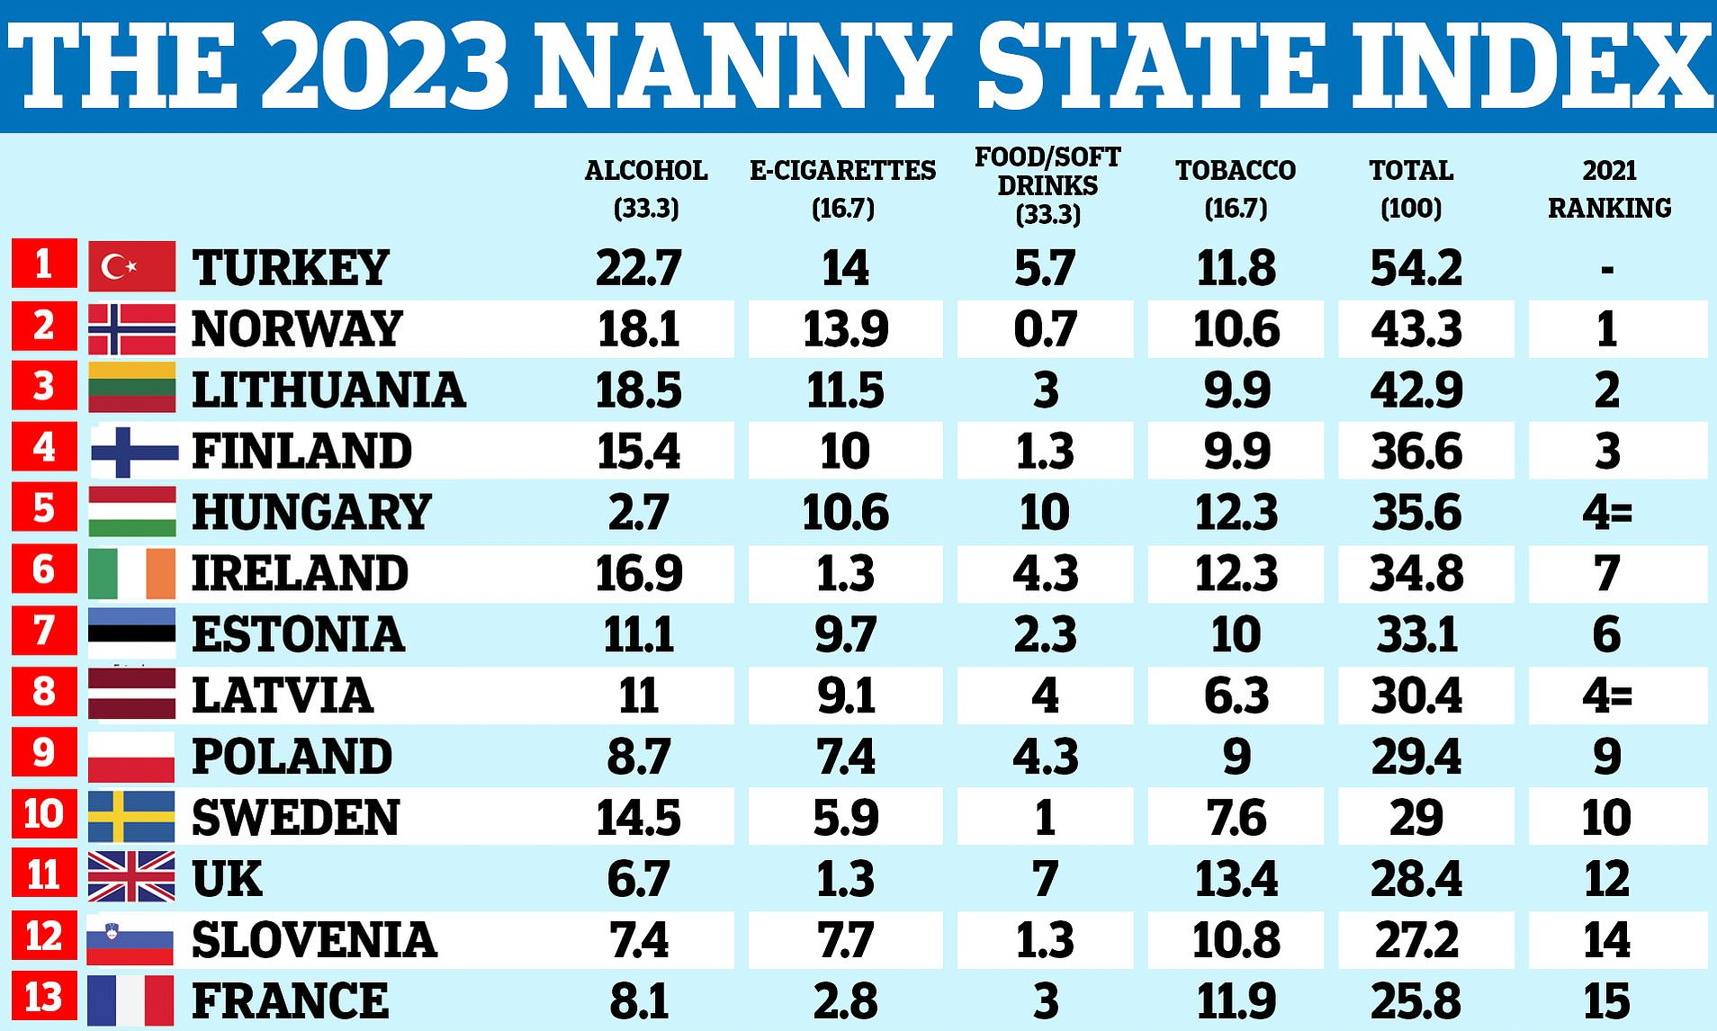
Nanny or neglectful: is there a middle ground for state actors in nutrition?
Learning from history?
Seatbelt laws, anti-smoking interventions, fortification, food and drug regulation and inspection have all achieved some success. Why?
Regulation on producers, manufacturers, and advertising, not directly on behaviour or choice
Combination of multiple strategies for intervention, including education but not limited to it. Remember that your budget for health education cannot compete with manufacturers’ budgets for advertising.
Successful co-option of public concerns and thus social pressure

