Slide 1
Anniversary Fever? History and the Culture of Celebrating the Age of the NHS
Professors Roberta Bivins and Mathew Thomson
Centre for the History of Medicine
University of Warwick
www.peopleshistorynhs.org
Notes:
Yesterday was the 75th anniversary of the NHS. Did you notice?
Right from the start, Britain’s National Health Service has been a subject for anniversary reflection. Politicians, the press, and the broadcast media have used the anniversary as an opportunity to review the service’s achievements as well as failures, reflect on its future, and sometimes thank its staff. What is more recent is that this event has developed into an exercise in public celebration. That transition provides the subject for this lecture. Reflecting our own experience of developing a cultural history of the NHS in the midst of the 70th anniversary of 2018, the lecture also considers the challenges and opportunities for historians in a context of what one might describe as anniversary fever. Across the paper, we look at the affective and effective labour anniversary moments do for NHS activists and critics alike, arguing that NHS anniversaries have come to serve, yes, as birthdays, but also as x-rays, focusing public attention on the NHS to elicit at some moments critical complaint, and at others, protective ‘love’.

Slide 2
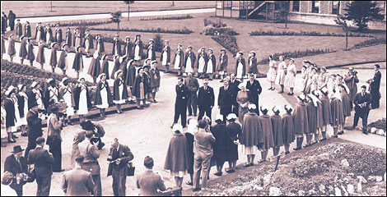
Notes:
July 5th 1948 saw surprisingly little public fanfare. Photographs of Minister of Health Aneurin Bevan symbolically opening the service through a visit to one of the hospitals taken over by the new service have come to be used prominently in later anniversaries, but at the time this event attracted little publicity. The image of a rather regimental, small ceremony on the slide was included in the local Manchester Guardian on 6th July, with the caption highlighting this as a process of ‘Transfer’.
Around the country one can trace some small local ceremonies, but usually to thank those who had run hospitals that were now being taken over: in other words, to commemorate a passing rather than an arrival. Even an exhibition in Whitehall intended to educate and inform the public about explicitly commemorated the centenary of the 1848 Public Health Act, not the birth of the new NHS.

Slide 3
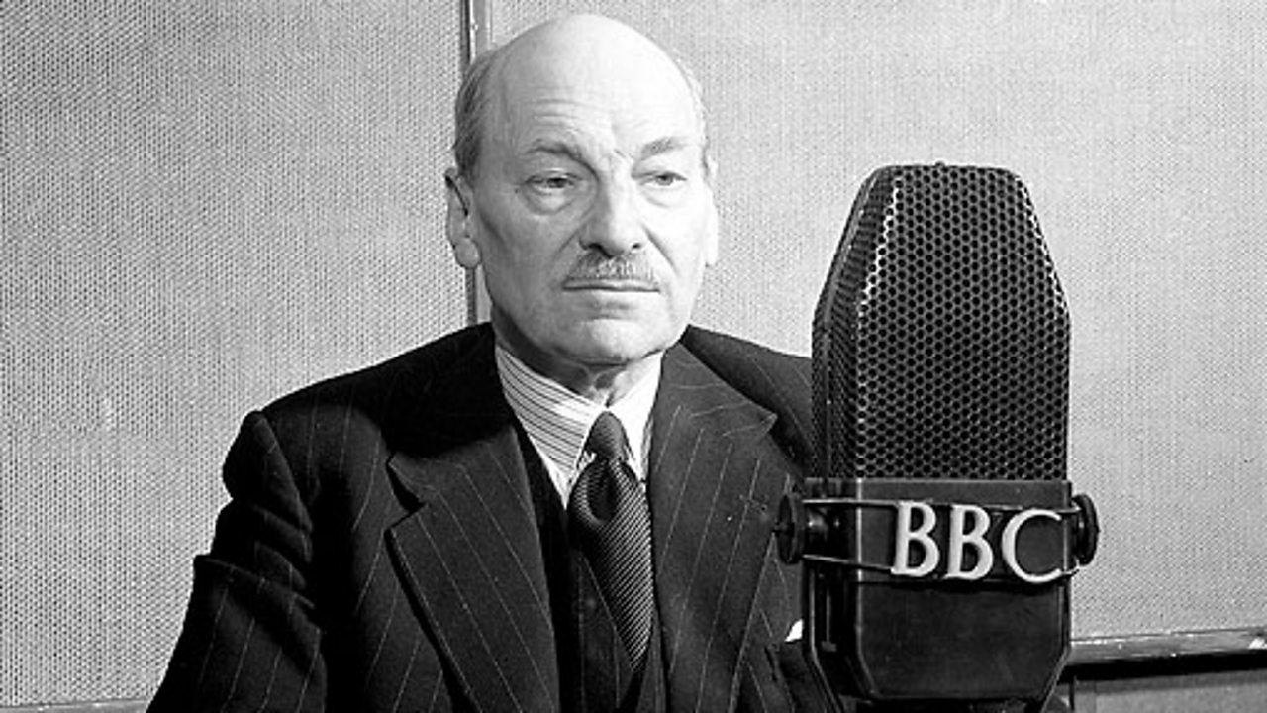
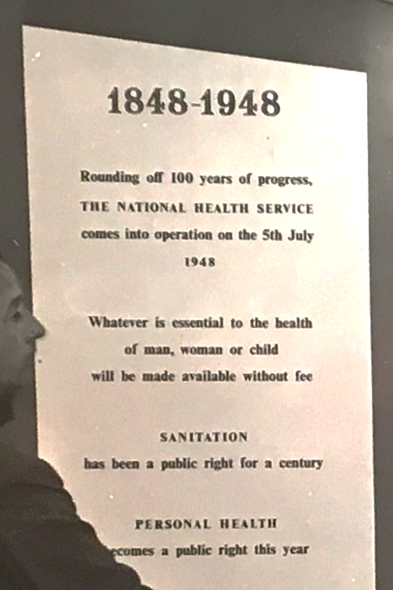
Notes:
The night before the appointed day, Labour Prime Minister Clement Attlee did address the nation via a 15-minute BBC radio broadcast on ‘The New Social Services and the Citizen’. [Slide 3] Even here, the National Health Service had a surprisingly low profile, not mentioned until the last five minutes. The speech was an exercise in calming both the fears of opponents and the hopes and expectations of those who had most to gain, and stressed continuity and comprehensiveness rather than change or revolution. Beyond providing a platform for this muted statement, BBC coverage on the launch was virtually non-existent. https://www.bbc.co.uk/archive/the-new-social-services-and-the-citizen/zhrwbdm.
Indeed, the most prominent anniversary celebration we have found in 1948 was the COI’s ‘Health of the People’ exhibition celebrating the 100th anniversary of the 1848 Public Health Act, not the birth of the NHS, which was represented ‘rounding off 100 years of progress’.

Slide 4
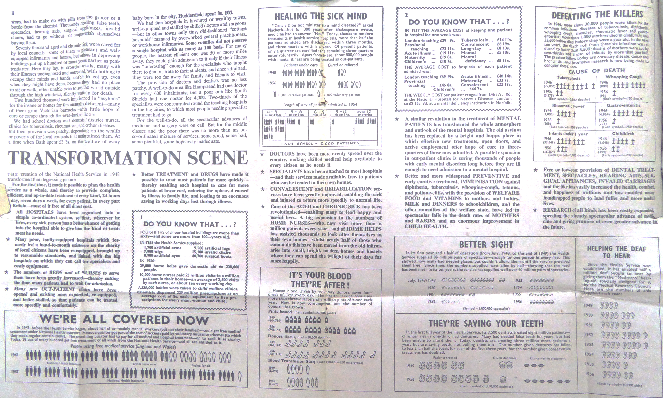
Notes:
By the 10th anniversary, the British and international press, at least, had learned to appreciate NHS anniversaries as a moment to take stock of the service – and numbers addressing its provision and cost always made for good copy.
But coverage should not be equated with celebrations. Indeed, at the 10th anniversary, the Daily Mail, among other papers could not even bring itself to use the word ‘celebrate’, preferring instead only to ‘record’ the anniversary before launching into criticisms of its expanding budget. NEXT SLIDE

Slide 5
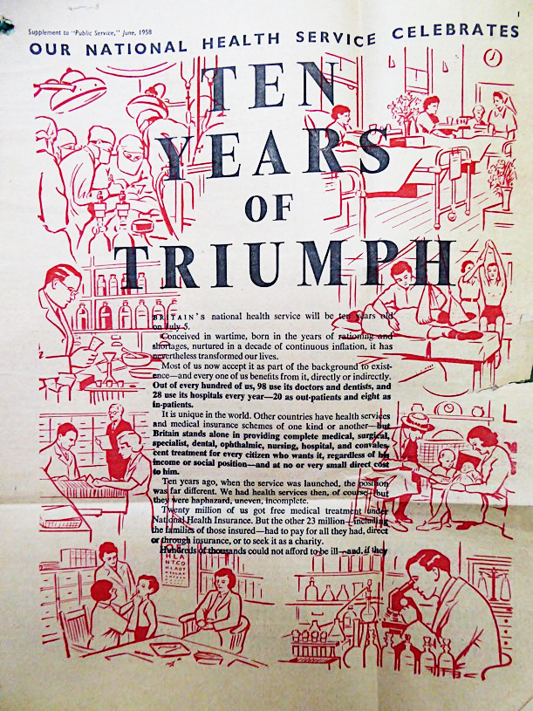
1958: The NHS triumphant at 10 –or just feverish?
‘Most of us now accept it as part of the background of existence...’
‘In these ten years medical science has probably made greater strides than in the previous century… Beside it the Health Service is merely a milestone in social evolution.’
Daily Mail 2 July 1958
Special ‘Tear-Out’ Supplement for Public Service, house journal of NALGO (National and Local Government Officers) Union, June 1958.
Notes:
Bemused, the then Health Minister Derek Walker Smith told his parliamentary colleagues that the circulation of any celenratory material – including the pull-out supplement produced by the National and Local Government Officers Union was not an ‘appropriate’ task for the State. Like his civil servants, he clearly felt it was no part of his role to ‘stimulate a major celebration of the Anniversary’. The BBC too, still seems to have seen its main role as provider of public information. ITV, in contrast, devoted a substantial portion (10 of 30 minutes) of its very first ‘Look Ahead’ programme, broadcast in the week of 5th July, to the NHS. But this was about mapping its next ten years, rather than celebrating its accomplishments. When there was a focus on celebration it was turned inwards towards the staff of the service in reward for their contribution. Perhaps NALGO got it right with their calm assertion…

Slide 6
The NHS at 20: ‘Something for Nothing’
‘Something for nothing: for twenty years, that’s what the health service has meant to most people… How long can this utopian situation go on?’
http://www.bbc.co.uk/archive/nhs/5157.shtml (1.53)
Notes:
Start at 1.53
By the 1960s, the mood was shifting. After two decades of post-war security, rising expectations, and rising if still insufficient budgets for the NHS, the 20th anniversary was marked by a BBC Panorama documentary, Something for Nothing, [Slide 6] which provides us with a stark reminder that there is nothing new in the idea of the NHS being in a state of crisis.

Slide 7
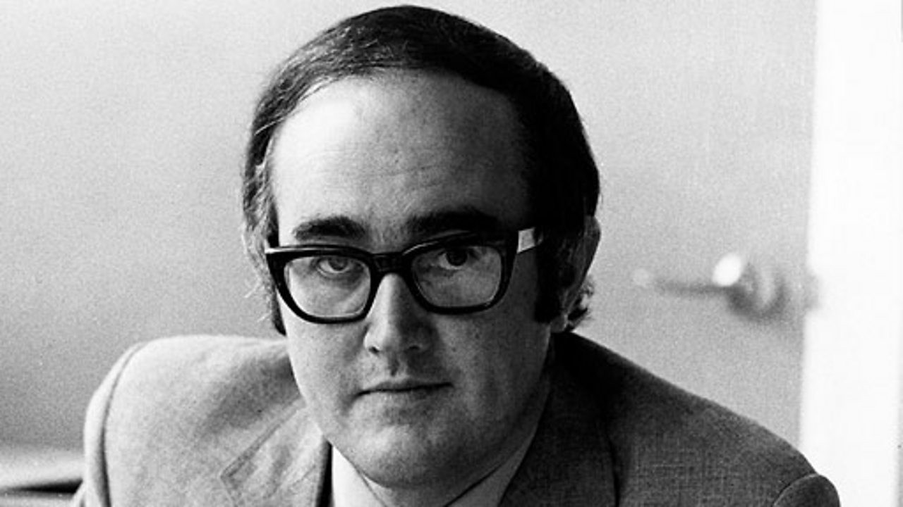
Notes:
Presented by James Burke of Tomorrow’s World, [Slide 7]‘Something for Nothing’ reflected a new sensibility: the service needed to turn its attention to a challenging future and was too bound down by what the NHS had come to mean to the British people over the last twenty years. Universal health provision might have started off as a principled position, but it had already become an immutable force through the self-interest of patients and the fear of politicians to question what rapidly became – at least in the eyes of its opponents, including the Fellowship for Freedom in Medicine – a ‘sacred cow’. Arguably, it was an ideal that held back proper evaluation of the challenges that the health service now faced, and it added an unsustainable burden of demand to a service unequipped to cope. Spurred into reflection by what it saw as the complacency of anniversary celebration – the ‘birthday’ approach -- Something for Nothing suggested that the distorting weight of public meaningfulness was the root problem of a service now dying on its feet.
Andrew Seaton, ‘Against the “Sacred Cow”: NHS Opposition and the Fellowship for Freedom in Medicine, 1948–72’, Twentieth Century British History, Volume 26, Issue 3, September 2015, Pages 424–449. Seaton cites the FFM describing the NHS as a ‘sacred cow’ in April 1968, exactly at the time of the BBC’s documentary. My own research has uncovered the association emerging a decade earlier in the Lancet and BMJ, but only entering media discourse (and only sporadically) in the decade after the 10th Anniversary.

Slide 8
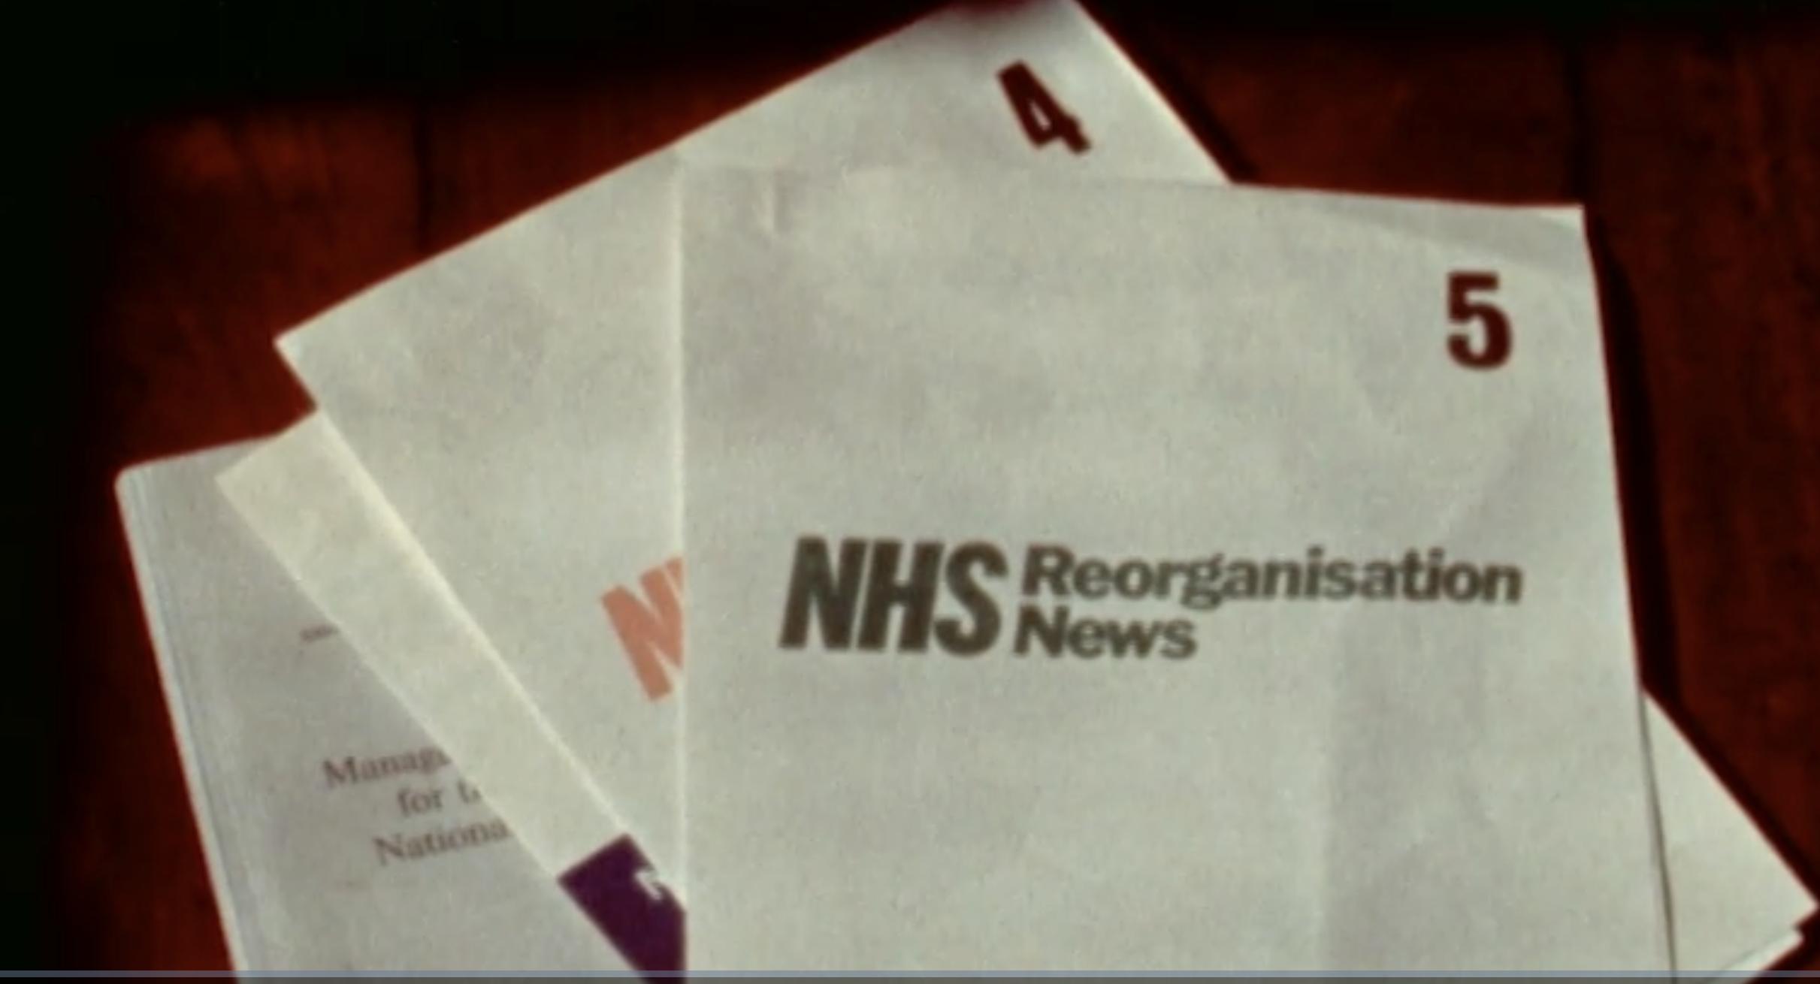
https://player.bfi.org.uk/free/film/watch-new-way-of-caring-1973-online
Notes:
The 25th anniversary of the service provided a further excuse for a round of programming and debate over the future of the institution. The kind of celebration that we have become used to in recent years remained strikingly absent. One difference to the 20th anniversary was the arrival of a new hope for the future in the form of plans for major reorganisation of the service, disrupting the already emerging narrative of the NHS as an untouchable ‘sacred cow’. Yet even NHS staff required education to understand the coming revolution which had, nonetheless, almost eradicated talk of NHS stagnancy in key professional journals.[Slide 8]A number of BBC programmes attempted to evaluate the merits of the proposed changes; however the issues were complex, with no easy answers. This did not make for exciting programming. Bone-deep the examinations may have been amongst the experts, but these were hardly issues suited to capturing the public’s anniversary imagination.
NHS Training Aids Unit, ‘A New Way of Caring’ (Dir. Trevor Payne; Sponsor DHSS), 1973 accessed online at https://player.bfi.org.uk/free/film/watch-new-way-of-caring-1973-online 1 June 2023. Whereas some 14 articles in the BMJ and Lancet condemned NHS as a sacred cow between 1958 and 1967, only 2 spoke to this theme between 1968 and 1977.

Slide 9
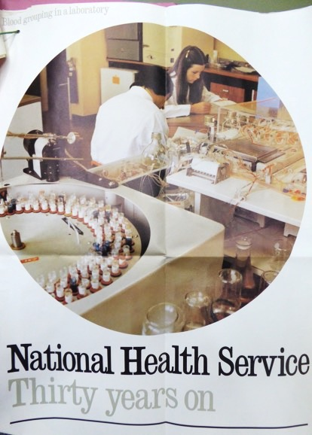
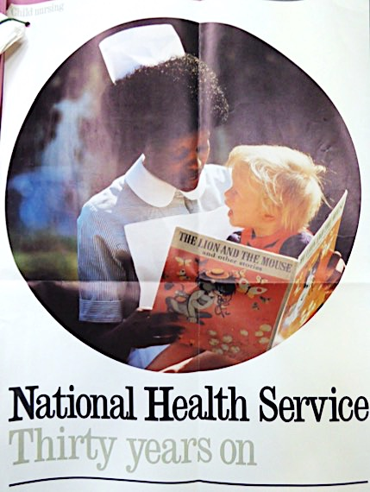
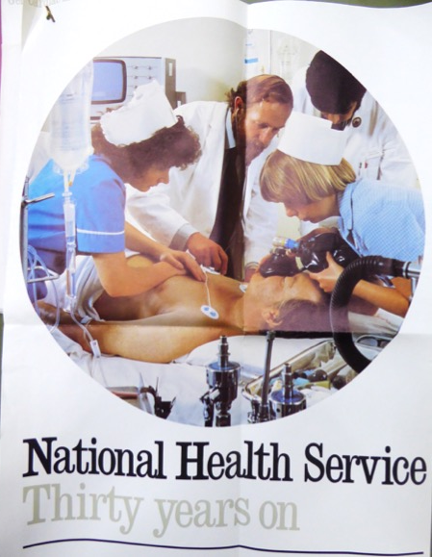
The NHS at 30: ‘political credit might be got for it’
Cardiac Arrest Team, Laboratory Services, Child Nursing. Also publicised: Services for mentally disabled children, geriatric care (and of course, the Social Services)
Notes:
The decade ended with efforts from the Labour Party explicitly to ‘celebrate’ the 30th anniversary as a vehicle for a positive vision of the welfare state both past and – importantly to avoid the appearance of ‘complacency’ – future. Pragmatically, the Health Minister saw this as a useful tool ‘to improve relations within the Service’ and hoped ‘political credit may be got for it

Slide 10
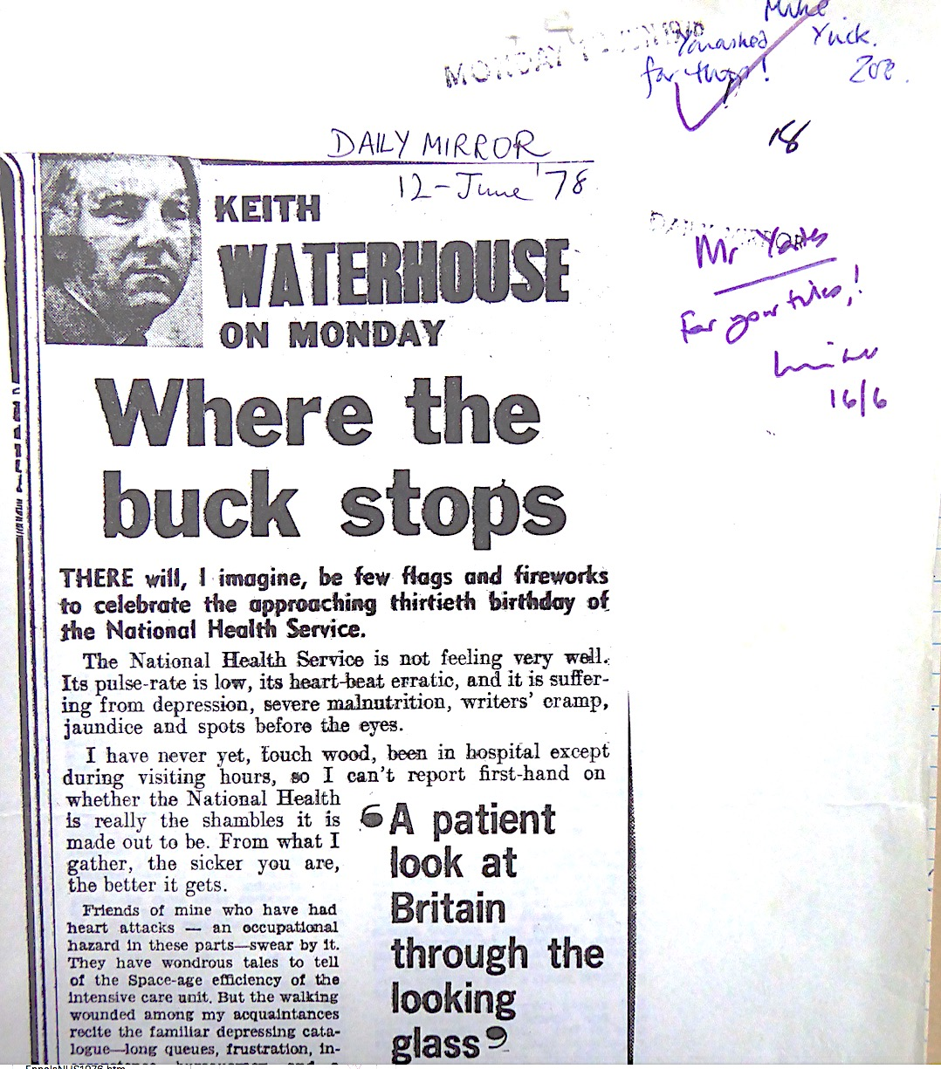
The NHS at 30: ‘2 sandwiches and 1 warm gin and tonic’
‘Any celebration must NOT be a party political event’
‘There should be no lavish social entertainment...’
‘We have got to get the media on our side but ...the Press have got into the habit of knocking the Welfare State.’
‘The objective in celebrating the occasion is to draw public attention to the important contributions made by the local security service and the national health service to the national well-being. In so doing it is hoped that the favourable publicity of a valuable job well done will result, reflecting credit on hard-working staff which in turn would give a boost to staff morale.’ Ennals, Jan.1978
‘Why celebrate the 30th anniversary and not the 25th? Only one answer – election – which cynics would be quick to discern, and there was already a feeling of cynicism and anti-Central Government in the service…’ DHSS internal memo
Notes:
Civil servants admitted qualms about the choice internally: ‘Why celebrate the 30th anniversary and not the 25th? Only one answer – election – which cynics would be quick to discern’. There were also concerns not only that activist groups like ‘Save Our Hospitals’ might take advantage of any events, but that the 20th anniversary commemorations had done ‘more harm’ than good. The health unions, in contrast remained more positive (at least initially), seeing the 30th anniversary as an important moment to ‘appeal to a lot of people who had no recollection of what life was like before the introduction of the NHS’. Unfortunately, internal NHS dynamics were unfavourable and the then Permanent Secretary of the DHSS grumbled: ‘with the English genius for disparaging its own institutions, the Press have got into the habit of knocking the Welfare State.’
This framing of the anniversary as a moment to push back against a rising tide of cynicism permeates internal discussions, setting the stage for what we see as the emergence of affective activism around the NHS: the deliberate mobilisation of feelings, as much as meanings and facts, around the Health Service to ward off perceived threats to its survival. In the 30th Anniversary moment, the threat was at its heart, declinism. A draft of the Prime Minister’s speech for the event explicitly made this point: ‘I know some people think we have nothing to celebrate. Pessimism and cynicism are in fashion. More – they are almost a religion. One of the biggest problems the British people have had to face in recent years has been the clamour of the fainthearts and the knockers.’ Moreover, this dark mood threatened the NHS specifically: ‘They claim the health service is in a state of collapse – when in fact it continues to provide a splendid service for our people … in a world of limited resources and unlimited demand.’
And of course this is not new; as early as 1948, the BBC internally regarded the NHS — or at least propaganda about it — as a rebuke to declinist views of the post-war nation…
With its future in the 20th anniversary’s critical look forward, those cultivating NHS anniversary culture at 30 turned to history – and interestingly, at least within the DHSS and among some in the Service, to what might be called the ‘view from abroad’, which some saw as both more accurate and more positive than attitudes shaped by cynicism and disputes at home. As the Prime Minister asserted on 5 July 1978. ‘No wonder the fame of the health service is known throughout the world; the excellence of its medical and nursing training attracts doctors and nurses from many countries’

Slide 11
40 years: The (re)view from abroad is love-ly… but not necessarily optimistic.
Original: Charles Griffin Daily Mirror 4 Feb 1988
Original: Kal (Kevin Kallaugher), Today, 7 October 1986
‘The British Love their NHS’, Washington Post, 1988
Notes:
The mood in relation to the NHS as the 40th anniversary approached in 1988 was also thoroughly gloomy. Strikingly like the 75th anniversary yesterday this mood reflecting not just the critiques from right and left but also the everyday realities of a service under ever-increasing strain. Conservative politicians were poorly placed to celebrate the NHS, with Thatcherism often blamed for its decline, and the Labour Party on thr attack. The fact that Moore chose July 5th to tell employers to look to health insurance for their workers is further indication of the fragility and divisiveness of the anniversary moment at this midpoint of the service’s history.
But press coverage indicates that the public mood was more affectionate – even, according to the US press, loving.

Slide 12
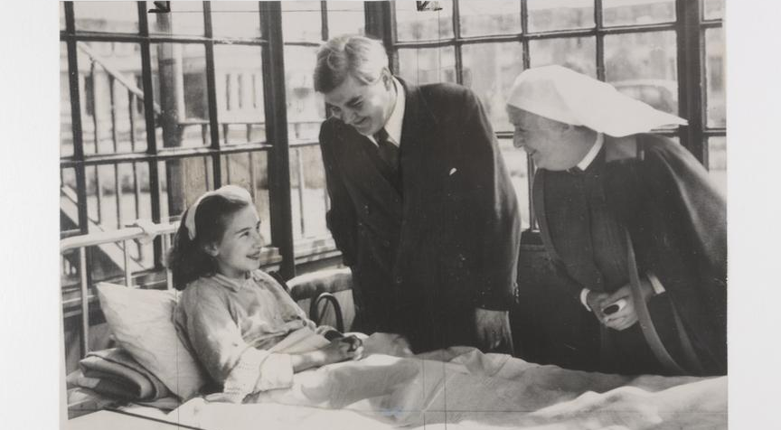
Notes:
Sylvia Beckingham, [Slide 12] pictured with Nye Bevan as a child patient in once-little known (but since their 40th anniversary re-discovery endlessly reprinted) publicity stills for the Appointed Day, made similar claims in a Daily Mail interview: ‘ “We have not got a lot to be proud of around the world – but by gum we have got our National Health. It matters to the British people, and I am so glad to be able to say it.”’ Elsewhere the Daily Mail editorial staff suggested that at 40, the Health Service suffered less from failings or underfunding than from its own success and ‘the revolution of rising expectations’ in an era of increasing prosperity. Even the staid Sunday Times poked fun at DHSS Secretary John Moores for his sudden about-face ‘from being the arch-proponent of privatisation to … the best friend in government of free health care’, ‘bringing cheer to the birthday party’ and committing to the preservation of the NHS. The paper admitted that the NHS has a track record of achievements ‘that would make private industry gasp’.

Slide 13
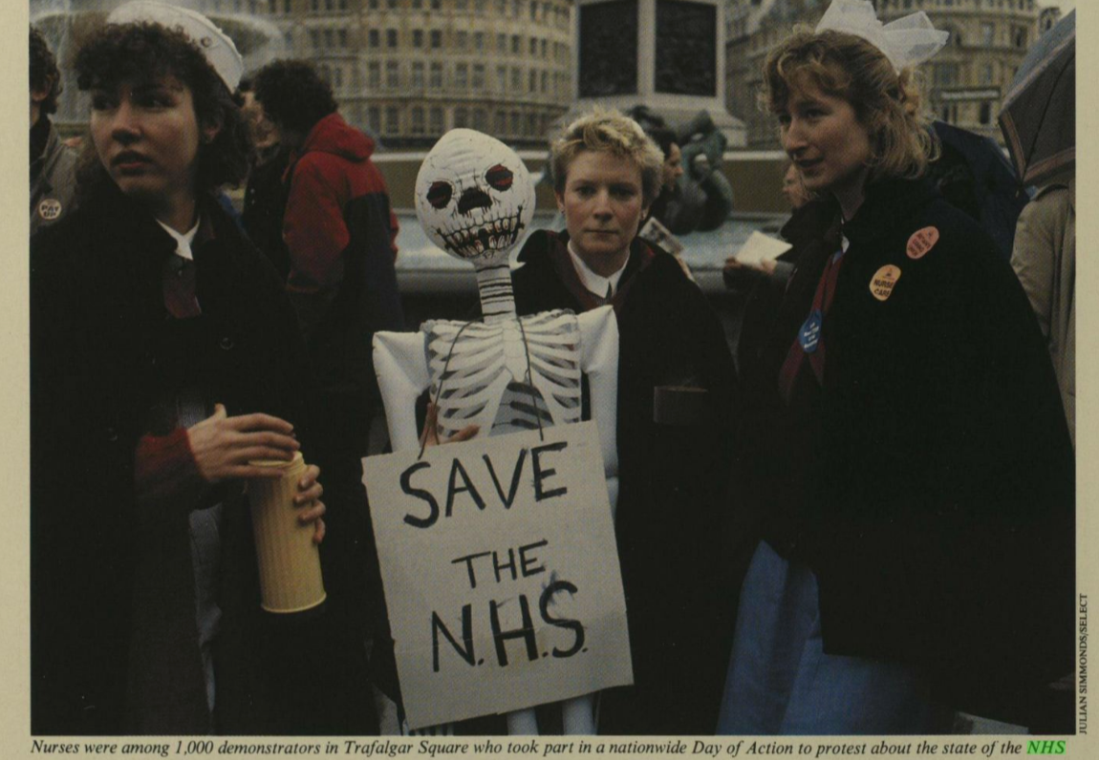
Notes:
An earlier national ‘Day of Action’ protest in Trafalgar Square hints again at a relationship between perceptions that the Service’s survival was under threat and the emerging links between NHS affective discourse and NHS activism. The Illustrated London News pictured nurses marching with a skeleton. The skeleton carried a placard begging ‘Save the NHS’. [Slide 13]This connection between public affect – here, fear of threatened changes to the NHS -- and public activism was already seen by some policy makers and politicians as a dangerous obstacle to reform.

Slide 14
And New Labour’s NHS at 50: ‘All our tomorrows’?
Notes:
A significant shift of tone followed the defeat of the Conservatives and election of Tony Blair in 1997. Most significantly, the anniversary was now being recognised as a day of national and explicitly public celebration, for the first time in such distinct and organised form. The landmark of the half century no doubt helped. It facilitated official state endorsement in the form of commemorative stamps and coins. Moreover, the NHS itself became involved in creating a national campaign of events and competitions. It even used the internet, which now reached 9% of the population, with a website to coordinate activity and promote commemorative electronic postcards. The expenditure involved did once again spark criticism. But this time, well ahead of the anniversary, increasingly elaborate plans for celebration were being organised and publicised. Organisation began even before the election of the new Labour government in May 1997. Already in January of that year, Sandy Macara, Chair of the BMA, was looking forward to a celebration ‘transcending the traumas of the recent past’. Following their election Labour was keen to back celebration plans and used the anniversary to announce new funding and support.Health Secretary Frank Dobson symbolically visited Trafford General Hospital where Bevan had opened the service in an act of ‘unashamed nostalgia’—and shameless top-down opportunism, washing New Labour in the bubbling spring of public affection for the service. . These were advertised for sale at £9.99 for commemorative sets of both: ‘Celebrate 50 Years of the NHS’, Daily Mail, 19 May 1998, p. 20.
. A copy of the home page of the web site is accessible at: https://tomgidden.gitlab.io/home.htm.
‘Outrage at Cost of NHS’s 50th Birthday’, Daily Mail, 30 June 1998, p. 13.
Labour not only backed celebration plans but would use the anniversary to announce new funding and support, with Health Secretary Frank Dobson symbolically visiting Trafford General Hospital in an act of ‘unashamed nostalgia’:

Slide 15
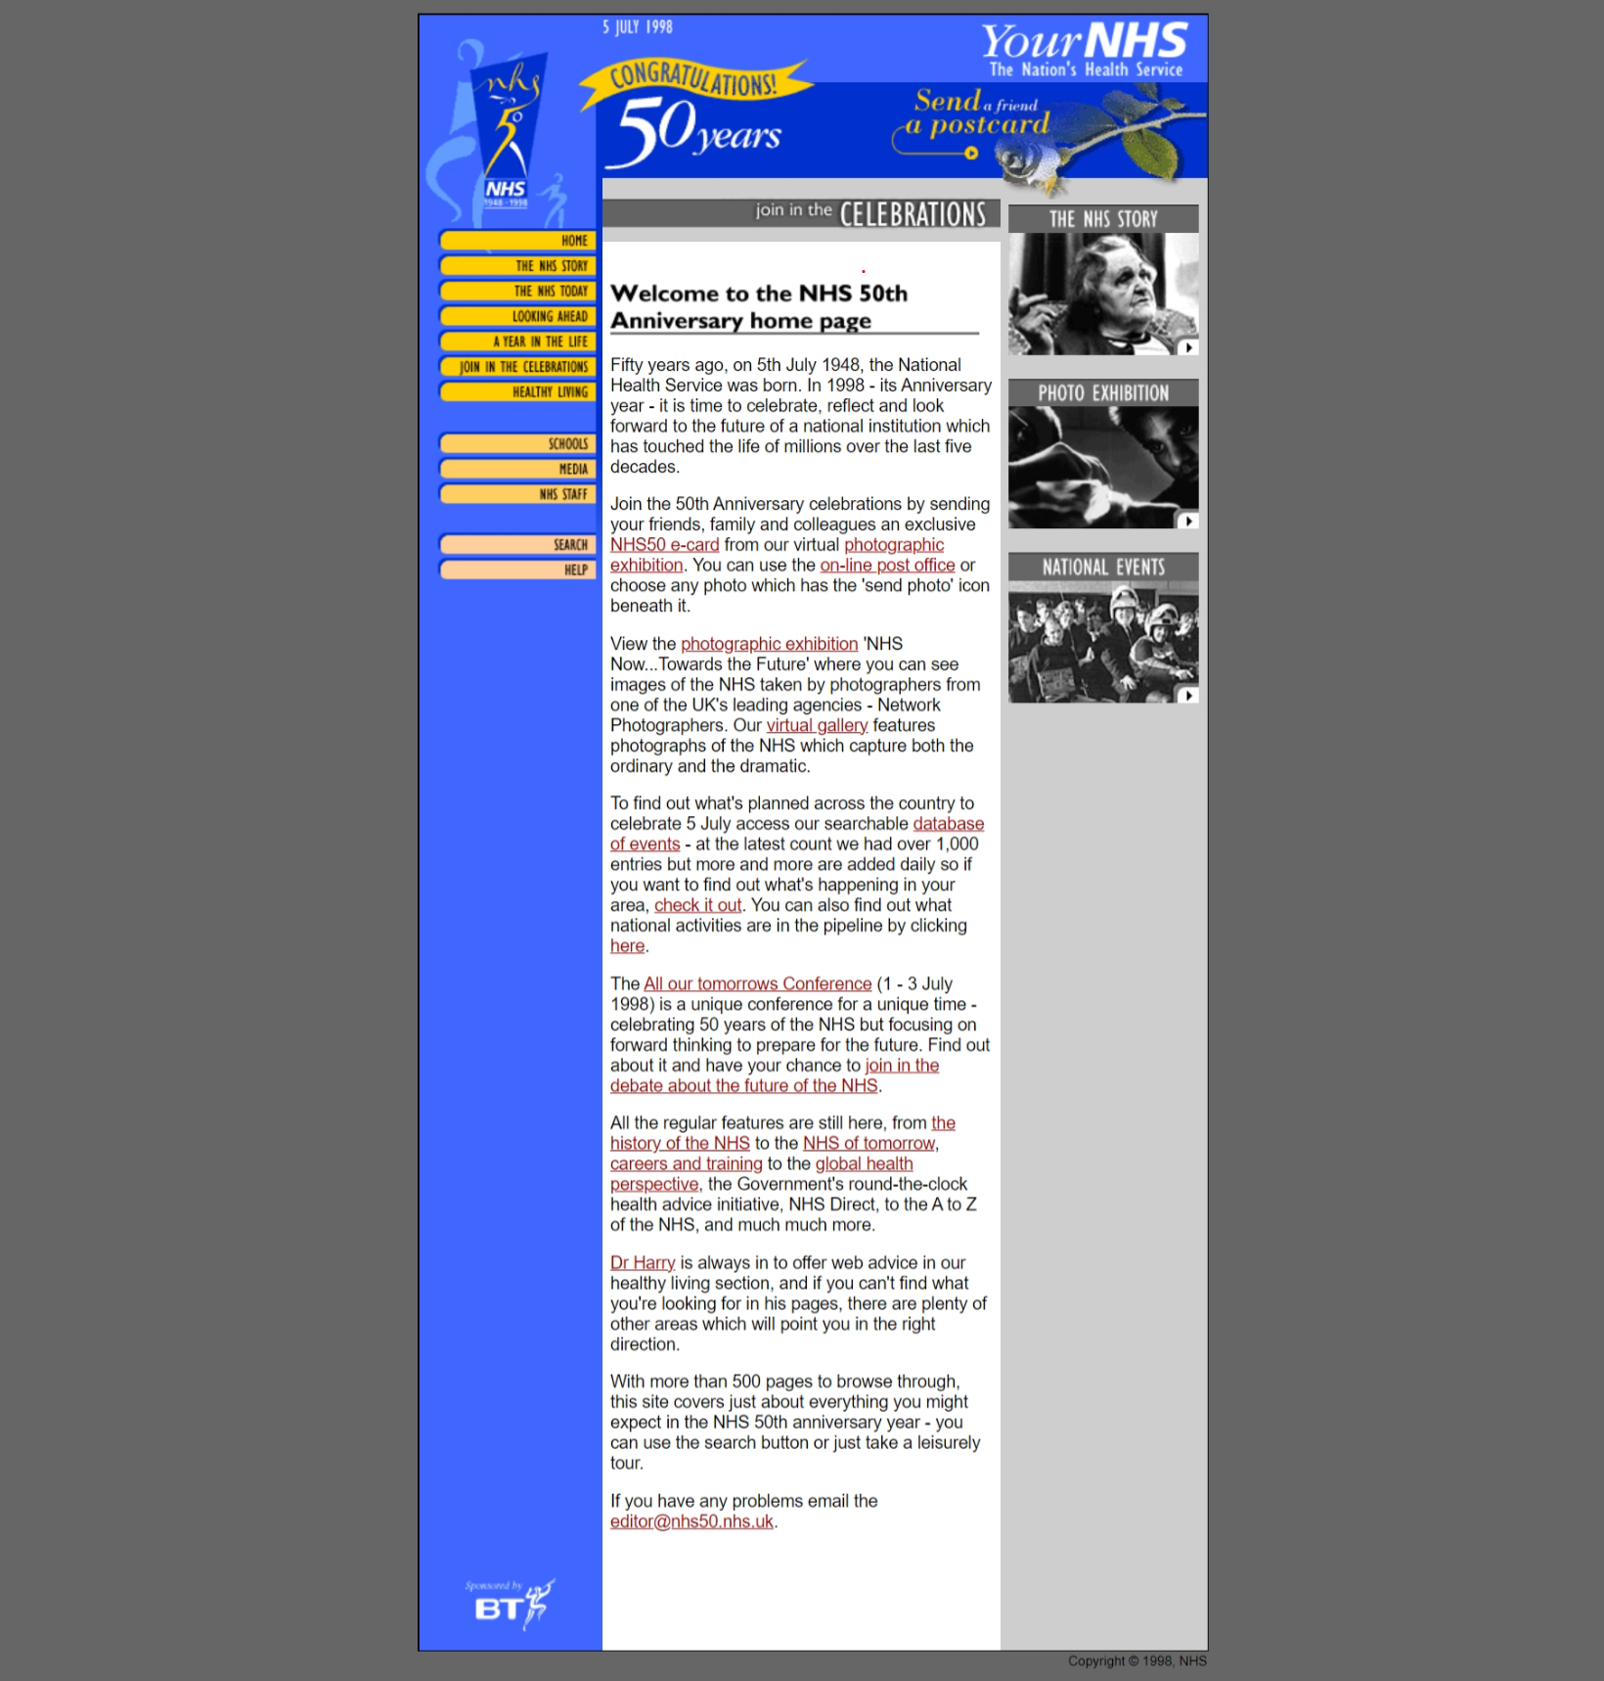
Notes:
There was even a website to fire online enthusiasm – not to mention Buckingham Palace garden parties for NHS workers, a ceremony at Westminster Abbey, and exhortations for the public to become involved – and fund their own celebratory or commemorative events – perhaps with help from BUPA: perhaps a high point the the newLabourish-ness of New Labour.
The shift in tone from previous low-key and gloomy anniversaries is striking. It is hard not to emerge with the impression that the 1998 anniversary serves as something of a pivot point It was certainly easier for politicians to evoke ‘loving’ the NHS as a mainstream sentiment in a time of financial largess than one of crisis: Blair’s New Labour received the ‘political credit’ that had eluded Callaghan at the 30th anniversary. But these celebrations also confirmed the NHS as an object appropriate for general public feeling, and affirmed the sense of ‘ownership’ Jennifer Crane has documented emerging from activism in the 1980s

Slide 16
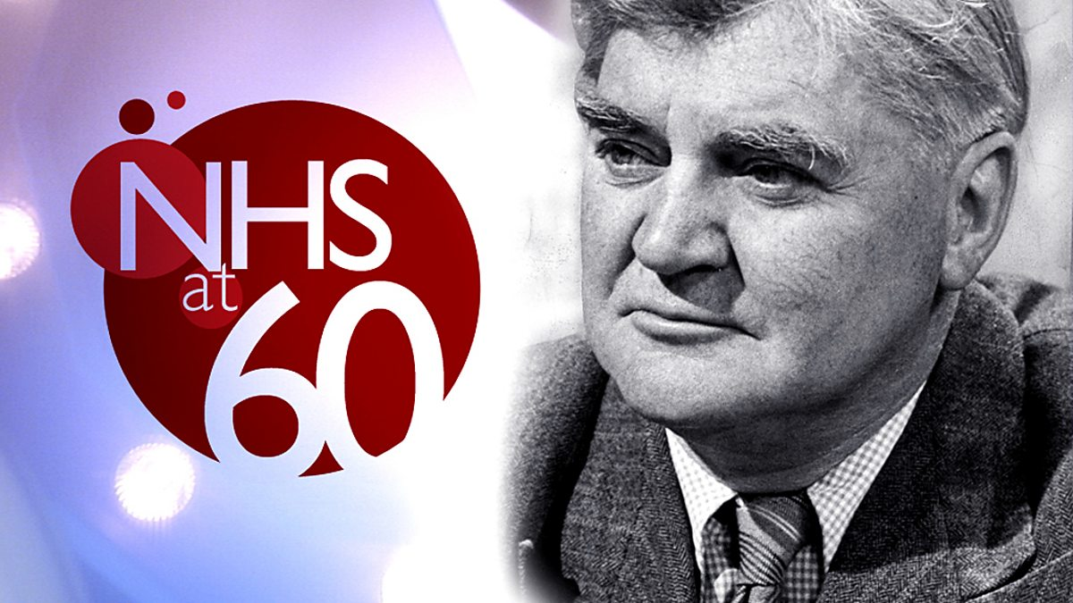
Notes:
The 60th Anniversary saw yet more nostalgia and further re-working of the Service’s complex history into a simpler story of a heroic founder, a villainous opposition (conservatives and medical professionals alike).
The state of play is characterised by an hour-long historical documentary The NHS: A Difficult Beginning, broadcast on BBC2 in the prime 8.30 pm evening slot on July 5th. The uncertainties and ambivalences of ‘Something for Nothing’ or the 1982 BBC Radio Stuffing their Mouths with Gold are nowhere to be seen . Instead Imelda Staunton told the audience that the NHS was ‘beyond political debate’.

Slide 17
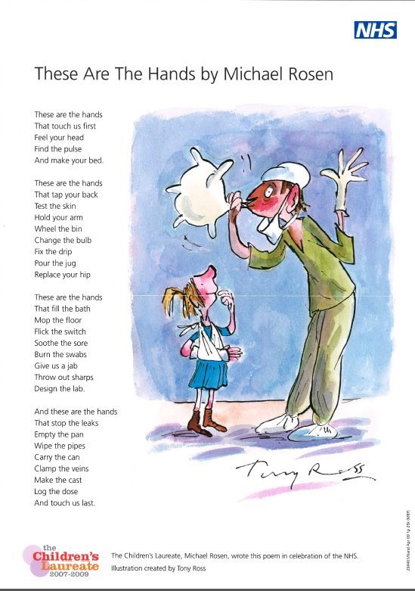
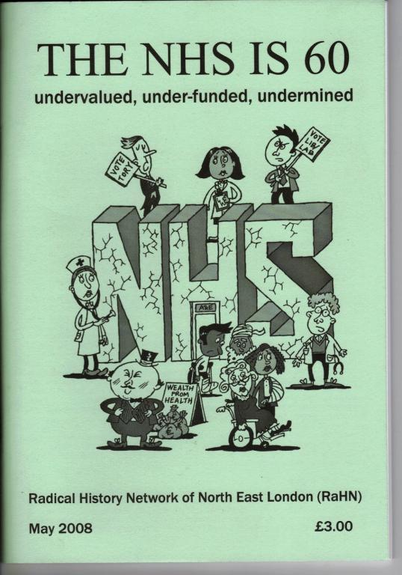
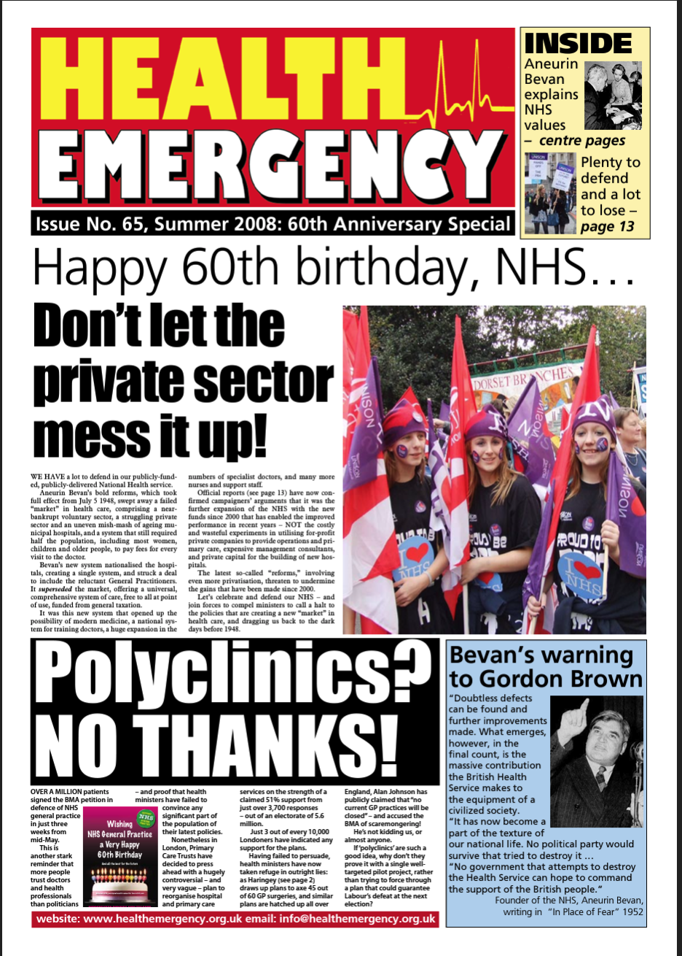
The NHS at 60: Evoking Affect for Action?
Notes:
But clouds were also visible on the horizon, at least to NHS activists, who commemorated the 60th anniversary through protests, placards, and radical rather than nostalgic history. [Slide 18]. These evoked the public’s affection for the NHS to ward off privatisation.

Slide 18
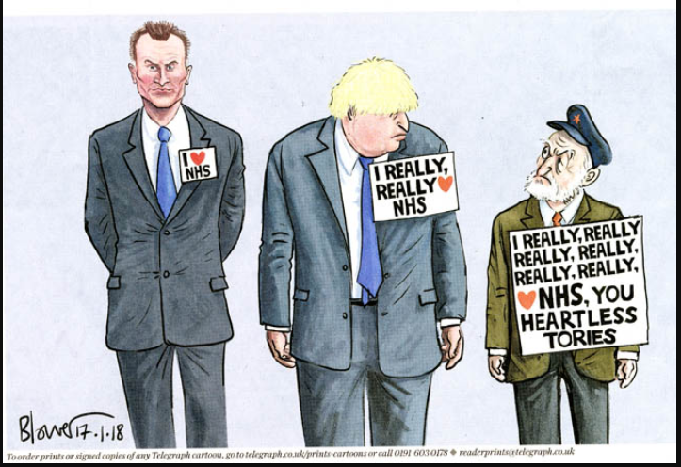
Patrick Blower, Daily Telegraph, 17 Jan 2018
Notes:
The 70th anniversary of 2018 took celebration to a new level. This had not just the powerful institutional support of the BBC and broader media behind it, but also the backing of politicians and NHS leadership. And everyone was seeking political credit for it, not least Prime Minster Theresa May, who followed in Blairite footsteps by offering her own big birthday present to the NHS.
Indeed, politicians of all parties competed to ‘love’ the NHS most after a turbulent decade that saw financial retrenchment and uninhibited politicization of the Service during the Brexit debates, prompting media scorn. [Slide 19]

Slide 19
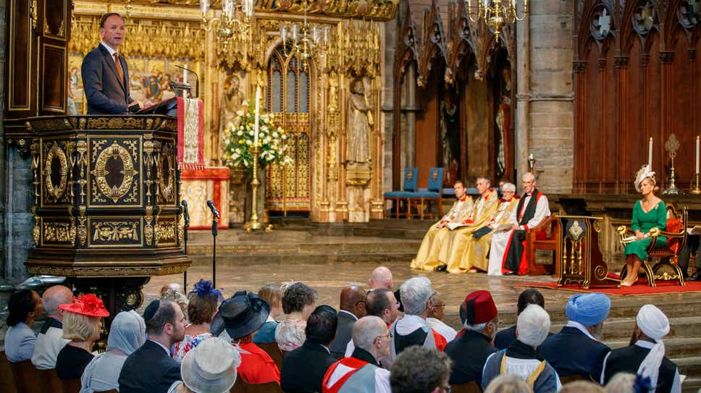
Notes:
And NHS England created a publicity machine for ensuring that the anniversary took centre-stage, involving services at Westminster Abbey and York Minster and ‘NHS70Tea’ parties across the country

Slide 20
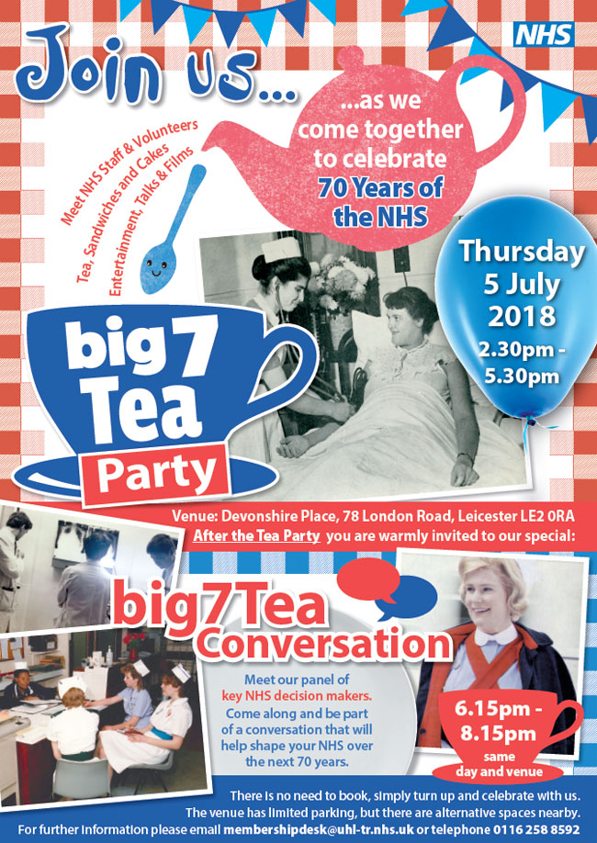

Slide 21

Notes:
Foreign correspondents looked on bemused, seeking explanations from experts and service users alike.
History was again deployed as an anniversary tool. There were programmes celebrating Nye Bevan, including The Man Who Made the NHS. But drawing on interviews with patients and staff, Owen Sheers’ poetic BBC drama, To Provide all People, [Slide 22] exemplified another important trend that came to the fore more powerfully than ever before in 2018: meaning, affection, even faith now centred on the stories and experiences of ordinary people. In a powerful populist equation, seeing the NHS as the people’s NHS elevated it beyond criticism over its many recognised faults We were ourselves regularly asked for such explanations, before and during the anniversary.

Slide 22
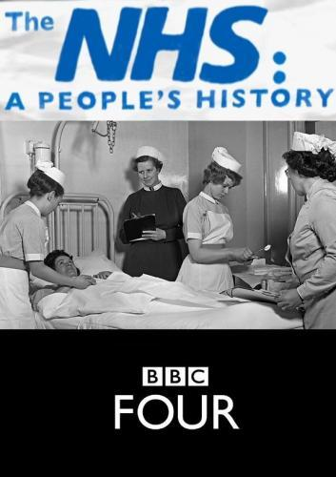
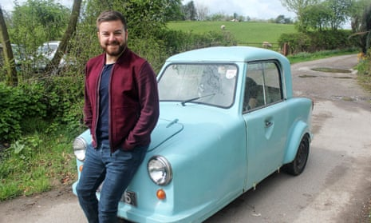
Notes:
2018 may have seen crystallization of the ‘national treasure’ status of the NHS but in reaching a kind of anniversary fever it also saw such representation begin to be called into question.

Slide 23
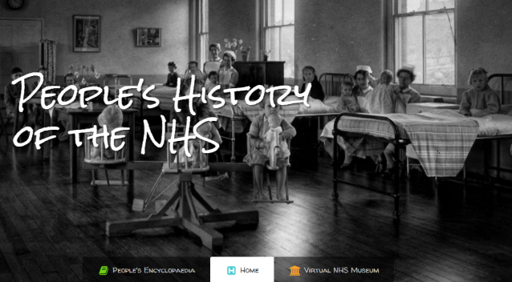
Notes:
Seeing the service as the People’s NHS could provide the platform to ask new questions about who the NHS served, who served the NHS, and who was excluded from its working understandings of the british public. Could such critical examinations effect change in attitudes of the NHS – or did they, by including the previously excluded or forgotten mearly expand the celebrations to new heros?

Slide 24
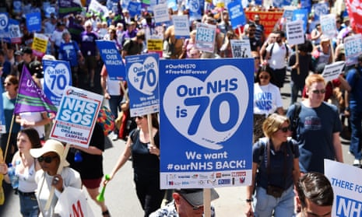
People march through London to mark 70 years of the NHS. Photograph: Andy Rain/EPA
Notes:
On the streets and in the press , there were some signs of a willingness to problematise public attitudes and meaning in the face of anniversary fever, but this was on the margins and was overshadowed by the most pervasive public exercise of celebration in the life of the service. The scale, range, and celebratory, affectionate nature of coverage on a forum such as the BBC that historically had been more reticent and open to searching criticism was remarkable and so too was its reach.

Slide 25
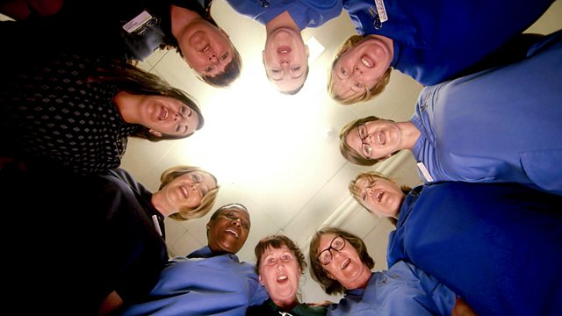
Notes:
It would be tempting to say that the anniversary coverage of 2018 had become inescapable. It would also be tempting to extrapolate from the tone and message of such coverage to public feeling.

Slide 26
Questions?

Slide 27
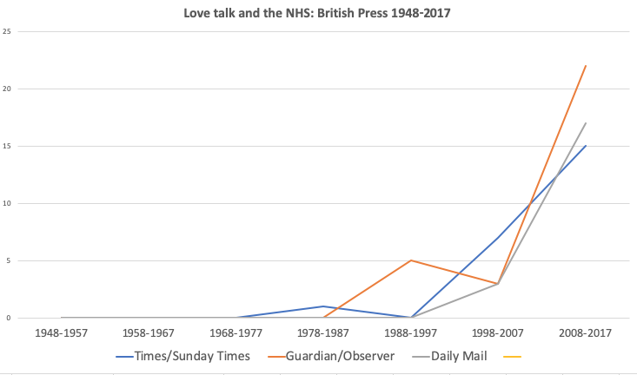
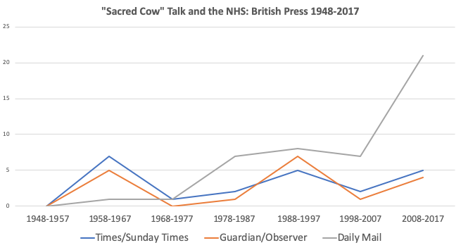
SO: when do Britons ‘love’ the NHS?
NB: These counts are indicative rather than exact.

Slide 28
‘Protect the NHS’: Affect and UK Government Coronavirus Messaging, March-May 2021

