Slide 1
Immigration and the NHS
Professor Roberta Bivins
Centre for the History of Medicine
University of Warwick
peopleshistorynhs.org

Slide 2
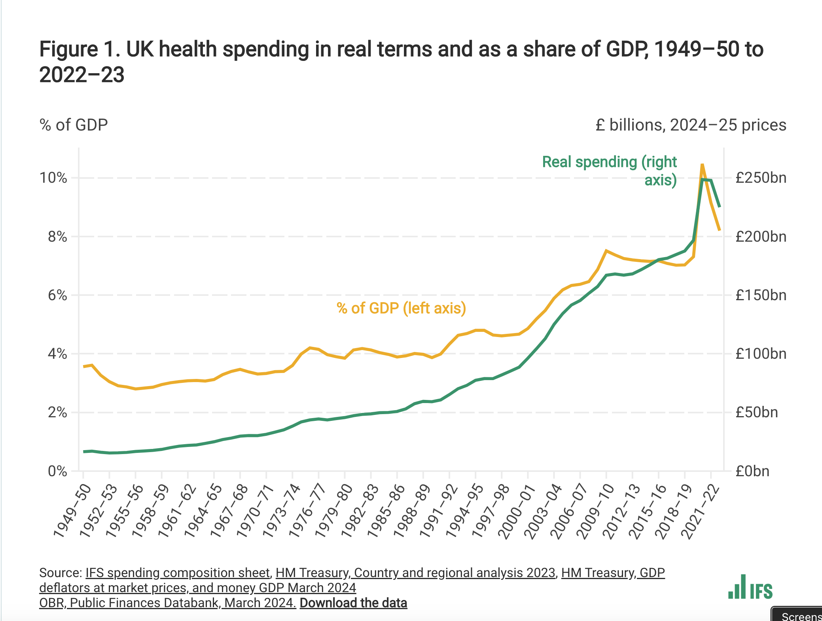
Why look at migration through an NHS lens? A few NHS facts…
The NHS employs 1.5 million people DIRECTLY (that’s not counting 147,000 in GP surgeries, or 24,000 dentists, or outsourced groups). That’s about one in every seventeen people in the UK and has been Britain’s biggest employer since the 1960s.
The NHS accounts for the largest single tranche of UK central government spending and has been larger than defence since 1988.
31% of NHS staff are from ethnic minorities, and Britain relies on immigration for 35% of its doctors and 27.2% percent of its nurses and health visitors.

Slide 3
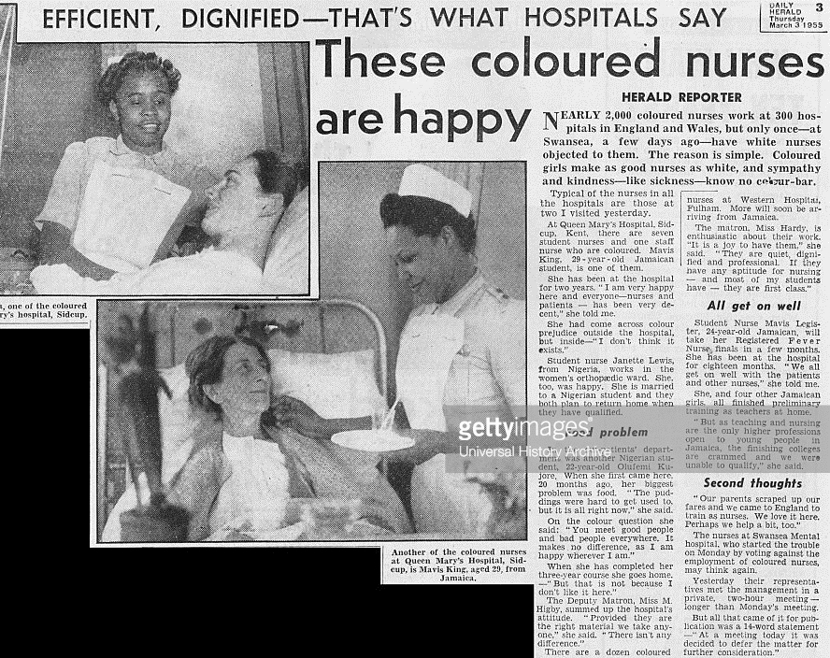
This is not new…
Even before the NHS, Irish nurses staffed the wards across the UK, particularly in TB and asylum care.
By 1949, the Ministries of Health and Labour were working actively with the Colonial Office, the Royal College of Nursing and the General Nursing Council to actively recruit Caribbean women.
Enoch Powell supported Caribbean nurse recruitment in his role as Health Minister in 1962.
By late 1965, there were as many as 5000 Jamaican women staffing British hospitals.
By 1977, 12% of all student nurses and midwives in Britain were recruited overseas, with 66% of those from the Caribbean.
‘These coloured nurses are happy’, Daily Herald, 3 March 1955.

Slide 4
British policy making in mid-century migration: confounding factors
Universal post-war labour shortages, followed by persistently high demand for cheap labour (and of course equally persistent demand for qualified and unqualified NHS staff);
Geopolitics, including Cold War and UK leveraging of Commonwealth relationships, ‘influence’ to protect status as a ‘great nation’;
‘Race relations’: tension between popular and political self-identification as a ‘tolerant nation’ and racist responses to migrant, ethnic communities;
Constant Treasury pressure on spending departments, including Health, to cap costs and secure efficiency combined with resistance to increase general taxation levels or hypothecate tax levies.

Slide 5
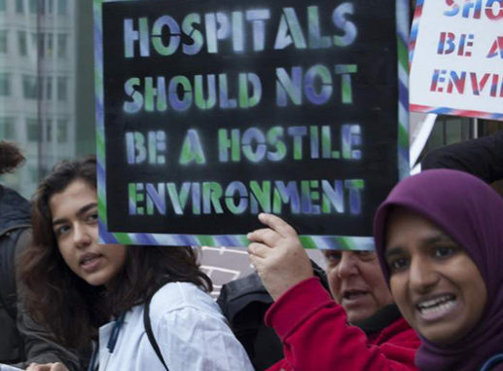
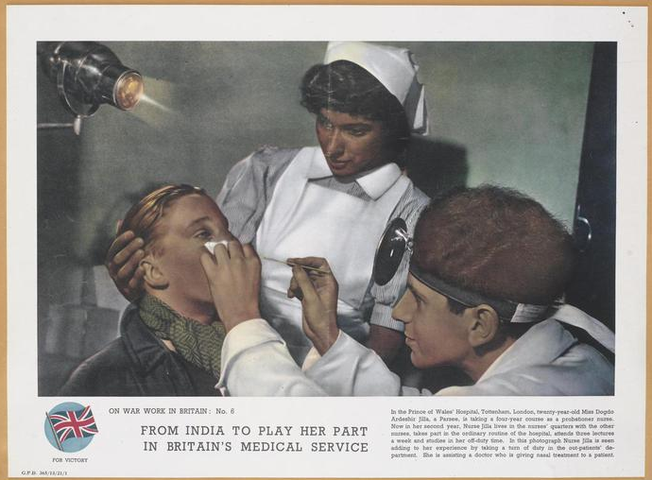
Migration and the NHS: from ‘civis Britannicus sum’ to the ‘hostile environment’…
‘In a world in which restrictions on personal movement and immigration have increased we still take pride in the fact that a man can say Civis Britannicus sum whatever his colour may be, and we take pride in the fact that he wants and can come to the Mother country.’
Henry Hopkins, Colonial Office, 1954
© Crown Copyright. IWM http://www.iwm.org.uk/collections/item/object/33289
Notes:
ON WAR WORK IN BRITAIN: No. 6 FROM INDIA TO PLAY HER PART IN BRITAIN'S MEDICAL SERVICE In the Prince of Wales' Hospital, Tottenham, London, twenty-year-old Miss Dogdo Ardeshir Jilla, a Parsee, is taking a four-year course as a probationer nurse. Now in her second year, Nurse Jilla lives in the nurses' quarters with the other nurses, takes part in the ordinary routine of the hospital, attends three lectures a week and studies in her off-duty time. In this photograph Nurse Jilla is seen adding to her experience by taking a turn of duty in the out-patients' department. She is assisting a doctor who is giving nasal treatment to a patient.
COLONIAL IMMIGRANTS
HC Deb 05 November 1954 vol 532 cc821-32

Slide 6
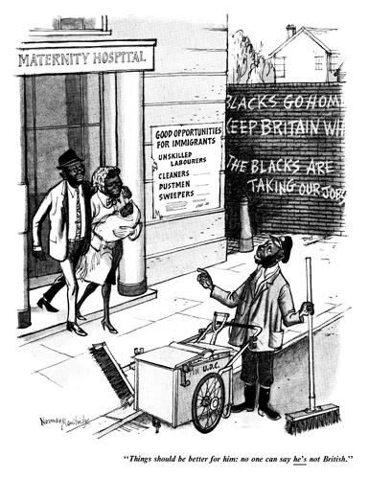
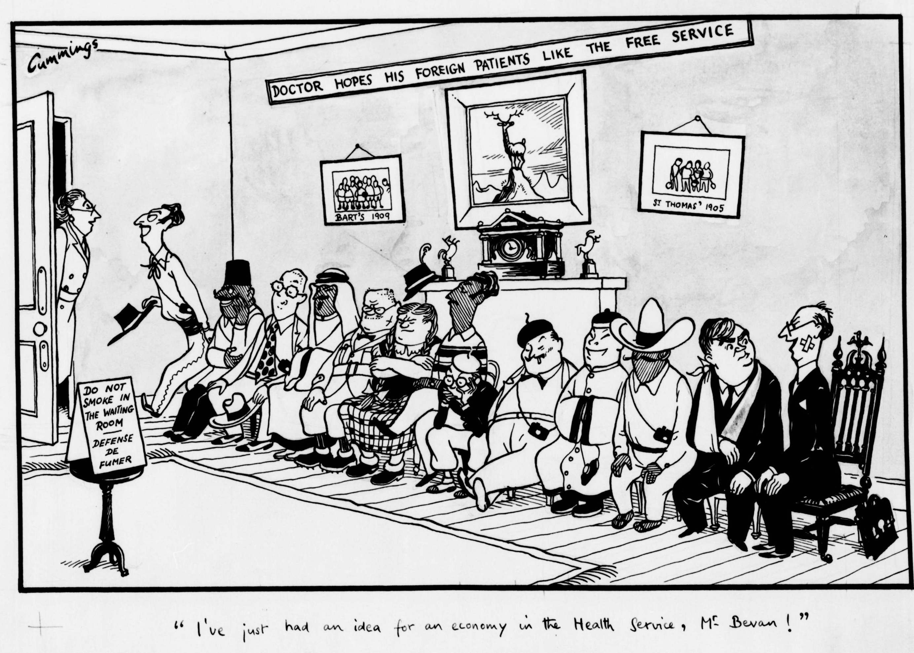
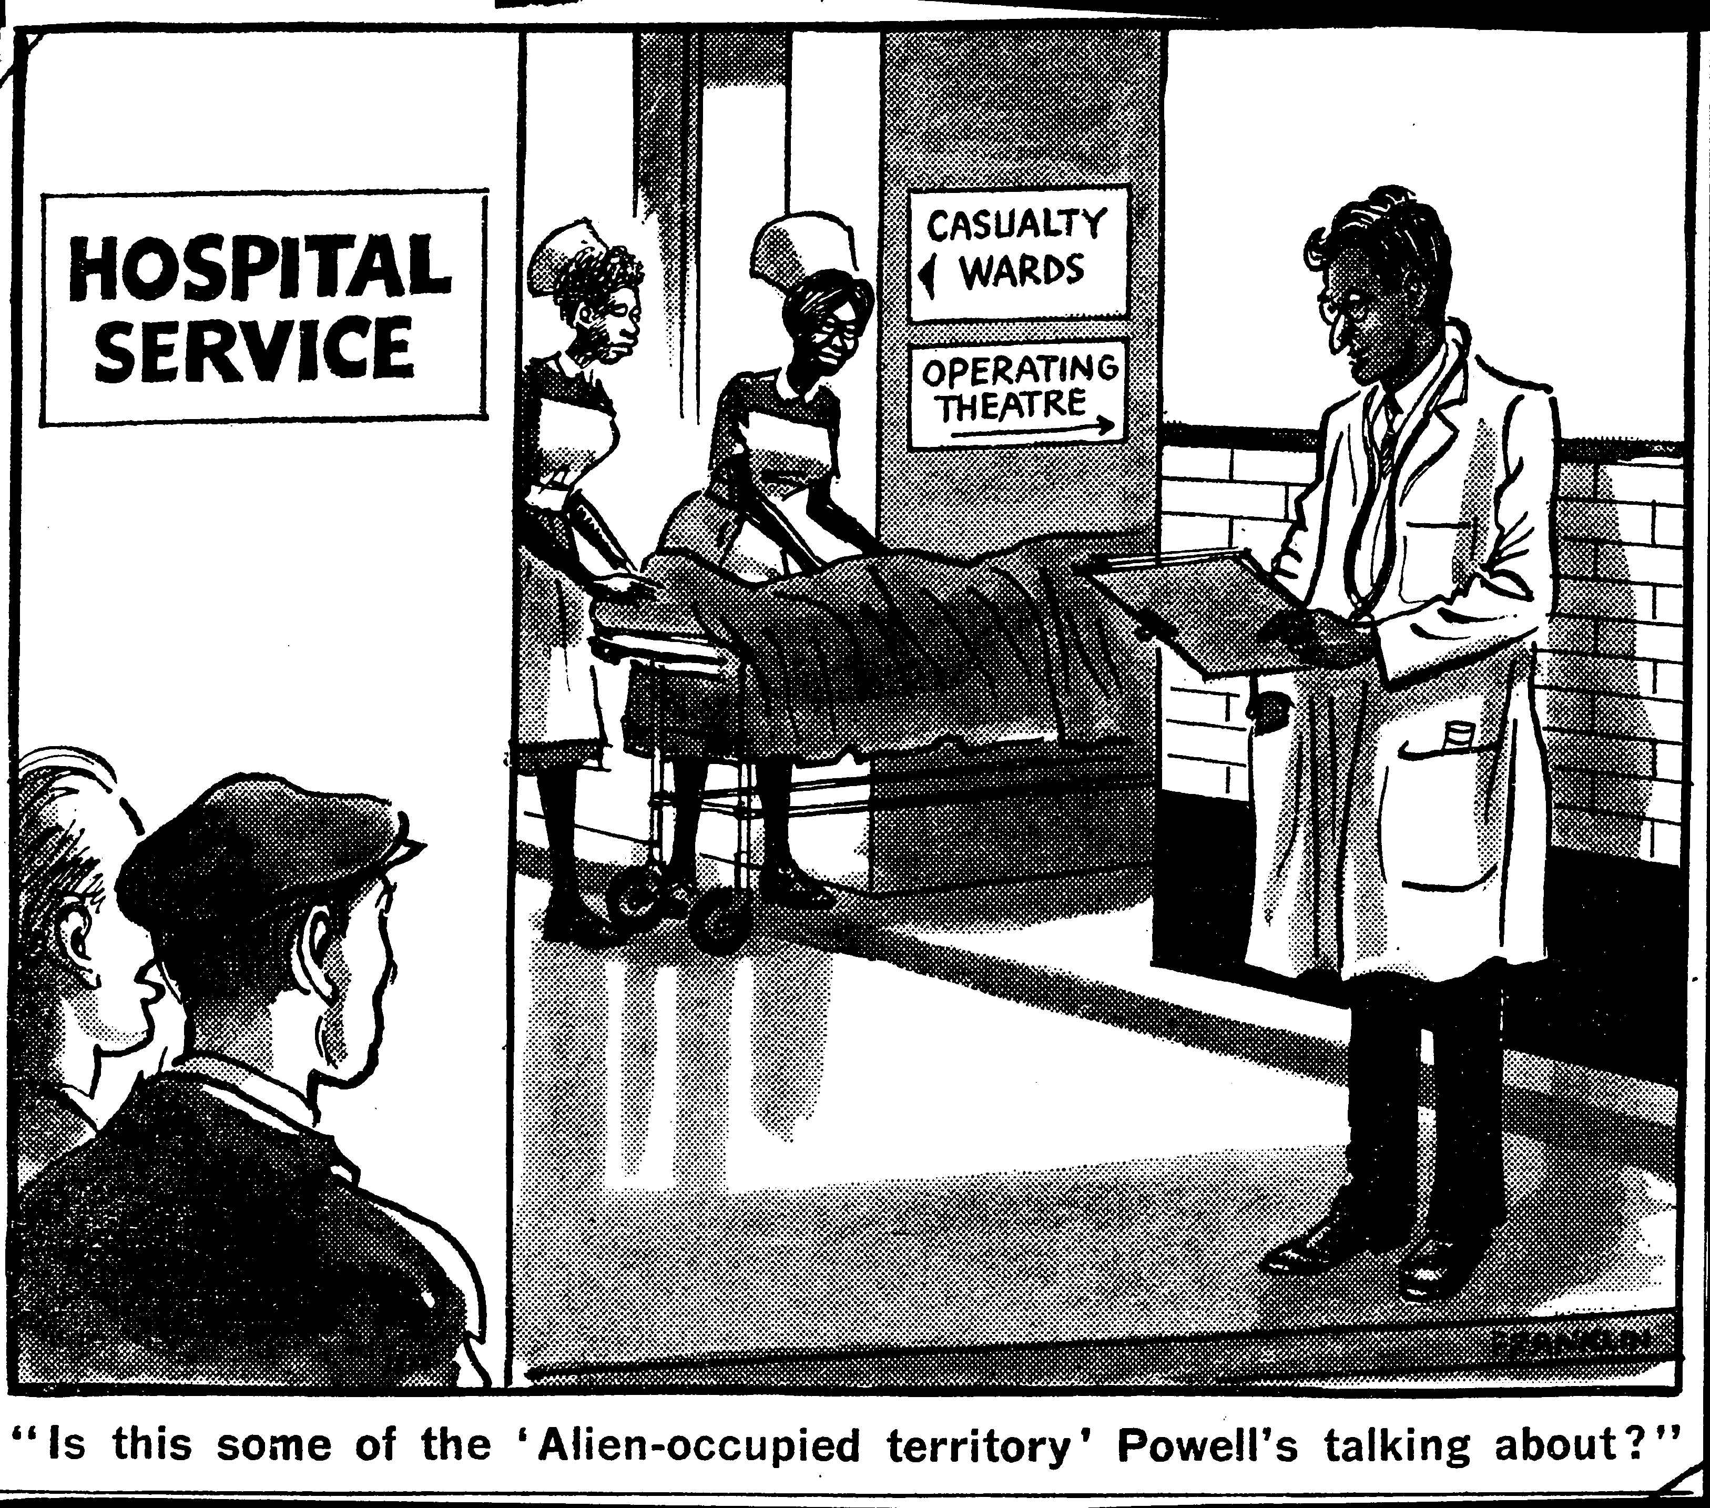
Historical Tropes How have Britons thought about migrants and the NHS from 1948-2018?
‘Things should be better for him; no one can say he’s not British.’
1954
1949
1969

Slide 7
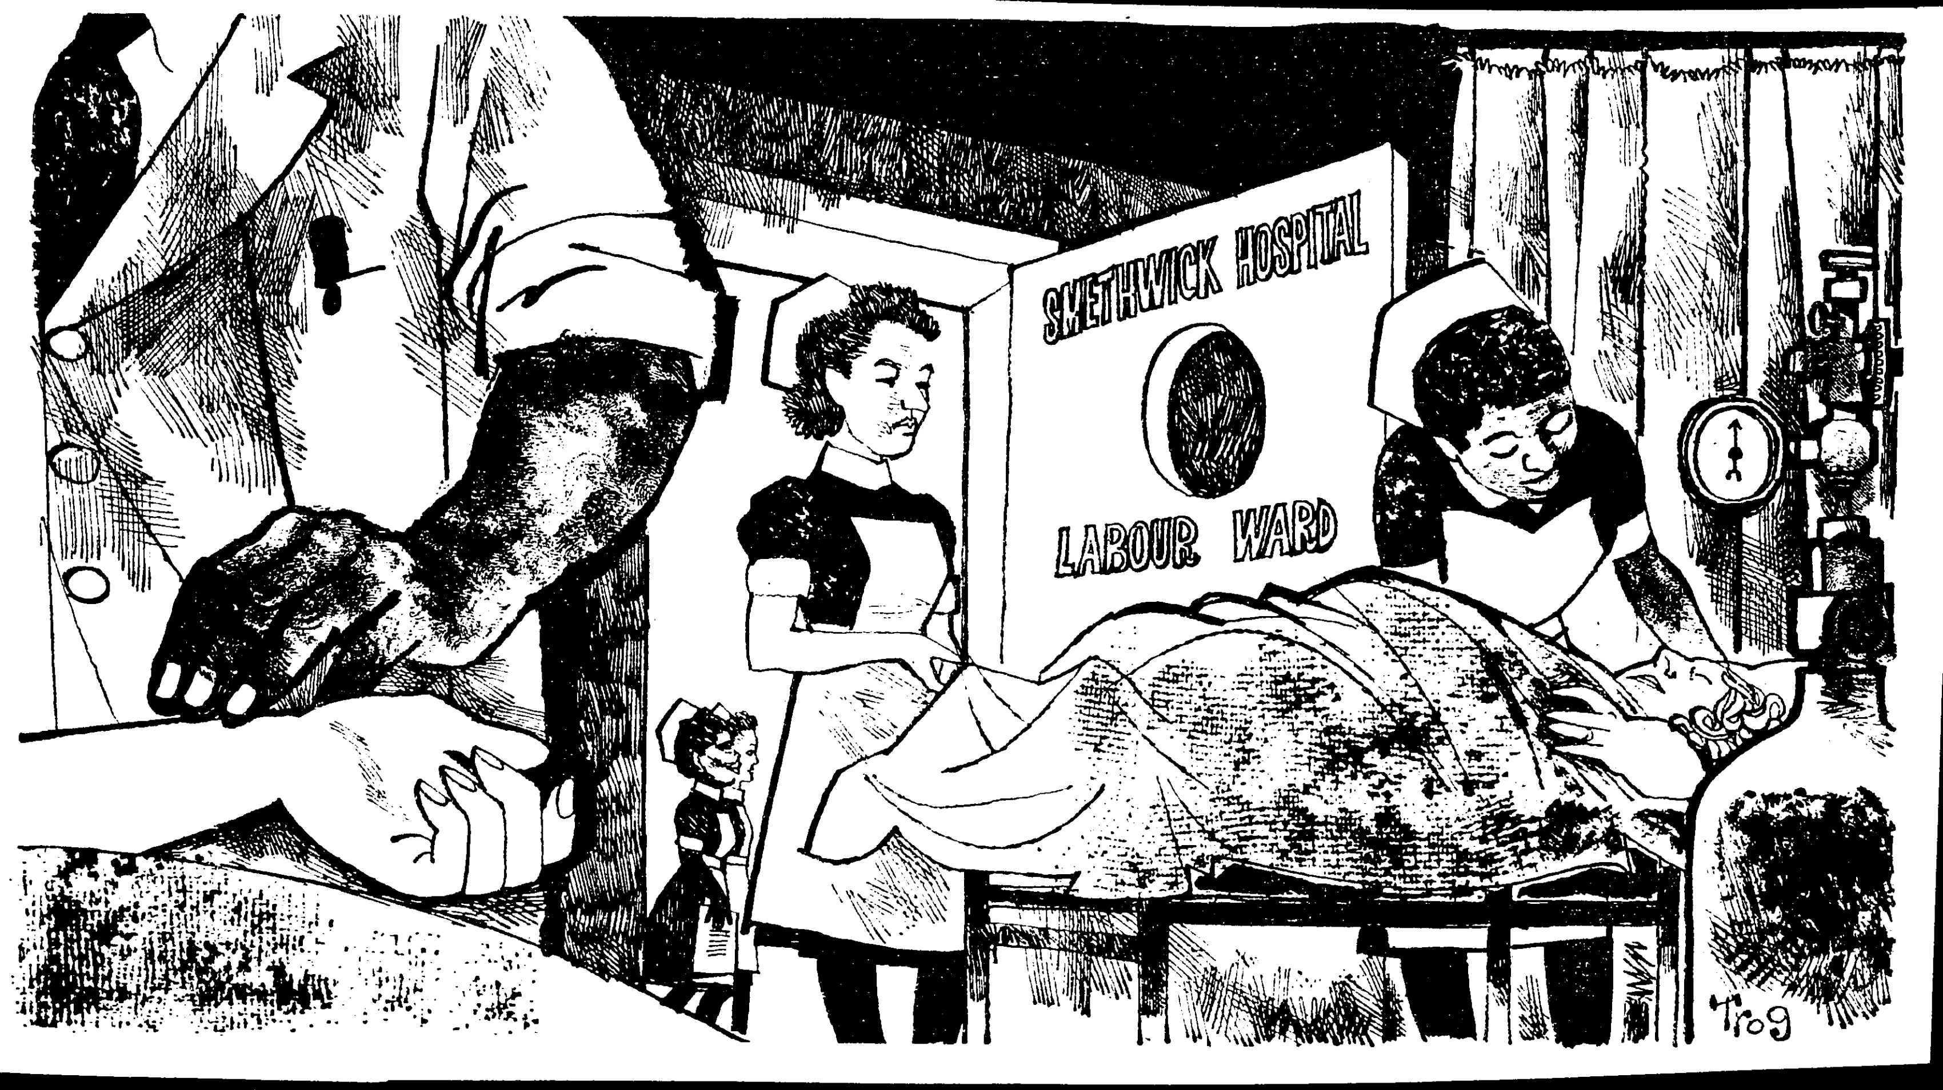
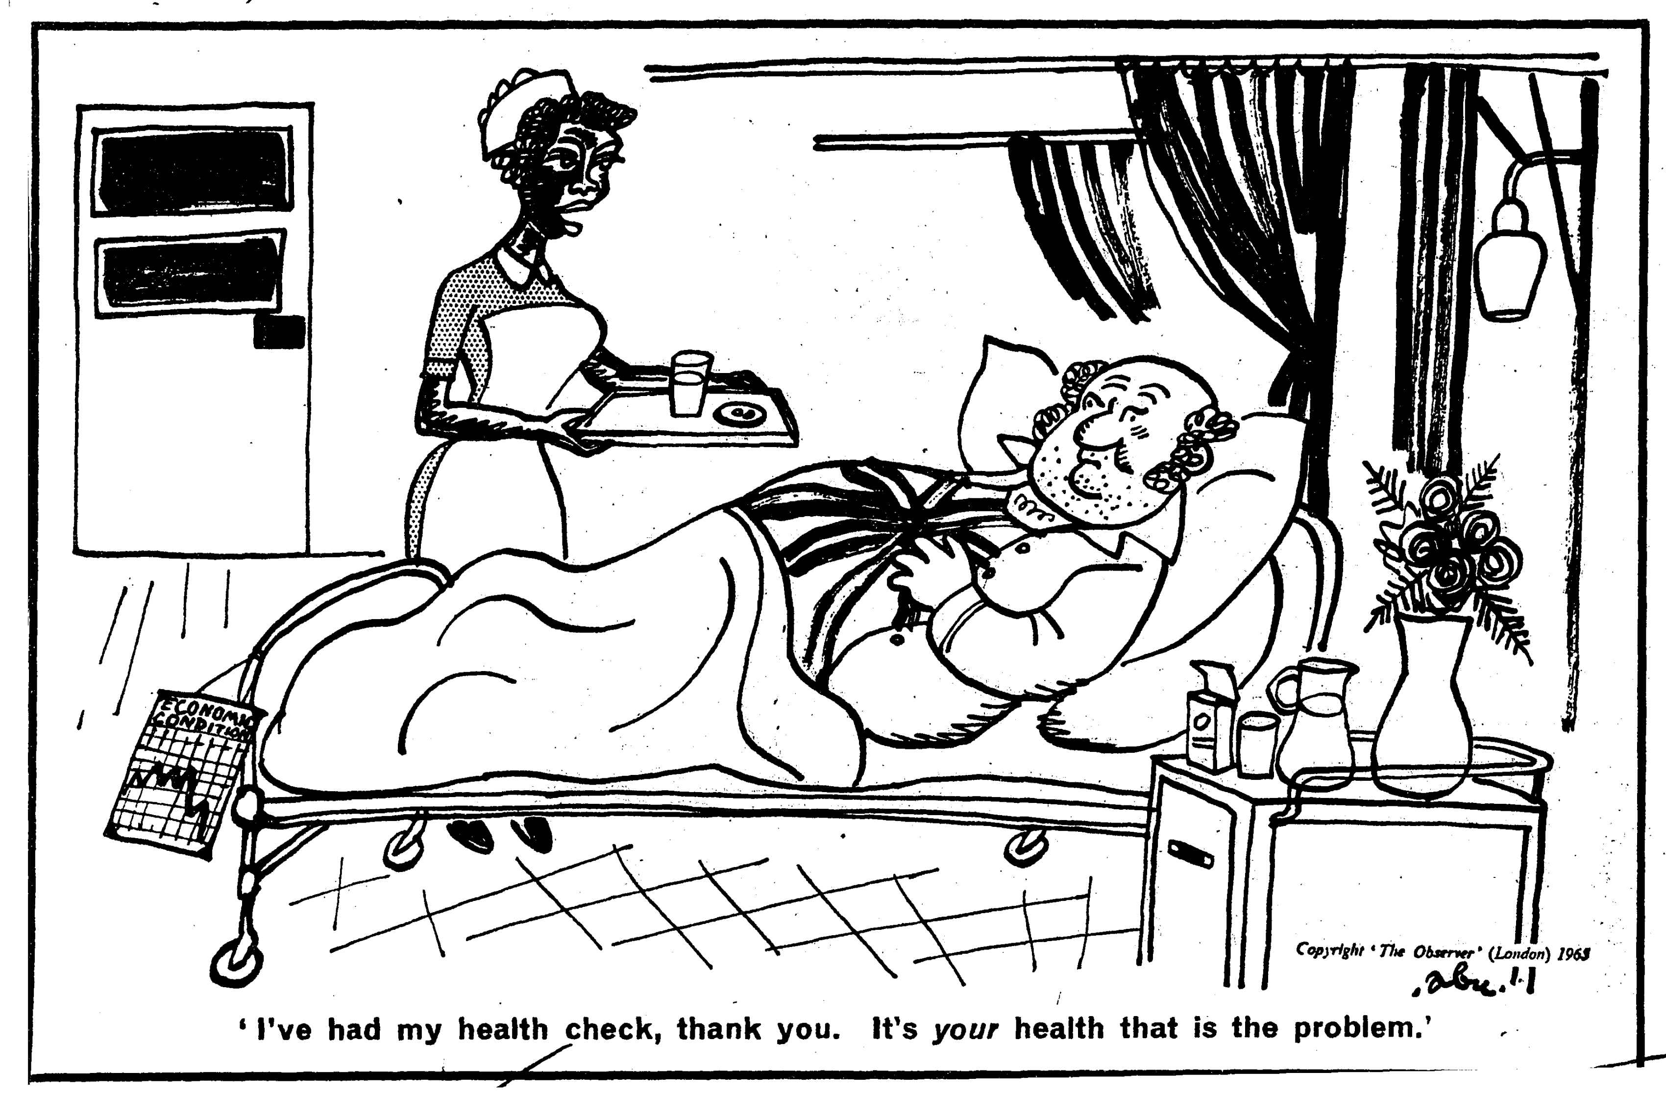
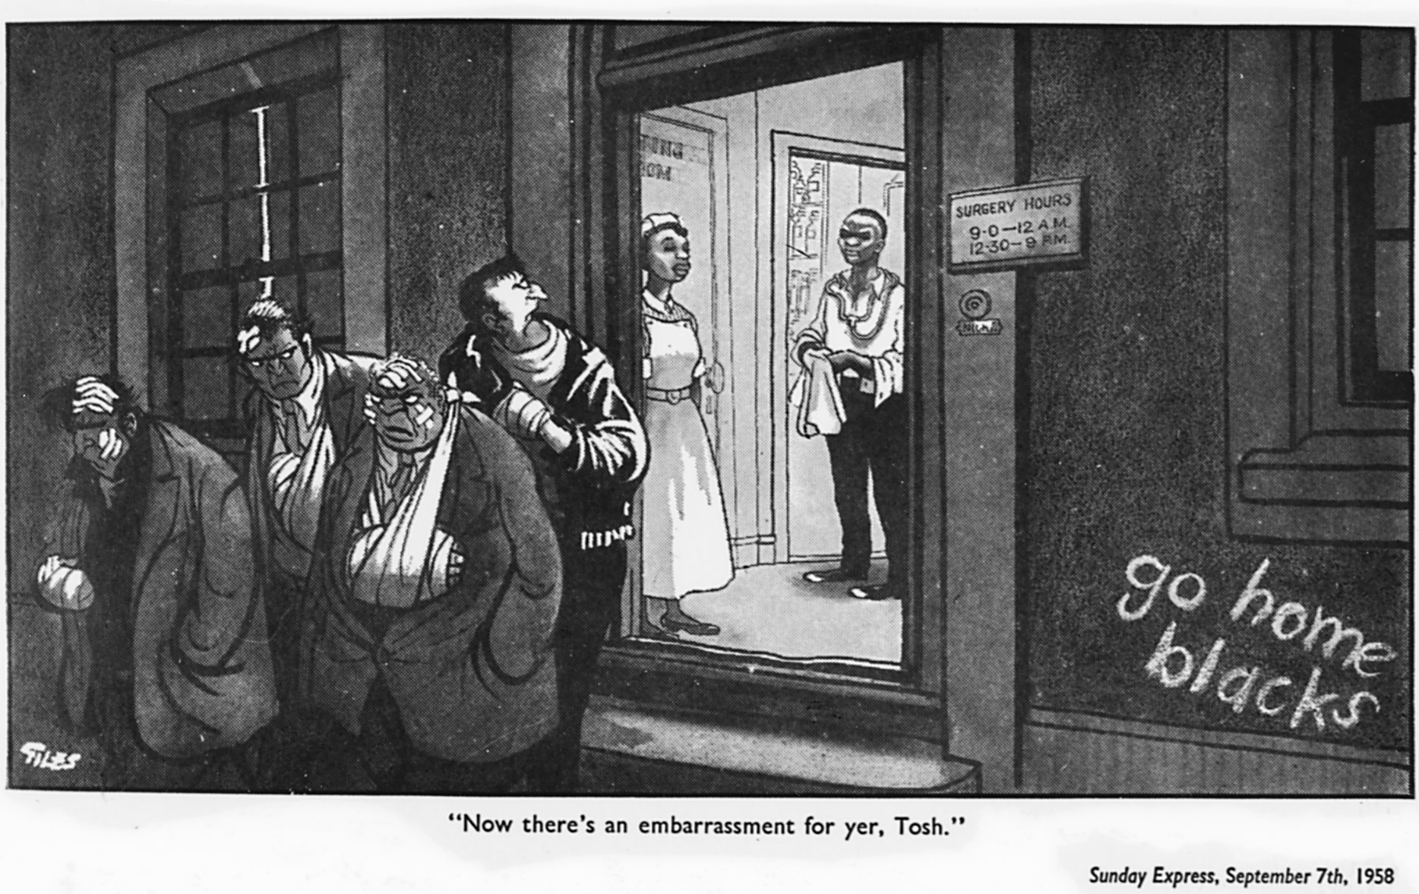
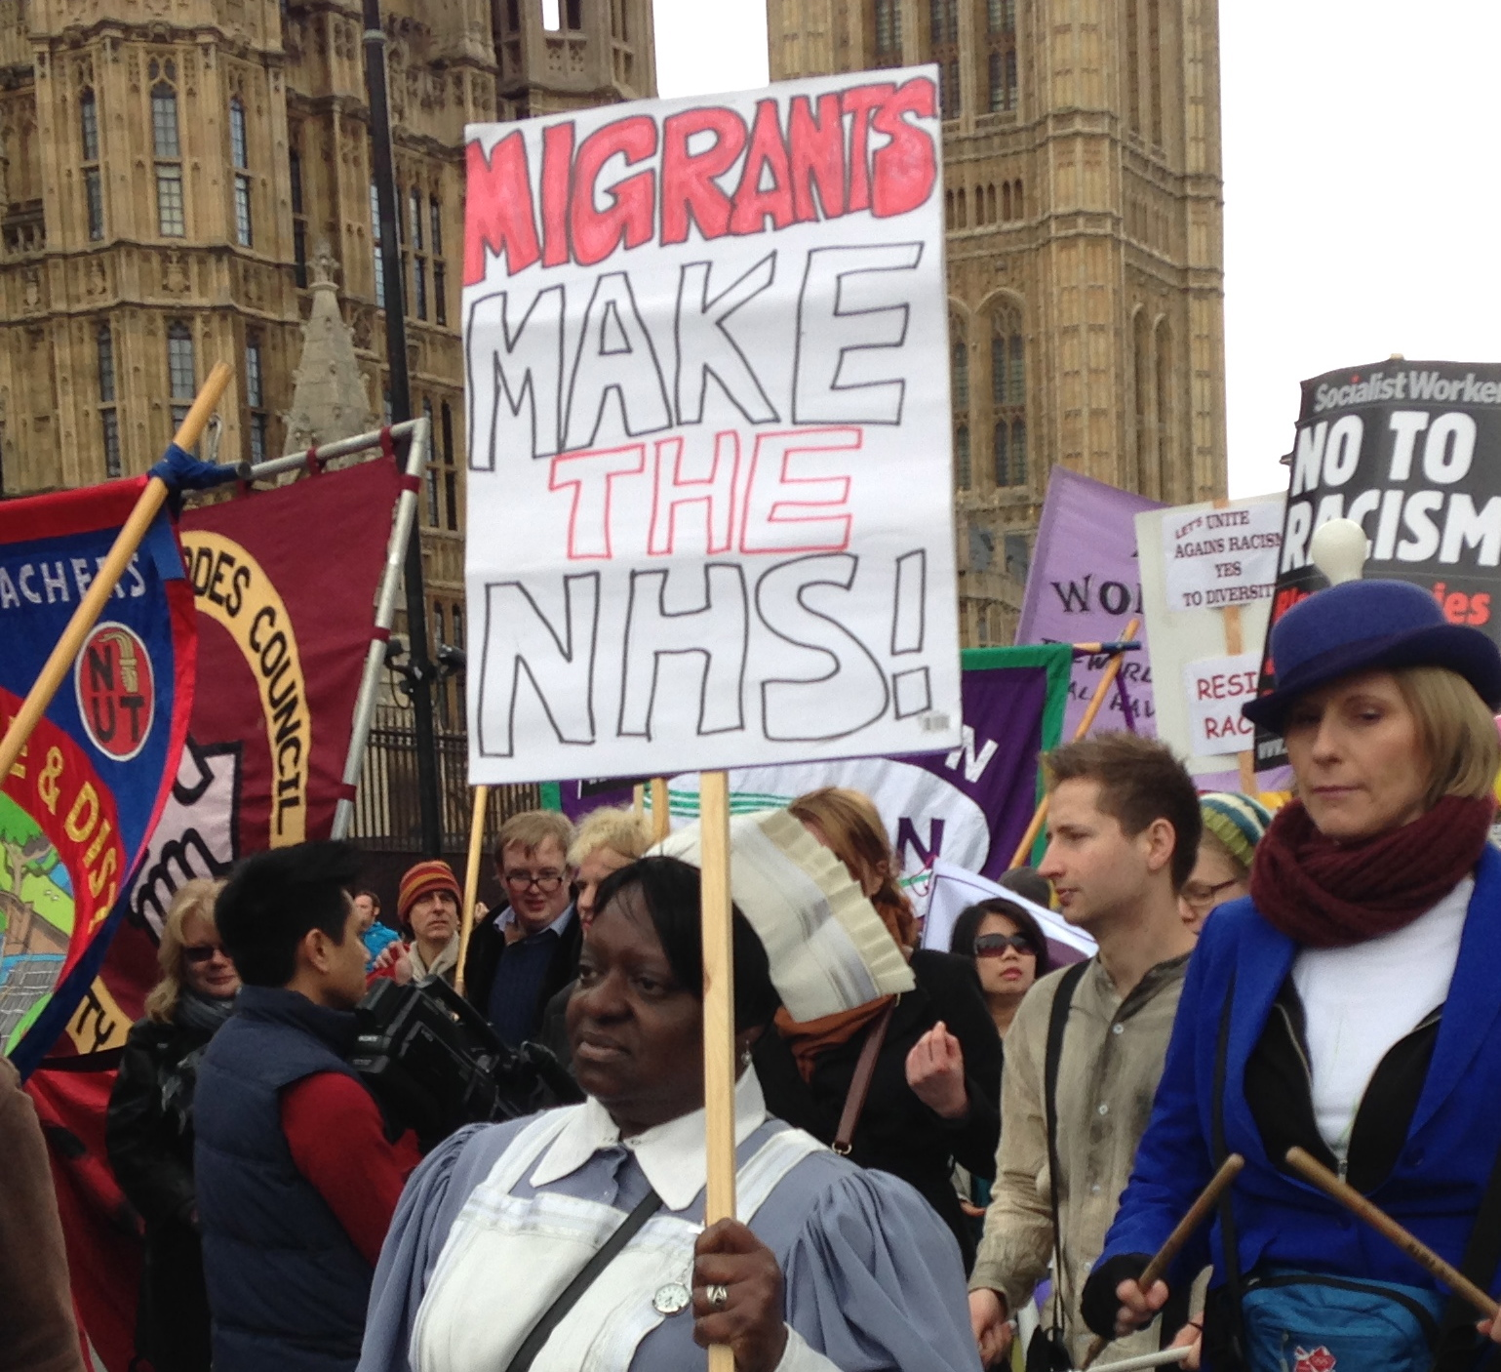
1964
1965
2016
1958

Slide 8
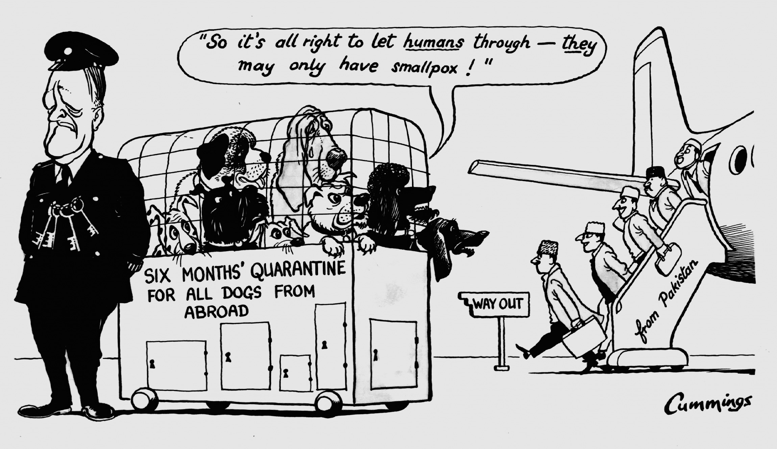
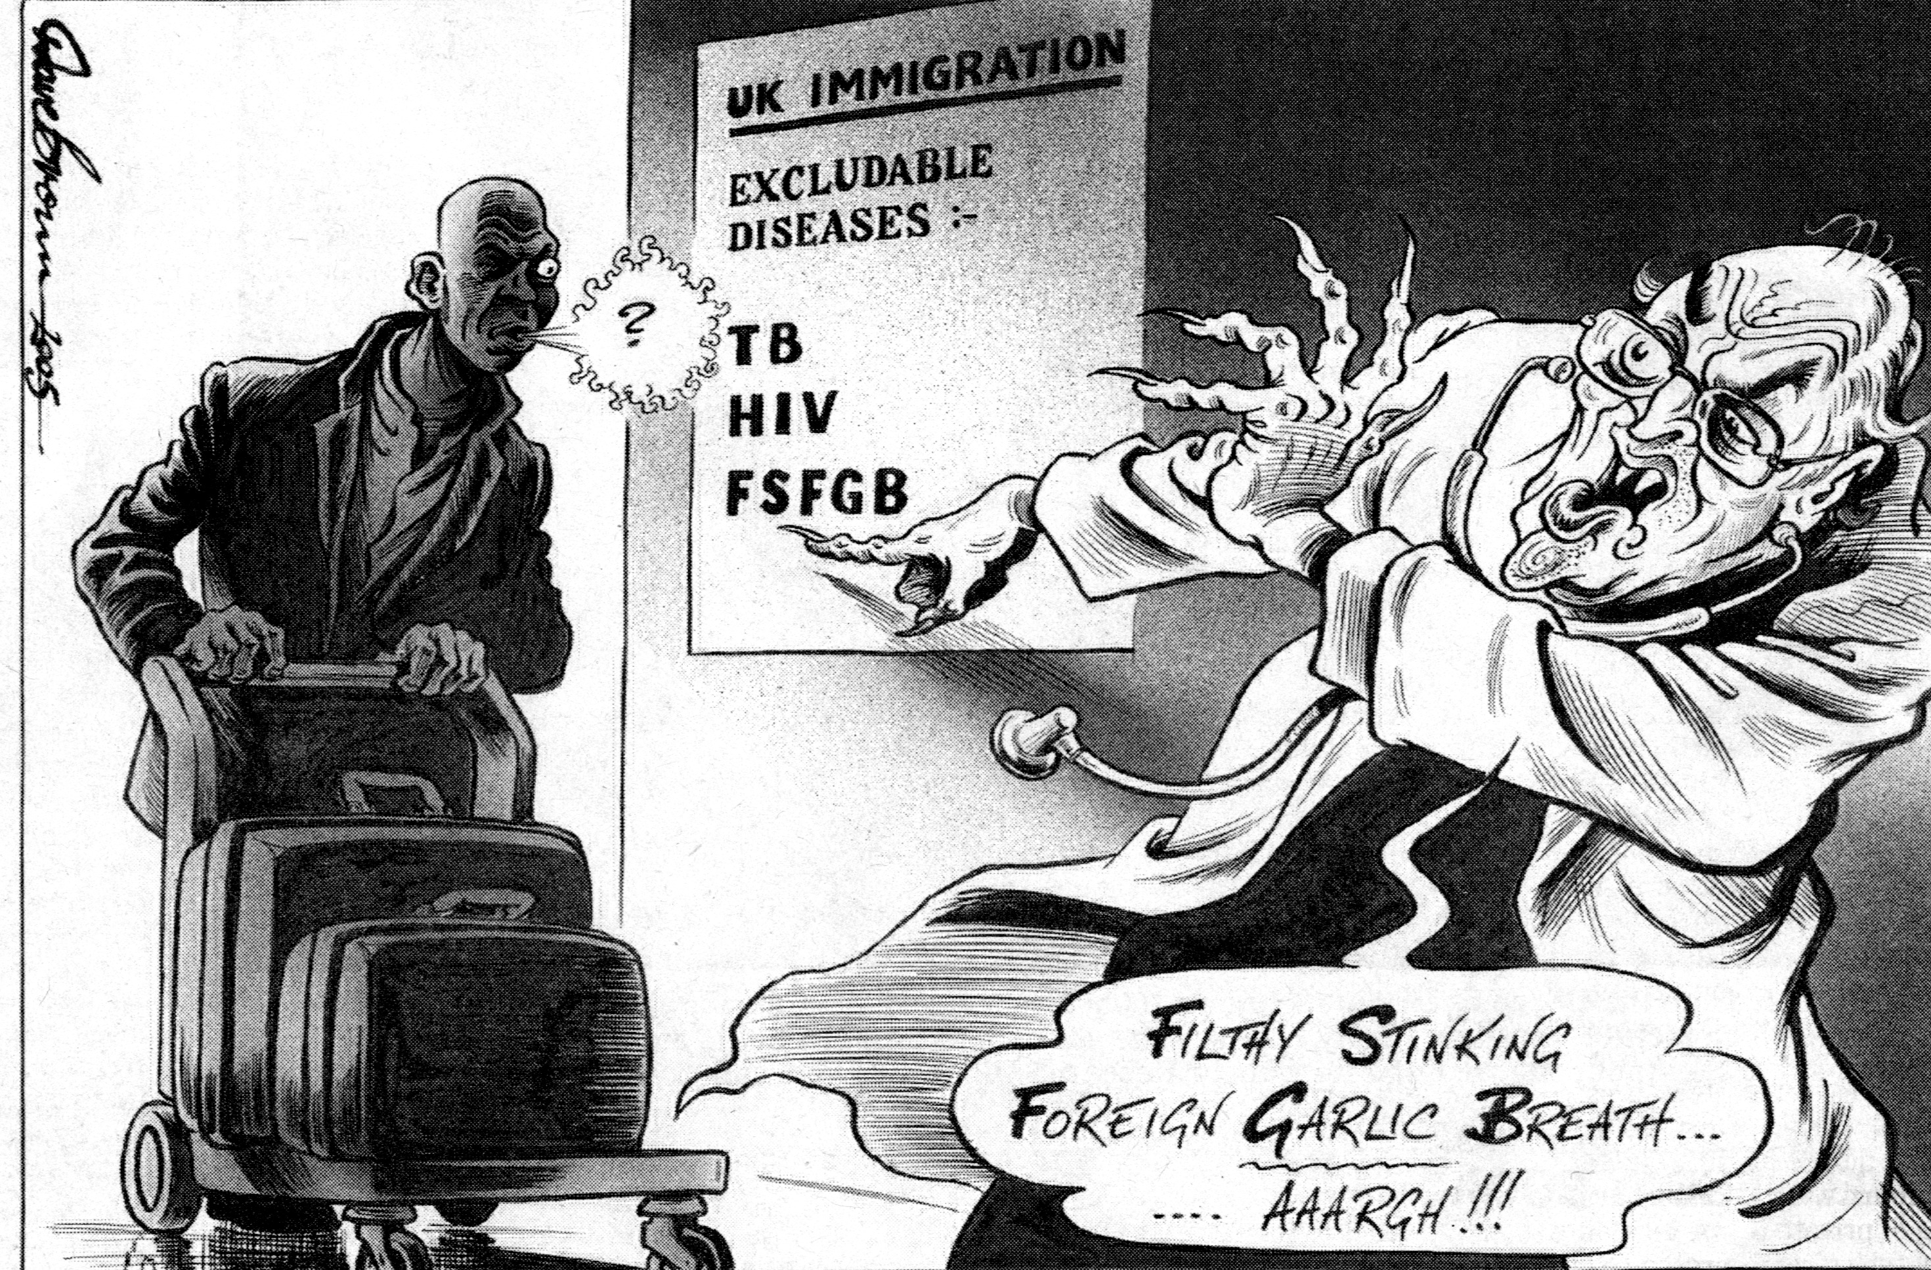
But the NHS has patients as well as staff… the ‘Foreign Contagions’ motif
© Express Syndication Ltd., British Cartoon Archive, University of Kent, Michael Cummings, Daily Express, 17 Jan 1962
© Dave Brown, British Cartoon Archive, University of Kent, Dave Brown, Independent, 16 Feb 2005.
© Daily Mail, 1968
© Daily Mail, 2008

Slide 9
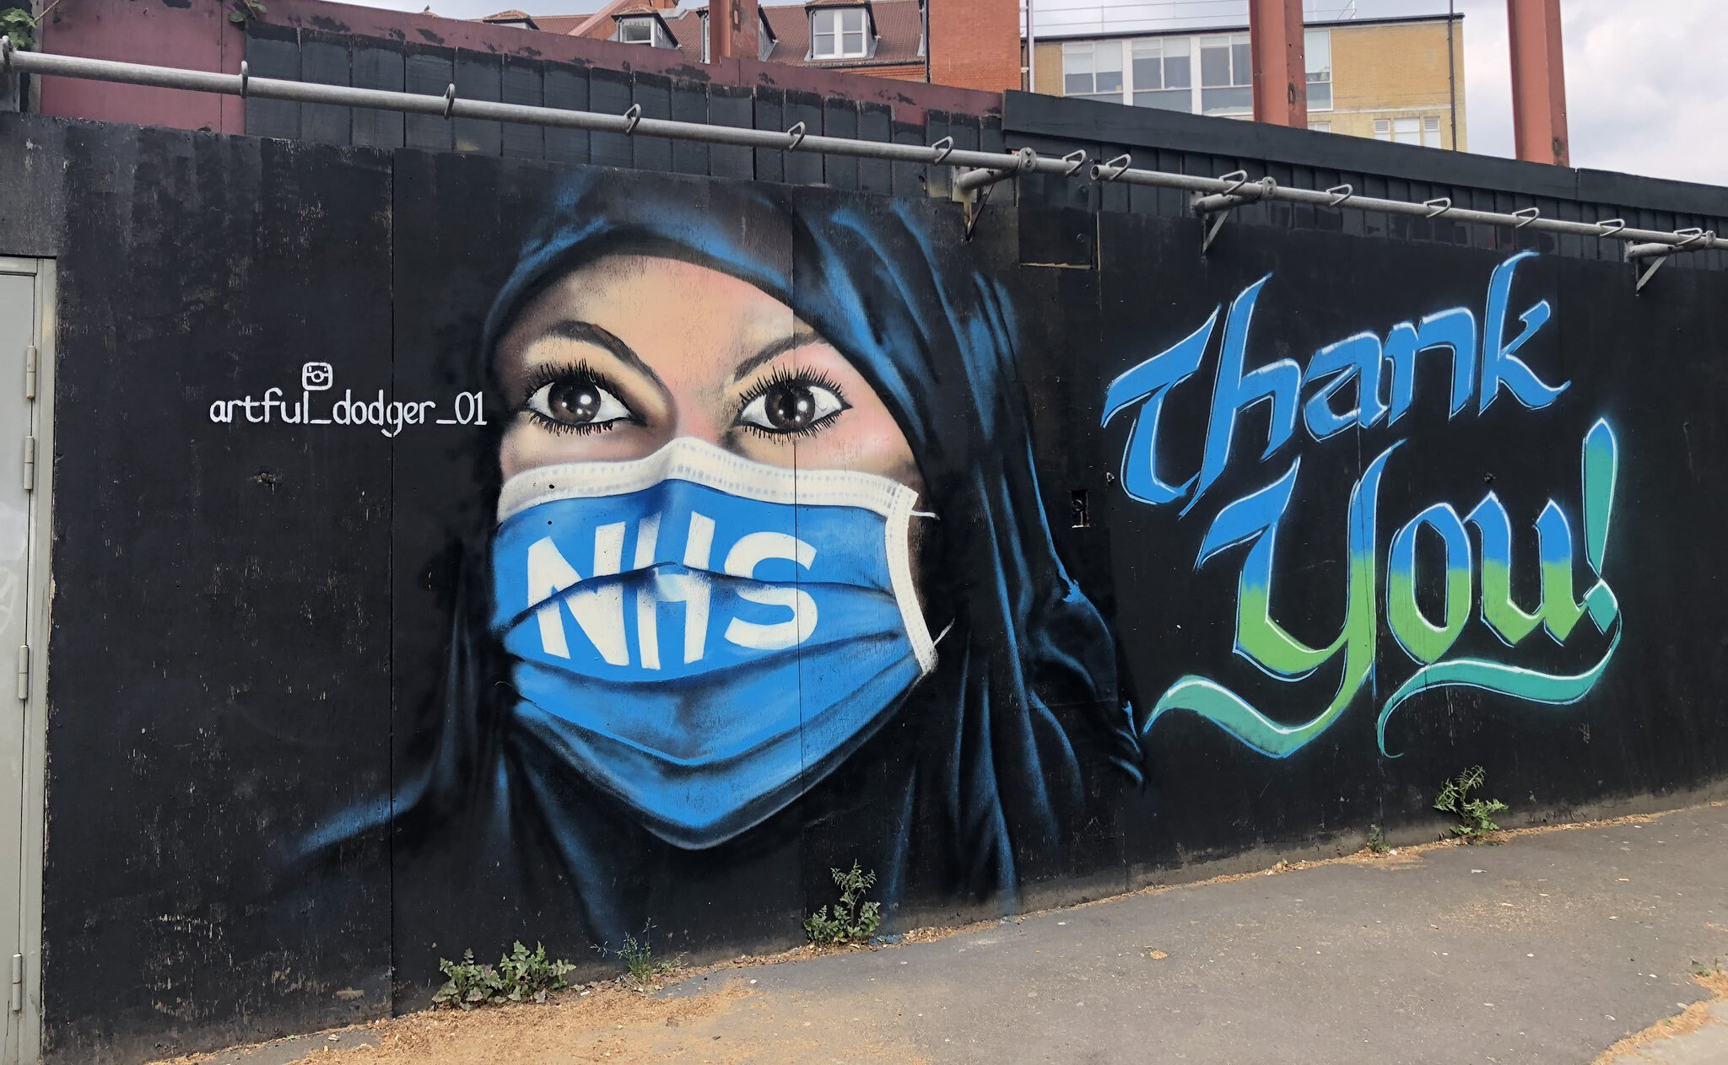
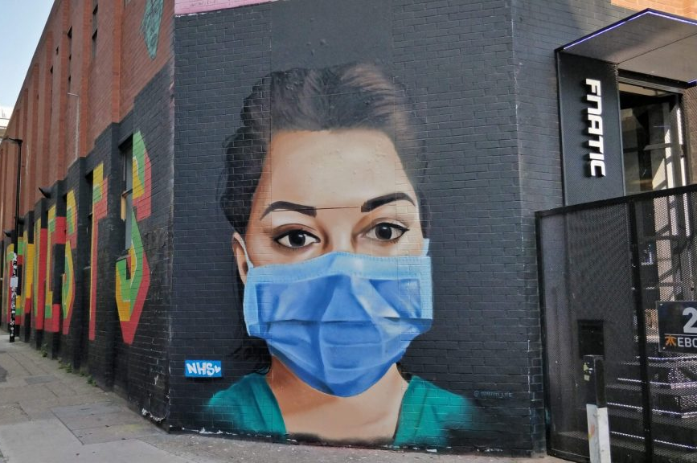
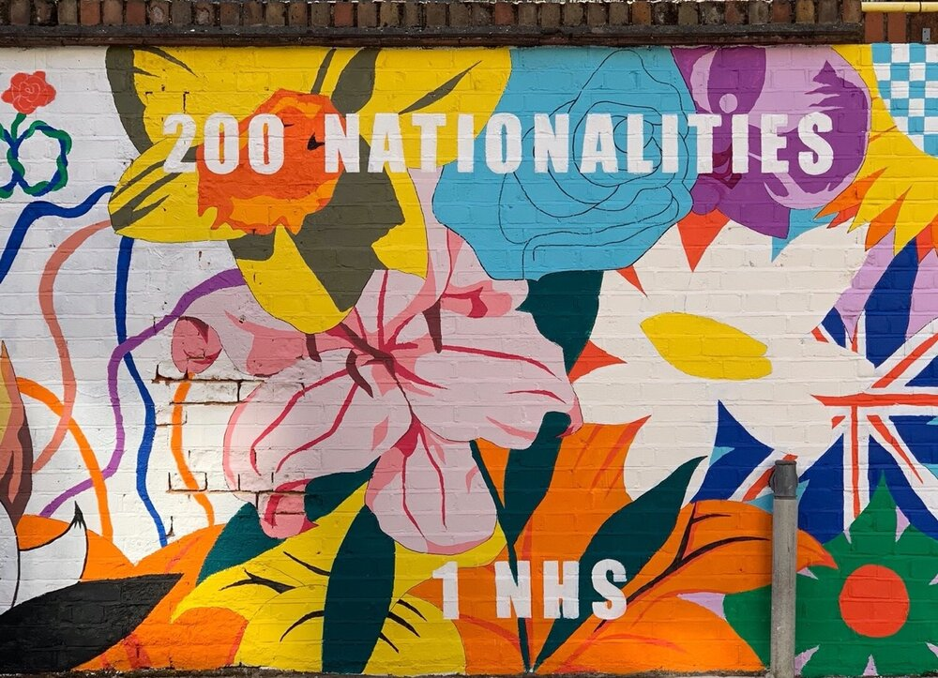
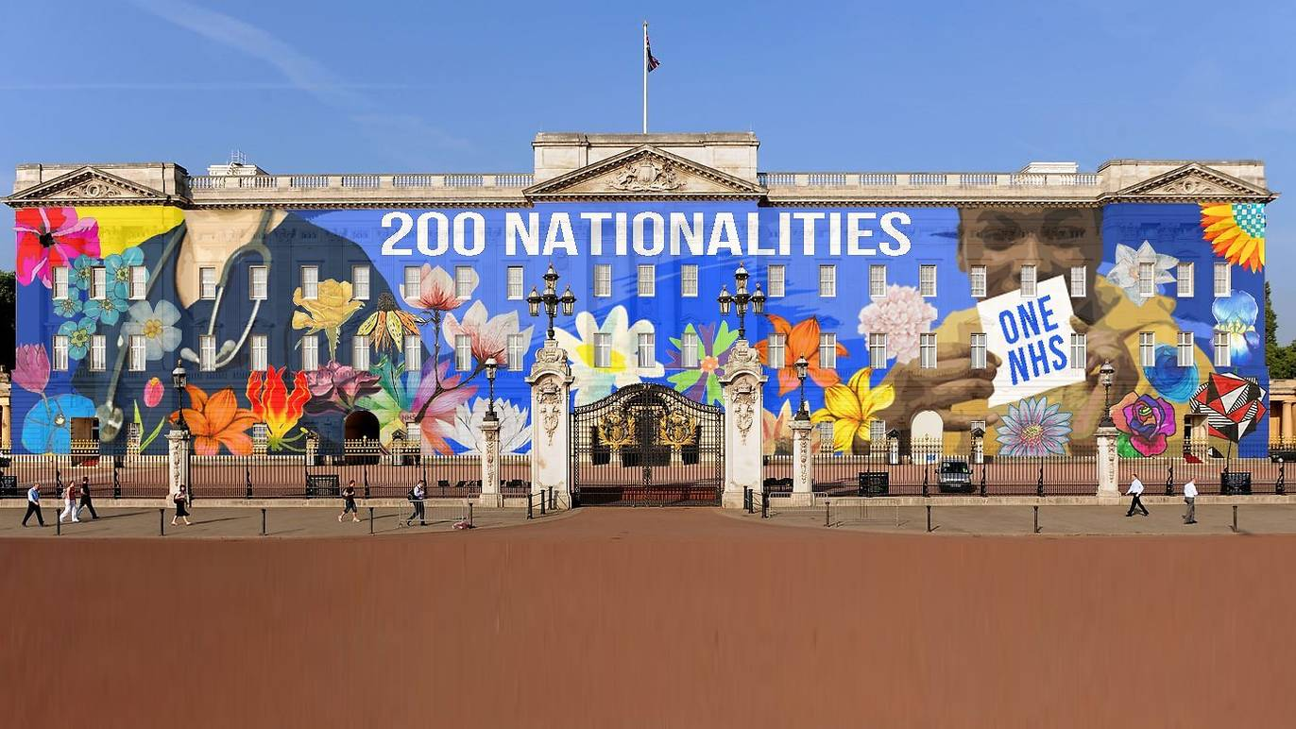
And in the Covid Crisis?

Slide 10
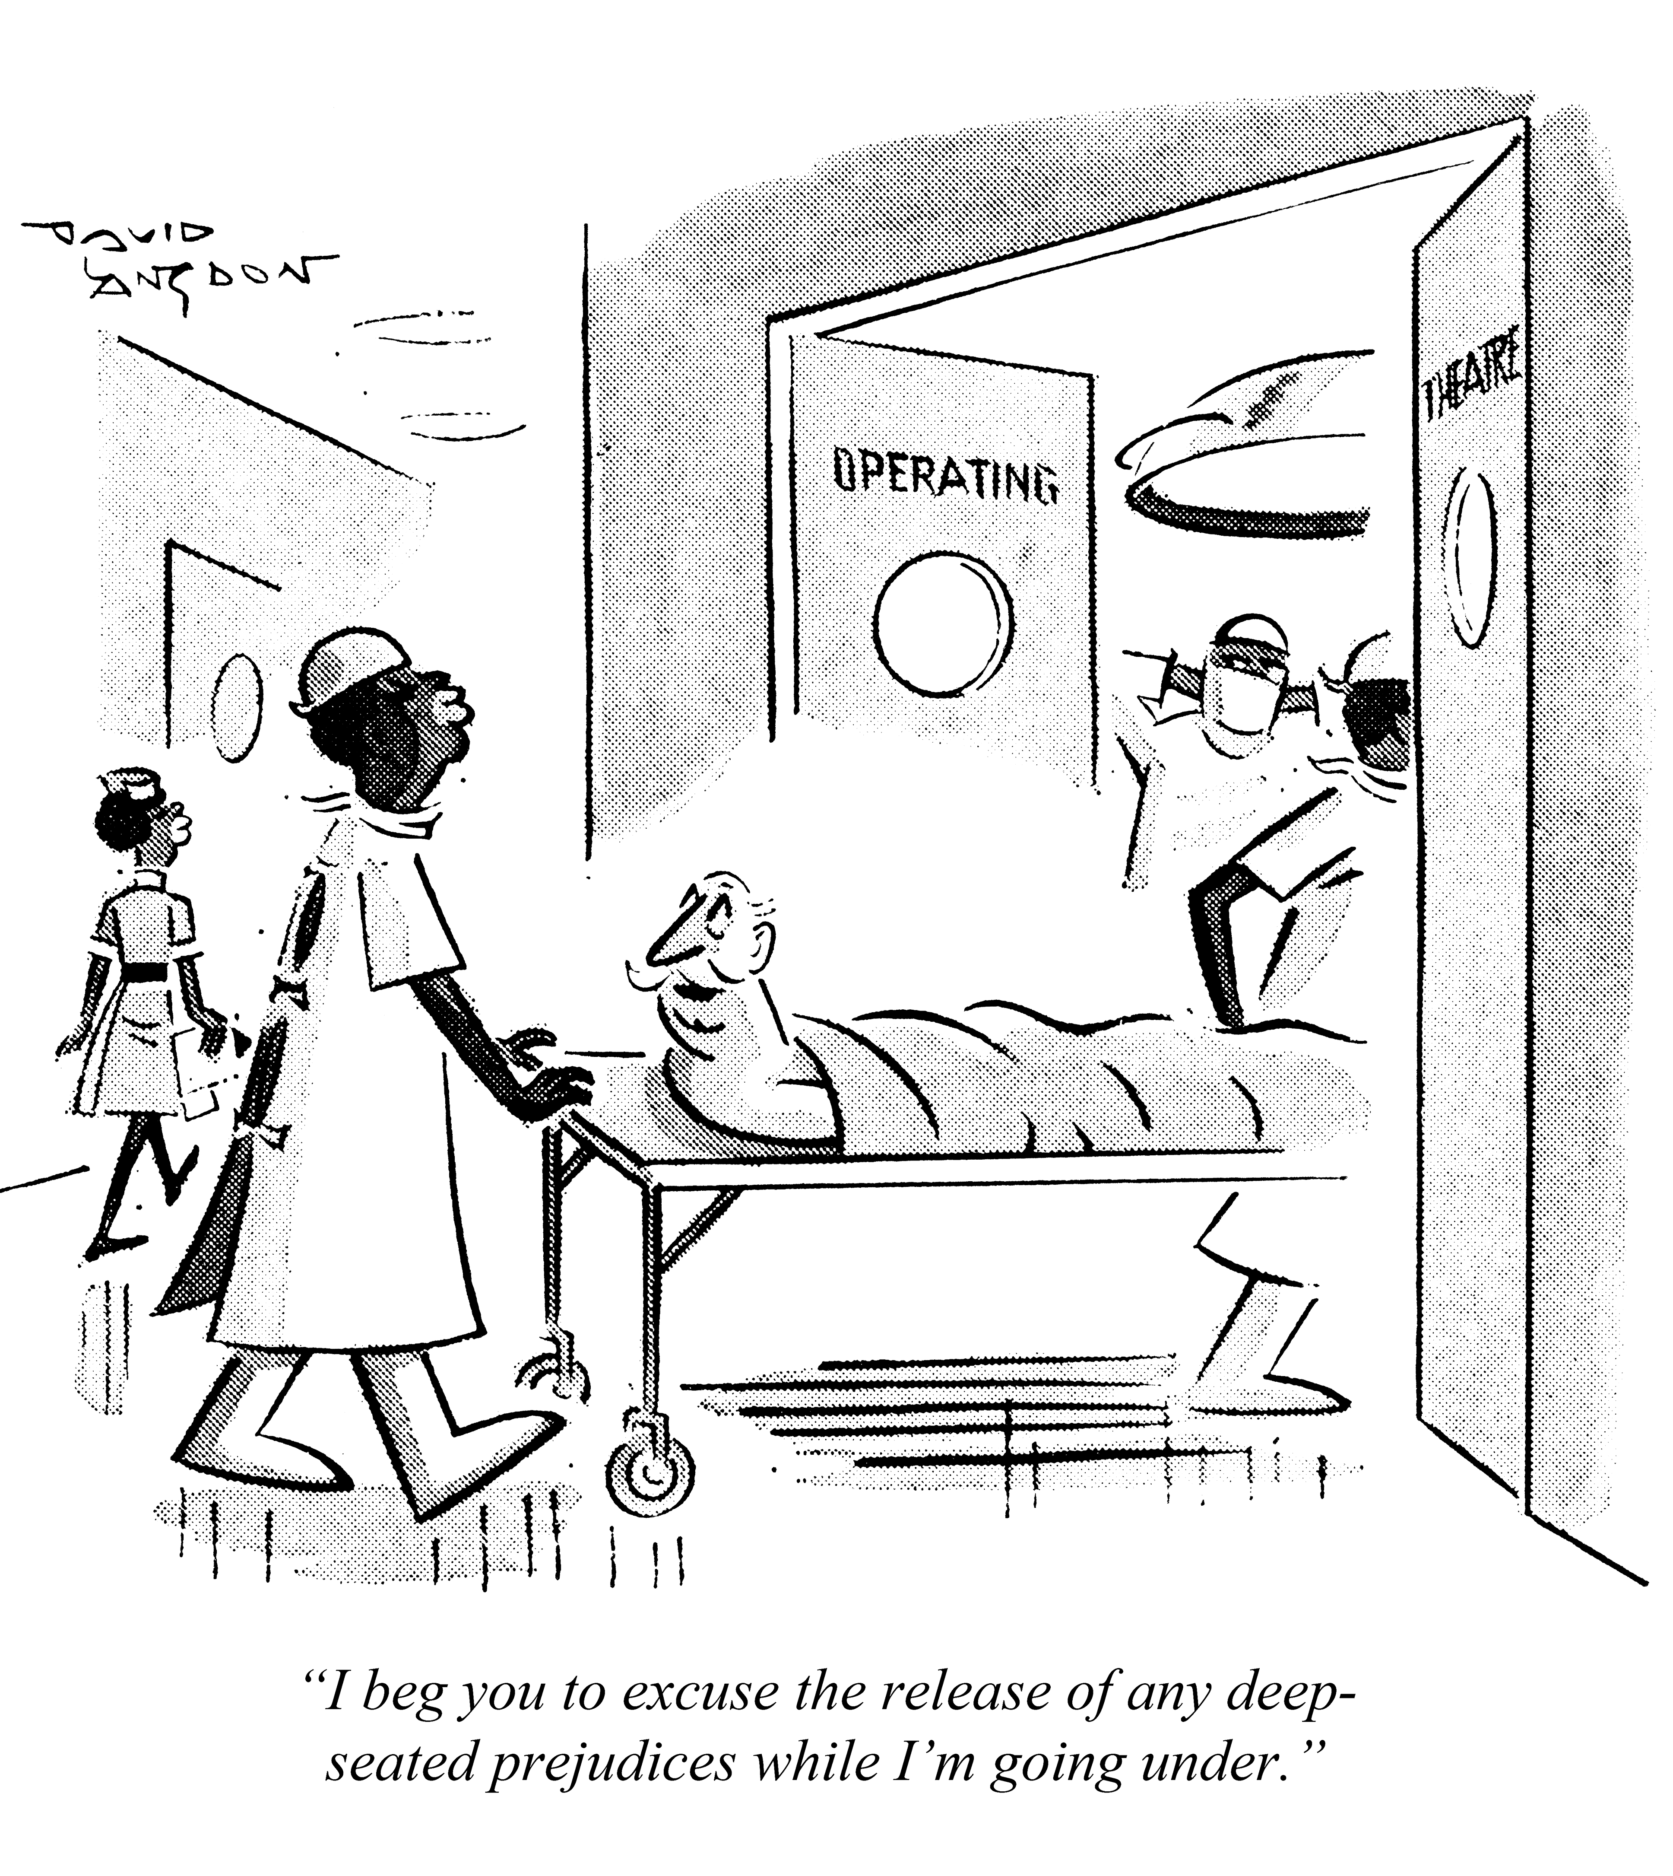
* NHS as a symbol of national values (including ‘tolerance’ and ‘egalitarianism’) * NHS as site for anti-racist rhetoric and discourse * NHS as a flashpoint for concerns about ‘excess’ immigration AND immigration restriction; about migrants as undeserving beneficiaries of welfare state AND as heroic providers of welfare services
Findings
© Punch Archive, David Langdon, Punch 1969

