Slide 1

Surveillance Capitalism
Seeing like a super corporation?
Roberta Bivins
r.bivins@warwick.ac.uk
FAB3.54

Slide 2

‘Private eyes
They're watching you
They see your every move
Private eyes
They're watching you
Private eyes
They're watching you watching
You watching you watching you…’
Hall and Oates, 1981
Chris Wiley, Cambridge Analytica: “We knew so much about so many individuals that we could understand their inner demons and we could figure out how to target those demons, how to target their fear, how to target their anger, how to target their paranoia, and with those targets we could trigger those emotions, and by triggering those emotions we could then manipulate them into clicking on a website, joining a group, telling them what kind of things to read, telling them what kind of people to hang out with, even telling them who to vote for.”

Slide 3
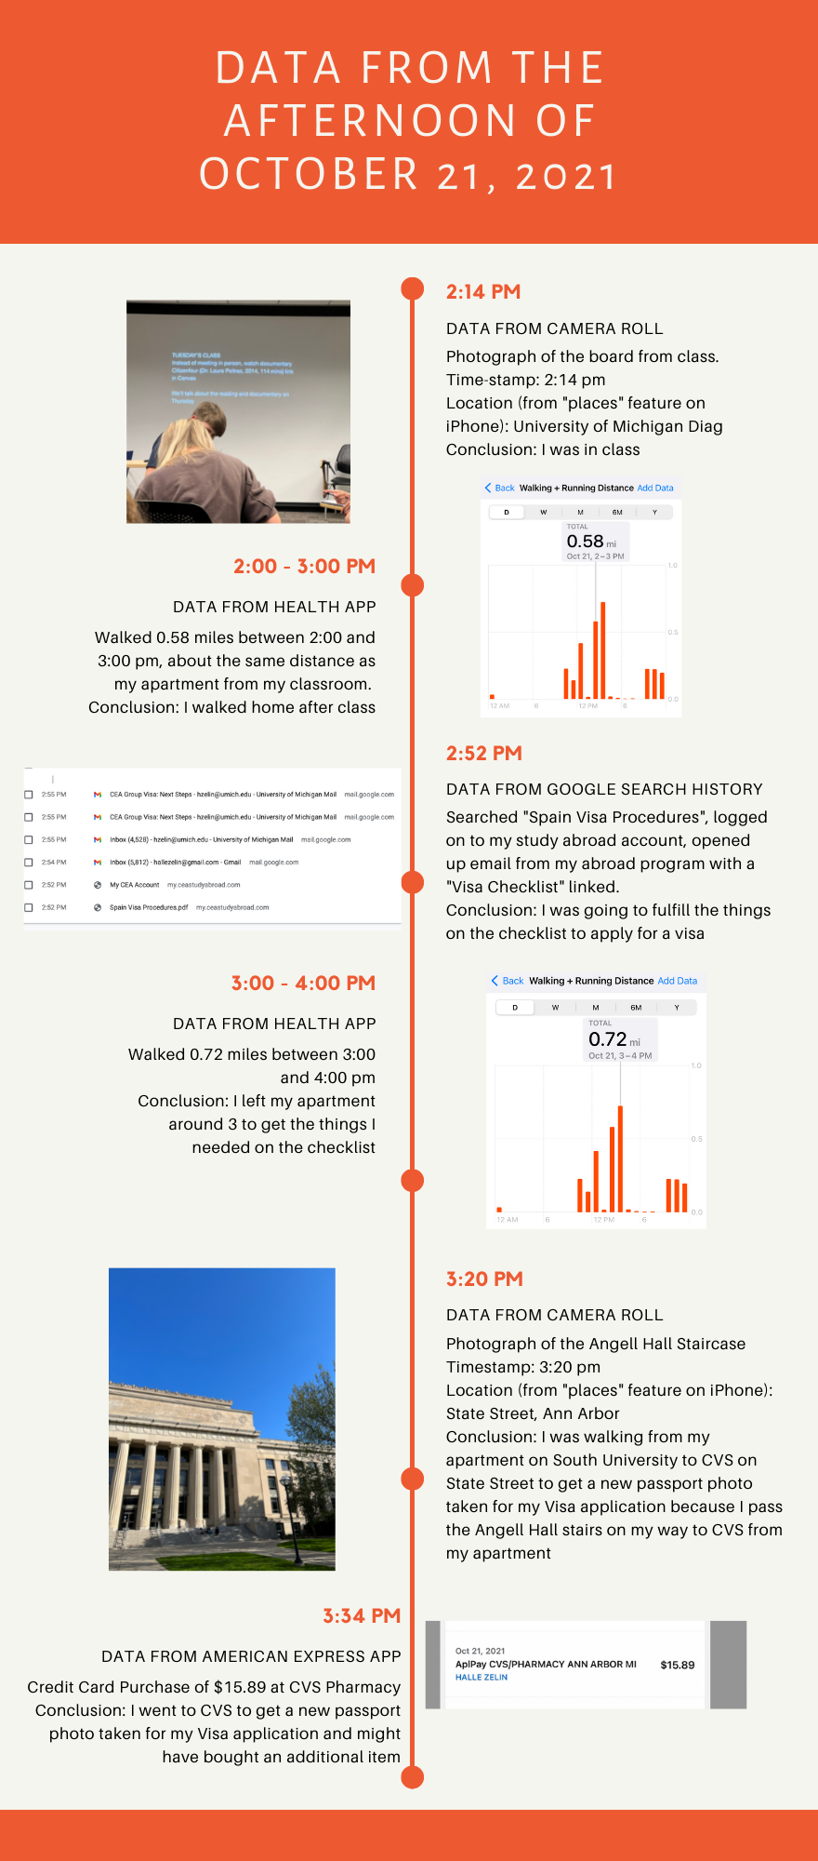
What is Surveillance Capitalism?
Who does it look ‘at’?
What does it ‘see?
And who, exactly, is looking?

Slide 4
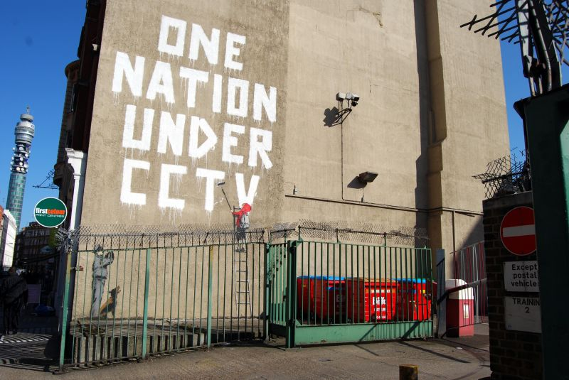
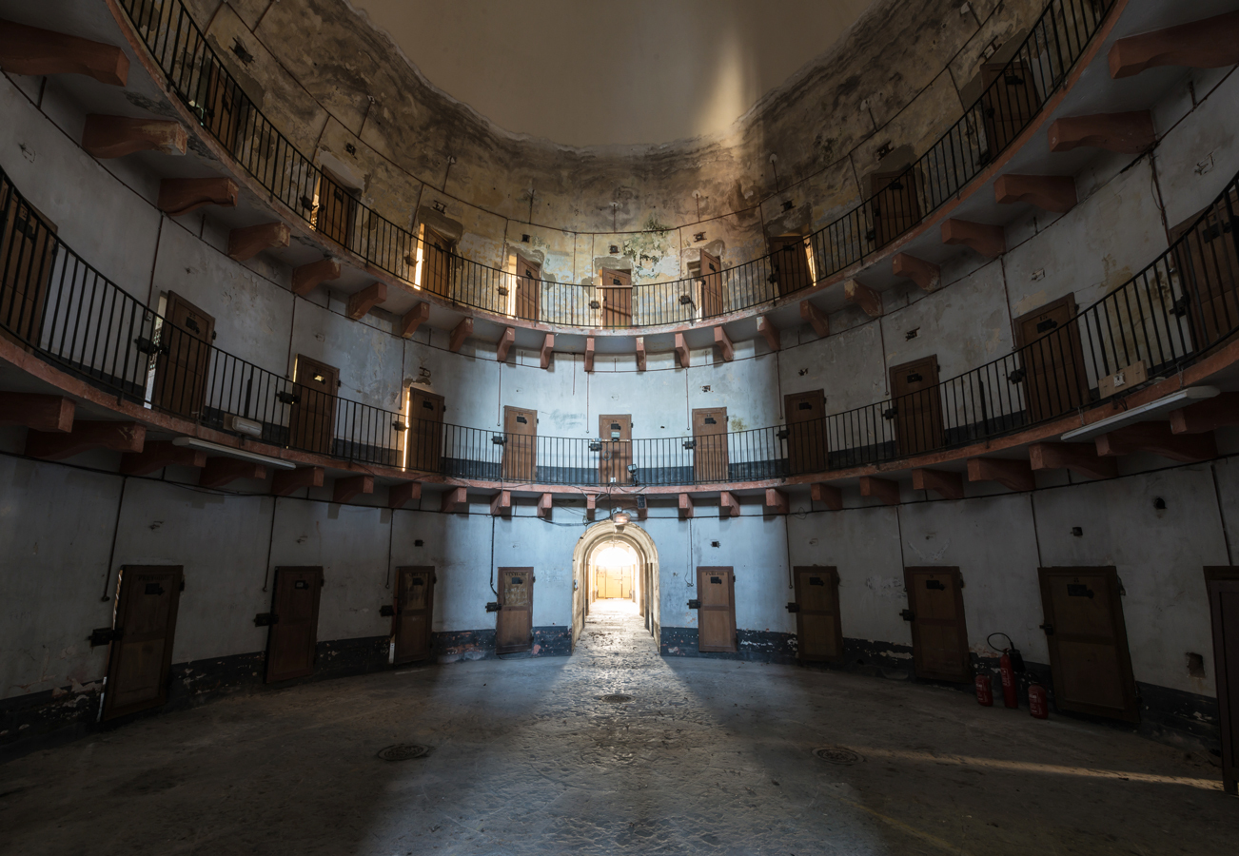
What’s OLD about surveillance capitalism?
Q. When was the first law enacted protecting the privacy of electronic communication?
1862, in California. What kind of privacy did it protect? The privacy of corporate intel (from wiretapping of the telegraph lines). First conviction? 1864.
By 1930s, corporate use of wiretapping in union busting became public.
Photo taken by Romain Veillon, https://www.archdaily.com/937611/the-architecture-of-surveillance-the-panopticon-prison (accessed 18 Nov 2023)
Notes:
Fun blog on early wire-tapping: https://www.smithsonianmag.com/history/brief-history-surveillance-america-180968399/
Historical text: Brian Hochman, The Listeners: A history of Wiretapping in the US, Harvard University Press, 2023.

Slide 5

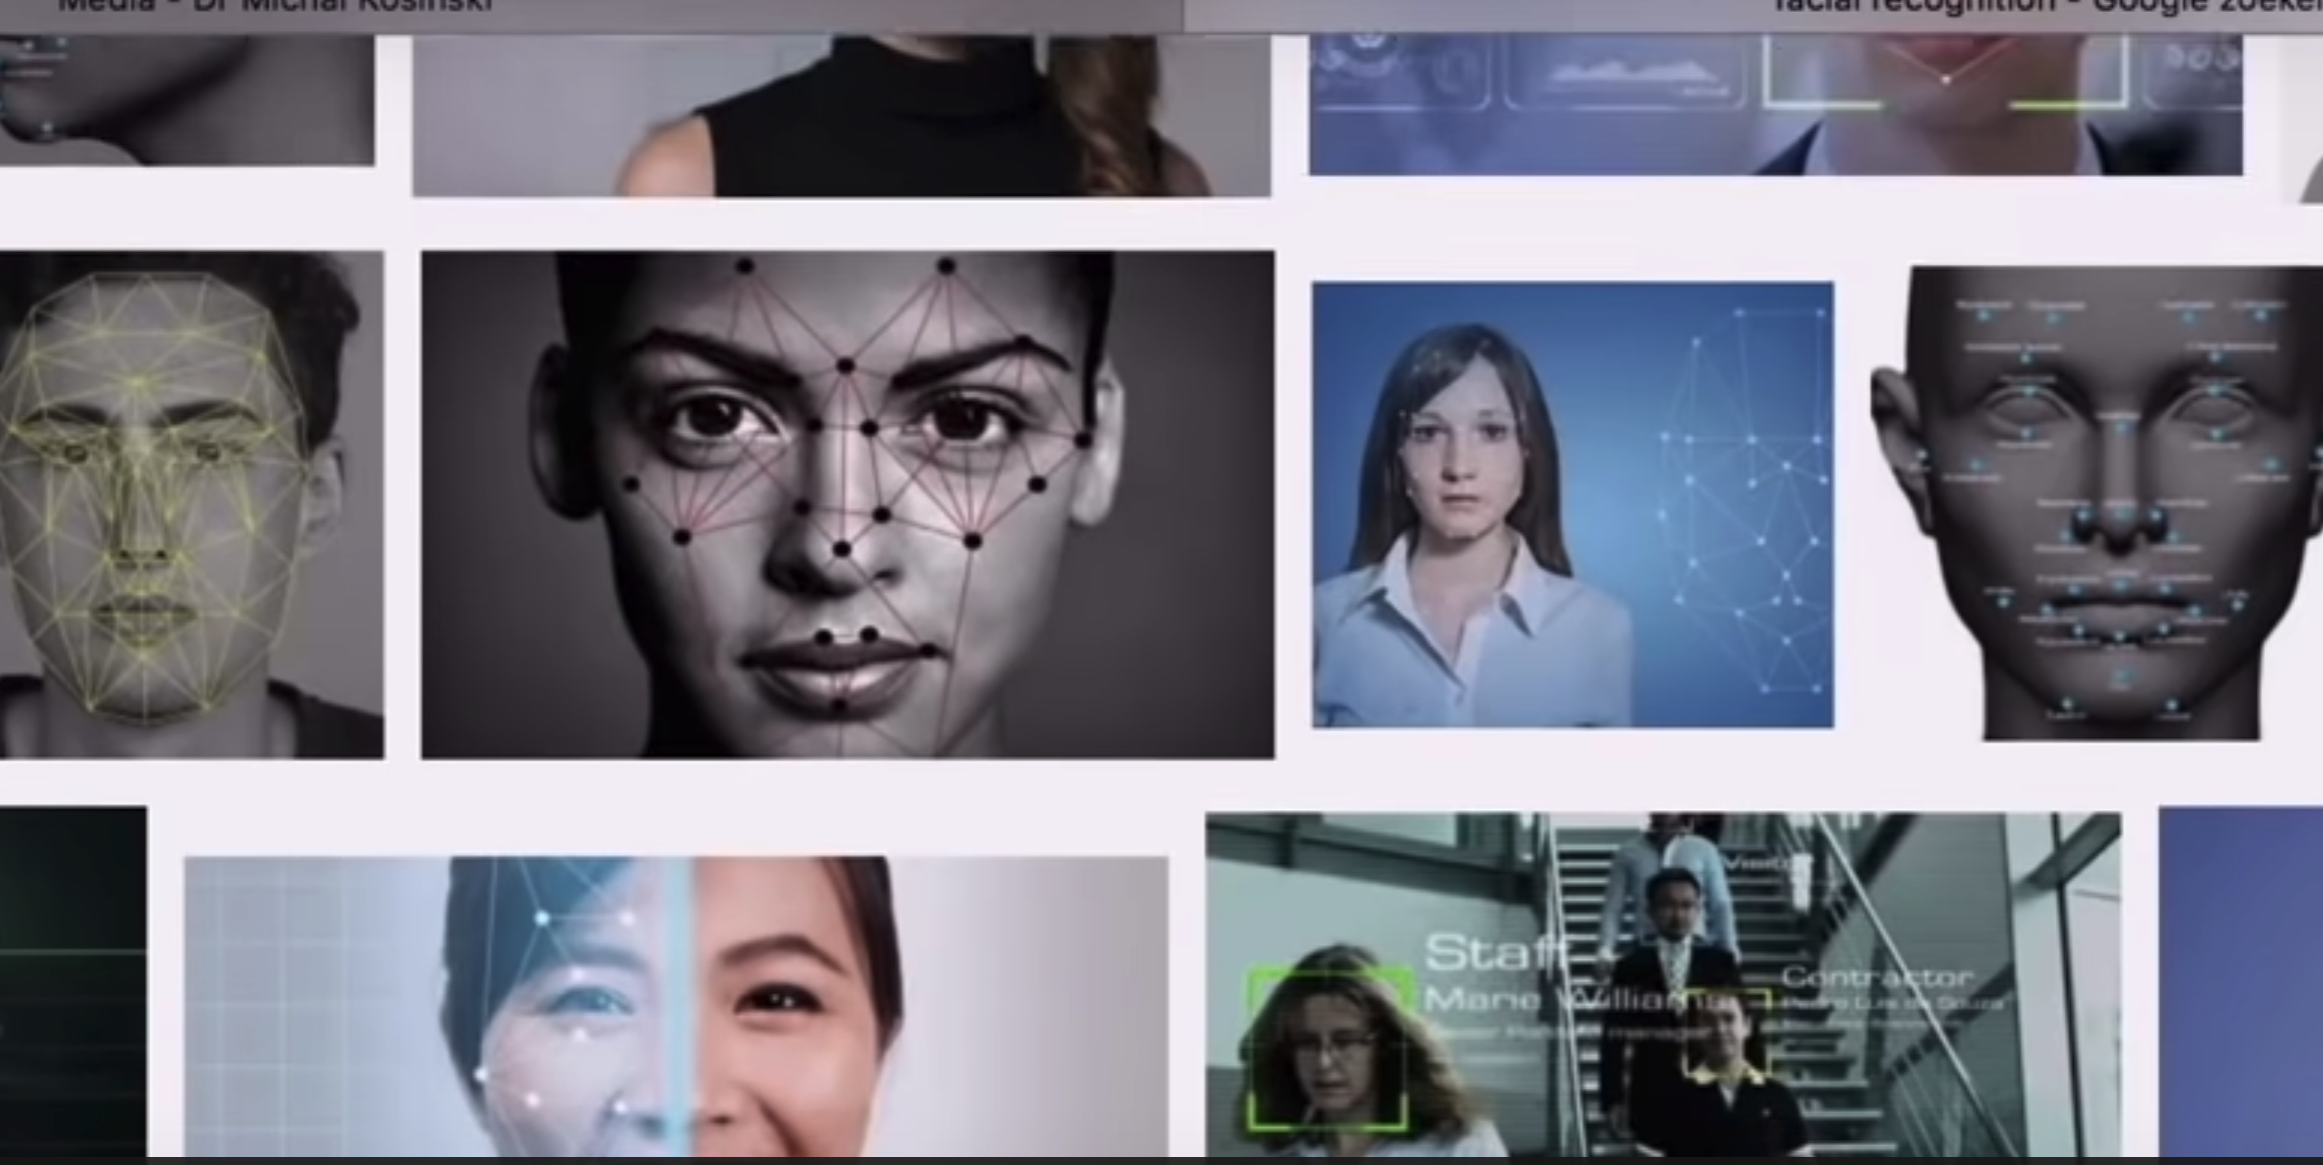
And what is NEW about it?
Shoshana Zuboff: What is Surveillance Capitalism
Shoshana Zuboff ‘On Surveillance Capitalism’ 00:00-12:21
Notes:
For a longer video, see: https://youtu.be/hIXhnWUmMvw

Slide 6
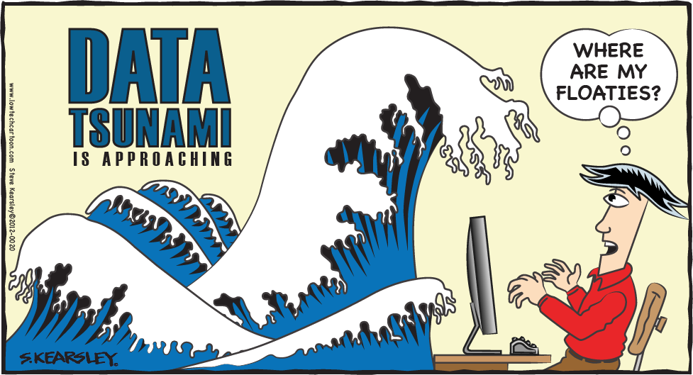
So what’s wrong with ‘surveillance capitalism’?
Extractive by design?
Dis-abling by design?
Invasive by design?
Deceptive by design?

Slide 7


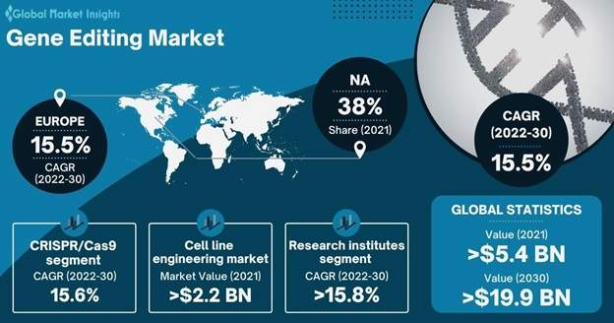
And what are the risks/benefits of ‘surveillance capitalism’?
If repurposed by the state?
If monopolised by corporate entities?
If repurposed to attain ‘public goods’

