Slide 1
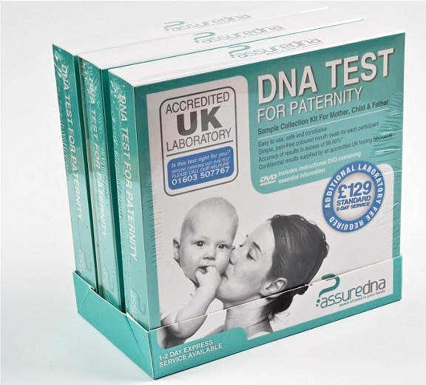
Suspects and certainties:
Genes, identities and female agency in late 20th century Britain
Roberta Bivins
Centre for the History of Medicine University of Warwick

Slide 2
Genetics, Identity and Parenthood in an age of certainty
The legal framework in Britain before 1991
Parenthood and Citizenship
Parenthood and ‘Custody and Control’
Pre-1914 Nationality descends to infants from fathers in the case of marriage, and from mothers only in the absence of marriage. Children born in British Isles treated jus soli.
1914-22 Transmission of subject status along legitimate male line for Britons born overseas
1948-1981 Gradual development of UK citizenship linked inheritance of citizenship from legitimate fathers with marriage; and right of abode with financial provision.
1981 British mothers gain right to pass on nationality to children born overseas
1981 ‘Fatherhood’ for transmission of nationality assigned to the husband of the mother at the time of child’s birth.
1983 Jus soli replaced by jus sanguinis
Only in 21st c. do illegitimate children born abroad to UK fathers gain citizenship by birth if paternity can be proven.
Filius nullius and ‘mater semper certa est’: paternal ‘custody and control’ the protected norm except in cases of ‘bastardy’ – ‘fathers’ rights negated the possibility of mothers’ rights’ (de Manneville vs de Mannville, 1804).
1834 New Poor Law strips paupers of key parental rights, fearing ‘hereditary pauperism’ and enabling state ‘custody and control’ that also subordinated (poor) children’s welfare to welfare of the state. ‘Bastardy Clause’ de facto dilutes responsibility of fathers to illegitimate children
Late 19th and early 20th c. guardianship laws create a judicial duty to child welfare).
1973 Parental equality in matters of custody and control finally established.
1987 legal equalisation of ‘legitimate’ and ‘illegitimate’ (citizen) children (but not completely for citizenship purposes until 2025)
1990 Social Security Act enables DSS to claw income support costs back from non-resident parent
1991 Child Support Act establishes Child Support Agency
Notes:
1857 Creation of the Divorce Court, which regularly challenged the sanctity of paternal rights to ‘control and custody’ where husbands had not performed their ‘marital duty’ to provide religious education and financial support.
1886 Guardianship of Infants Act formally introduces a legal responsibility for courts to consider welfare of children in their adjudication of custody. This is in order to control abuses while not recognising ‘rights’ for women or children according to Ben Griffin paper.

Slide 3
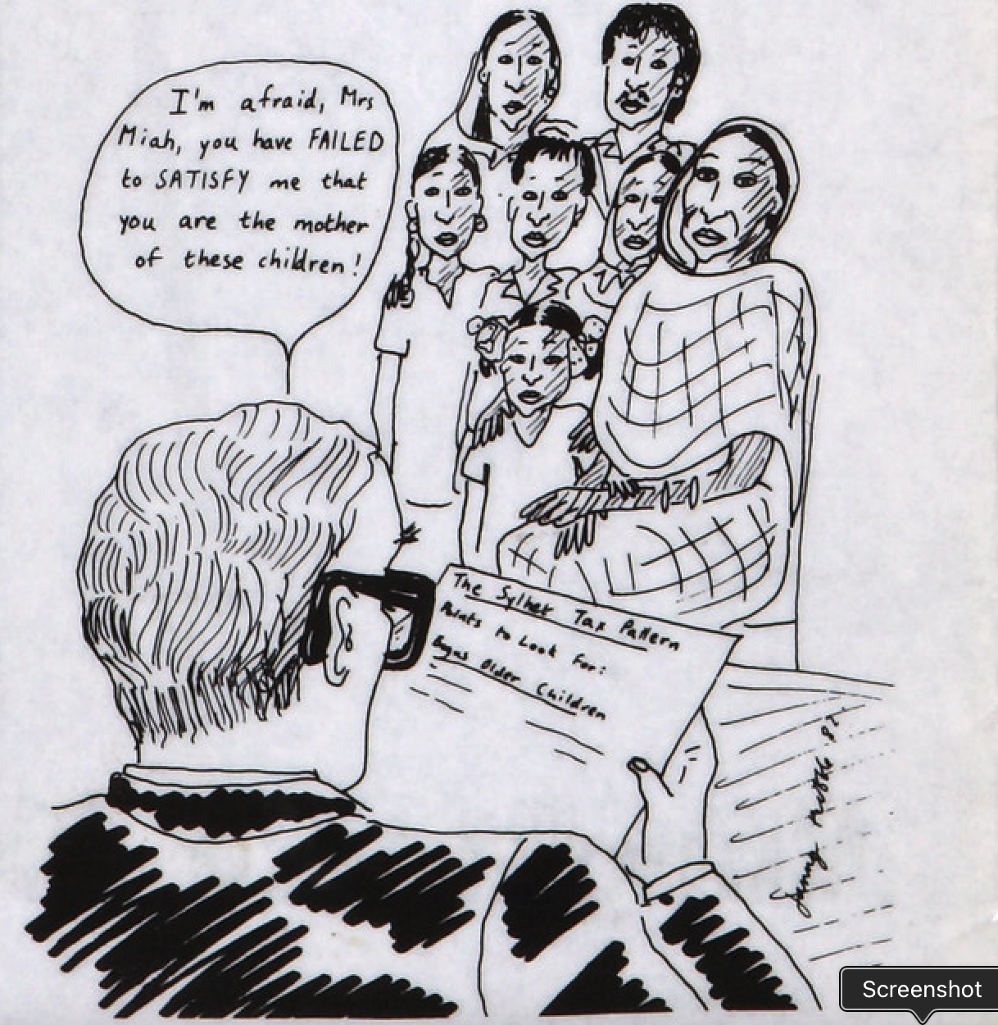
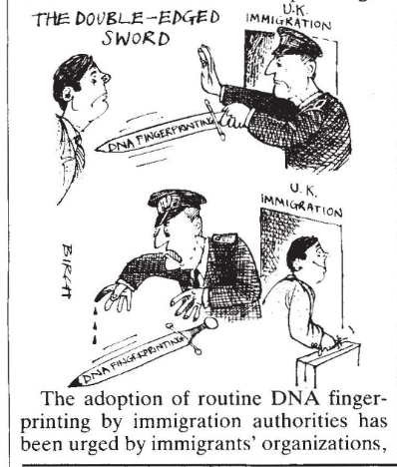
Identifying Asian men: Bureaucratic identity but biological paternity
The ‘Sylheti Tax Pattern’
The ‘double-edged sword’ of DNA

Slide 4
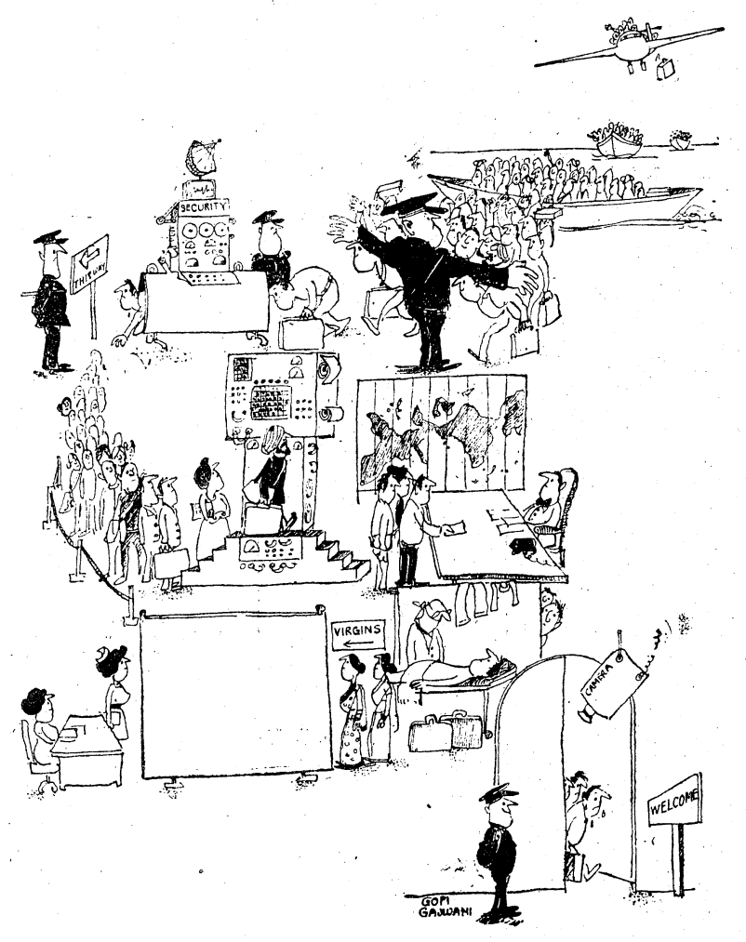
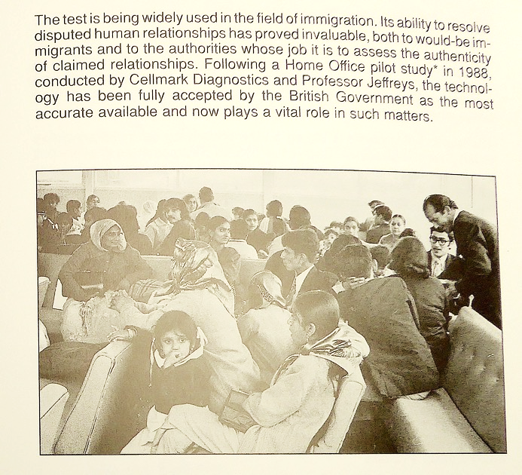
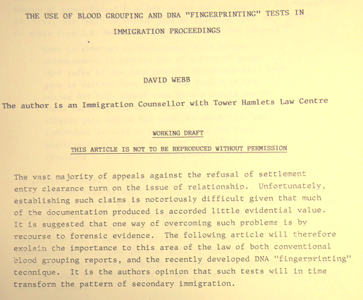
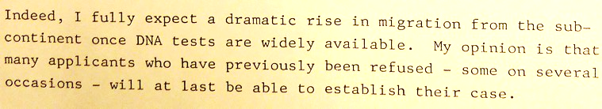
Identifying Asian women at the border: Virginity or Maternity
From Virginity Testing for Asian Fiancées (to prove that they are not wives)
To DNA testing for Asian mothers (to prove that they are wives)

Slide 5
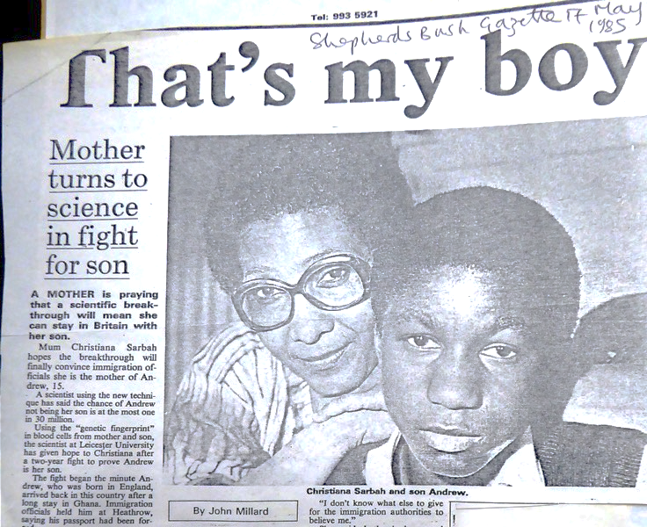

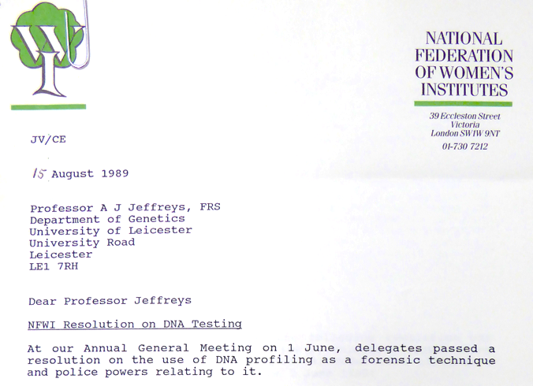
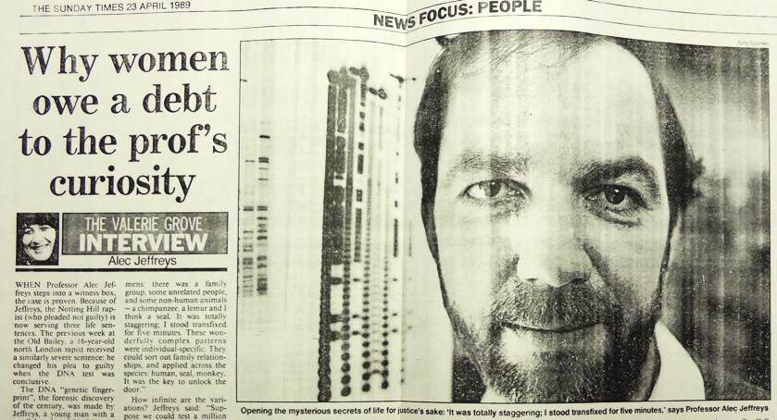
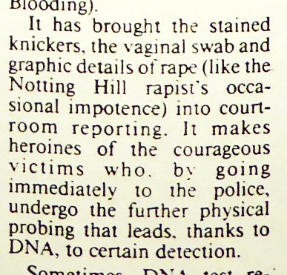
From seizing certainty to losing agency
Women and the introduction of genetic profiling
1985: Seona York and Christiana Sarbah recruit Alec Jeffreys to support Sarbah’s appeal against the deportation of her young son on the grounds that she is not his mother.
1989: Home Office replaces proof or familial relationship with economic capacity to support as primary barrier to reunification migration
1989: Women demand acceptance of DNA evidence in cases of rape and affiliation
1995: CSA begins to use DNA to claw back costs of mothers’ income support from ‘feckless fathers’

Slide 6
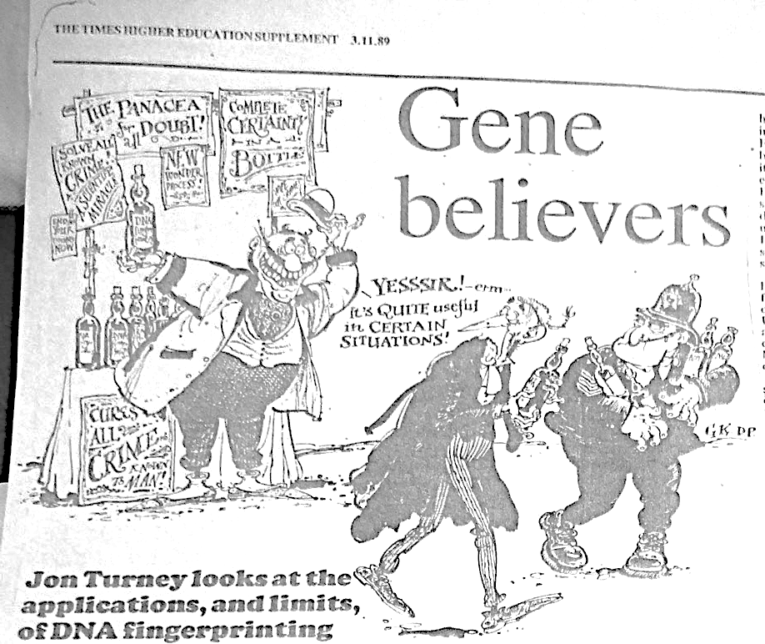
Certainty for ‘certain situations’ – but for whom?
‘The striking ability of the [‘genetic fingerprinting’] techniques to resolve individual cases – to the great joy of the protagonists in immigration disputes, or mothers seeking child maintenance for example – does not give firm ground for the wilder predictions… A technical novelty can change the basis of arguments in the courtroom, but is unlikely ever to eliminate them.’
Turney, Times Higher Ed, November 1989
‘A government study on genetic fingerprinting last July revealed a high percentage of immigrant parentage claims to be genuine. The immigration laws have since been changed. Proof of family ties is no longer the major criterion for settlement in this country.’
Jon Trux, ‘A Case of Unmistakeable Identity’, Observer, 13 August 1989

Slide 7
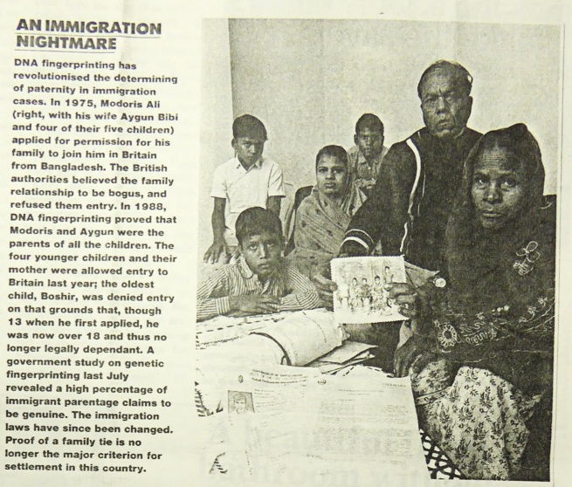
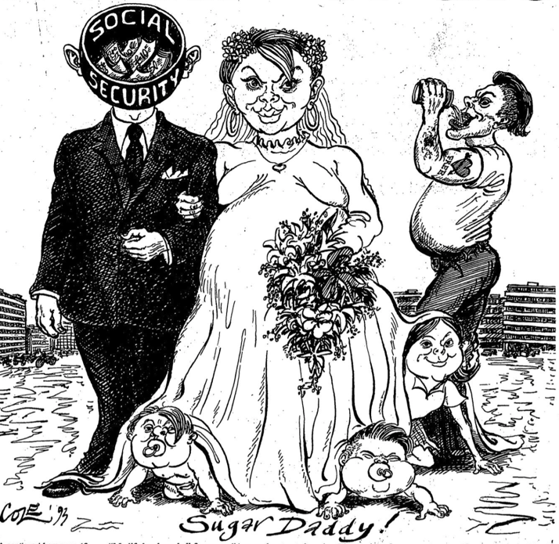
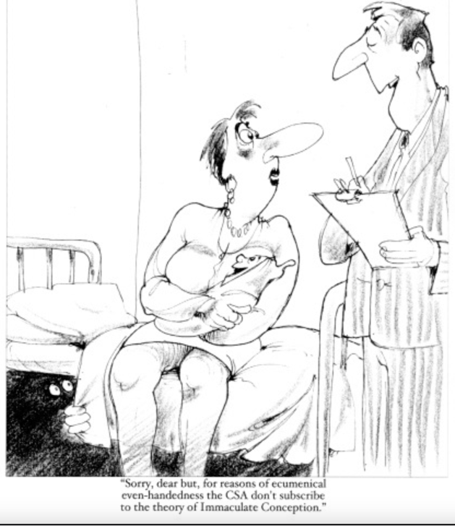
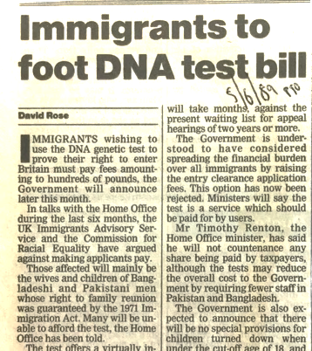
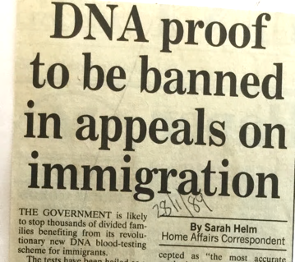
DNA for Deadbeat dads: After the immigrants, the ‘underclass’?
‘A government study on genetic fingerprinting last July revealed a high percentage of immigrant parentage claims to be genuine. The immigration laws have since been changed. Proof of family ties is no longer the major criterion for settlement in this country.’
Jon Trux, ‘A Case of Unmistakeable Identity’, Observer, 13 August 1989

Slide 8
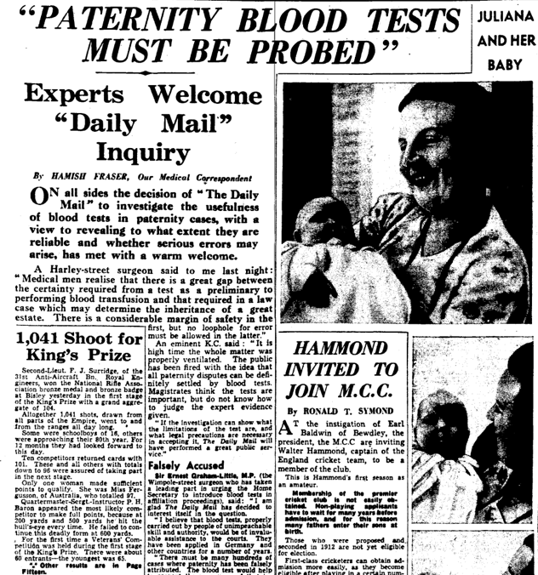
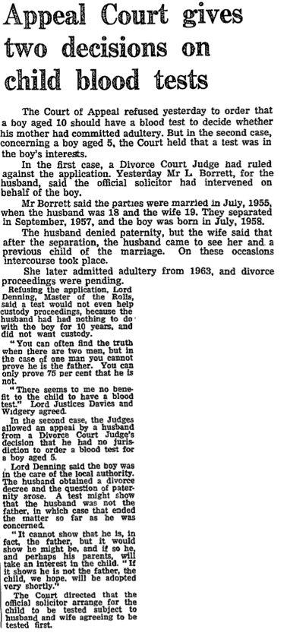
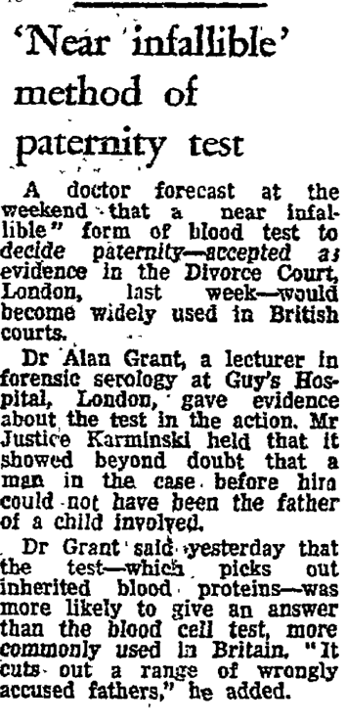
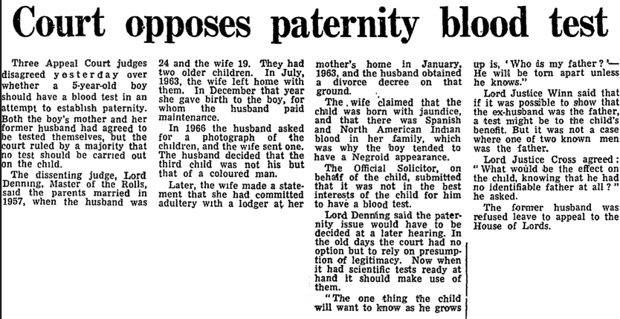
Testing for Paternity: Attitudes towards blood tests before genetic certainty and bioborders
‘Not in the best interests of the child…’
‘It is best [for the child]
that truth will out’
‘When it comes to the crunch,
Justice must prevail’
‘Blood testing is not a sure
way of discovering parentage’
Daily Mail 1970
‘Cuts out a range of wrongly
accused fathers…’
Guardian 1966
‘In the old days, the court had no option but to
rely on presumption of legitimacy. Now when it
had scientific tests ready a hand, it should make
use of them’ Guardian, 1969
‘Serious lapses of justice may occur and bring discredit on scientific discoveries which if properly used, can save 1000 innocent men a year…’ Daily Mail, 13 July 1938

Slide 9
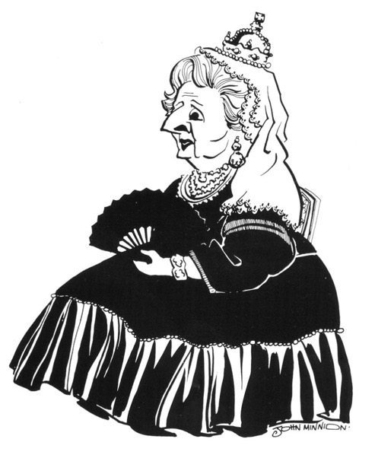
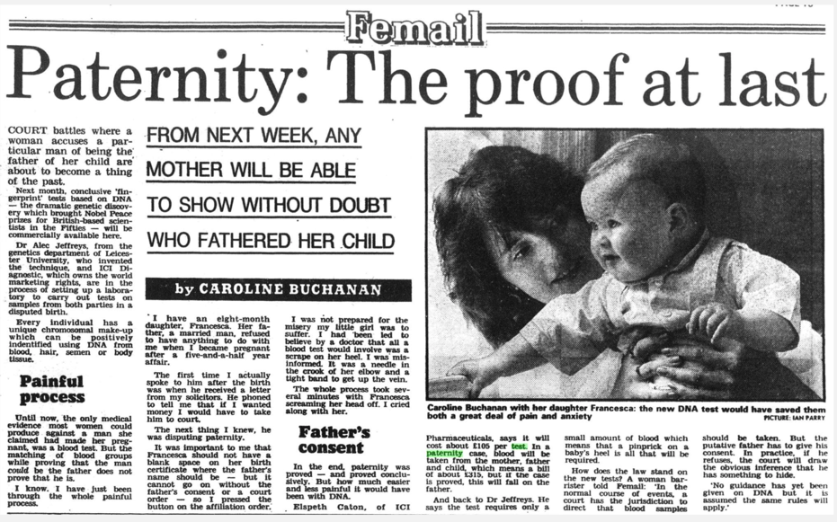
After-effects: From genetics at the border to DNA for Deadbeat Dads
‘Appalled at the size of the bill left behind by
Fathers…’
‘Family life is under threat’
‘the absent male’
‘Nearly 1 in seven families’
‘Mothers struggling…’
‘Moved by the plight of the
growing number of children of
broken marriages…
determined to make errant
fathers pay …’

Slide 10
The Rise and Risks of Certainty
The Ad: "Whose child is it? Are you really the father? The curious, suspicious or disbelieving who just want peace of mind can now conduct paternity checks in the comfort of their own home. Do-it-yourself DNA tests are now available in Britain.”
The Chair of Commons Health Select Committee: "I hope the Government will find some way to block the activities of this agency and other agencies undertaking similar testing. … I want to see it stopped. Clearly there is a huge gap in law here where there is no provision in respect of non-medical use of DNA.”
The ‘DNA Testing Agency’: "They [critics and the government] are defending the position where they are controlling the tests in this country. We are giving people the opportunity to do private testing. There is nothing deceitful or underhand about it."
http://news.bbc.co.uk/1/hi/health/131744.stm 1998

