Slide 1
Screening Suspects and Suspect Screening: Illness, Immigration, and the National Health Service in Britain
Professor Roberta Bivins
Centre for the History of Medicine
University of Warwick
peopleshistorynhs.org

Slide 2
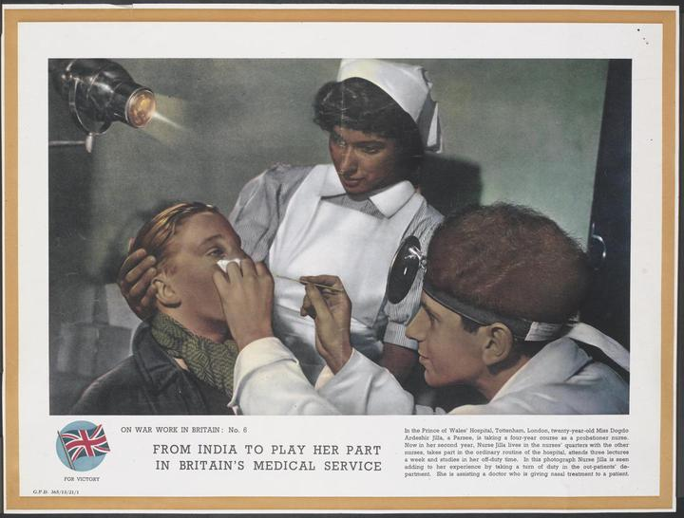
From Civis Britannicus Sum …
‘In a world in which restrictions on personal movement and immigration have increased we still take pride in the fact that a man can say Civis Britannicus sum whatever his colour may be, and we take pride in the fact that he wants and can come to the Mother country.’
Henry Hopkins, Minister of State, Colonial Affairs, 1954
© Crown Copyright. IWM http://www.iwm.org.uk/collections/item/object/33289
Notes:
ON WAR WORK IN BRITAIN: No. 6 FROM INDIA TO PLAY HER PART IN BRITAIN'S MEDICAL SERVICE In the Prince of Wales' Hospital, Tottenham, London, twenty-year-old Miss Dogdo Ardeshir Jilla, a Parsee, is taking a four-year course as a probationer nurse. Now in her second year, Nurse Jilla lives in the nurses' quarters with the other nurses, takes part in the ordinary routine of the hospital, attends three lectures a week and studies in her off-duty time. In this photograph Nurse Jilla is seen adding to her experience by taking a turn of duty in the out-patients' department. She is assisting a doctor who is giving nasal treatment to a patient.
COLONIAL IMMIGRANTS
HC Deb 05 November 1954 vol 532 cc821-32

Slide 3
…To ‘country of origin’ screening (for some), NHS surveillance (for others)
2016
2005

Slide 4
Tropes: how have Britons thought about migrants and the NHS?

Slide 5
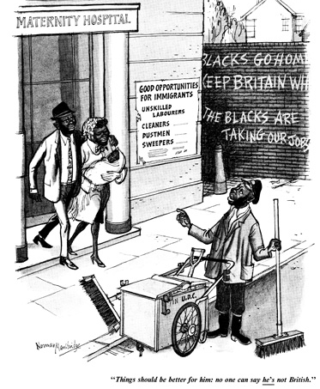
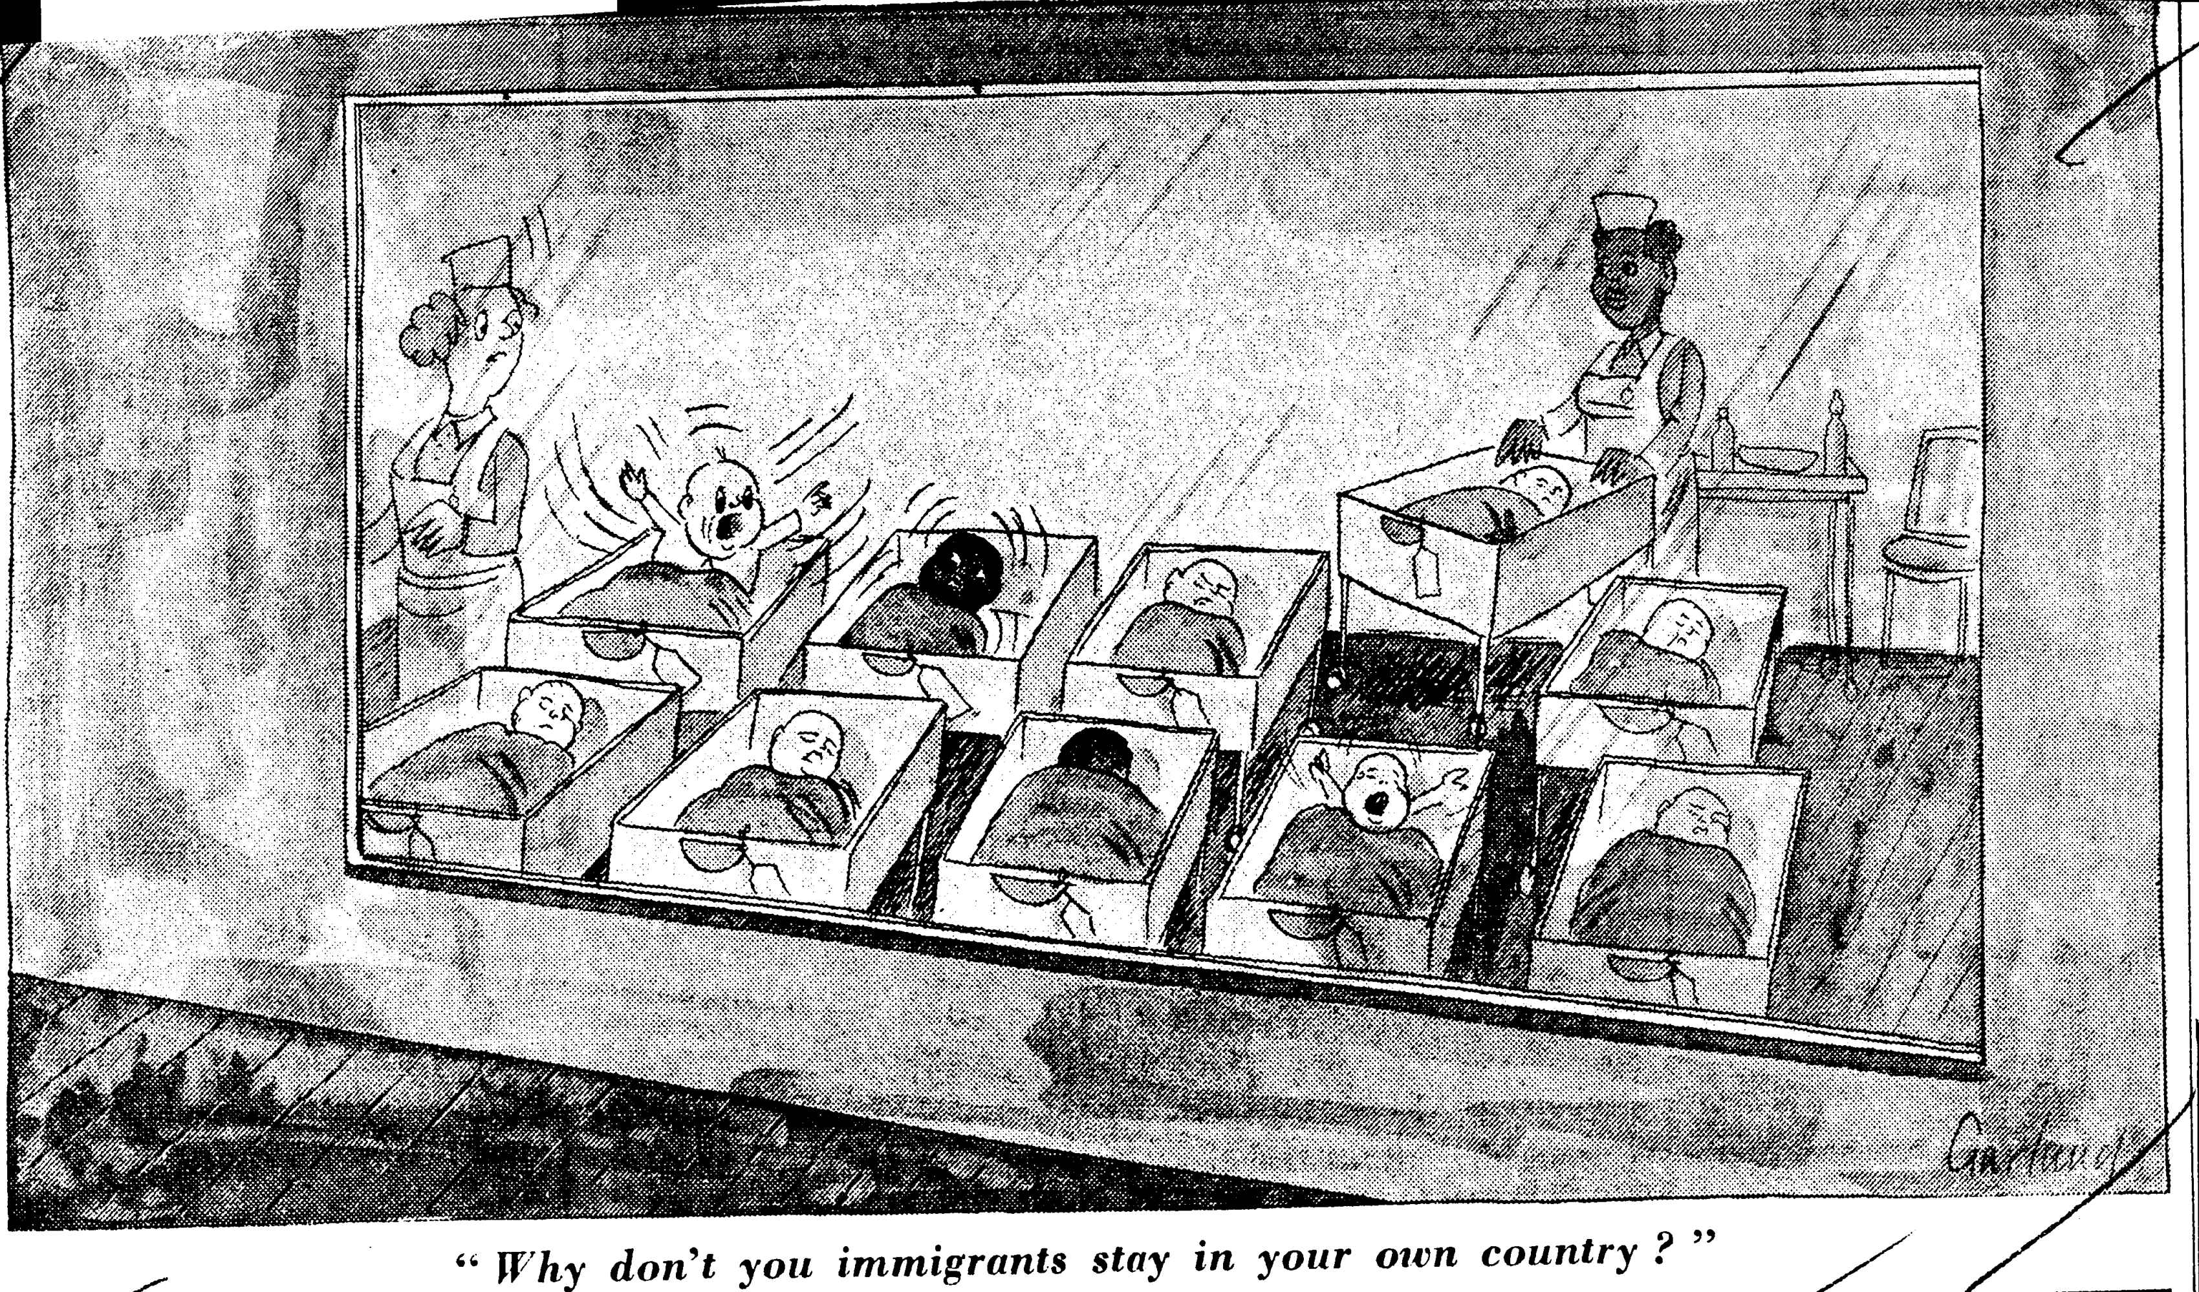
Saviours of the Service or ‘born immigrants’?
© Punch Archive, Norman Mansbridge, Punch 1954
© Telegraph Media Group, Nicholas Garland, Daily Telegraph, 25 April 1968 British Cartoon Archive, University of Kent

Slide 6
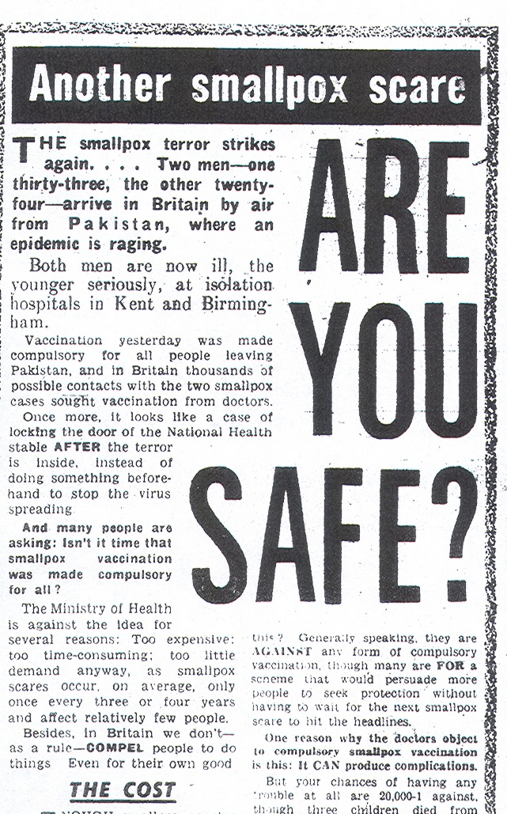
‘Imported Evil’:
‘CHECK! A foreigner brings smallpox into this country and a Ministry of Health spokesman admits that there is no check… Scandalous!’
‘Once more it looks like a case of locking the door of the National Health stable AFTER the terror is inside…’
2004
1962
2001
Notes:
IMAGE FROM JAN 4 DAILY MIRROR
QUOTE FROM Daily Mirror letters, Jan 1

Slide 7
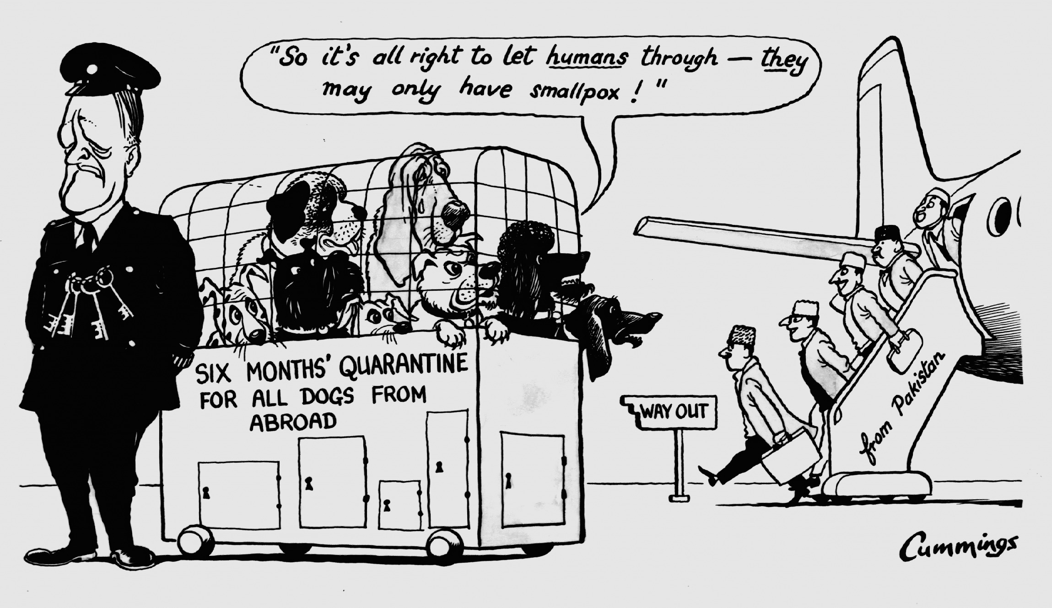
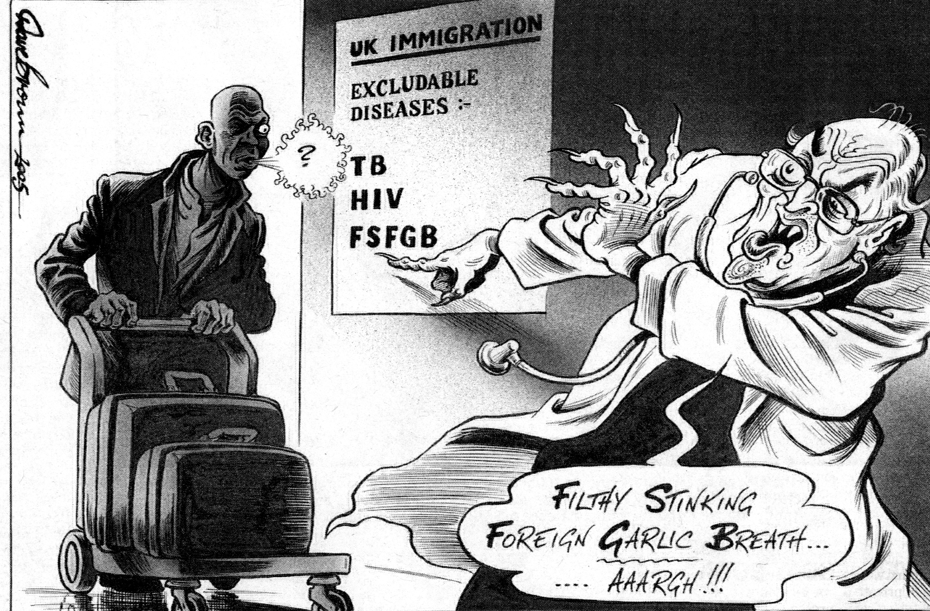
‘Foreign Contagions’
© Express Syndication Ltd., British Cartoon Archive, University of Kent, Michael Cummings, Daily Express, 17 Jan 1962
© Dave Brown, British Cartoon Archive, University of Kent, Dave Brown, Independent, 16 Feb 2005.

Slide 8
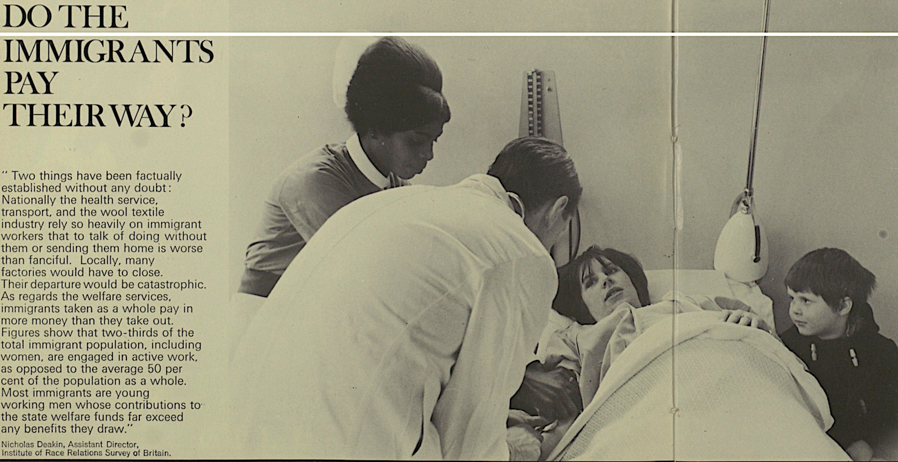
Illustrated London News, 1968
Immigrants: ‘burdening’ or benefiting the NHS?
Daily Mail, 17 July 1968

Slide 9
Factors mediating border medical surveillance in Britain 1948-2016
Existing legal powers, esp. power to examine/exclude
Economics (value of migrants/costs of control vs costs of identification and treatment)
International standing and agreements
Practicability of ‘control’ (degree of medical consensus; disputed extent of medical threat; facility and efficacy of screening)

Slide 10
Medical authority in mid-century migration: Confounding factors
Increasing awareness of medical uncertainty, ambiguity (e.g. TB latency)
High costs, lengthy process required for accuracy in medical surveillance
Absence of medical consensus within UK and between UK and other medical cultures
Availability of (affordable) effective treatments, undercutting rationale for exclusion, generating calls for humanitarian responses
Ever-greater concern about transmission in transit (militating against deportation)
Ever higher numbers of migrants increases costs and reduces efficiency of medical examination
Extremely limited ability to refuse entry on medical – or any – grounds (eg spouses, financees, dependent children under 18, and some aged dependents all exempt or admissible on exceptional humanitarian grounds)

Slide 11
British state authority in mid-century migration: confounding factors
Universal post-war labour shortages, followed by persistently high demand for cheap labour (and of course equally persistent demand for qualified and unqualified NHS staff)
Geopolitics, including Cold War and UK leveraging of Commonwealth relationships, ‘influence’ to protect status as a ‘great nation’
‘Race relations’: tension between popular and political self-identification as a ‘tolerant nation’ and racist responses to migrant, ethnic communities
Constant Treasury pressure on spending departments, including Health, to cap costs and secure efficiency combined with resistance to increase general taxation levels or hypothecate tax levies

Slide 12
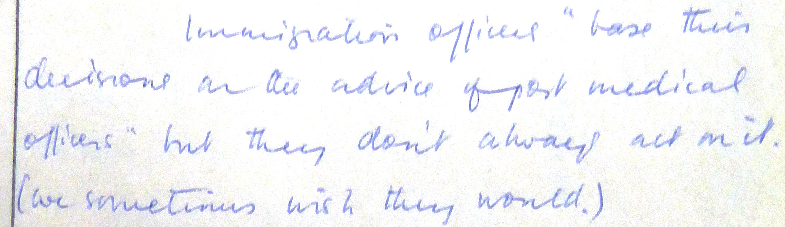
Migrant medical inspection, Heathrow 1962-1971

Slide 13
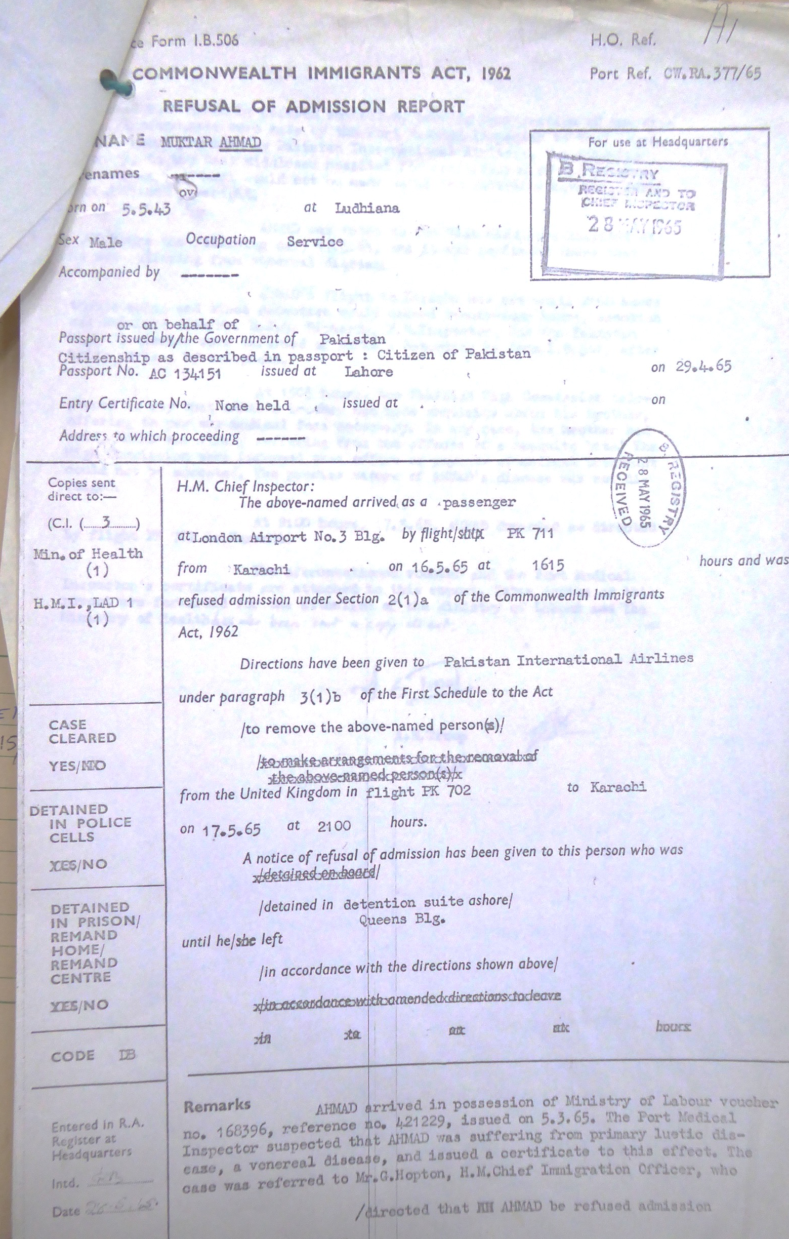
Medical Repatriation: Heathrow 1965
16:15 16 May Labour Voucher holder M.A. arrives at Heathrow from Karachi. He is routinely referred to Port Medical Inspector who suspects VD primary lesion, and certifies accordingly. M.A. is then refused entry by the Chief Immigration Officer, pending confirmation of disease and detained in Queens Building Detention Suite.
10:00 17 May M.A. taken for VD examination to West Middlesex Hospital; VD diagnosis reportedly confirmed; Pakistani Embassy informed (since his detention would exceed 24 hours).
15:05 17 May Pakistani High Commission forwards brother’s offer to pay for any medical treatment, and to note doubts about the diagnosis; offer rejected.
21:00 17 May M.A. returned to Pakistan by PIA
BUT: investigations continue until Jan 1966

Slide 14
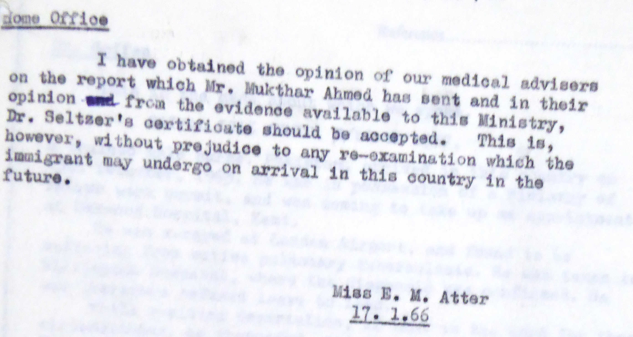
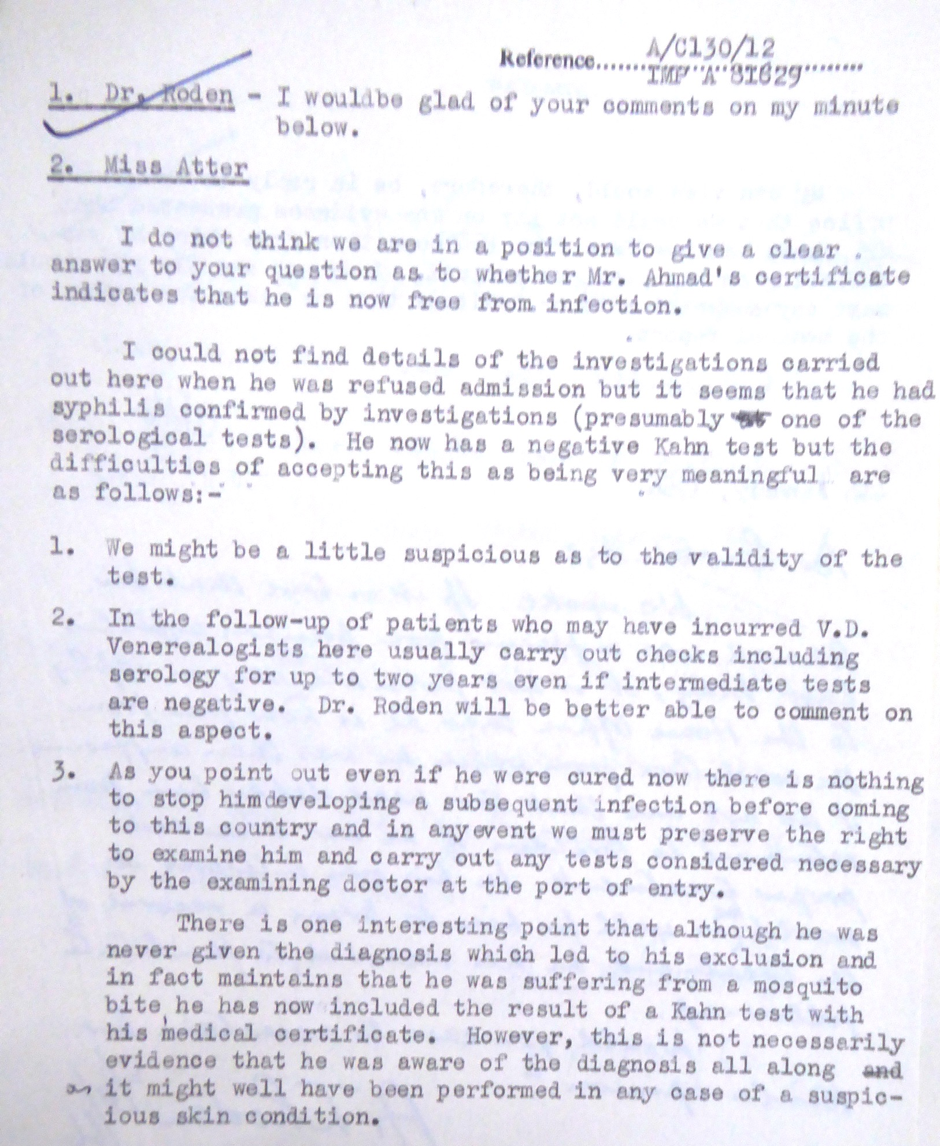
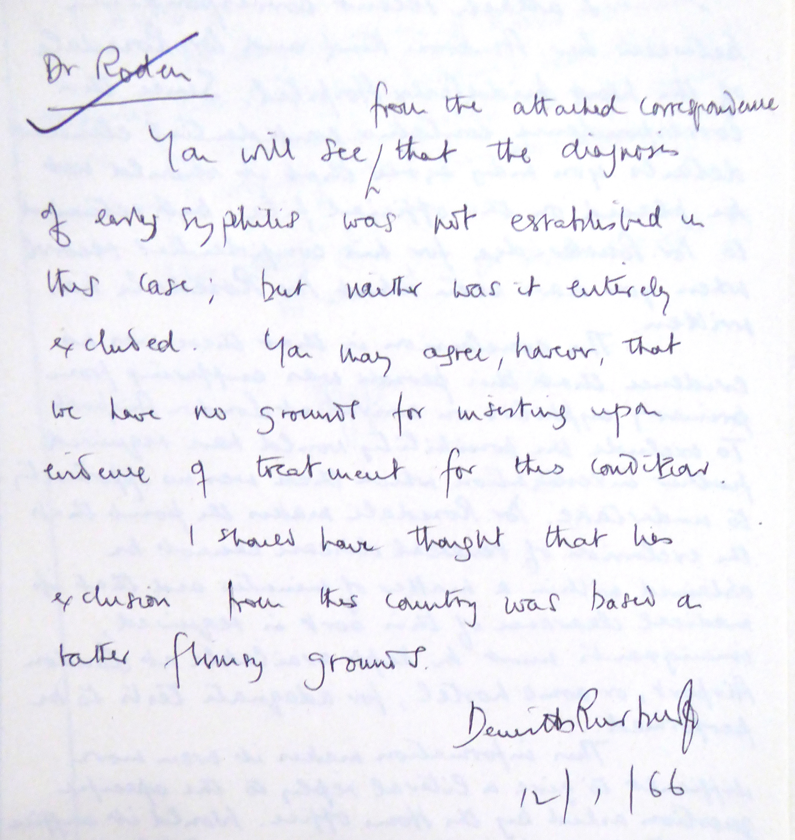
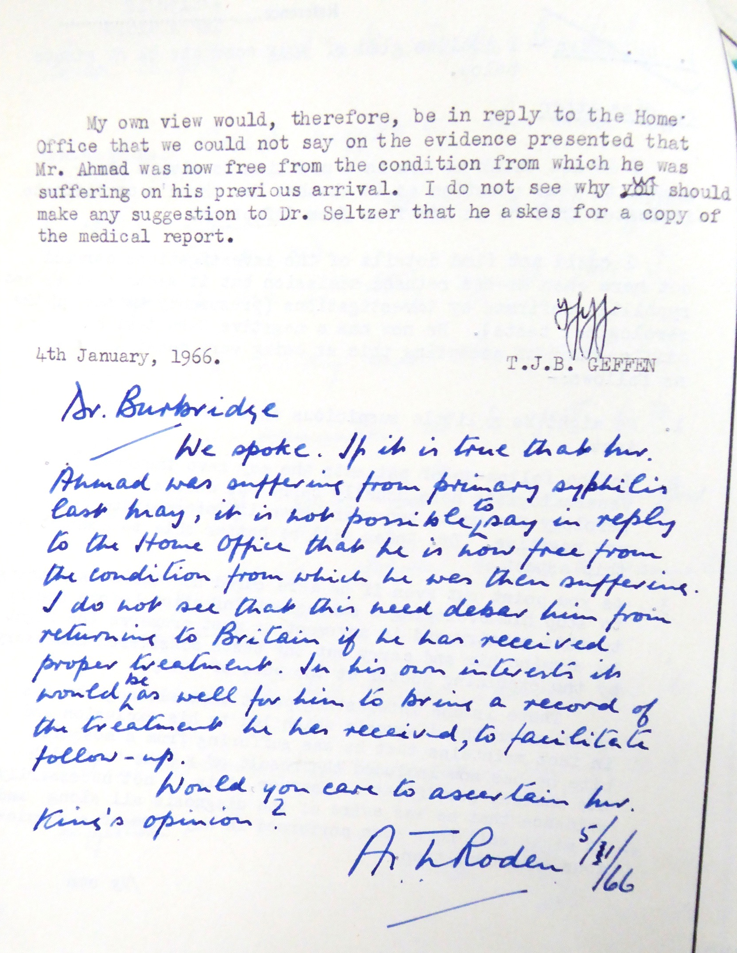
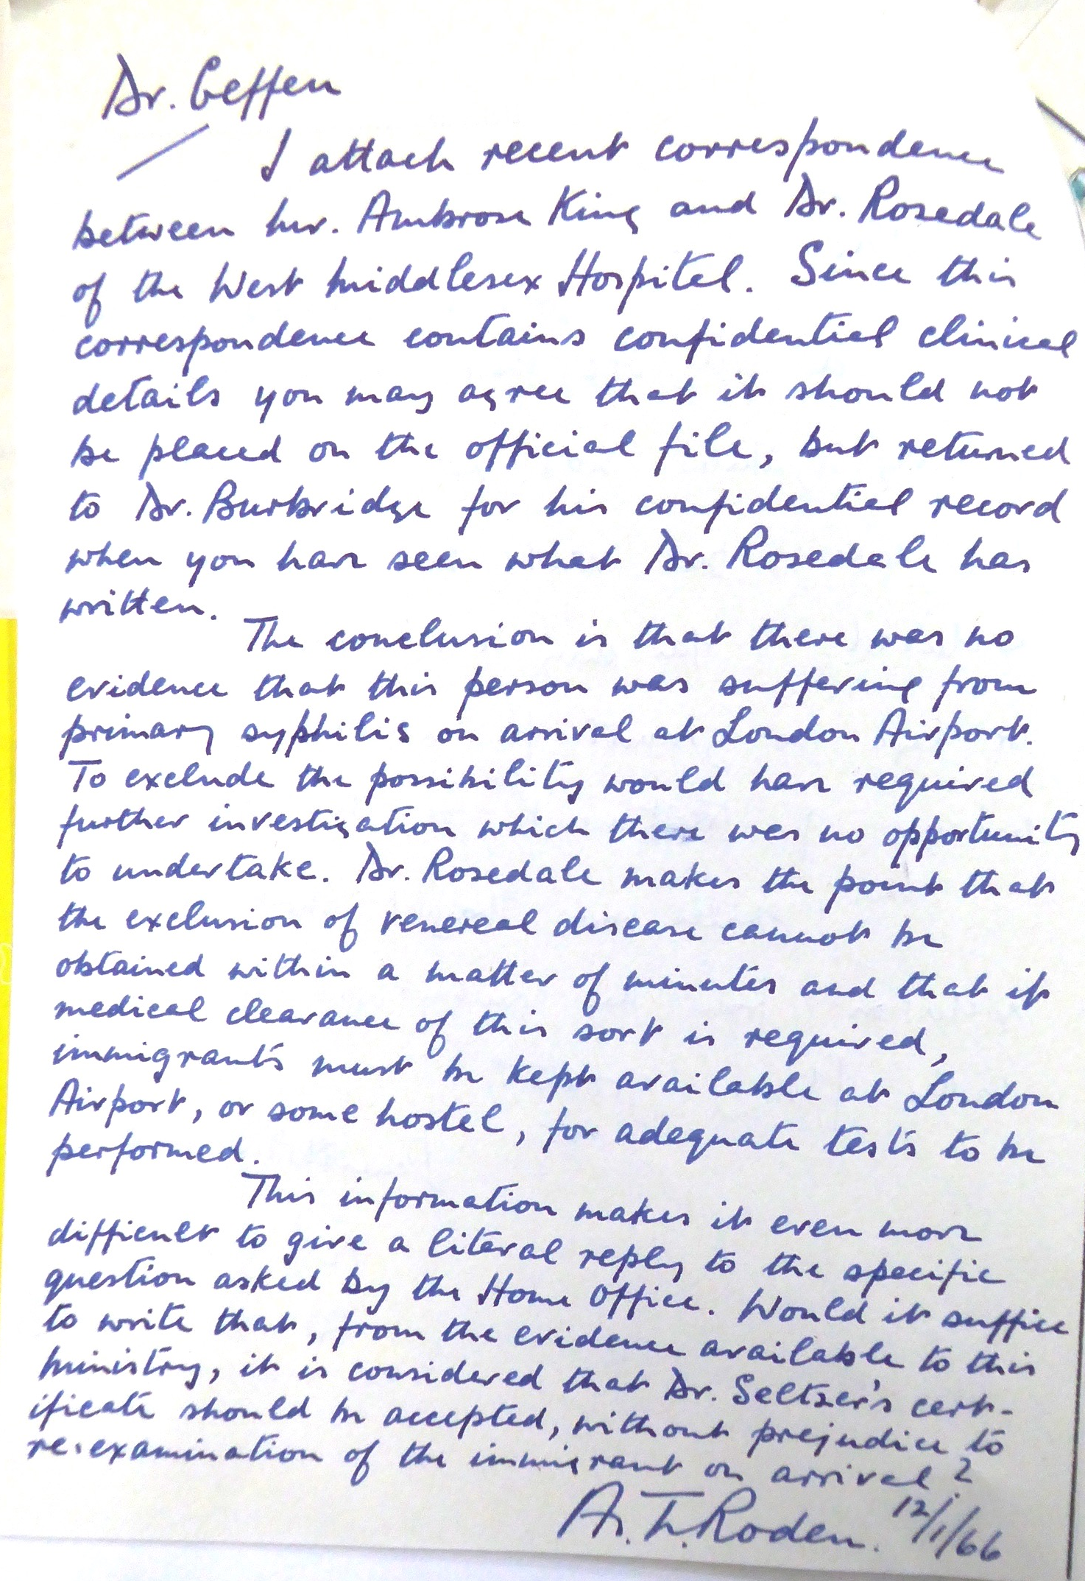
From ‘Confirmed by investigations’ to ‘flimsy grounds’: the trajectory of a border medical examination
What the M.A. case reveals:
The limits of both medical and bureaucratic certainty
The degree to which Ministry/DHSS guidance was subject to individual re-interpretation at the border;
The role played by NHS resources in facilitating complex medical examination
The availability (and yet limited efficacy) of appeal on medical authority
The fundamentally arbitrary nature of medical ‘control’ given separation of medical scrutiny from powers of admission.

Slide 15
‘Doctors differ’: the perils of medical opinion ‘The HO have now received representations from him supported by a note from Dr. B.K Sikand of the New Delhi TB Centre…’ ‘Most chest physicians in the UK would consider…’ ‘Medical opinion in this country, which has the last word, differs, however .’

Slide 16
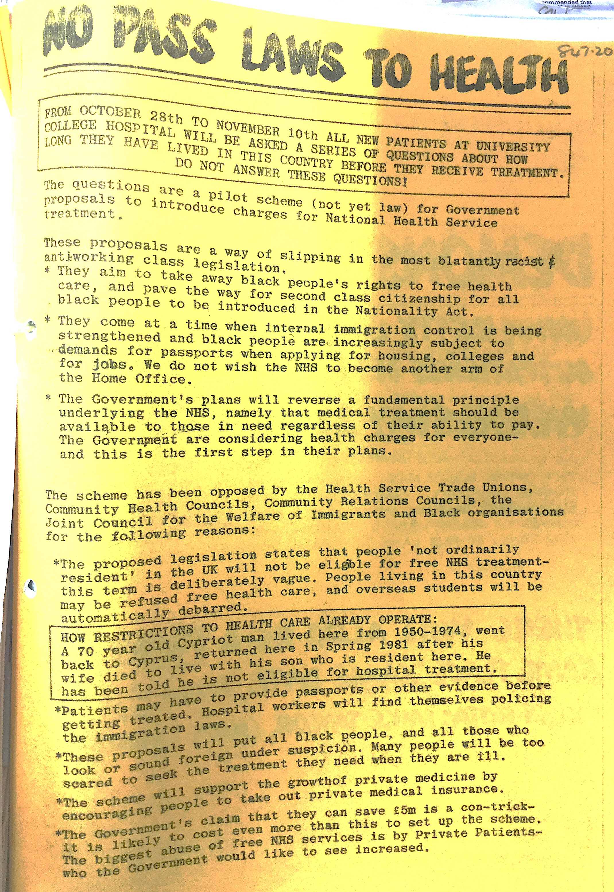
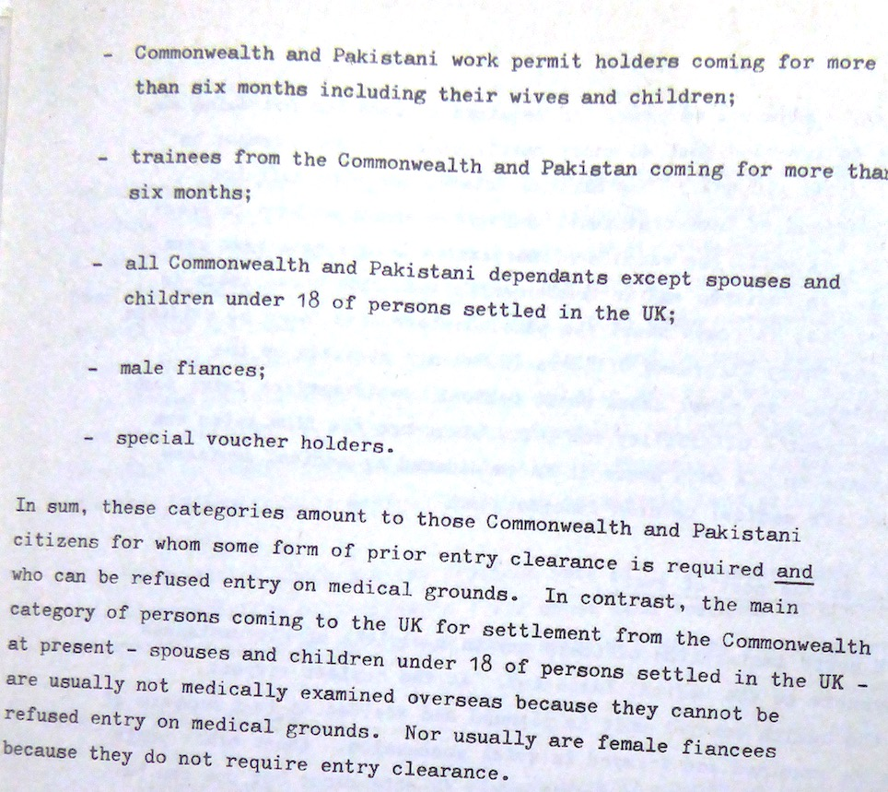
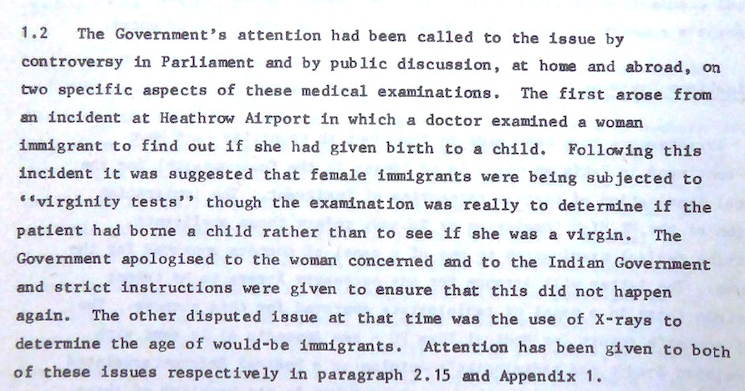
‘Port of Arrival’, the NHS, and the Yellowlees Report
Suspect bodies
Clear epidemiological evidence of higher rates of TB in specific migrant and ethnic communities;
Popular and medical clamour for tighter screening at the border prompts extension of controls to ‘suspect groups’, but cannot be applied retrospectively (or efficiently).
Suspect Screening
Border screening could not be universal or comprehensive; was racialised, arbitrary;
‘Internal Border’ screening and management possible because NHS was universal and comprehensive;
But dependence on NHS meant that policing internal border required either expensive/inefficient universal screening or potentially discriminatory targeted screening of ‘entitled’ Home population.

Slide 17
So how was the shift to mandatory screening and treatment in ‘high-risk’ countries of origin enabled?
‘Asylum crisis’ refashions migration as ‘uncontrolled’ and ‘uncontrollable’ and revisits narratives of migrants as burdening NHS; resulting legislation places more migrants into ‘controlled’ categories.
EU expansion creates new (also ‘uncontrollable’) sources of cheap labour.
Decline of political sensitivity to global ‘race relations’ and decreased value of Commonwealth as vehicle for political influence.
Increased confidence in reliability and sensitivity of medical testing abroad, as medical expertise in migrant-sending nations develops, and can be co-opted;
Attractions of outsourcing costs, once consensus existed for TB as ‘imported illness’.

Slide 18
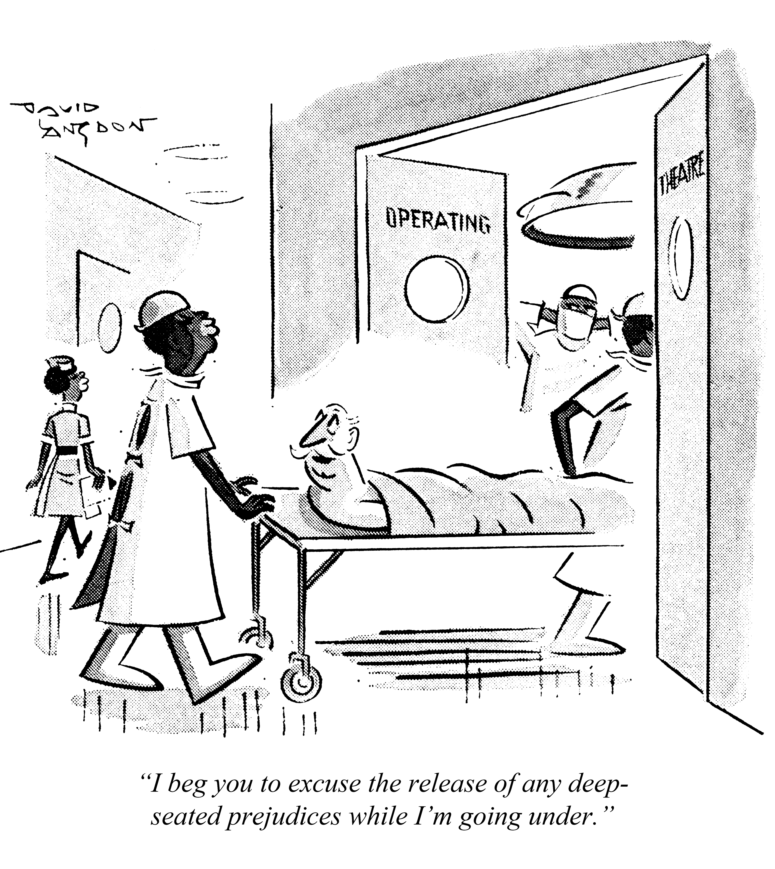
Tensions between ‘traditions of tolerance’ and ‘deep-seated prejudices’ both at the borders and in the NHS create opportunities for migrant health screening, but limit its exclusionary effects and render it ‘suspect’; Exclusionary health controls only become possible in conjunction with a) new screening tools that reduce medical ambiguity, promote consensus for ‘importation’; and b) professionally credible ‘country of origin’ screening programmes
Findings
© Punch Archive, David Langdon, Punch 1969

