Slide 1
The prehistory of HIV in East Africa
Shane Doyle
s.d.doyle@leeds.ac.uk

Slide 2
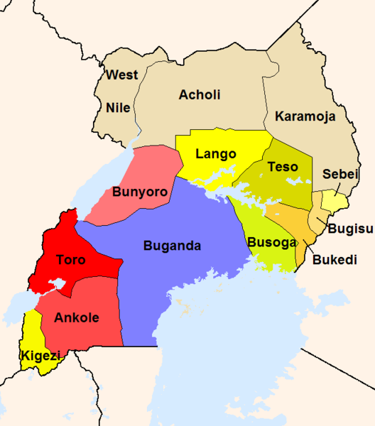
UGANDA
. Kampala
Buhaya
TANZANIA

Slide 3
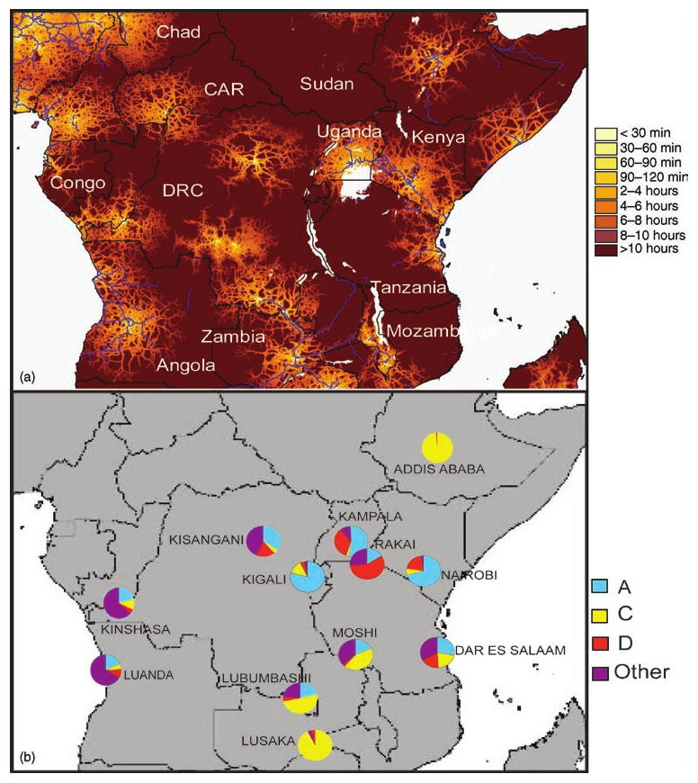
Sub-types of HIV-1 Group M

Slide 5
Interconnectedness of town and country in Uganda and NW Tanzania

Slide 6
Sexual narratives
‘After my first marriage I did not want to marry again, but of course, I had several lovers.’
Int. Therese M., Busindi, Aug. 2000, b.1935

Slide 7
Male FGD, Kisubi Kiwulwe, 4 Sept. 2004, born 1921, 1921, 1933
Q How many wives have you had?
R₁ Two.
R₂ No you had five!
R₁ I had two proper wives, the other women I lived with were just malaya – prostitutes.

Slide 8
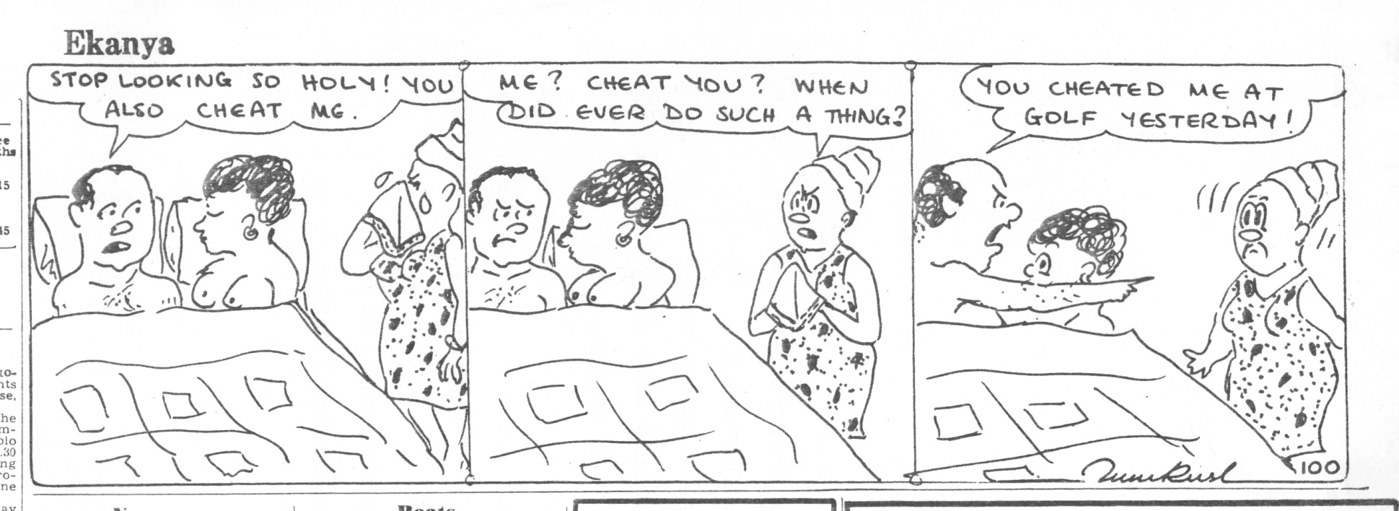
Uganda Argus, 10 June 1971, p.6

Slide 9
‘Your stars this week’
Uganda Weekly News, 5 Feb. 1978, p.13
Aquarius Love - go out and have your nets stretched for a big catch
Aries If you still want to be at peace, let alone the married and the students
Taurus Love - be very careful about members of the opposite sex
who want you for just one thing only! Money.
Virgo Love - try to be as loyal to your friend as you would like that person to be to you
Scorpio Money - invest it rather in assets than in bottles of beer and sex.

