Slide 1
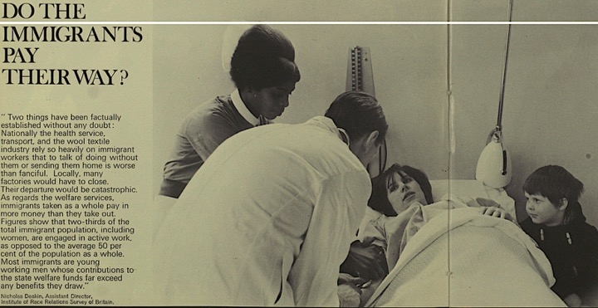
Recognising ‘race’ in the NHS
Roberta Bivins
University of Warwick
peopleshistoryNHS.org
@robertabivins
#HeretoStay70
©Illustrated London News, 18 May 1968

Slide 2
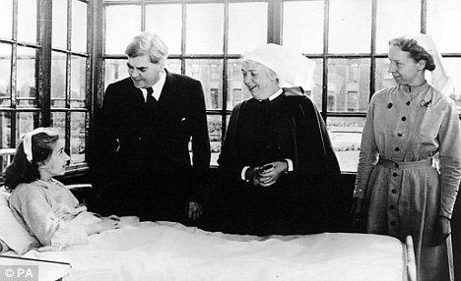
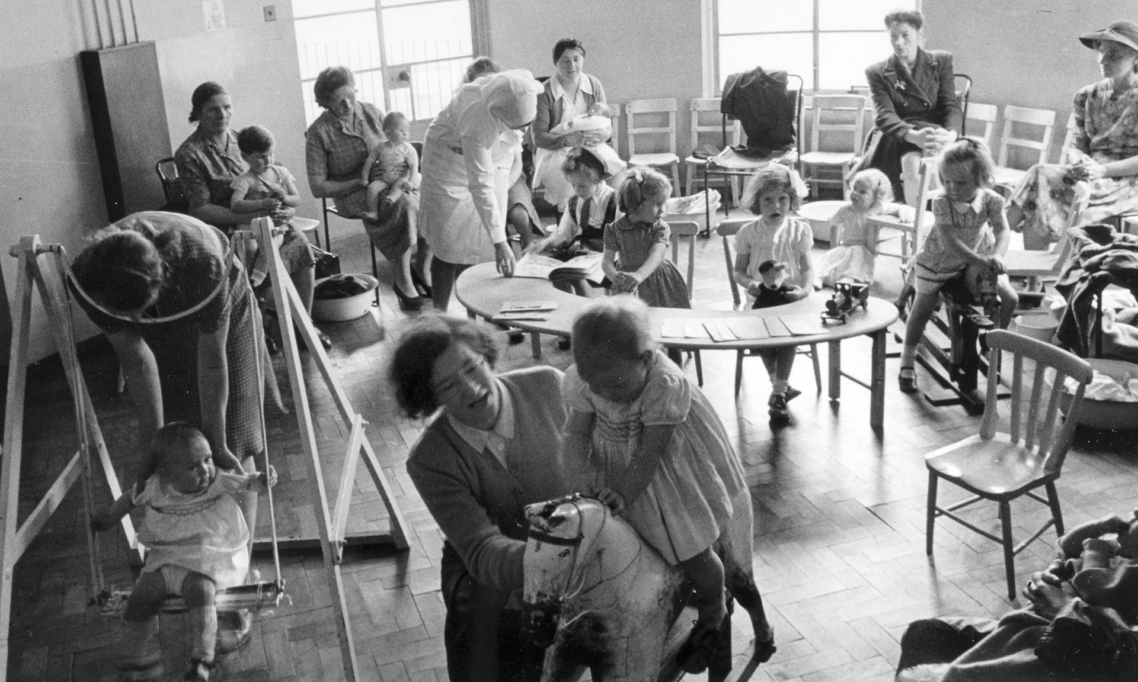
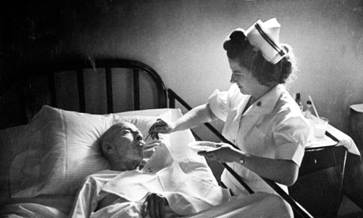
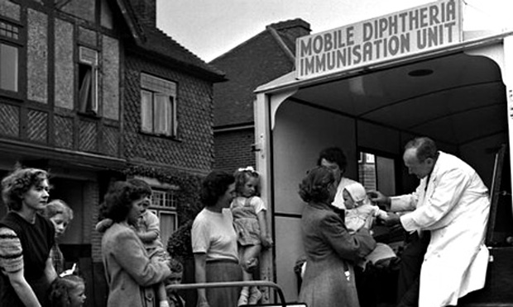
Traditional Visions of ‘Our NHS’
Wikimedia/University of Liverpool Faculty of Health & Life Sciences, CC BY-SA
©Popperfoto/Getty Images
So what is missing from this traditional picture?
©W. Eugene Smith/Time & Life Pictures/Getty Images
©Popperfoto/Getty Images

Slide 3
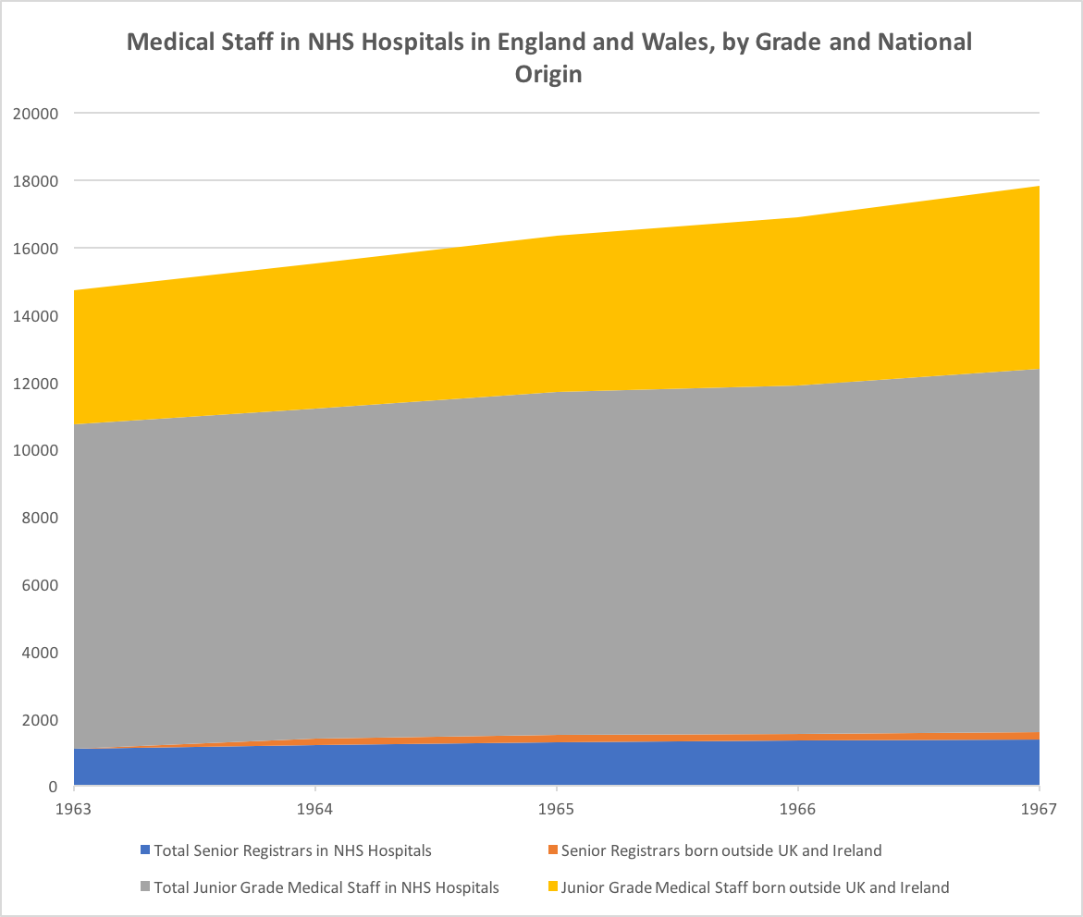
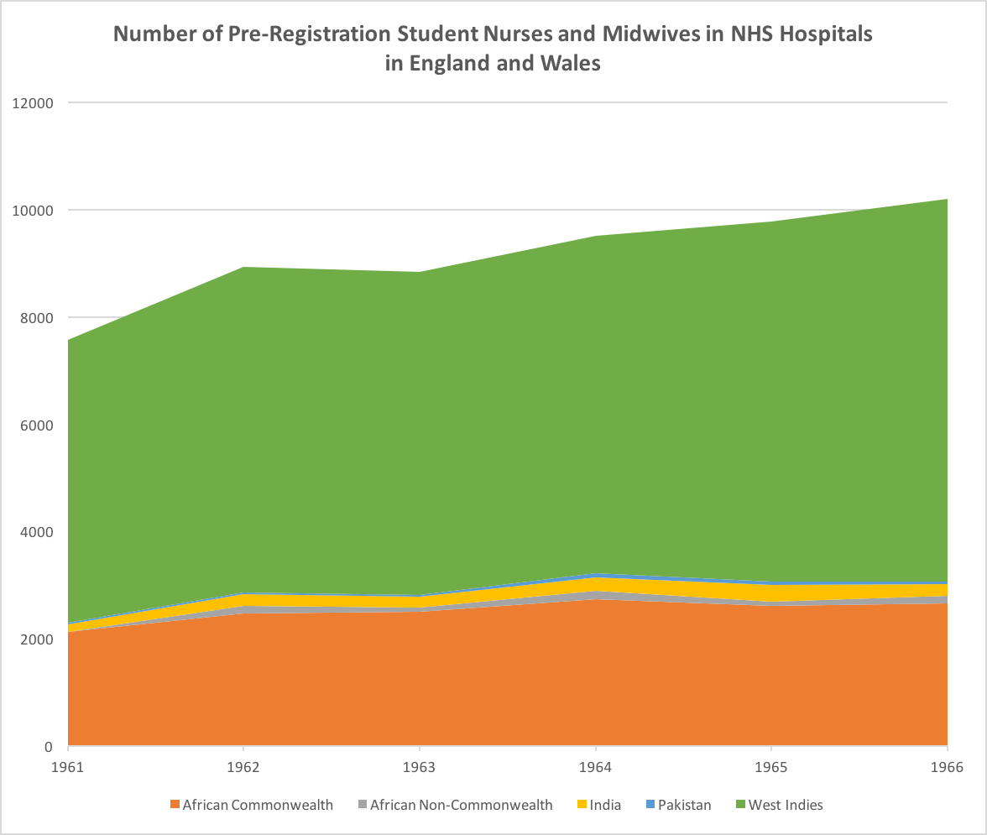
An NHS History of Super-Diversity
Non-UK Medical Staff, Junior Grades
Student/Pupil Nurses and Midwives, West Indies
Total Medical Staff, Junior Grades
Student/Pupil Nurses and Midwives, African Commonwealth
NB: Significant proportion of growth in NHS hospital medical staff in 1960s comes from (recruited) medical migration

Slide 4
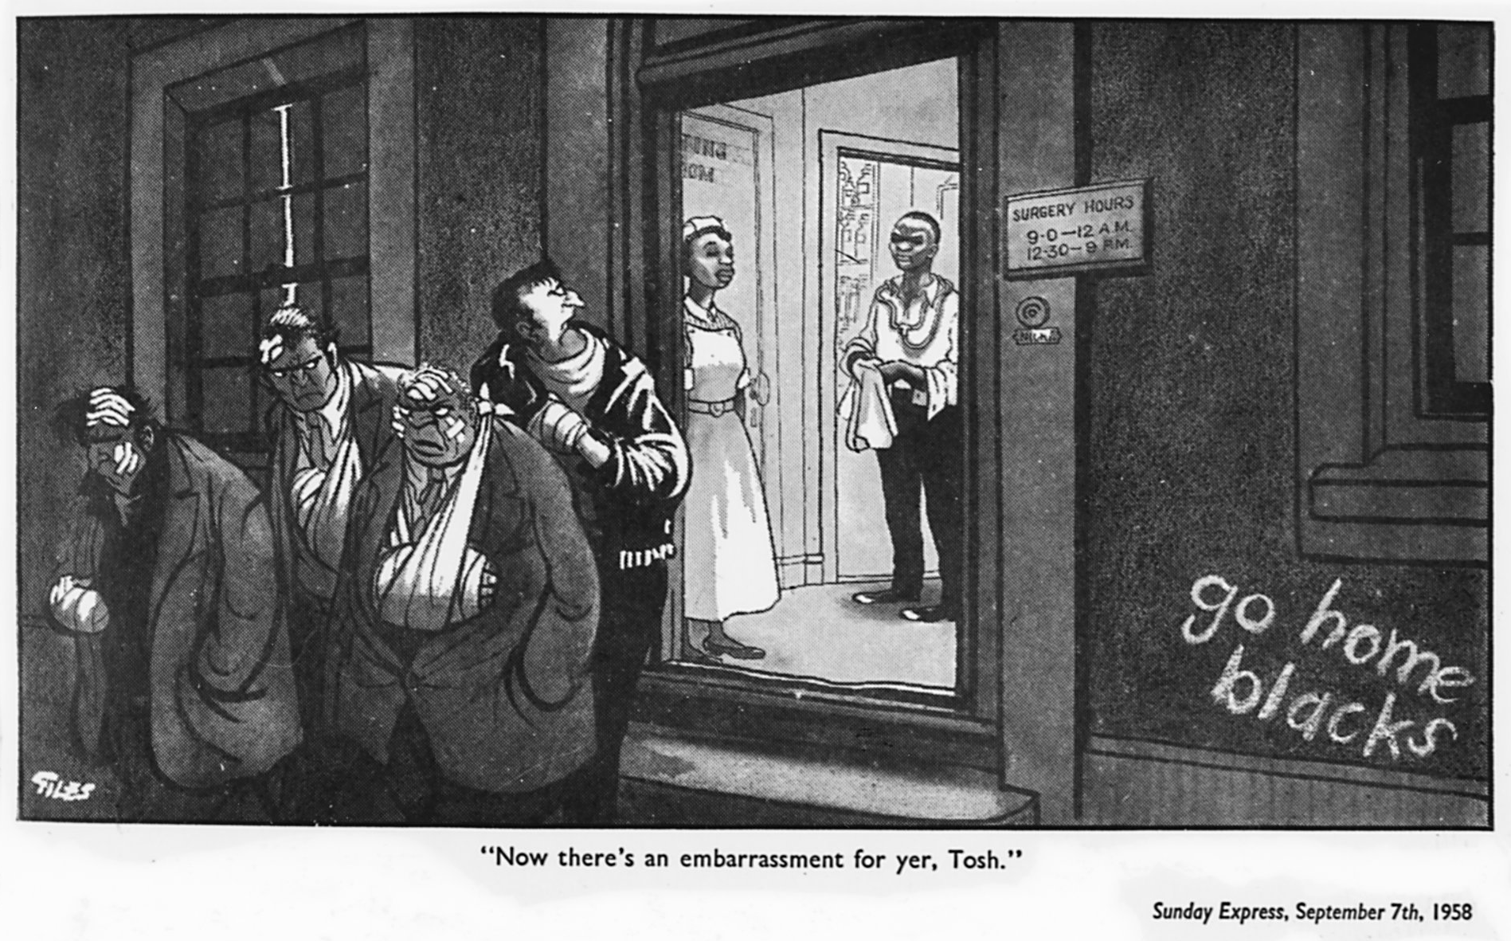
Sites for seeing ‘race’ in the NHS: Being the NHS/Burdening the NHS
Norman Mansbridge © Punch Cartoon Archive, 1966
Multiracial NHS as a Rebuke to Popular Racism…
BUT
...‘our NHS’ as an earned entitlement for ‘born (White) British’ alone.

Slide 5
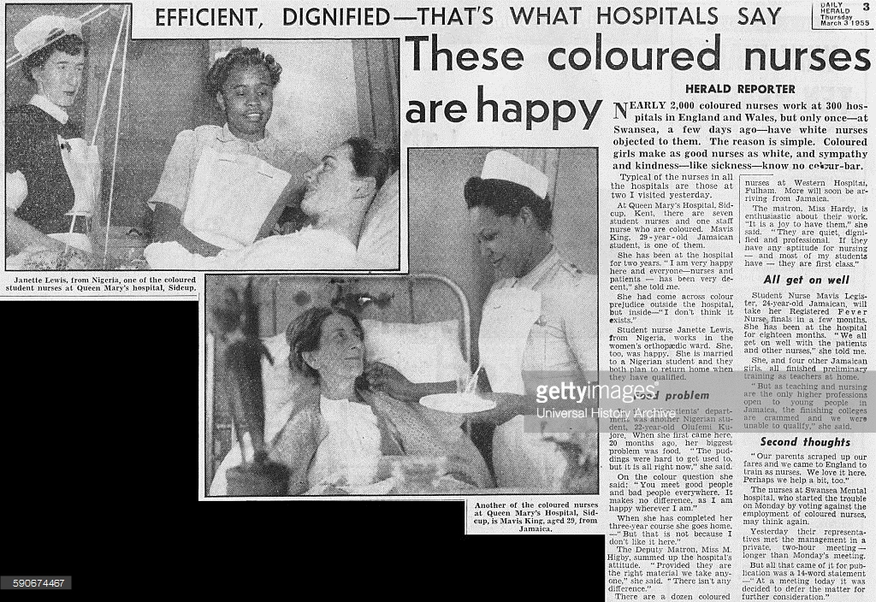
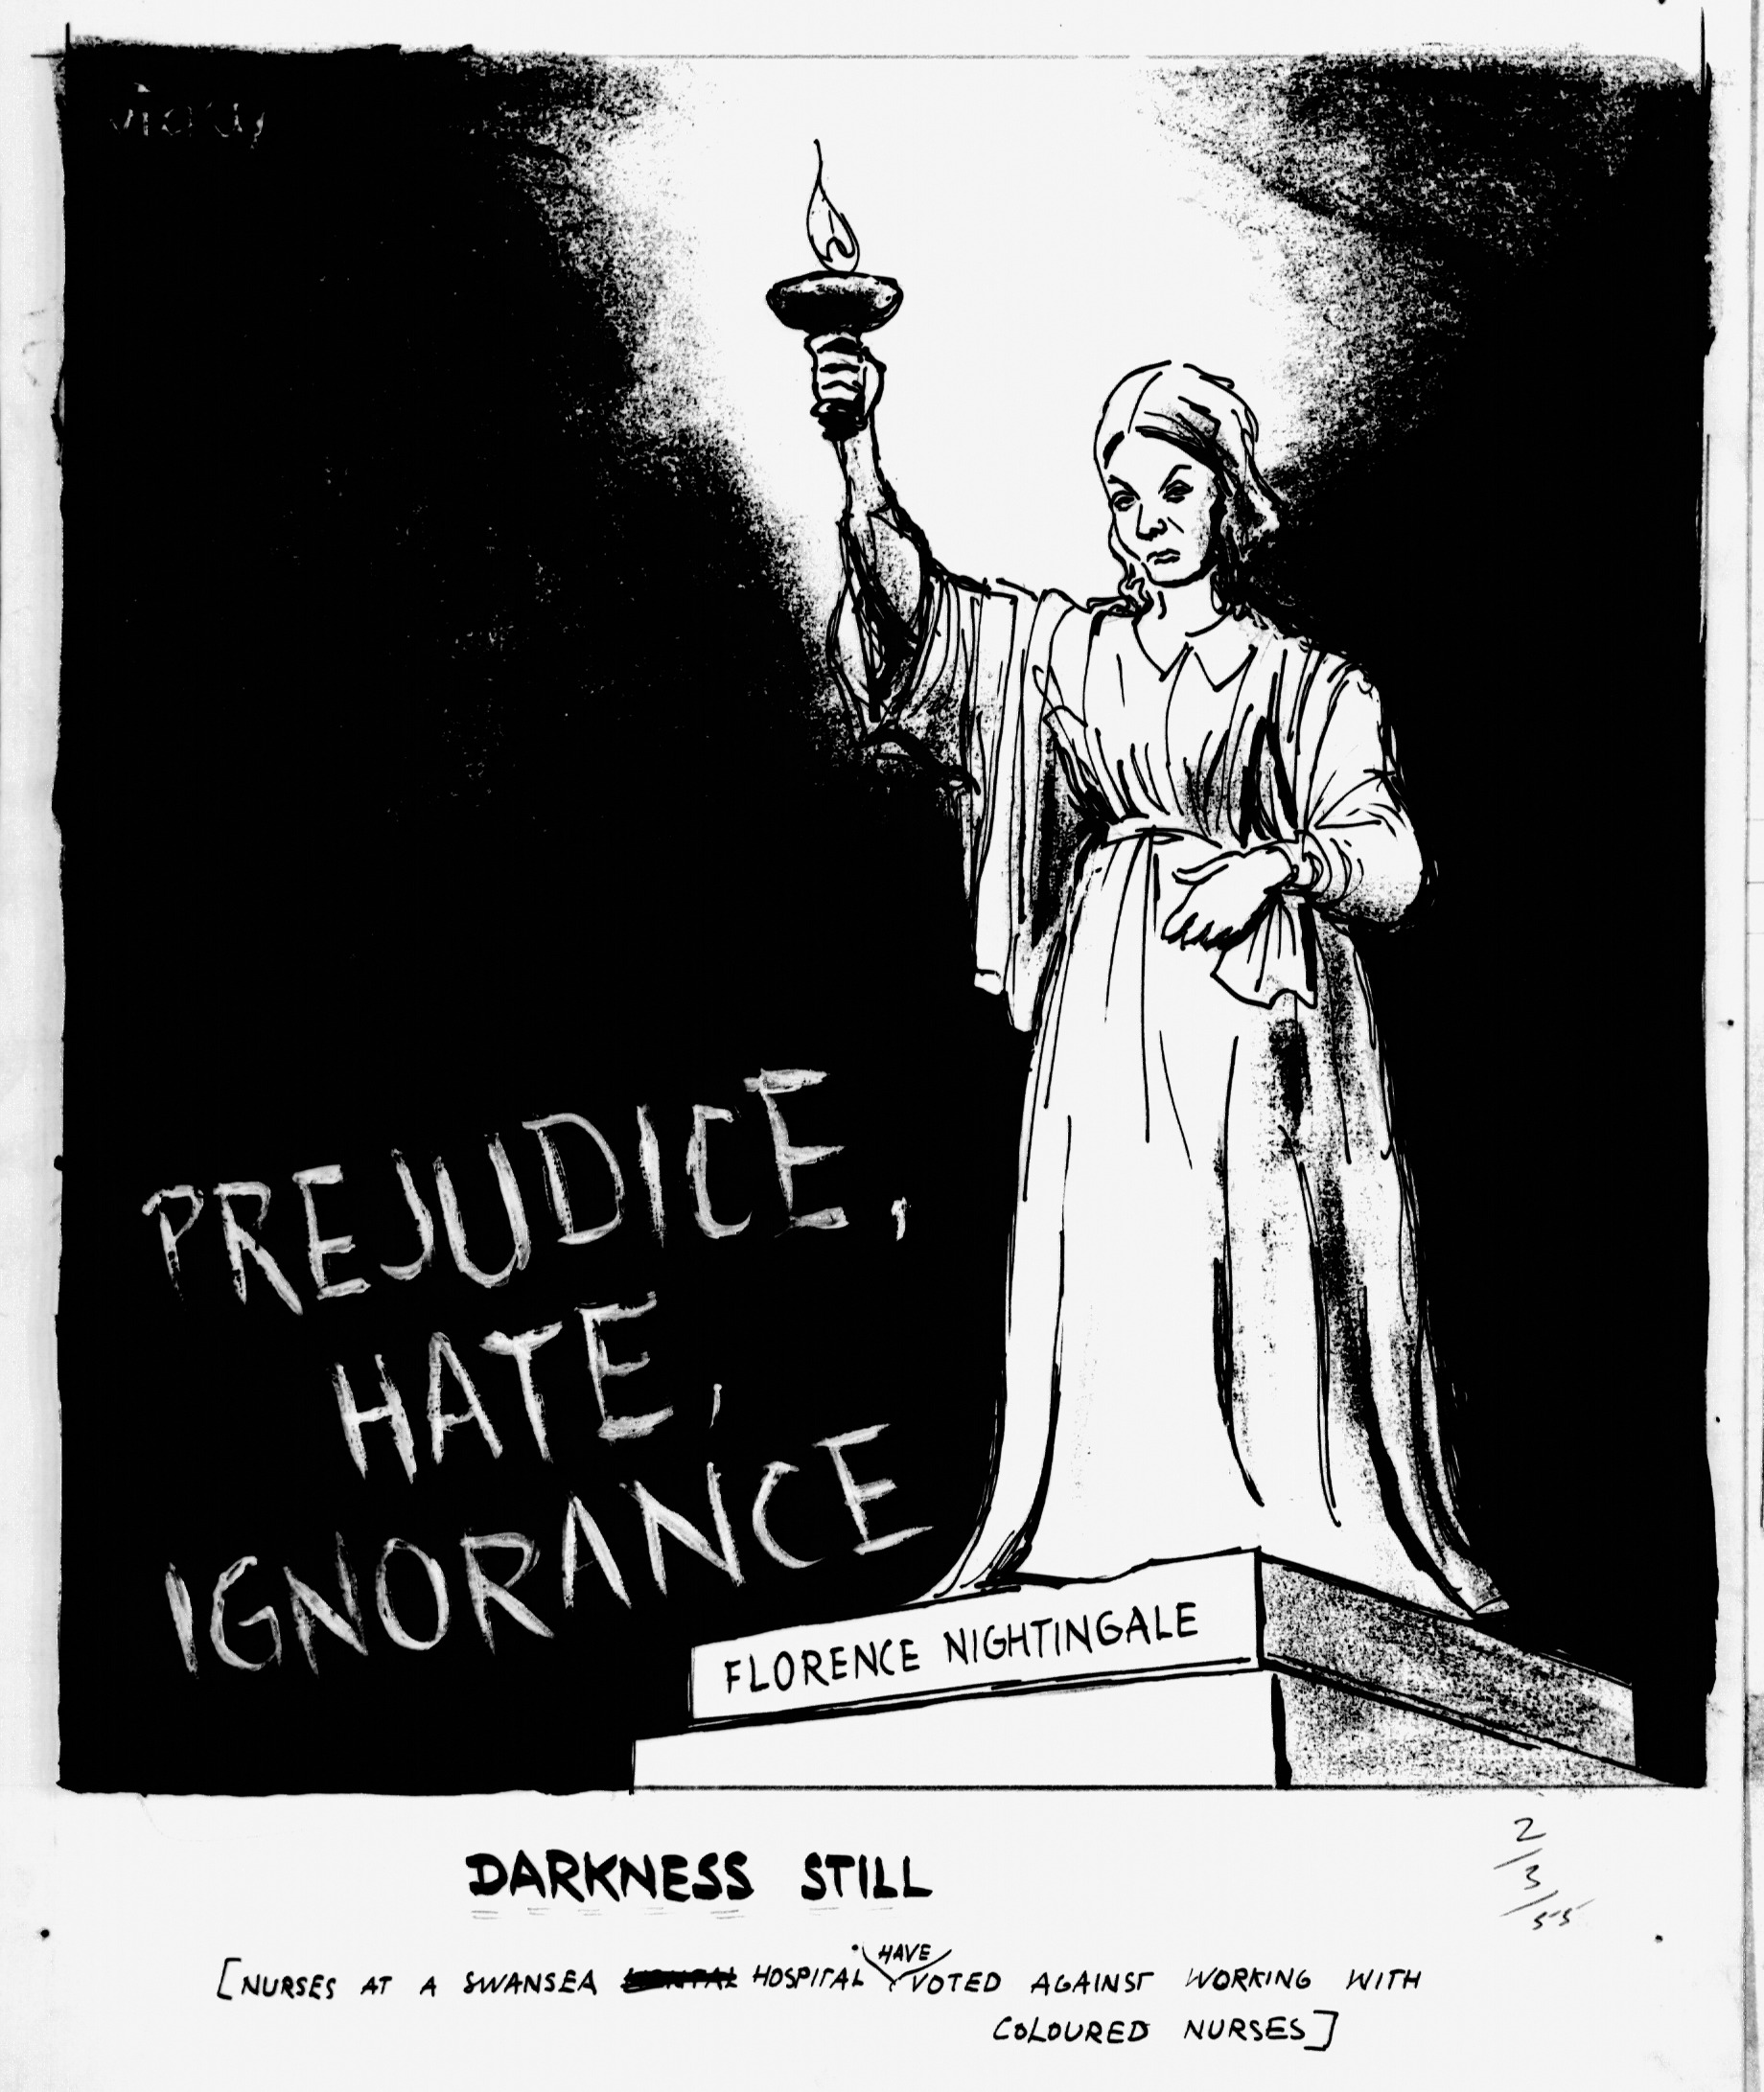
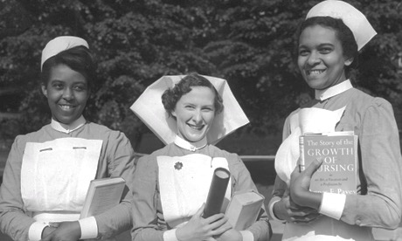
Being the NHS:
‘Without them, the Health Service would by now have collapsed.’
(MP Hugh Delargy, Lab, Thurrock, 1961)
Daily Herald, 1955
‘I will not permit any form of colour discrimination in the National Health Service.’ Bevan, Nov. 1948
BUT
‘[I]t has been found that the susceptibilities of patients tended to set an upper limit on the proportion of coloured workers who could be employed either as nurses or domiciliaries.’ Home Office, 1949
Vicky, ©Daily Mirror 1955
Meager/Fox Photos/Hulton Archive/Getty Images
Notes:
St Mary’s Hospital Medical Hospital Staffs (Coloured Persons)
HC Deb 04 November 1948 vol 457 c95W 95W
§

Slide 6
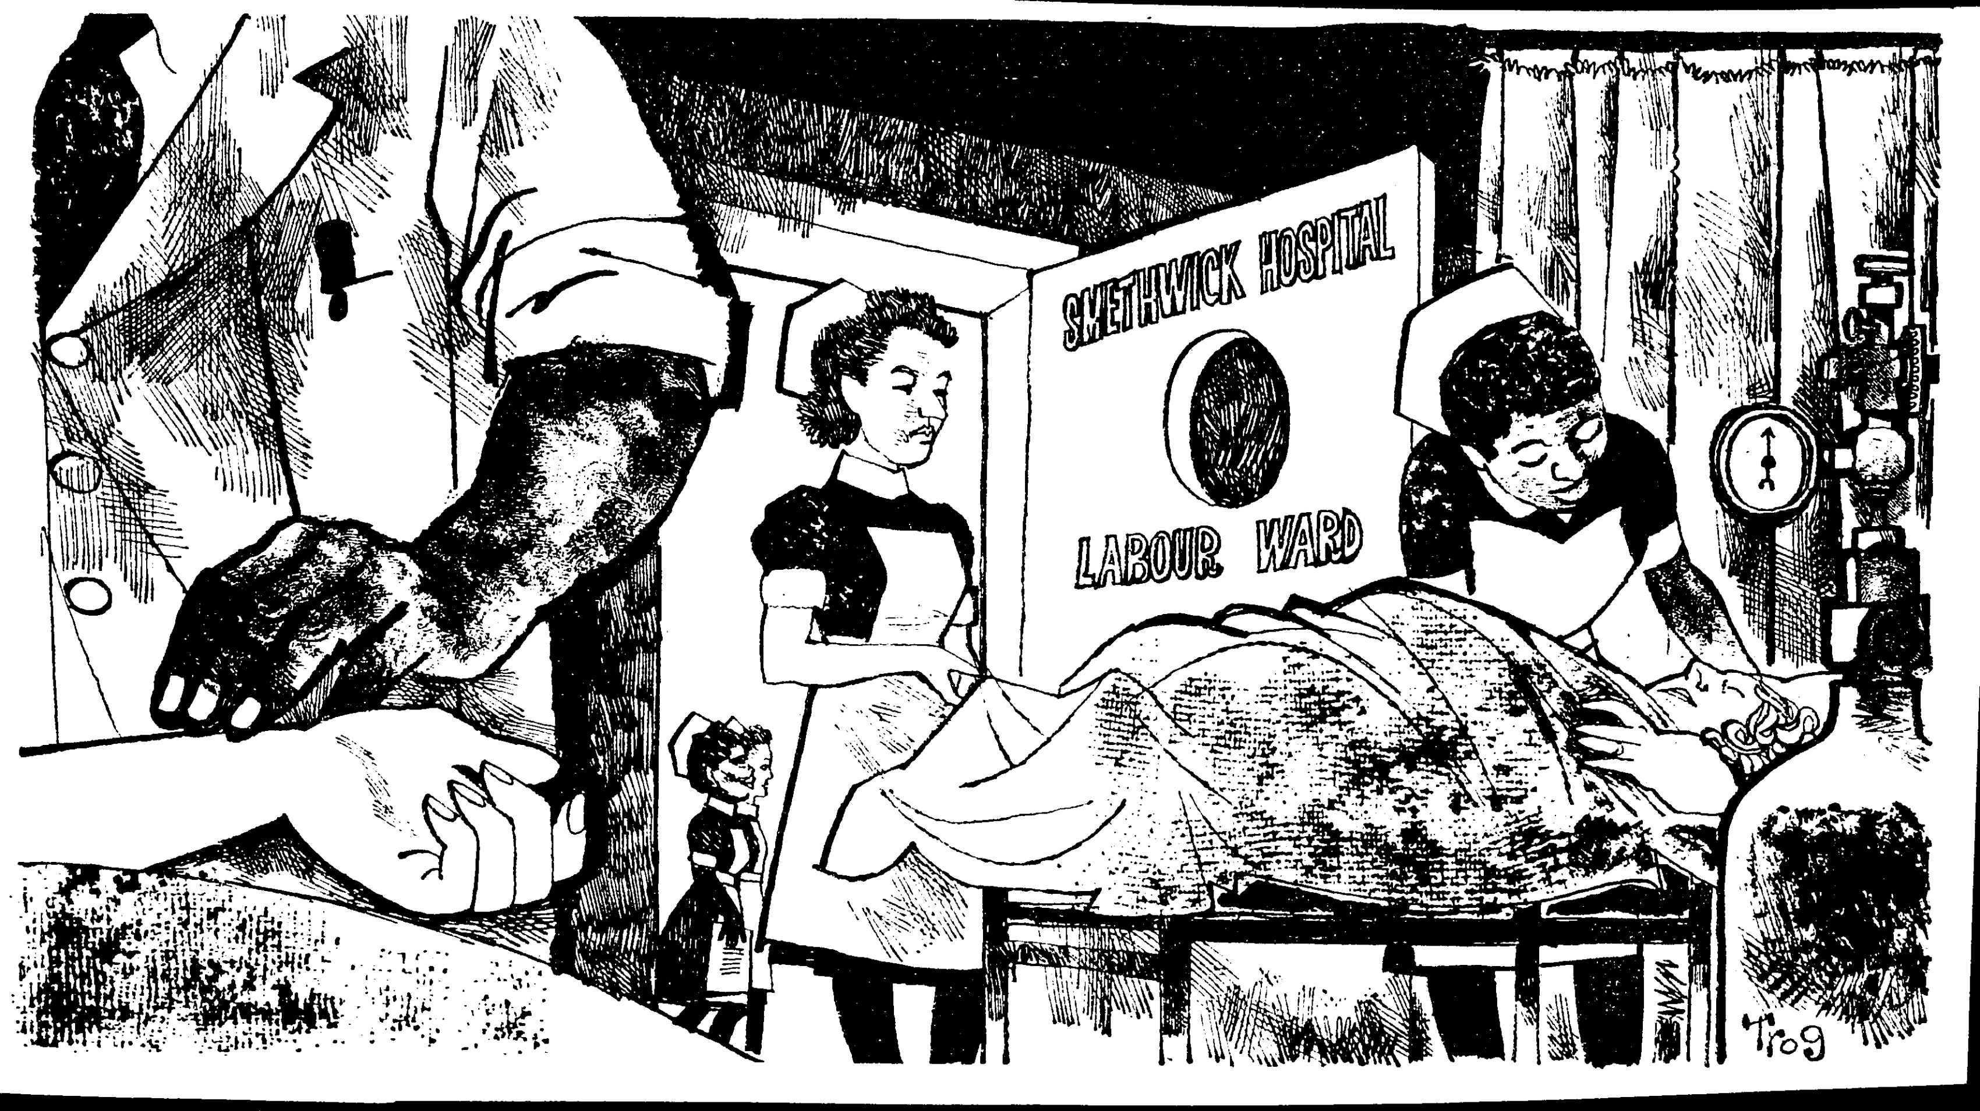
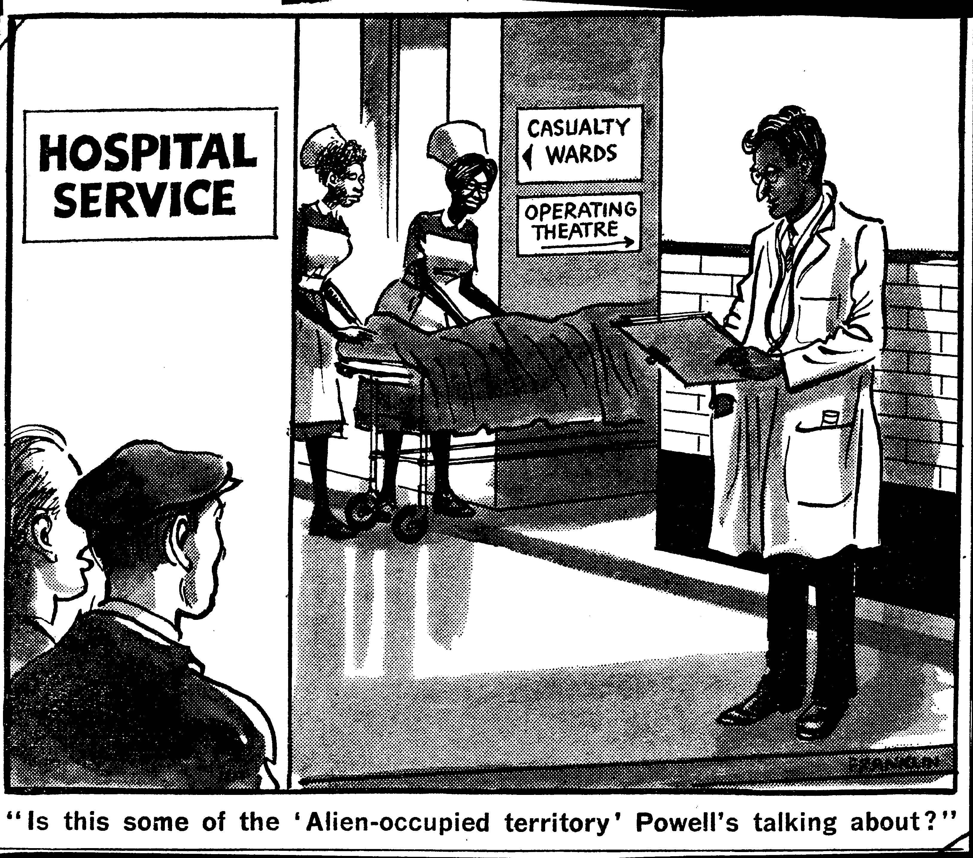
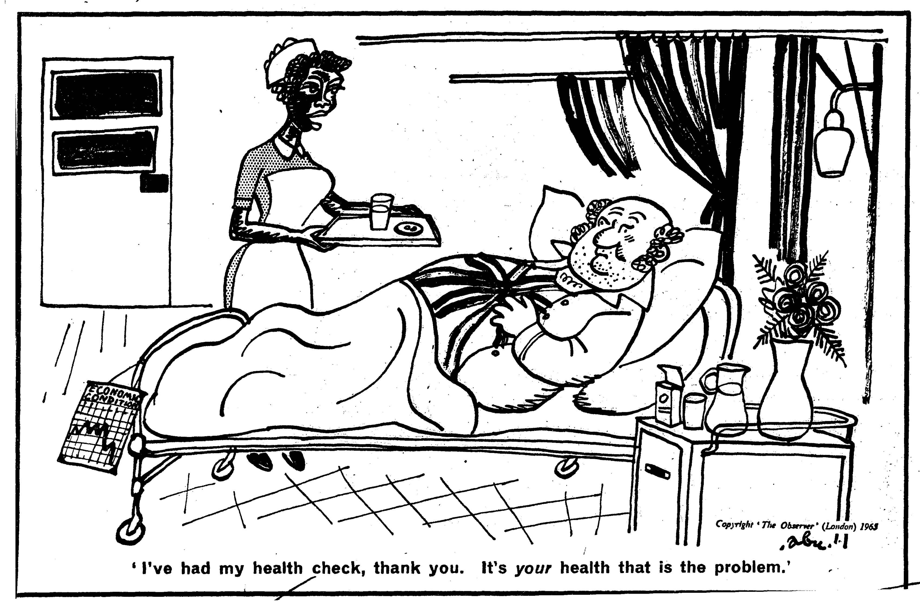
Trog, ©New Statesman, 1964
Franklin, © Daily Mirror, 1969
Abu Abraham, © Observer, 1965

Slide 7
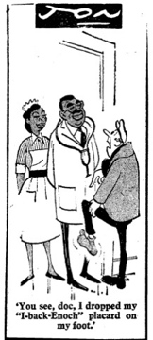
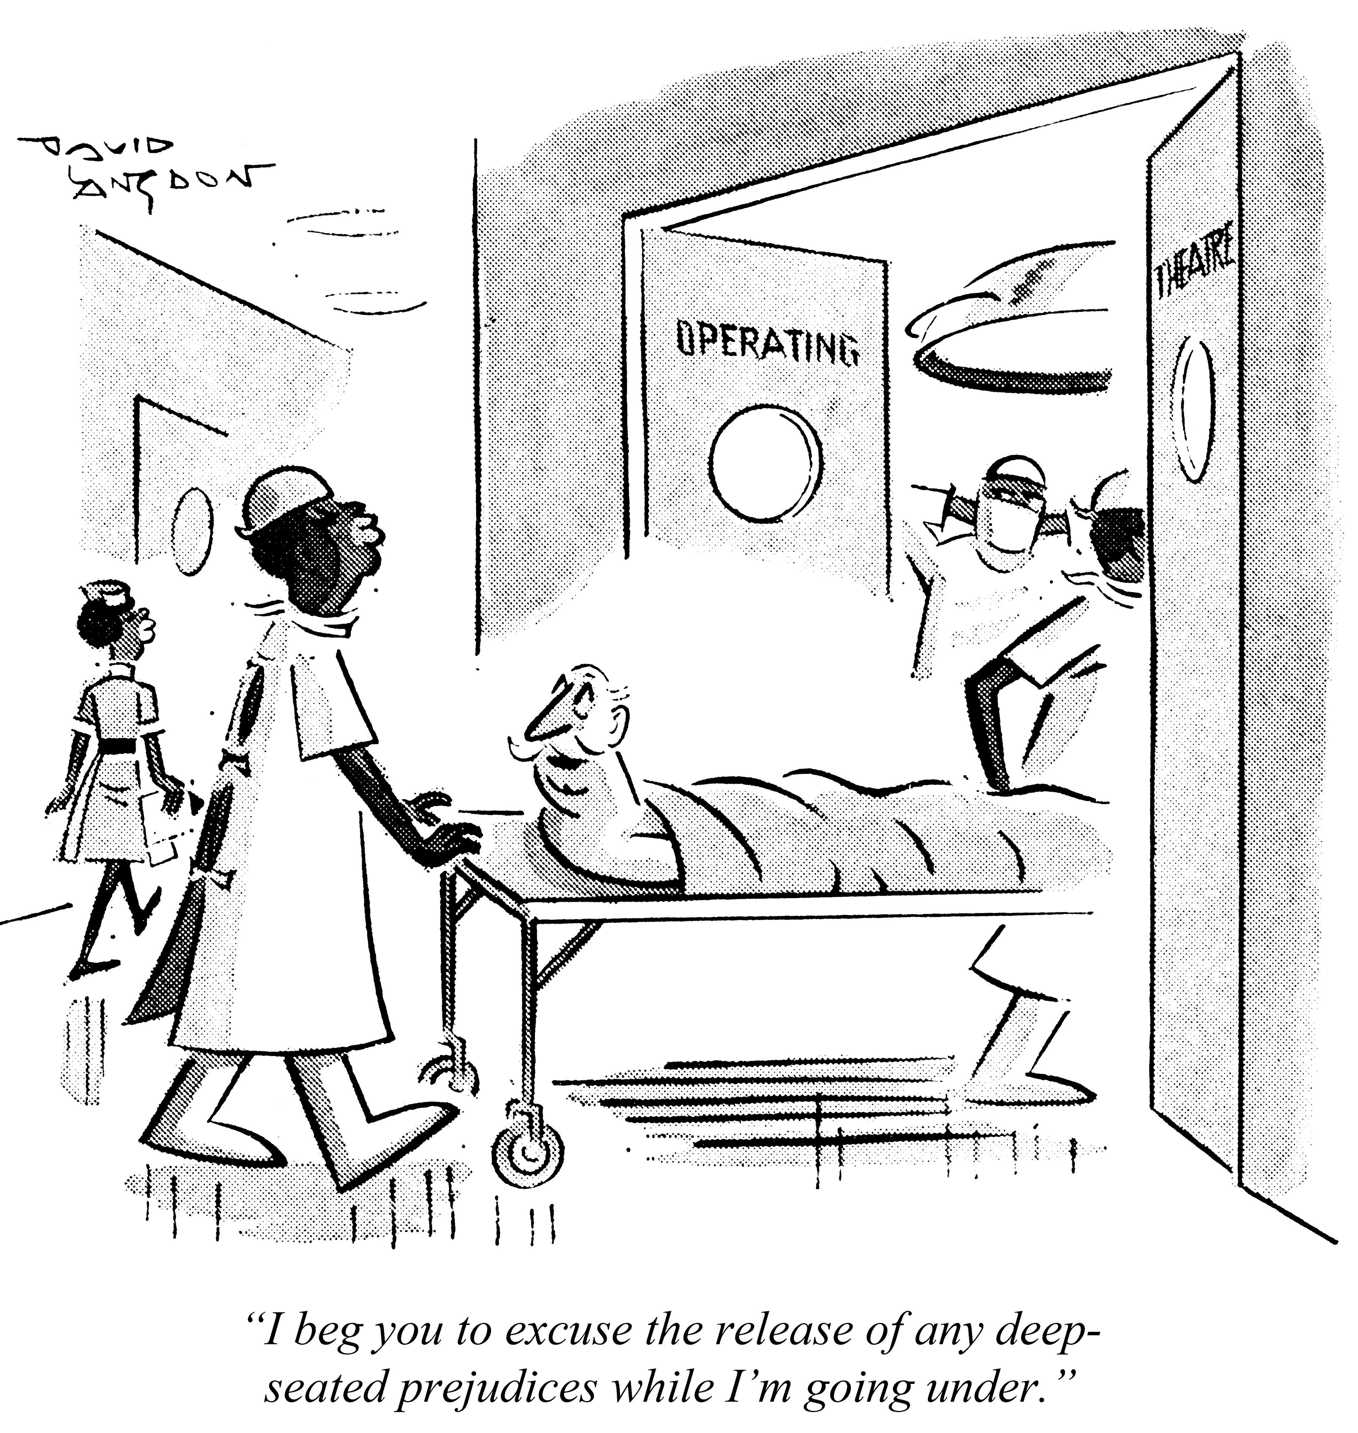
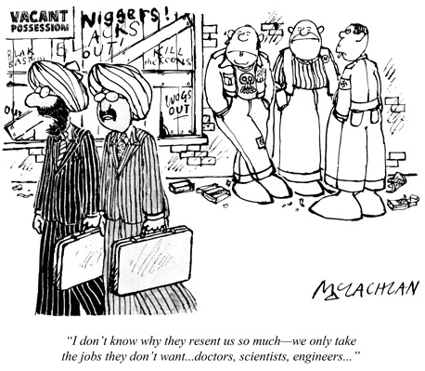
Immigrant Doctors and ‘Deep-seated Prejudices’
© Associated Newspapers Ltd., British Cartoon Archive, University of Kent, Jon [John Williams Philpin Jones], Daily Mail, 24 April 1968
© Punch Archive, David Langdon, Punch 1969
© Punch Archive, Ed McLachlan, Punch 1979

Slide 8
When is NHS discrimination not racism?
When it is ‘commonsense’…
‘It is a delight to visit hospitals, certainly those in the Midlands, and see the dark-skinned nurses going about their jobs. In one hospital which I know particularly well the phrase used about these nurses is that they “think the world of them”.
But, if I may say so, they are trained, they are under discipline, mostly they live in. If one asked the matron what is thought of the situation … the matron would be inclined to give the very practical kind of answer which one would expect from a matron— “They are excellent, but you do not want to have too many of them.” I wish to ask, are we to condemn such an attitude as a racialistic one? I should say no. I should say that it is a commonsense attitude.’
Geoffrey Lloyd, MP (Con) Sutton Coldfield, 1964
Notes:
Schedule.—(ACTS CONTINUED.)
HC Deb 17 November 1964 vol 702 cc229-331

Slide 9
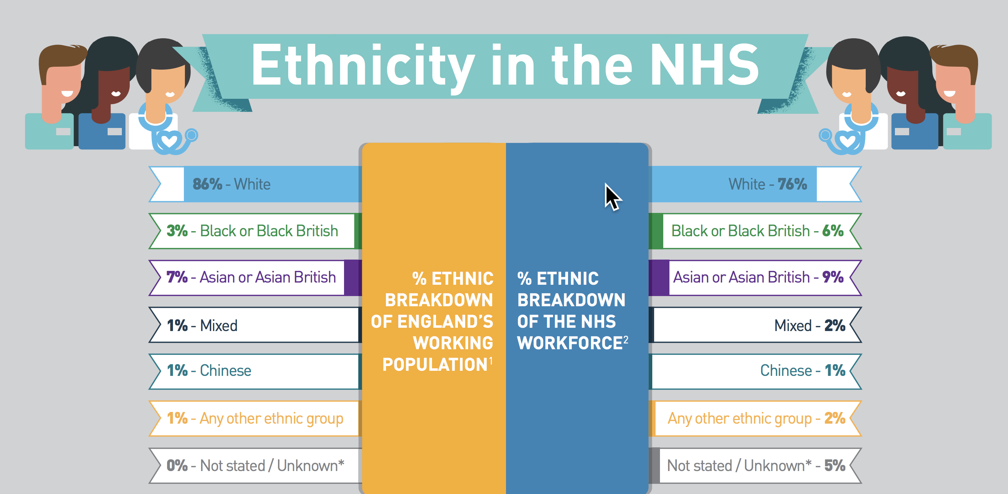
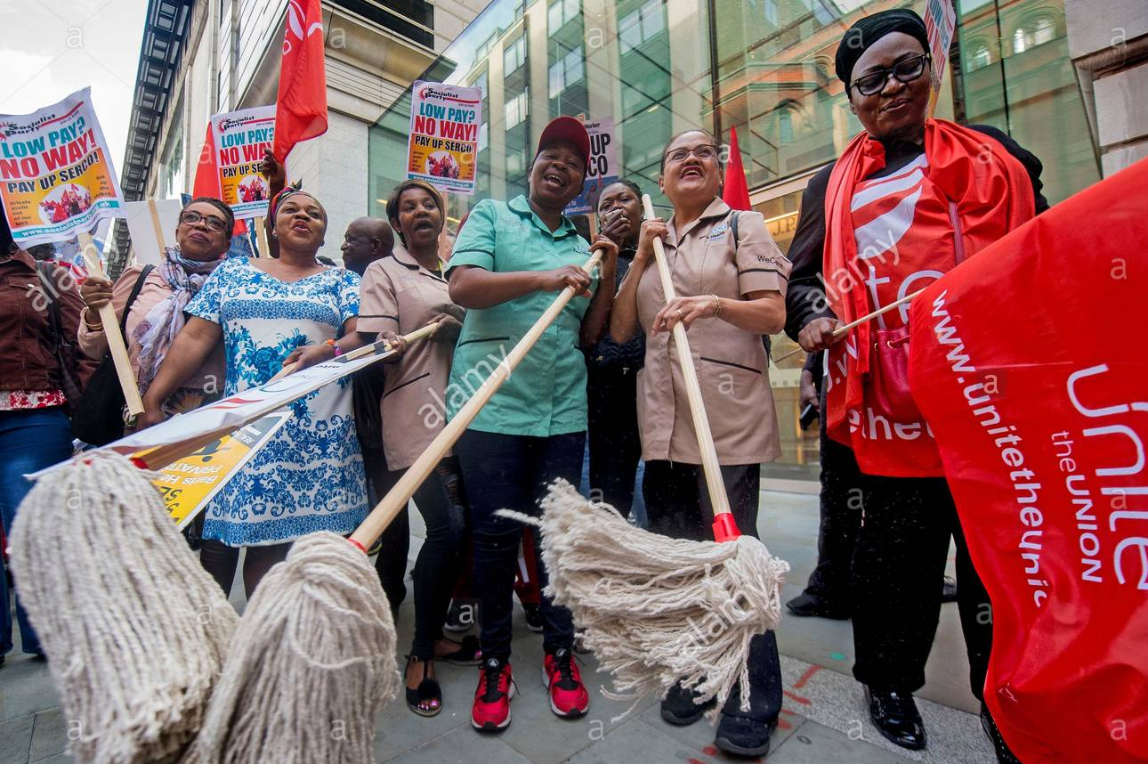
2019: In every category except Chinese, BAME staff are over-represented in the NHS workforce
And note that these data do NOT include outsourced NHS workers: porters, cleaners, laundry workers, caterers, clerical staff and agency clinical staff – groups who are ethnically diverse, and include high proportions of BAME workers.
© PA Images / Alamy Stock Photo 2017
Notes:
https://www.nhsemployers.org/case-studies-and-resources/2019/05/diversity-in-the-nhs-infographic 2019

Slide 10
Editorial
Response to
Mid-Staffs
Hospital
Enquiry, 2013

Slide 11
Burdening the NHS: ‘a new sort of immigrant—one who arrives on the obstetric delivery table’
(Dr David Kerr, Wandsworth, HC Deb 17 November 1964)
…[A]reas which have attracted immigrants in recent years …often have as many as 50 p.c. of their maternity beds occupied by women from the West Indies, Nigeria and Ghana. The percentage bears no relation to the proportion of white and immigrant mothers-to-be in the community. A doctor explained, ‘The coloured women are here mainly for social reasons. They come from homes which have no bathrooms or lavatories. They are therefore referred to hospital by their family
doctors…’ It often causes resentment. The doctor admitted: ‘some people feel very strongly about the fact that women born and brought up in this country are being kept out of hospital to have their difficult first babies while immigrants take up the available space.’ Daily Mail, 1963
Notes:
Emergency! Wards Full! Hugh McLeave. Daily Mail (London, England), Monday, October 07, 1963; pg. 6; Issue 20978. (1394 words)
‘I want to refer particularly to the difficult problems faced by students of mature age who bring their wives over here—or perhaps I had better refer to the student of mature age who brings his wife over here. That would be a more tactful way of putting it. The inevitable processes of nature lead to the appearance of a new sort of immigrant—one who arrives on the obstetric delivery table. Unhappily, the difficulties which these people face in terms of housing accommodation, finance and the need to pursue a course of studies—often on the part of both husband and wife—have led to the farming out of these children, not for adoption but for fostering, often at remote distances. In some cases these children are well looked after, and in some cases they are not. In one case in my experience, where the necessity for fostering was recognised and embarked upon, the child subsequently died in a fire. Dr David Kerr, Wandsworth Schedule.—(ACTS CONTINUED.) HC Deb 17 November 1964 vol 702 cc229-331

Slide 12
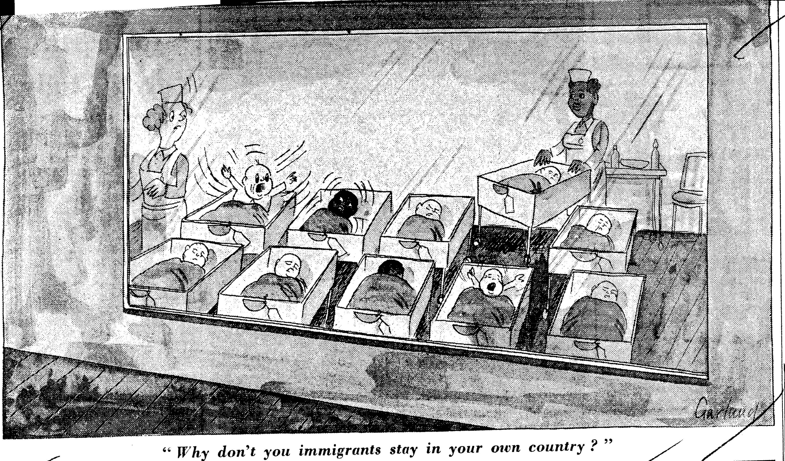
Born (an ‘immigrant’) in the NHS
© Telegraph Media Group, British Cartoon Archive, University of Kent, Nicholas Garland, Daily Telegraph, 25 April 1968

Slide 13
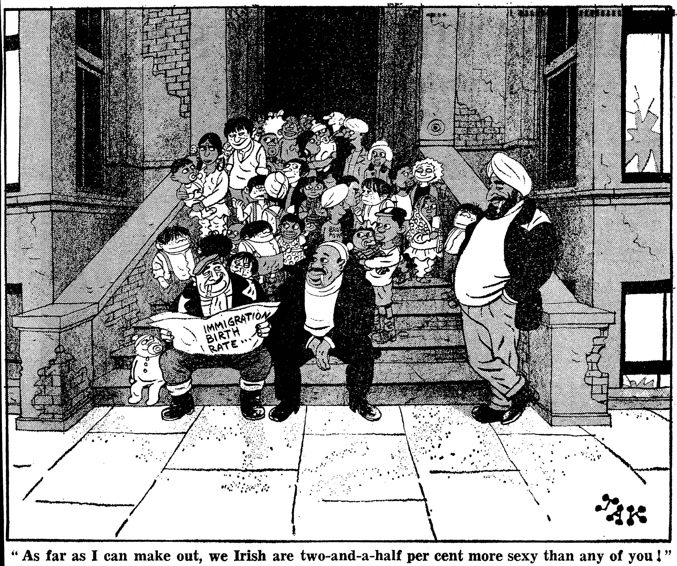
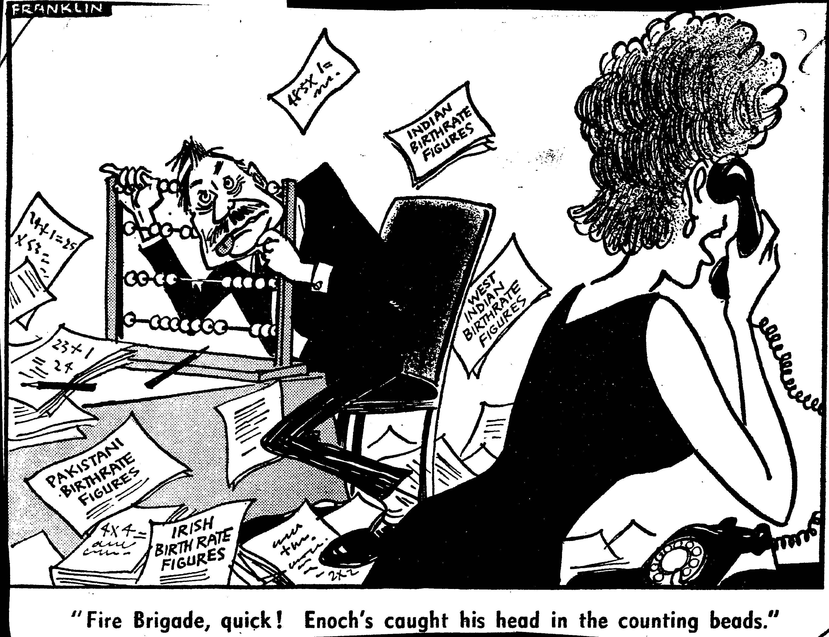
News: 10 March: Enoch Powell released a statement pointing out that a report by the Registrar General on immigrant births justified the prediction he had made in the House of Commons on November 11 that the true figure of immigrant births was much higher than the Government had been estimating.
© Associated Newspapers Ltd. / Solo Syndication, British Cartoon Archive, University of Kent, Jak [Raymond Jackson], Evening Standard, 12 March 1970.
© Mirrorpix, British Cartoon Archive, University of Kent, Stanley Franklin Daily Mirror, 12 March 1970.

