Slide 1
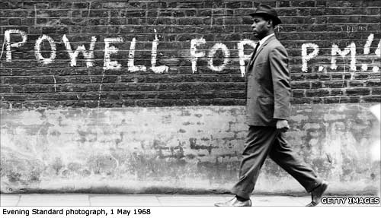
Immigration and Race in Postcolonial Britain
Making History
Week 9
Roberta Bivins
Office: H330
E-mail r.bivins@warwick.ac.uk

Slide 2

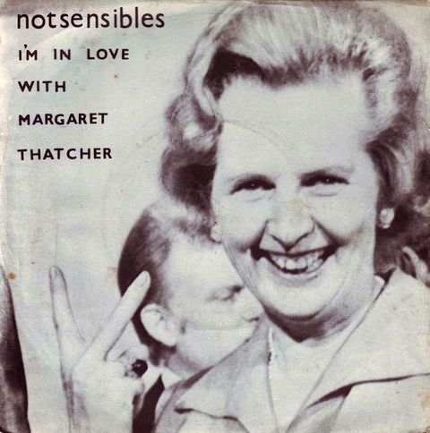
‘Ding-dong, the witch is dead’ or ‘I’m in love with Margaret Thatcher’?
Margaret Thatcher, almost uniquely among post-war UK politicians, remains hugely controversial even after her 2013 death. Why? And how much did ‘Thatcherism’ really change Britain?

Slide 4
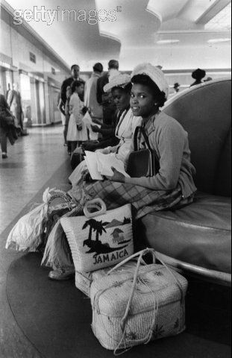
1948: Empire Windrush
Wartime experiences in UK
Demobilisation
Unemployment in West Indies
Labour shortage in UK
Active recruitment of, eg transport workers, nurses
Open UK borders (while US bordered closed after 1952 McCarran-Walter Act

Slide 5
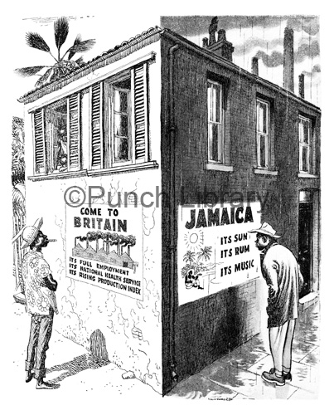
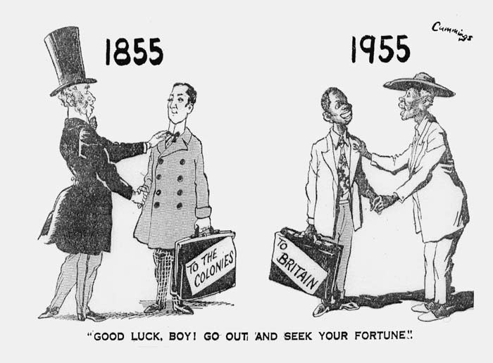
Push/Pull
Year Migrants
1955 27550
1960 49650
1961 66300
1962 31800
1963 3241
← Cummings cartoon. Daily Express, 12 January 1955

Slide 6
Why ‘Open Door’ Britain?
1948 British Nationality Act
British reliance on Commonwealth both for labour and for foreign exchange
Enduring imperial identities and ties
Costs of border control
NOT because there was any great enthusiasm for
‘these in any case none-too-desirable-comers-in’ Captain C. Waterhouse, MP to William Deedes, Home Office, 1956.
AND…

Slide 7
(Cold War) Winds of Change 1960
We have seen the awakening of national consciousness in peoples who have for centuries lived in dependence upon some other power… Today the same thing is happening in Africa … The wind of change is blowing through this continent, and whether we like it or not, this growth of national consciousness is a political fact. We must all accept it as a fact, and our national policies must take account of it. … I sincerely believe that if we cannot do so we may imperil the precarious balance between the East and West on which the peace of the world depends. … the great issue in this second half of the twentieth century is whether the uncommitted peoples of Asia and Africa will swing to the East or to the West. Will they be drawn into the Communist camp? Or will the great experiments in self-government that are now being made in Asia and Africa, especially within the Commonwealth, prove so successful, and by their example so compelling, that the balance will come down in favour of freedom and order and justice? The struggle is joined, and it is a struggle for the minds of men. What is now on trial is much more than our military strength or our diplomatic and administrative skill. It is our way of life. The uncommitted nations want to see before they choose.
Harold Macmillan, 1960
Watch the speech: http://www.bbc.co.uk/archive/apartheid/7203.shtml
"We are the people who brought civilisation to Africa, … To do justice in Africa means not only being just to the black man of Africa, but also to the white man of Africa.“
South African Prime Minister, H F Verwoerd

Slide 8
And why did the door close?
2 principal historiographical arguments (to be discussed in seminar)
‘Trigger’ events/trends?

Slide 9
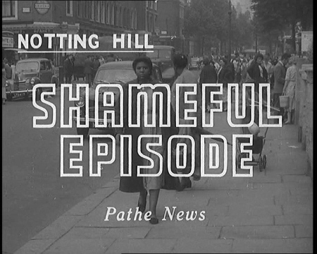
1958 Notting Hill (and other) Riots
Something new and ugly raises its head in Britain. In Notting Hill Gate, only a mile or two from London’s West End - racial violence. An angry crowd of youths chases a negro into a green grocer shop while police reinforcements are called up to check the riot, one of many that have broken out here in a few days. The injured victim, a Jamaican, is taken to safety. But the police have not been able to reach all the trouble spots so promptly and the quietest street may flare up at any moment. … Opinions differ about Britain’s racial problems. But the mentality which tries to solve them with coshes and broken railings has no place in the British way of life. This violence is evil and the law and public opinion must stamp it out.
http://www.britishpathe.com/video/shameful-episode-aka-racial-riots/

Slide 10
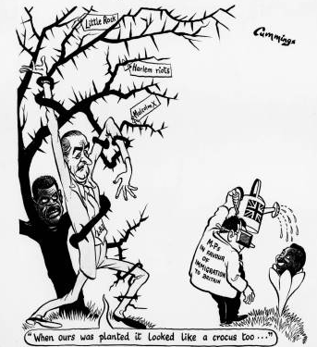
The Rise of ‘Control’ in the 1960s
Conjunction between discourses of:
Control of immigration [1962, 1965, 1968, 1971]
Control of ‘race relations’ [1965, 1968, 1976]
(c) Michael Cummings, Daily Express, 3 Mar 1965, courtesy of British Cartoon Archive, University of Kent.

Slide 11
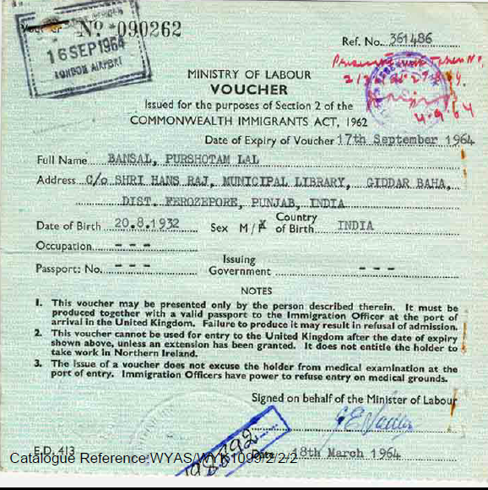
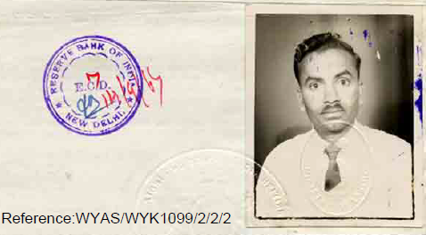
Ending Imperial Identity? The 1962 Commonwealth Immigrants Act
A response to:
Long-term pressure to control (esp. non-white) immigration
Fears of economic stagnation
Anger at housing shortages
Shock of Notting Hill ‘race riots’
And weakening economic and cultural ties to Empire/ Commonwealth

Slide 12
Cold War context
‘the future of the free world or of the whole world depends on attitudes to colour questions inside individual Western countries’
Harold Wilson, ‘Schedule [Expiring Laws Continuance Bill]’, Hansard HoC, 27 November 1963,
‘If as the centre of a great multi-racial Commonwealth we could achieve good race relations in Britain, we would be making a great contribution to the peace of the world.’
Christopher Brocklebank-Fowler (Bow Group), Conservative Party Conference, 15 October 1965
Notes:
Need to control entry recognised--but not on racial basis
The Guardian (1959-2003) [London (UK)] 15 Oct 1965: 7.

Slide 13
Racism as a disease (and immigration control as the cure?)
‘This terrible thing which poisons and corrupts all human relationships on both sides is so hard to cure because it is irrational … a kind of psychosis which cannot be exorcised by rational arguments. … Children can be disinfected by historical and biological facts.’
Bishop of Southwell, Hansard HoL 1963
‘It must be from the home that this virus is caught and the problem is not so much disinfection as inoculation to confer immunity to the virus of race prejudice and colour consciousness.’
Lord Lucan (6th Earl…) Hansard HoL 1963
Notes:
CURES FOR THE ILLS OF RACIAL INTOLERANCE: Formal education not enough
The Guardian (1959-2003) [London (UK)] 13 Mar 1963: 2.

Slide 14
See also http://www.radiotimes.com/news/2015-03-15/britains-racist-election-how-one-1964-battle-for-voters-turned-toxic and http://www.bbc.co.uk/historyofthebbc/memories/elections/smethwick
Growth and Growing Visibility of Explicit Racism in High-Migration Britain:
Fears of Political Extremism
and Smethwick 1964

Slide 15
Race Relations Act 1965
Forbade discrimination in ‘places of public resort’ (but not private homes/housing/shops/employment) on grounds of ‘colour, race, or ethnic or national origins’ – but scant powers to enforce.
Discrimination not made a criminal offence (just civil), and only worst offenders could be referred to courts.
Mediation via Race Relations Board for any complaints

Slide 16
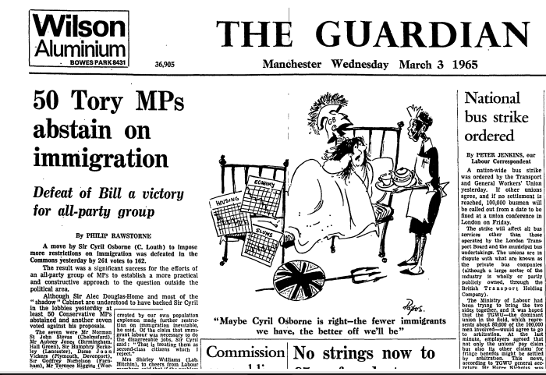
Immigration Control + Race Relations: ‘A more practical and constructive approach’?
Copyright Guardian Newspapers Limited Mar 9, 1965; Copyright © 2013 ProQuest LLC. All rights reserved.

Slide 17
From ‘Assimilation’ to ‘Integration’: the ‘liberal hour’
‘I do not regard [integration] as meaning the loss, by immigrants, of their own national characteristics and culture. I do not think that we need in this country a ‘melting pot’, which will turn everybody out in a common mould, as one of a series of carbon copies of someone’s misplaced vision of the stereotyped Englishman… I define integration, therefore, not as a flattening process of assimilation but as equal opportunity, accompanied by cultural diversity, in an atmosphere of mutual tolerance”
Labour Home Secretary Roy Jenkins, 1966
Notes:
Anthony Lester (ed.), Essays and Speeches by Roy Jenkins (London, 1967), 267. The quote is taken from Jenkin’s famous May 1966 speech to the National Committee for Commonwealth Immigrants, during his tenure as Home Secretary

Slide 18
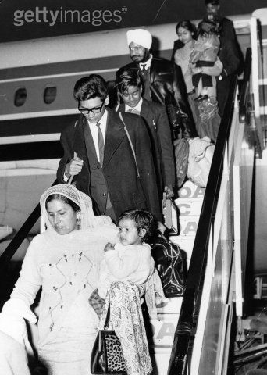
1968: Kenyan Asians
‘Winds of change’ and Africanization
BBC News, 4 February: ‘Although most turned down the chance to take Kenyan nationality when it was offered to them, more than 100,000 did take up the chance to get British passports. They are now arriving at the rate of more than 1,000 a month to start a new life in the UK, a country which most have never seen.’
Harold Wilson and James Callaghan rush through 1968 Commonwealth Immigrants Act
Commonwealth Secretary, George Thomson: ‘to pass such legislation would be wrong in principle, clearly discrimination on the grounds of colour, and contrary to everything we stand for.’
"Only Kenyan citizens are being allowed work permits, … I was forced to sell my fleet of lorries and come to Britain to look for a new life.“ Omar Shamar, Mombasa

Slide 19
22 February - 1 March 1968
‘Our best hope of developing in these Islands a multi-racial society free of strife lies in striking the right balance between the number of Commonwealth citizens we can allow in and our ability to ensure them, once here, a fair deal not only in tangible matters like jobs, housing and other social services but, more intangibly, against racial prejudice. If we have to restrict immigration now for good reasons, as I think we must, the imminent Race Relations Bill will be a timely factor in helping us to show that we are aiming at a fair balance all round. Conversely, I believe that the reception of the Race Relations Bill will be prejudiced in many minds, and support for it weakened, if people think that the numbers entering are unlimited or unreasonably high…’
James Callaghan, Home Office 1968
(PRO, CAB 129)135, Home Secretary's memorandum C(68) 34, 12 Feb. 1968.

Slide 20
Rivers of Blood: 20 April 1968
‘ “In this country in fifteen or twenty years time the black man will have the whip hand over the white man”. I can already hear the chorus of execration. HOW dare I say such a horrible thing? How dare I stir up trouble and inflame feelings by repeating such a conversation? The answer is that I do not have the right not to do so. Here is a decent, ordinary follow Englishman, who in broad daylight in my own town says to me, his Member of Parliament, that this country will not be worth living in for his children. I simply do not have the right to shrug my shoulders and think about something else. What he is saying, thousands and hundreds of thousands are saying and thinking — not throughout Great Britain, perhaps, but in the areas that are already undergoing the total transformation to which there is no parallel in a thousand years of English history.’
http://vimeo.com/82038851 [to 4.29 -- after this it becomes a pitch for contemporary anti-immigrationism and racism]

Slide 21
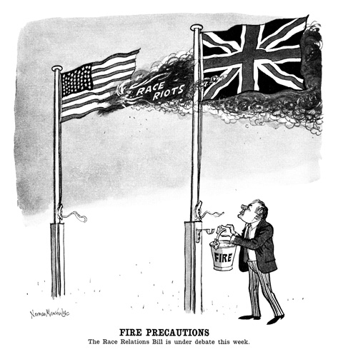
Race: The Trans-Atlantic Gaze
Norman Mansbridge, Punch 1968

Slide 22
Race Relations Debate, October 1968
My Lords, I think we all agree that racial discrimination is, in fact, a disease of society … forms of racial discrimination as we see them in this country to-day … must then be treated as a disease and, what is more, as a disease which affects not solely the patient but society as a whole. In the past we have suffered from many such diseases… we have had epidemic typhoid fever and tuberculosis as an endemic disease of society. These diseases have now been largely conquered… Secondly, the physical diseases which I have mentioned have been dealt with … by laws which enforce public health, by laws of hygiene… What are needed now are laws against defiling our society with the excrement of diseased minds as well as bodies and laws against spitting foul words in the atmosphere as well as against spitting germ-laden sputum into the atmosphere to infect other people with those horrible diseases.
Baron Walston, HoL,

Slide 23
Immigration and Race Relations, post 1968
1971 Immigration Bill/ 1972 Immigration Act: further restricted primary migration, introduced concepts of patriality [parents/grandparents born in UK] and ‘right of abode’ for ‘patrials’ while eliminating the idea that Commonwealth migrants would automatically be entitled to settle regardless of length of stay. Enabled funded repatriation.
1975 Race Relations Act: finally established that discrimination on grounds of race/ethnicity/national origins was illegal in the fields of employment, the provision of goods and services, education and public functions (e.g. housing, NHS).
1981 British Nationality Act: defined a distinctive ‘British’ citizenship (as opposed to CUKCs) modified jus soli to include children born to citizens or settled residents (male or female) only; removed right of abode from non-citizens.
2000 Race Relations (Amendment) Act placed statutory duty on public bodies to PROMOTE equality and to demonstrate effectiveness of anti-discrimination measures
Notes:
http://news.bbc.co.uk/onthisday/hi/dates/stories/february/24/newsid_2518000/2518513.stm

Slide 24
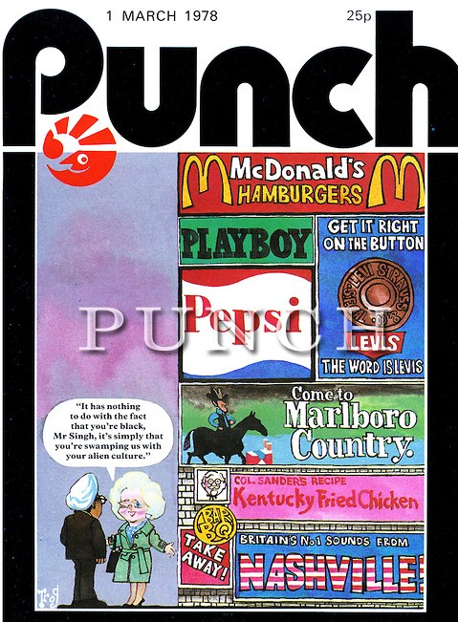
‘It has nothing to do with the fact that you’re black…’
‘I am the first to admit it is not easy to get clear figures from the Home Office about immigration, but there was a committee which looked at it and said that if we went on as we are then by the end of the century there would be four million people of the new Commonwealth or Pakistan here. Now, that is an awful lot and I think … that people are really rather afraid that this country might be rather swamped by people with a different culture … the British character has done so much for democracy, for law and done so much throughout the world that if there is any fear that it might be swamped people are going to react and be rather hostile to those coming in.’
Thatcher, 1978

Slide 25
Immigration restriction and Race Relations (again)
‘So, if you want good race relations, you have got to allay peoples' fears on numbers. ... we must hold out the clear prospect of an end to immigration because at the moment it is about between 45,000 and 50,000 people coming in a year. Now, I was brought up in a small town, 25,000. That would be two new towns a year and that is quite a lot. So, we do have to hold out the prospect of an end to immigration except, of course, for compassionate cases. Therefore, we have got to look at the numbers who have a right to come in. There are a number of United Kingdom passport holders—for example, in East Africa—and what Keith and his committee are trying to do is to find out exactly how we are going to do it; who must come in; how you deal with the compassionate cases, but nevertheless, holding out the prospect of an end to immigration.’
Margaret Thatcher TV Interview for Granada World in Action, Jan 27, 1978

Slide 26
‘Rather Swamped’
http://www.youtube.com/watch?v=sHhKI5ijnxQ&desktop_uri=%2Fwatch%3Fv%3DsHhKI5ijnxQ&app=desktop 039-1.55
Impacts: http://www.youtube.com/watch?v=-YqDNmDstOo

Slide 27
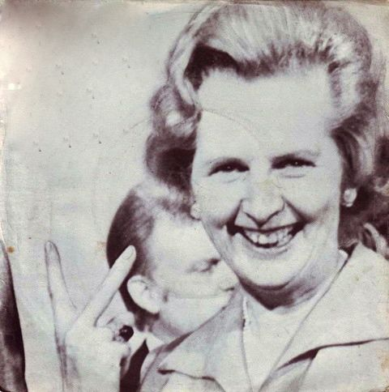
So: 1979 and all that: Did Thatcher change British responses to race and migration?

Slide 28
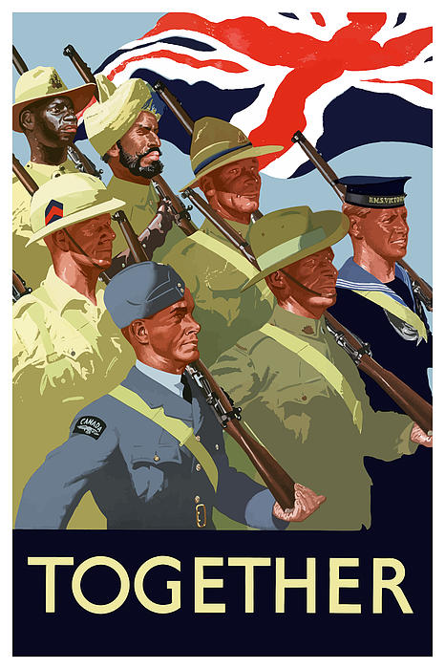
‘Nothing is more colour-blind than the capitalism in which I placed my faith’?
1948 British Nationality Act
1981 British Nationality Act
Notes:
Thatcher, Path to Power, 1995, p. 406

Slide 29
British Nationality Act 1981
Modified jus soli to require one citizen (or permanent resident) parent for the transfer of citizenship;
Ended privileging of paternal descent (until its enactment in 1983, only fathers passed British citizenship to their children born abroad;
Replaced ‘patriality’ with ‘citizenship’;
Virtually abolished the ‘British subject’, replacing it with ‘British citizenship’, ‘British Overseas citizenship’ and ‘British Dependent Territories Citizenship’ (neither of the latter gave right of entry, and BOCs were effectively stateless if not endowed with a local citizenship). NB. Removed these rights from Hong Kong Chinese before handover in 1997 – but 50,000 ‘Belongers’ were given full citizenship).

Slide 30
Reminders
Film Screening: "Still The Enemy Within", Tuesday 3rd March (week nine), 7PM in MS.02
Voting: NO ONE is automatically registered to vote. If you have not recently REGISTERED to vote as an individual, you can do so here: https://www.gov.uk/register-to-vote

