Slide 1
Immigration and the NHS
Professor Roberta Bivins
Centre for the History of Medicine
University of Warwick
peopleshistorynhs.org

Slide 2
British policy making in mid-century migration: confounding factors
Universal post-war labour shortages, followed by persistently high demand for cheap labour (and of course equally persistent demand for qualified and unqualified NHS staff);
Geopolitics, including Cold War and UK leveraging of Commonwealth relationships, ‘influence’ to protect status as a ‘great nation’;
‘Race relations’: tension between popular and political self-identification as a ‘tolerant nation’ and racist responses to migrant, ethnic communities;
Constant Treasury pressure on spending departments, including Health, to cap costs and secure efficiency combined with resistance to increase general taxation levels or hypothecate tax levies.

Slide 3
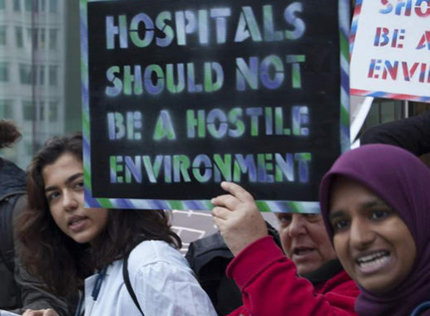
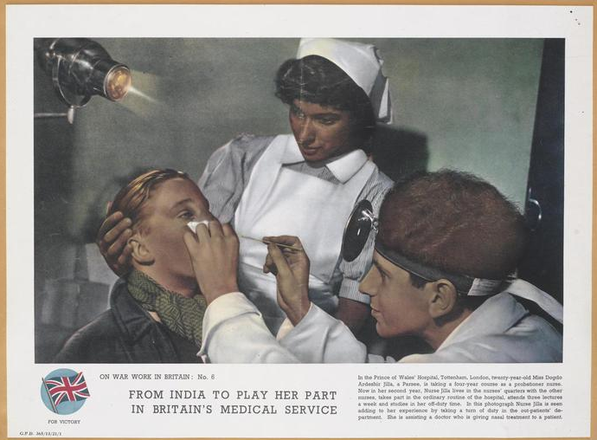
Migration and the NHS: from ‘civis Britannicus sum’ to the ‘hostile environment’…
‘In a world in which restrictions on personal movement and immigration have increased we still take pride in the fact that a man can say Civis Britannicus sum whatever his colour may be, and we take pride in the fact that he wants and can come to the Mother country.’
Henry Hopkins, Colonial Office, 1954
© Crown Copyright. IWM http://www.iwm.org.uk/collections/item/object/33289
Notes:
ON WAR WORK IN BRITAIN: No. 6 FROM INDIA TO PLAY HER PART IN BRITAIN'S MEDICAL SERVICE In the Prince of Wales' Hospital, Tottenham, London, twenty-year-old Miss Dogdo Ardeshir Jilla, a Parsee, is taking a four-year course as a probationer nurse. Now in her second year, Nurse Jilla lives in the nurses' quarters with the other nurses, takes part in the ordinary routine of the hospital, attends three lectures a week and studies in her off-duty time. In this photograph Nurse Jilla is seen adding to her experience by taking a turn of duty in the out-patients' department. She is assisting a doctor who is giving nasal treatment to a patient.
COLONIAL IMMIGRANTS
HC Deb 05 November 1954 vol 532 cc821-32

Slide 4
Why look at migration through an NHS lens? A few NHS facts…
The NHS employs one in every seventeen people in the UK and has been Britain’s biggest employer since the 1960s.
The NHS accounts for the second largest tranche of UK central government spending.
The Commonwealth Fund ranks the NHS as the most efficient and effective health system in the world; OECD figures place UK spend on healthcare at less than half of US spend.
The NHS remains the most popular British institution – more popular than the Queen – despite post-austerity declines in patient satisfaction.

Slide 5
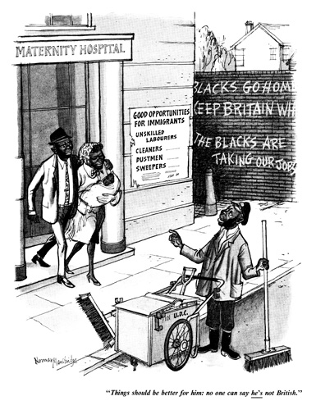
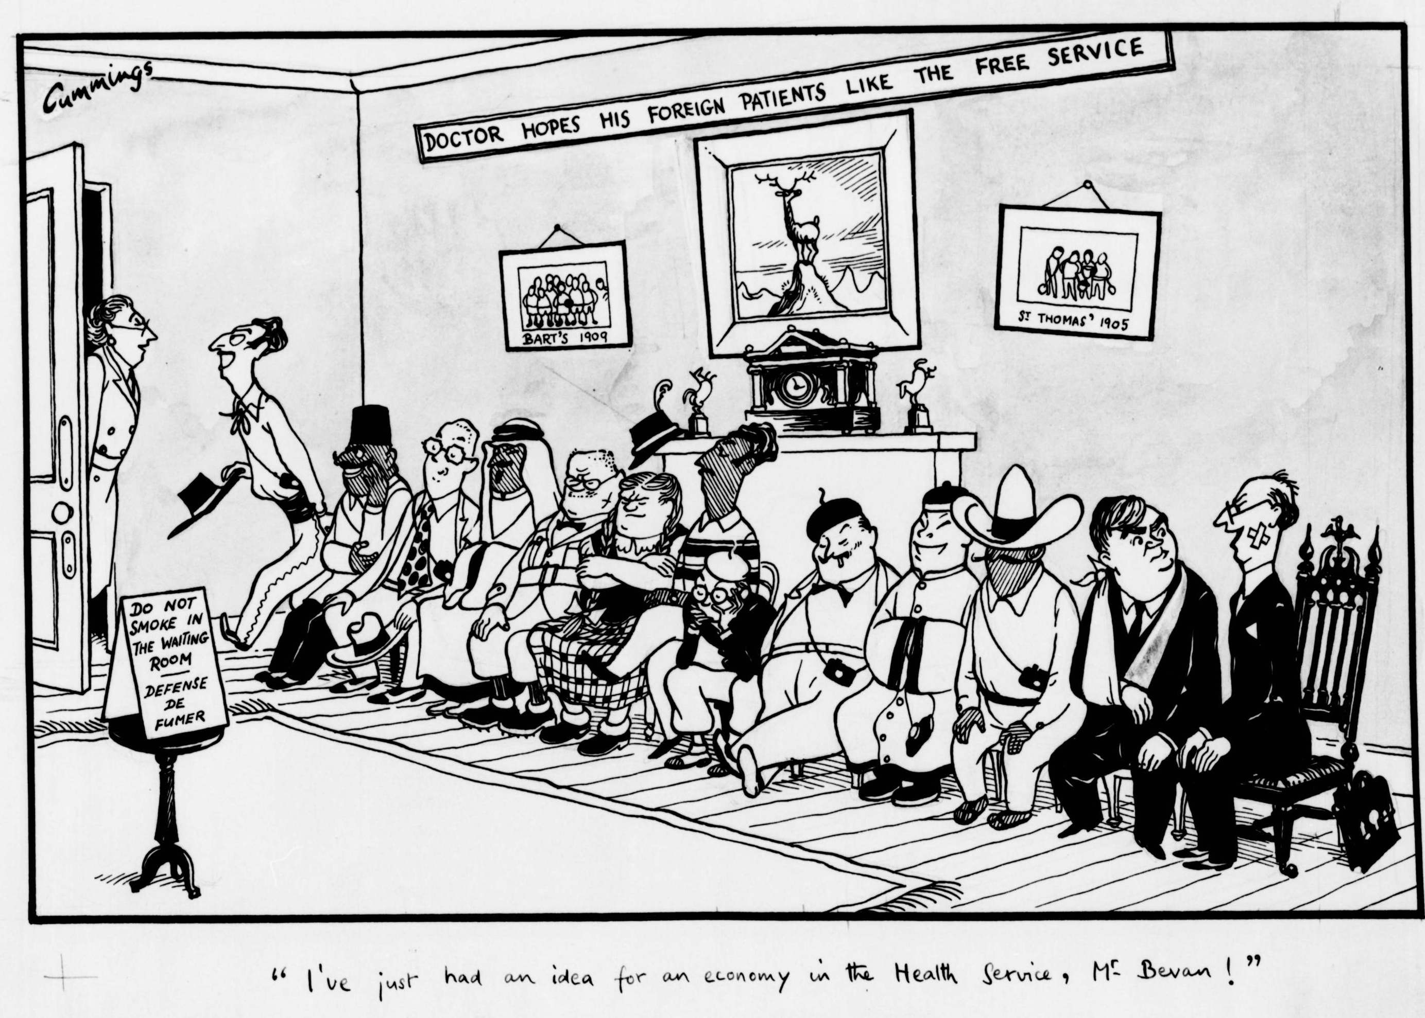
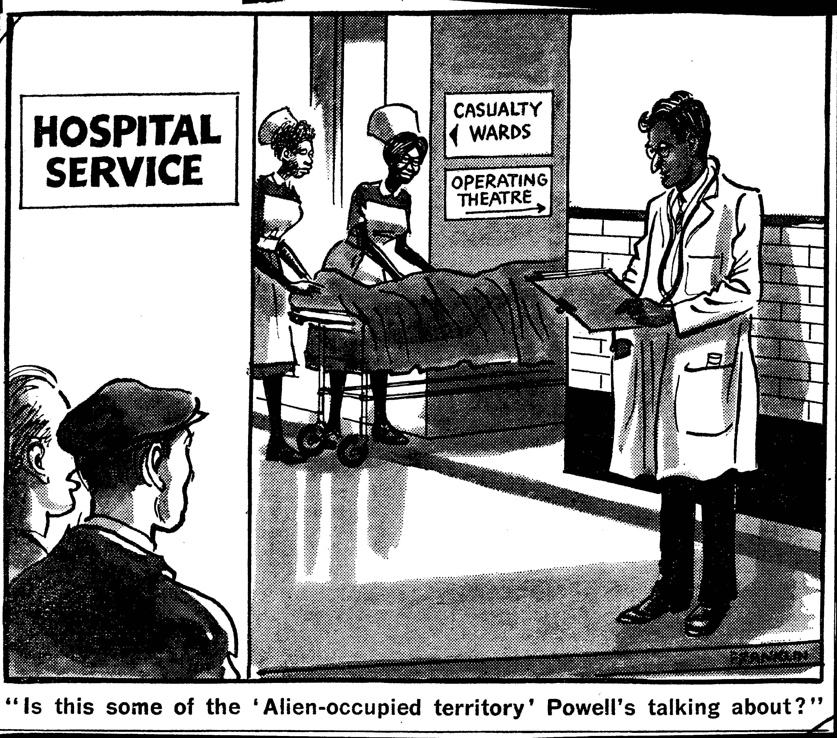
Historical Tropes
How have Britons thought about migrants and the NHS from 1948-2018?
‘Things should be better for him; no one can say he’s not British.’
1954
1949
1969

Slide 6
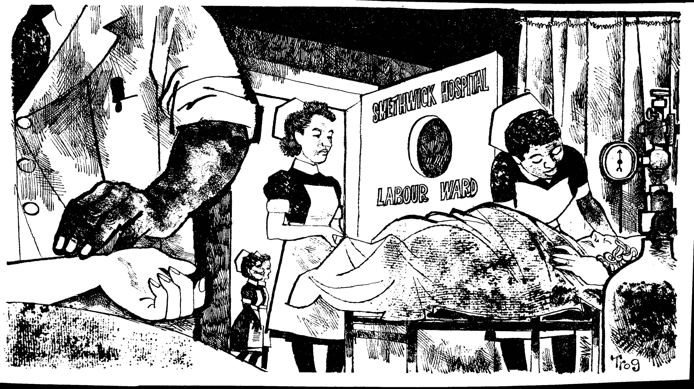
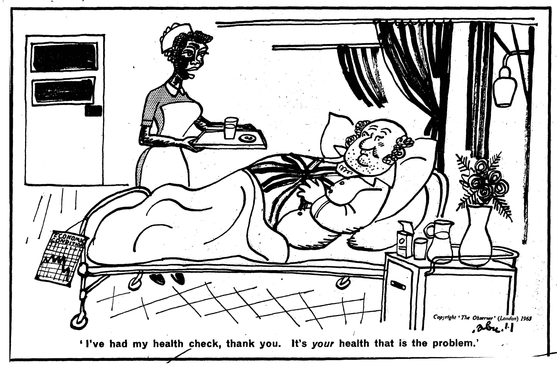
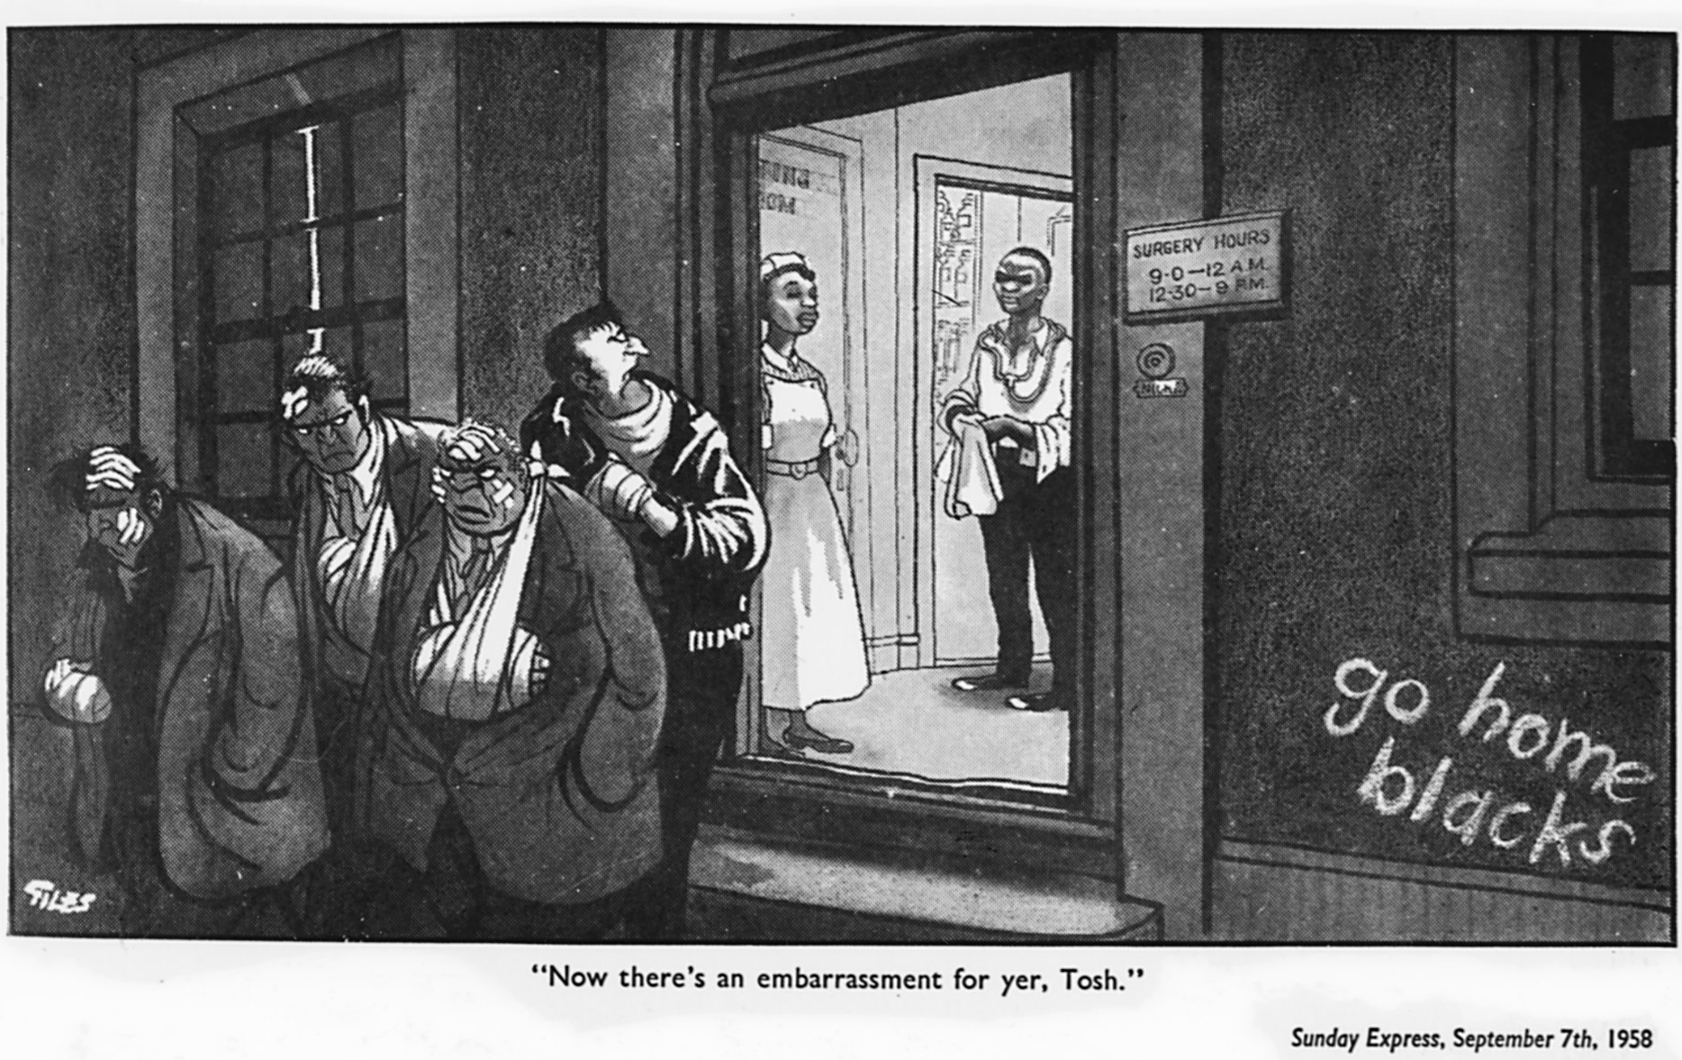
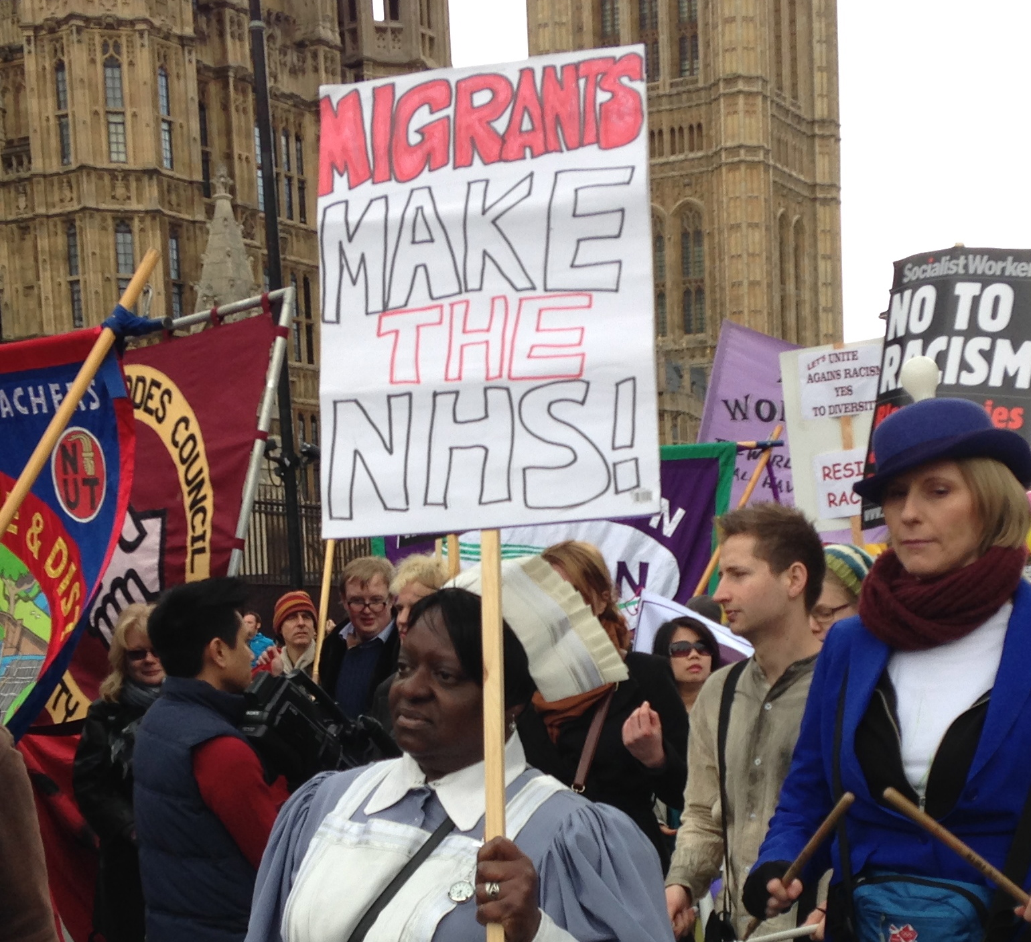
1964
1965
2016
1958

Slide 7
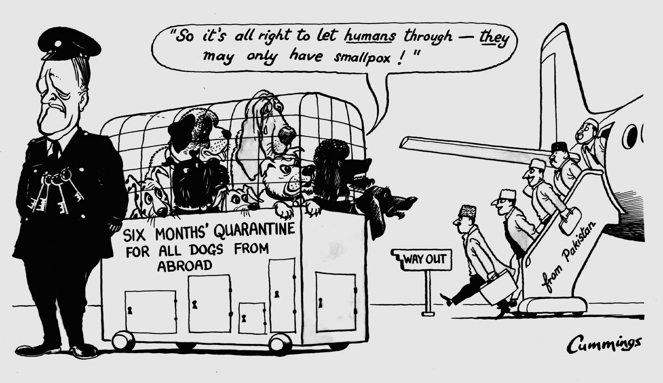
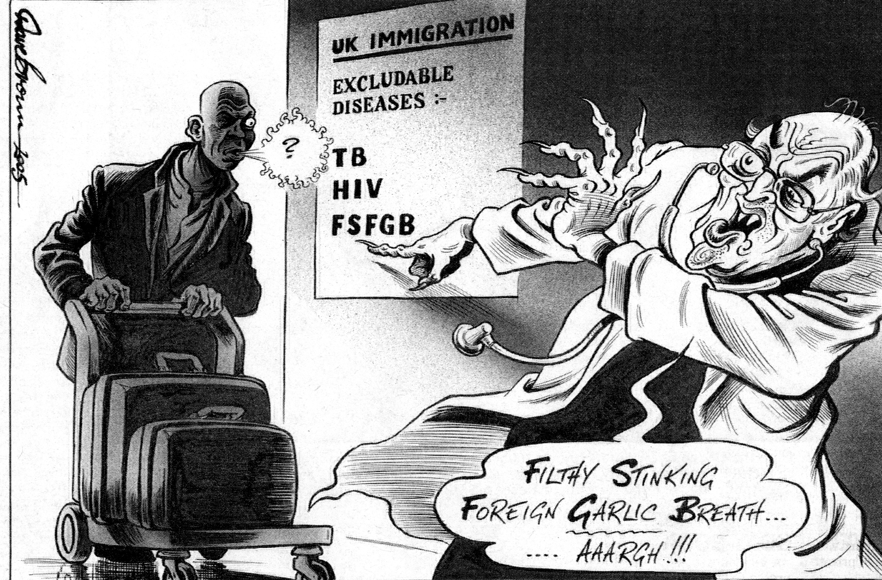
But the NHS has patients as well as staff… the ‘foreign contagions’/ ‘battening on our social services’ motif
© Express Syndication Ltd., British Cartoon Archive, University of Kent, Michael Cummings, Daily Express, 17 Jan 1962
© Dave Brown, British Cartoon Archive, University of Kent, Dave Brown, Independent, 16 Feb 2005.
© Daily Mail, 1968
© Daily Mail, 2008

Slide 8
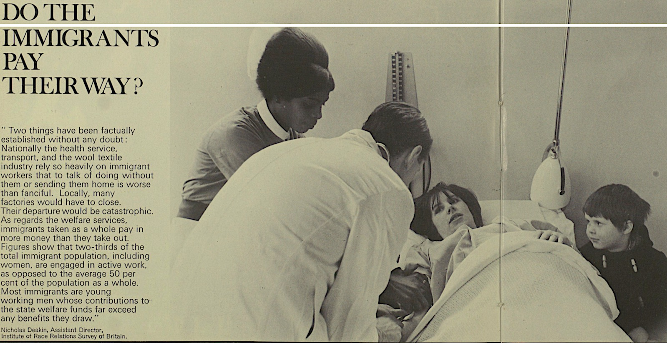
Illustrated London News, 1968
Immigrants: ‘burdening’ or benefiting the NHS?

Slide 9
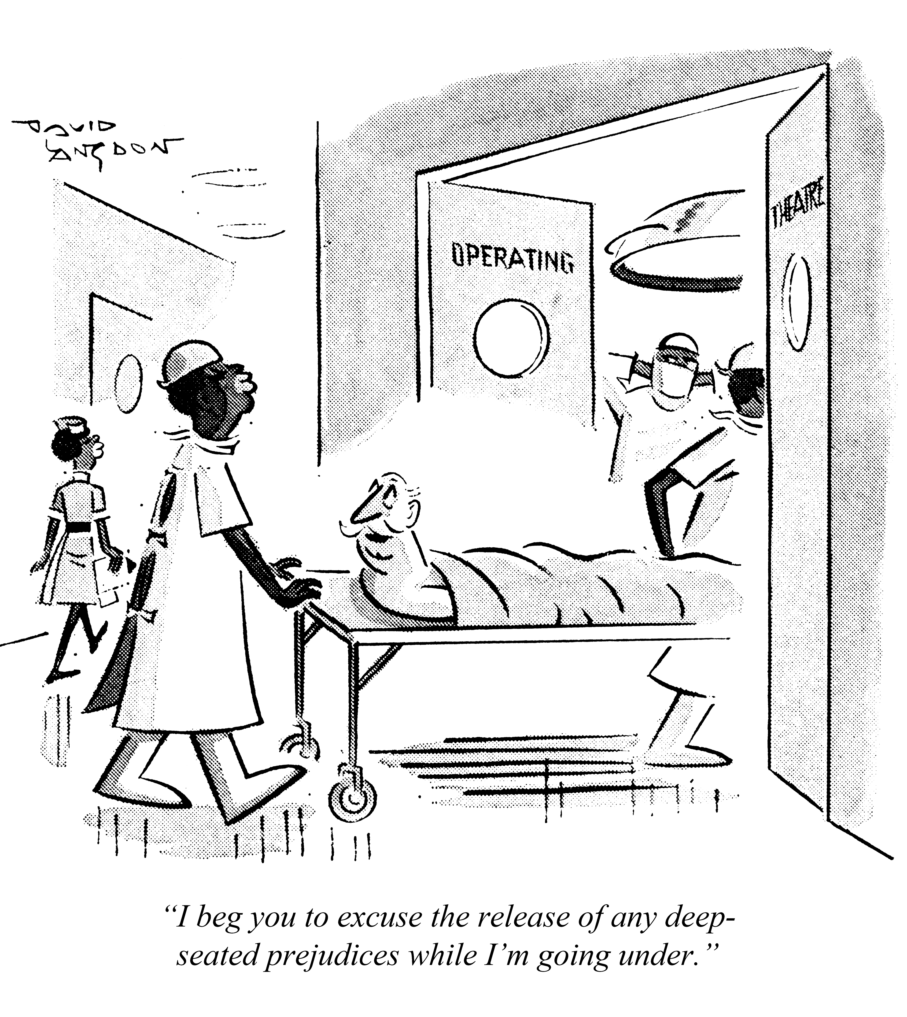
* NHS as a symbol of national values (including ‘tolerance’ and ‘egalitarianism’)
* NHS as site for anti-racist rhetoric and discourse
* NHS as a flashpoint for concerns about ‘excess’ immigration AND immigration restriction; about migrants as undeserving beneficiaries of welfare state AND as heroic providers of welfare services
Findings
© Punch Archive, David Langdon, Punch 1969

