Slide 1
“Take me to the river”: Water Cures in the Twentieth Century
Roberta Bivins
University of Warwick
Centre for the History of Medicine

Slide 2
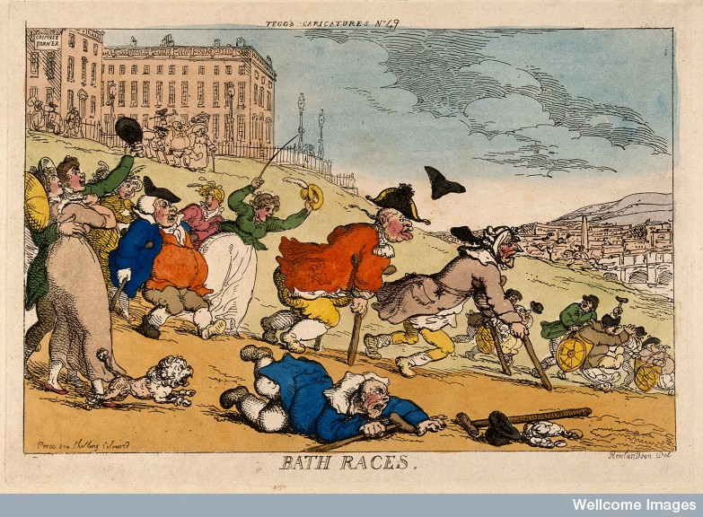
Taking the waters…
Notes:
Rowlandson Bath races

Slide 3
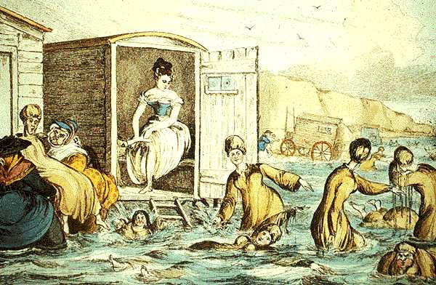

Slide 4
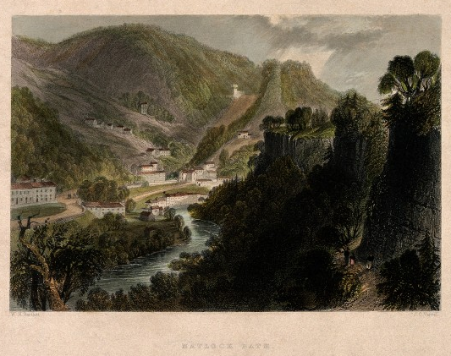
Wellsprings of power: nature, hydropathy and ‘the water cure’
A view of Matlock Baths, Derbyshire1840

Slide 5
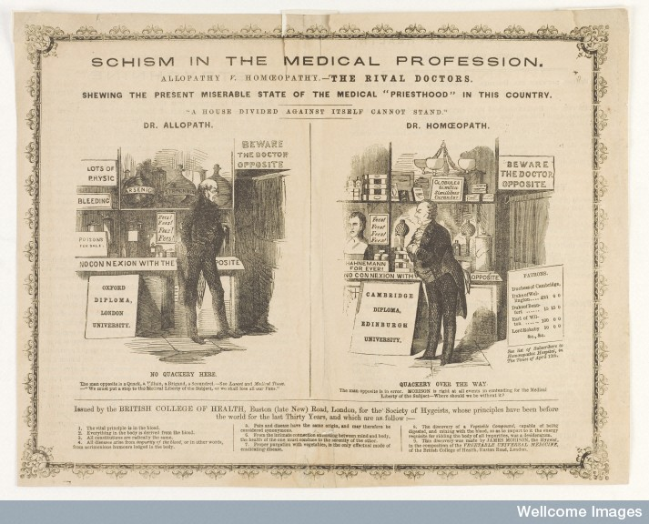
‘for sure and gentle remedial effect…’: Homeopathy and the ‘disgust for medicine’
Notes:
It is not in the corporal atoms of these highly dynamized medicines, nor their physical or mathematical surfaces (with which the higher energies of the dynamized medicines are being interpreted but vainly as still sufficiently material) that the medicinal energy is found. More likely, there lies invisible in the moistened globule or in its solution, an unveiled, liberated, specific, medicinal force contained in the medicinal substance which acts dynamically by contact with the living animal fibre upon the whole organism (without communicating to it anything material however highly attenuated) and acts more strongly the more free and more immaterial the energy has become through the dynamization.
Is it then so utterly impossible for our age celebrated for its wealth in clear thinkers to think of dynamic energy as something non-corporeal, since we see daily phenomena which cannot be explained in any other manner? Hahnemann, Organon of Medicine 6th edition

Slide 6
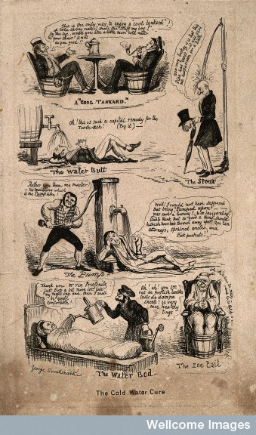
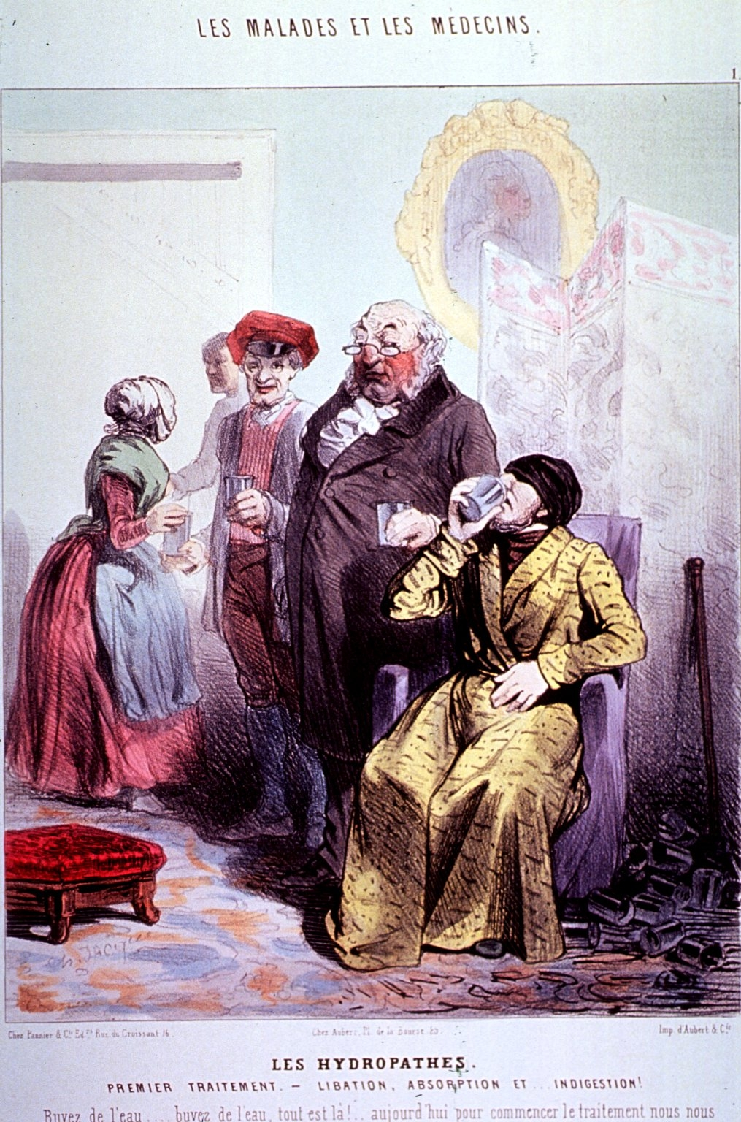
Notes:
Title: Les Hydropathes Premier Traitment.- Libation, Absorbtion et... Indigestion!/ Ch. Jacque.
Series Statement: Les Malades et les médecins; 1
Creator: Jacque, Charles Émile, 1813-1894, artist.
Publication Information: [Paris?] : Aubert & Cie, [188-] A man, wearing a robe and a cap that is pulled down over his eyes, is sitting in a chair and drinking from a glass; standing next to him is a red-faced physician who is ready to hand him another glass; attendants stand in the background holding glasses

Slide 7
‘All the rest is water…’: 19th century healing waters and alternative medicine
1841 First British hydro opens at Stansteadbury
1842 Malvern established; by 1861, 6000 patients a year are treated there
1853 Smedley’s Matlock hydro opens; treats 3000 patients annually by 1876
1877 Smedley’s Practical Hydrotherapy is in 15th edition, with sales of 95,000 copies
By 1891, 63 hydros in UK, including 20 in Scotland
1832 First homeopathic dispensaries: London and Bristol
1844 First homeopathic professional association
1843-4 First journal
1849 First hospital
1860s, homeopaths have 4 medical societies, 2 quarterly and 3 monthly journals, at least 5 hospitals, and 59 dispensaries in Britain
1866 London Homeopathic Hospital had treated 59,138 patients
Hydropathy
Homeopathy
Notes:
Mary Gove Nichols, 1887

Slide 8
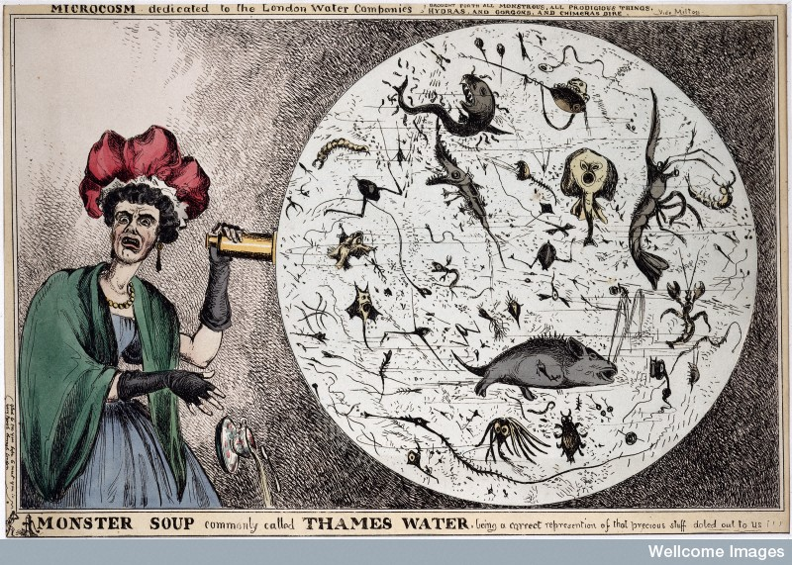
From Monster Soup…

Slide 9
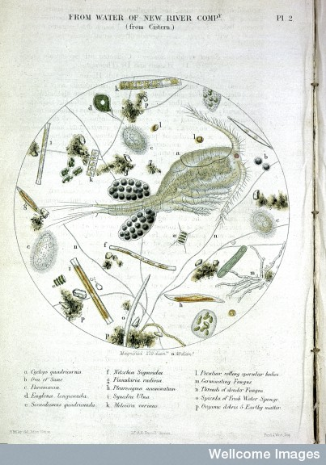
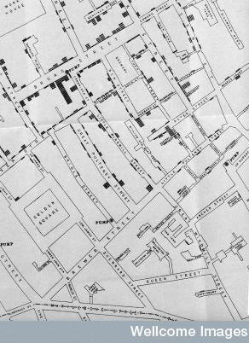
…To the Broad Street Pump
Notes:
Thames at Brentford and Thames at Hungerford. From: A microscopic examination of the water supplied to the inhabitants of London and the suburban districts by Arthur Hill Hassall Published: Samuel Highley London 1850
Street Map of Soho, around Golden Square, illustrating incidences of cholera deaths during the period of the Cholera Epidemic, 1853. c. 1850

Slide 10
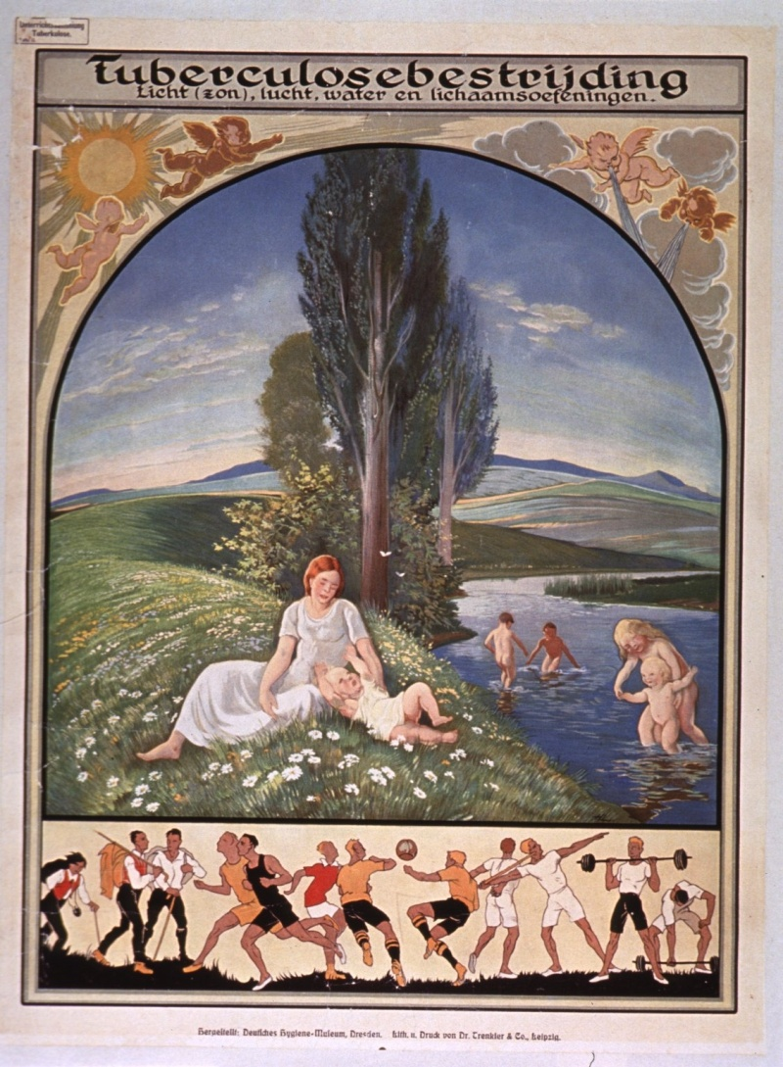
The persistence of ‘purity’: Health, water, and the hygiene of nature in the 20th century
Notes:
Tuberculosebestrijdi ng licht (zon), lucht, water en lichaamsoefeningen. Dresden : Deutsches Hygiene-Museum, [1920s] Title at top of poster. Title addresses the idea of sunlight, air, water, and physical exercise as ways to fight tuberculosis.

Slide 11

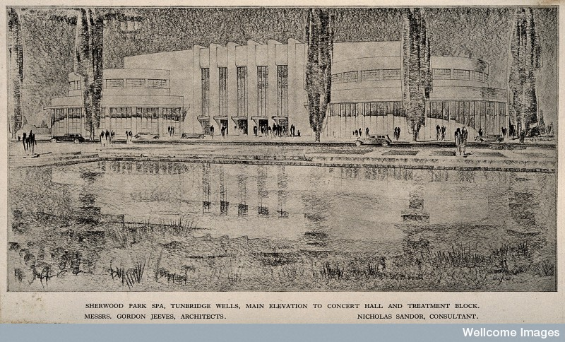
Hydro-tourism, 1930s style
Sherwood Park Spa, Tunbridge Wells,
Main elevation to concert hall
and Treatment Block , 1932

Slide 12
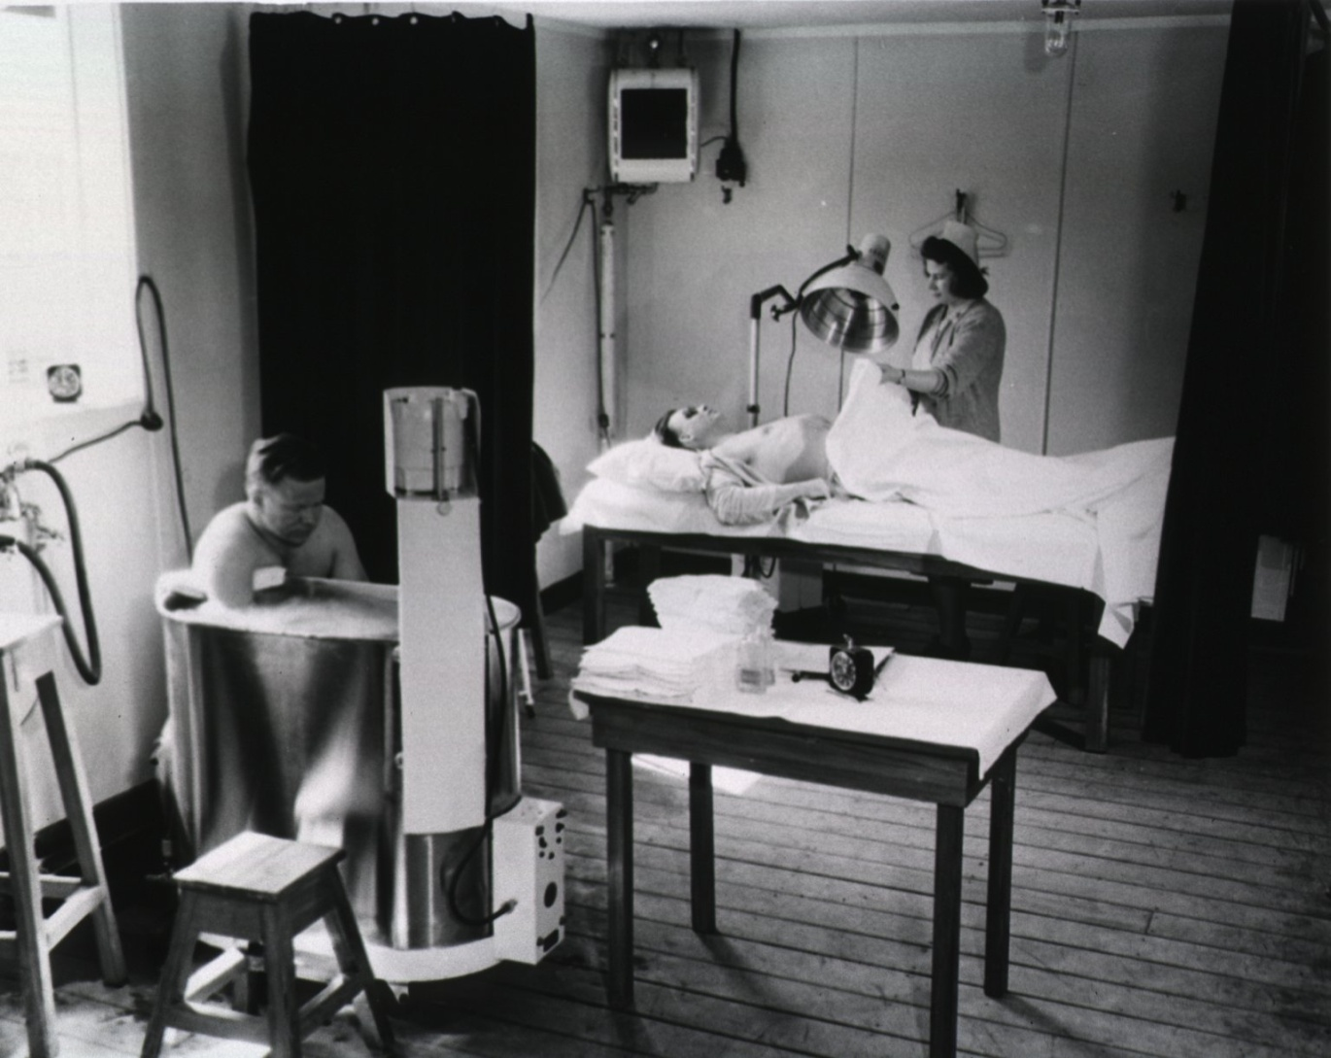
From hydropathy to hydrotherapy
The hydrotherapy and ultraviolet room of the
Physiotherapy Dept, 39th General Hospital NZ
Notes:
‘Treatment at the 39th General Hospital, New Zealand’. US Army, 1944: Picture caption: The hydrotherapy and ultraviolet room of the Physiotherapy Dept., 39th General Hospital, New Zealand ...

Slide 13
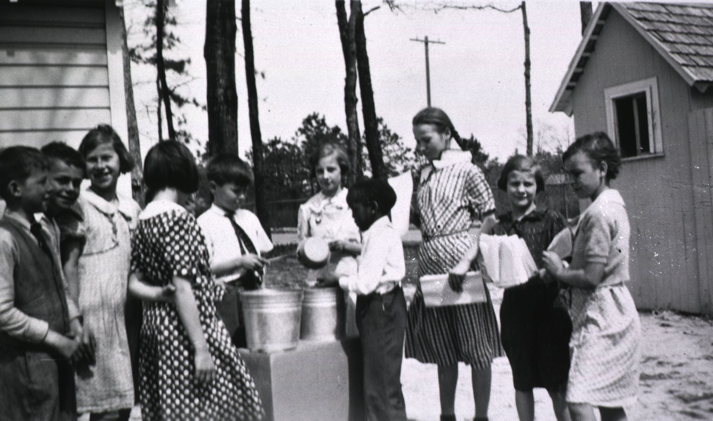
Assembly lines of health : Teaching handwashing, 1936
Notes:
[Rural hand-washing facilities] Agricultural School Atlantic County, New Jersey Archives, 1894-1952, box 1. children from the Agricultural School, Atlantic Co. N.J., at a make-shift hand-washing assembly line. Two buckets of water, a child holding a dipper, and another child handing out paper towels. Received from Lulu P. Dilworth, in 1936.

Slide 14
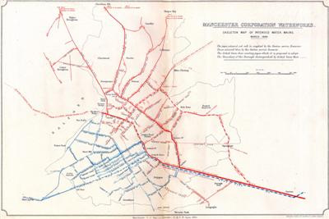

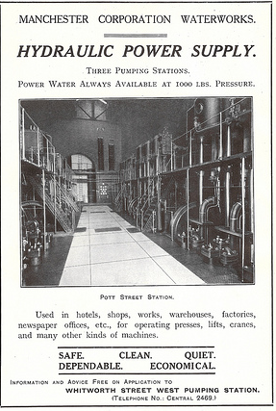
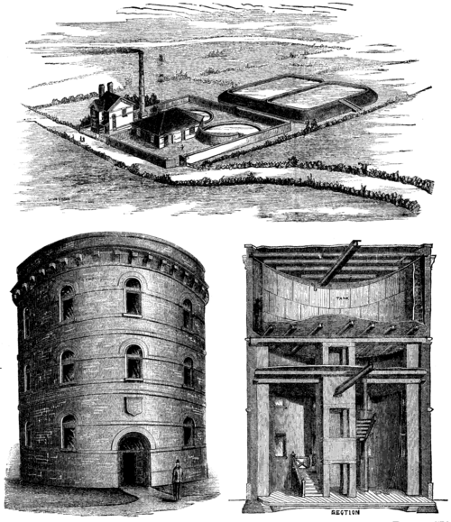

Slide 15

Never give a germ a BREAK…
Notes:
Beware-- drink only approved water. United States. War Dept. [Washington, D.C.] : War Dept., 1944.

Slide 16
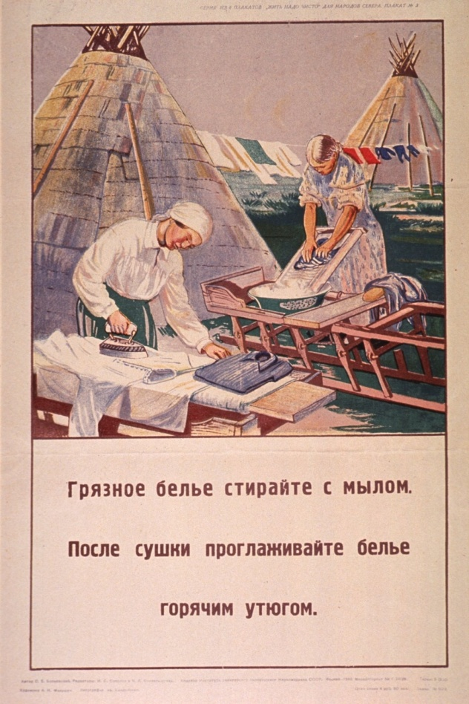

Notes:
Clean dry clothes keep him on the job / H. Price [Washington, D.C.] : U.S. Public Health Service : 1942.
Griaznoe bel'e stiraĭte s mylom posle sushki proglazhivaĭte bel'e gorichim utiugom. Moskva : Institut sanitarnogo provseshcheniia, Narkomzdrava SSSR, 1940. Series statement in upper right corner. Series urges "clean living" and is directed to people in the northern regions of the Soviet Union. Visual image is an illustration of two women working outdoors. One scrubs a garment on a washboard and the other irons a shirt. Two teepees or conical tents are in the background. Title below illustration urges washing dirty clothes with soap and pressing them with a hot iron after they are dry.

Slide 17


Notes:
Cutar kwalara kare iyalanku daga cutar kwalara. USAID/Nigeria Nigeria] : Johns Hopkins University. Population Communication Services, [19--?] Prevent Cholera "Designed and produced for the Northern League of NGOs."
Hygiène individuelle et collective [Senegal] : Ministère de la santé publique, [19--] Note at top of poster announces the 10th fortnight of hygiene and cleanliness. Visual images are illustrations of a water jar, handwashing, and a man and woman sweeping up.

Slide 18
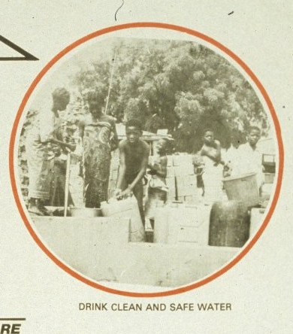

Health in the developing world: from reservoirs of disease to reservoirs against disease
Notes:
Health for all by the year 2000 the countdown has begun. Kwara State (Nigeria). Ministry of Health. Ilorin [Nigeria] : Ministry of Health, Kwara State, [1983] Visual images include four b&w photo reproductions and an ascending arrow. The photos show core elements of a healthy lifestyle: people stand near a variety of fresh foods, children draw water from a well, men put trash in a trash truck, and mothers stand in line to have their babies immunized. The arrow progresses by steps from 1979 to 2000 and identifies 1983 as a year to focus on primary health care. Note and publisher information at bottom of poster. "World Health Day, 7th April, 1983."

Slide 19
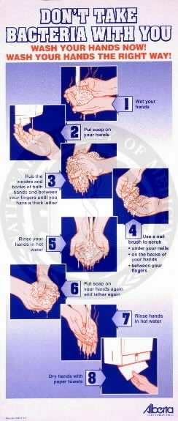
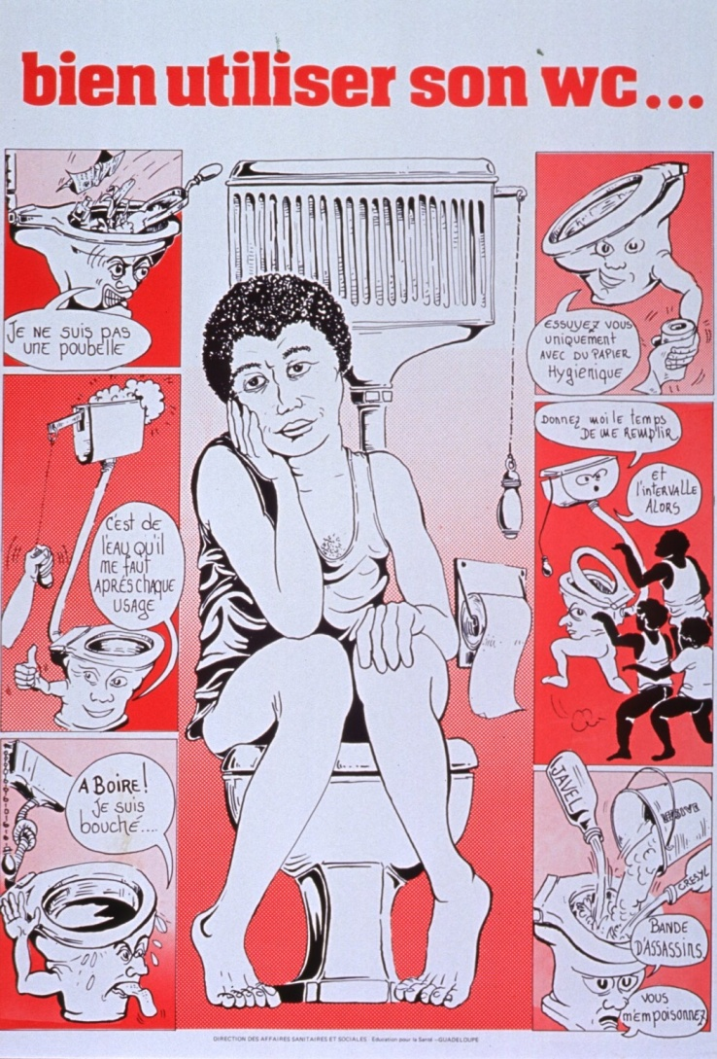
Notes:
Bien utiliser son WC-- Guadeloupe. Service d'éducation pour la santé. Guadeloupe : Direction des affaires sanitaires et sociales, Éducation pour la santé, [19--] is an illustration of a man sitting on a toilet. Six cartoon panels surround this image, depicting the proper use of a toilet. Suggestions include not using it as a trash can or way to dispose of toxic liquids, flushing after each use and allowing the tank to refill, using extra water if the toilet is plugged, and using only toilet paper.

Slide 20

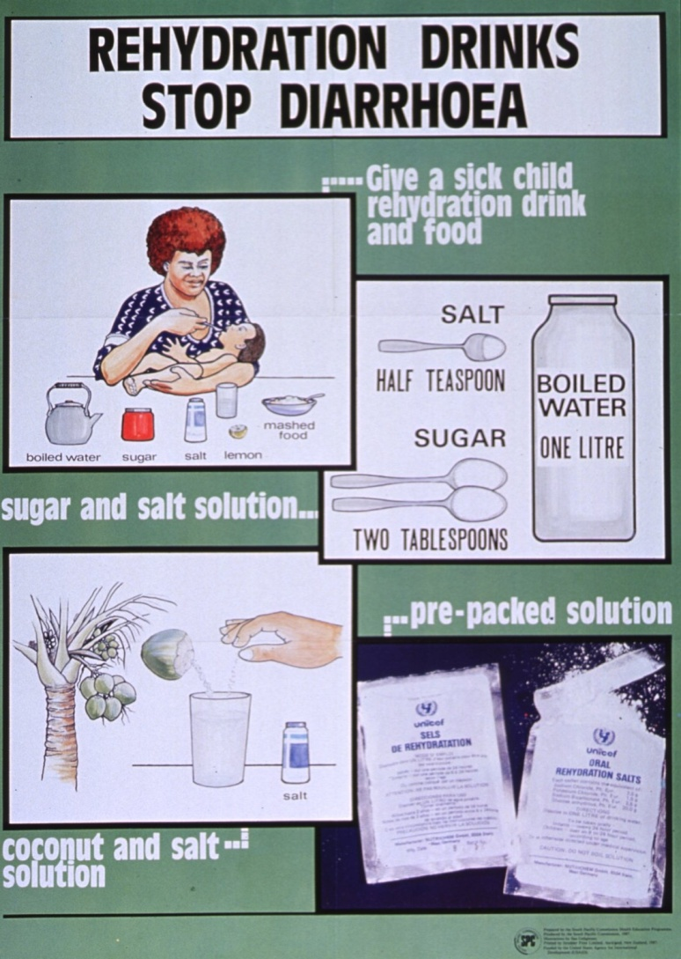
Oral Rehydration Therapy
Notes:
Diarréia é água suja diarréia é lixo, diarréia é morte. Programa de Assistência Integral à Saúde da Mulher e da Criança (Brazil) Ministério da Saúde, Divisão Nacional de Saúde Materno-Infantil, Programa de Assistência Integral à Saúde da Mulher e da Criança, [19--] Diarrhea is dirty water, diarrhea is trash, diarrhea is death. Caption below photo stresses that children with diarrhea continue to be fed and that rehydration solution is available from the nearest health service. Smaller color photo reproduction in lower left corner shows a packet of rehydration soloution.
Rehydration drinks stop diarrhoea illustrations by Sau Ueligitone. United States. Agency for International Development. [New Caledonia] : South Pacific Commission, 1987.

Slide 21
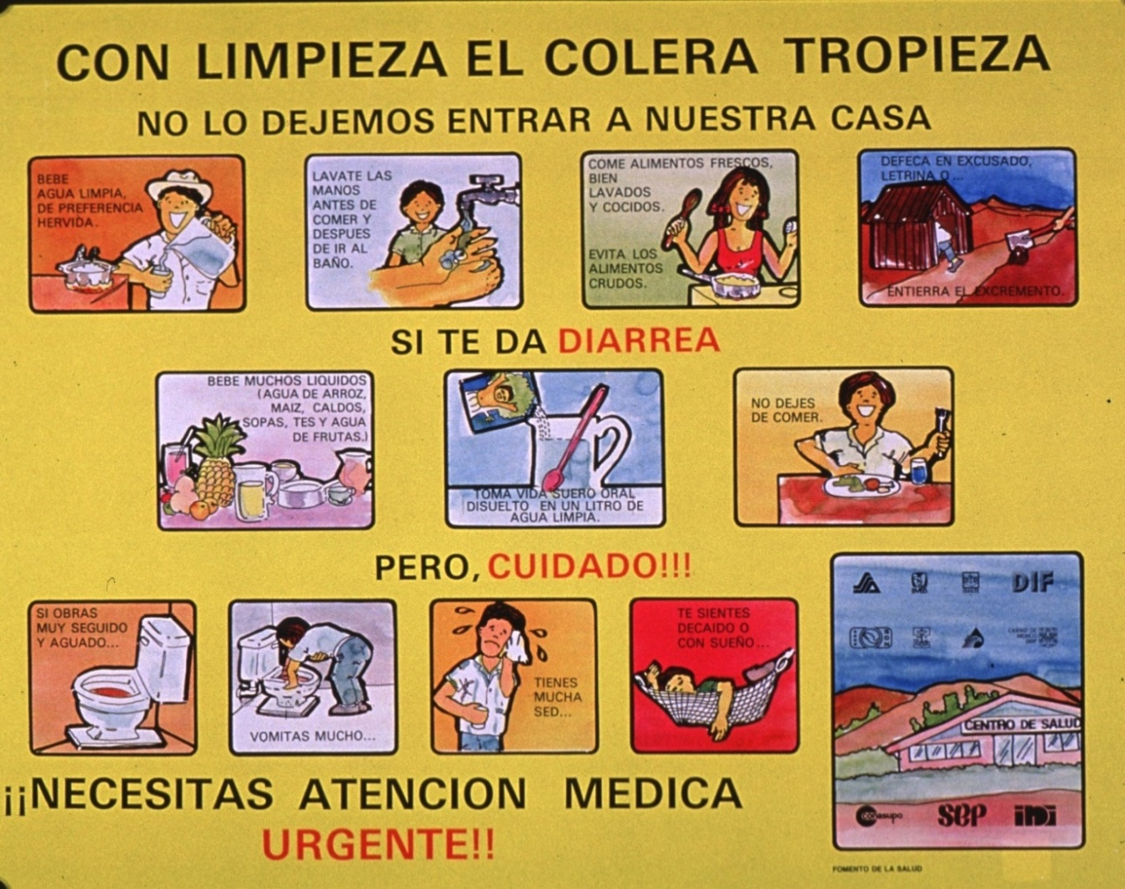

Rehydration therapies and international health promotion
Notes:
Con limpieza el colera tropieza no lo dejemos entrar a nuestra casa. Mexico. Secretaría de Salud, [Mexico : SSA, 19--] Title at top of poster addresses cleaning and not letting cholera enter the house. Visual images are illustrations depicting water, handwashing, cooking, an outhouse, juices and rehydration solution, a toilet, and a man vomiting, sweating, and sleeping. Text accompanying illustrations addresses measures to prevent cholera, what to do when diarrhea strikes, and symptoms that require urgent medical attention. Many logos, an illustration of a health center, and note in lower right corner.

Slide 22

Discussion: Water cures in the 20th century?

Slide 23


The persistent trickles …

Slide 24
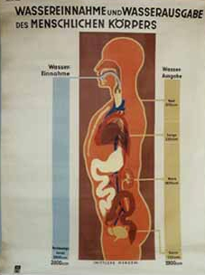
…and the floods.

Slide 25
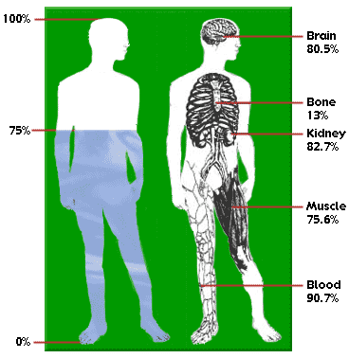
Water and (and water as) the stuff of humanlife…

Slide 26
“If hygiene is now so despicable in the eyes of the Physician, he has himself to blame for her state, for he left her in bad company, where she has been seduced and corrupted…’ Dr. A Kilgour, 1834
Notes:
Lecture upon the Ordinary Agents of Life, as applicable to Therapeutics and Hygiene; or, The Use of Atmosphere, Habitations, Baths, Clothing, Climate, Exercise, Food and Drinks, etc. , in the Treatment and Prevention of Disease. (Edinburgh, 1834)

