Slide 1
Finding and Using Medical Sources
TSM
Optional Skills Session
Week 19

Slide 2
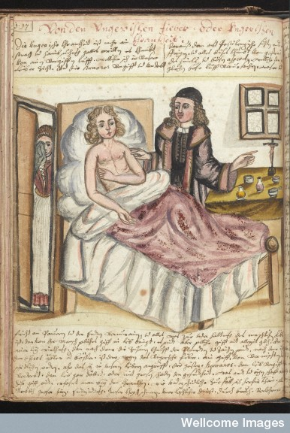
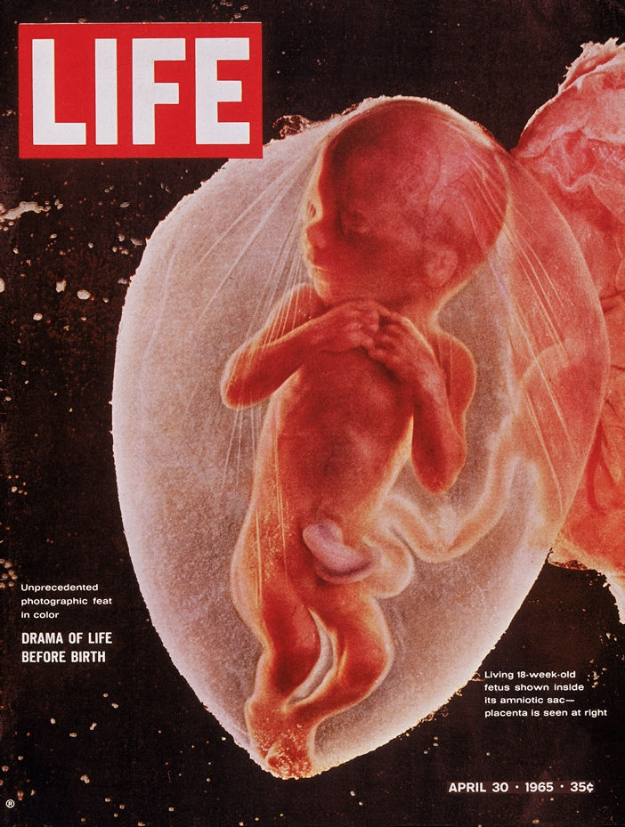
Source types: Medical Images
Representations of Medical Practices
Representations of medical subjects

Slide 3
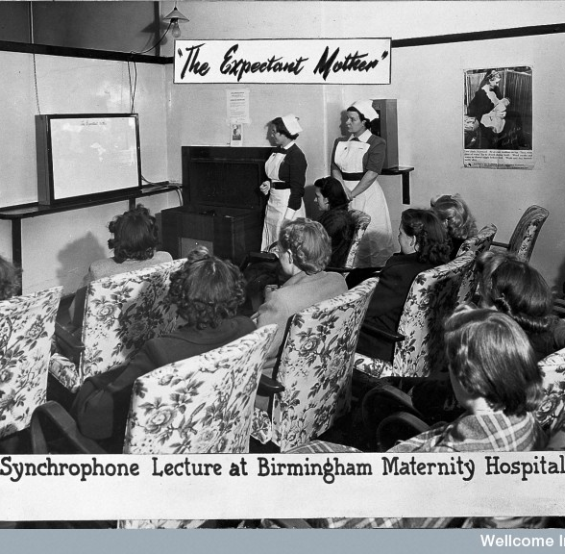
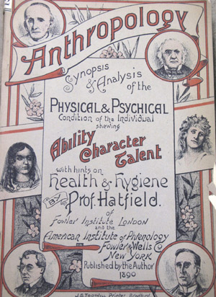
Medical Images
Public Health
Anthropometric/Anthropological

Slide 4
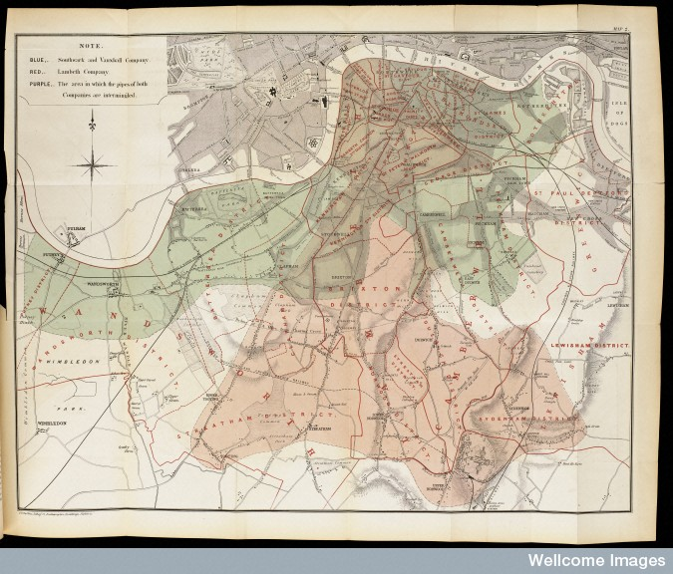
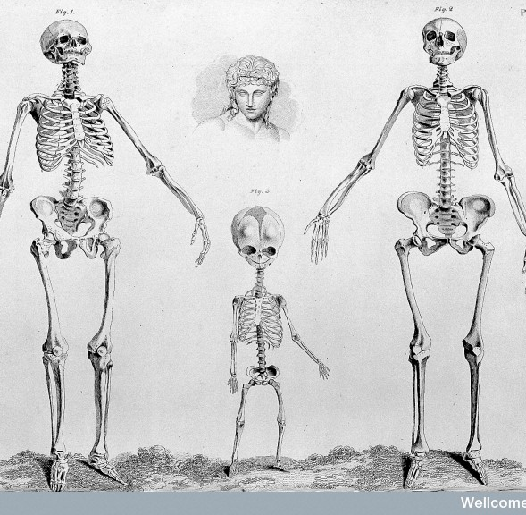
Visualised Data
Representations of medical knowledge
Medical Maps
Map showing the intimate mixture of the water supply of the Lambeth with that of the Southwark and Vauxhall Company, 1854, John Snow, On the mode of communication of cholera (London, 1855)

Slide 5
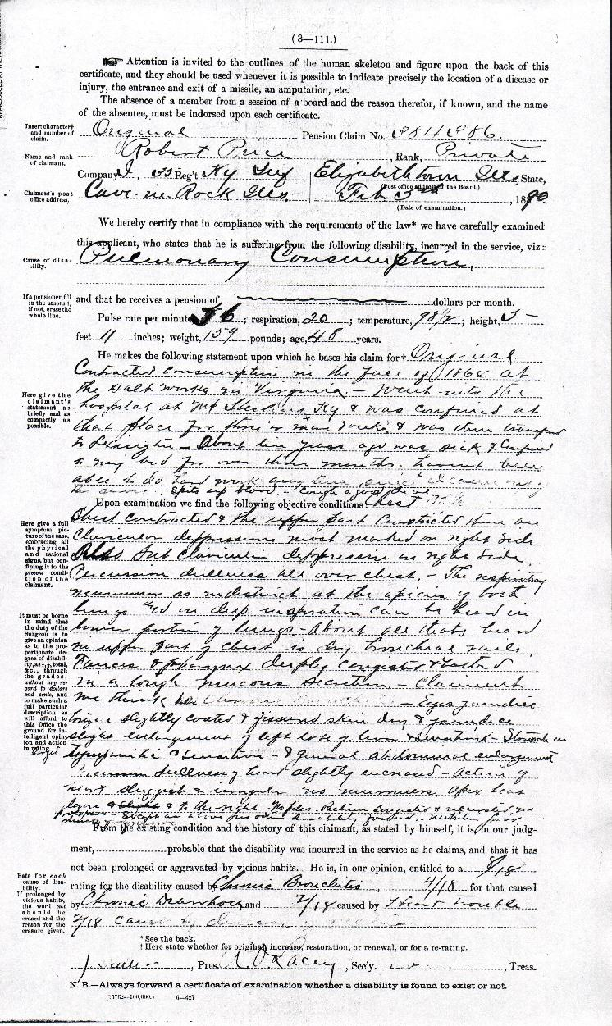
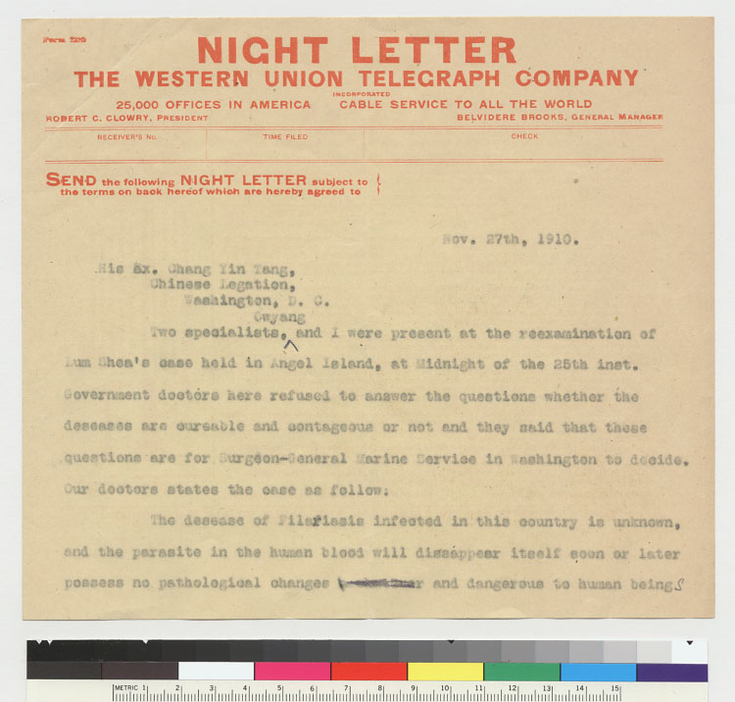
Archival Material
Medico-Legal Documents
Medical records

Slide 6
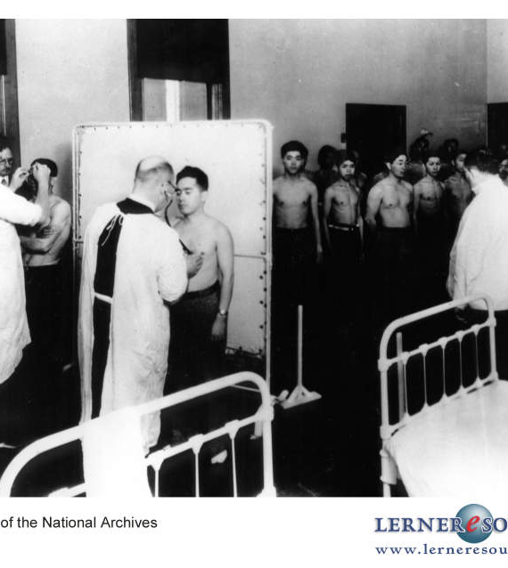
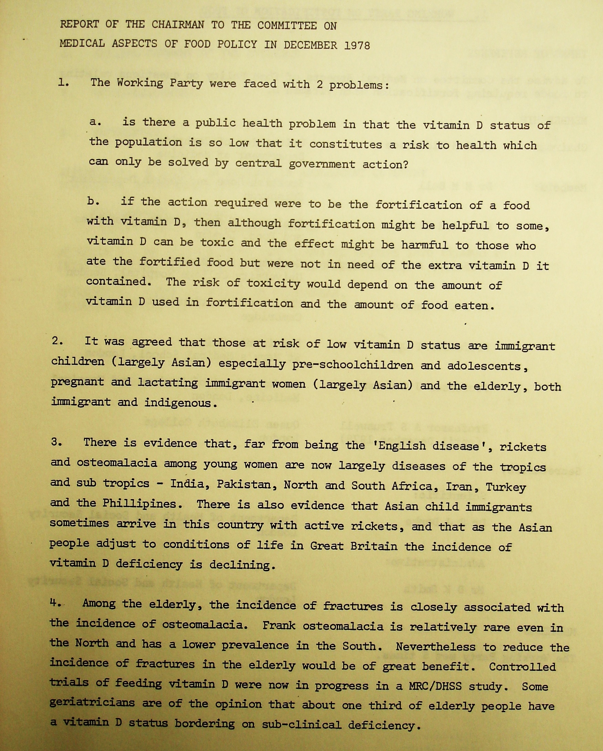
Archival Material: Records of the Medical State

Slide 7
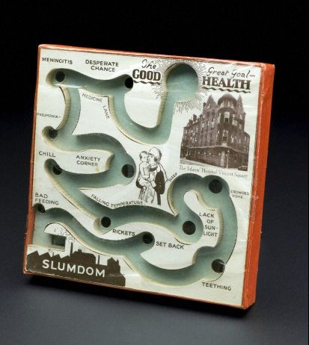
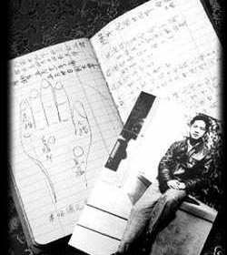
Medical Objects

Slide 8
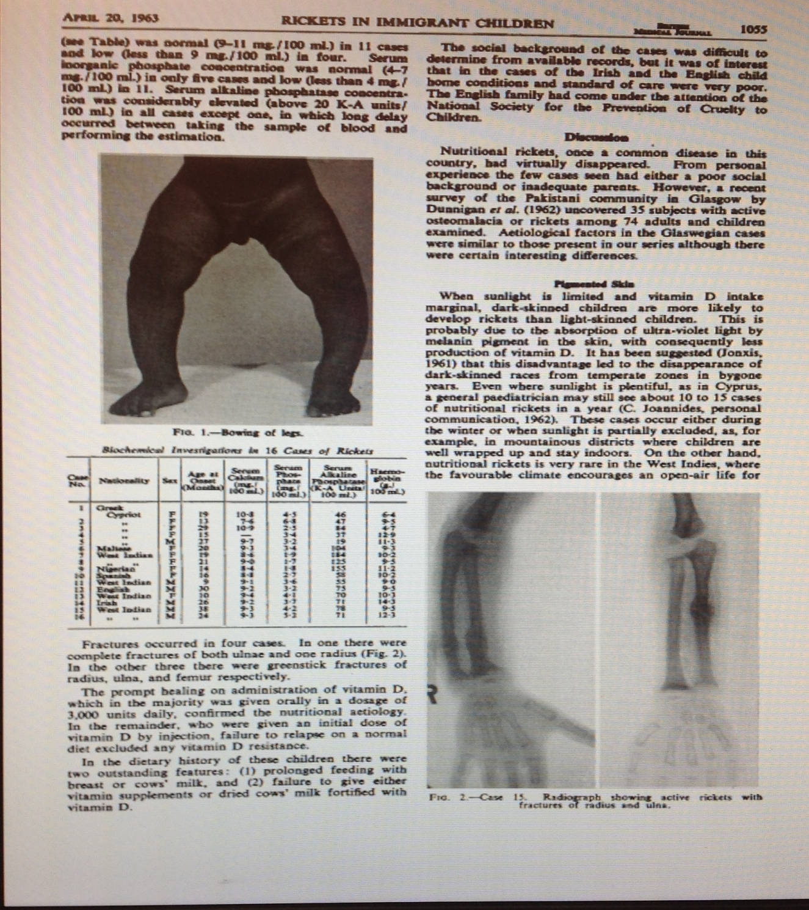
And the medical press…
“Of all the immigrant communities, the Asians tend to be the most isolated, partly because they cling to their traditional social habits, which means that women remain firmly within the family unit and simply do not know about diet deficiencies, and partly because of language problems. .... The trouble is that a diet suitable to the Indian subcontinent simply does not contain the vitamins and oils needed in Britain's climate, and the campaign helps people understand what changes they must make.”
‘Smiles about rickets’ BMJ, Jan 1982

