Slide 1
How to be a historian: what do historians DO?
Professor Roberta Bivins
Centre for the History of Medicine
University of Warwick
peopleshistorynhs.org
Dr Elise Smith
Centre for the History of Medicine
University of Warwick

Slide 2
Part One
Ask your neighbours:
  What do historians do?
  Come up with a couple of examples (think about why YOU have come to study history!)

Slide 3
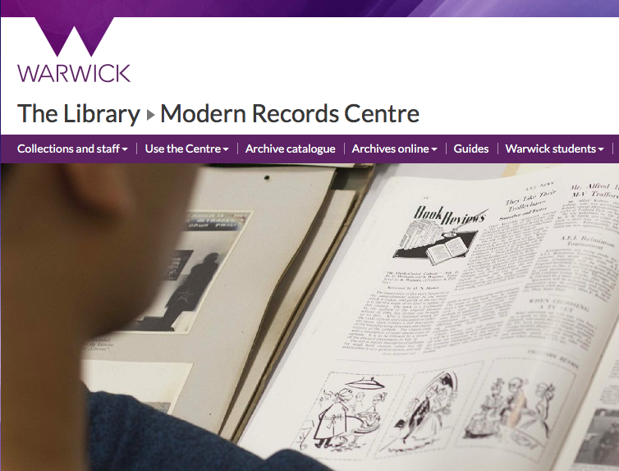
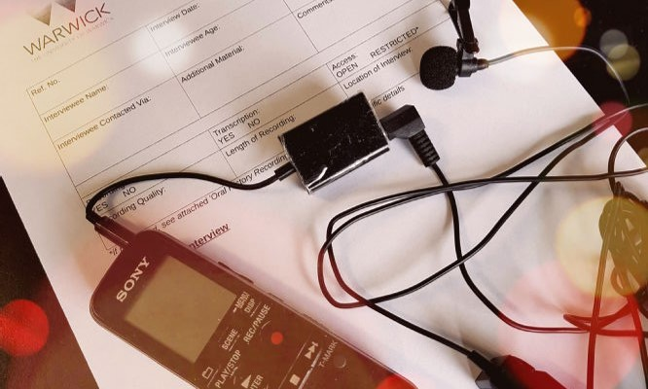
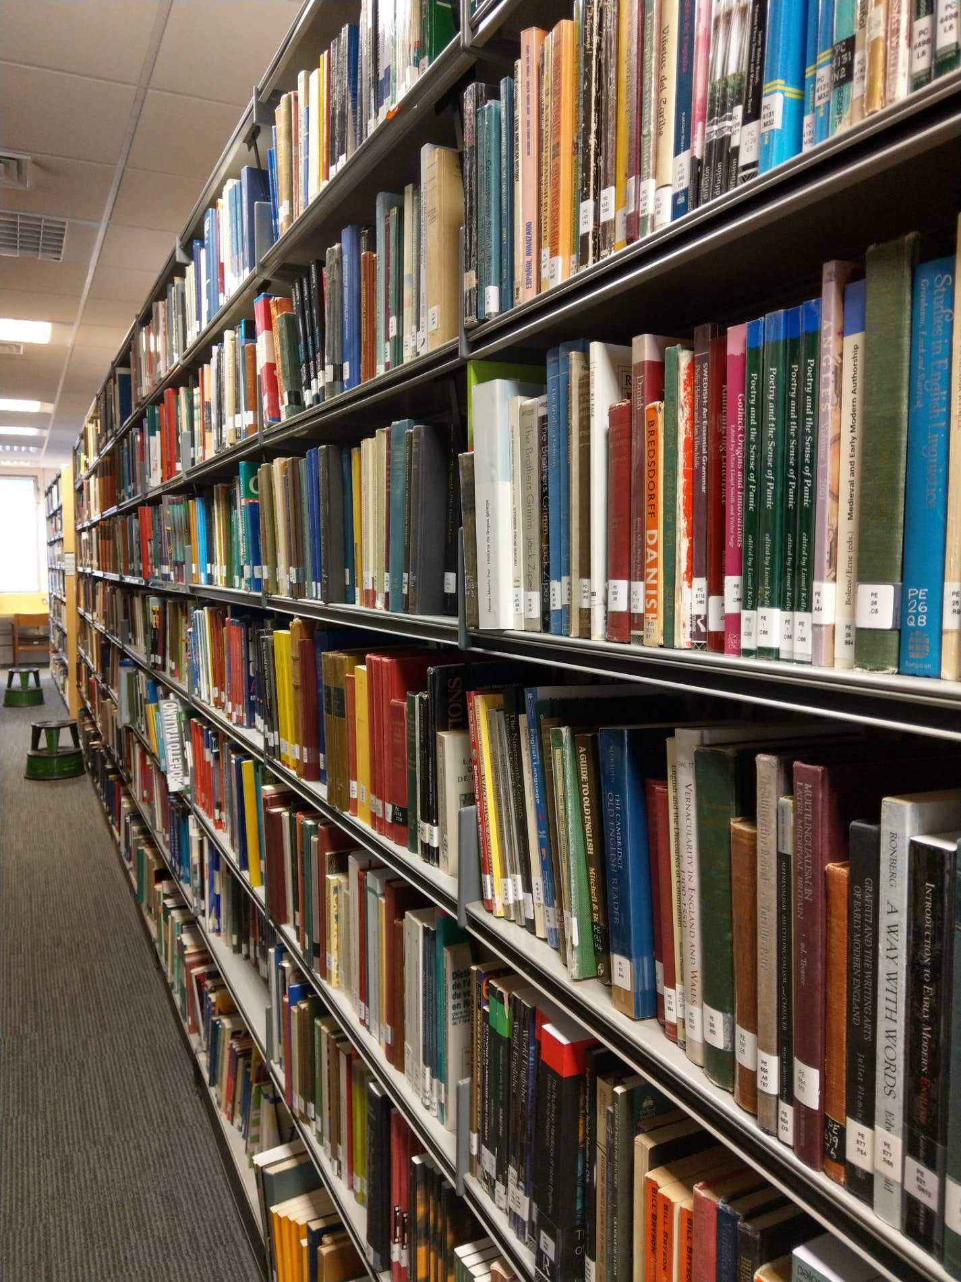
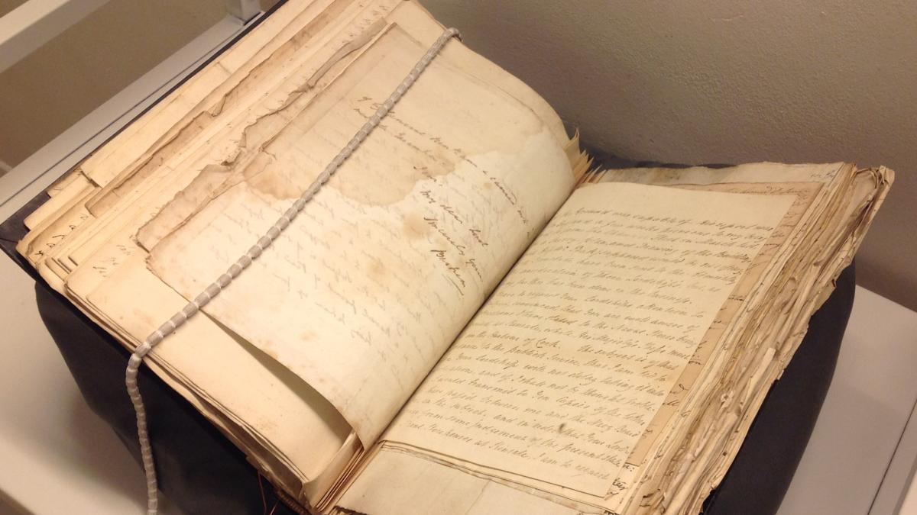
So… what DO we do?
Research… through texts, interviews and mixed media…

Slide 4
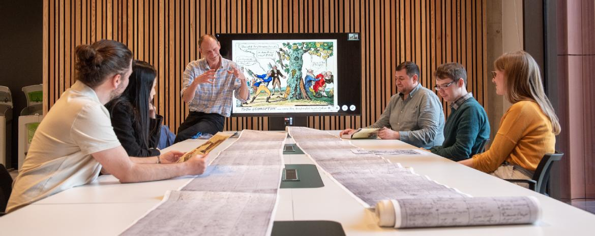
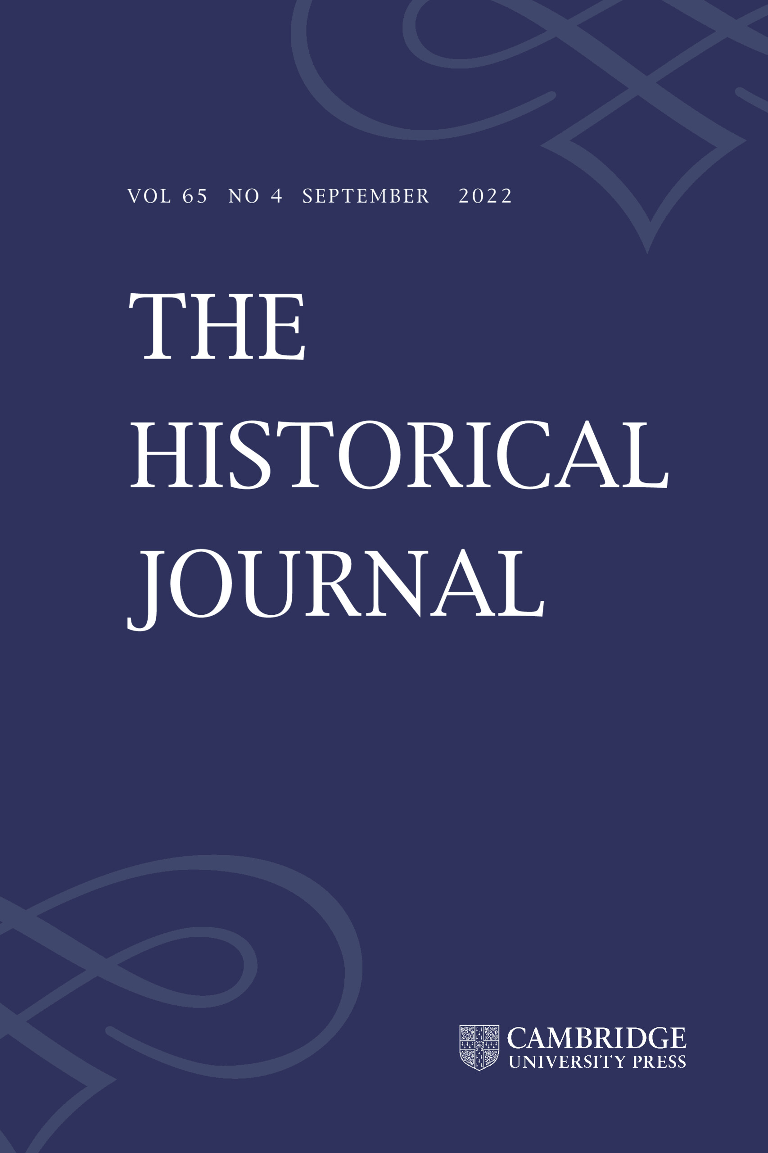


So… what DO we do?
Academic communication… through teaching, conferences, publishing

Slide 5
So… what DO we do?
Advise and inform… heritage organisations like museums;

Slide 6

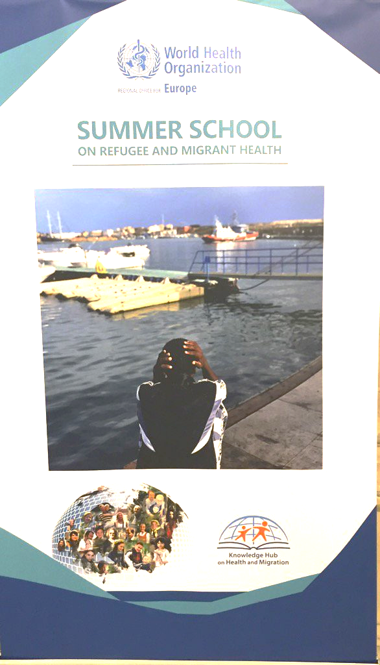
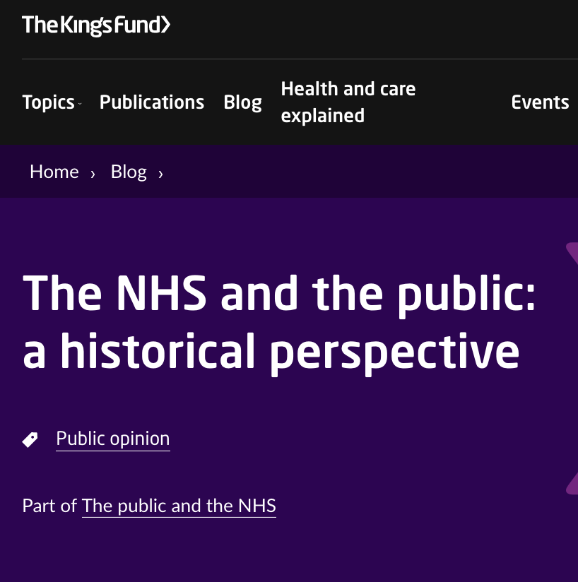
So… what DO we do?
Advise and inform… policy and policy-makers…

Slide 7
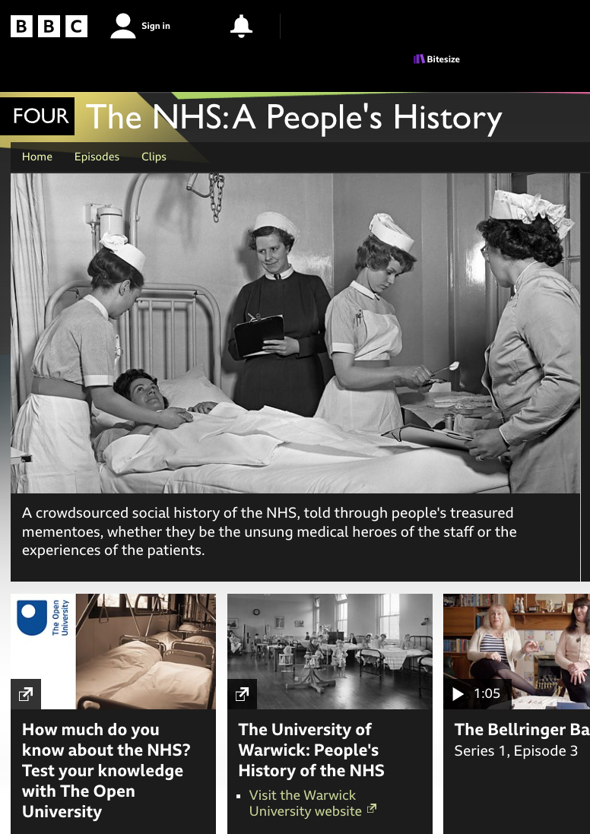
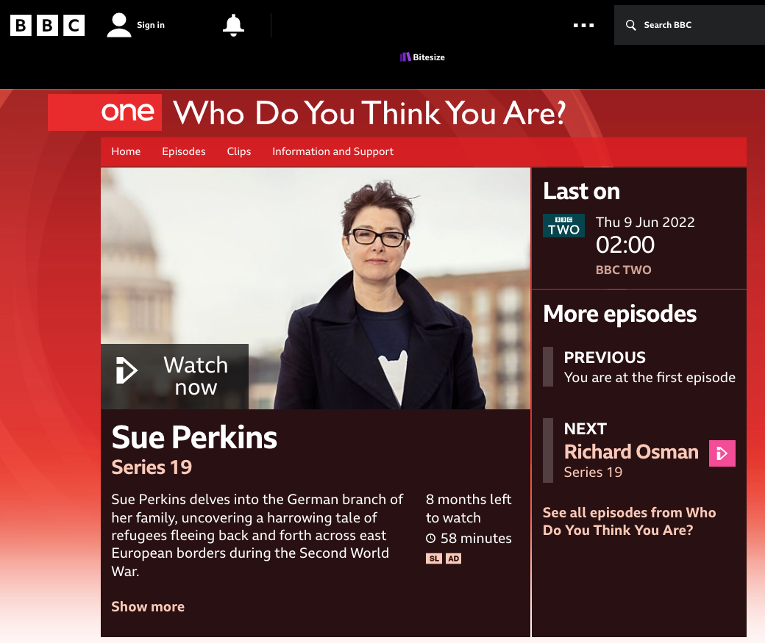
So… what DO we do?
Advise and inform…
the media and the public…

Slide 8
Generating Ownership, Excitement and Trust Through Better Understanding of Our Shared Pasts
Recognise the historically global nature of knowledge and knowledge production
Showcase more inclusive and representative stories
Include users and consumers in the story of science, technology, medicine, culture…

Slide 9
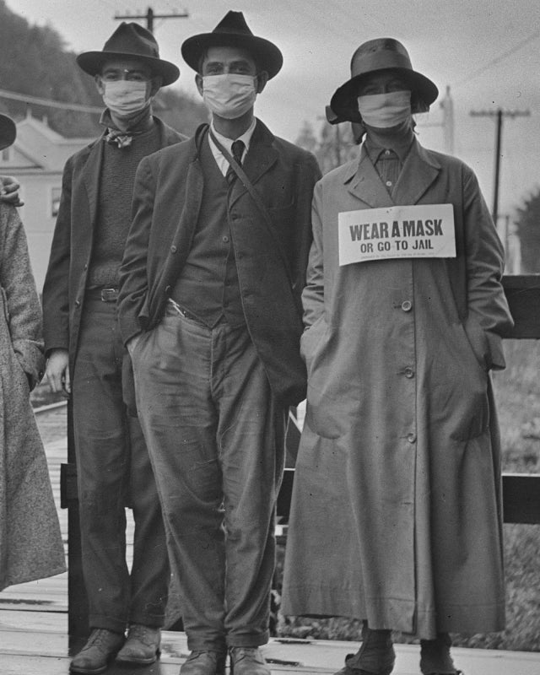
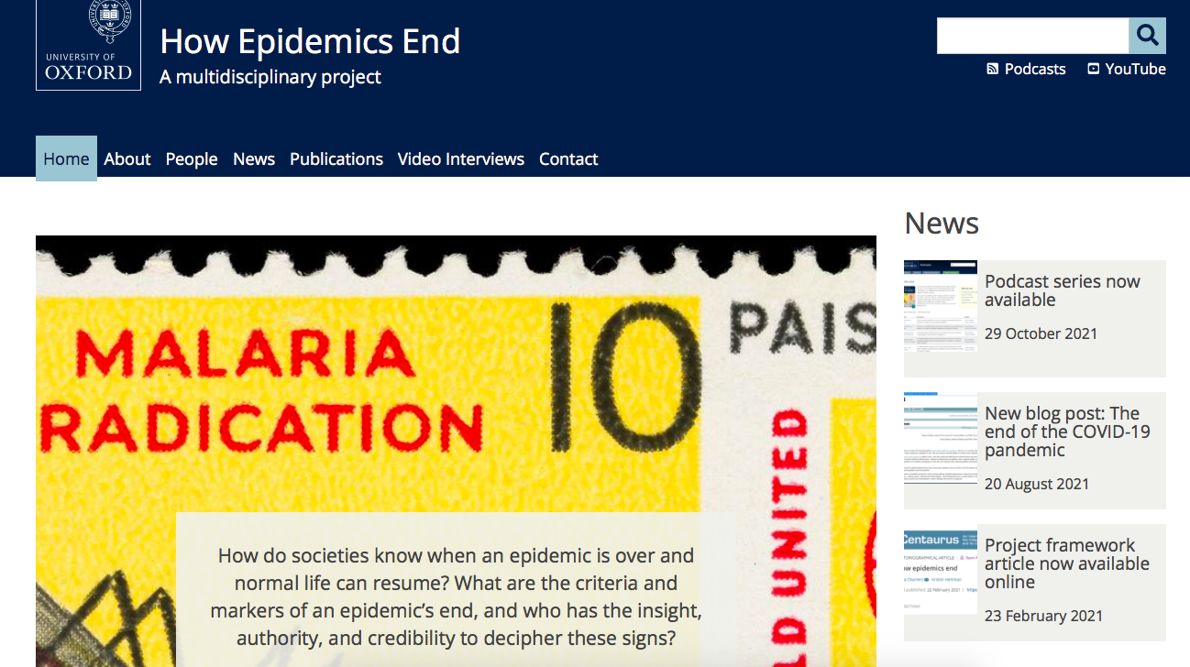
How does this work in practice?
Let’s talk about Covid…
Precedents and the ‘lessons’ of history…

Slide 10
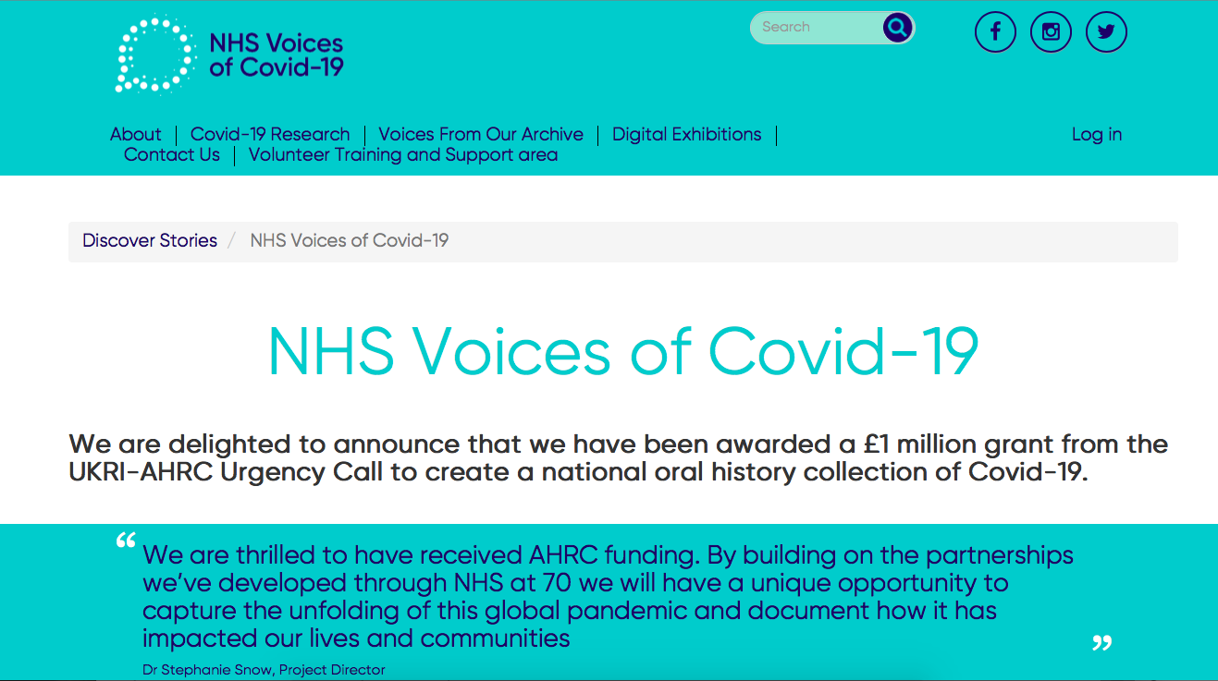
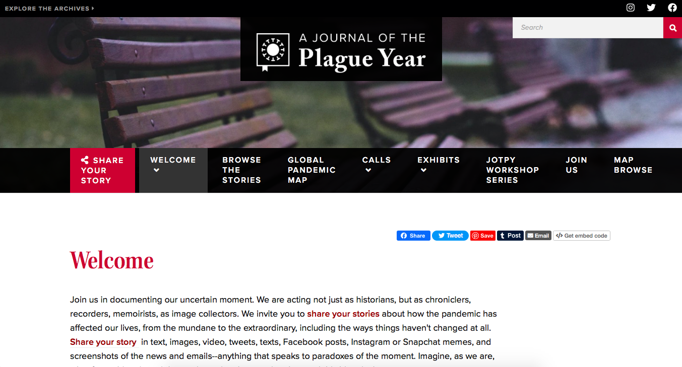
How does this work in practice?
Let’s talk about Covid…
Collecting for the future…

Slide 11
So you will be a historian…
What do YOU want to do?

