Slide 1
The Abortion Debate

Slide 2

Why was there little debate about abortion pre-1973?
Why did Catholics oppose abortion?
Why did feminists oppose abortion?

Slide 3
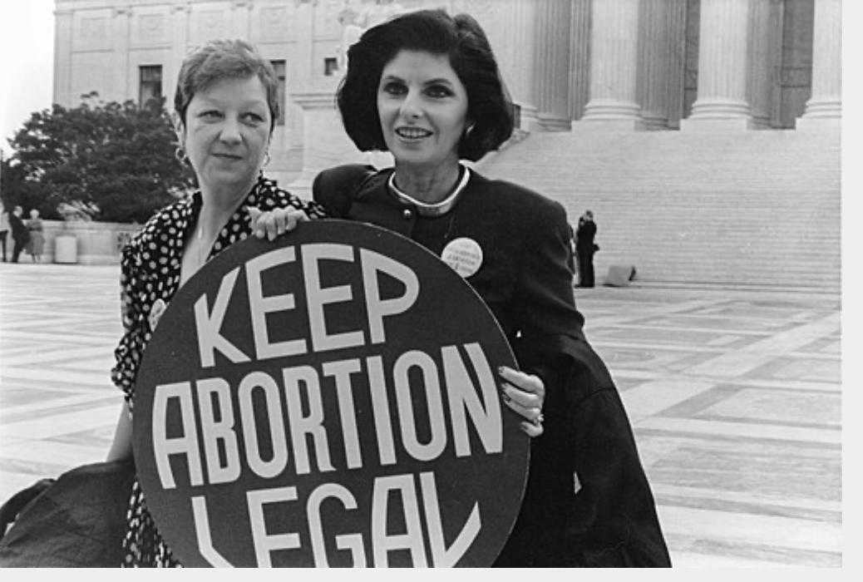
Roe vs Wade
What did it decide?

Slide 4
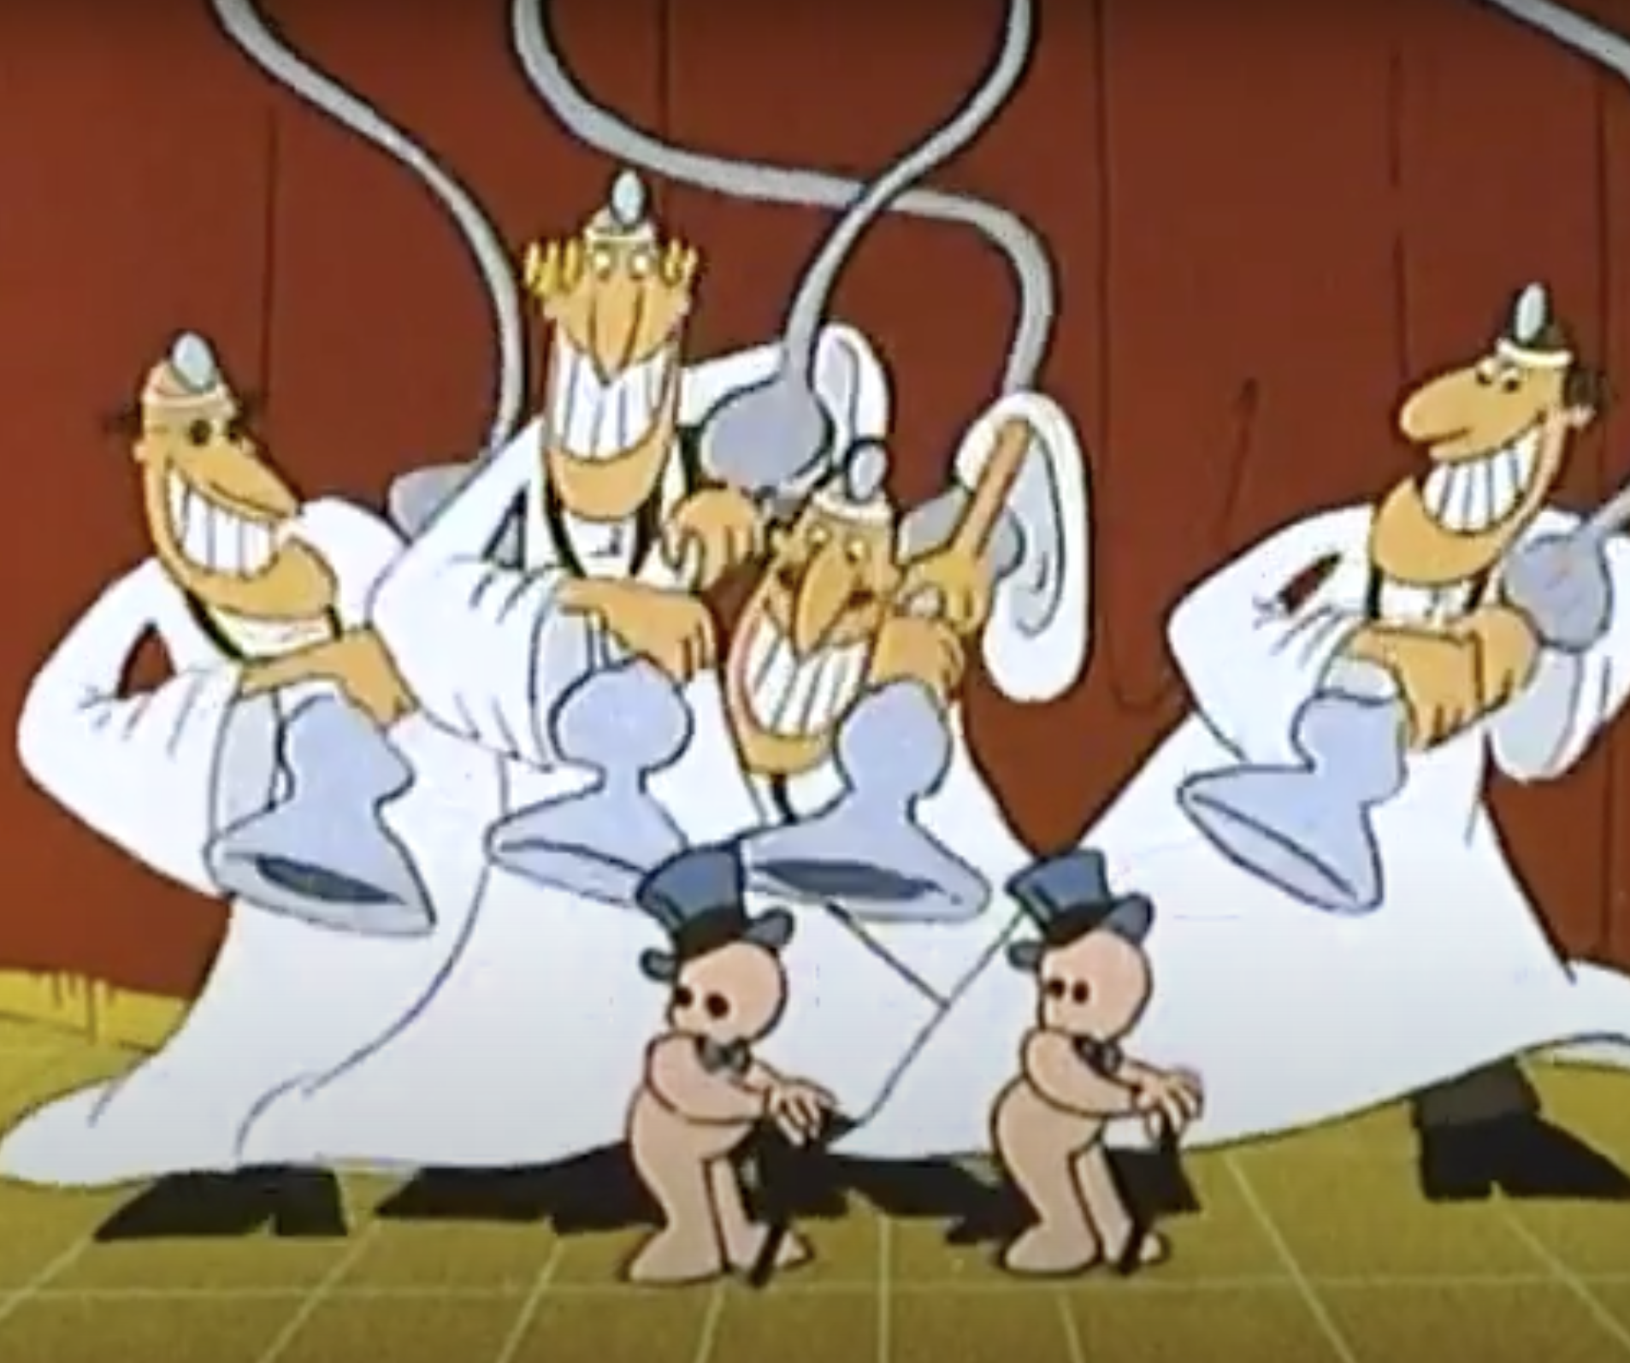
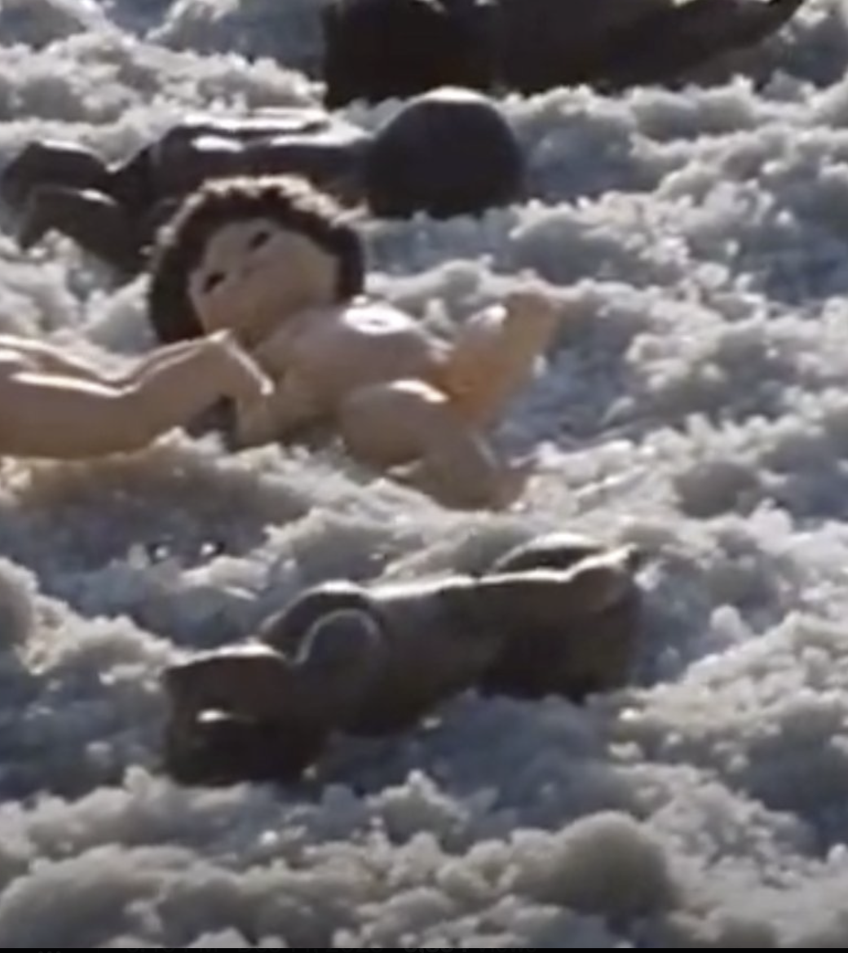
What Ever Happened to the Human Race? (1979) https://www.youtube.com/watch?v=py02pQTyeTE

Slide 5
Why has abortion become the key single issue in the United States?
What does it signify?
Why abortion? Why not drugs, immigration, the economy, foreign policy?
What will be the new divisive cultural issue? Trans rights, same-sex marriage?

Slide 6
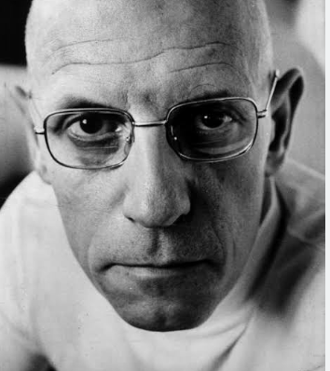
Biopolitics
“ The ways in which modern power structures regulate and govern everyday life, behaviors, and bodies.”
Sanitation
Medical care
Environmental Policy
Politics concerning the body

