Slide 1
Archives and Secrets
Week 3

Slide 2
Operation Legacy
Why did the UK start to burn or hide state documents?
What kind of documents did the UK dispose of?
How did this differ throughout the Empire?

Slide 3
Supplementary questions
Did Operation Legacy work?
What should be the role of the historian of the British Empire?
How does finding out the truth about colonization affect a) the colonizer b) the colonized?

Slide 4
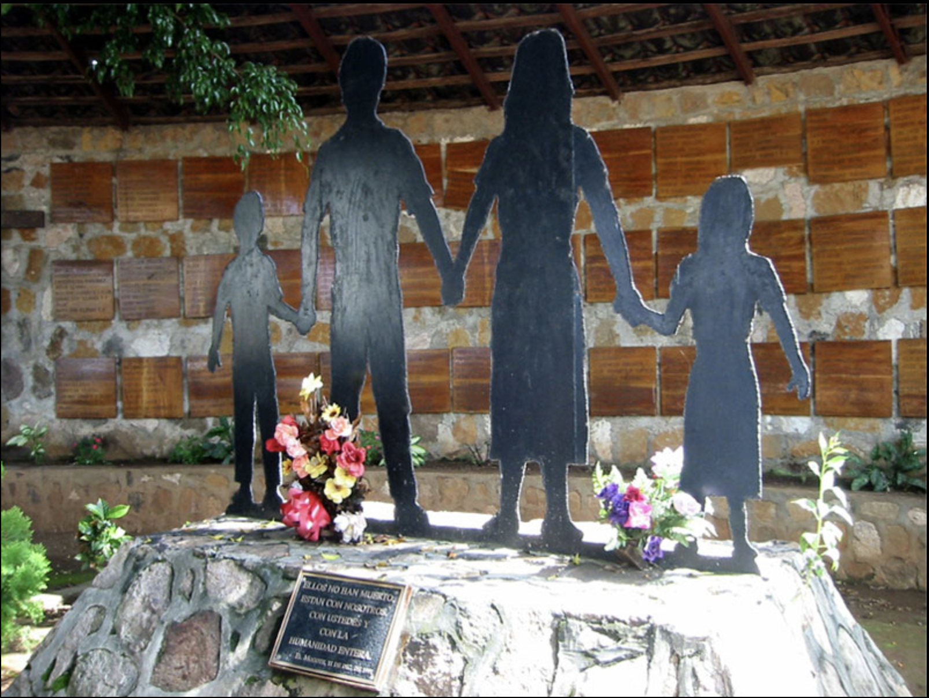
Do secret histories matter?

Slide 5
Between 1947 and 1989, most Latin American countries employed counterinsurgency techniques to repress communists, radicals and guerrillas.
Counterinsurgency strategies were hatched in the “grey zone” of politics or the “covert netherworld”. This was the preserve of soldiers, spies, policemen, criminals, and professional hitmen.
Transitional Justice. As part of the process of democratization some Latin American countries held Truth and Reconciliation Commissions and prosecuted Dirty War security agents. They uncovered the “grey zone”.
E.g. Chile, Peru, Uruguay, Argentina.

Slide 6
However, other Latin American countries did not. They refused to open archives, gave amnesties to security agents, and either refused to hold Truth and Reconciliation Commissions or held ineffective or incomplete ones.
E.g. El Salvador, Honduras, Mexico.

Slide 7
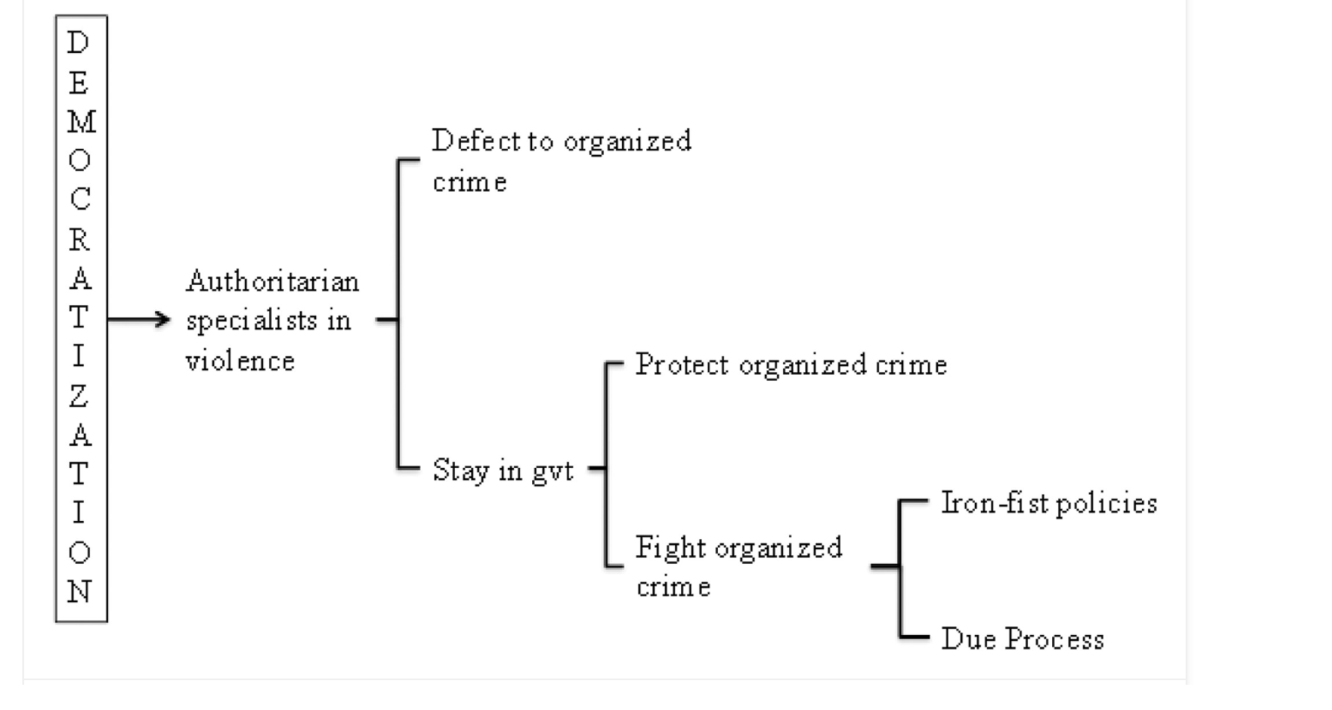
Guillermo Trejo Juan Albarracín, and Lucía Tiscornia, “Breaking state impunity in post-authoritarian regimes: Why transitional justice processes deter criminal violence in new democracies”

Slide 8
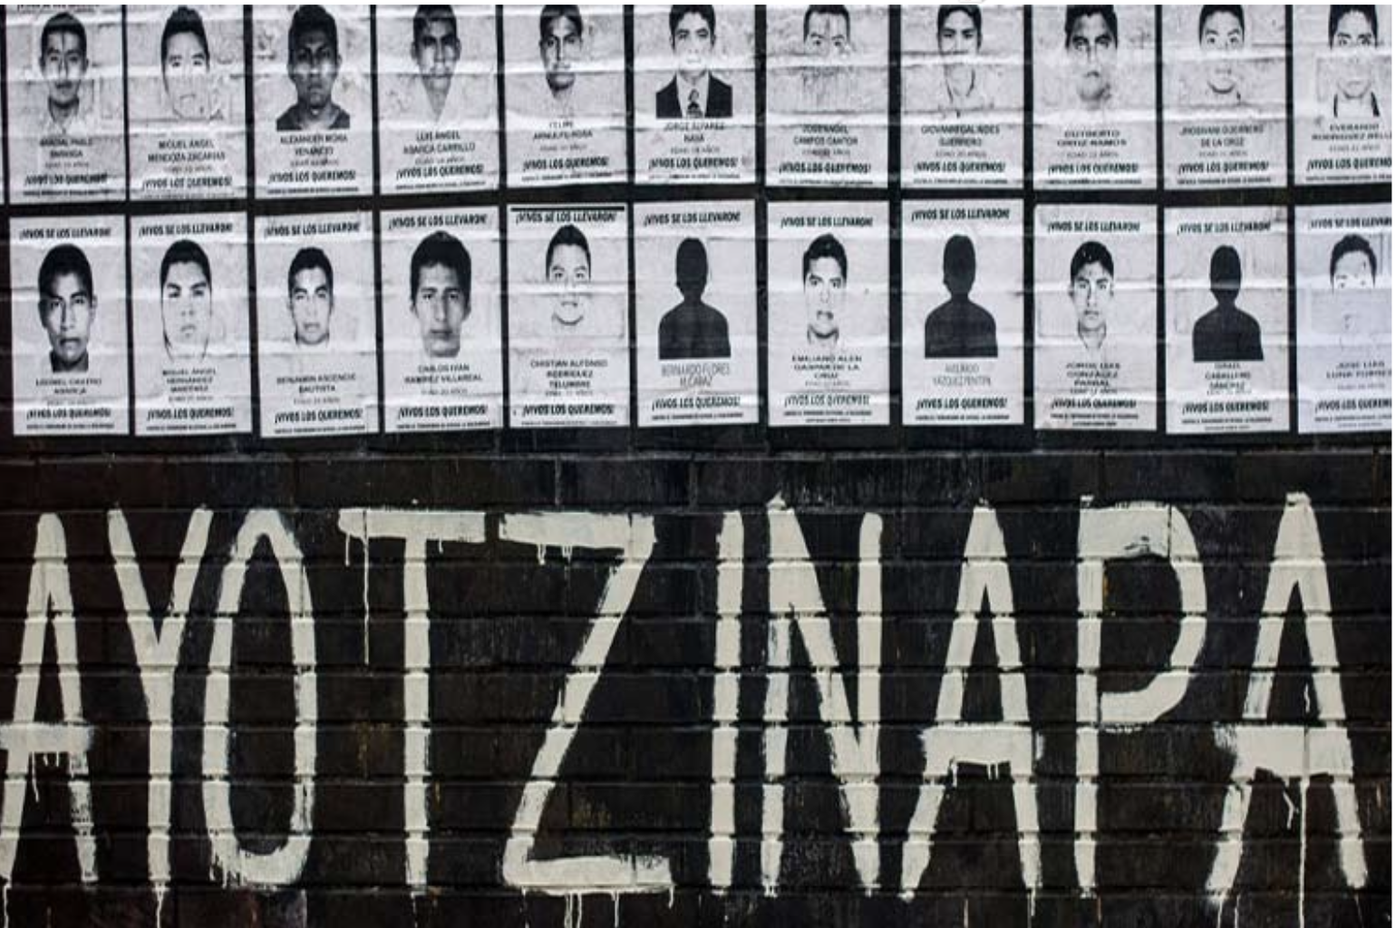
The continuing specter of secrecy

Slide 9
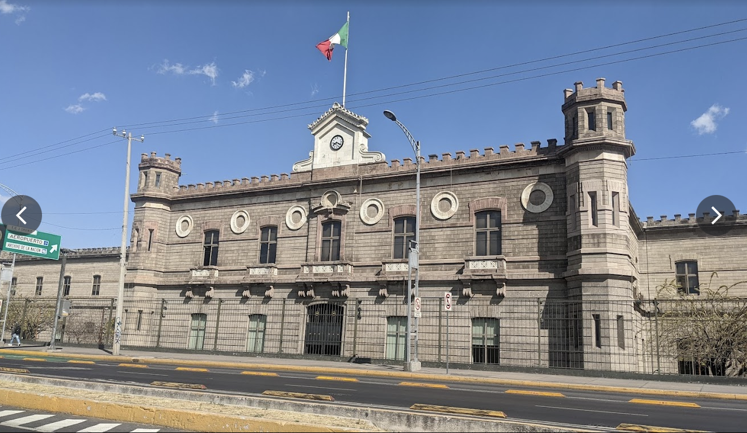
How the state keeps secrets in Mexico

Slide 10
The United States
What role did the USA play in the Latin American dirty wars?
Why did the US maintain its secrets?
How does the USA maintain its secrets?
Ways out?

