Slide 1
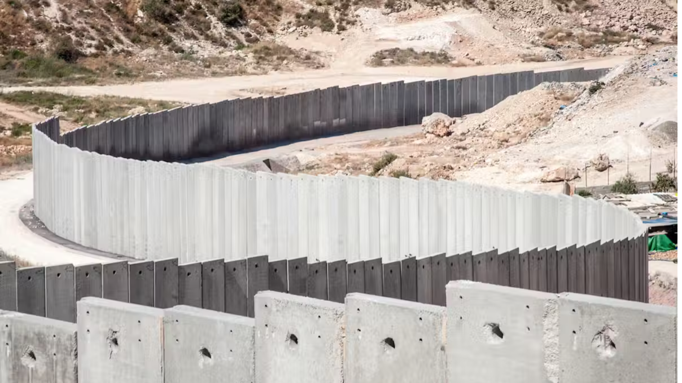
Borders

Slide 2
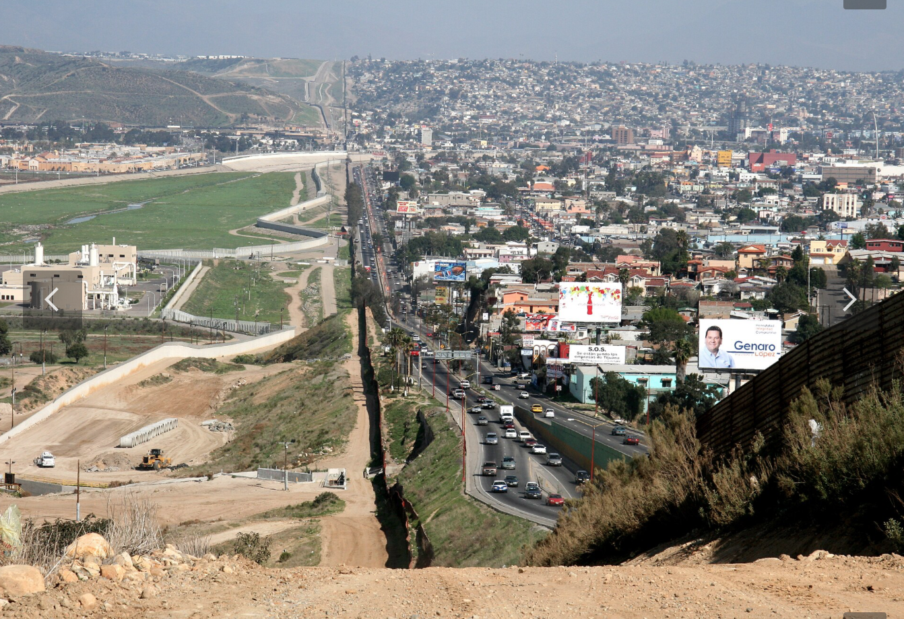
How were borders invented?
How did pre-modern borders function?
Why and when did states introduce borders?
How do borderlands relate to borders?

Slide 3
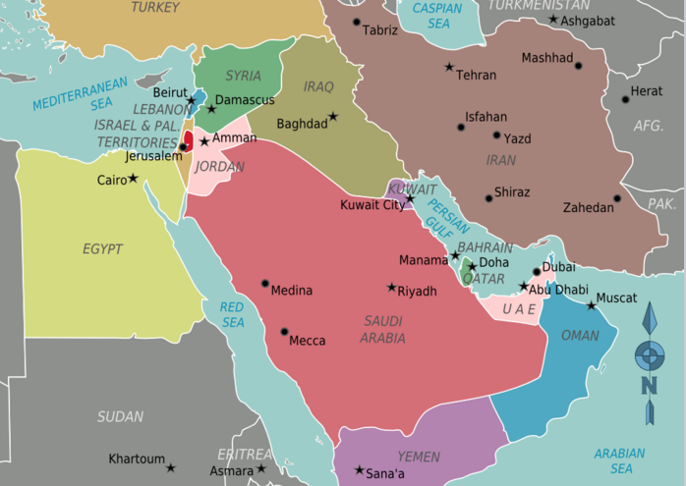
How do borders intersect with histories of colonialism?
“Britain must therefore be understood as a contemporary colonial space” .
How do contemporary immigration regimes act as “colonial systems”?

Slide 4
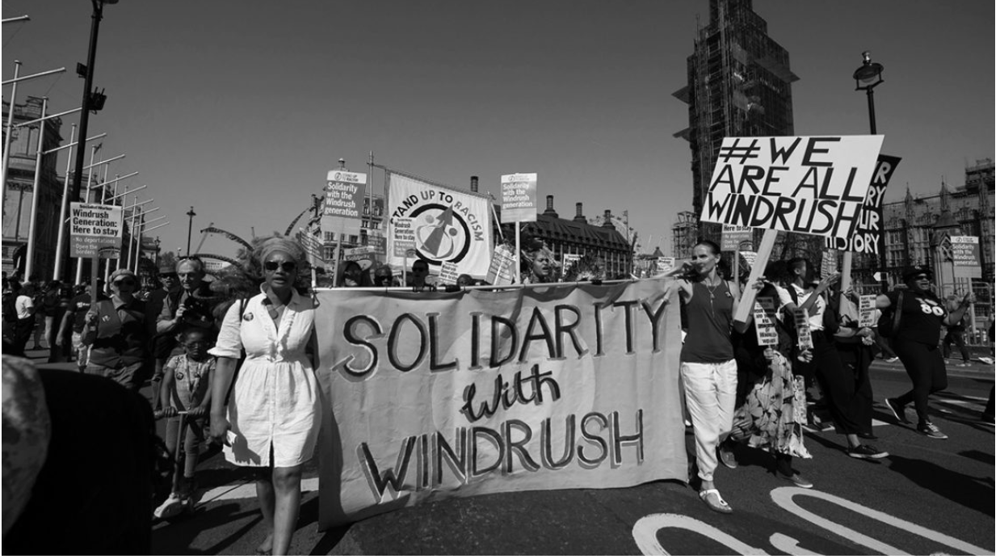
What does the Windrush scandal tell us about race and immigration?

Slide 5
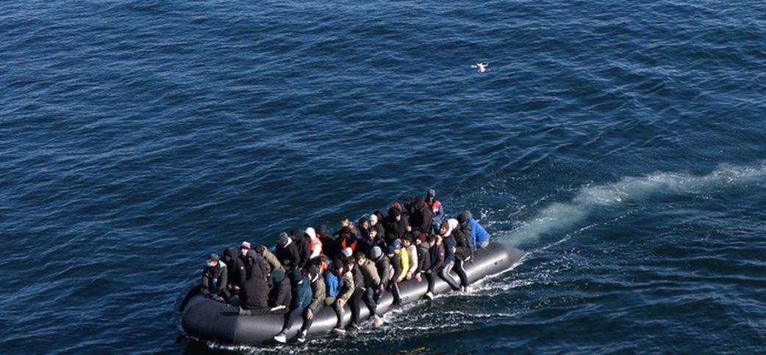
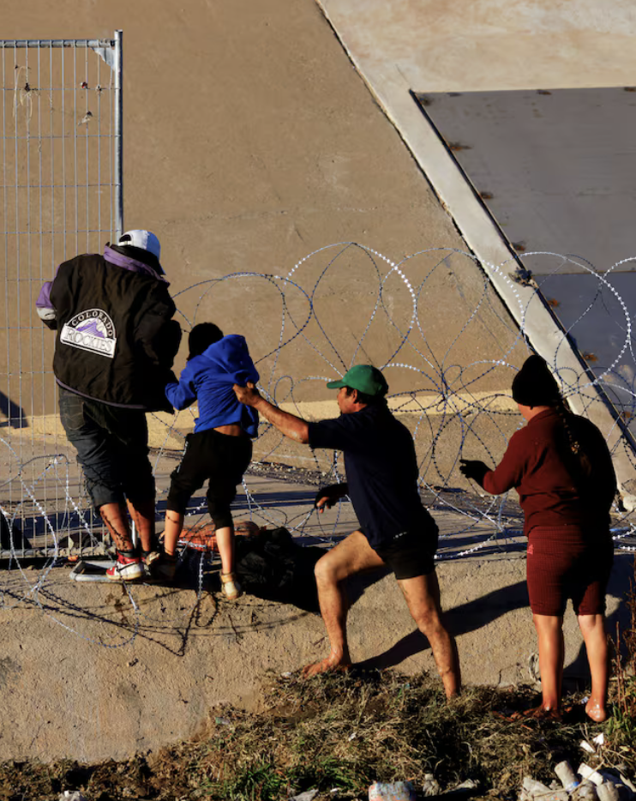
“Irregularized migration should be seen as anti colonial resistance.”

Slide 6
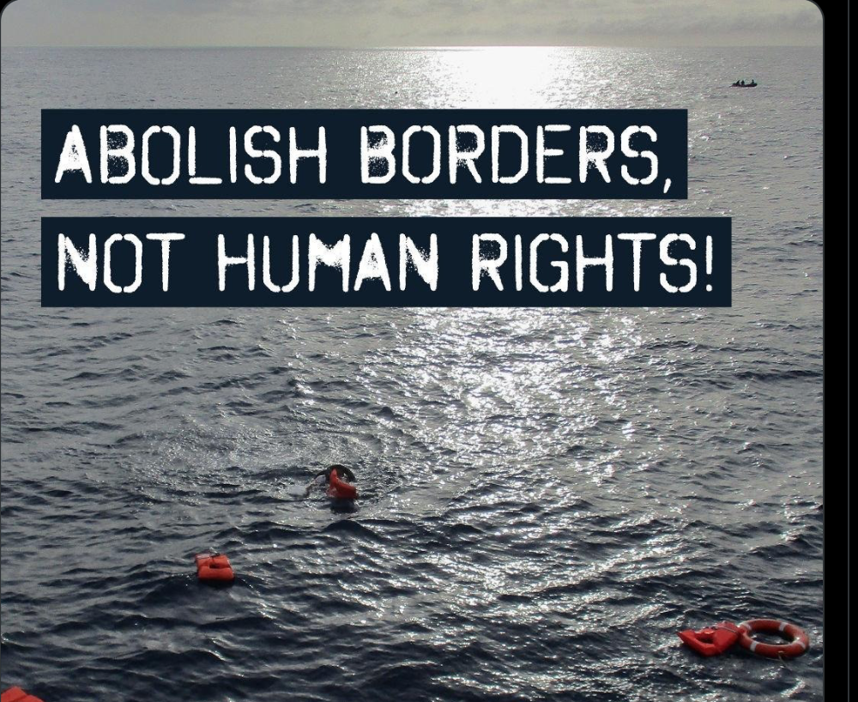
What are the arguments for the abolition of borders?

Slide 7
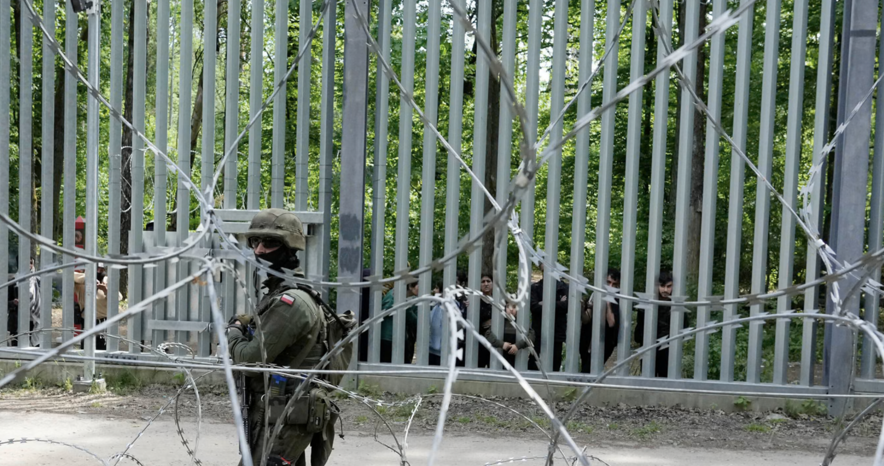
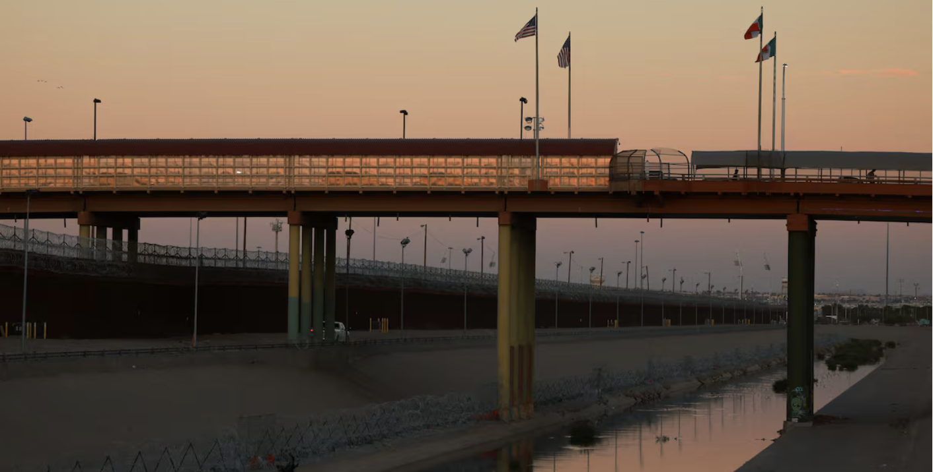
What no one talks about
Migrant buffer zones
Use of migrants as means to destabilize countries.

Slide 8
“

