Slide 1

Capitalism and bullshit

Slide 2
Some definitions
What is capitalism?
What is neoliberalism?
What is surplus value?

Slide 3

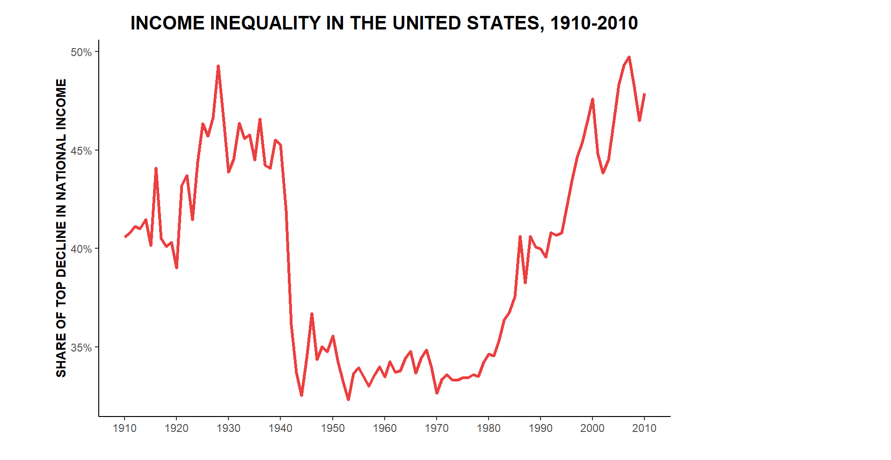
How do you stop a Revolution?

Slide 4
Freedom
Neoliberalism and freedom
Karl Polanyi, The Great Transformation

Slide 5
Bullshit jobs
What is a bullshit job?
Types of bullshit job
Flunkies
Goons
Duct tapers
Taskmasters

Slide 6
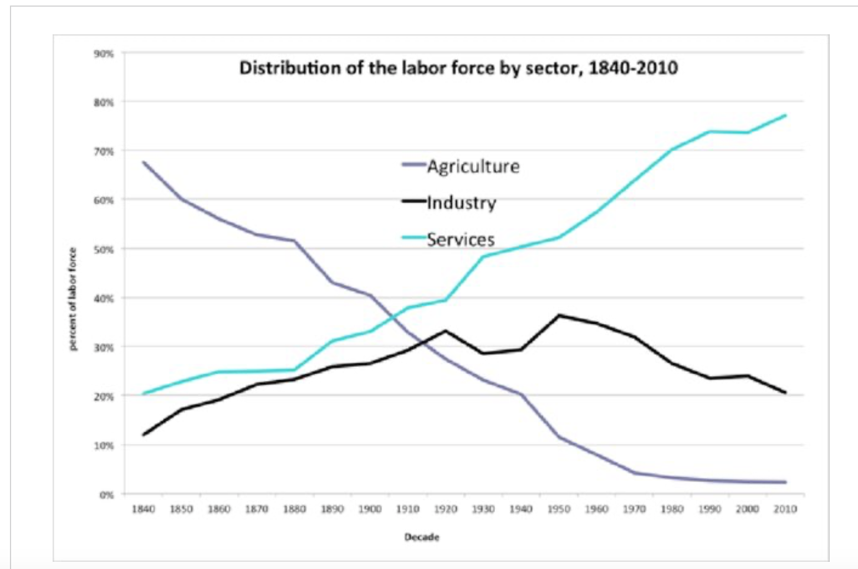
Why do we live in the age of bullshit jobs?
Is the FIRE economy a new form of feudalism?
Is the service sector “guard labour”?

