Slide 1
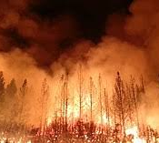

Capitalism and the Climate Emergency

Slide 2
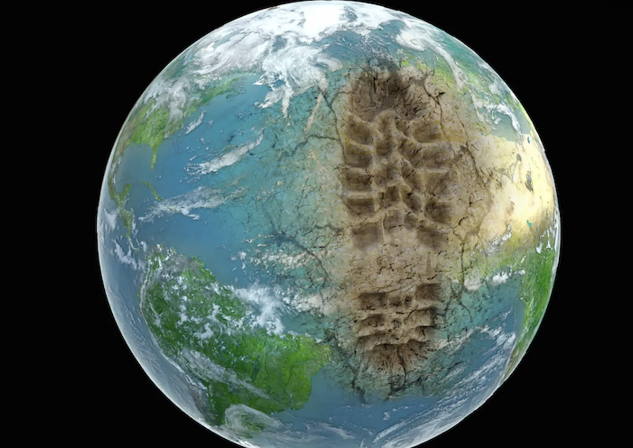
What is the Anthropocene?
What narrative of human development does the term “anthropocene” rely on?

Slide 3
The colonial critique (Raj Patel and Jason Moore)
Where do Patel and Moore locate the beginnings of capitalism?
How did this new form of capitalist development differ from feudalism?
How did this new form of capitalism affect the environment?
Why is the epistemological separation between “nature” and “society” crucial to the development of capitalism?

Slide 4
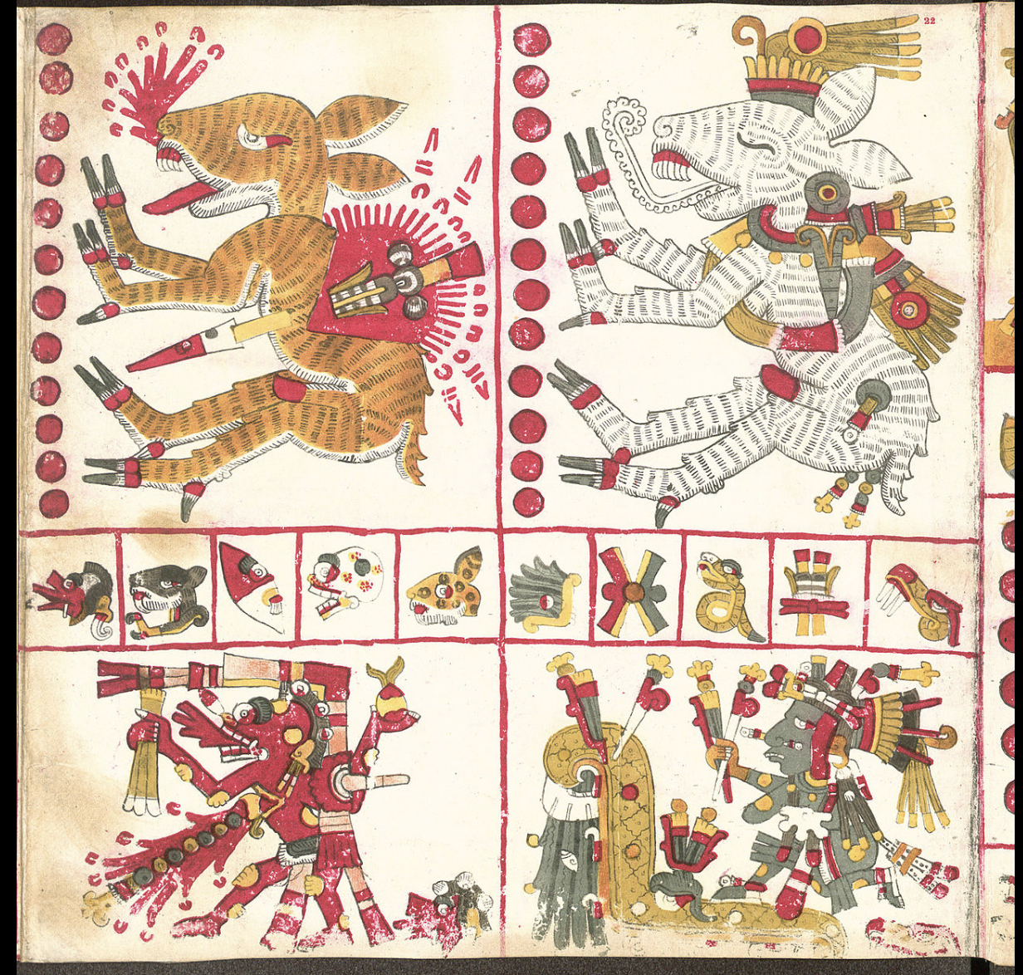
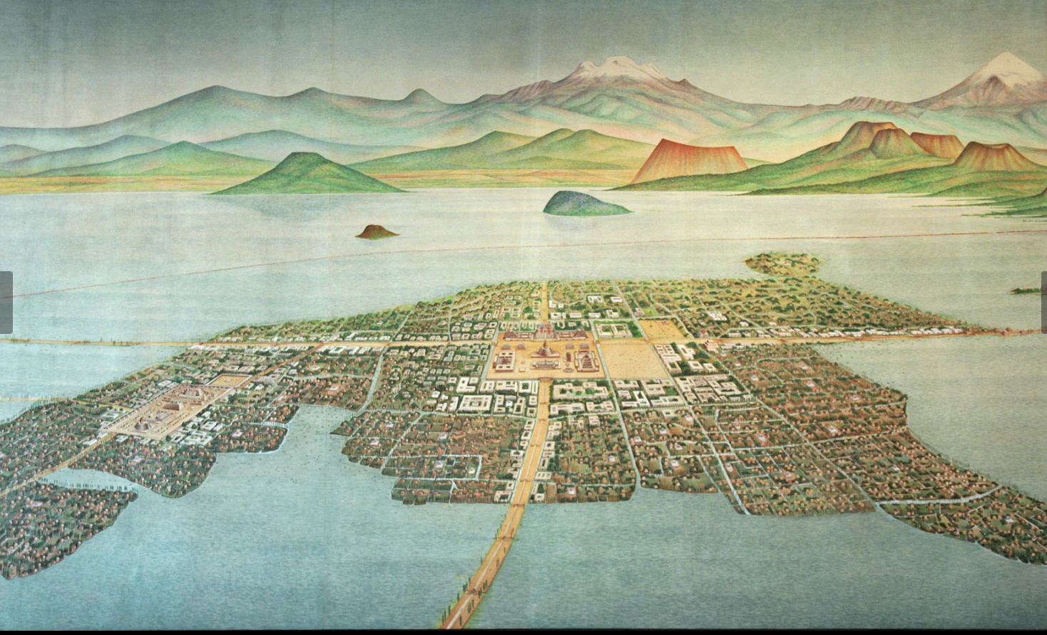
How did pre-capitalist societies view nature?

Slide 5
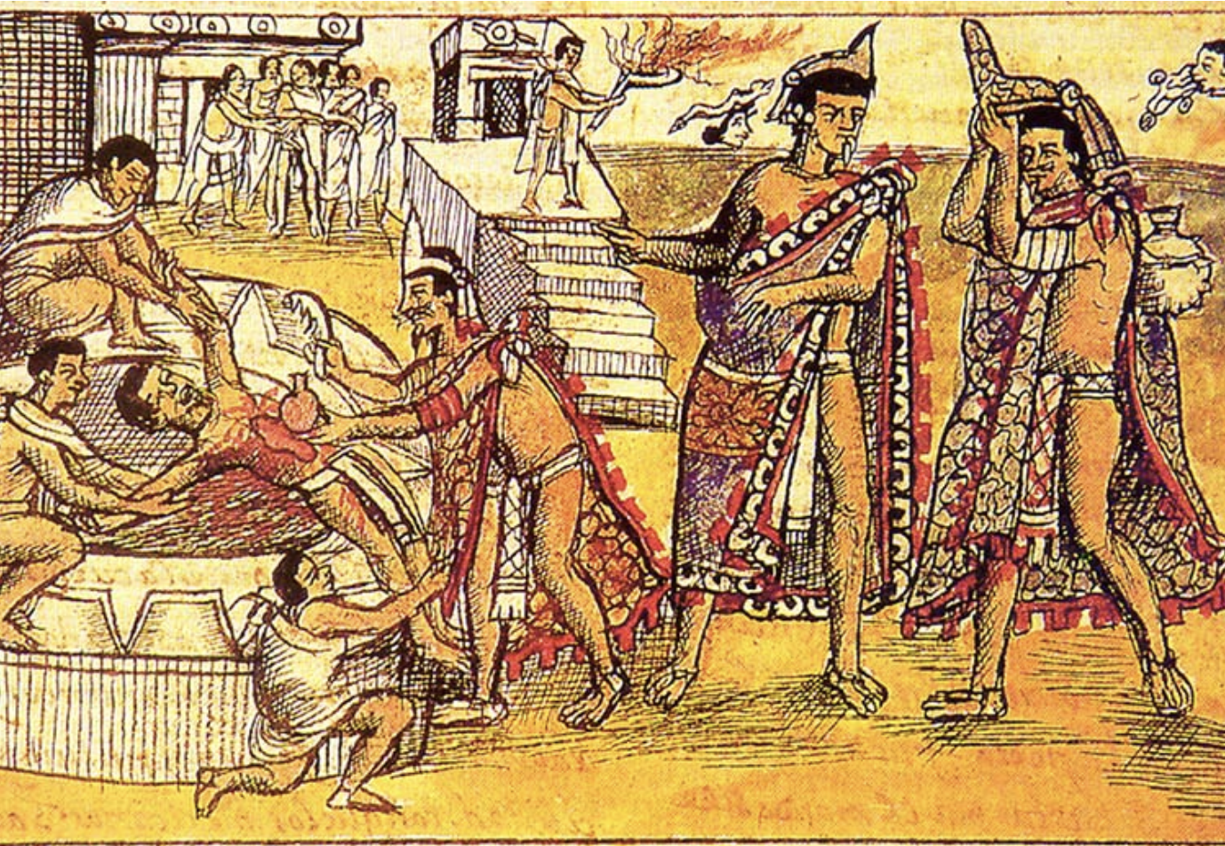

Slide 6
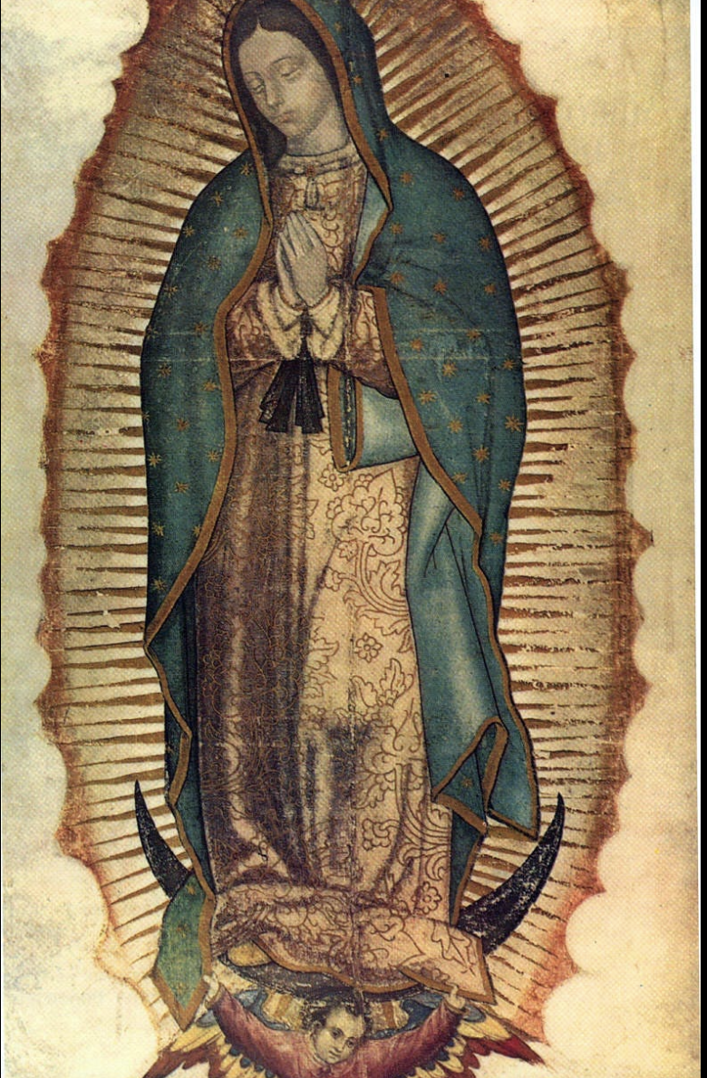
Religion and nature?

Slide 7
The fossil fuel critique (Andreas Malm)
Where does Malm locate the beginnings of capitalism?
What social and economic factors did this “leap forward” rely on?

