Slide 1
The Mexican Cartels: A Brief History
Benjamin T. Smith
University of Warwick

Slide 2
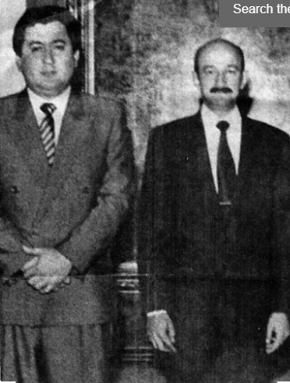
Phase 1: 1960-c. 1990, the State as Mafia
“What did you do to turn them into real police officers? Did you give them the budget? Did you give them gas for the trucks? Did you give them better weapons, trucks, vehicles, intelligence, information, technology, than the traffickers had? If you didn't give them any of this, really, what did you give them? You sent them off to become what they became - to take money from drug traffickers in order to fight them. Maybe they take the money from some of the traffickers to fight the other traffickers.”

Slide 3
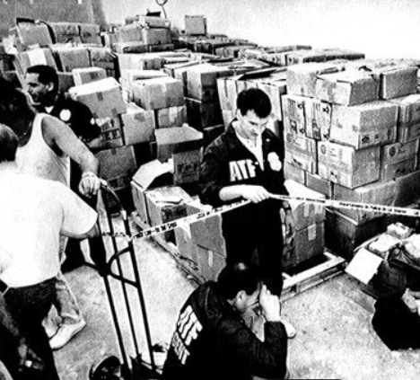
Phase 2: 1989-2000, The Cartelization of Mexico

Slide 4
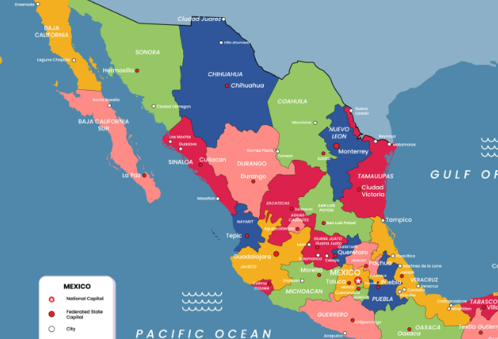
Phase 2: 1989-2000, The Cartelization of Mexico
Ciudad Juárez: Rafael Aguilar Guajardo (former DFS agent)
Tecate: Joaquín Guzmán Loera aka El Chapo (trafficker)
San Luis Río Colorado: Hector Palma aka El Güero (trafficker)
Nogales and Hermosillo: Emilio Quintero Payan (trafficker)
Tijuana: Jesus Labra Aviles (trafficker)
Sinaloa: Ismael Zambada aka El Mayo and Baltazar Díaz Vega (traffickers)
Mexicali: Rafael Chao López (former DFS agent)
Matamoros: Juan Garcia Abreu (trafficker) and Carlos Aguilar (former federal policeman)
Freedom to traffic through all zones: Rigobtero Campos Salcido (former DFS agent)

Slide 5
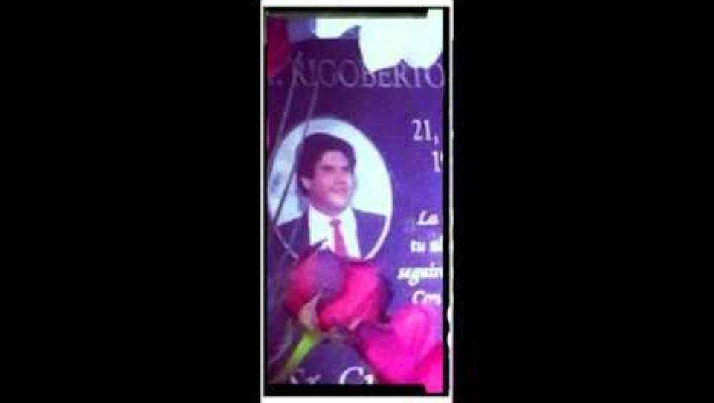
The first cartel victim, Rigoberto Campos Salcido

Slide 6
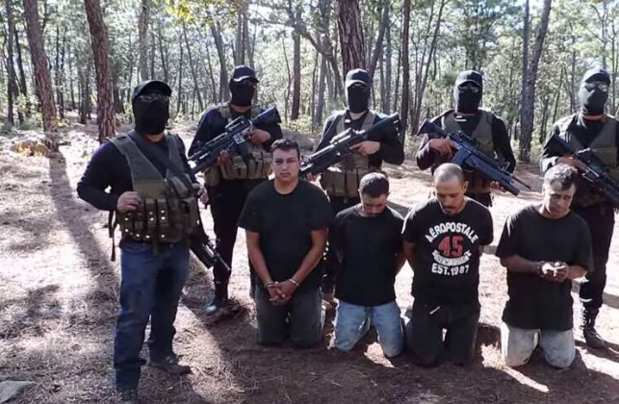
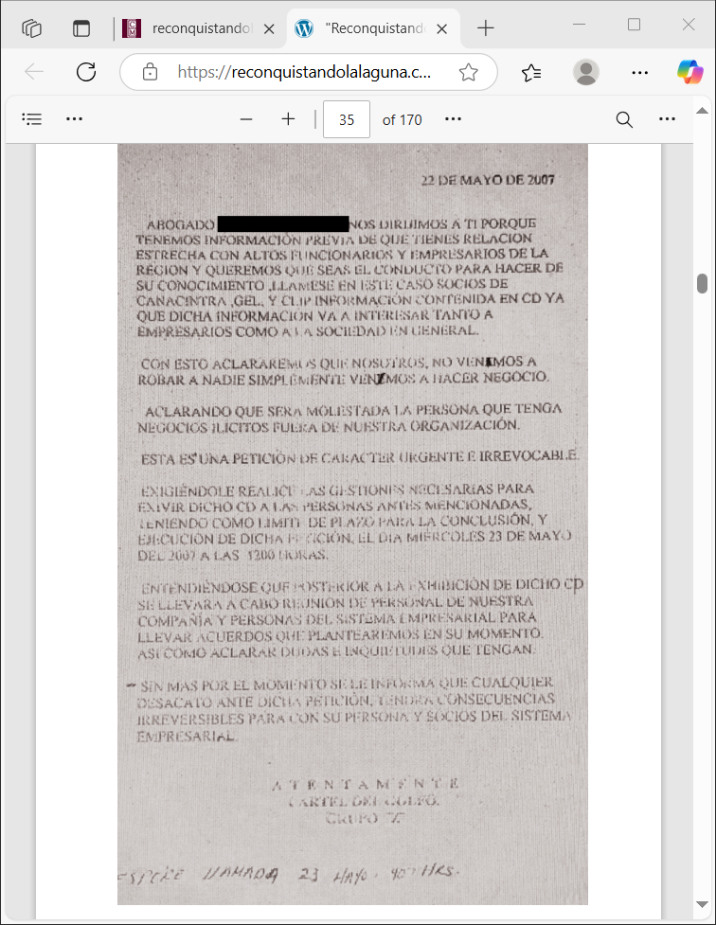
Phase 3: 2000-2025, Shake down everything

