Slide 1
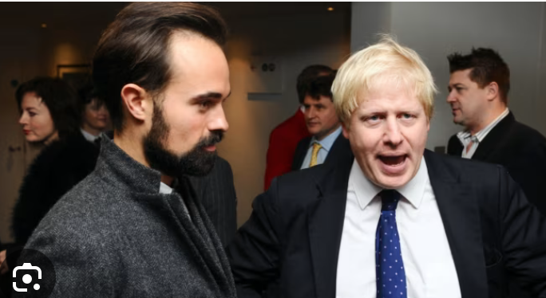
Corruption

Slide 2
Standard definition of corruption as “use of public goods for private gain”

Slide 3
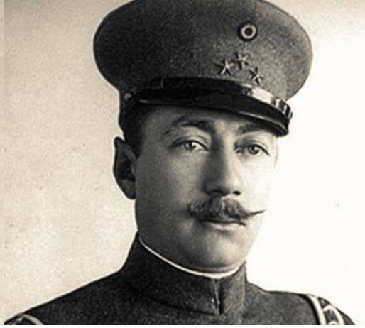
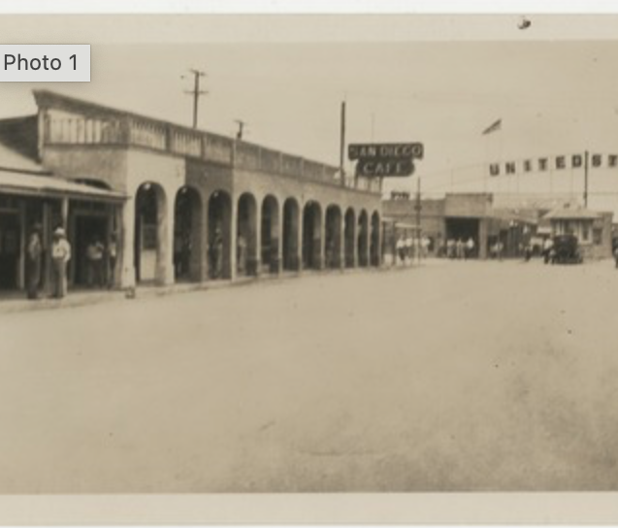
Some examples
Esteban Cantu, Governor of Baja California

Slide 4
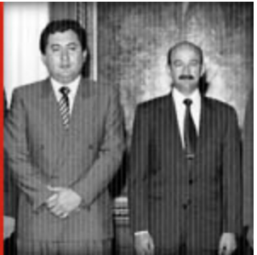
Guillermo Gonzalez Calderoní, head of Mexican Federal Judicial Police (PJF)
PBS: Why are so many Mexican police commanders corrupt?
GCC: What did you do to turn them into real police officers? Did you give them the budget? Did you give them gas for the trucks? Did you give them better weapons, trucks, vehicles, intelligence, information, technology, than the traffickers had? If you didn’t give them any of this, really, what did you give them? You sent them off to become what they became — to take money from drug traffickers in order to fight them. Maybe they take the money from some of the traffickers to fight the other traffickers.

Slide 5
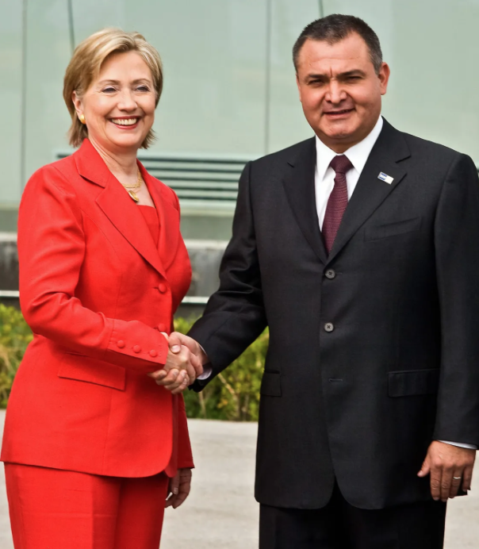
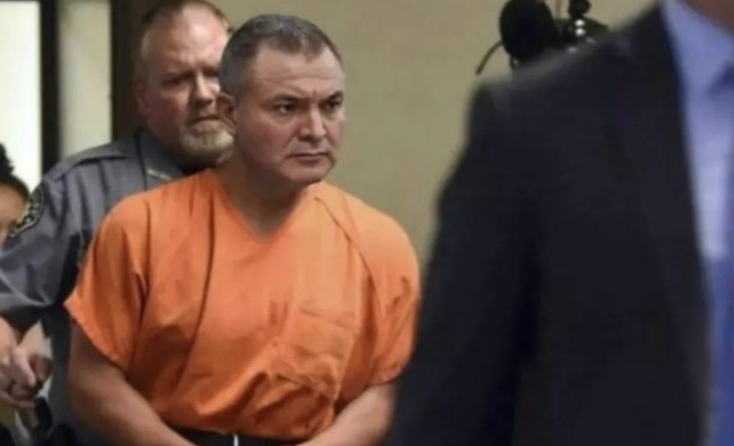
Genaro García Luna, head of PJF

Slide 6
Some questions about traditional idea of corruption
Is it simply a stick used to beat non-Western countries?
Can it be generalized? What, for example, about the traditional practice of gift giving in some societies? Or guanxi in China, or compadrazgo in Latin America.
What about the role of the law? Have Western countries simply placed a veil of legality over corrupt practices? Lobbying, money laundering.
Petty corruption vs grand corruption. Alan Riding claimed corruption was “oil and glue” of Mexican system. Vs failed infrastructure projects.
Does corruption help OR hinder economic development?

Slide 7
Aiysha Varraich, and Bo Rothstein, Making Sense of Corruption
They argue that there is a universal idea of corruption
What evidence do they present?
What is their idea of corruption?
Do you see any problems with it?

