Slide 1
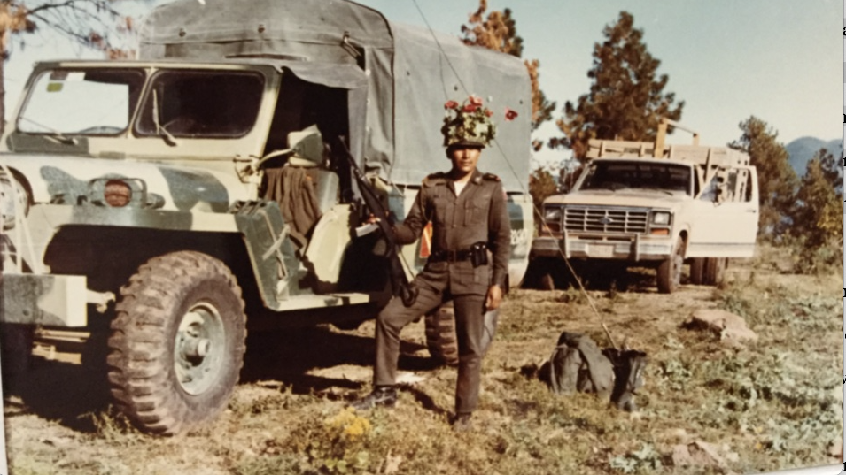
The First War on Drugs
Benjamin T. Smith
University of Warwick

Slide 2
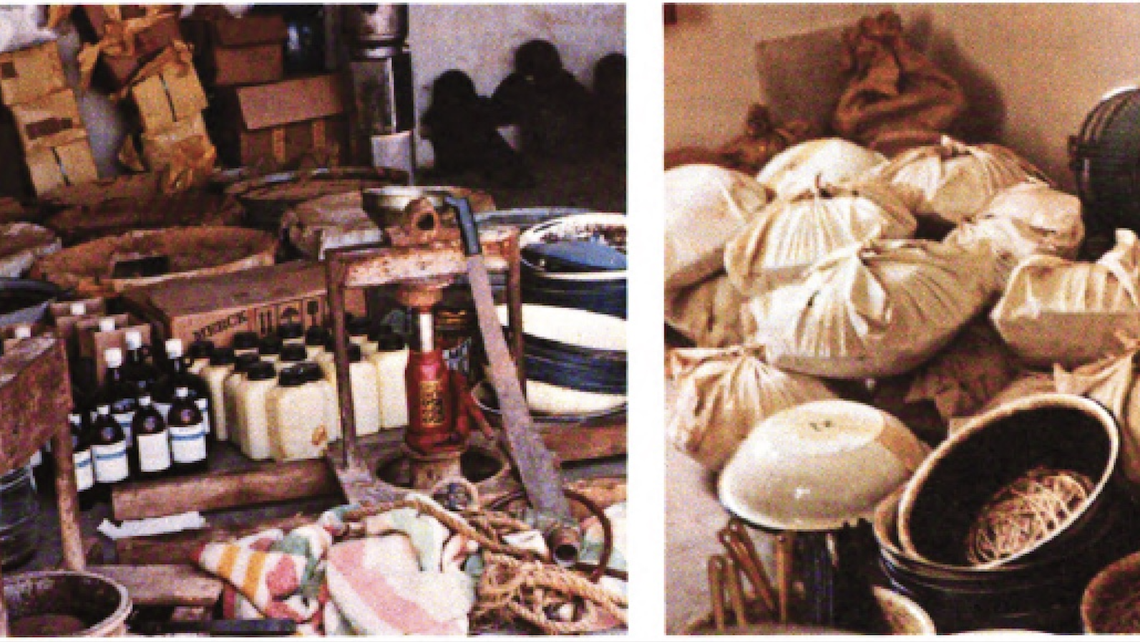
PLAN
What caused the first war on drugs?
What did the first war on drugs involve?
What were the effects?

Slide 3
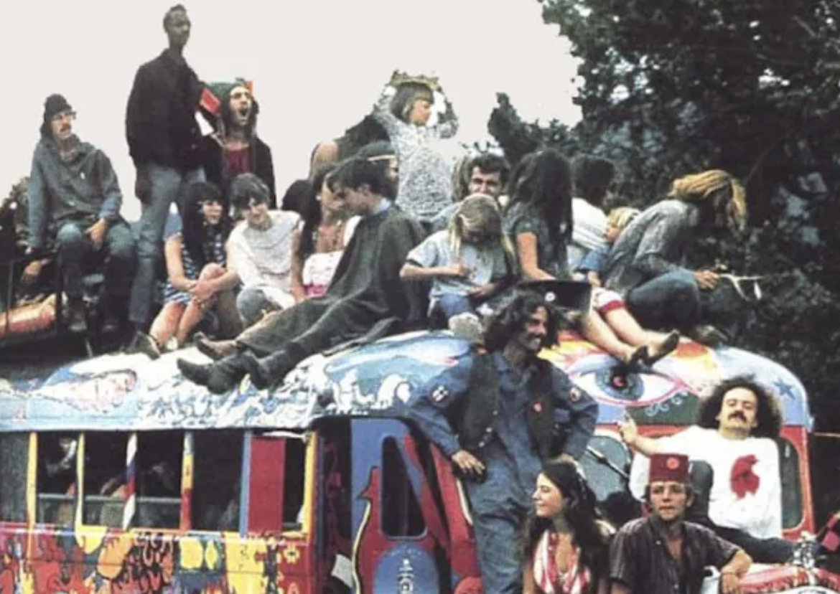
Between 1965 and 1975, there was a huge upswing in U.S. drug use.
By late 1970s, 40% of high school students smoked marijuana
In 1975, there were 600,000 heroin addicts in the USA

Slide 4
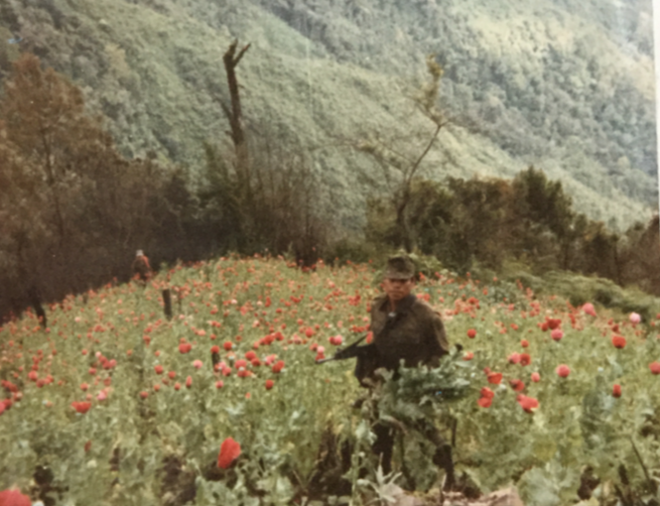
U.S. narcotics increasingly came from Mexico.
Seizure of marijuana at the border rose from 300kg in 1961 to 81 tons in 1969.
By 1976, 95% of U.S. heroin came from Mexico

Slide 5
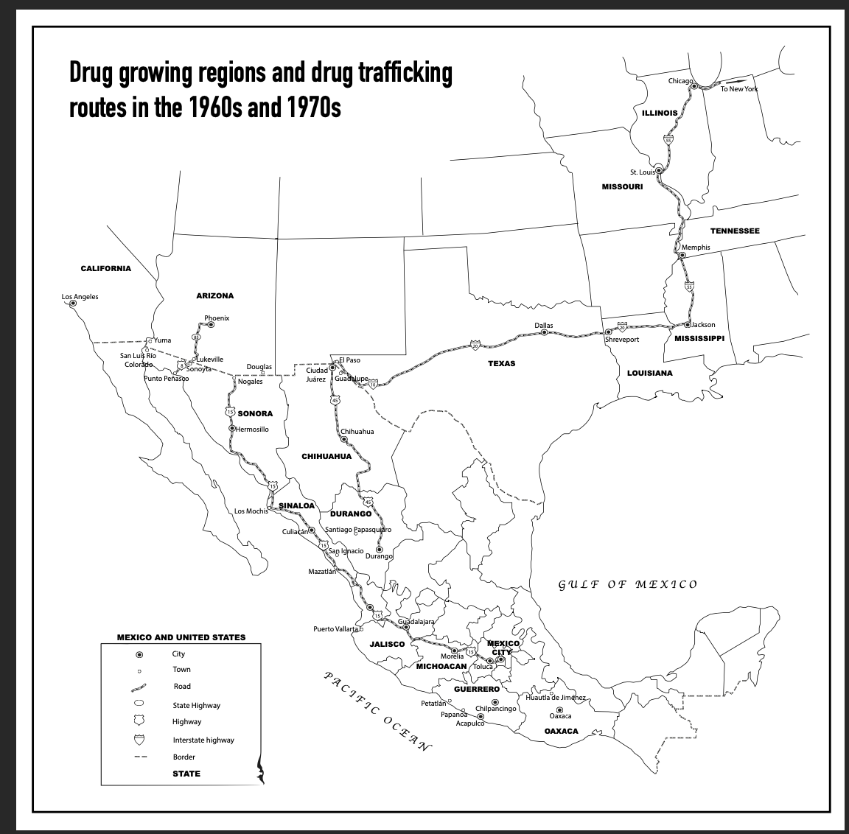

Slide 6
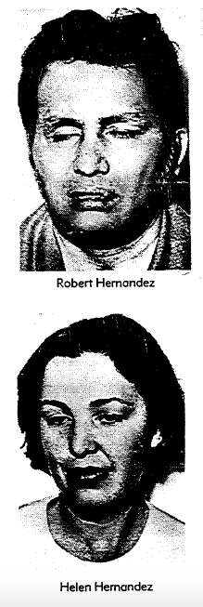
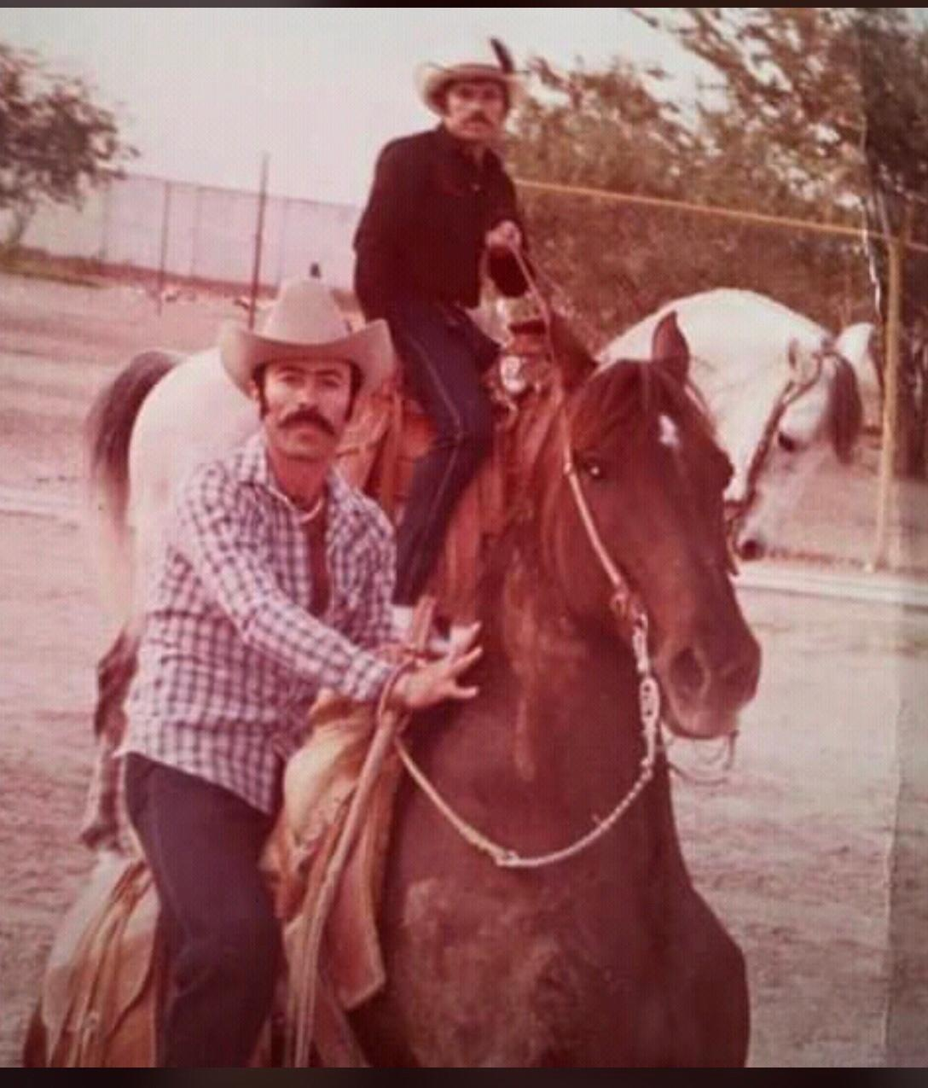
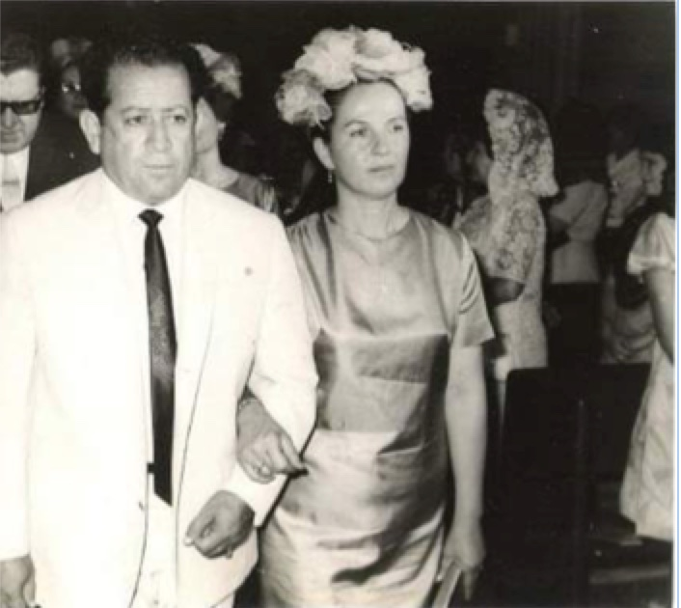
The major traffickers

Slide 7
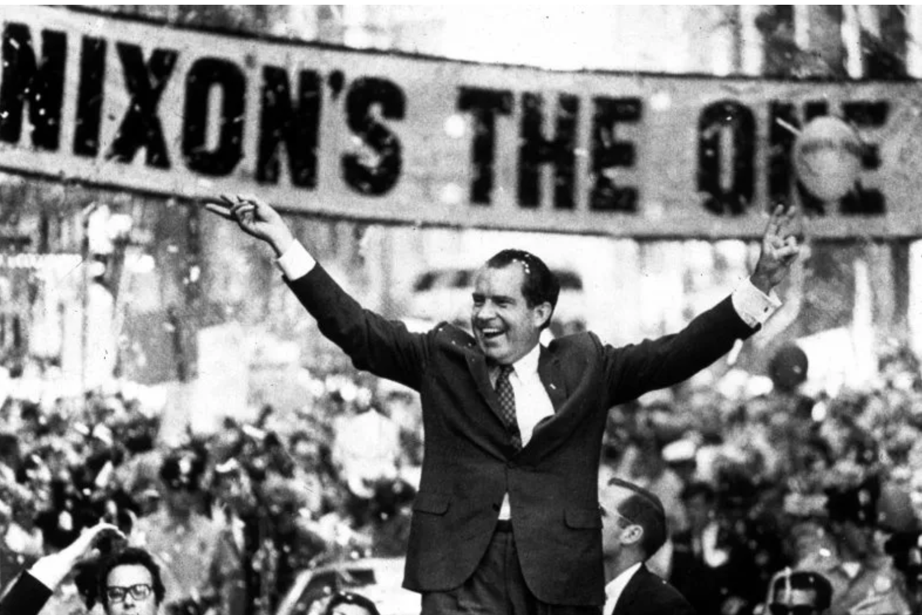
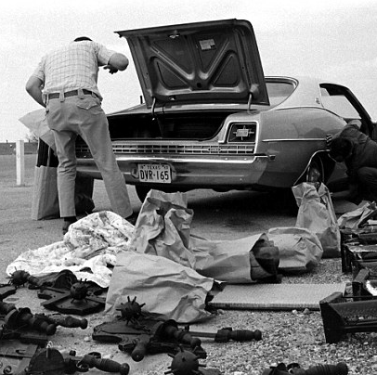
1969: Operation Intercept

Slide 8

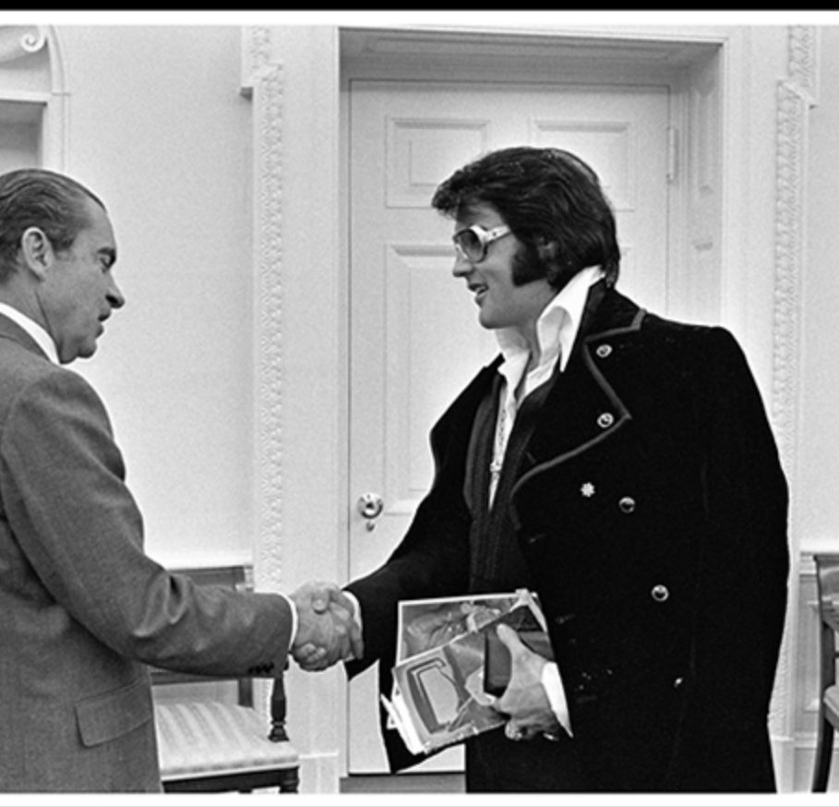
The Drug Enforcement Administration
Created in 1973.
Formed of agents from US Customs, Bureau of Narcotics and Dangerous Drugs, CIA, FBI, and Food and Drug Administration.
2000 agents.
1973-1975. DEA beset by scandals, increasing drug liberalization, and declining budget.

Slide 9
How to persuade Mexico to crack down on drugs
DEA, “Potential for Forward Strategy Against Heroin in Mexico”, 1975.
If “the Mexicans are reluctant to support intensive poppy eradication using helicopter borne herbicides…and punitive action against opium cultivators” the U.S. would have to “fabricate some external or induced incentives”

Slide 10
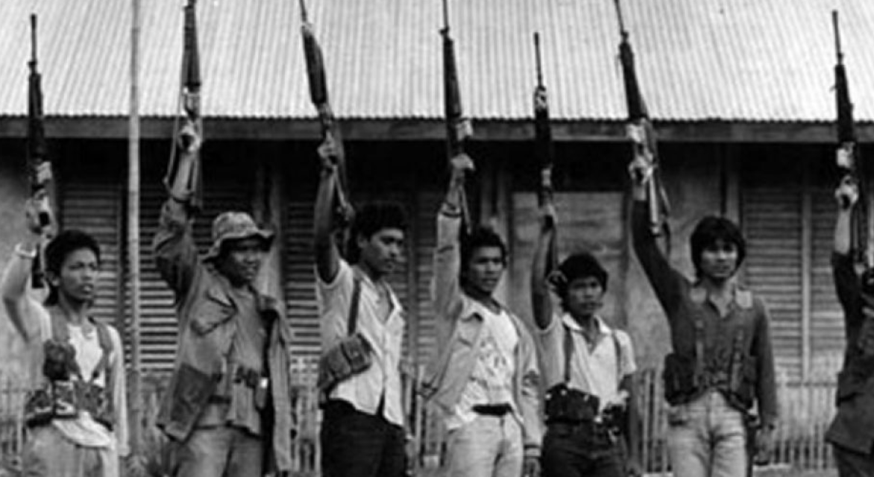
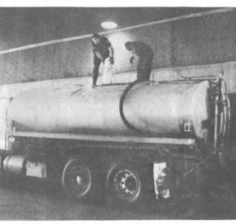
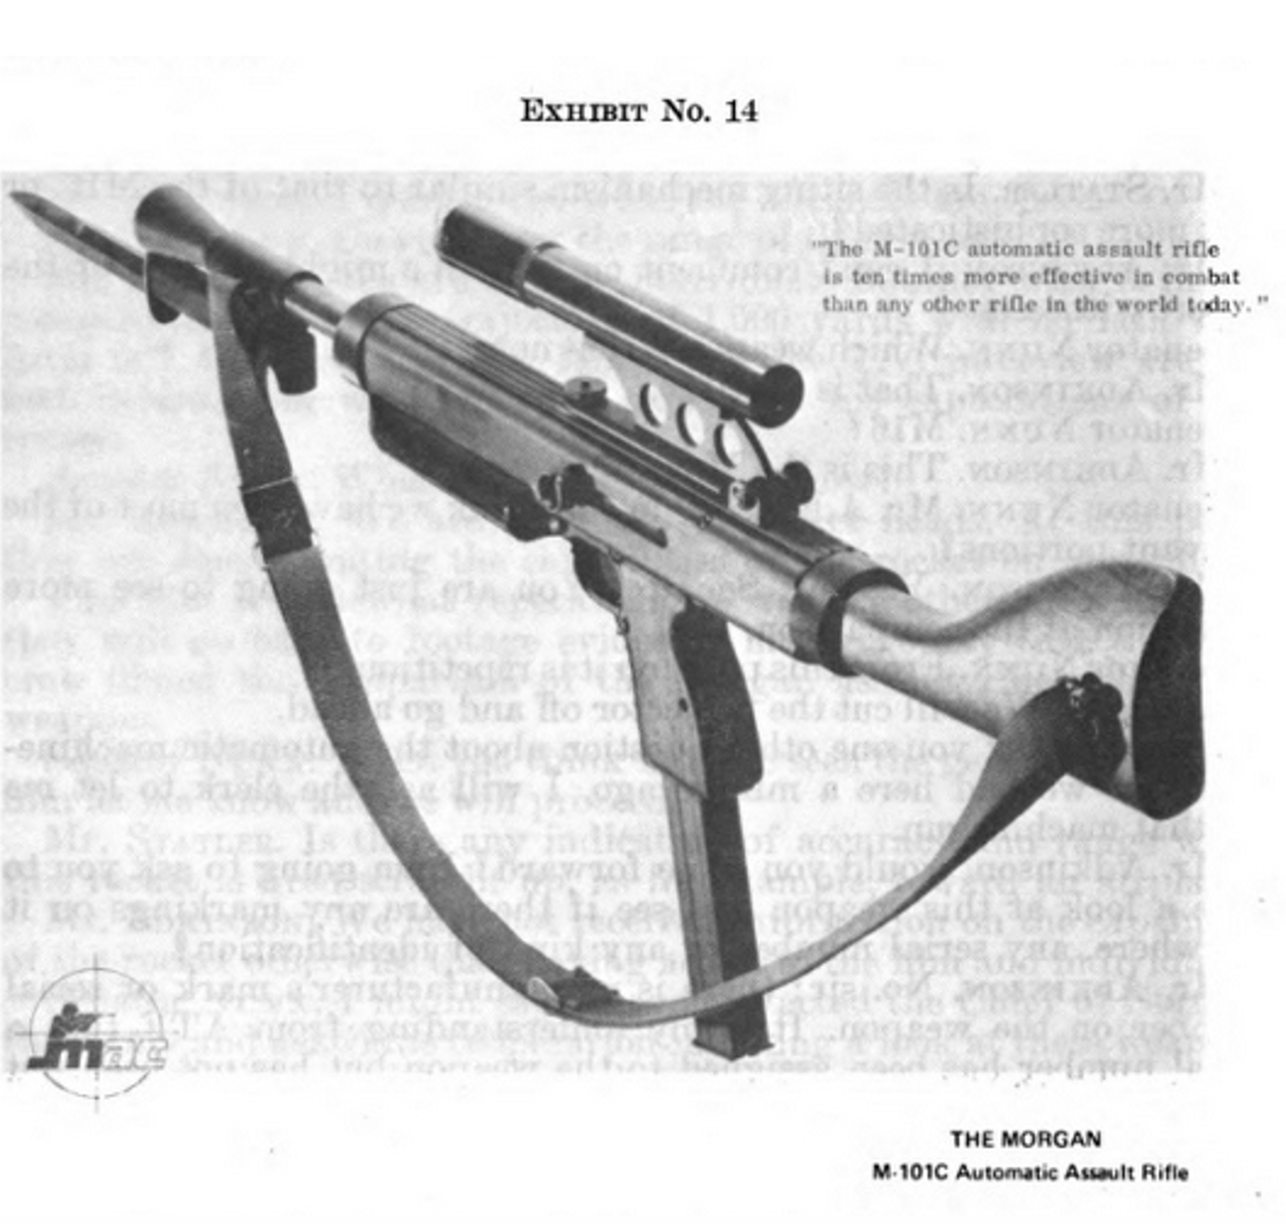
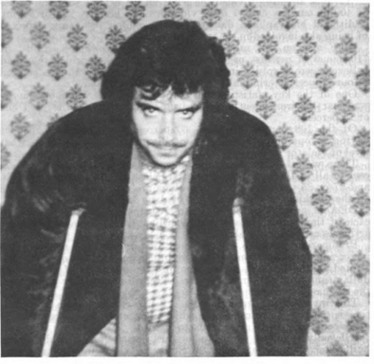
“The induced incentive”: The Alberto Sicilia Falcon Case

Slide 11
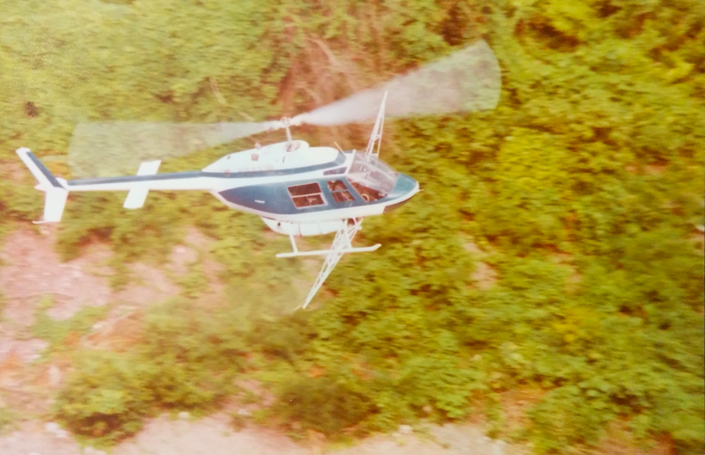
15/11/1975 Operation Condor
Spraying of paraquat on marijuana fields and 2,4-D on opium fields
10,000 troops on counternarcotics patrol.
400 Federal Police involved in counternarcotics.
70 DEA agents in Mexico as “advisors”

Slide 12
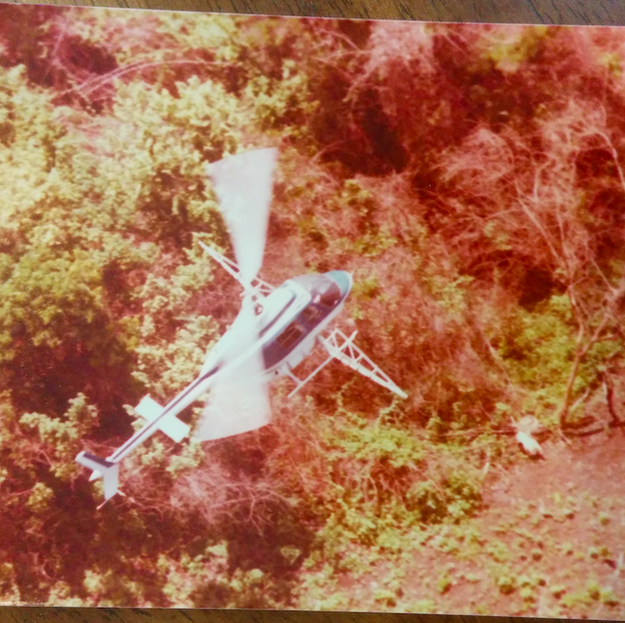
The effects
1976-1978, annual destruction of 18000 acres of poppies.
Increase in heroin price per milligram from $1.26 to $2.19.
Decline in overdoses from 2000 in 1976 to 1500 in 1978.
Mexican heroin declined from 95% to 50% of the U.S. market.
Condor becomes model for counternarcotics campaigns across the globe, in Thailand, Burma, Peru, Bolivia, Colombia, and even South Africa.

Slide 13
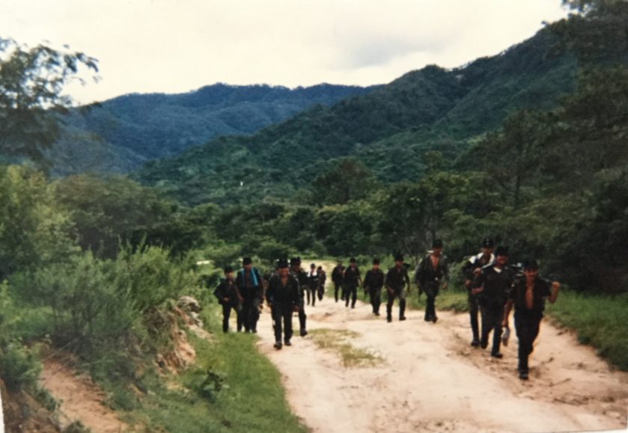
1) Counternarcotics as counterinsurgency

Slide 14
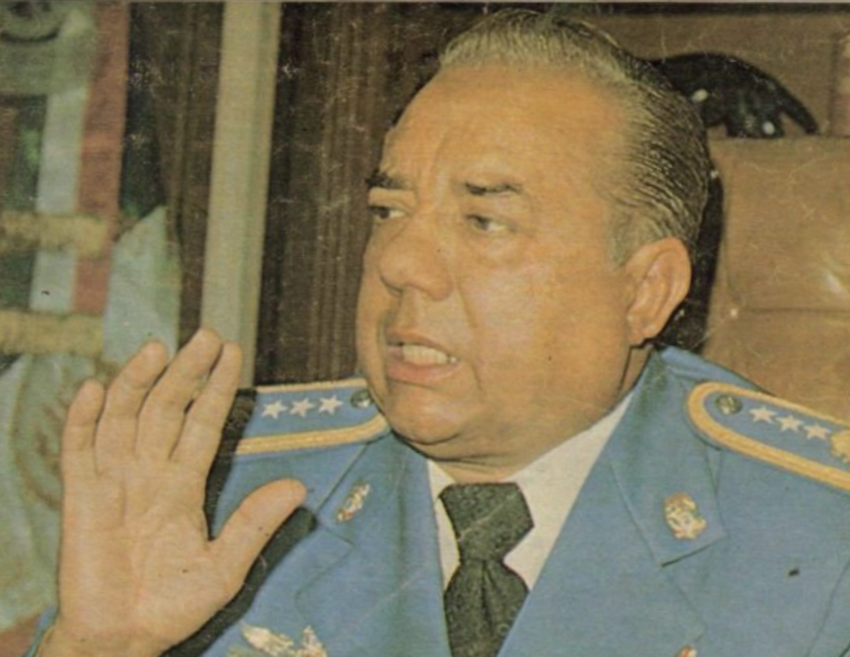
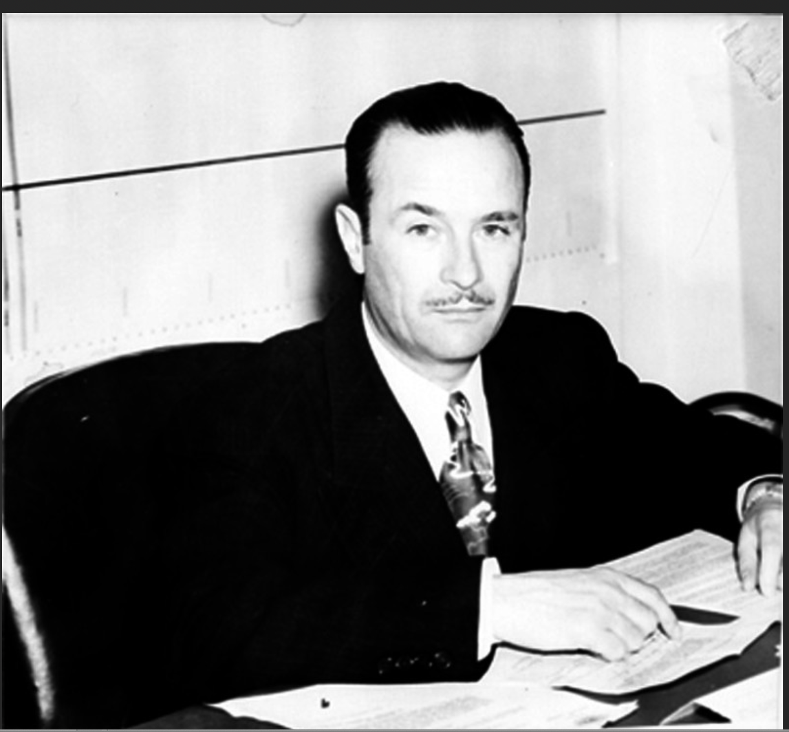
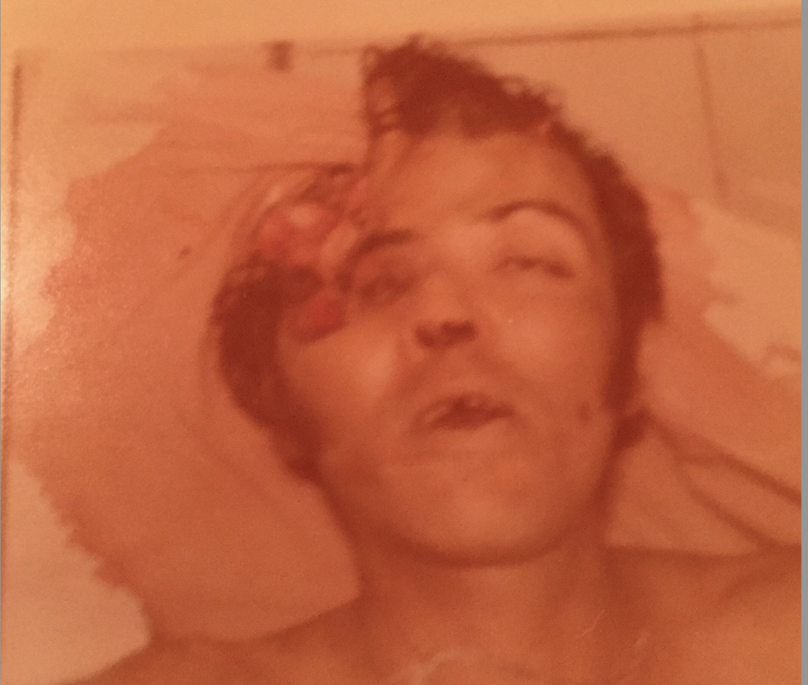
2) The federal takeover of the drug trade
The Detention-Extortion Cycle
Operated principally by Attorney General’s office and Federal Police.
Detain drug traffickers
Kill or imprison some
Torture others
Then extort a percentage of their profits.
If they refuse to pay, detain them again

Slide 15

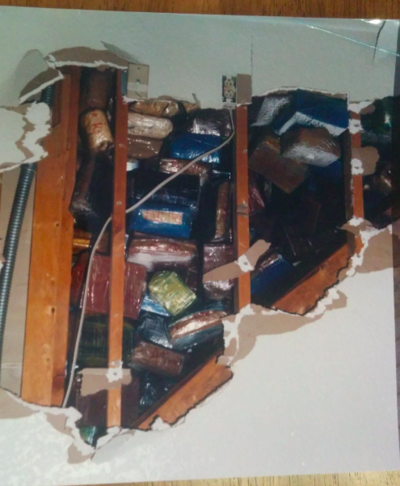
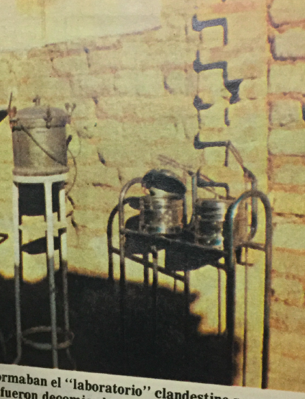
3) The shift to cocaine

