Slide 1
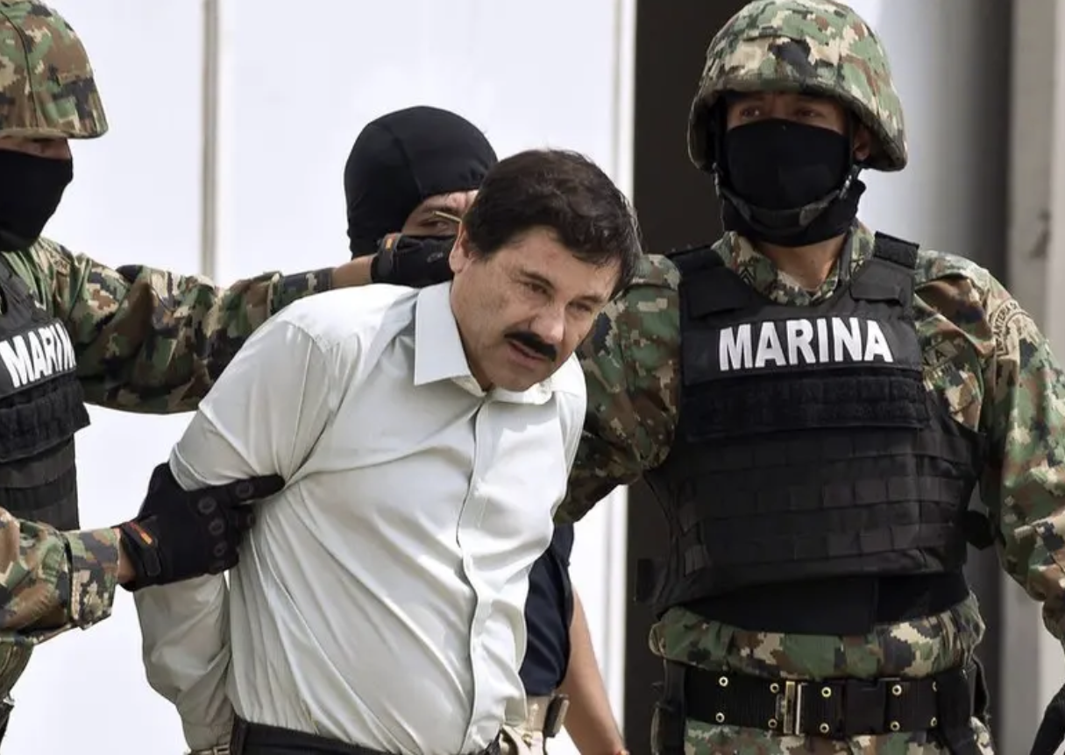
Day 1: An introduction to Organized Crime

Slide 2






Organised crime groups

Slide 3
A brief chronology of organized crime
Italian Mafia | Other mafia
1860s. Unification of Italy. Creation of Sicilian mafia, ‘Ndrangheta, Camorra. 1880s Italians start to migrate en masse to USA. First mention of mano negra and omerta in US papers 1920 Prohibition in Italy 1925-1929 Mussolini “crackdown” on mafia 1931 Castellammarese war 1943 USA invades Sicily. 1952 Kefauver hearings 1957 Apalachin Meeting. Mafia moves into narcotics 1960s-1980s. Italy’s ”years of lead” 1982 Falcone bombing 1986-1992 Maxi trial | Mid C18: Emergence of Heaven and Earth Society and other secret societies in China. 1750s-1850s. Societies group together against Qing empire. 1890s Emergence of Yakuza as major political players in Japan. 1912 Qing empire falls. Many Chinese secret societies become criminal gangs. 1920-1930s Shanghai Green Gang becomes world’s first narcotics gang. 1945-1950 Yakuza helps rightwing government in Japan fight communists. 1970s Birth of Comando Vermelho in Brazilian prisons. 1980s. Emergence of Mexican and Colombian cartels. 1990s. Emergence of Russian mafia 1990s. Emergence of Mara Salvatrucha and Barrio 18 in Central America

Slide 4
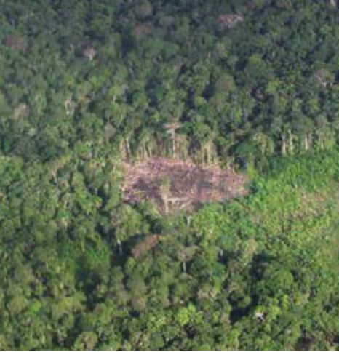
Organised crime groups today
UNODC estimates that organized crime groups generate c. $3 trillion dollars a year. This is around 3% of global GDP.
They are responsible for most of the world’s trade in illicit products.
They are also responsible for 22% of the world’s homicides. This rises to 50% in the Americans.
They are also responsible for other major disturbances:
  Migration
  Environmental degradation

Slide 5
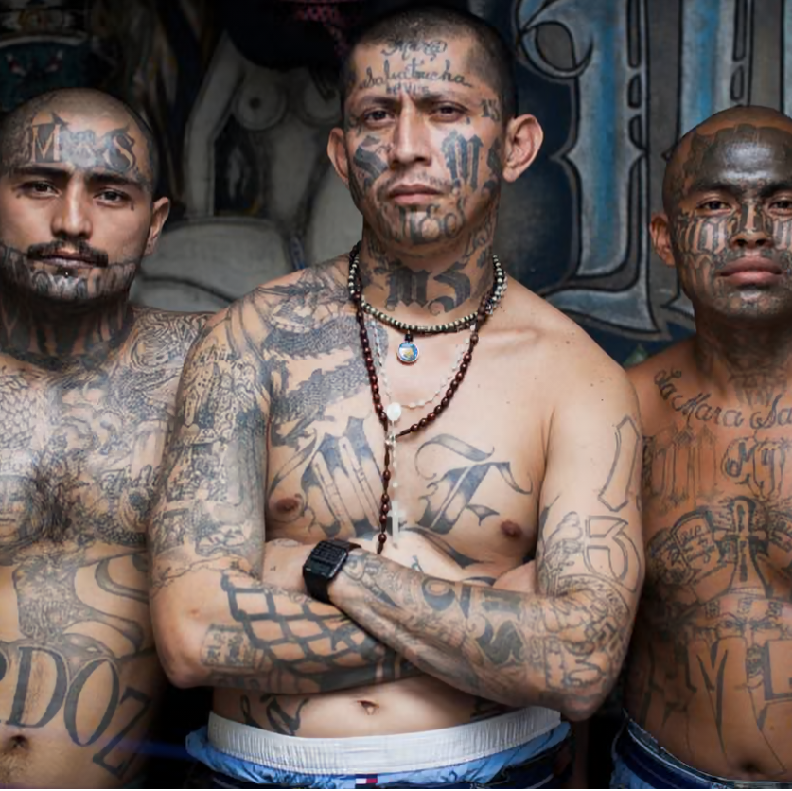
Questions about organized crime
1 Is organized crime “organized”?

Slide 6
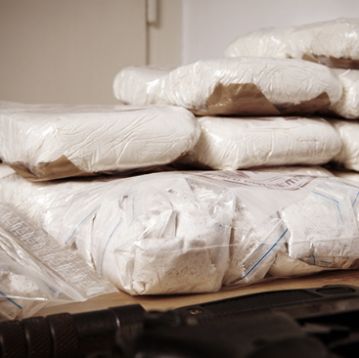
Questions about organized crime
2) What do organized criminals do?

Slide 7

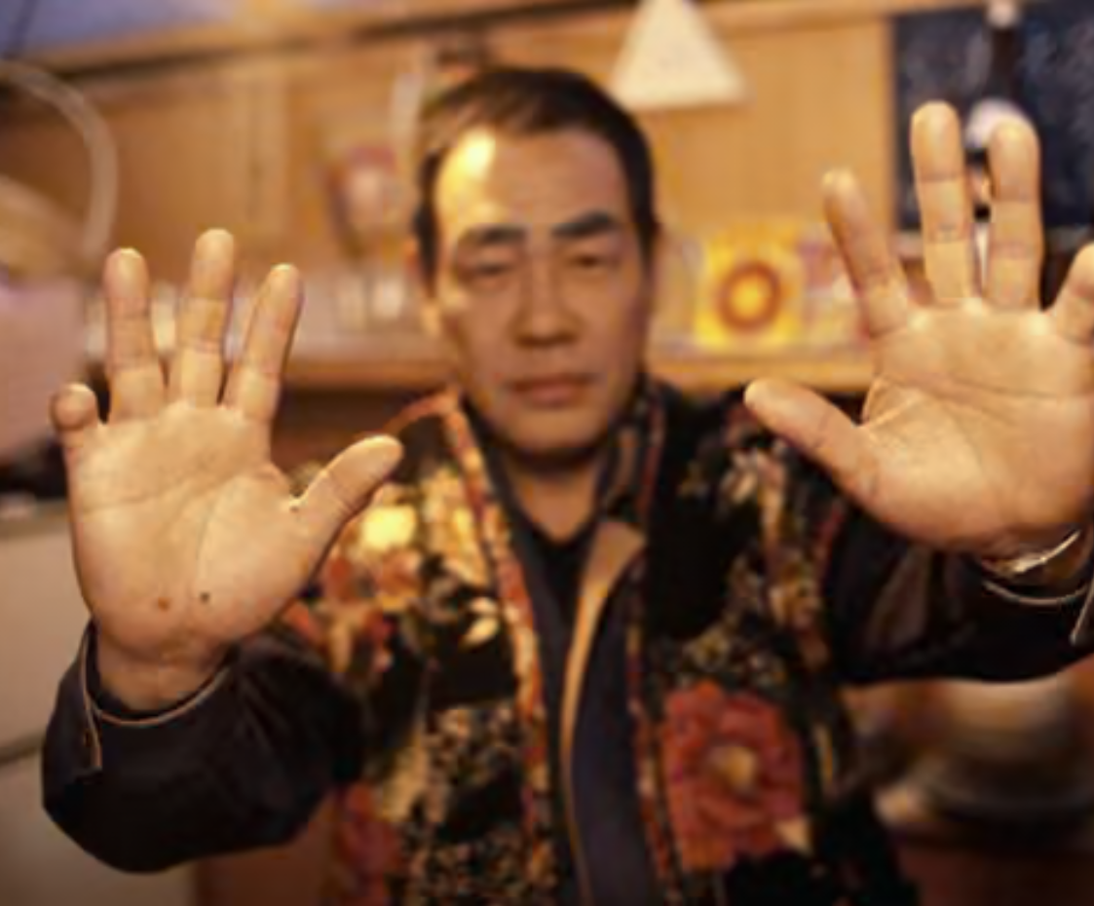
Questions about organized crime
3) If organized crime is organized, what makes it so?
  Geographical control?
  Familial/clan ties?
  Ritual?

Slide 8
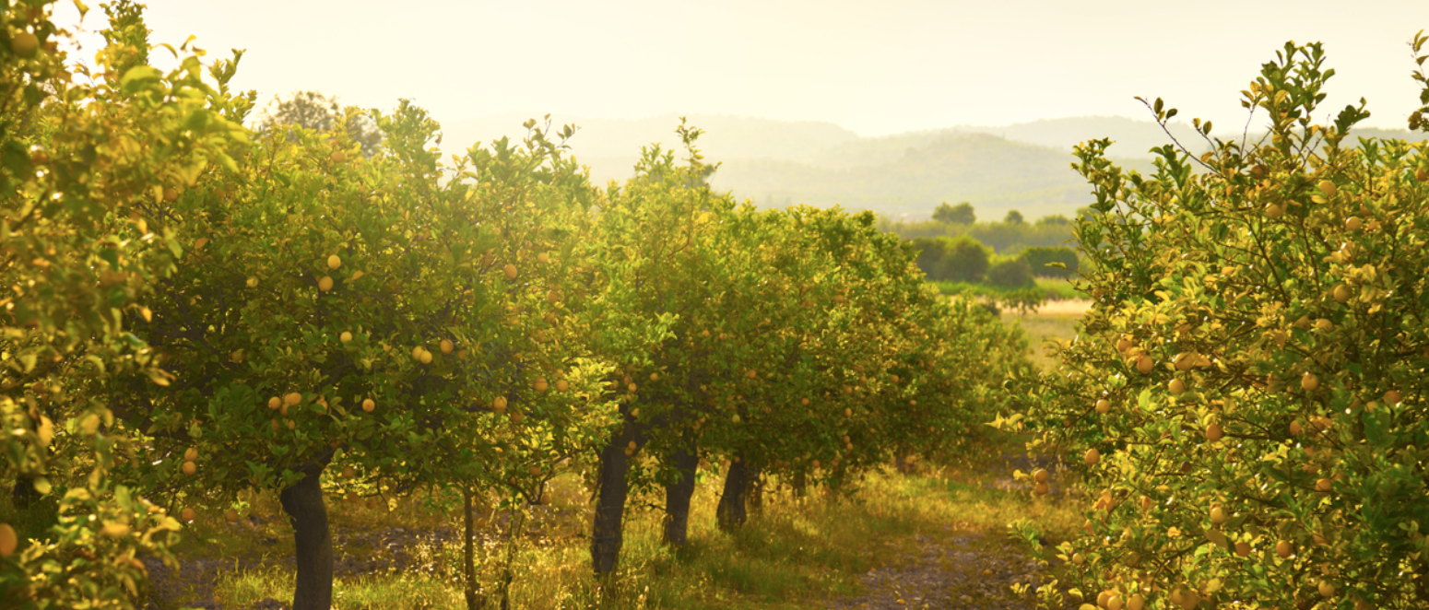
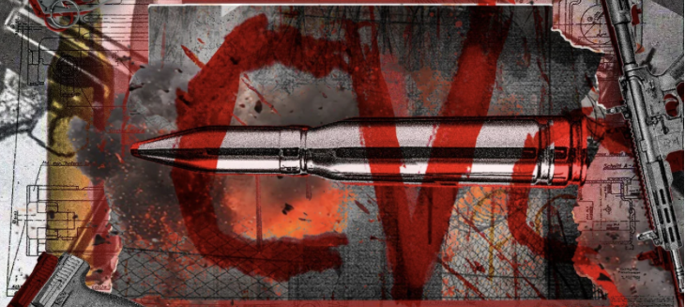
Questions about organized crime
4) What is the relationship between organized crime and capitalism?

Slide 9
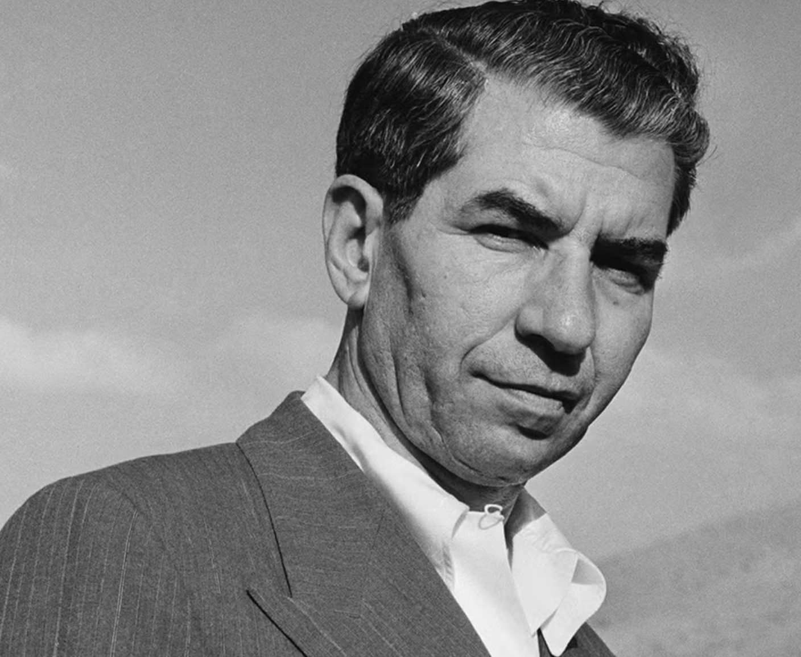
Questions about organized crime
5) What is the relationship between organized crime and the state?

Slide 10

Questions about organized crime
6) What is the relationship between organized crime and culture?

Slide 11
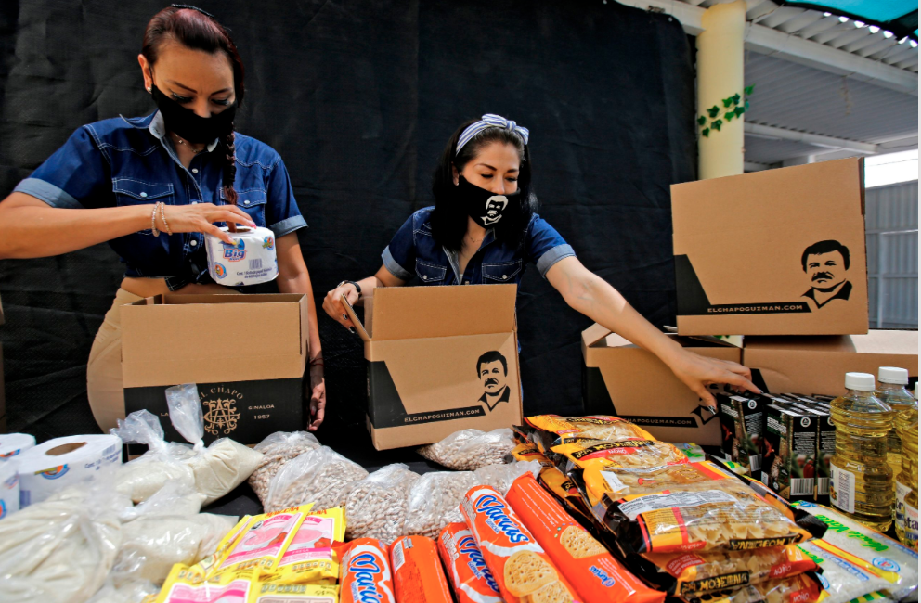
Questions about organized crime
7) What is the relationship between organized crime and society?

Slide 12
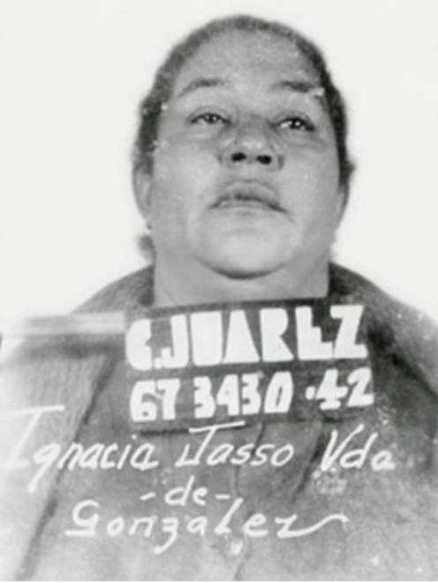
Questions about organized crime
8) Are organized crime groups essentially extensions of “masculine culture”? What role can women play?

Slide 13

Questions about organized crime
9) Where does the underworld end and the overworld begin?

Slide 14
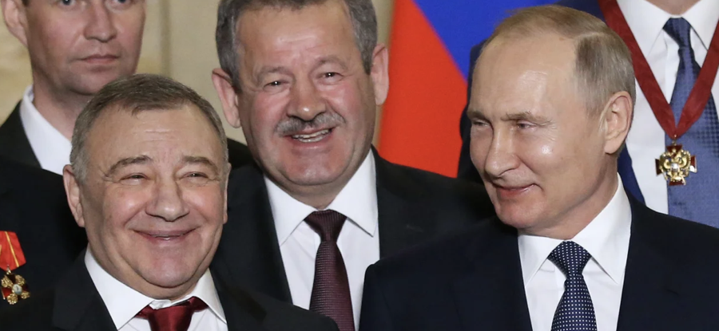
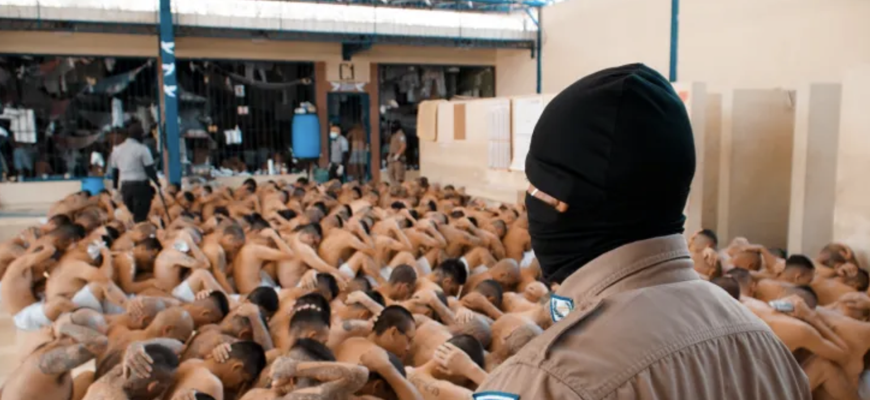
Questions about organized crime?
10) How do we stop the influence of organized crime?

Slide 15
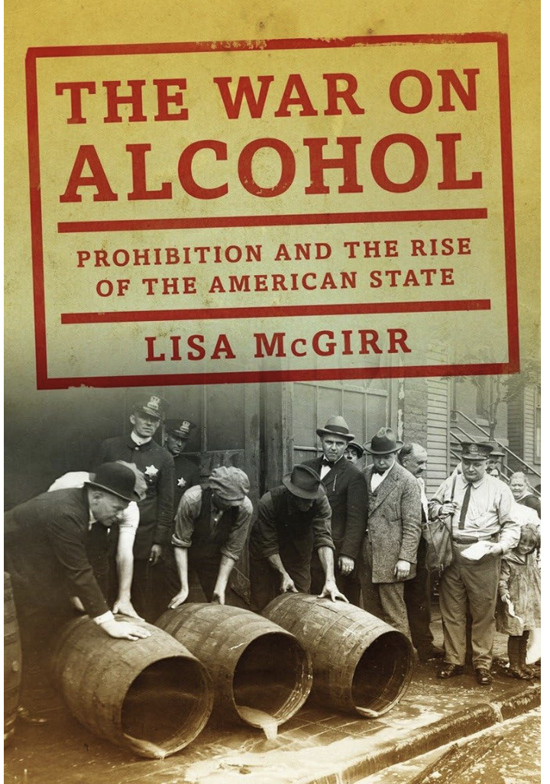
Questions about organized crime
11) How can we research organized crime? Why do so few historians include it in standard histories of nations?

