Slide 1
Day 3: What is organized crime?

Slide 2
What is crime?
An unlawful act punishable by the state or another authority.
Two problems:
  What is legal and illegal? There are laws, which tie in with popular customs (i.e. against rape or murder). And there are laws, which offend popular custom and simply defend the interests of the elite. (Theft in C18 England was punishable by death). As a result, social scientists often divide acts into licit (allowed by law and popular custom) and illicit (banned by law but broadly accepted by popular custom). Can you think of one of these acts?
  What is legal in one country is illegal in another. E.g. The production of alcohol in Canada was legal. The sale of alcohol in the U.S. from 1920 to 1933 was illegal. Who was responsible for the crime of smuggling alcohol into the U.S. The U.S. liquor businessmen who set up in Canada and knowingly sold their liquor to poor smugglers, the poor smugglers, or the mafia that bought the liquor from the smugglers? Which government was responsible for clearing up the crime? Or the current U.S. arms trade to Latin America?

Slide 3
What is organized crime?
Can we define organized crime by the type of crimes that are committed?
The term “organized crime” has been used by the C19 to describe multiple different forms of crime.
In general, in C20, it has been used to describe groups which provide “illicit goods and services”. These can be illegal, regulated, or taxed. Can you think of some examples?
However, it is used to describe other forms of crime, including fraud, theft, and robbery. In UK, it was first used to describe Bolsheviks.
Levi “organized crime is a Rorschach blot which can be read as almost anything”

Slide 4
What is organized crime?
Such is the variety of crimes committed by organized criminals that criminologists have sought other ways to define them.
Geographical control. According to one rather narrow definition of organized crime, it involves the control of crime (and some non-crime activities) in a certain area. The organized crime group protects criminals in this area in return for a fee. Organized crime is a “protection racket”. (Varese, Gambetta etc).
E.g. The Italian mafia, the Yakuza, some Mexican cartels.
At the same time, organized criminals can regulate crimes in a given area. This is called “criminal governance”.
.

Slide 5
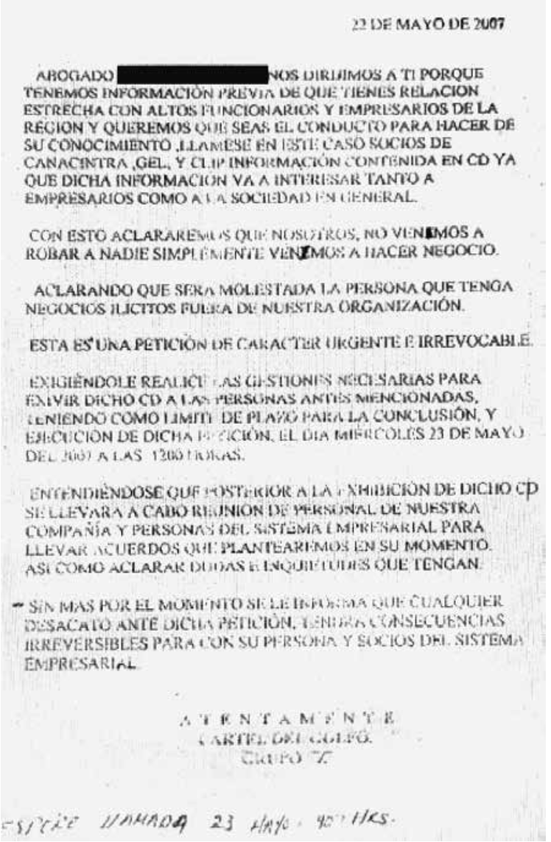

Slide 6
But there are problems with this definition.
What about smuggling groups? They often control limited or no geographical space. Can they be organized crime groups? E.g. The Sinaloa cartel.
It doesn’t differentiate between the Sicilian mafia (which has been around for over 150 years) and a small, short-lived Mexican American street gang, like the Barrio Azteca.

Slide 7
So other criminologists examine the level of organization of organized crime. Is it centralized? Is it hierarchical? Are orders given and obeyed? Are their rituals that all members follow?
So some (like Letizia Paoli) differentiate between Mafia and organized crime.
Mafia (like the Triads, Yakuza, Sicilian Mafia, ‘Ndrangheta, and Camorra) must have the following:
  Longevity
  Large size.
  Formalized and complex structure.
  Elaborate cultural code, rituals, norms and sanctions through which they create collective identity.
  Multifunctionality.
  Goal of political dominion and ability to provide governance services.
  Popular legitimacy and power sharing.
They conclude, as a result, that the Mexican cartels are NOT mafias.

Slide 8
Yet as a historian, and particularly a Latin American historian, this is problematic.
  1) How much time denotes “longevity”? Paoli claims four generations.
    A) Members of the same families have been producing drugs in Mexico for 5 or 6 generations.
    B) When did the Sicilian Mafia become a “mafia”, in 1960? When there were 4 generations of Sicilian Mafiosi… but also when it’s power in the United States had been radically reduced?
    C) When were mafias founded? The Sicilian Mafia claims the medieval period. The Triads claim the fourteenth century… should we take this as true? Or should we take the time when they are first called the mafia by the press? So, we are using a press misnaming (according to Paoli’s logic) to date the start of Paoli’s scheme?

Slide 9
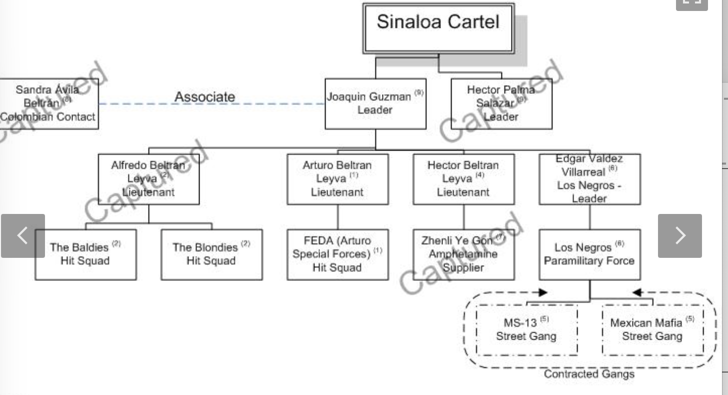
2) How do we work out the organizational structure of an organized crime group or mafia?

Slide 10
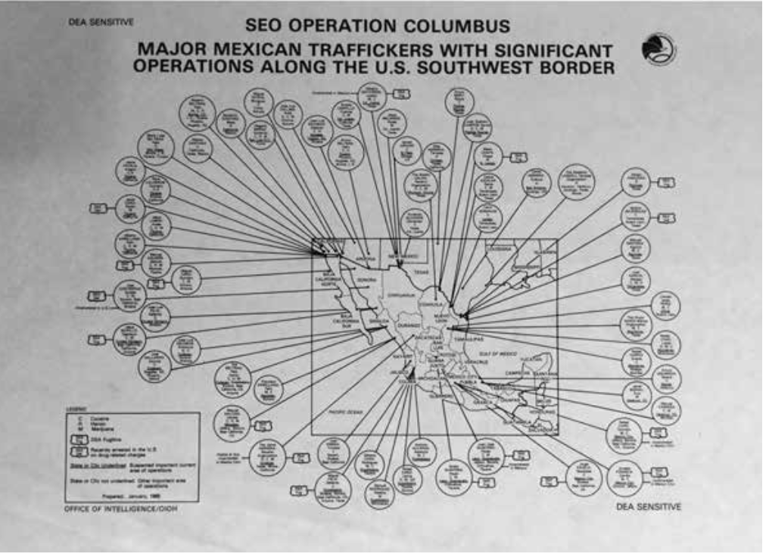
Yet we know that in reality, we know that this is fiction. Drug “cartels” or “mafias” or “DTOs (drug trafficking organization) are massively decentralized.
The portrayal of these organizations hierarchical is, at least in part, a policing device, designed to offer easy, publicly celebrated, wins.

Slide 11
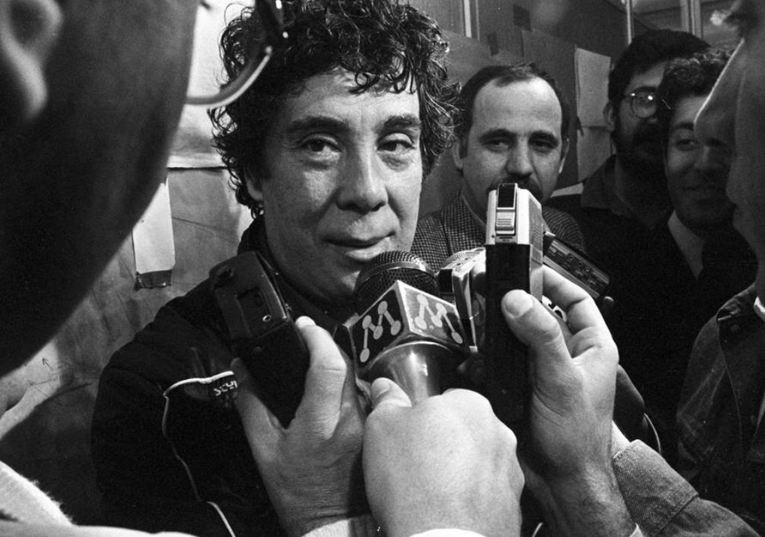
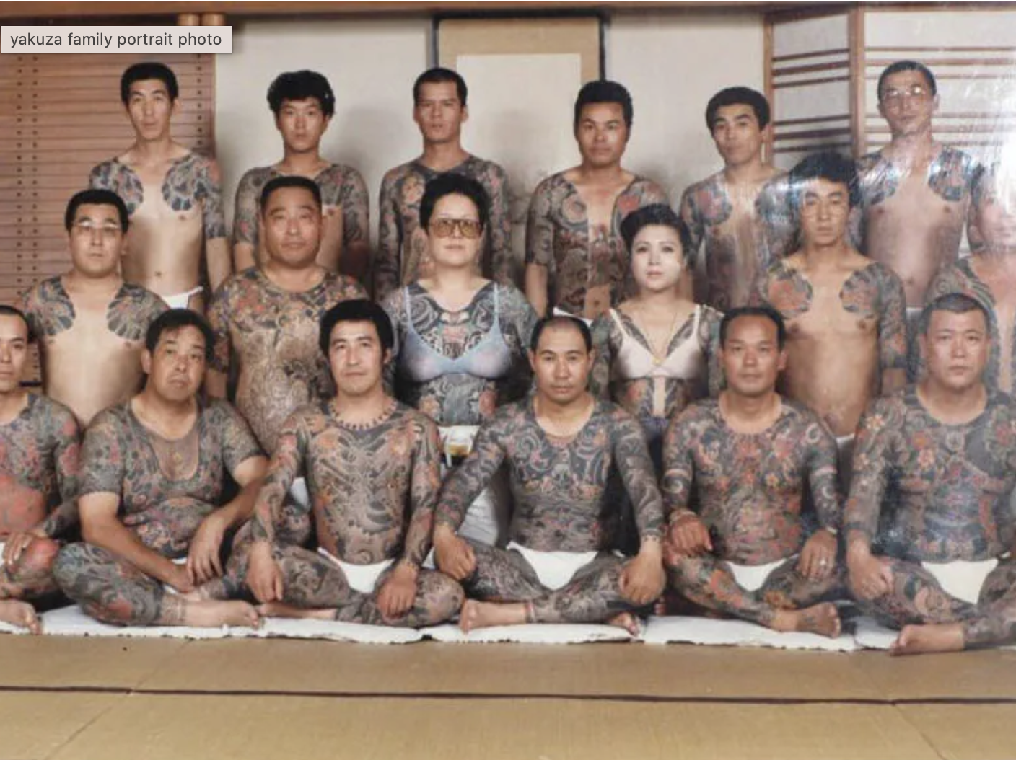
3) Rituals. We know many of the rituals of the mafia. From the 1960s onwards pentiti (repentants) came forward and revealed these rituals. (e.g. Tommaso Buscetta)
The Yakuza is a legal organization. Its rituals (like tattooing and finger cutting) are deliberately public.
But many disguise their rituals. We know, now, that the Familia Michoacana based its rituals on the Freemasons.
What about rituals that are deliberately hidden. (Claudio Lomnitz on cannibalism)

Slide 12
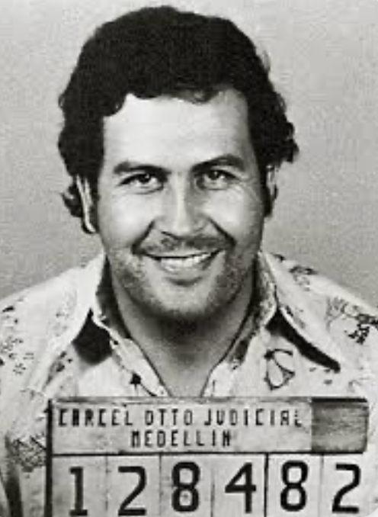
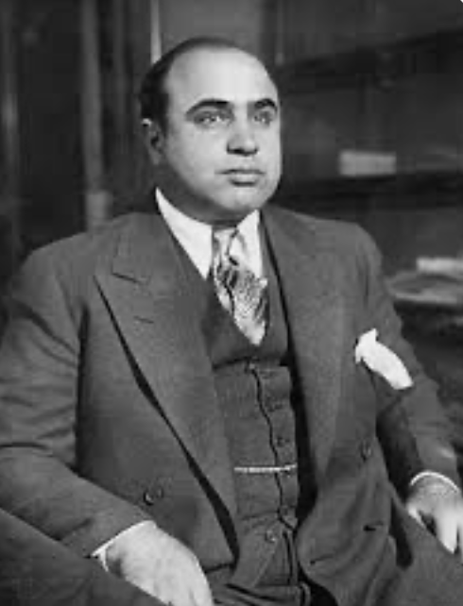
The mythification of the mafia
Once we start to look inside organized crime groups, at their organizational structure, the relative power of individuals, their rituals, we hit the problem of mythification.
What groups mythologize the mafia (and their members) and why?

Slide 13
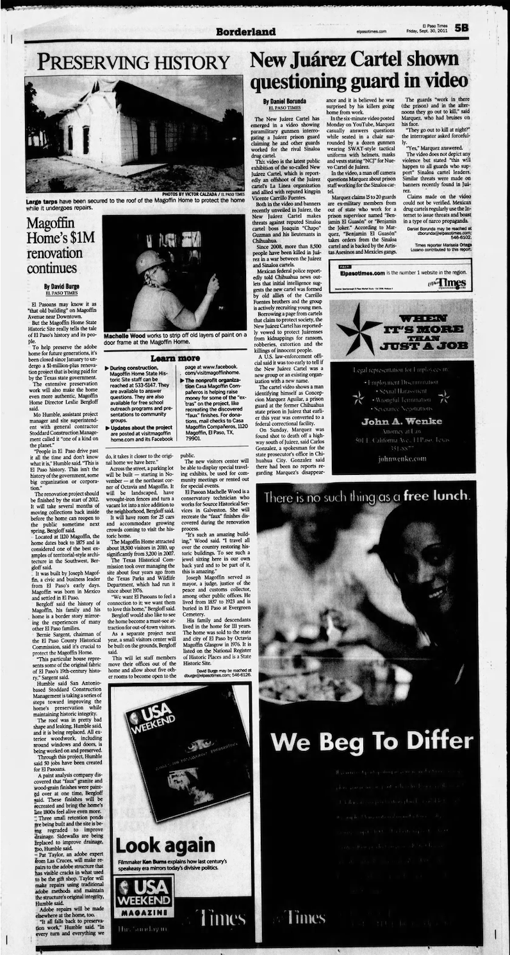
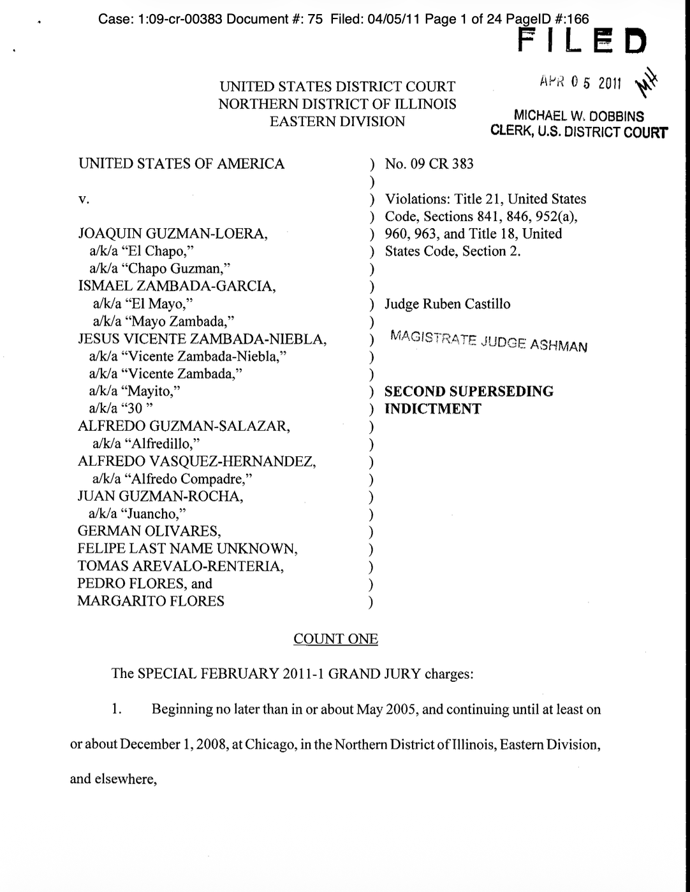
What sources do scholars of organized crime use?
How do they get round the implicit problems in these sources

Slide 14
Metaphors for organized crime and ways to investigate it
BUSINESS
Some criminologists see organized crime as a business. (Dwinght C. Smith, Reuter). They introduced economics to the study of organized crime.
They look at individual crimes, and their economic rationale. E.g. Loan sharking faces similar problems to a bank.

Slide 15
STATE or QUASI-STATE-LIKE BODY
In 1971 Thomas Schelling, Nobel prize winning economist suggested that that the business of organised crime was not the provision of illegal goods and services but the extortion of those that provided illegal goods.
This was followed by Gambetta and Varese. They argue that mafia is “an industry which produces, promotes, and sells private protection”
They are interested in extralegal or criminal governance (see also Lessing, Desmond Arias etc).

Slide 16
Here, one of the major questions is the relationship between organized crime and the state
Are organized criminals rivals to the state?
Or are they allies of the state?
Or do they change over time?
  Lupsha (1988) had idea of predatory, parasitical and symbiotic stages.
  Or are changes dependent on exterior factors (international, national and regional policing).
How useful is the term “corruption” in describing relations between organized crime and the state?

Slide 17
ASSOCIATIONAL NETWORK
(e.g. Francis Ianni, Letizia Paoli). Using social network analysis, these scholars find that associational networks (e.g. family, or imagined family) provided trust and bonds for members of organized crime groups.

Slide 18
So, what to do?
So, most criminologists tend to stick to supposedly strict definitions (although ones that often do not stick to the historical facts). E.g. Paoli, Gambetta, Varese.
Others take a more “cultural constructivist” approach. They study what is called “organized crime”. E.g. Von Lampe. Organised crime is “a vague denominator of a mixed basket of phenomena that have variously been labelled organized crime.” Problem of sources.
Good historians of organised crime (like John Dickie) write with an acknowledgement of
  The tensions between the different definitions.
  The problems of sources and mythification.

