Slide 1
The origins of the Italian mafias

Slide 2
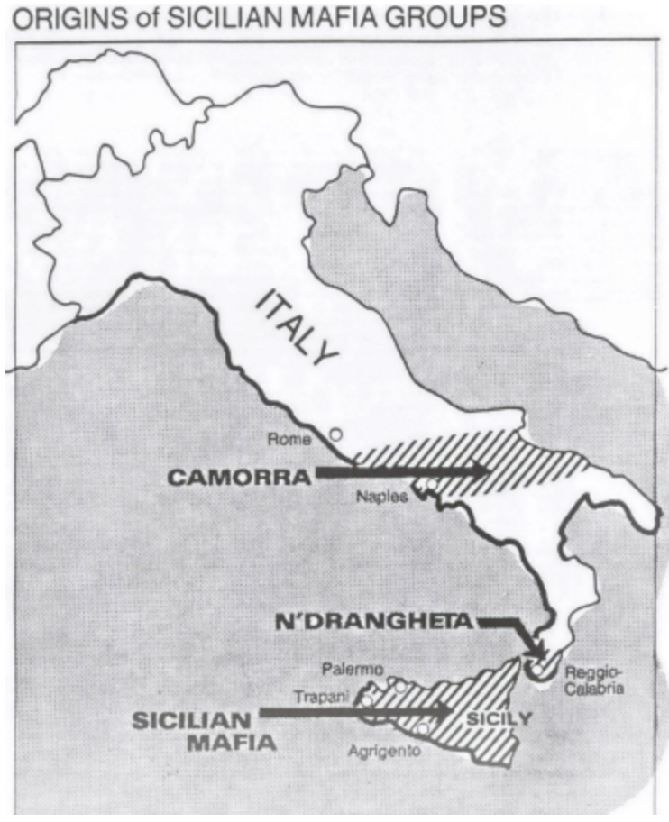
Sicily: Cosa Nostra or Mafia
Naples: Camorra
Calabria: ‘Ndrangheta

Slide 3
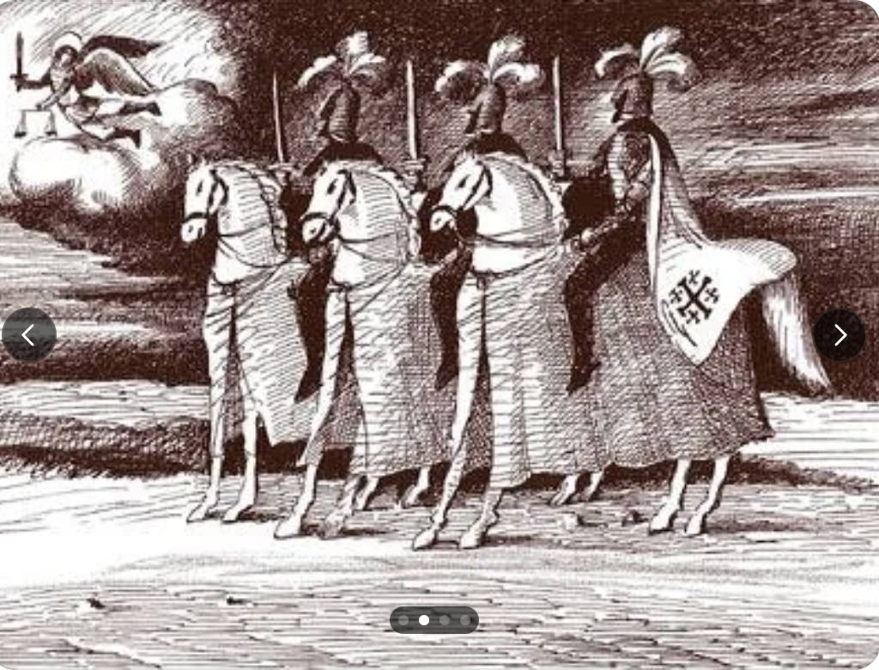
The story of the Garduña brothers: Osso, Mastrosso and Carcagnosso

Slide 4
The labels
Mafia: first used in Sicily in the 1860s to denote both organized criminals AND a distinct organization. Soon came to denote any organized crime group throughout the globe.
Cosa Nostra: ”Our thing”. Invention of US branch of the Sicilian mafia in the 1960s
‘Ndrangheta: Calabrian word for “manliness” or “courage”, invented in 1950s.
Camorra: The name, used by the Mafia in Naples, since its birth.

Slide 5
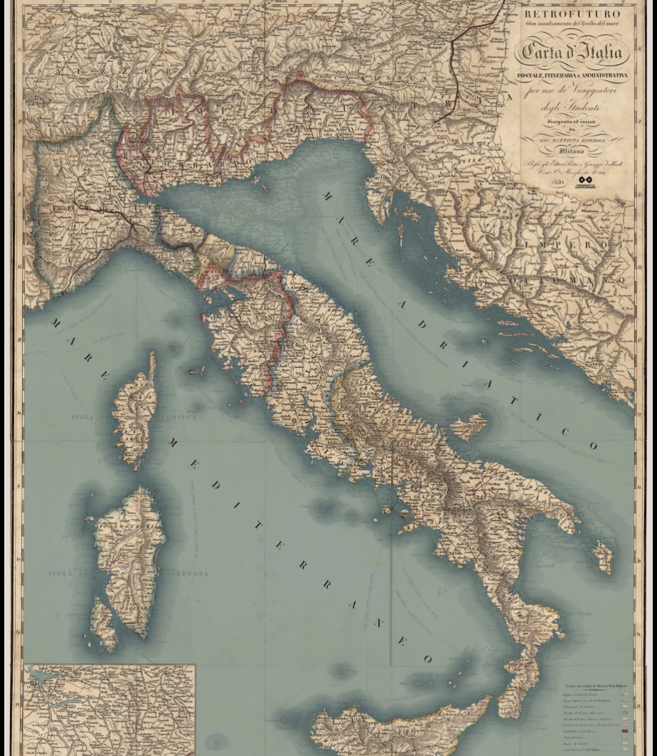
The Camorra
During the early nineteenth century Italy was “more a geographical expression” than a state. It was divided between one foreign power (Austria), two Dukedoms, a Grand Dukedom, two Kingdoms and a Papal State.
The biggest of the kingdoms was Naples, which also encapsulated Sicily. It was ruled over by the Bourbons.
1805 Napoleon kicks out the Bourbons, get rid of feudal law, and introduces private property.
1815 Bourbons return. However, they are now threatened by many Naples residents who want a return to Republicanism.

Slide 6
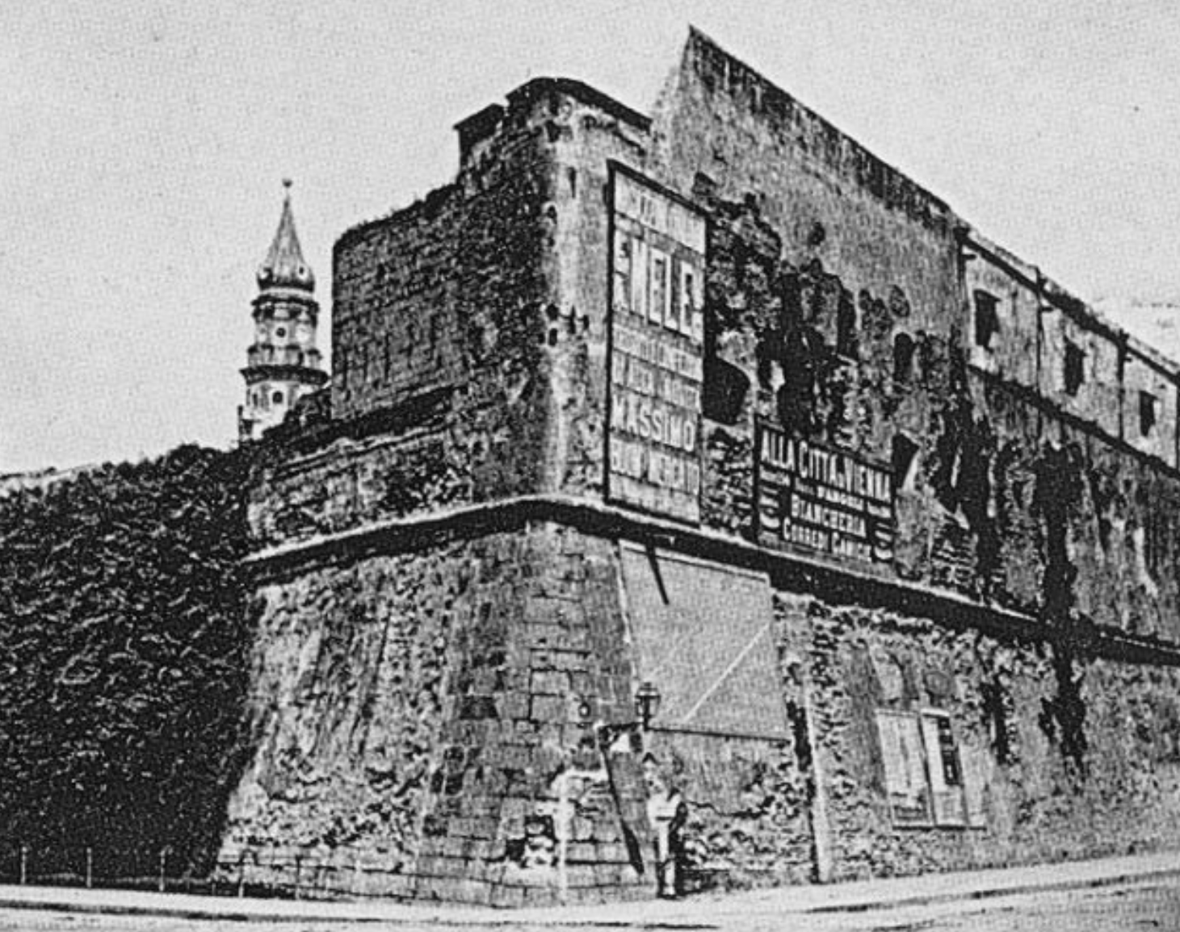
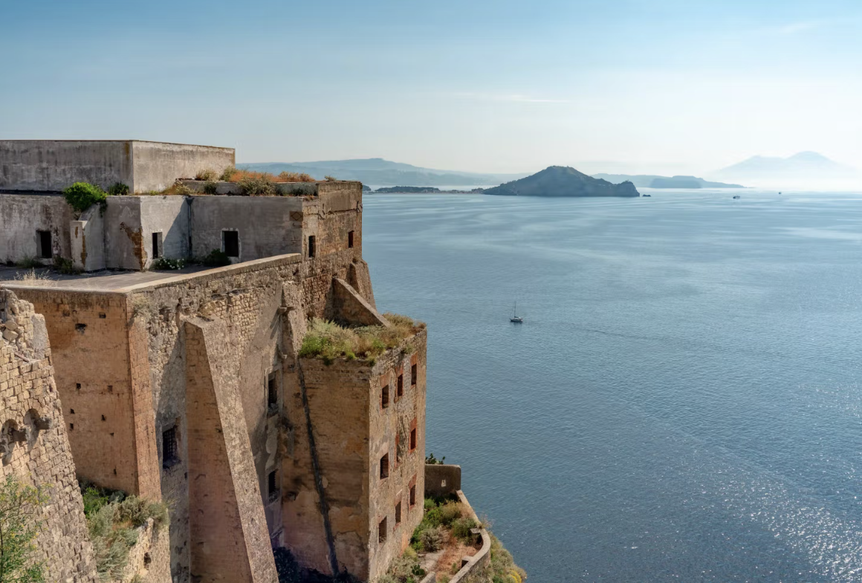
Mass imprisonment of both bandits and political prisoners in places like the Castello de Carmine.
It is here that we first glimpse the camorra. They were a group of prisoners, who ruled the prison, with their own rules and regulations.

Slide 7
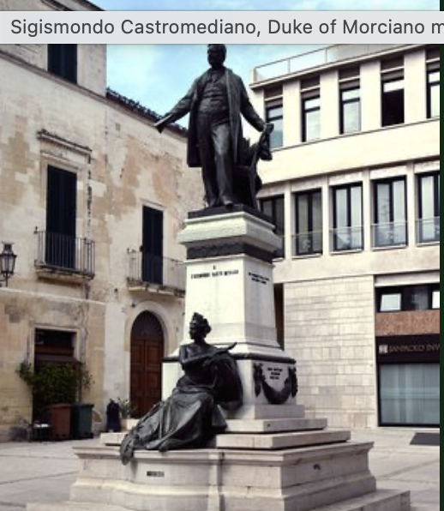
Sigismundo Castromediano, Duke of Morciano, meets a well-dressed man on his first day in prison
“Well, well, gentlemen! Fortune has smiled on you. All of us here have been waiting to honour you. Long live Italy! Long live Liberty!” We camorristi, who share your sad and honorable fate, hereby exempt you from any camorra obligation… Gentlemen, take heart! I swear by God that no one in this place will touch a hair on your head. I am the boss of the camorra here, and so I’m the only one in charge. Absolutely everyone is at my beck and call, including , including the commanders and his jailers”
Strict hierarchy, regulations, charging of taxes or pizzo

Slide 8
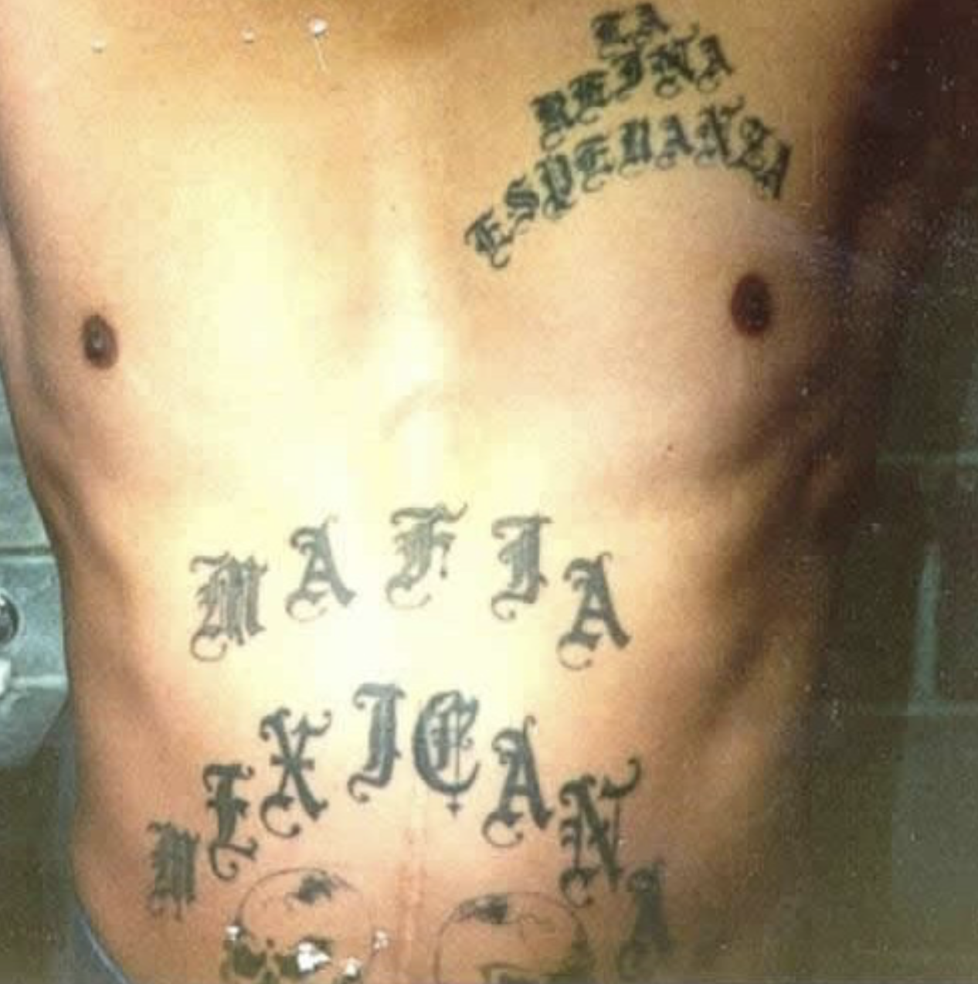
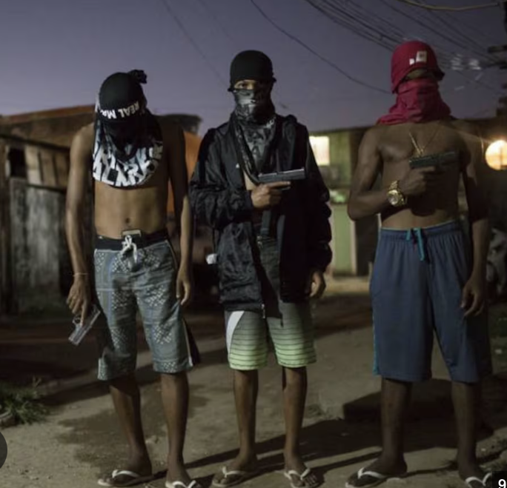
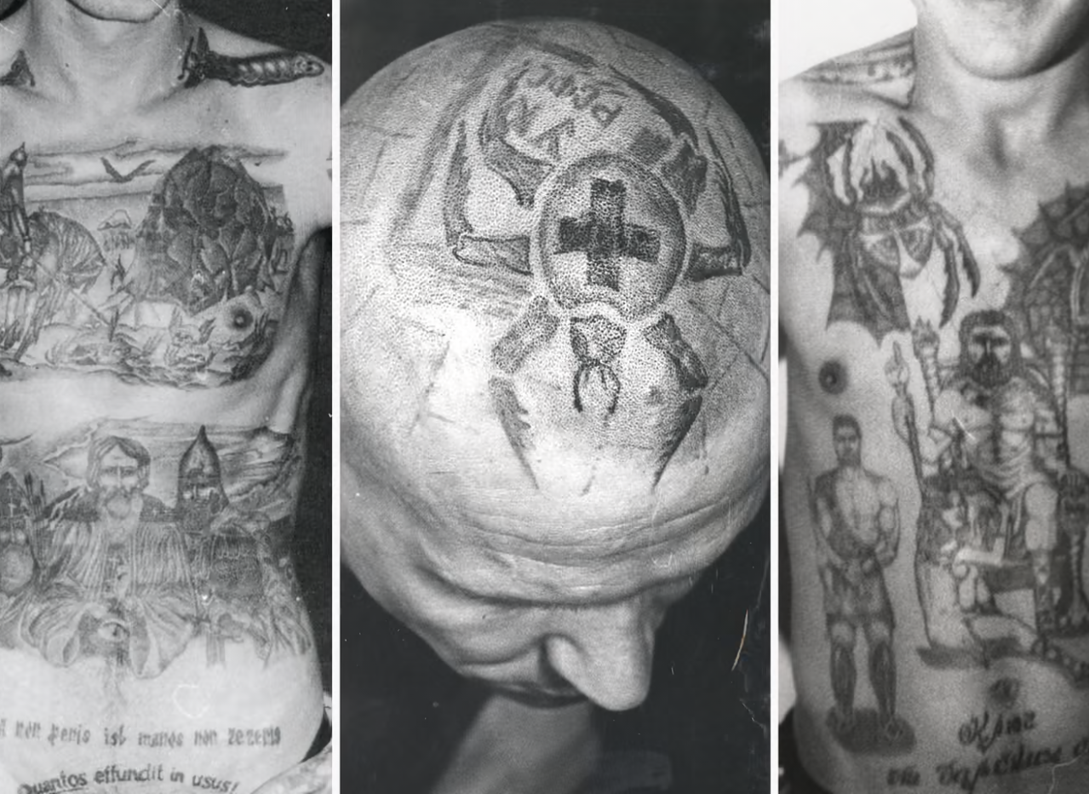
The Camorra started as a prison gang
Contrary to what Foucault says, in most prisons even today, gangs rule.
Some have managed to thrive on the outside, including

Slide 9
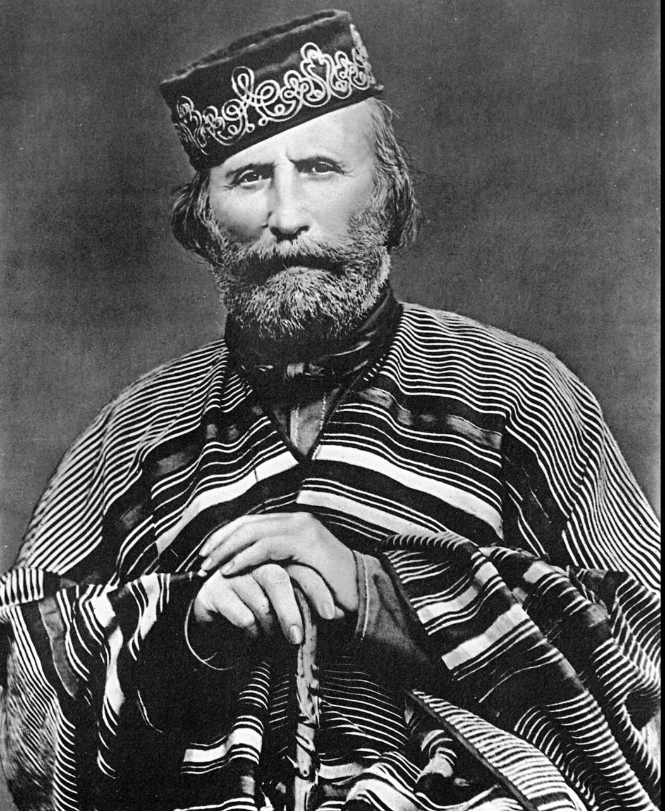
1858-1860: Italian Republican leaders drove out Austrians and united Italy. Called the Risorgimento
Naples in 1860. 500,000 inhabitants. Many were very poor. (30% of infants died before first birthday).
Policing had always been done by reformed criminals. (Police called the feroci or “fierce ones”).
In the post-Risorgimento era, policing was given to the Indepedence leaders’ prison friends.

Slide 10
1860s: What did the Camorra do?
They took the prison system of charging pizzo, and brought it into the city.
Charged legal vendors at the pressure points of the urban economy: quays where cargos came in, city gates where produce landed, markets where it was distributed.
Charged criminals, pickpockets, thieves, and prostitutes for not putting them in prison.
1860 The camorra backed the pro-Independence fighters against the Bourbons. Then, when the Bourbons were ejected, they brought order to the city.

Slide 11
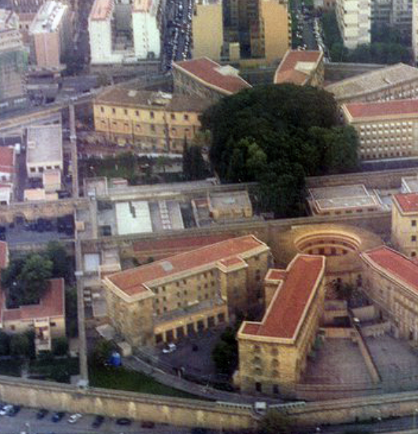
The Sicilian Mafia
Bourbon control of Sicily was much weaker than in Naples.
During the C19, there were multiple rebellions and conspiracies against Bourbon rule. Many of what an 1838 Bourbon report called “unions, or brotherhoods, sects of a kind” turned to crime. E.g. The Charcoal Burner sect.
1860-1866 right-wing government attempted to crack down on both criminals and pro-Sicilian independence fighters.
September 1866 rebels, mostly agricultural laborers, but also including mafiosi and pro-Sicilian Independence leaders took Palermo for seven days. They attempted to breach the Ucciardone prison.

Slide 12
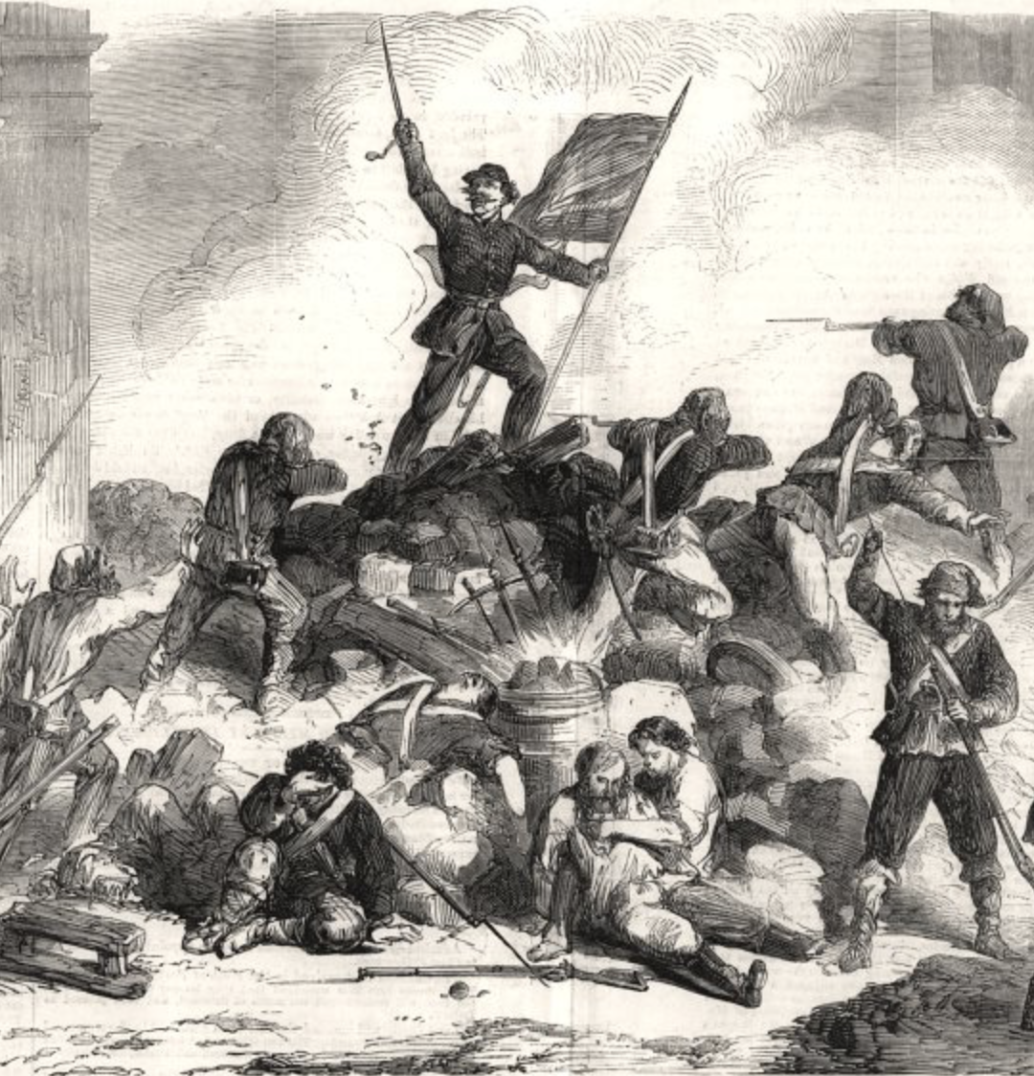
Picture of a mafiosi
The first man to get shot during the September 1866 rebellion was Turi Miceli. He had led the revolt. He was a mafiosi.
He grew up in the agricultural lands around Palermo called Conca d’Oro. By 1860s, they grew oranges and lemons for U.S. and U.K. market. They were the most expensive agricultural lands in Europe.
On the one hand, mafiosi like Miceli learned how to make money from the citrus groves.
  They generated risk. They could vandalize the trees, steal the products, or close the sluice gates that let in water.
  On the other hand, they could (for a fee) offer protection both from themselves, from other mafiosi and from independent thieves.
  They ran a protection racket. As Gambetta surmised, they provided protection for private property.
  But they also existed in the “legal world”. By the 1860s, then they operated the sluice gates, guarded the groves, and took the lemons to market.

Slide 13
Turi Miceli was also a political opportunist. He understood that revolutions were good times to open prisons, burn records and kill off cops and informers.
1840s Miceli was a bandit.
1848 He rebelled against Bourbons.
1849 When revolution disintegrated he backed invading Bourbons
1860 He supported Garibaldi against the Bourbons
He was recruited to National Guards. His men were described as “robbers, cammoristi, Bourbon royalists and corrupt men”.
1866 Rose up for Sicilian Independence from Italy.

Slide 14
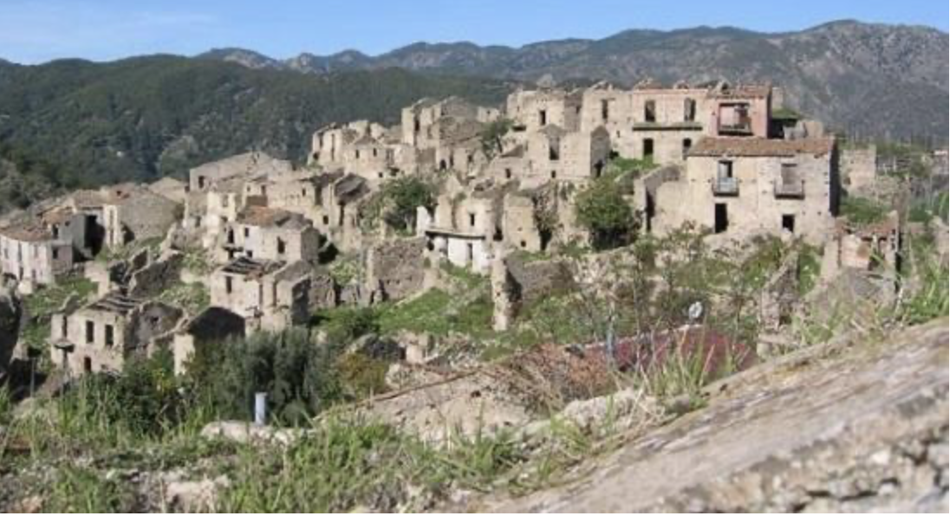
The ’Ndrangheta
Calabria as very poor, sparsely populated area in south of Italy.
No gangsterism there in 1850s-1870s.
However, in 1880s reports piccioti “lads” operating protection rackets in Palmi, state capital.
1892 trial reveals that they are ex-prisoners, had tattooed hieroglyphs denoting rank, wore a uniform of tight trousers and untied silk scarves.
By 1894 piccioti were also reported to be in the remote villages in the Greek speaking mountains of Calabria. Trial revealed that the boss, Filippo Velona, was initiating boys into the organization. They had to swear oath to him “Father, forgive me if I have strayed in the past, and I promise not to stray in the future”

