Slide 1
Day 5: The Mafias and the State

Slide 2
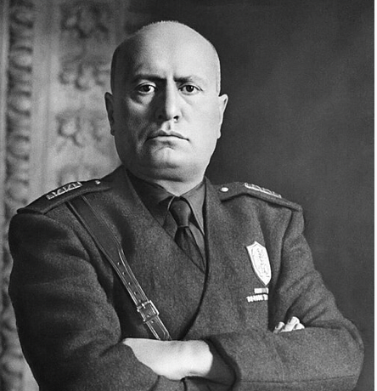
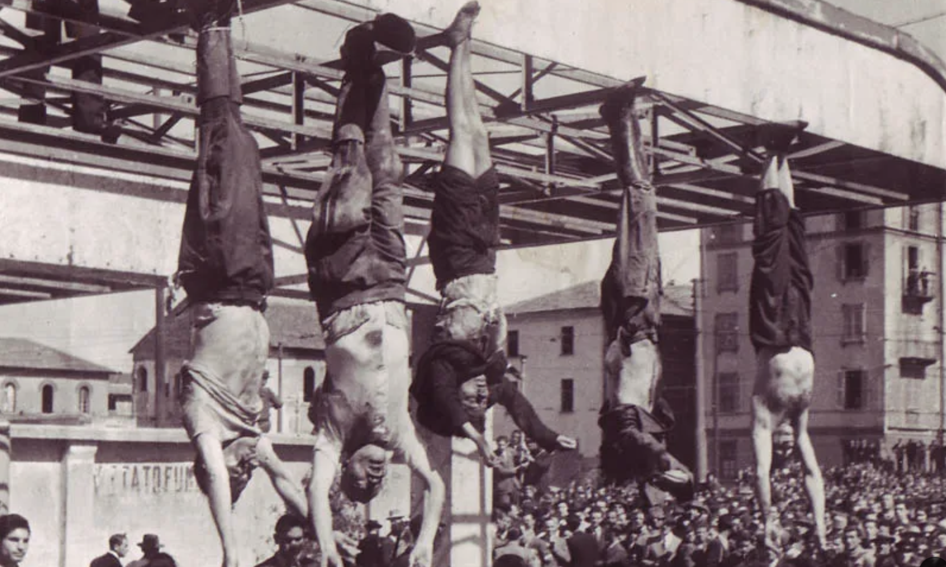
Benito Mussolini, Il Duce of Italy 1922-1943
Former socialist
Became prime minister after 1922 March on Rome
Created one party dictatorship, banned labor strikes
Tried to create Italian Empire in Africa
June 1940 joined Nazis in WWII

Slide 3
Mussolini and the Mafia
Initially Mussolini used election. And many mafiosi and their elite protectors joined the Partido Nazionale Fascisti. They were welcomed, as they controlled elections especially in Calabria and Sicily.
However, in 1924 Mussolini changed electoral law to guarentee PNF a parliamentary majority. Later that year fascists killed the head of the socialist party, Giacomo Matteotti. Finally, January 1925 Mussollini declared himself dictator.
He no longer needed the mafia’s electoral power.

Slide 4
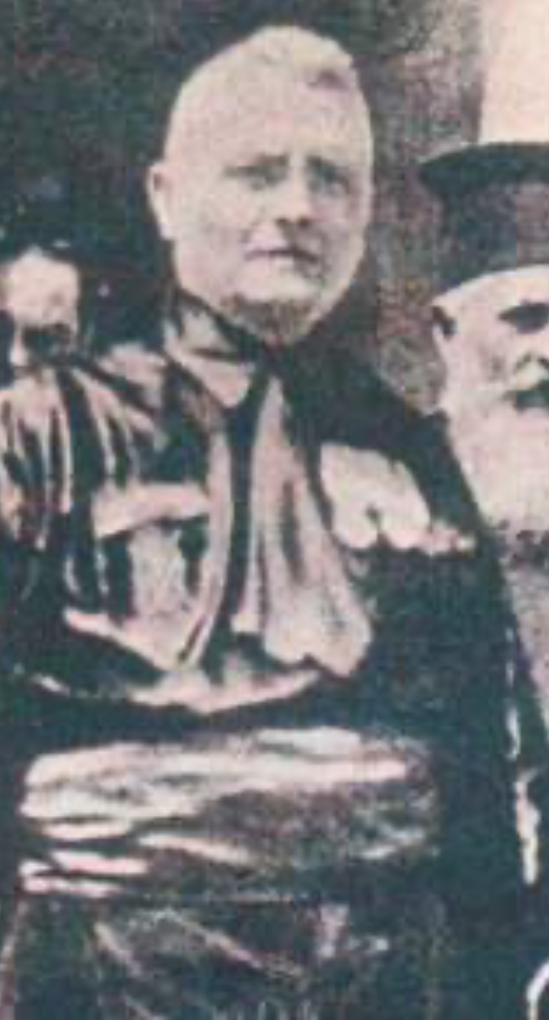
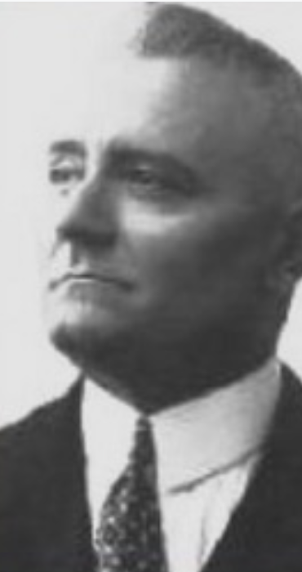
October 1925, he sent Cesare Mori aka “The Iron Prefect” to Sicily.
1925-1928 Mori engineered a series of full-scale police attacks on mafia towns. He started on the hilltop town of Gangi, before moving to villages around Palermo.
Men were arrested en masse. Women and children were taken hostage. Goods were sold off. Cattle were butchered in the town square.
By 1928, 11,000 arrests.
""These operations were carried out in considerable numbers and on a large scale: and the rapidity with which they succeeded one another and the exactness of evidence on which they were based completely strangled the criminal associations which for so many years had flourished with impunity. And the whole island chanted a hymn of liberation.”,
”Dismayed and panic stricken, they fell like flies, wit no other gesture of resistance but a feeble attempt at flight to well concealed hiding places. They were all struck down.
Cesare Mori, My Struggle against the Mafia, 1933.

Slide 5
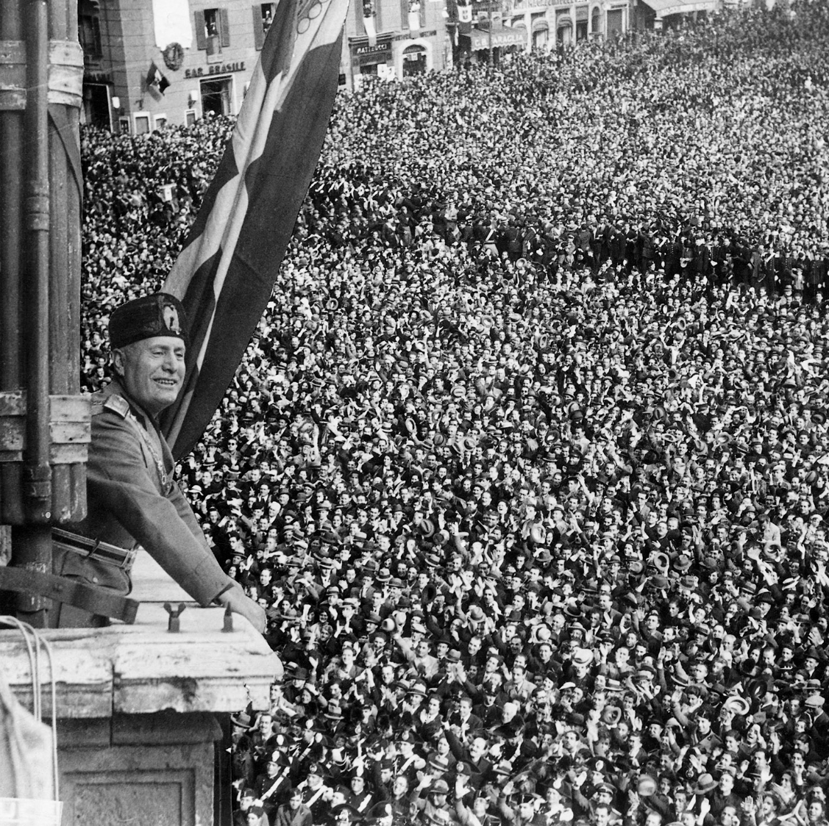
26 May 1927 Mussolini gives his Ascension Day speech
“Everything within the state. Nothing against the state. Nothing outside the state”
The Sicilian mafia was a state within a state. “When will the struggle against the mafia come to an end? It will come to an end not just when there are no longer any mafiosi, but when Sicilians can no longer remember the mafia”
As a result, Mussolini put Mori’s efforts at the centre of his speech. He cited statistics. Murders had declined from from 675 in 1923 to 299 in 1926. He concluded: “When will the struggle against the mafia come to an end? It will come to an end not just when there are no longer any mafiosi, but when Sicilians can no longer remember the mafia”

Slide 6
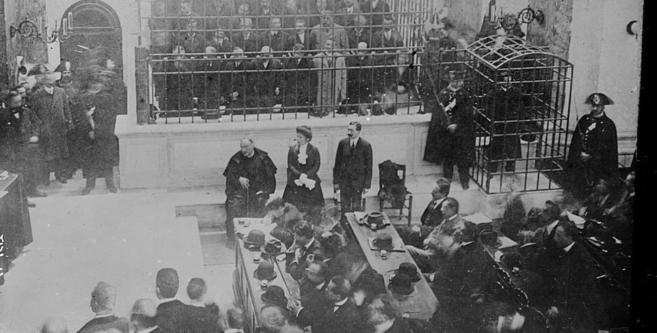
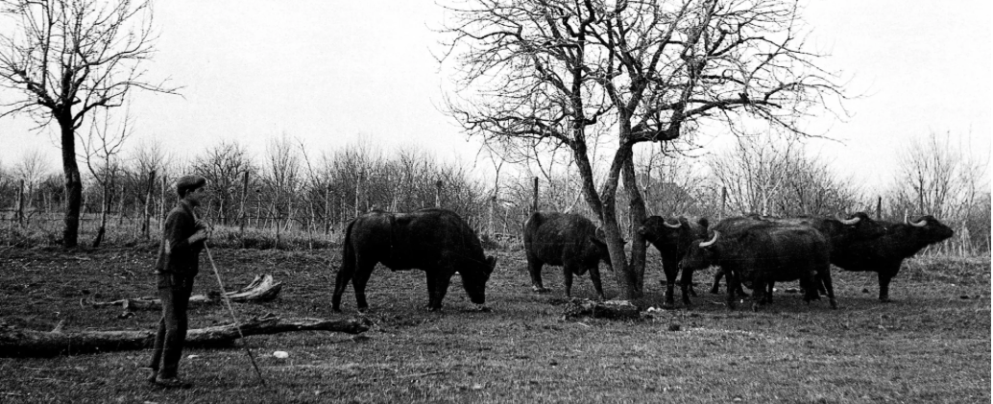
Mussolini vs the Camorra
1911-1912. Major Cuocolo trial had decimated mafia in urban Naples.
However, by the late 1920s gangsterism had moved to the boggy marches of Mazzoni. Here, there were vast herds of buffalo, which produced Italy’s mozzarella.

Slide 7
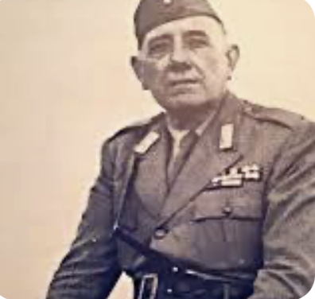
Mussolini sent Vincenzo Anceschi to sort out the problem with the words “Free me from this delinquency with iron and fire!”. Fascists claimed that it was a program of “moral drainage”
Again, there were mass arrests. Between December 1926 and May 1928, 9143 people were arrested.
Anceschi unlike Mori cautioned Mussolini against heralding success. He claimed that fascist party was prone to mafia infiltration. But Mussolini took no notice.

Slide 8
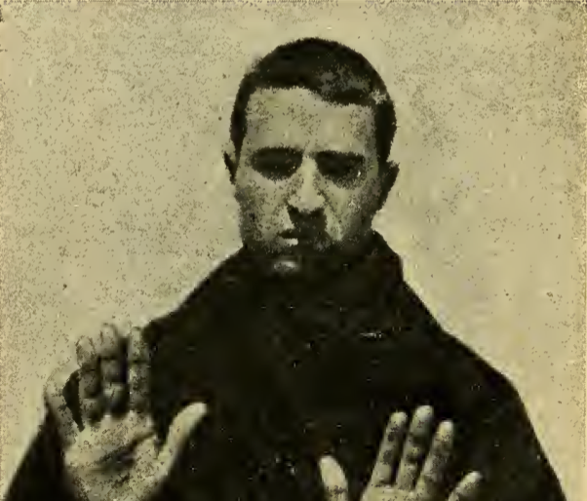
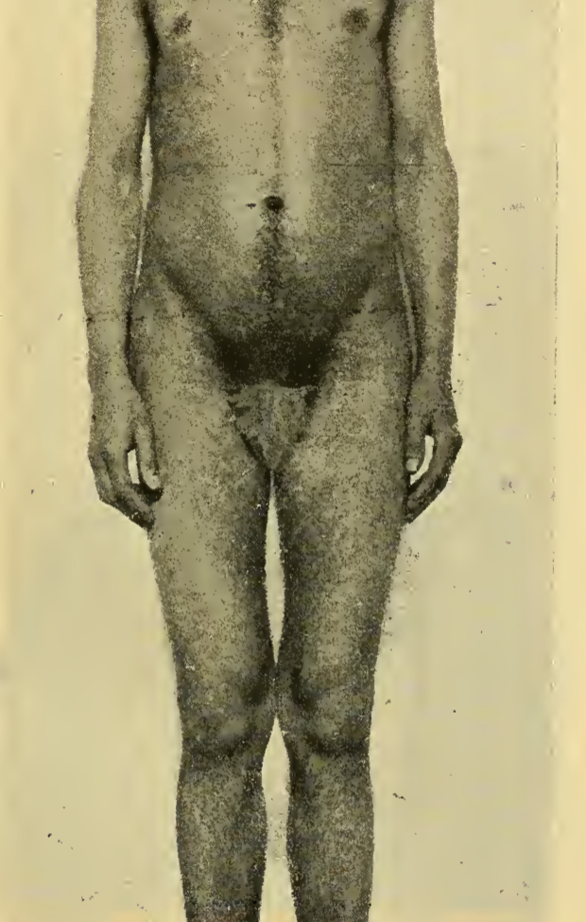
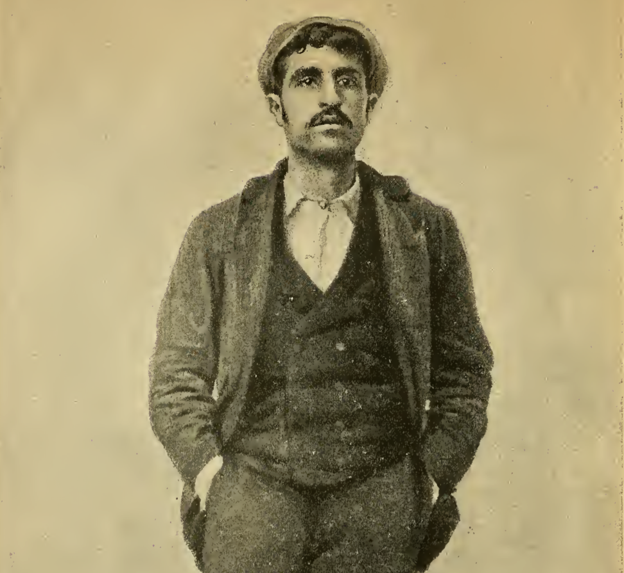
Mussolini vs The ‘Ndrangheta
The situation in Calabria was rather different. The brigands of Calabria had been less protected than the Sicilian mafia or the rural Camorra.
They did not face a sustained campaign. Rather they faced occasional round ups. Many were arrested, then released.
E.g. 1929 in Locri. 48 gangsters arrested. One was a businessman, another a cobbler. They were both released on no more solid grounds that “It was implausible that they would have shady dealings with what was essentially a bunch of beggars”. One of these ”beggars” had mafia rulebook in his house.
Dickie and others suggest that in many regions of Calabria,
  mafia had infiltrated the judicial system
  ’Ndrangheta more than Sicilian mafia or Camorra was based on tight, familial ties. Each ‘ndrina or group was one extended family. Few even today turn state’s evidence
  Women were integrated into this clan or familial system e.g. 12 of 166 of Giuseppi Musolino’s band were women.

Slide 9
A brief interlude in the United States
On 8 July 1938 Il Mattino published the following short story.
“The Fascist Vito Genovese, enlisted in the New York branch of the Fascist Party and currently resident in Naples, has donated 10,000 Lire. The Roccarainola branch received 5000 Lire as a contribution to the cost of the land required to build the local party headquarters. The other 5000 Lire is for building Nola’s Heliotherapy centre”

Slide 10
However, until recently most historians and mafiosi claimed that Mussolini campaign had succeeded.
In 2007, discovery of massive report by carabinieri, mostly from Sicily.
“Despite repeated waves of vigorous measures taken by the police and judiciary, the criminal organization known in Sicily and elsewhere by the vague name of the mafia has endured, it has never really ceased to exist. All that happened is that there were a few pauses, creating the impression that everything was calm… It was believed – and people who were in bad faith endeavored to make everyone believe – that the mafia had been totally eradicated. But all of that was nothing more than a cunning and sophisticated maneuver designed by the mafia’s many managers – the ones wo had succeeded in escaping or remaining above suspicion during the repression. Their main aim was to deceive the authorities and soften up so-called public opinion so that they could operate with every greater freedom and perversity”
“Behind the politician’s mask, behind the honorific title, behind the all-pervasive hypocrisy, and the imposing wealth, there lurked the coarsest kind of with evil, grasping instincts, whose warlike early years n the ranks of the underworld have left an indelible mark of infamy”.

Slide 11
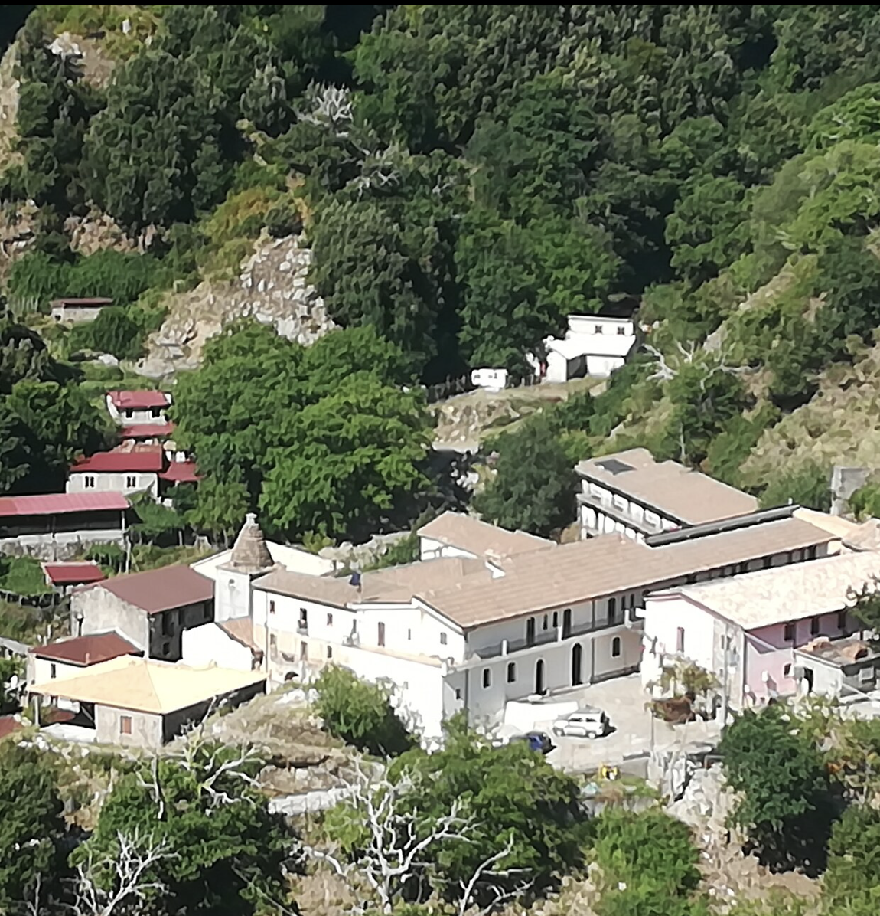
Or in Calabria
Giuseppe Delfino, carabiniere at the Plati station.
1927 uncovered a major cattle rustling ring and arrested six mafiosi.
However, according to his son, he then made a pact with the mafia. He got them to agree to only do murders far from the Sanctuary of the Madonna. He even went to annual pilgrimage with the members of the mafia, dancing tarantella with them

Slide 12
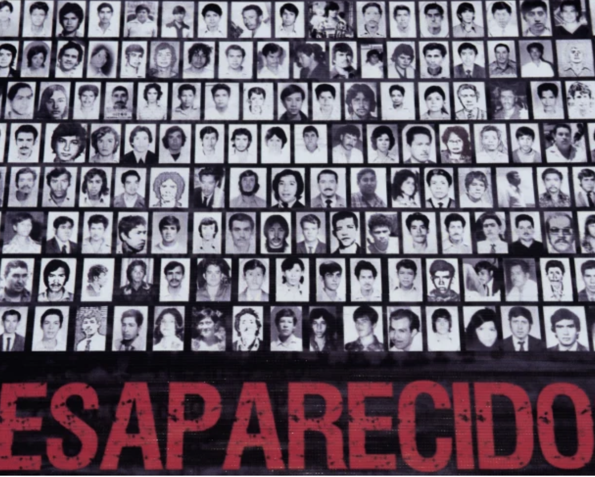
Do reduced homicides often indicate an agreement between the authorities and organized crime?

Slide 13
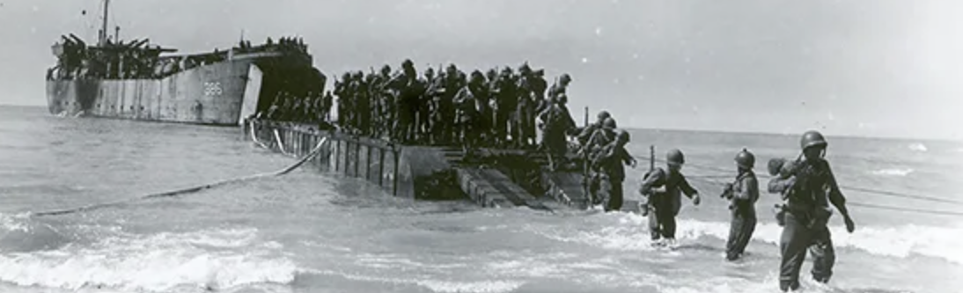
25 July 1943 Allies invaded Sicily.
3 September 1943 Allies crossed to Calabria
8 September 1943 Allies declared victory over Italy.
1 October 1943 Naples liberated. However, spent next 20 months defeating Germans in Italy.

Slide 14
The invasion of Sicily was called Operation Husky
Lieutenant Anthony J. Marsloe had no qualms about dealing with gangsters. “The exploitation of informants, irrespective of their backgrounds, is not only desirous,” he said, “but necessary when the nation is struggling for its existence.”
Although US eventually decided against sending Lucky Luciano to Sicily to help resistance, they did openly court New York mafia support and contacts before the invasion.
Meyer Lansky: “The Navy wanted from the Italians all the pictures they could possibly get of every port of Sicily, of every channel and also to get men that were in Italy more recently and had knowledge of water and coastlines—to bring them to the Navy so they could talk to them.”
Lieutenant Anthony J. Marsloe “The exploitation of informants, irrespective of their backgrounds, is not only desirous,” he said, “but necessary when the nation is struggling for its existence.”
Joint staff report recommended “Establishment of contact and communications with the leaders of separatist nuclei, disaffected workers, and clandestine radical groups, e.g., the Mafia, and giving them every possible aid,”

Slide 15
After the invasion, allies faced outbreak of crime and black marketing of goods.
OSS suggests the following
“Only the mafia is able to bring about suppression of black market practices and influence the “contadini” who constitute a majority of the population…We have had conferences with their leaders and a bargain has been struck that they will be doing as we direct or suggest. A bargain once made here is not easily broken… We lent a sympathetic ear to their troubles and assured them, however feeble oou cooperation, that it was theirs for the asking”

