Slide 1
Covert Netherworlds: Conspiracy or Reality?

Slide 2
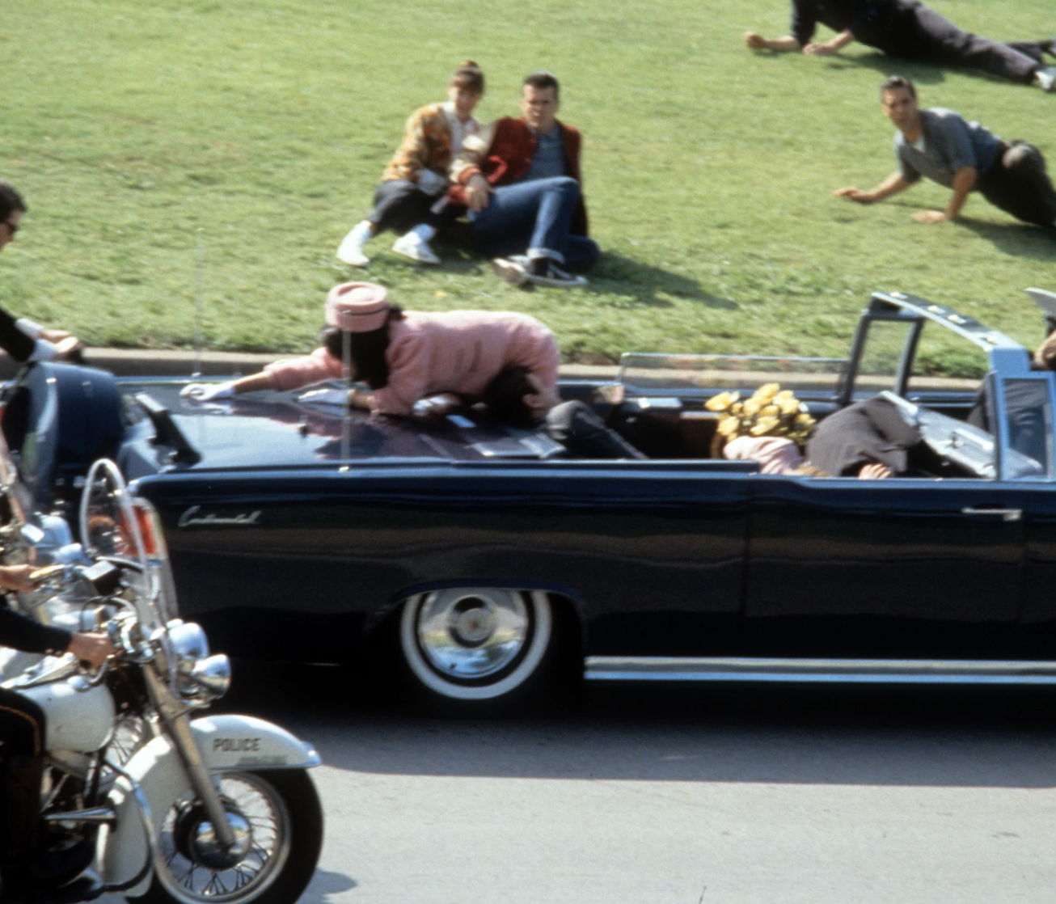
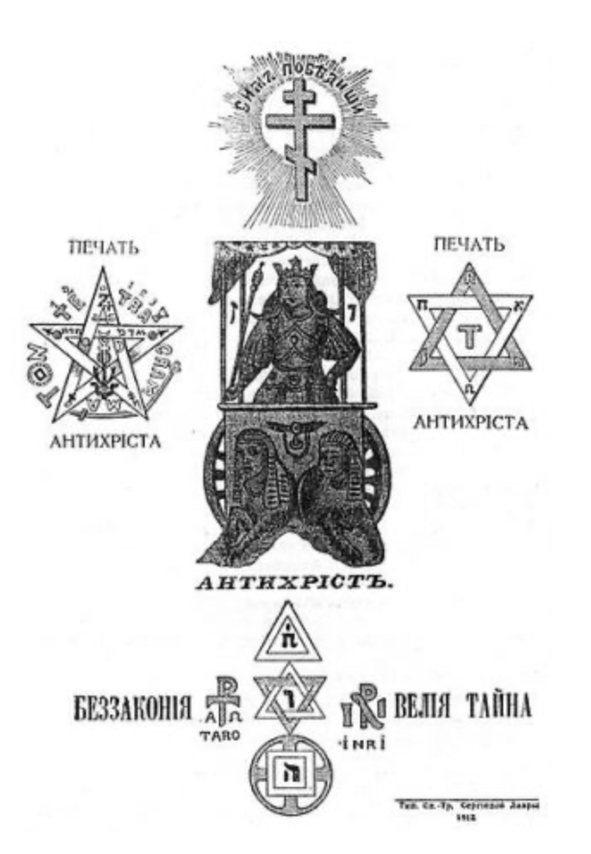
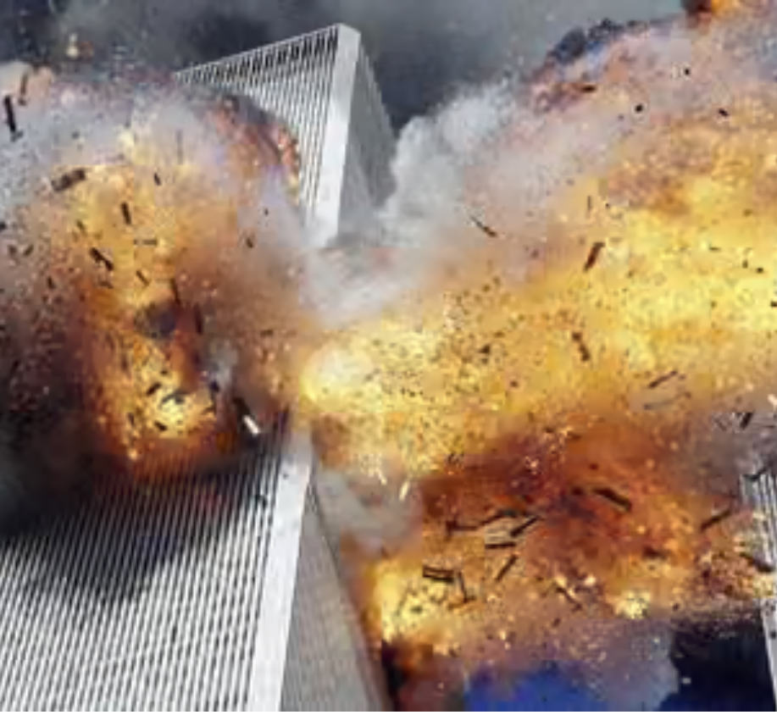
What is a conspiracy theory?
The belief that a secret but powerful organization is responsible for a complex and tragic event or series of events.
It involves:
  Careful planning
  Rejection of coincidence
  Argument that evidence is falsified
  Scapegoating of

Slide 3
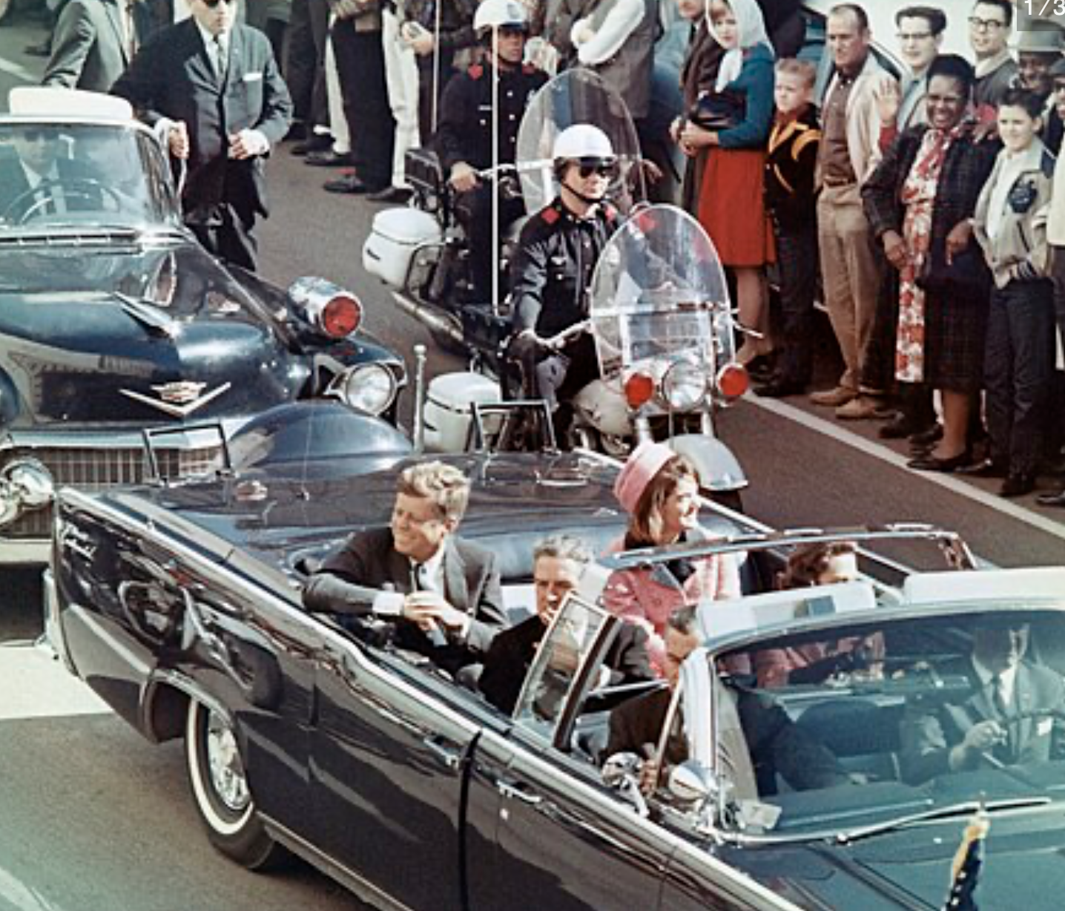
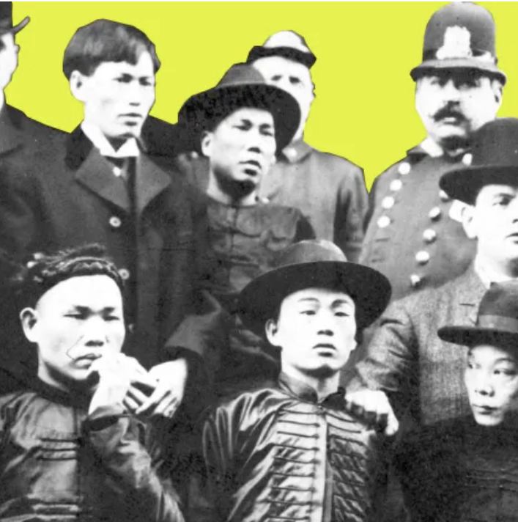
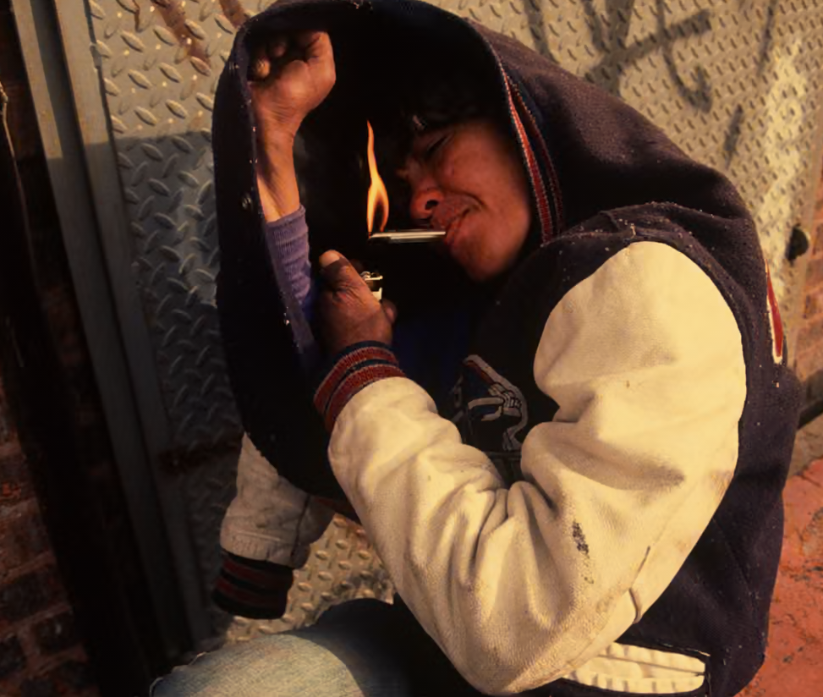
There are many connected to organized crime
They have often, but not always, been linked to surges in drug use.

Slide 4
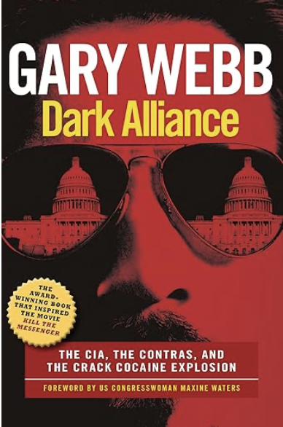
Academics, whether historians, sociologists or criminologists have tended to avoid any history that smacks of conspiracy theories

Slide 5
How to avoid conspiracy theories
Plausibility of sources.
Multiple sources.
Triangulation of these sources
Use of Occam’s razor: A problem-solving principle which states that when presented with competing explanations for the same phenomenon, you should prefer the one that requires the fewest assumptions.

Slide 6
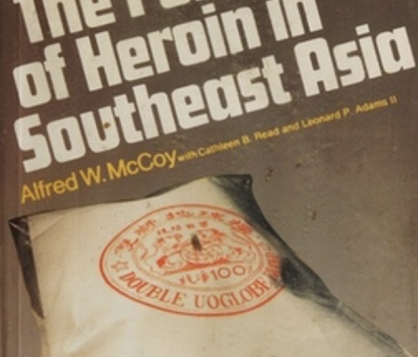
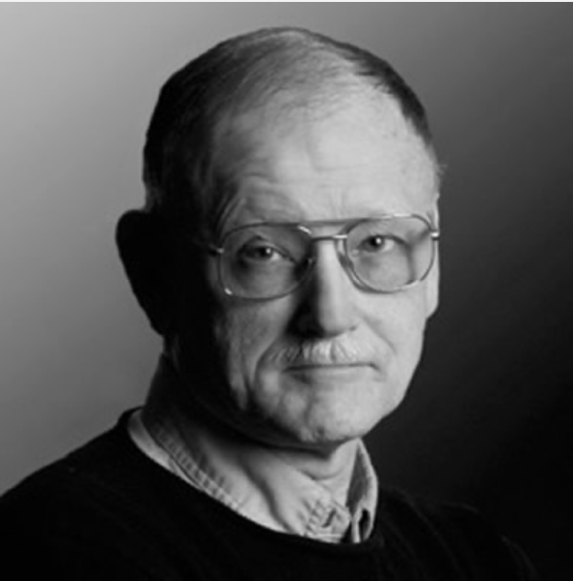
Alfredo McCoy
McCoy spent 18 months in Laos in 1969-1970. Interviewed 250 Laotian, Nationalist Chinese, CIA, French Intelligence and South Vietnamese.
He found that anti-communist forces (mostly nationalist Chinese) were growing opium and producing heroin.
"We have to continue to fight the evil of Communism, and to fight you must have an army, and an army must have guns, and to buy guns you must have money. In these mountains the only money is opium." General Tuan Shiwen, commander of the Kuomintang Fifth Army
This heroin was a) known about by CIA b) being flown out in Air America planes c) was causing heroin crisis in Vietnam among U.S. troops.

Slide 7
What are covert netherworlds?
“The invisible interstice in the world where secret services and criminal syndicates play significant roles”.
Also called grey zones, deep state, shadow government, shadow state, dark state, fourth branch, cryptocracy.

Slide 8
Some problems with the model
Extremely static
Plays down the state’s ability to “do dirty work” deniably.
Plays down the agency of organized crime groups.

Slide 9
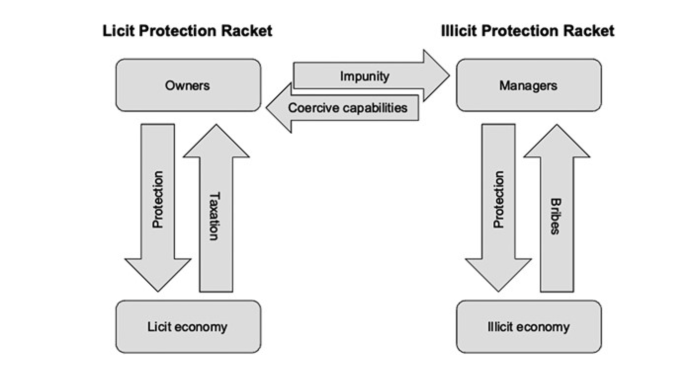
Another way of viewing state-organized crime relations

Slide 10
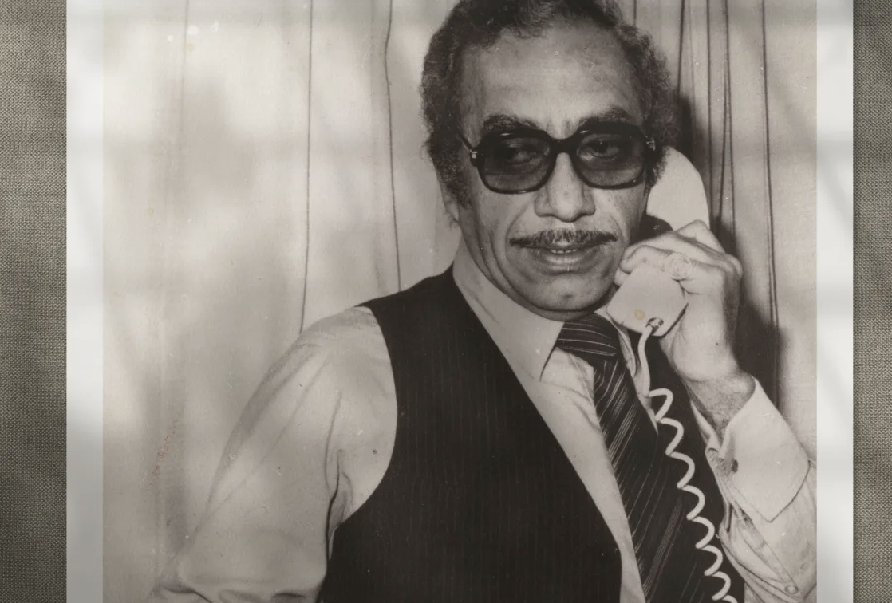
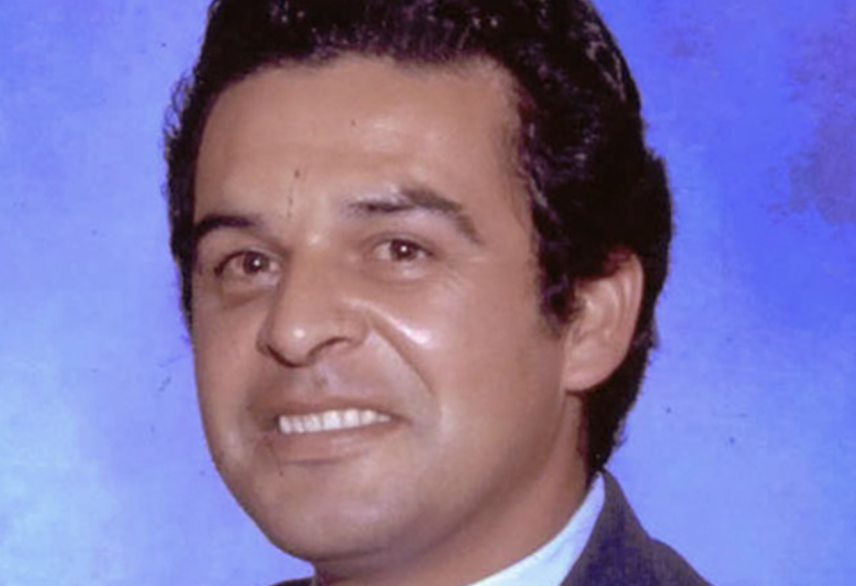
So, do states use organized criminals to “do their dirty work”? A case study.

Slide 11
The facts
In 1984 a hitman shot Mexican journalist, Manuel Buendia, outside his house.
The following year Mexican drug traffickers tortured and murder DEA agent, Enrique “Kiki” Camarena.

Slide 12
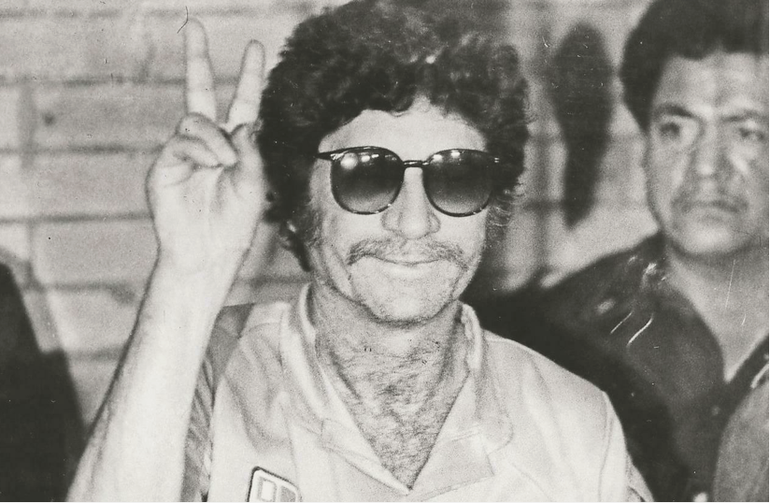
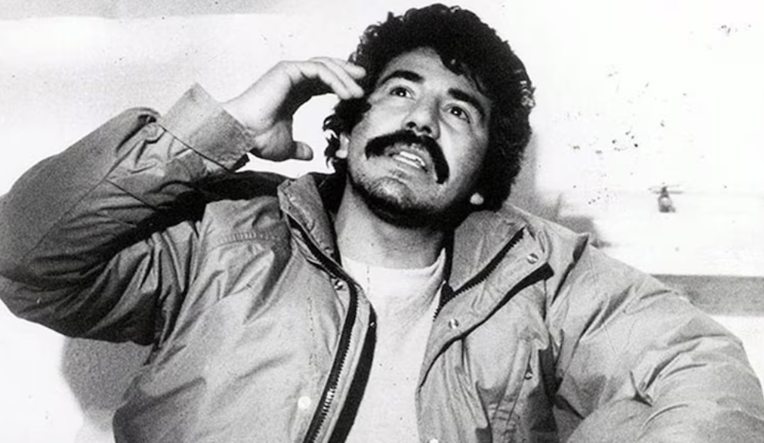
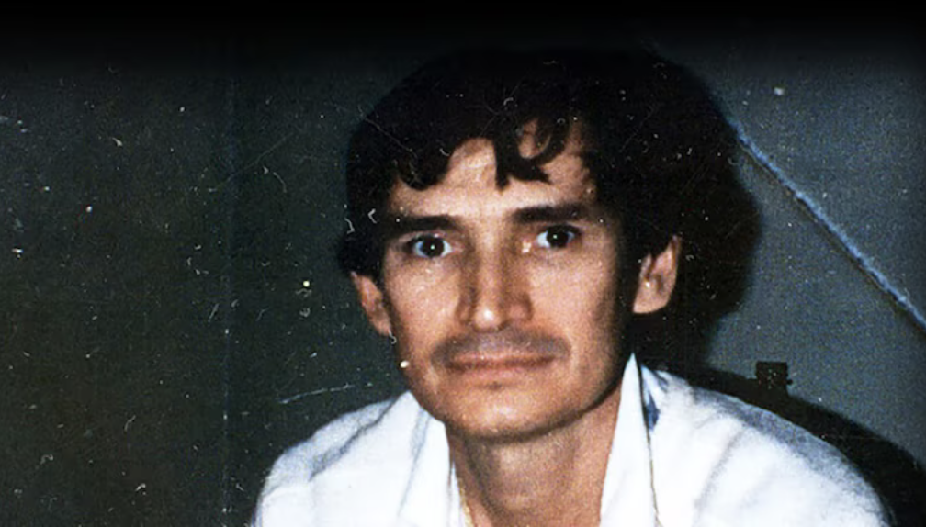
Initially, the U.S. authorities blamed the Mexican drug traffickers: The Guadalajara cartel

Slide 13
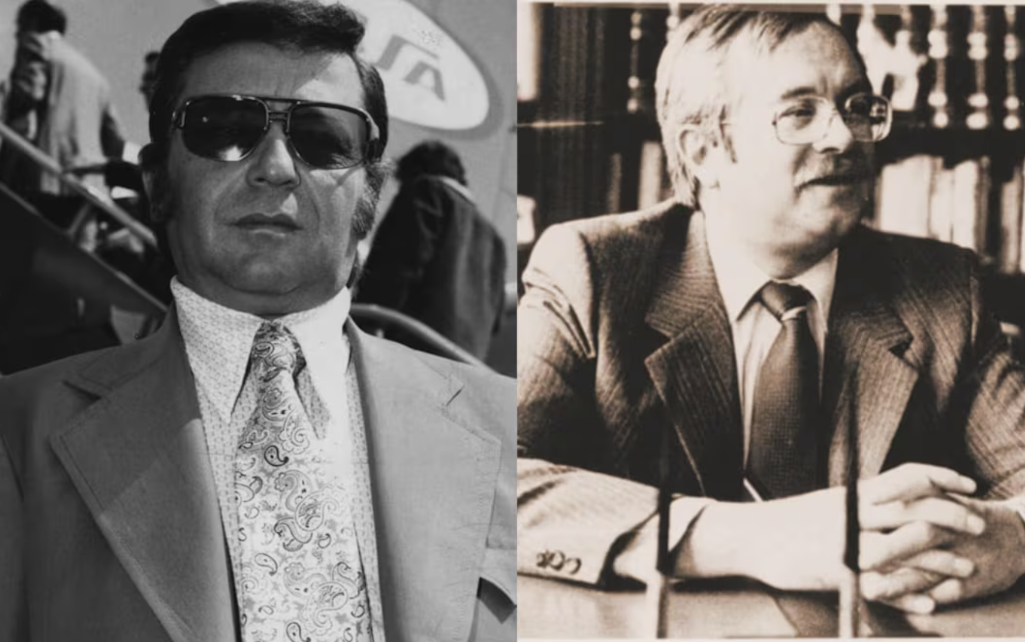
By late 1985 they also claimed that the Mexican secret service, the Dirección Federal de Seguridad (DFS) had protected the Guadalajara cartel.

Slide 14
They argued that Buendia was murdered because he had discovered the links between the DFS and the Guadalajara cartel.
They argued that Camarena had been murdered
  Because he had discovered the vast Bufalo marijuana ranch.
  Because he had fed Buendia information on the DFS-cartel link.
There were problems with this theory:
  Why kill Camarena for the Bufalo ranch? The cartel recovered most of the marijuana.
  Why kill Camarena and Buendia for the DFS-cartel link. DEA and CIA knew DFS was partially funded by drug money.

Slide 15
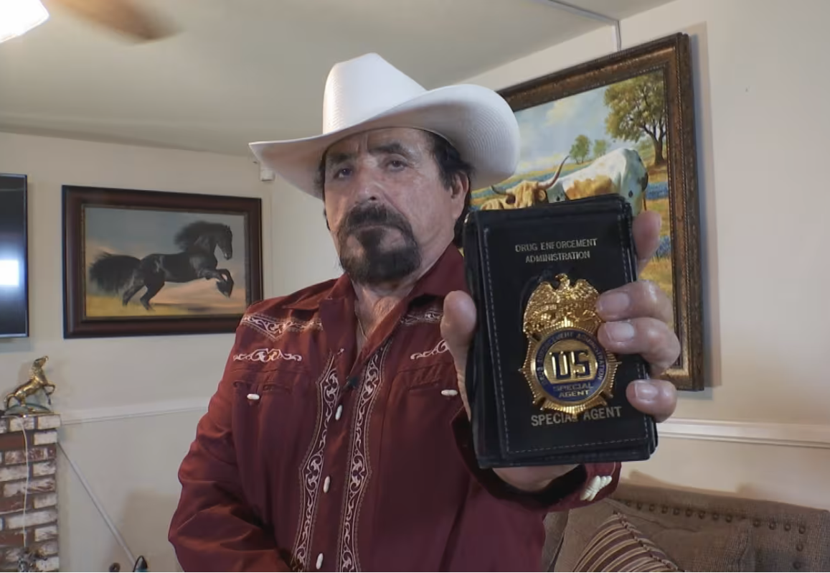
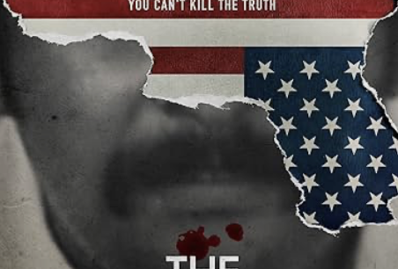
1988
DEA agent Hector Berrellez heads up Operation Leyenda, designed to investigate those also involved in the Camarena killing.

Slide 16
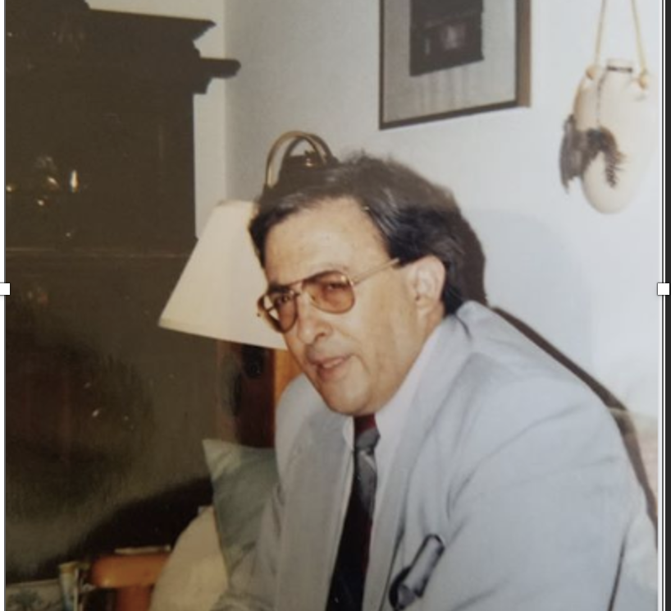
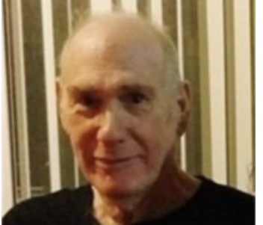
Over the next two years Berrellez discovered two major witnesses: Lawrence Victor Harrison and Antonio Garate Bustamante

Slide 17

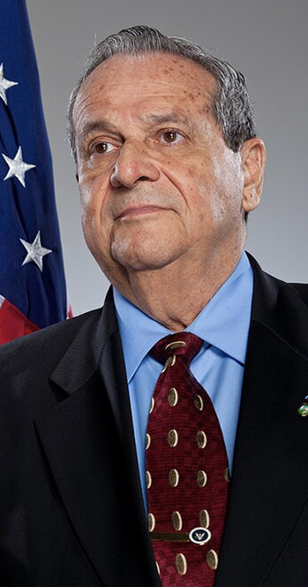
According to their testimonies:
  Lawrence Victor Harrison was a CIA deep cover spook, who ran comms for the Guadalajara cartel.
  Every layer of the Mexican government was involved including the Minister of the Interior, the state governor of Jalisco and the head of the army.
  The CIA was using the Guadalajara cartel to move cocaine on behalf of the Nicaraguan contras. They used the money from this to buy arms.
  The man in charge of this was legendary CIA agent, Felix Rodriguez.
  In 1990 they presented this evidence in an LA court.
  It became part of a largescale African American theory that the “CIA caused the crack epidemic”

Slide 18
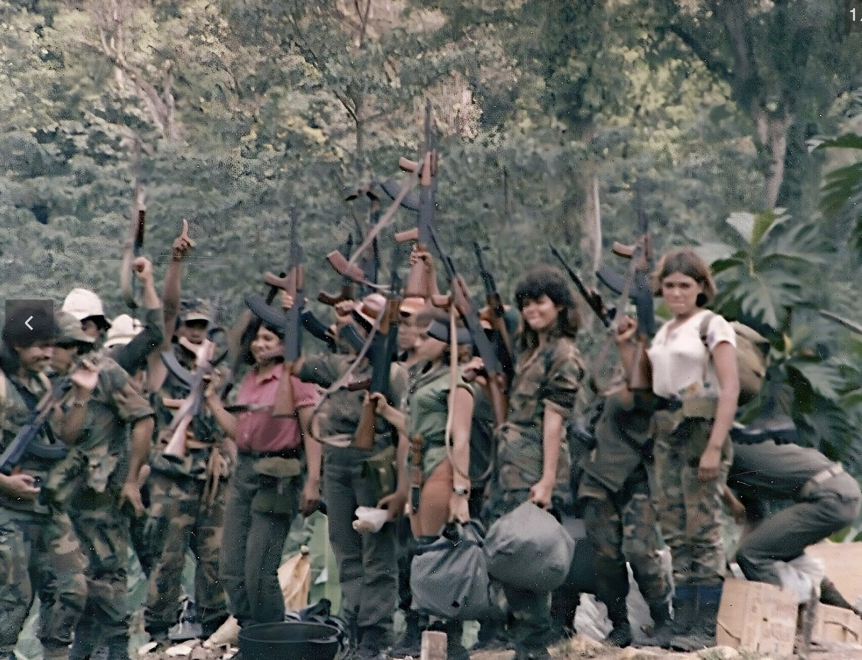
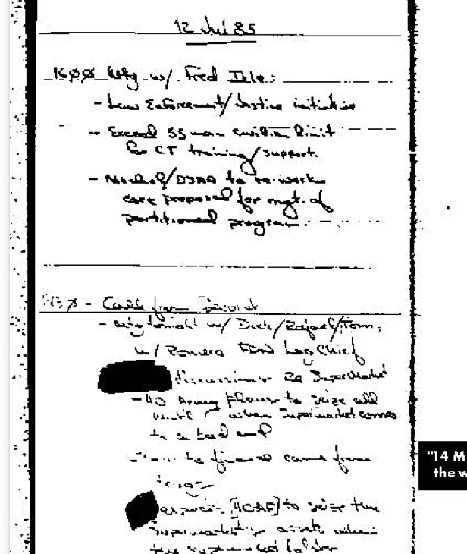
The CIA and the Nicaraguan Contras

Slide 19
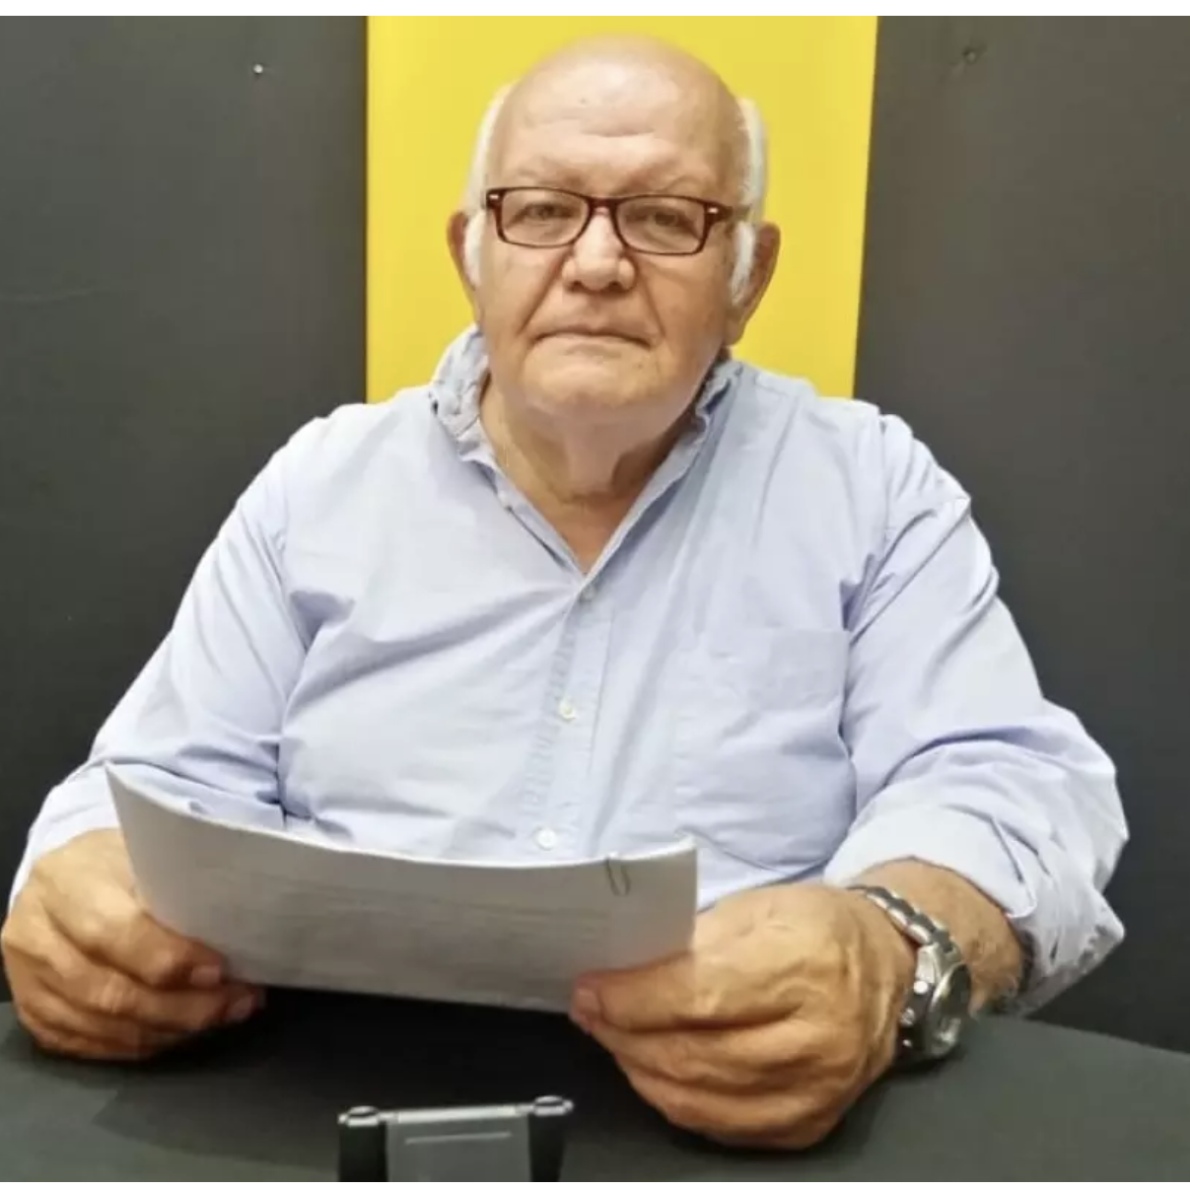
But there were massive holes in Berrellez’s case.
The origins of his two witnesses
The origins of the other 20 witnesses that Bellerrez brought from Mexico.
His methods of bringing culprits from Mexico.
The stories of Mexican government complicity. Too neat. Unbelievable.
The story of CIA complicity was again too neat.

Slide 20
So, what to make of the story?
Berrellez was lying. And he got his witnesses to lie. It is unlikely all the Mexican government met on four occasions in a house they later used to kill a DEA agent. And it is unlikely that the only well-known Latino CIA agent fronted its connections to the Guadalajara cartel.
Furthermore, the inference that the “CIA caused the crack epidemic” seems overstated.
  No evidence of CIA intentionality.
  Plenty of evidence of vulnerability of African American neighborhoods to largescale drug use.

Slide 21
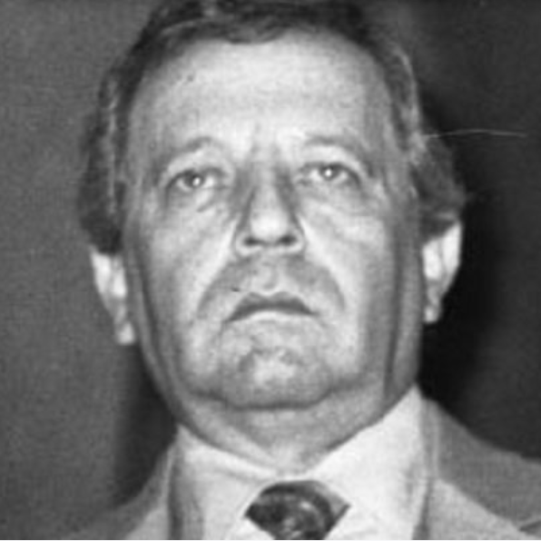
BUT
Who was Lawrence Victor Harrison?
Was the CIA really ignorant that its closet secret service ally, the DFS, was protecting drug dealers?
If the CIA was willing to allow Nicaraguan drug dealers to bring cocaine to the USA, why not Mexican ones?
Why were the Guadalajara cartel so confident they could get away with Buendia and Camarena’s murders?

Slide 22
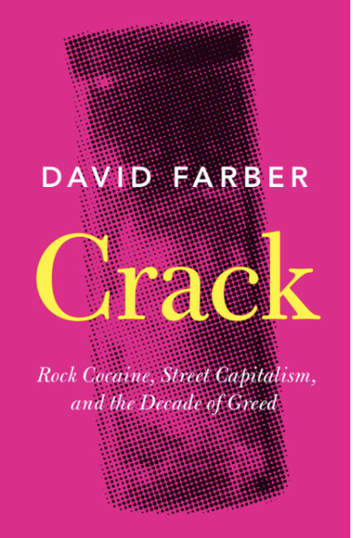
SO?
DFS used money from organized crime.
DFS used assassins from organized crime.
High-up politicians knew about this and sanctioned it.
High-up CIA agents knew about this and sanctioned it.
They had an agent (Lawrence Victor Harrison) in the Guadalajara cartel to monitor this arrangement.
The crack epidemic was not intentional but was caused by a sudden massive, state sanctioned influx of cocaine, the dropping of the price, the proliferation of crack technology, and the search for a market among the poor.

