Slide 1
Culture and Organized Crime

Slide 2
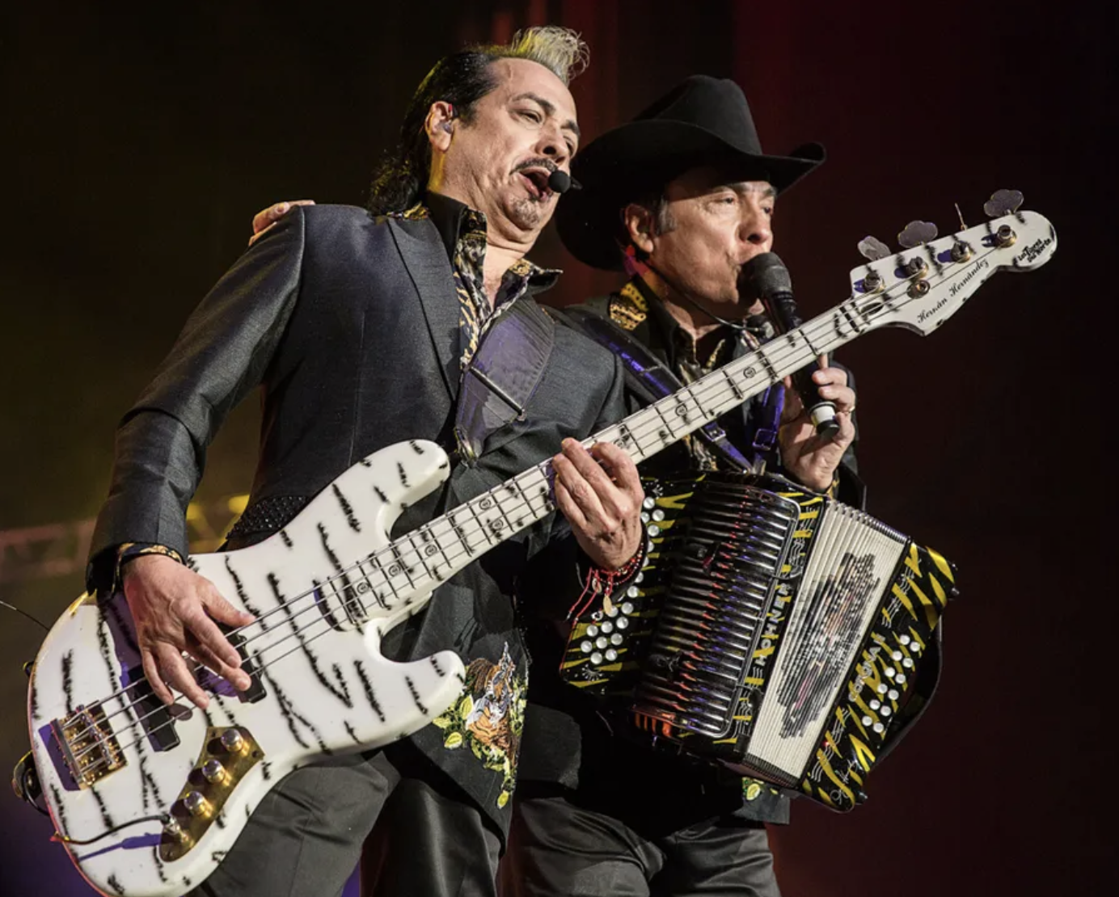
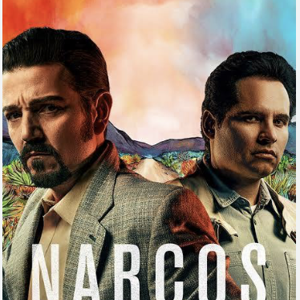
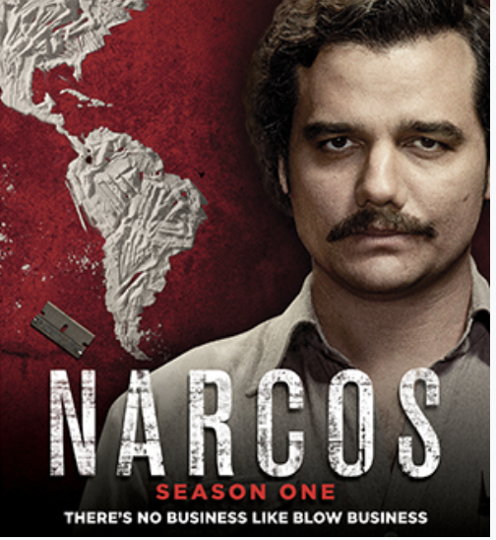
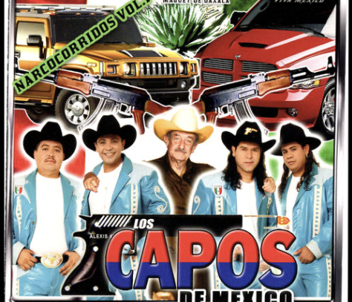
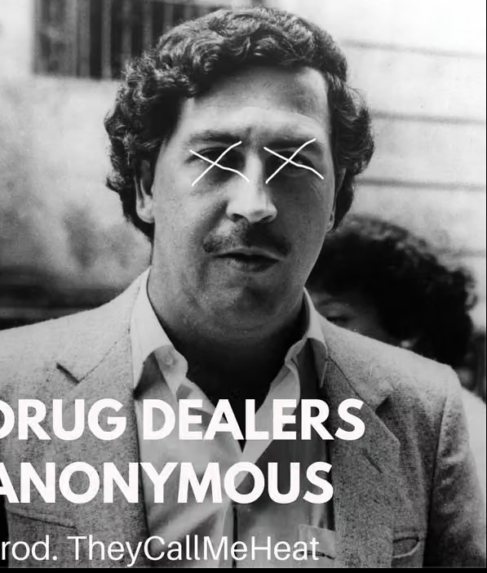
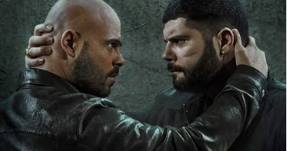
Podcasts, films, series, books, and songs about organized crime fill the airwaves

Slide 3

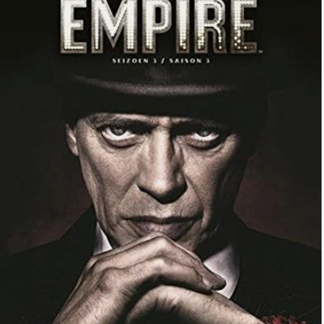
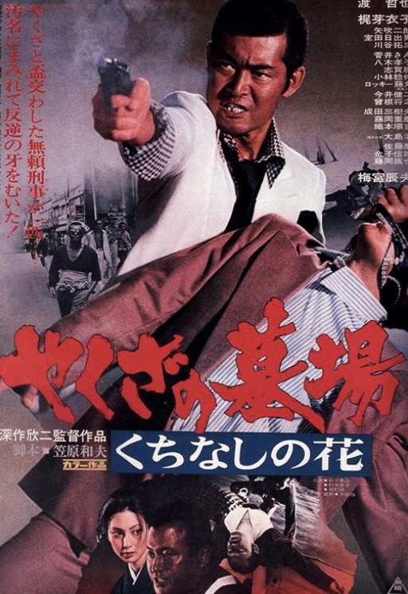

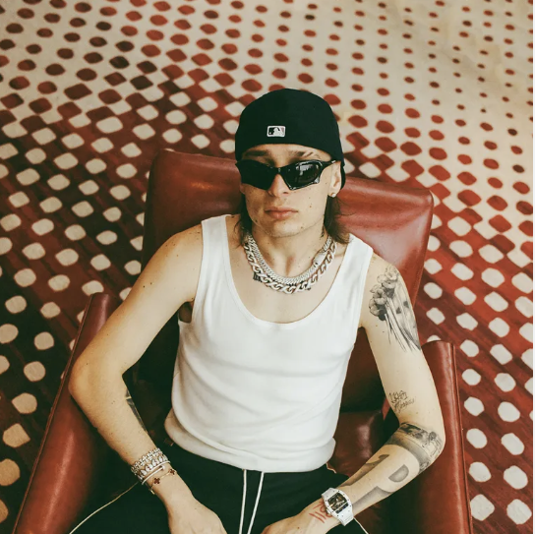
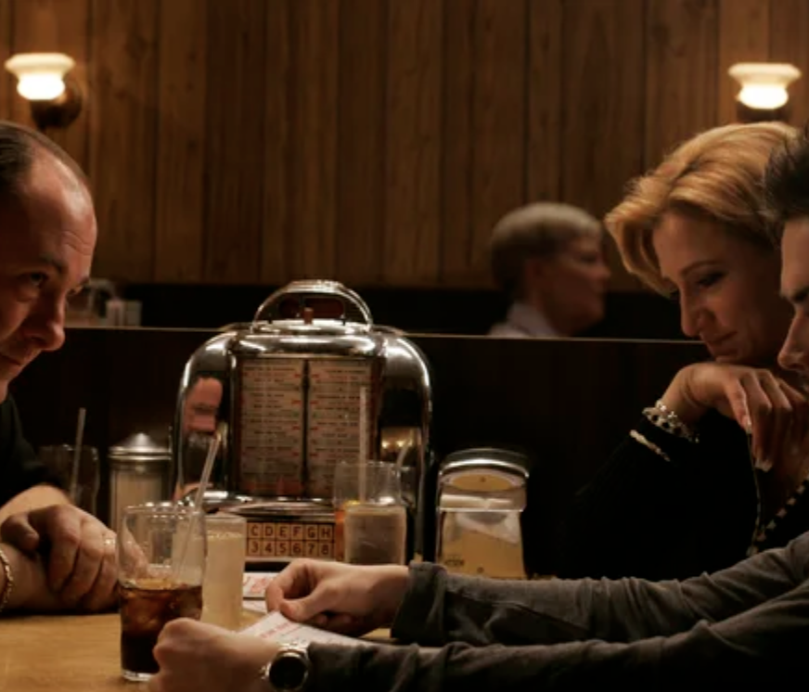
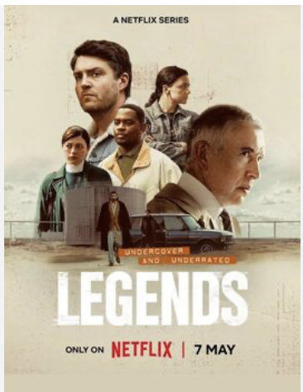
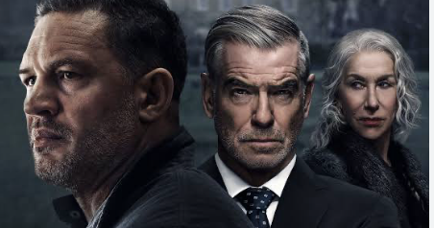

Slide 4
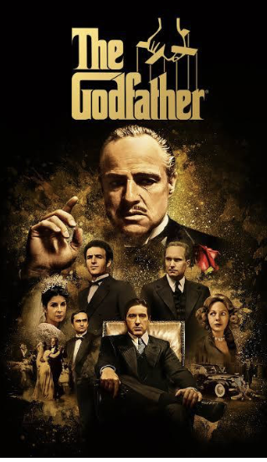
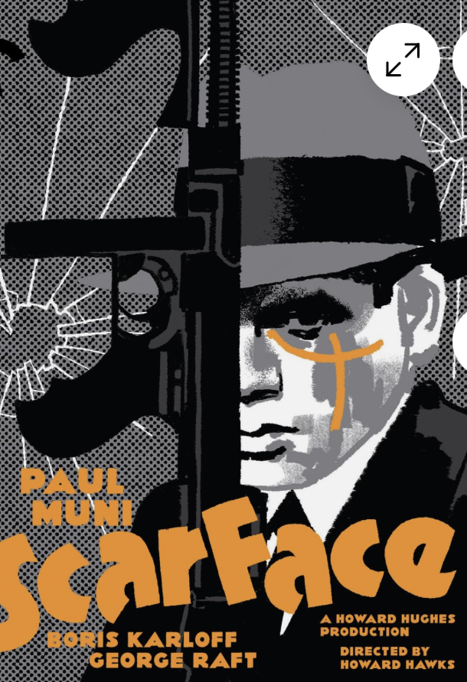
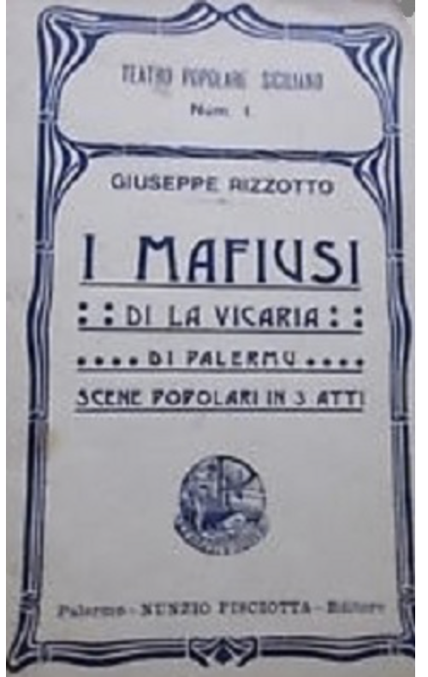
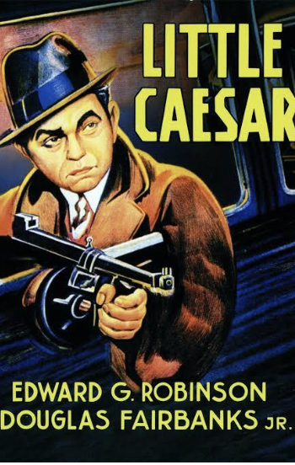
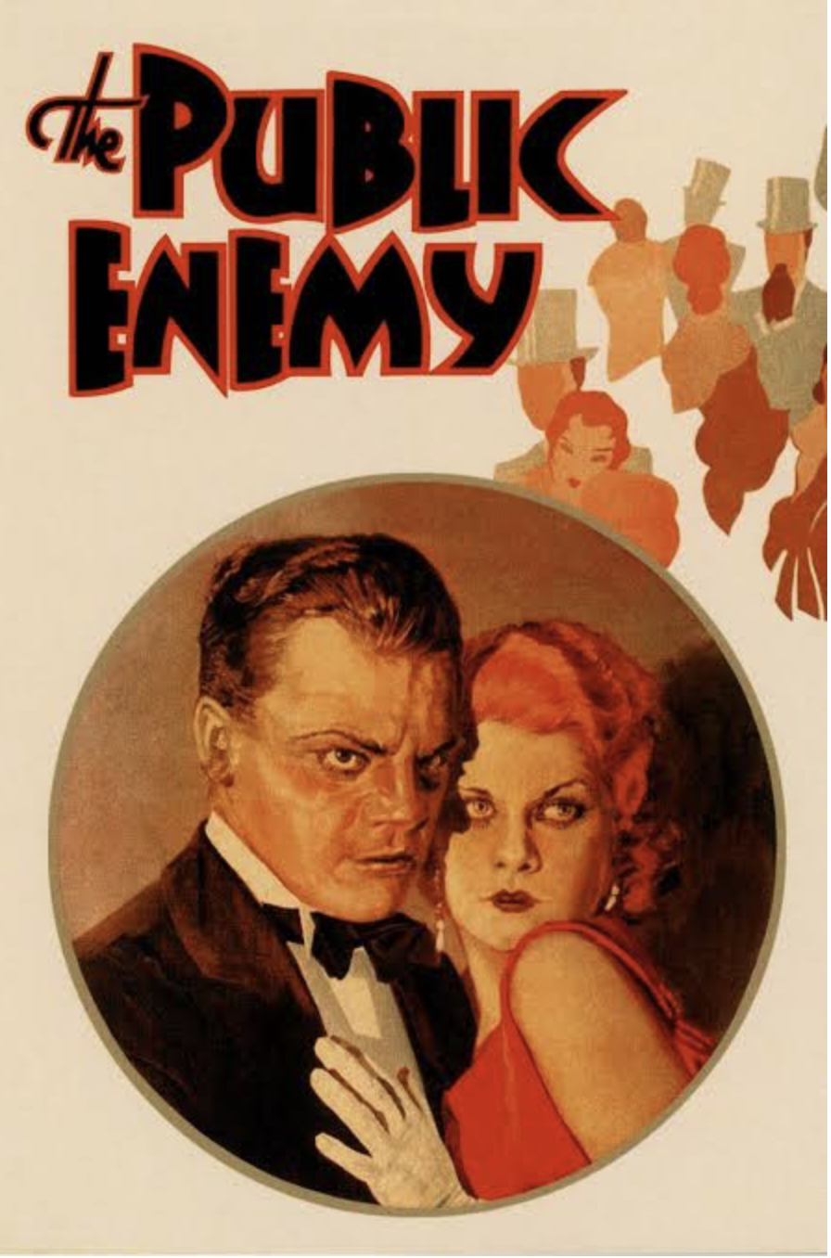
This is not a modern phenomenon. In fact, led by the U.S. culture industry, interest appears to have come in waves

Slide 5
So why do so many cultural forms embrace stories about the mafia/organized crime?

Slide 6

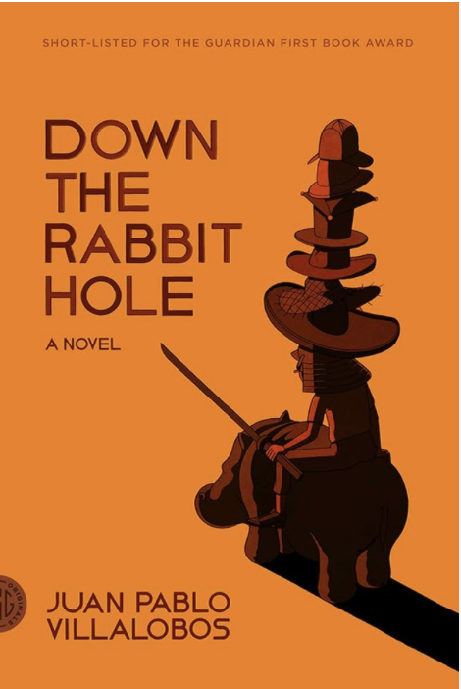
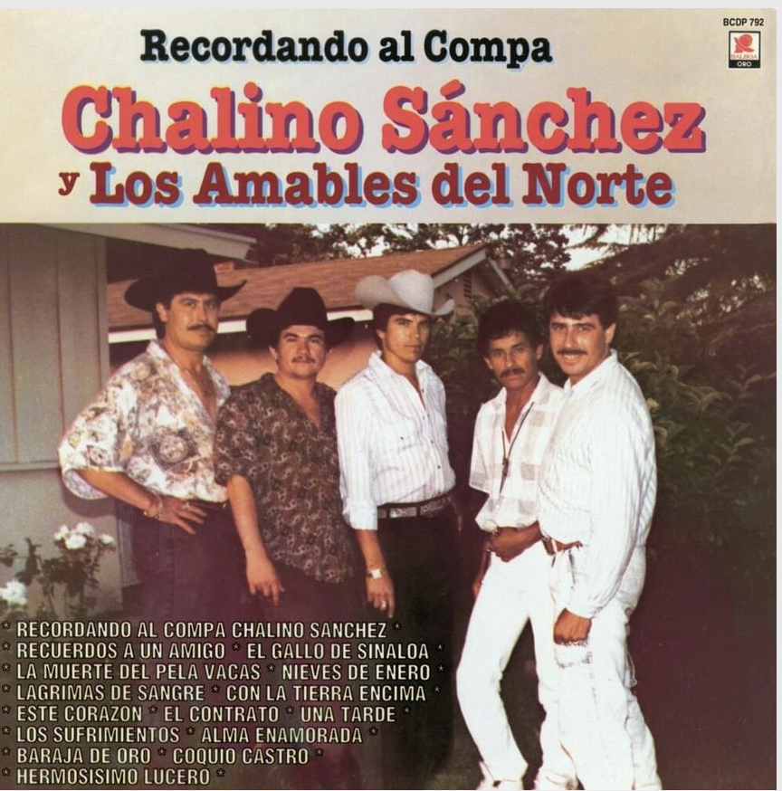
Should we differentiate between types of mafia culture?
Should we make a dividing line between high/low or raw/cooked mafia culture?
One is the unmediated product of the non-elites. The other has been mediated by these elites?

Slide 7
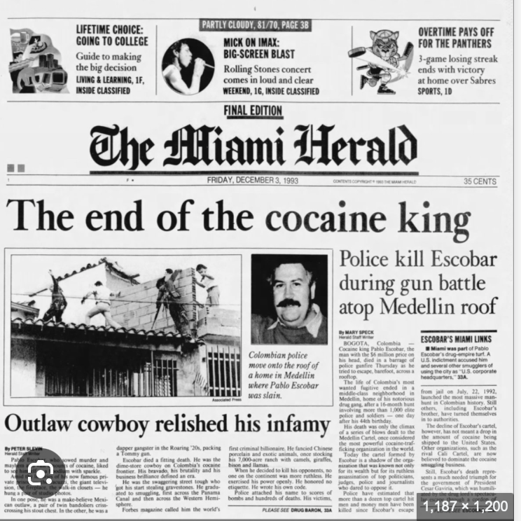
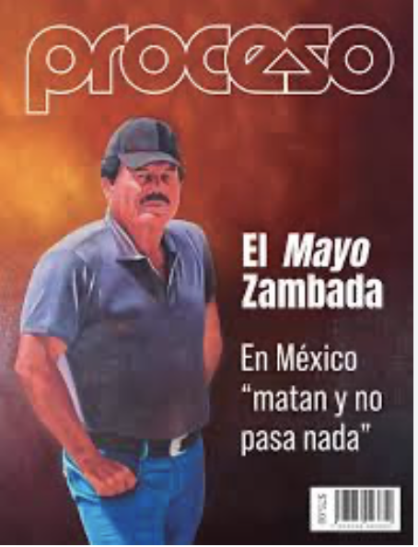
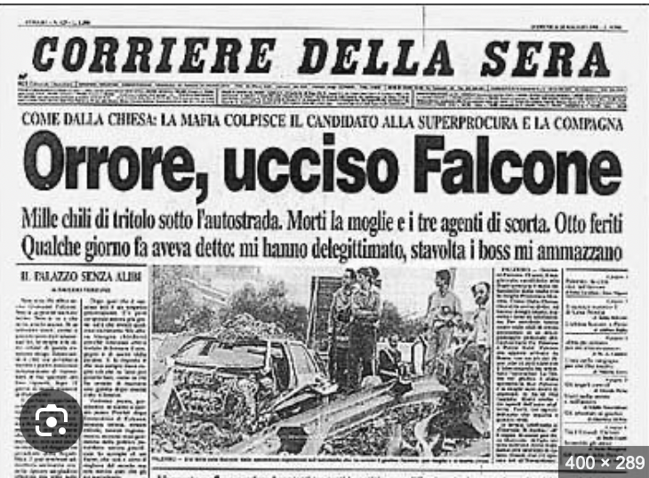
Furthermore, it should not be limited to distinct cultural forms. It should be extended to all the cultural ways in which organized crime is described. Thus, it should include language, mass media, the press.

Slide 8
Is it the voice of civil society?
Some theorists argue that during periods of state wars on the mafia, the public sphere is curtailed. News doesn’t get out.
As a result, members of civil society use cultural forms to bypass the state and tell what they deem the news.
They mostly focus on low or raw mafia culture.

Slide 9
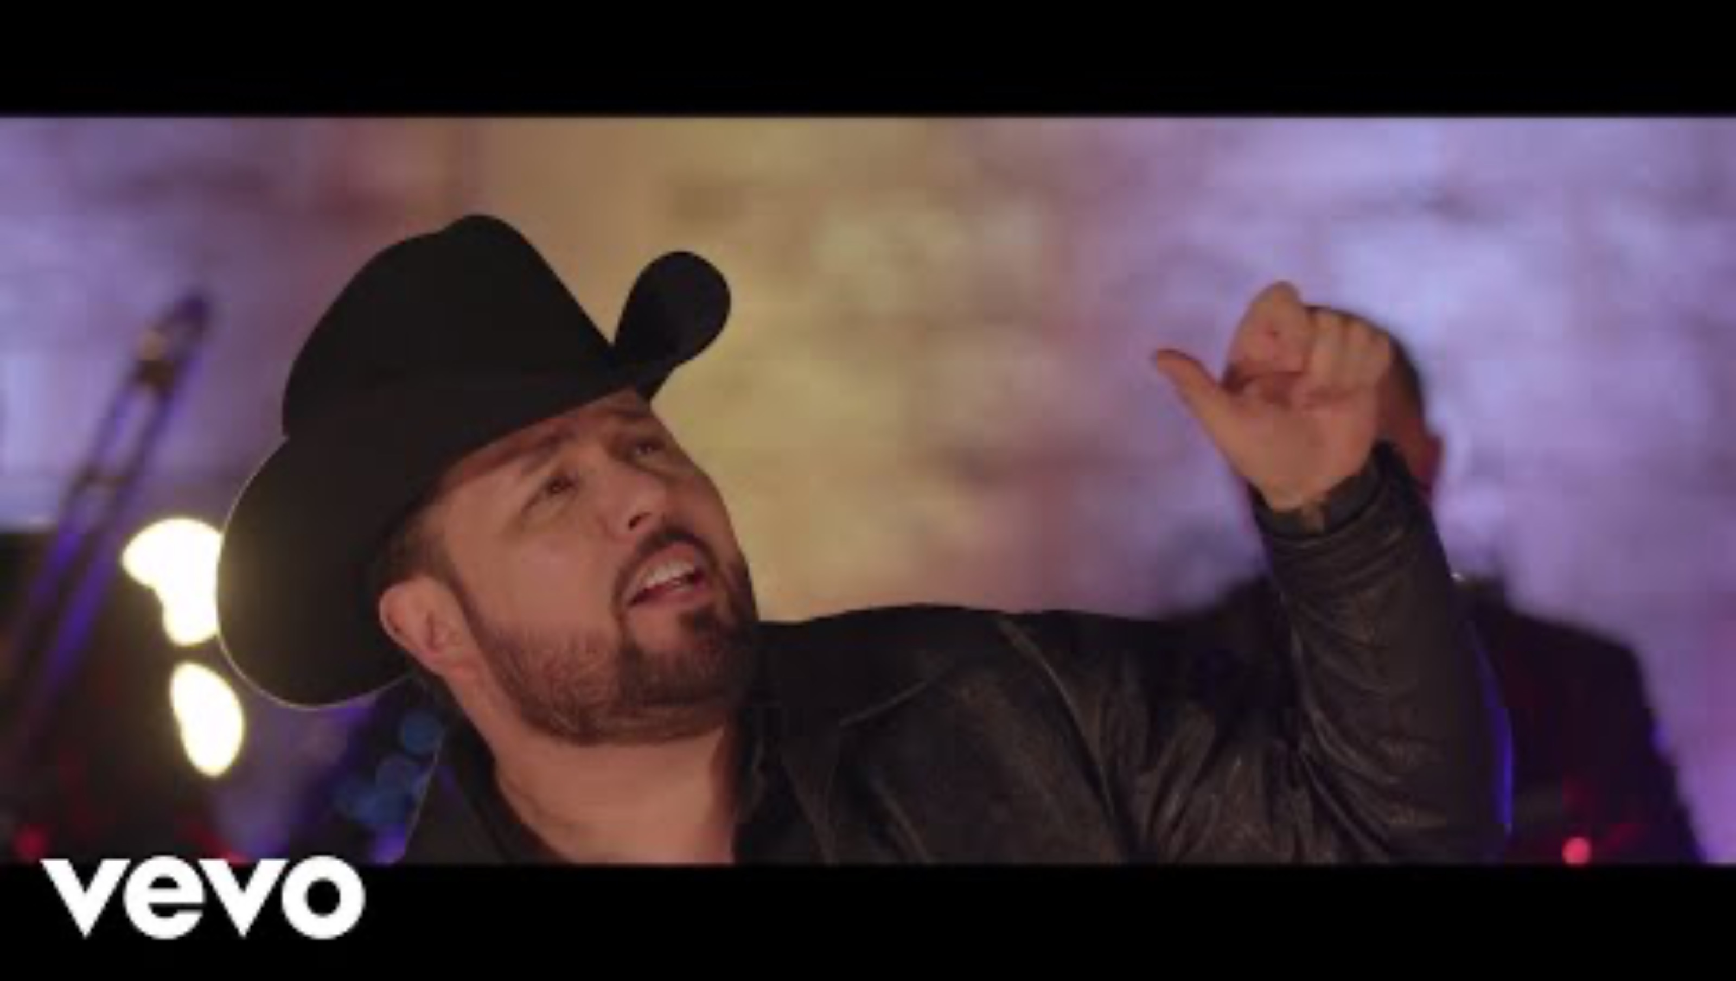
Operation Condor, 1976-1984

Slide 10
Is it the voice of the state?
Other theorists argue that much of the language, media coverage, and high cultural forms that deal with the mafia emerges from the state.
They argue that this language:
  Exculpates state involvement
  Simplifies complex phenomena
  Creates an enemy
  Makes a war winnable.

Slide 11
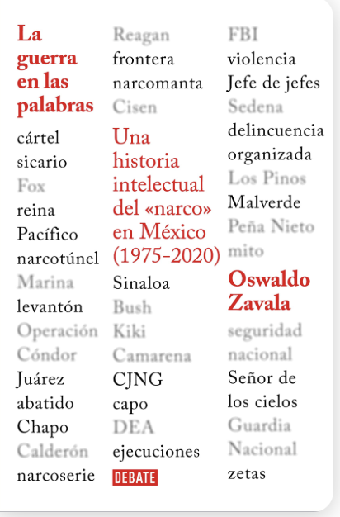
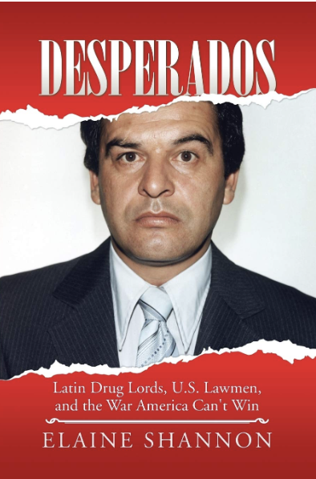
e.g. The term “cartel”
Originally used to describe group of companies which got together to fix prices.
In 1970s, used to describe oil-producing countries. The OPEC cartel. They were monopolists, bad capitalists.
End of the 1970s, first used by DEA to describe drug organizations.
1985-1990. DEA pushes this idea of the cartel in its press releases to describe both Colombian and Mexican traffickers.
1990-1995. They solidify this idea, by creating the “kingpin”, the leader of a cartel.

Slide 12
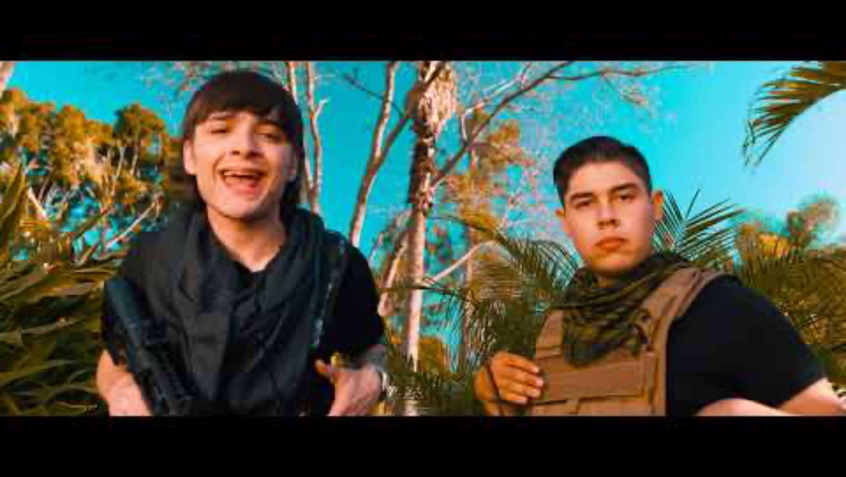
Is it the voice of organized crime?

Slide 13
What are the problems with these visions of mafia culture?

Slide 14
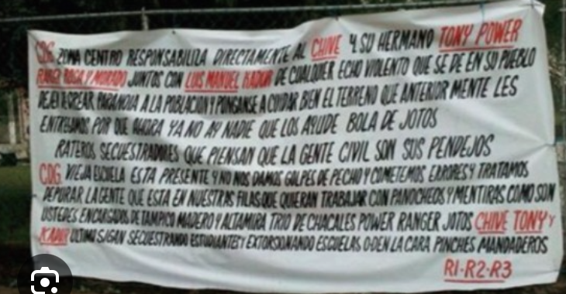
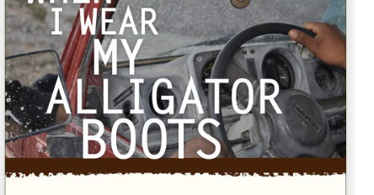
The mafia public sphere?
Should we embrace all the definitions?
Should we see mafia culture as the intersection of mafia, the state, and civil society’s discussions about the otherwise undiscussed sections of society and politics? (Paul Eiss, Shaylih Muehlmann).
Should we talk about a mafia public sphere?

Slide 15
Can we use mafia cultural forms as historical sources? What can they tell us?

