Slide 1
Day 8: Criminal Governance

Slide 2
In many regions of the world, millions of people live under criminal governance
In these places, the state does not have a monopoly over violence.
But the state is not entirely absent.
Tends to be in recent democracies, with limited state capacity.
However, not always. States can be very strong. And democracies can be developed. Criminal violence is EMBEDDED in the modern state.

Slide 3
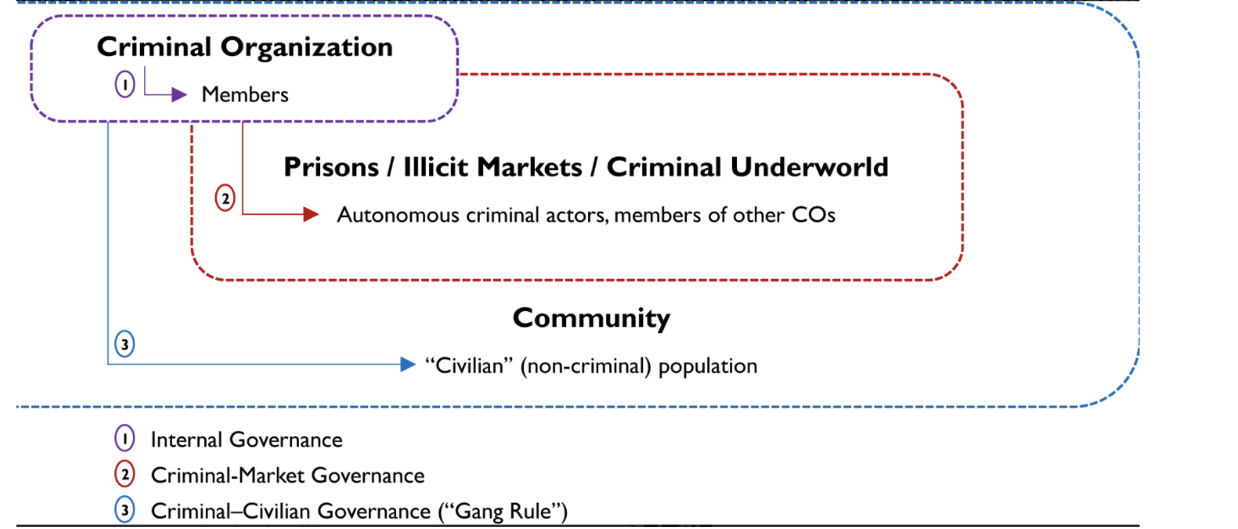
What does criminal governance involve?
In community, can involve
Control of property rights
Provision of justice
Dispute resolution
Provision of credit
Electoral politics
““Cases of neighbourhood squabbles and even domestic disputes … are clogging up our wiretaps, which are capturing fewer conversations about major PCC actions” Sao Paulo policeman

Slide 4
Primeiro Comando da Capital (PCC)
Comando Vermehlo (CV) emerged in 1970. Mixture of bank robbers and guerrillas. 1990s took control over Brazil’s prisons. 2000s returned to Rio de Janeiro and other cities. Decentered system under individual favela chiefs.
1992 Carandiru prison riot and massacre. 111 killed
1993 Formation of PCC under survivors.
Projected self like a social movement
““We must remain united and organized to avoid a similar or worse massacre than [Carandiru], a massacre that will never be forgotten in the conscience of Brazilian society… because we, the Comando, will change current carceral practices, inhumane, full of injustice, oppression, torture, and massacres.”
Declared alliance with CV and adopted its motto “Peace, Justice, and Liberty”
Statues have changed over the years. Now ““Peace among thieves and war against the state”

Slide 5
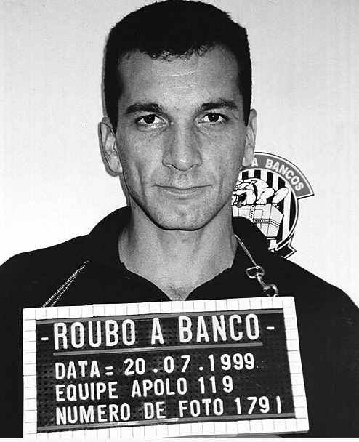
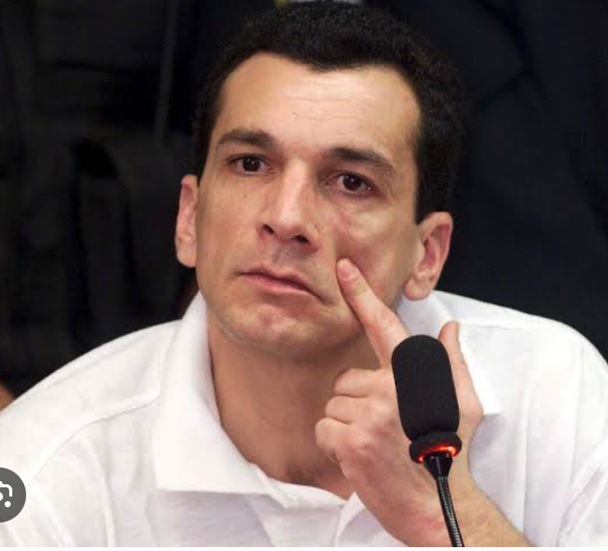
History of criminal governance
During 1990s, operated in prisons.
  Prohibited theft, rape, crack use and unauthorised violence.
  Provided limited welfare (food, medicine, hygiene products) for poorest
  Ensured supplies of drugs, cell phone and other contraband
  Bargains for better conditions
  Violently usurped control of other prisons.
2002 Coup by Marcus Willians Herbas Camacho, ”Marcola”. He gets rid of the personalistic, pyramidal structural of the gang. He flattens hierarchy into responsas or posts through which members rotate. Stressed igualdade and humilidade.
“In our time there was no such circulating system of authority. We were the founders. We had the last word and everyone else… obeyed and did exactly what we ordered. There was nothing about consulting two, three, four, or twenty opinions”

Slide 6
Inside prison PCC under Marcola
  Softened punishments
  Institutionalised formal tribunals or debates for serious violations in which juries of imprisoned leaders heard testimony from witnesses, victims and even counsels.
Outside prison
  Gradually took over Sao Paolo periphery.
  Monopolised drug sales
  Banned non-legitimate use of force

Slide 7
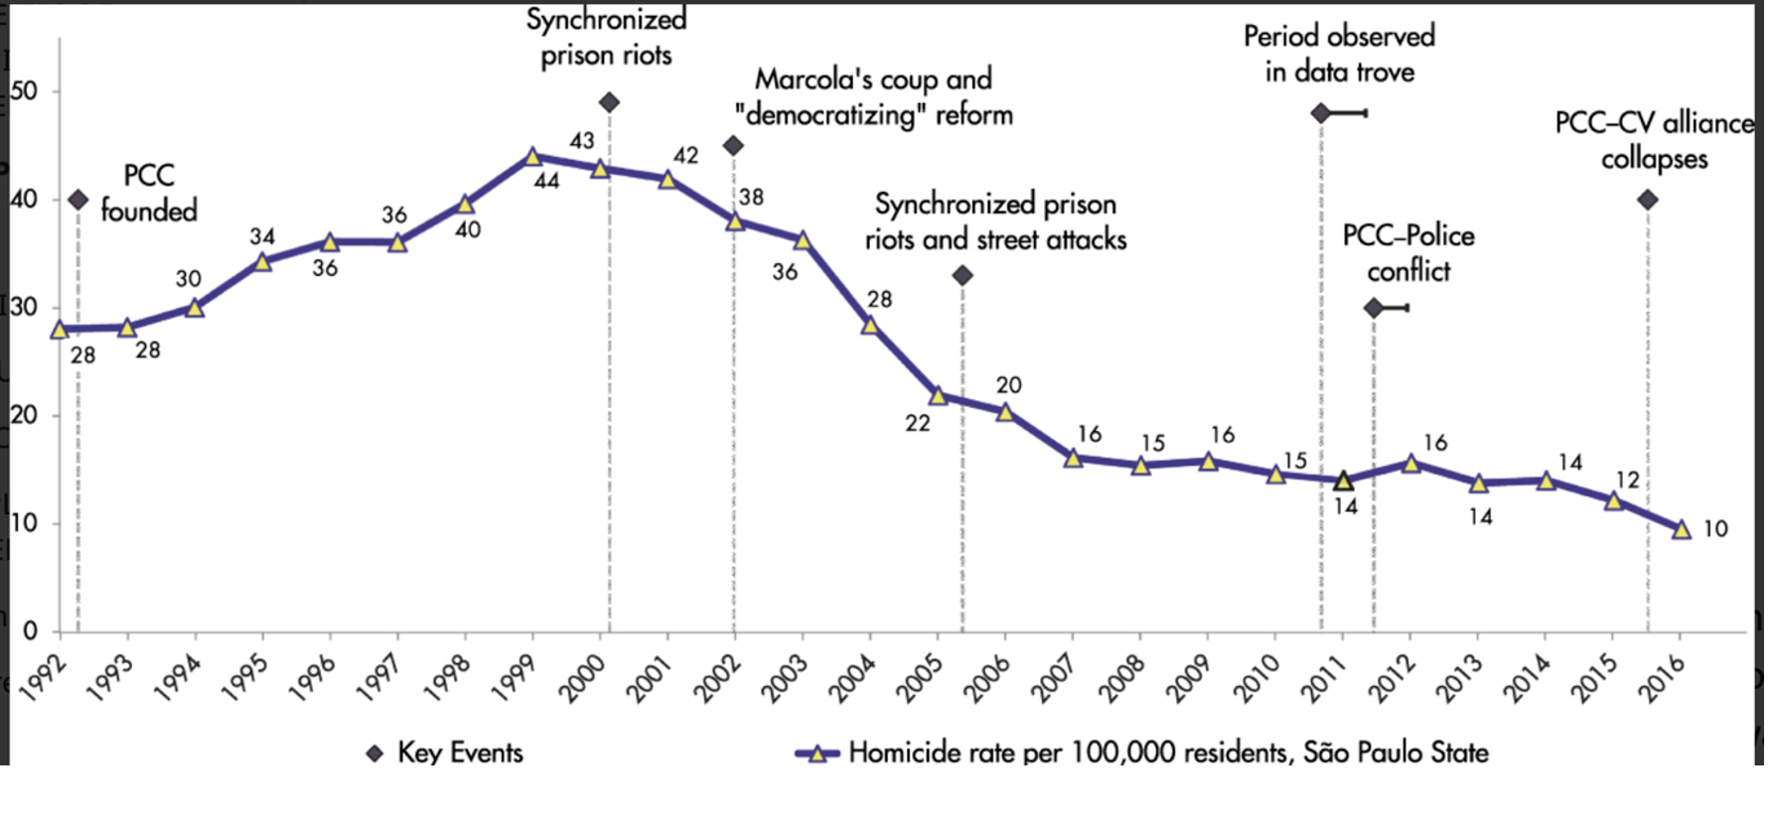
Huge drop in homicides

Slide 8
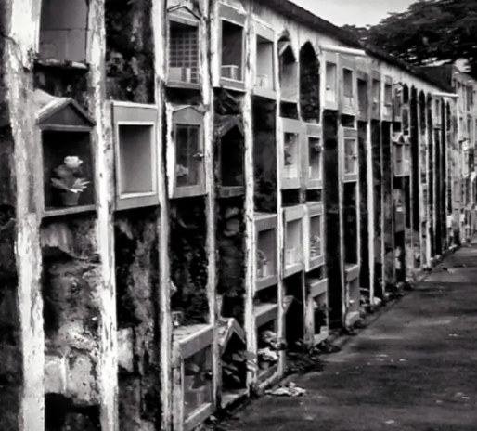
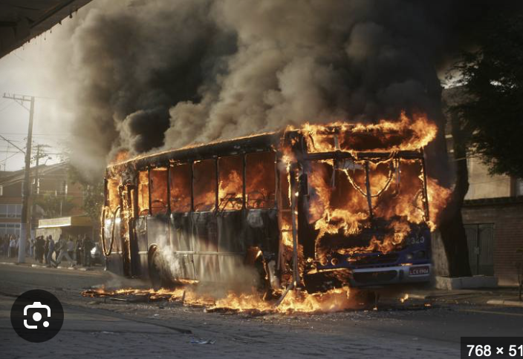
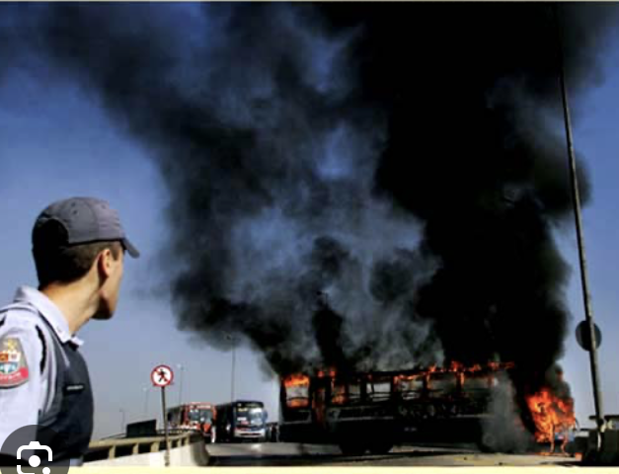
2006 Took over Sao Paolo and 90 prisons in state

Slide 9
PCC now
Since 2006 appears to have come to an agreement with government over control of city.
29,000 “baptized” members in 135 prisons in Sao Paolo alone.
Has cells in all 27 Brazilian states and five neighboring countries.
Question of state force?

Slide 10
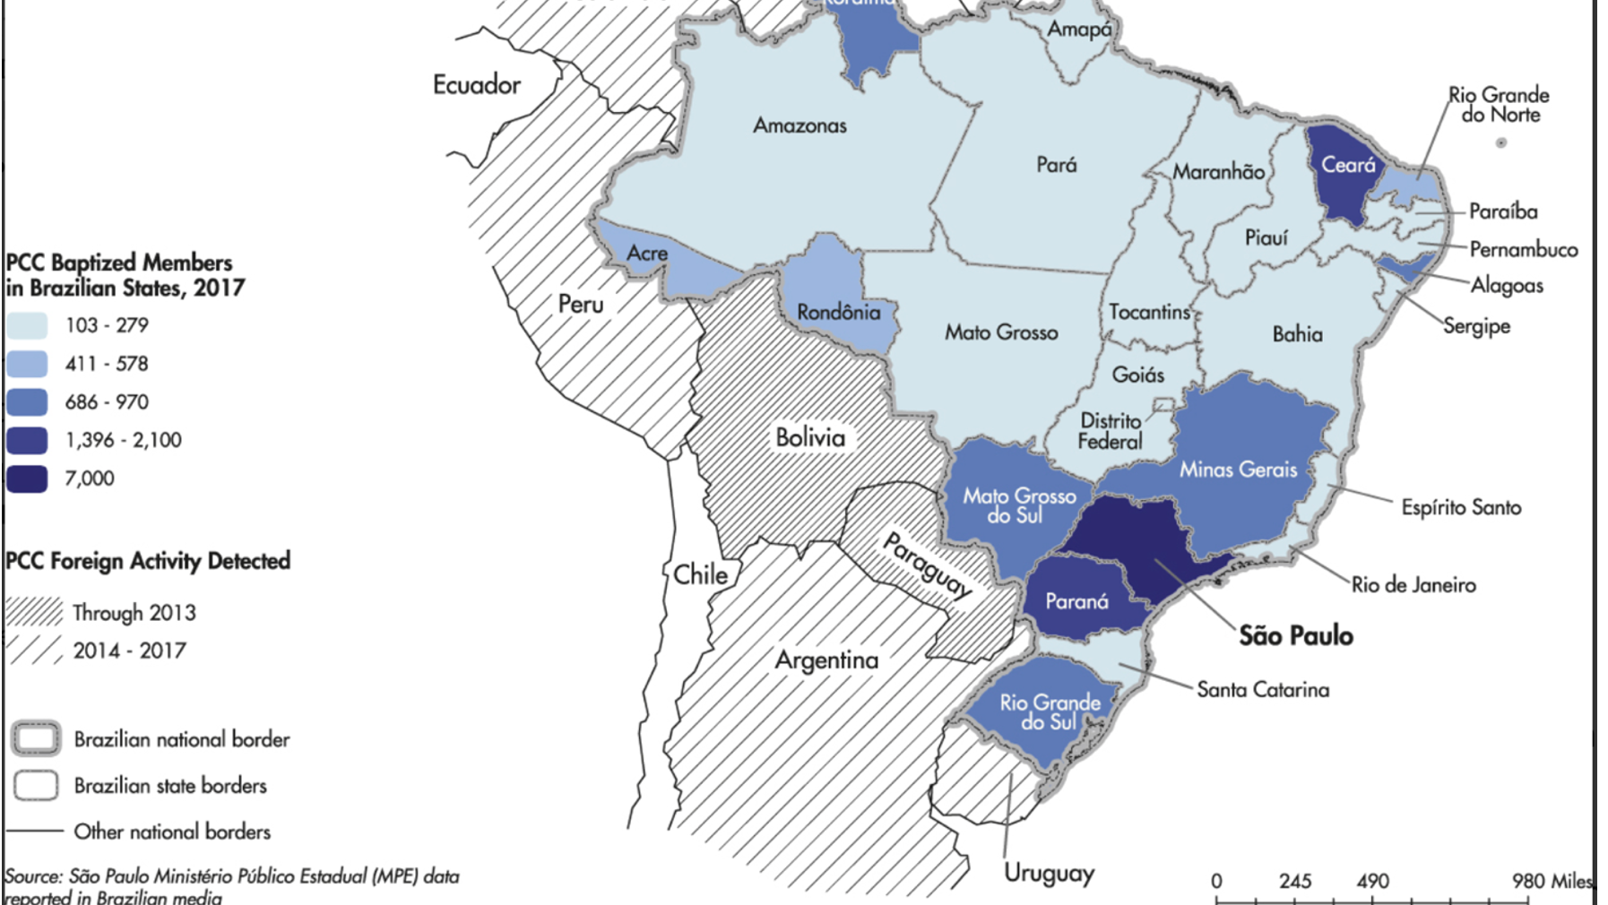

Slide 11
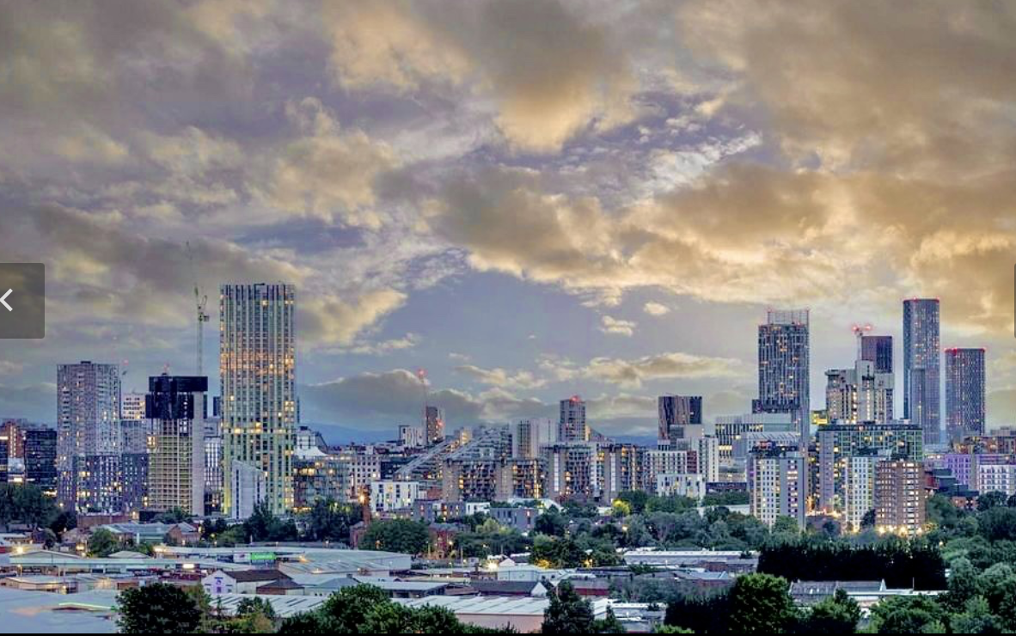
However, criminal governance is not limited to developing countries

Slide 12
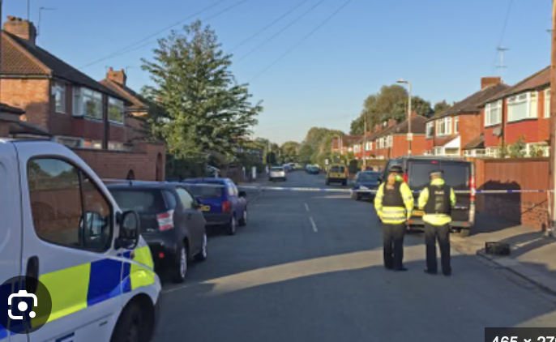
2016: Man attacked with machete; grenade thrown at house; 9 year old shot as opened door. 19 shootings in the year.
“Police don’t control the street”

Slide 13
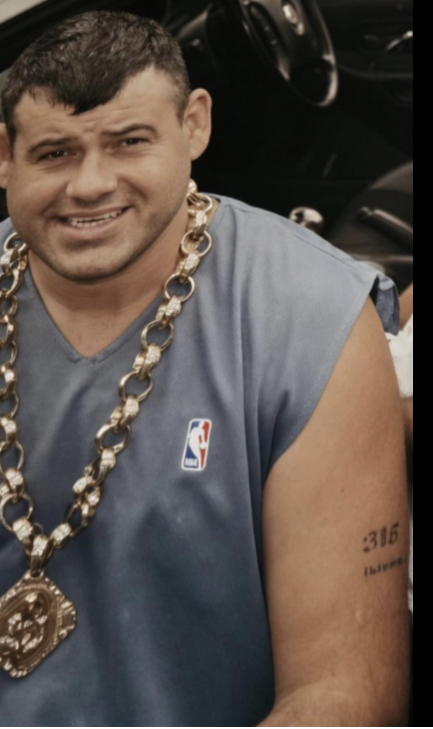
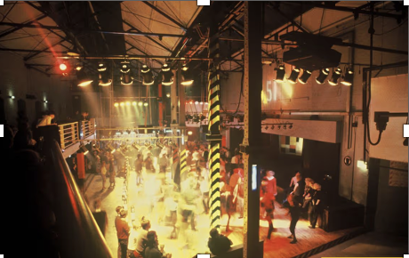
During the 1970s, series of families ran crime in Salford area. They were mostly involved in armed robbery.
In 1990s, they became increasingly involved in trafficking and sale of cocaine, heroin, and ecstasy.
1991, Noonan family put in charge of security at Hacienda nightclub.

Slide 14
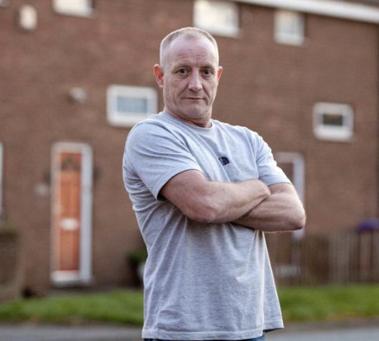
Another gang run by “Big” Paul Massey
1990s, establishes Pernall Management Security (PMS). Everyone knew than PMS security stood for Paul Massey security. Those on the firm were often in jail. It provided a way to get them money. It was a protection racket. Local businesses that didn’t employ PMS got robbed.

Slide 15
Introduced local justice system
Ethnographic study found that “locally well-known criminal gang effectively policed community”.
Set amount of monetary damage to family of 13-year-old hurt in joy-riding incident.
Reporting local crime to legitimate businesses was punished.
Names of grasses were spray painted on estates.
2012 Man shot in front of 30 persons in a pubic. No one came forward to testify. CCTV evidence went missing.
Allegedly stop sale of heroin in Salford.
Political control. Lib Dems didn’t contest ward due to safety concerns. Tories couldn’t find a candidate.

Slide 16
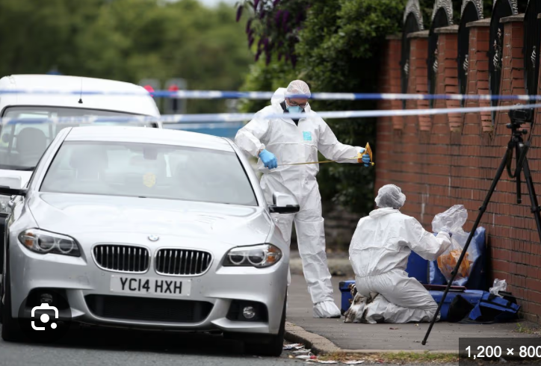
State collusion.
2015 Police brought in Paul Massey as a mediator among four Salford gangs.
Eventually he was shot by members of one of these gangs, the A Team.

