Slide 1
Mala del Brenta: Italy’s Fifth Mafia

Slide 2
The Mafia moves north
1956 The Italian government starts to employ policy of “internal exile” of mafiosi. Hundreds of Cosa Nostra, ‘Ndrangheta and Camorra move north into Lombardy, Piedmont, and Emilia-Romagna.
1960-1980s. Italian economic miracle. In many cities, mafias become involved in building trade, drugs, money laundering.

Slide 3
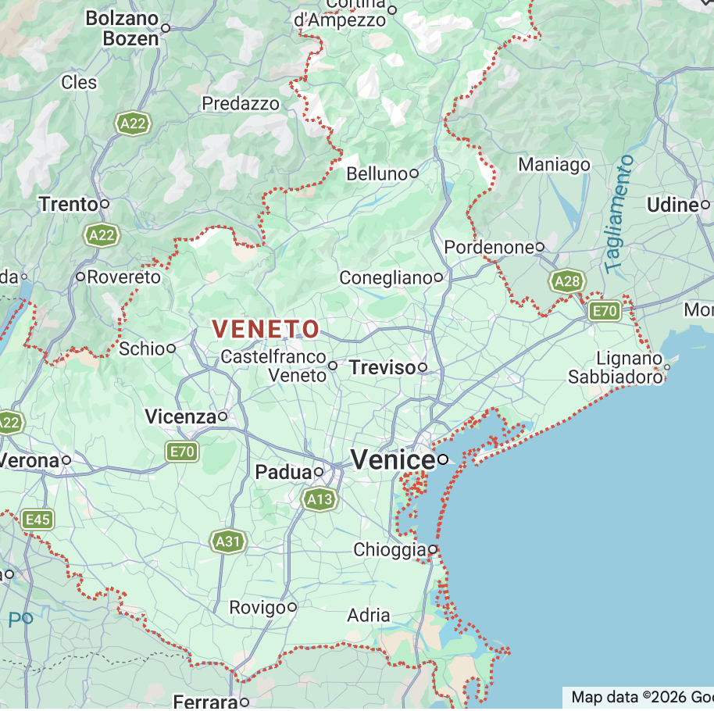
The place: Veneto
1950s, 1960s. Veneto was one of the poorest regions of Italy. Like in Sicily or Calabria, many people migrated from Veneto to US and Latin America.

Slide 4
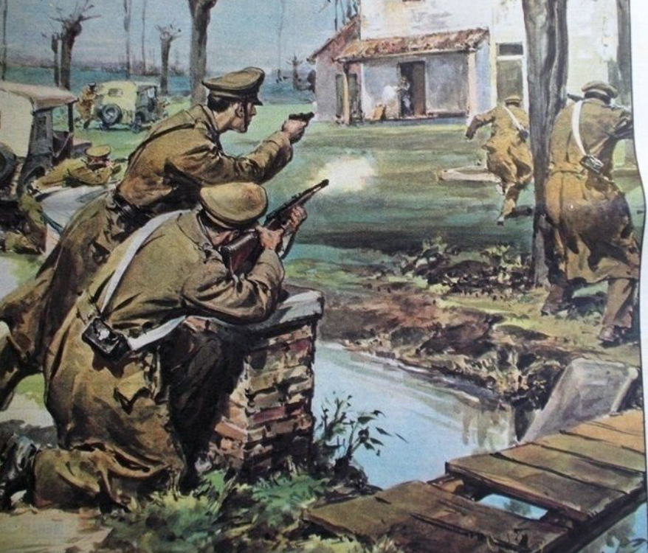
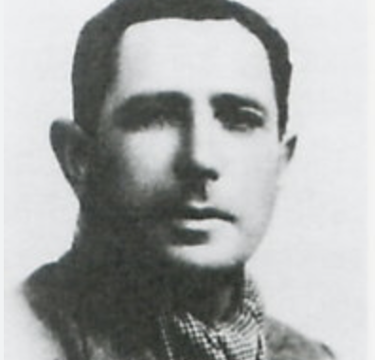
Bandit history
From 1920s onwards, tradition of banditi like in southern Italy.
Many, like Guiseppe “Bepi” Bedin, Elio Regato and Adriano Toninato had reputation as “Robin Hood” figures.
Began with stealing out of hunger. Moved to cattle rustling, then household appliances and bank robberies.
Broadly supported by communities. “No one betrayed me because I behaved well with everyone” Toninato.

Slide 5
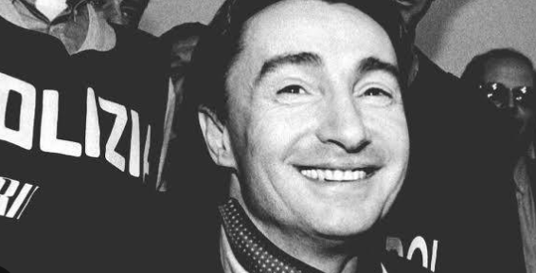
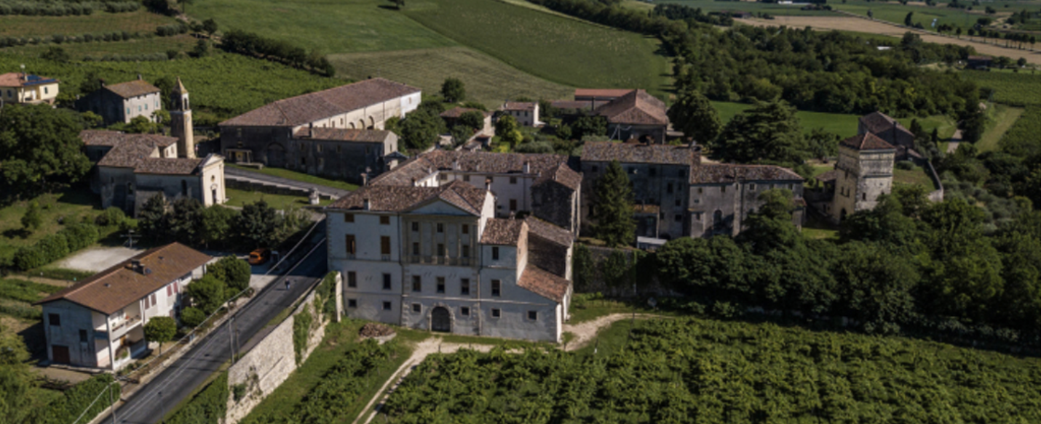
Felice Maniero grew up with stories of the bandits
His father, Ottorino Maniero, ran a bar in Campolongo Maggiore.
Toninato and his crew were regulars. His uncle, Renato, was a parttime member of the gang.
Campolongo Maggiore, small extremely rural village.
“The relationship that Maniero has with Campolongo Maggiore is one of empathy, it is one of reciprocated love. There is no hatred on the part of anyone. Campolongo Maggiore twenty years ago lived in silence because most of the families worked for the boss”, Mauricio Dianese, Venice journalist
1970s Felice Maneiero starts small scale livestock robbery.

Slide 6
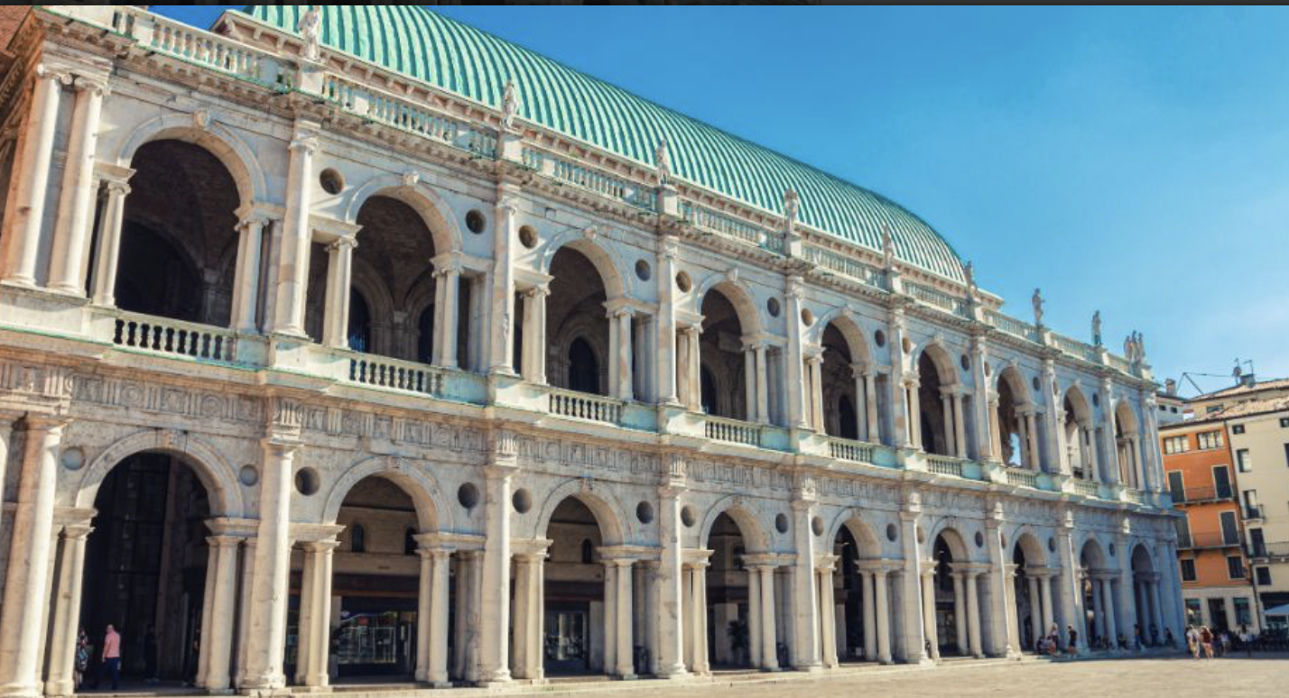
The northeastern Italian miracle
During 1970s and 1980s, Veneto experienced rapid economic growth.
Unlike Northwest not based on state-funded factories. Rather, based on the expansion of thousands of specialized, family-owned small and medium-sized enterprises. These fed Italy’s growing consumer market e.g. Benetton, De Longhi, Luxottica.
Built on old artisan industries. E.g. Vincenzo Morosetti as founder of gold industry in Vicenza in 1840s. Money put into education of goldsmiths. Consumer economic boom created market. Specialist laboratories purified Italy's gold. Jewelry makers made as much as 50% of Italy’s jewelry.
Classic meeting of poor rural peasants and rapid growth , highly profitable industry. However, rather than protecting the industry, Maniero and gang robbed it.

Slide 7
Creation of the Mala del Brenta
During the late 1970s, Maniero’s gang came together as an organized crime group.
“We were in a group, always: we went to discos, to bars without paying, where they made us pay for admission or reacted to us badly, we burned the club”
Started to control territory. “For some days now a group of young and clearly armed thugs during the evening and night hours have been committing acts of intimidation and violence against defenseless citizens and public establishments in Piovese…these episodes have significantly shaken public opinion… suddenly there was silence in the testimonies and the citizens’ distrust of the authorities”. Carabinieri report, 1976.
Started to develop a distinct culture. Linked to conspicuous consumption of late 1970s/early 1980. Adopted Gianna Nannini’s Un regazzo del Europa as their song. “Ragazzi di versace spruzzati di van cleef”

Slide 8
https://www.youtube.com/watch?v=hDUSAZje8zw

Slide 9
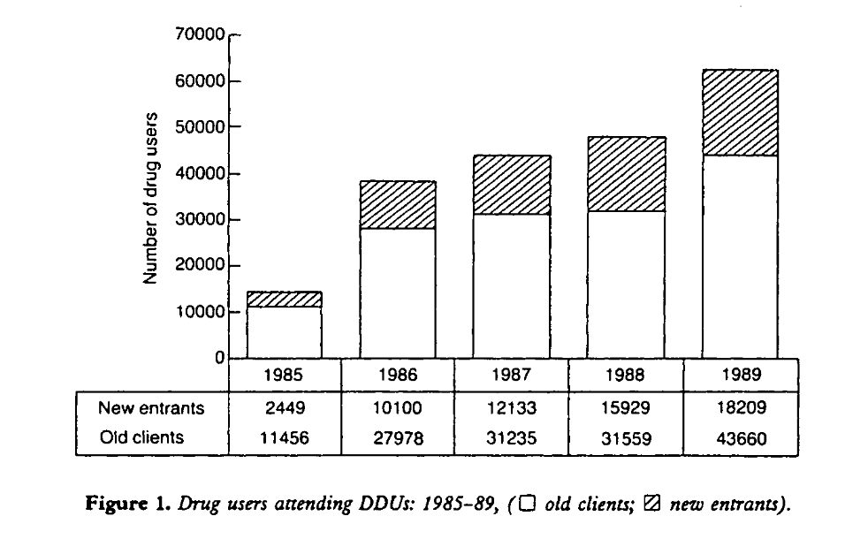
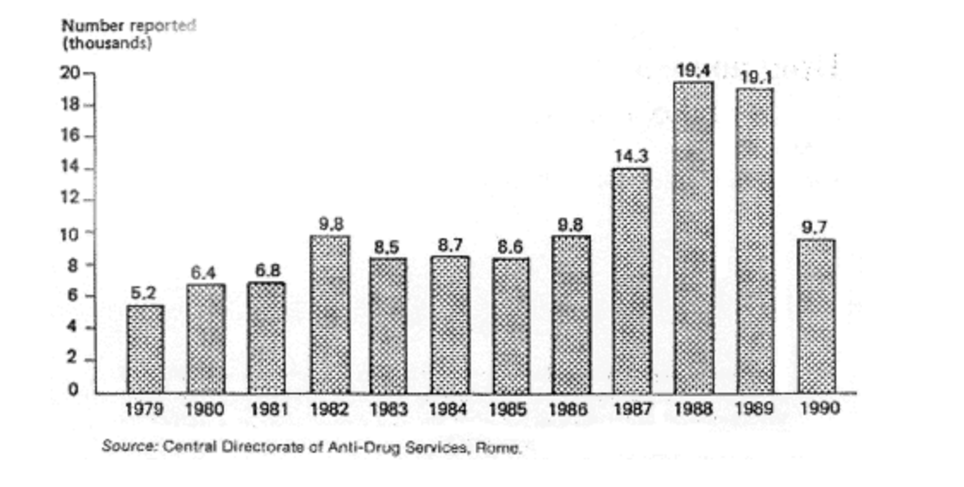
Felice Maniero and Mala del Brenta use territorial dominance to take over the drug trade in Veneto

Slide 10
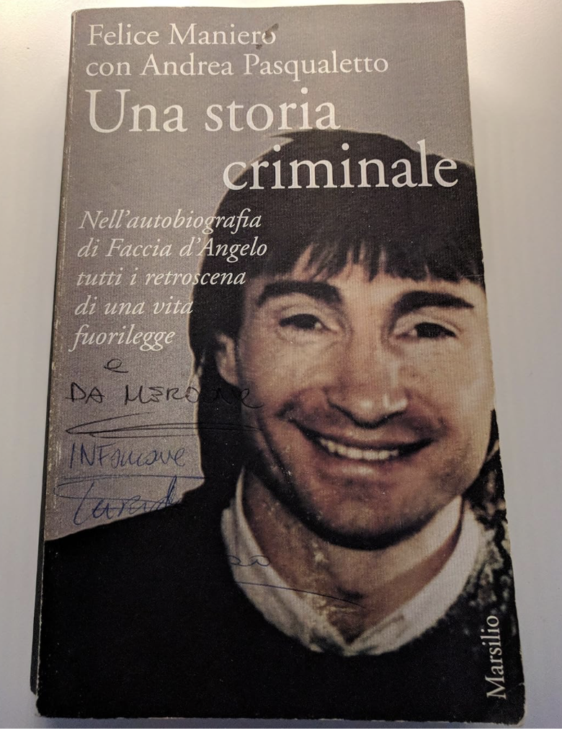
He first got heroin from Salvatore Enea in Milan and then Turkish connection and the PKK. He got cocaine from Colombia.
“In the beginning we were against drugs. Then we saw the area filled with southerners.in the gambling houses they were dealing and so we took the opportunity. We bought it and gradually took over the areas of Venice, Mestre, Chioggia almost all Padua. We bought it and distributed it to whoever had the various areas in hand; we delivered it and they paid for it”
Drugs demanded increasingly hierarchical organization and division of labour.
“The drugs. A cowardly thing,. You were selling death and making lots of money without risking anything. I didn’t like it and took care of it personally as little as possible. I kept the money from drugs, robberies and gambling. The rest I left to others. Like apartment burglaries: we had four teams leaving every night. They emptied about twenty a night. I left that to my lieutenants”

Slide 11
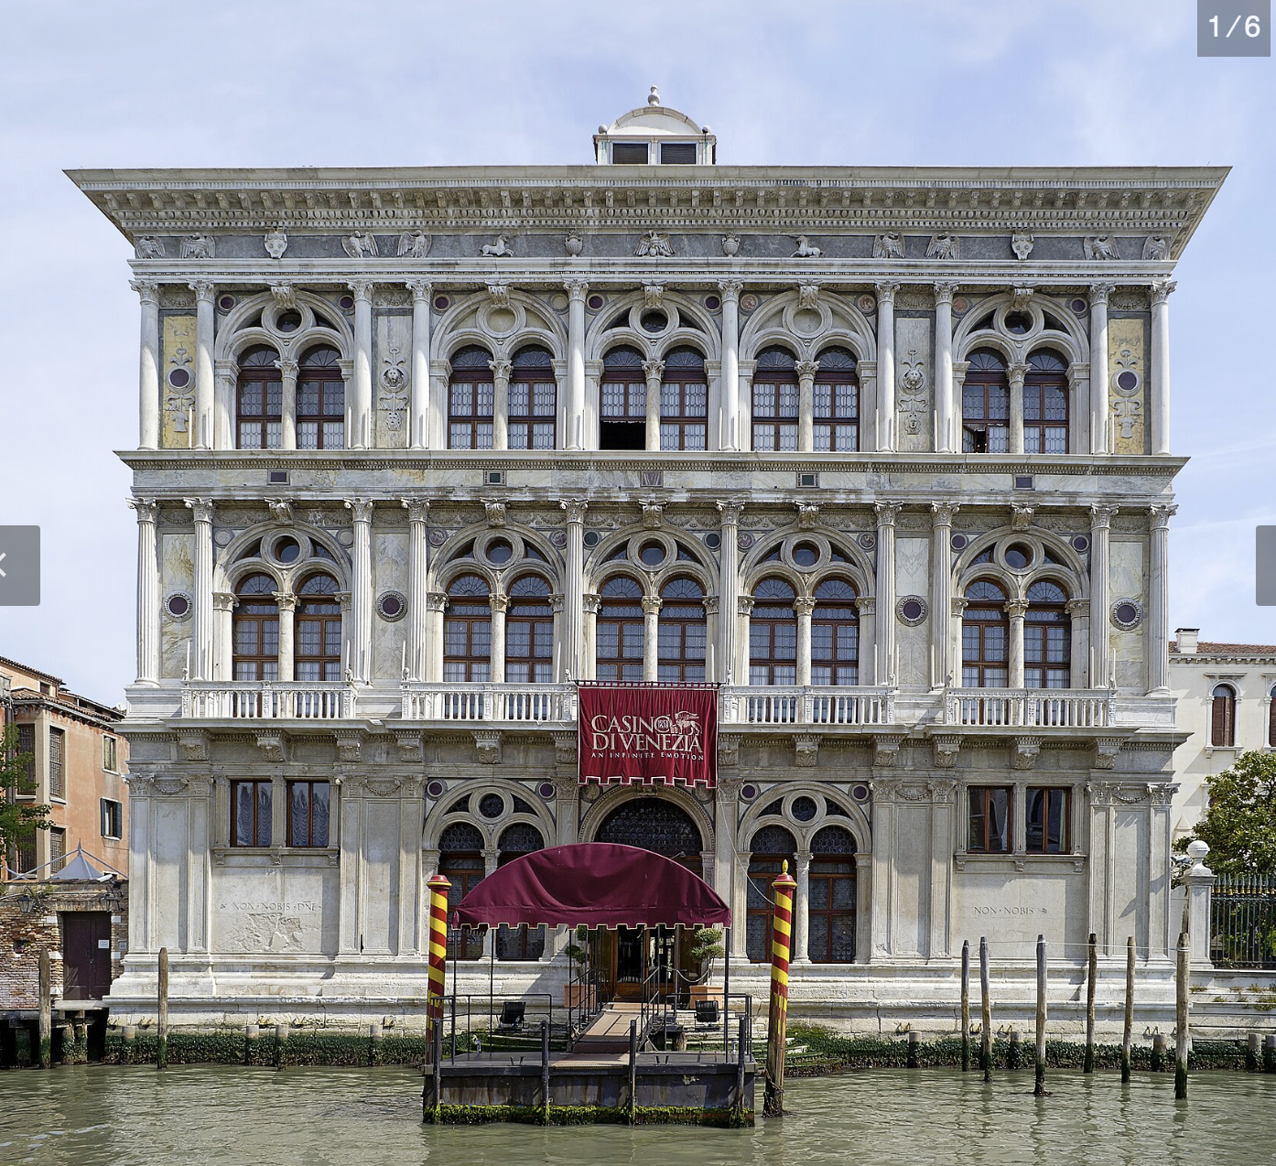
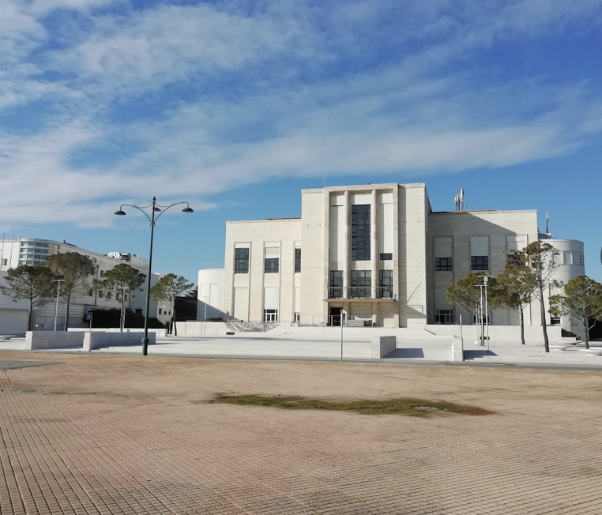
10 October 1980: Ca' Vendramin Calergi, Venice’s Casino
Gambling had a long history in Venice. By 1770s, there were 120 casinos in the city. In 1774 reformers closed down all of them “‘to preserve the piety, sound discipline and moderate behaviour’
1940s Venice council seeks to build a casino to rival Monte Carlo. Establish Palazzo di Casino on Lido (summer) and use Ca' Vendramin Calergi (winter)
”Money changers” (cambisti) or basically loan sharks were based outside gambling halls. They lent inveterate gamblers ready money at exorbitant interest rates.
Maniero’s men stormed the casino. They held guns to the cambistis’ heads and demanded they pay $15,000 a day to operate. The deal lasted 15 years.

Slide 12
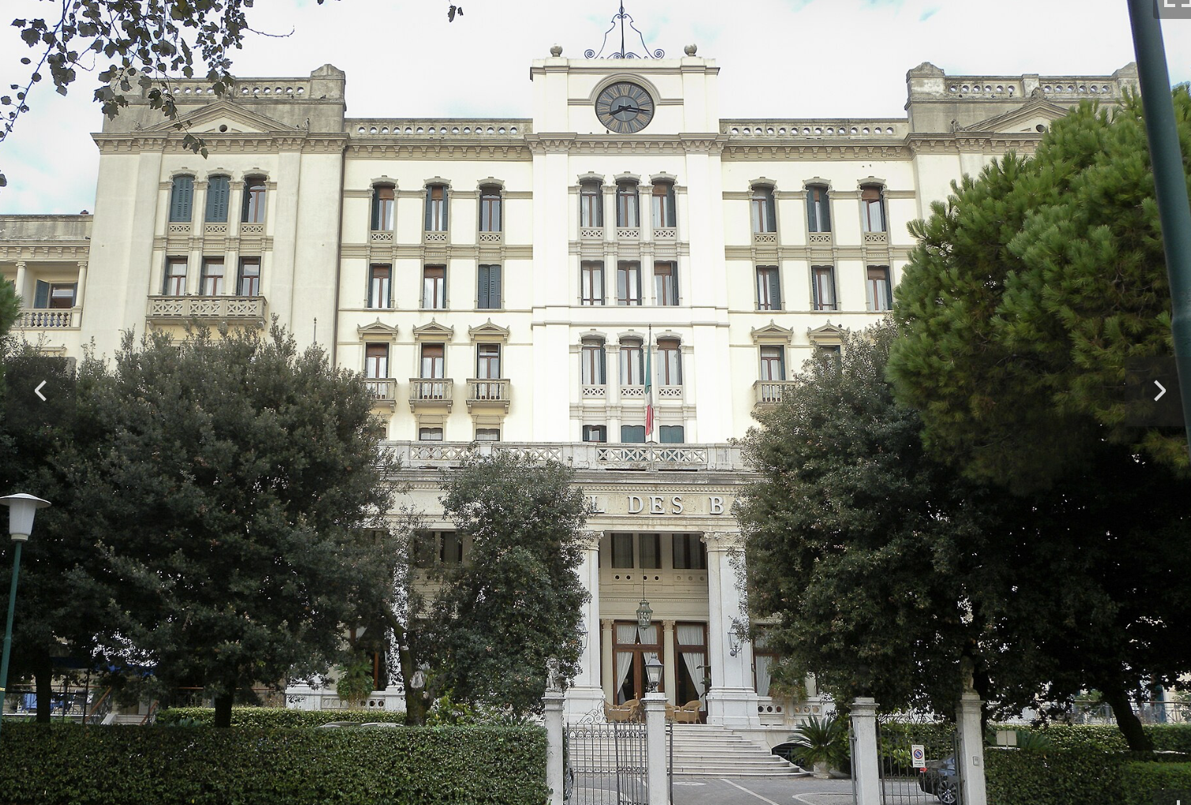
However, Felice Maniero and Mala del Brenta continued to rob.
“I don’t feel the adrenaline rush that a robbery gives me for anything else”
2 July 1982: Robbery of Des Bains Hotel. $5 million dollars
1 December 1983: Robbery of Marco Polo airport. 170 kg of gold.
1987 Attempted Venice-Milan train robbery

Slide 13
Kidnapping
1960s-1990s. Italian mafias moved into kidnapping. Deeply socially unpopular, especially among elites. There were different rationales. Around 700 declared kidnappings.
‘Ndrangheta kidnapped elites and used ransoms to enter international drug trade. Sicilian mafia used kidnapping to intimidate enemies (e.g. 1993 Giuseppe Di Matteo case).
Mala del Brenta also committed kidnapping. No more than a half dozen. Maniero claimed that got out of it as too risky.

Slide 14
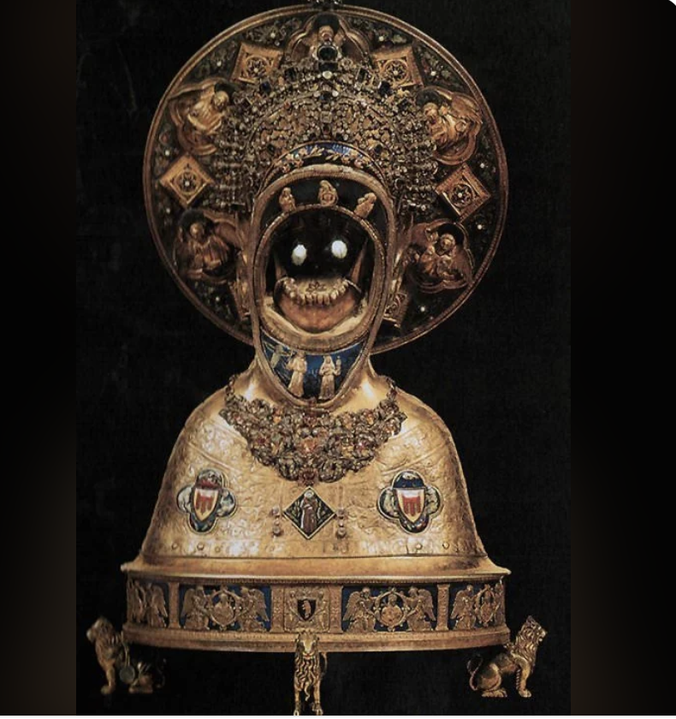
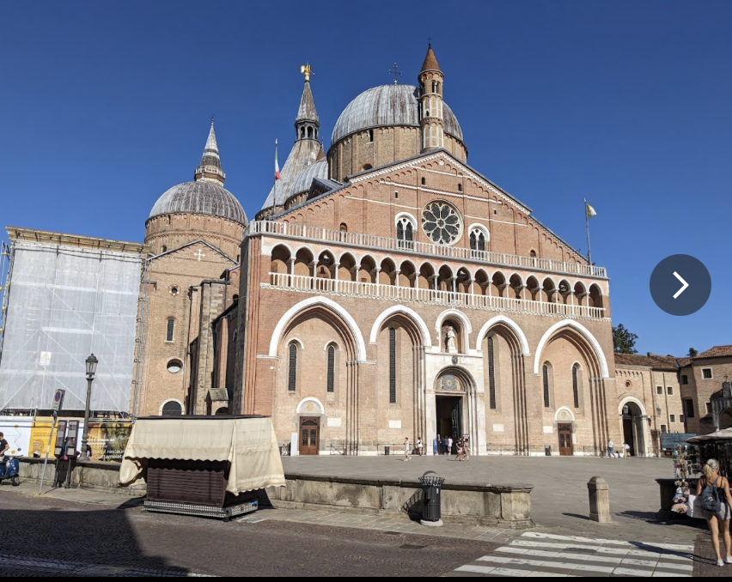
Art theft
1991 Theft of St. Antony’s chin from Basilica of St Anthony in Padua
Used in order to get his cousin out of prison.
Agreement made by members of Italian secret service and famous Padua fence.
Returned chin. Later did interview with newspaper of friars of St Antony’s. In it he tried to repair relationship with Catholics.

Slide 15
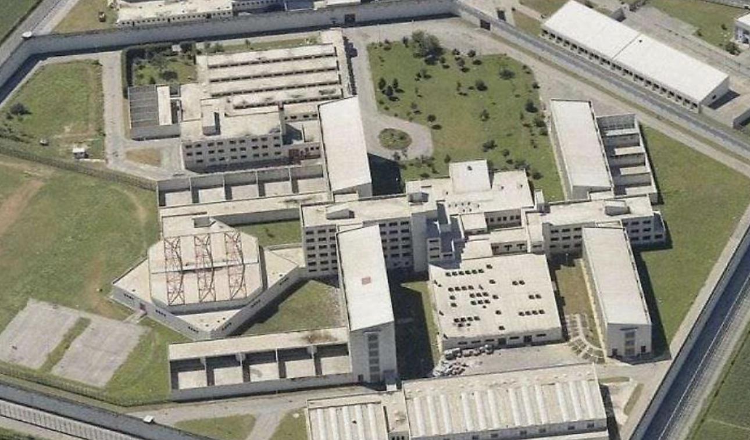
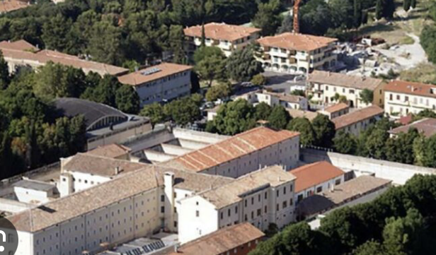
Famous for his escapes
1987 Escape from Fossombrome prison
1994 Escape from Due Palazzi prison

Slide 16
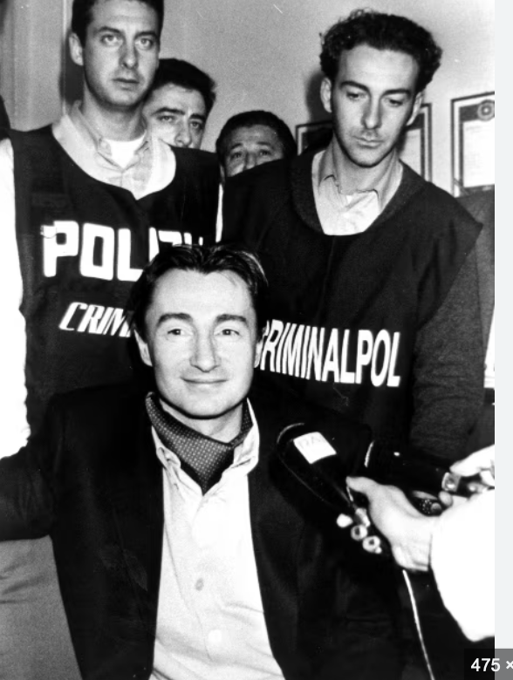
November 1994: Felice Maniero is arrested
He turns state witness. His confessions lead to the arrest of 300 members of the Mala del Brenta.

Slide 17
Questions
To what extend was Maniero a “social bandit”?
How influential were women in his organisation? Part of Maniero’s deal involved impunity for mother and sister. Boss of eastern Veneto said that his mother, Lucia Carrain, ran the gang. Cop who arrested him said ““Maniero was a complex figure, independent but conditioned by the female figures, especially his mother. Everything that Maniero has done in his past has never been a decision of his autonomy but on the push of others, especially women”
How violent was the Mala del Brenta?
  How valid are Maniero’s claims?
  Who killed Giancarlo Ortes and Antonella Bissolotti?
How connected was Mala del Brenta to the state?
  Prolonged impunity
  Defense against other organized crime groups?
  The cambisti deal?
  The escape?
  The eventual deal? Why was he allowed to keep his money?

Slide 18
Epilogue
From 1995 to 2010 Maniero was under witness protection program. 2010 he comes out, changes his name to Luca Mori.
Strange things keep happening.
2006 “Suicide” of his daughter Elena.
2015 Anyacquae affair.
2017 Discovery and confiscation of 17m euros of Maniero’s property
2019 Arrested for physically and psychologically mistreating partner, Marta Bisello.

