Slide 1

'The ultimate hidden truth of the world is that it is something that we make, and could just as easily make differently,'
DAVID GRAEBER

Slide 2
This year, we have looked at the recent history of
Capitalism
Climate change
Technofeudalism
Eugenics
Criminal Violence
“Pro-life” protestors
The new right
Populism
Slavery and reparations
Ukraine War
Migration

Slide 3
An alternative liberal vision of recent history
Gay rights
Feminism
Democracy
Access to consumer goods
Poverty (800m lifted out of poverty in China)
Anti-racism

Slide 4
An alternative vision of history?
Since the Enlightenment, history has been undergirded by idea of human progress.
  Society has got more complex (agriculture, division of labour, urbanization)
  Politics and bureaucracies have been created to cope with this complexity.
  Society has got, essentially, better.
This is a vision that is shared by liberals (Whiggish idea of history), Marxists, and even by the right.

Slide 5
All modern history is undergirded by a fairly simple evolutionary version of human progress. “Civilization” gets greater and greater.
1) Small bands, fairly anarchic, no need for hierarchy.
2) Small bands come together, form tribes, create leadership and hierarchy.
3) Small tribes come together (often with impetus of agriculture) and form “states”. These states have hierarchies and bureaucracies. These create civilizations. (Ancient Egypt, Ancient Greece, Rome, Aztecs etc)
4) Commerce, democracy, “freedom”. Basically, the French Revolution. This continues civilization. All good things spring from this – wealth, equality, health etc.
5) Socialism?

Slide 6
What if we are completely wrong about this evolutionary model of human progress?
What if there are no historical laws of progress? What if men and women have always experimented with social and political forms?
1) Look at the distant past
2) Ask whether large groups need leaders, hierarchy, bureaucracies?
3) Ask whether these large, leaderless societies might have founded alternative civilizations, that bypassed empires, feudalism, slavery, capitalism and achieved freedom, limited work, health, security?

Slide 7
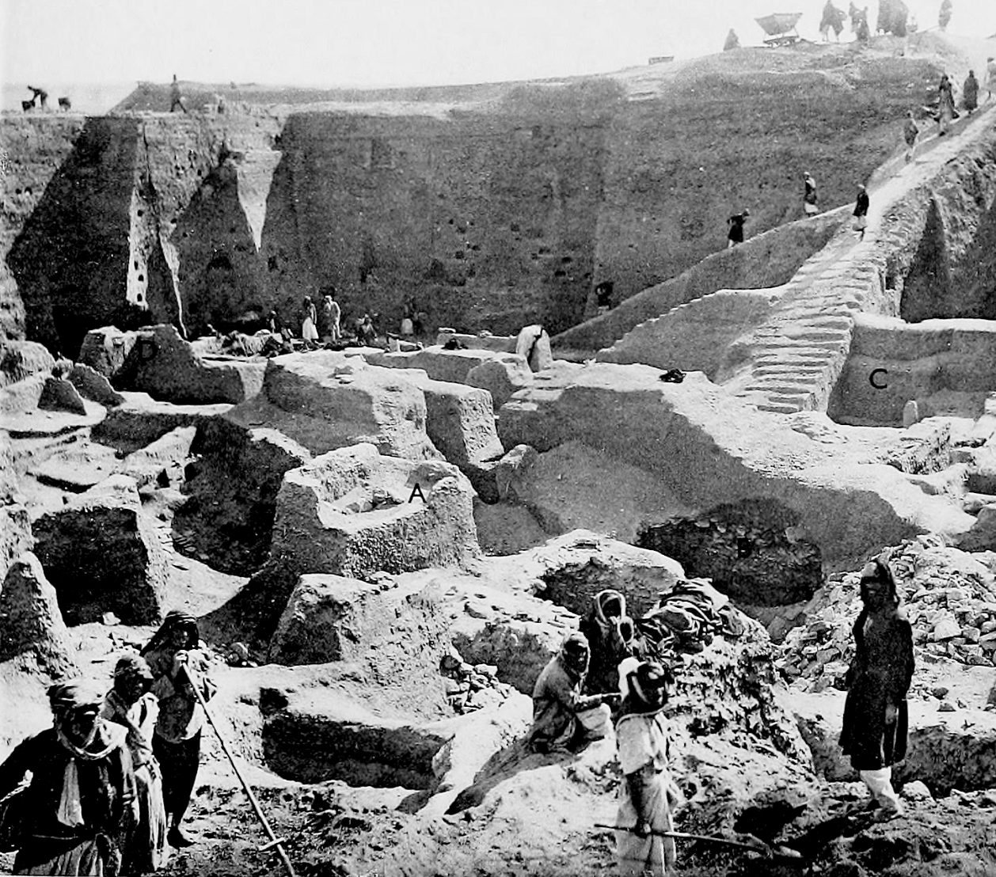
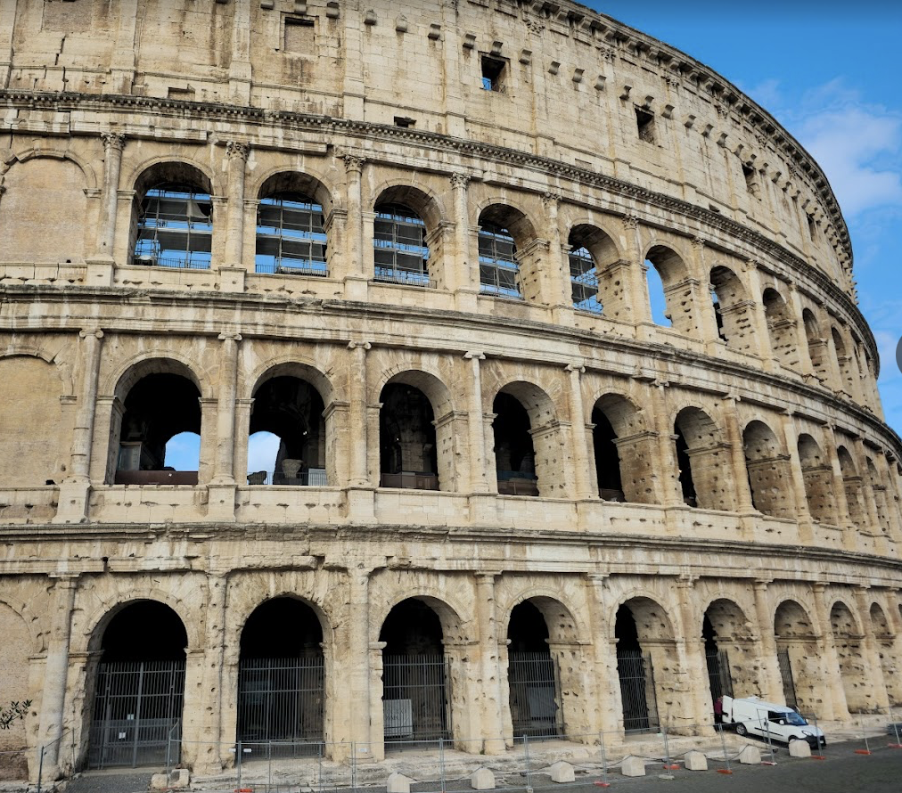
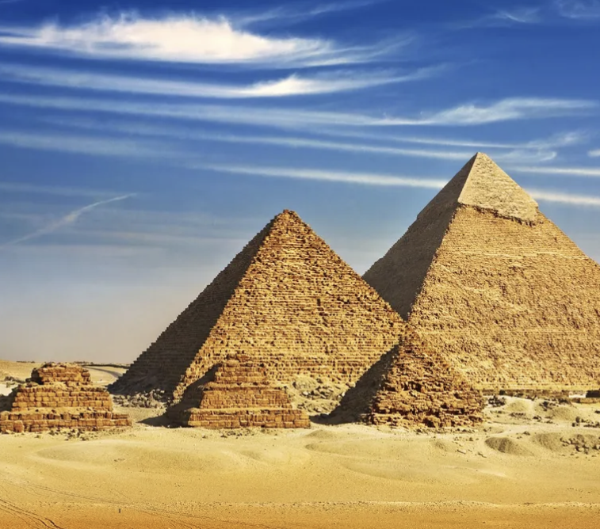
1) What is a civilization?

Slide 8
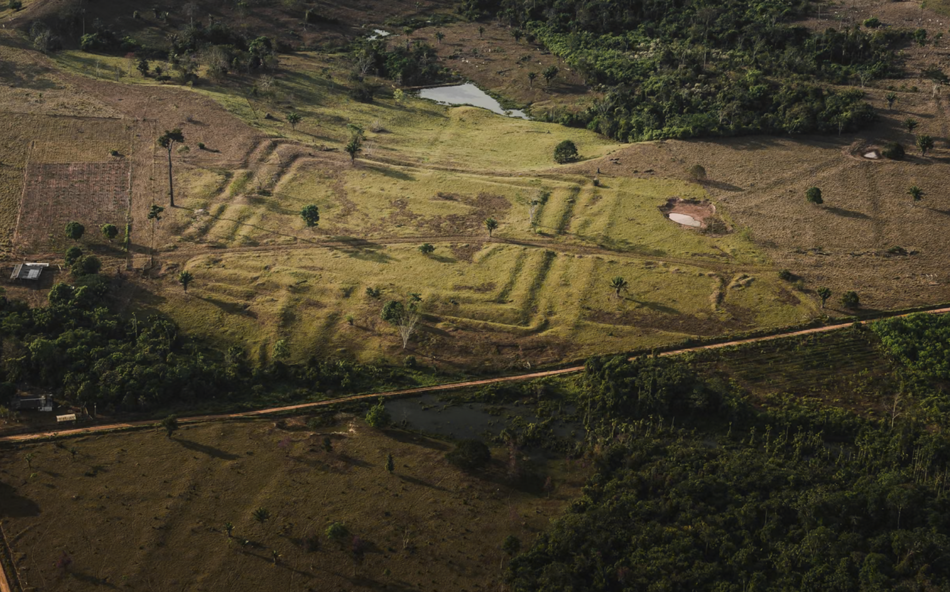
(Does civilization need agriculture?)
One of the essential ideas in the evolutionary theory is that man domesticated plants and animals.
This was more productive.
This involved large amount of labour.
As a result, we created hierarchies to implement this.
However, we now know that:
  Took 3000 years to adopt agriculture even in Mesopotamia.
  Most people dipped in and out of agriculture.
  There was no “agricultural revolution”
  E.g. Mayan Forest Cities, Amazon’s “Terra Preta”

Slide 9
Gaspar de Carvajal, Relación del nuevo descubrimiento del famoso río Grande que descubrió por muy gran ventura el capitán Francisco de Orellana
“Were a pin to drop from the sky, it would land on the head of an ‘Indian’, never falling to the ground”
“There was one settlement that stretched for five leagues [12.5-20 mi] without there intervening any space from house to house”
“Fine roads running into the interior which allow intertribal trade”

Slide 10
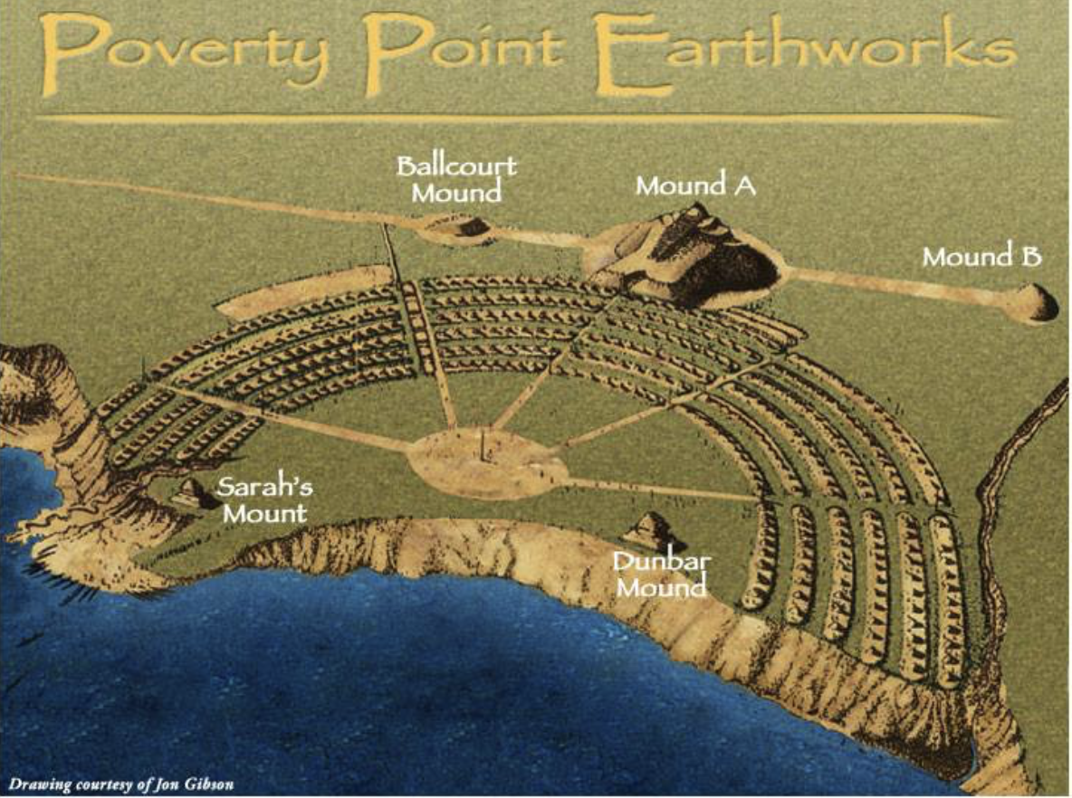
2) Civilizations without leaders/bureaucracies
Built 1800-1350 BC
Needed a lot of work. Mound A – 8 million baskets of earth. Must have been done in less than 3 months.
Needed at least 3000 workers – so at least 10,000 people to do it.
People who lived here
  No kings, no burials, no signs of violence.
  Hunter gatherers.

Slide 11
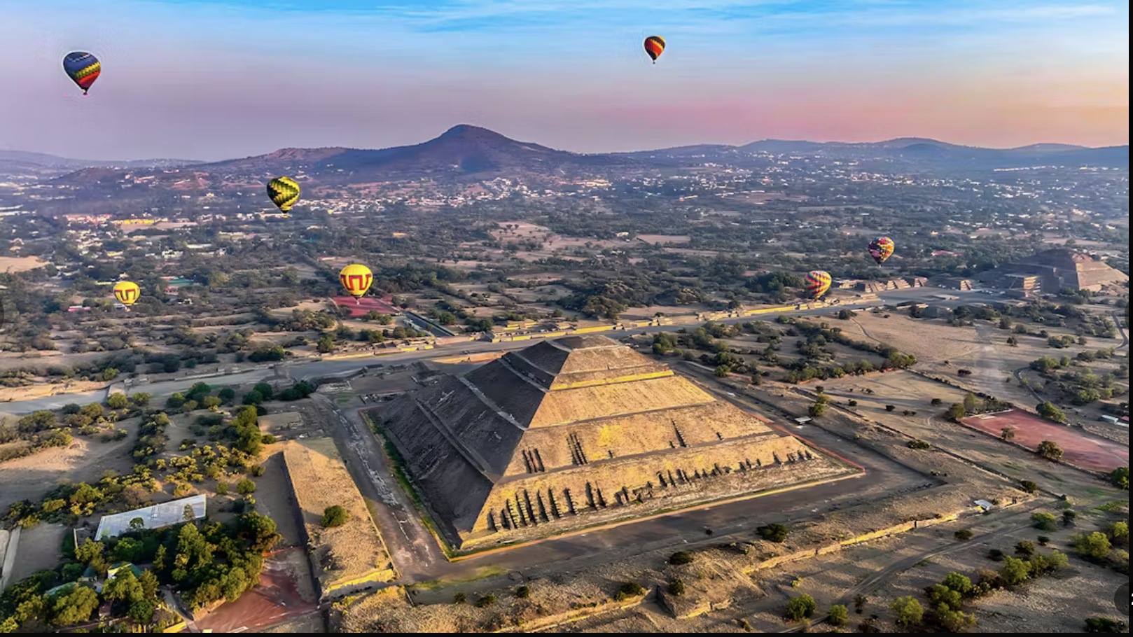
3) Are there are other routes to happiness?

Slide 12
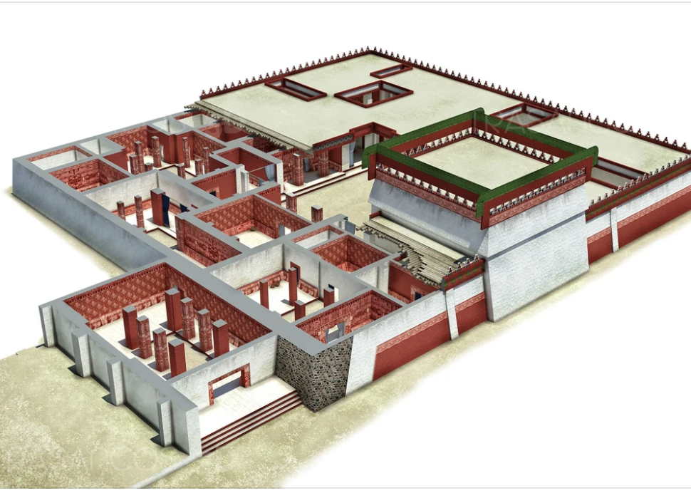
Did the Toltecs get rid of human sacrifice and build council houses?
Pyramids of Sun and Moon were built 200 BC-100 AD
Around the pyramids monumental palaces
Under pyramids mass graves of sacrificial victims
Around 100,000 inhabitants. Possibly biggest city in the world.
Around 300 AD something changed.
Pyramids burned; human sacrifices stopped; huge program of building.

Slide 13
