Slide 1
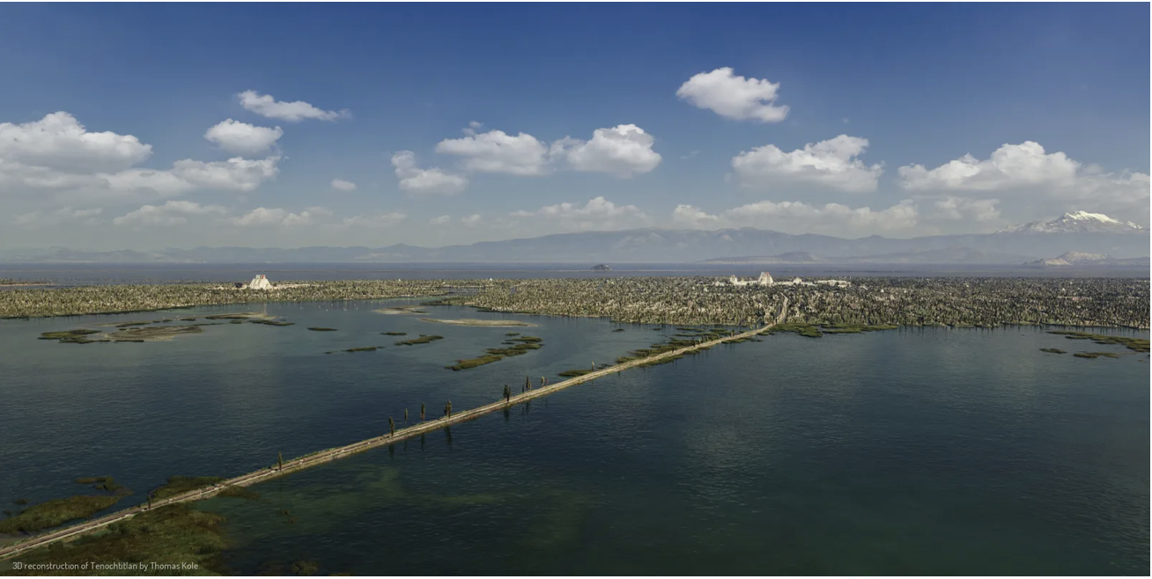
The Conquest of Mexico
Professor Benjamin T. Smith

Slide 2
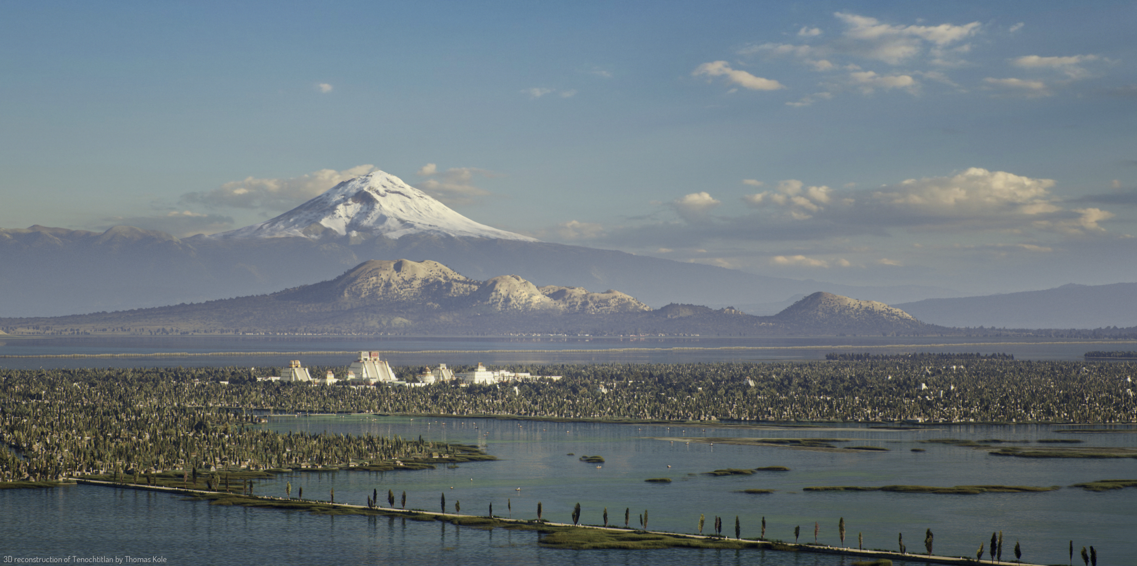
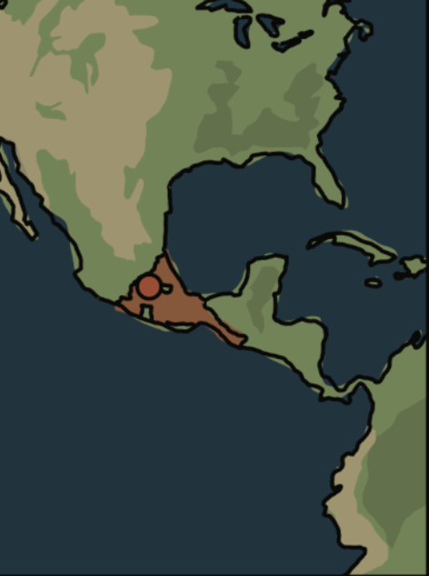
Tenochtitlan, capital of the Aztecs

Slide 3
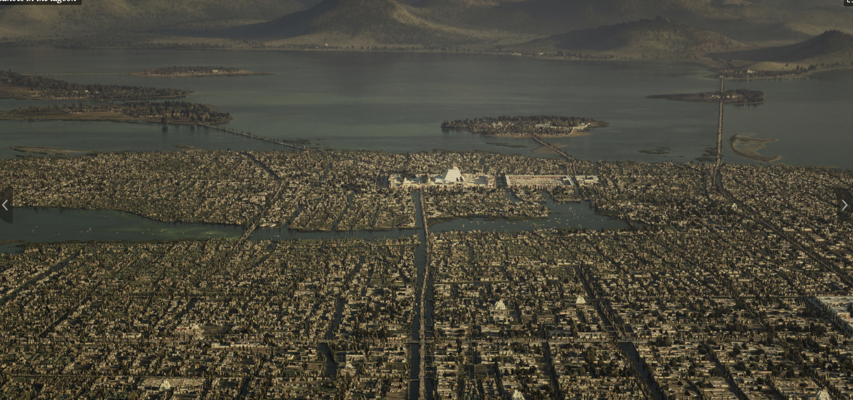

Slide 4
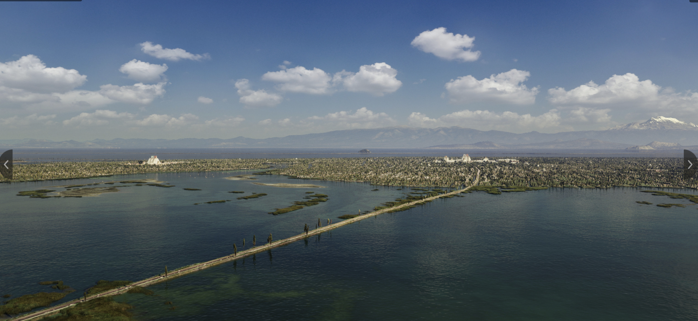

Slide 5
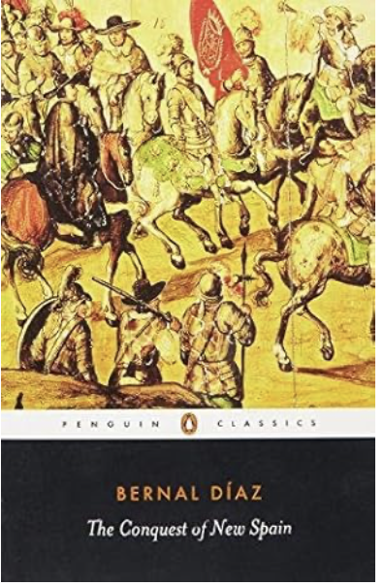


Slide 6
Quiz
When was the Conquest of Mexico?
Who led the Conquest of Mexico?
Who won?
Why did they win?

Slide 7
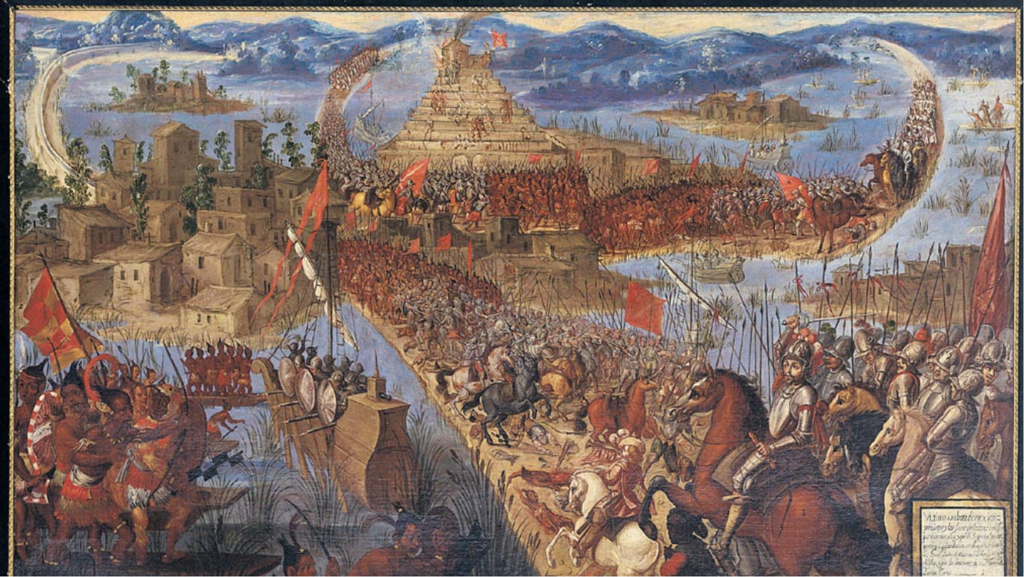
Second half of the seventeenth century. Oil on canvas. Jay I. Kislak Collection

Slide 8
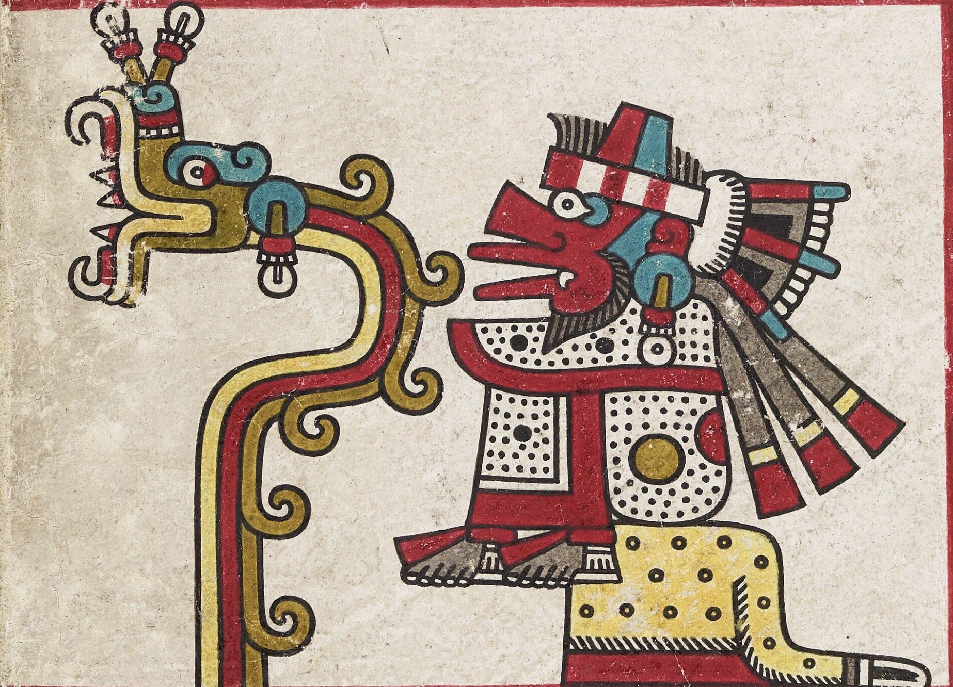
Francisco López de Gómora, Cortés’ secretary, writing in 1552 ““Many Indians came to gape at the strange men and at their attire, arms and horses and they said ‘These men are gods’”.
Hernan Cortés recounts Moctezuma’s speech to Charles V in letter of 1519
“A prince, conducted our people into these parts
but then departed from the country, we have
always heard that his descendants would come to conquer this land, and according to the direction from which you say you have come, namely where the sun rises, and from what you say of the great lord or king, who sent you, we believe and are assured that he is our natural sovereign.
Therefore be assured that we will obey you for
our sovereign in place of the great lord whom,
you mention. You have the power in all this land,
and all that we have is at your disposal. You are
in your own proper land and your own house
......”

Slide 9
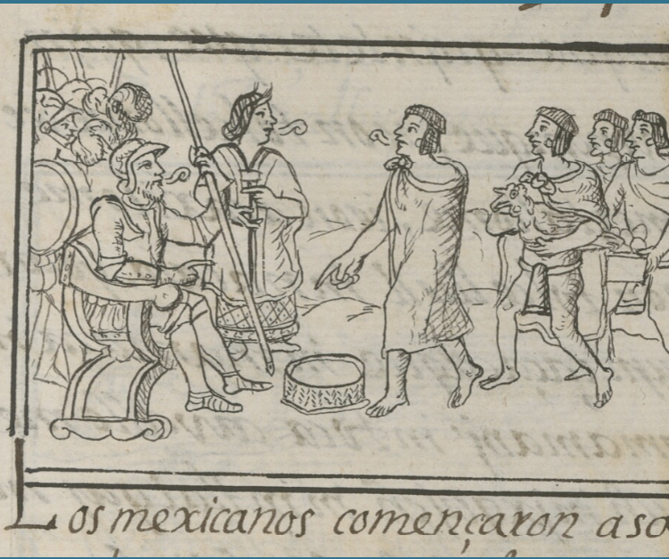
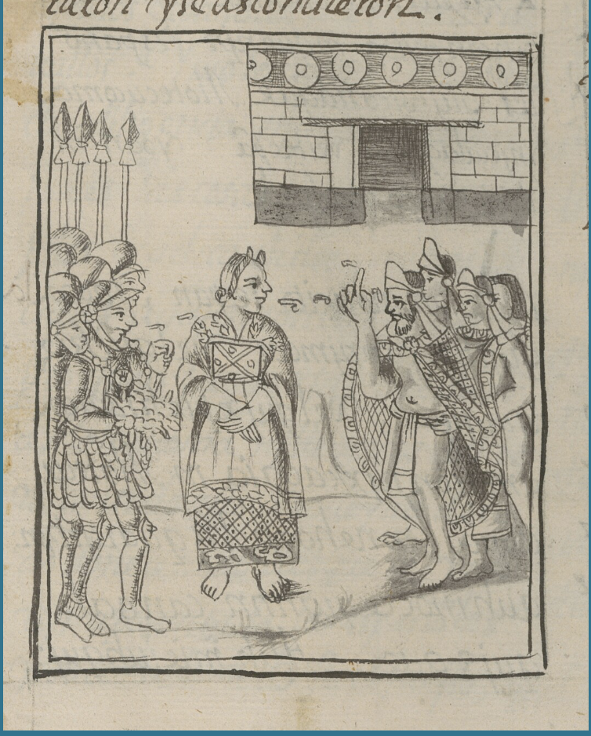
Florentine Codex

Slide 10
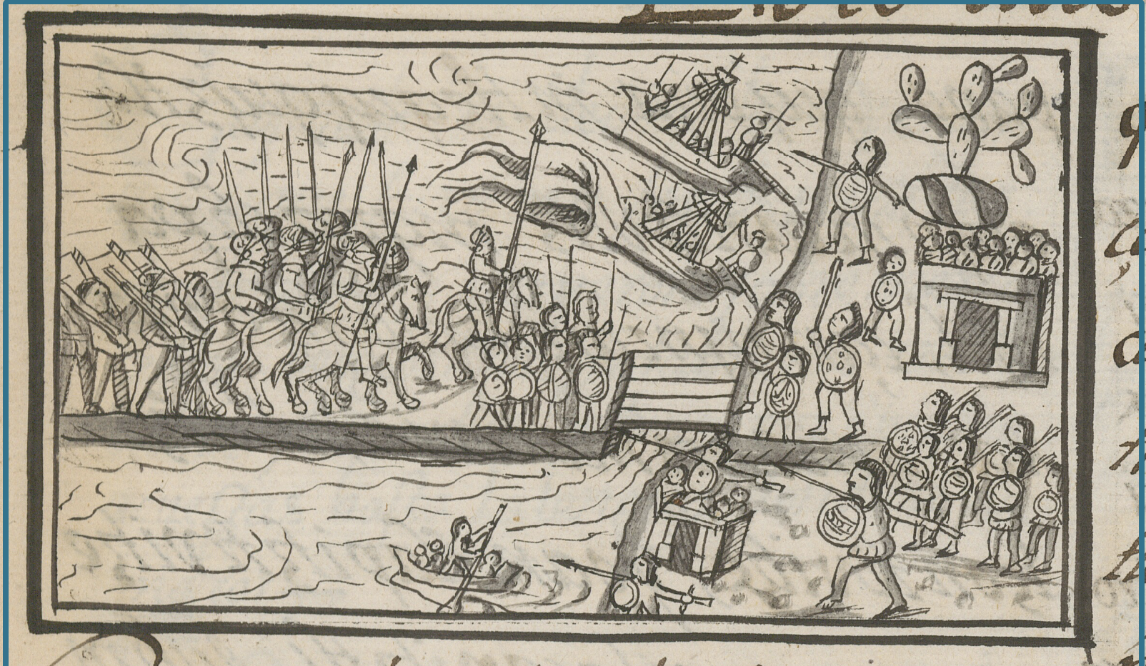
Florentine Codex

Slide 11
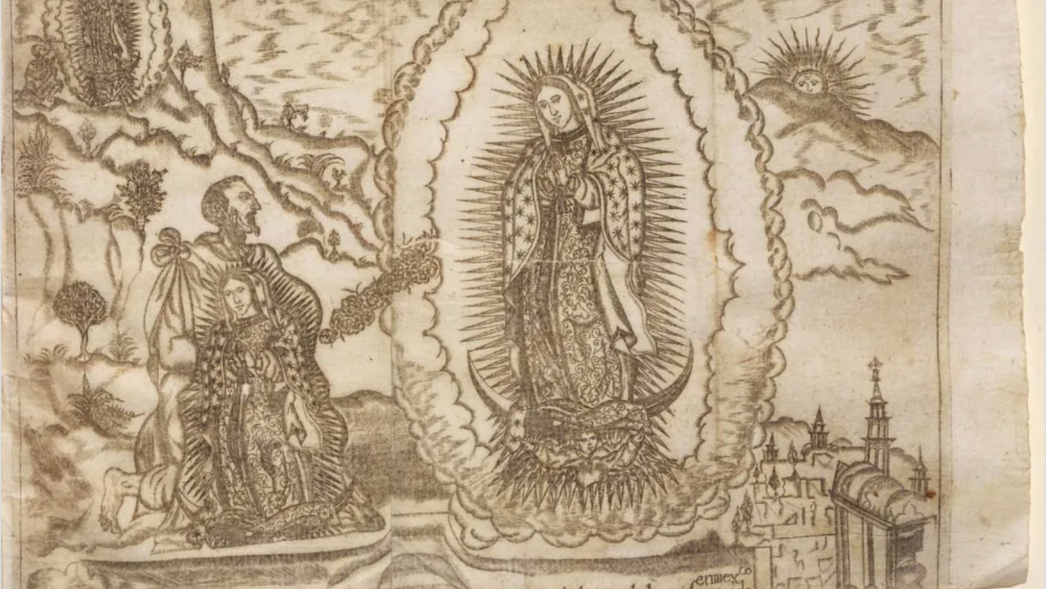
Luis Becerra Tanco, Felicidad de México en el principio, y milagroso origen, que tubo el Santuario de la Virgen María N. Señora de Gvadalvpe, extramuros: en la aparición admirable de esta soberana Señora, y de su prodigiosa imagen (1675)
elicidad de México en el principio, y milagroso origen, que tubo el Santuario de la Virgen María N. Señora de Gvadalvpe, extramuros: en la aparición admirable de esta soberana Señora, y de su prodigiosa imagen (1675) by Luis Becerra Tanco.
elicidad de México en el principio, y milagroso origen, que tubo el Santuario de la Virgen María N. Señora de Gvadalvpe, extramuros: en la aparición admirable de esta soberana Señora, y de su prodigiosa imagen (1675) by Luis Becerra Tanco.

Slide 12

The myth of developmental supremacy

Slide 13
