Slide 1
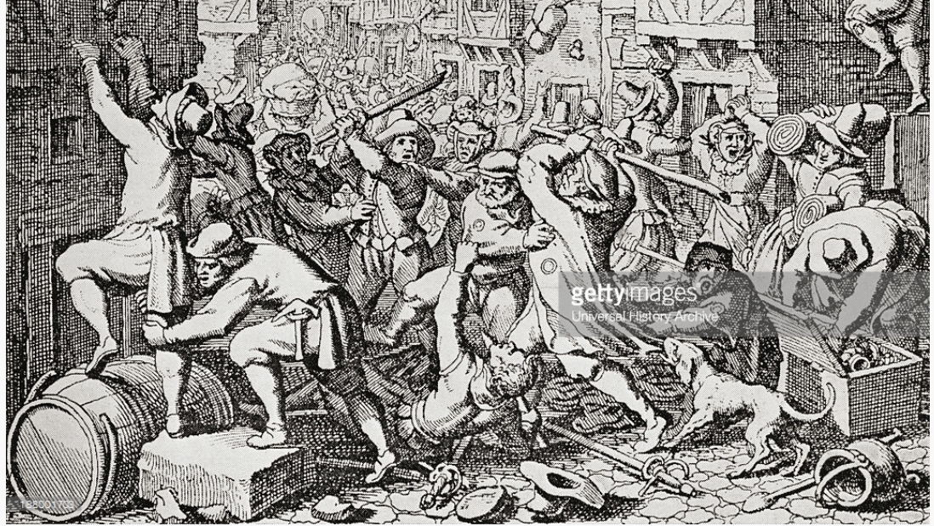
Men and Violence

Slide 2
A cultural approach to violence
Joachim Eibach: “violent action by men or women cannot be interpreted as contingent, individual acts, but rather as practices embedded in sociocultural contexts and accompanied by informal norms that mirror prevailing notions of gender and are often summarized in a specific code of honor.”
What does this mean?

Slide 3
A history of violence
Why did men in early modern Europe commit acts of violence?
What happened to rates of male violence post-Enlightenment?
Why?
Do you buy Pinker/Elias’ ideas about the “civilizing process”?
What does Pierre Bourdieu say about male violence?

Slide 4
Femicides
What is machismo?
How have anthropologists like Staudt explained the rise in femicides?
Why do cultures of masculinity not mirror changes in socio-economic status?

