Slide 1
A New Continent? Latin American Society and Politics after the Great Dying
Benjamin T. Smith, University of Warwick

Slide 2
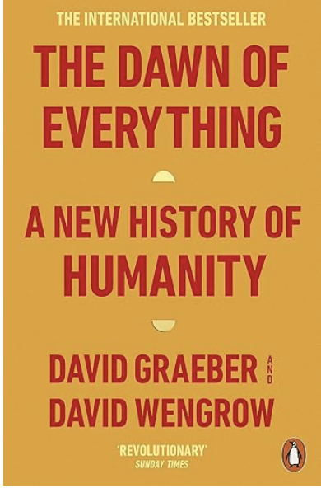
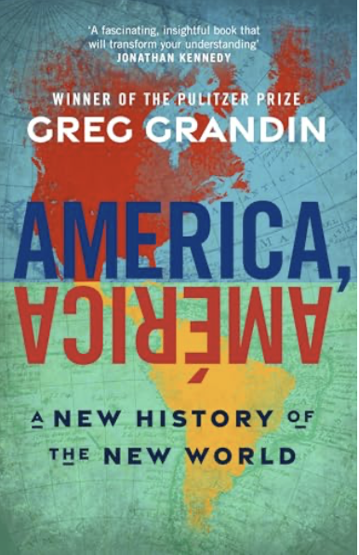
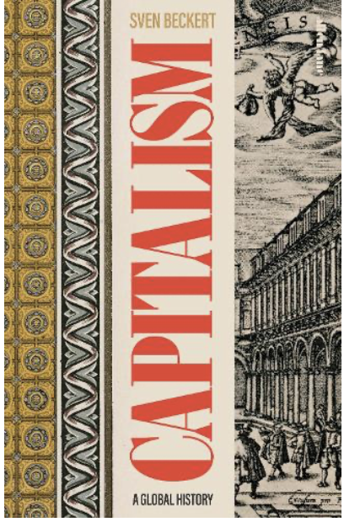
The two questions
Is it possible to write a narrative history of Latin American “everyday communism”?
How did this “everyday communism” shape Latin American “social liberalism”

Slide 3
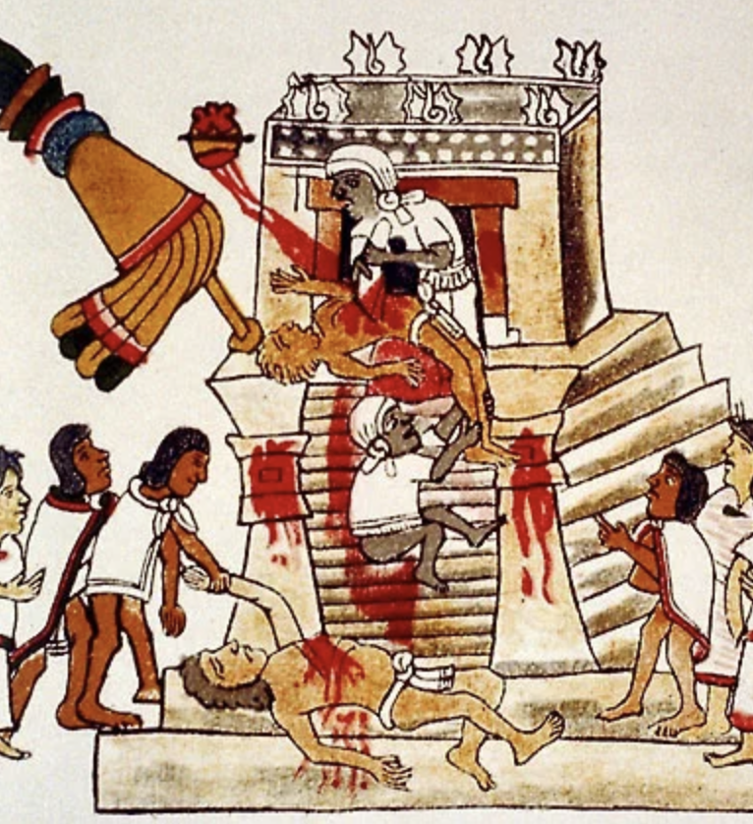
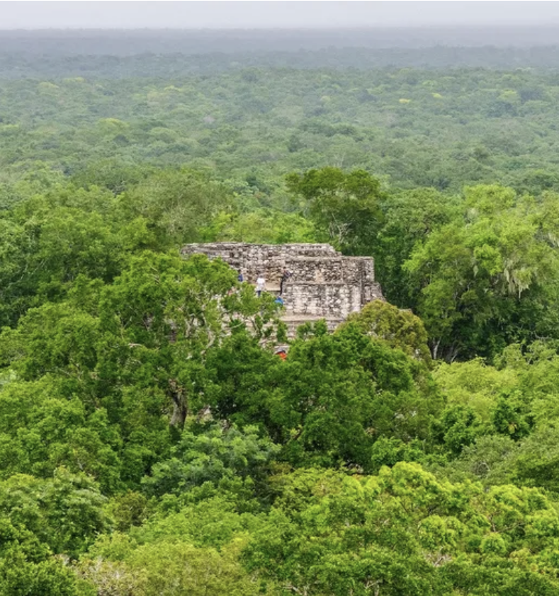
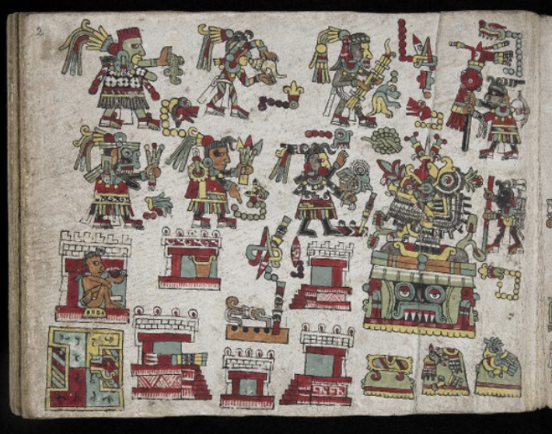
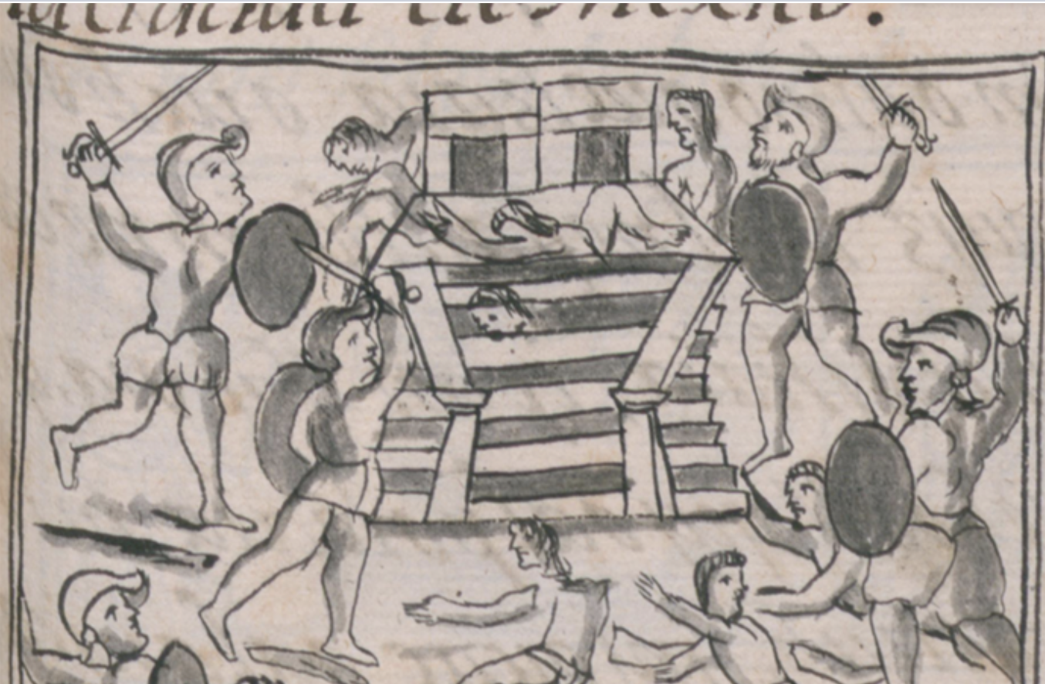
Unpromising starting points

Slide 4
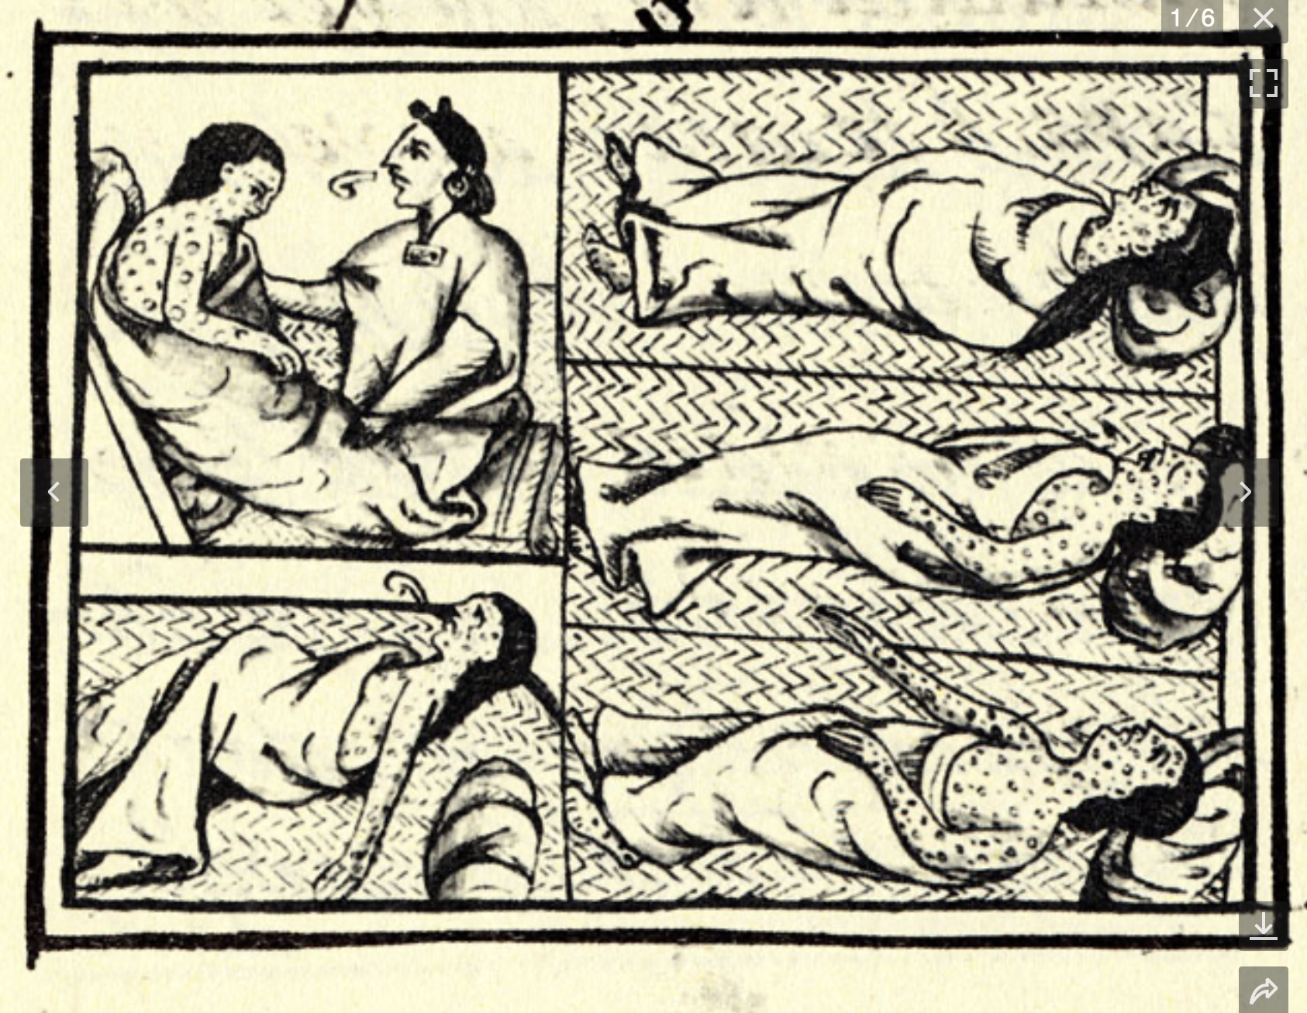
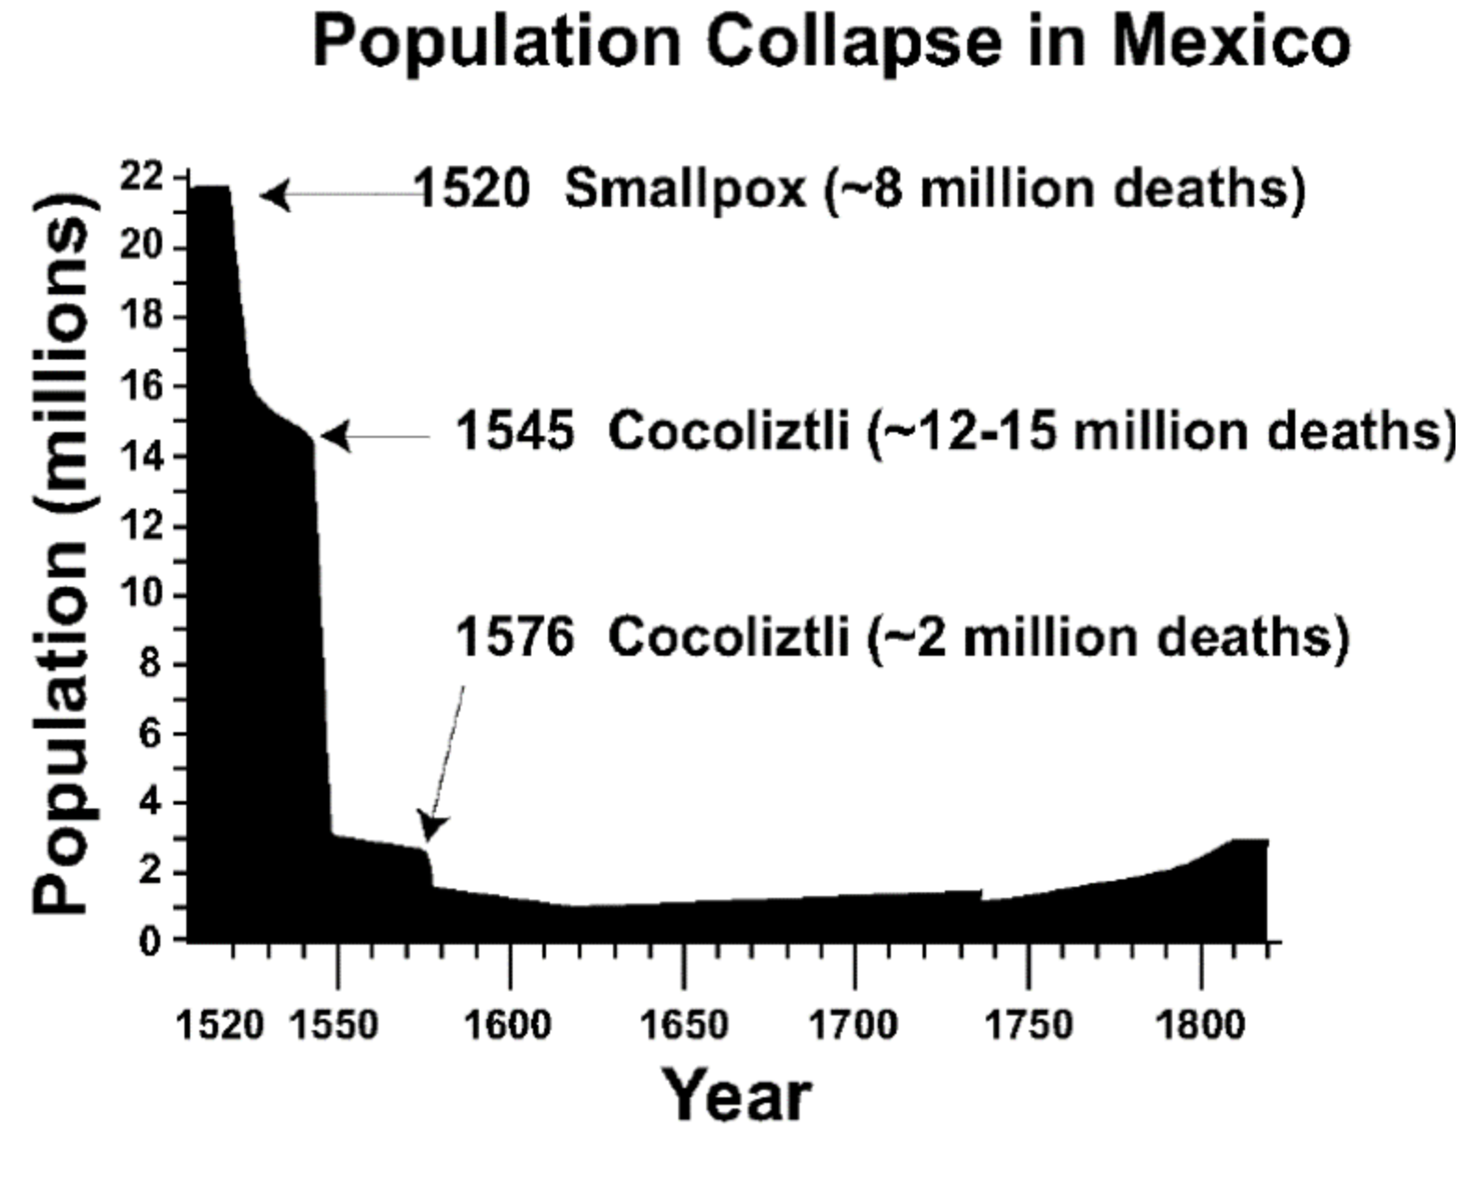
The Great Dying

Slide 5
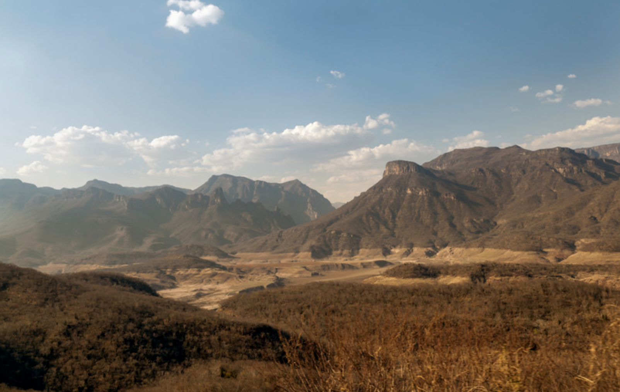
The Great Running Away?

Slide 6
Reconstruction: An underlying ideology?
Karl Polanyi argued that during the transition to capitalism, gain and profit from exchange were “raised to the level of justification of action and behavior of everyday life”.
  vs
Indigenous economic exchange, which stressed reciprocity and maintenance of equality within communities, and limited/regulated interaction with Spanish capitalism.

Slide 7
How did this affect the economic sphere?
Redistribution of goods through festivals and cargo system.
Employment of tequio or communal labor.
Social distancing of wealthy merchants.
Establishment of geographically limited markets.
Temporary migration.
Regulated capitalism.

Slide 8
How did this shape the political sphere?
Republicas de indios did not have property rights over land. Instead, they had legal jurisdiction over the territory. They were states within states.
Decline of old cacique.
Rule of principales (selected by cargo system).
Internal justice system.
Pirate caciques?
Bargaining by riot

Slide 9
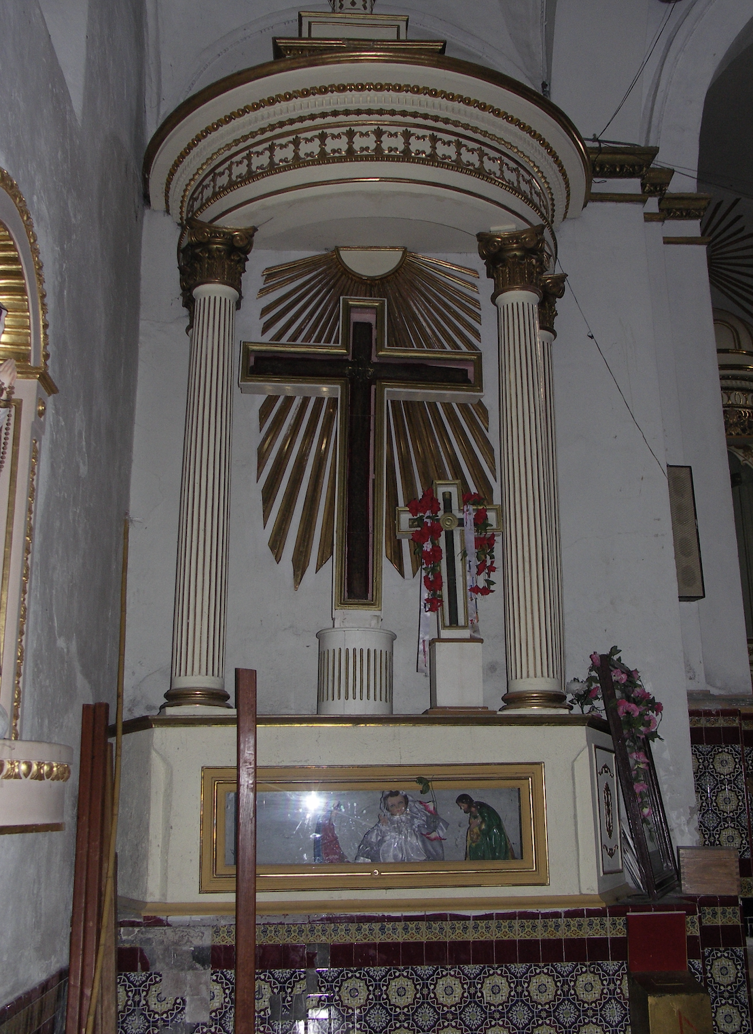
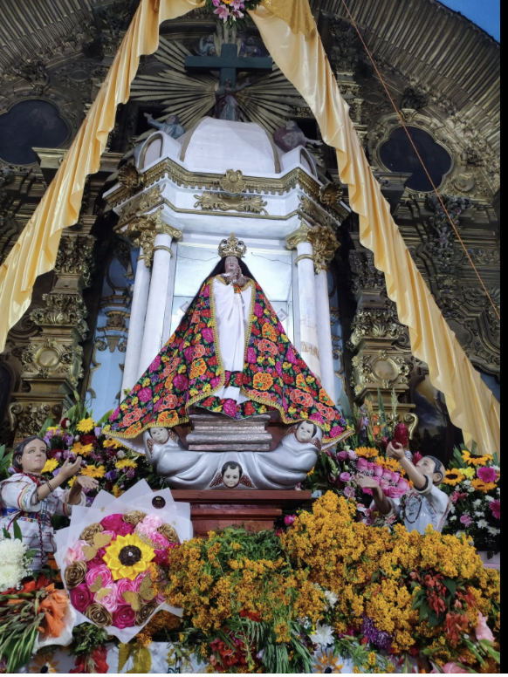
This new pact was firmly set in place by a) The Church

Slide 10
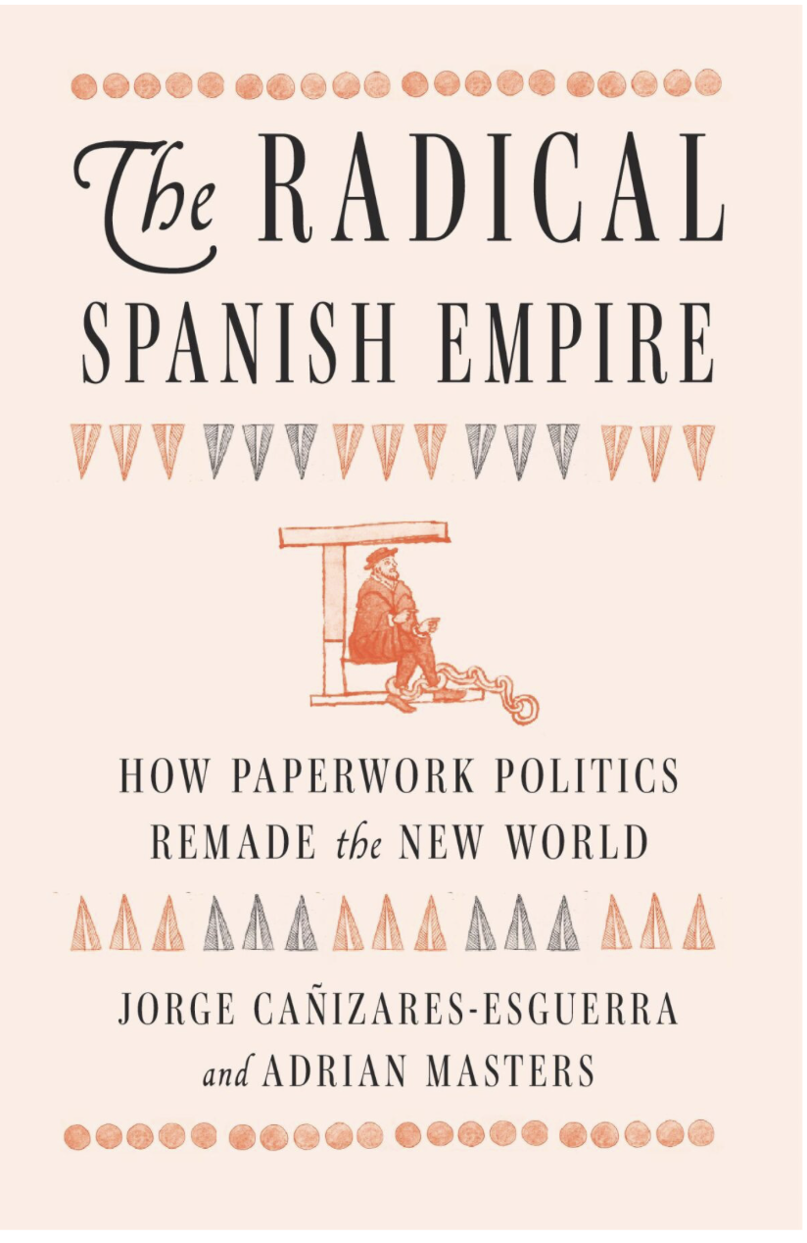
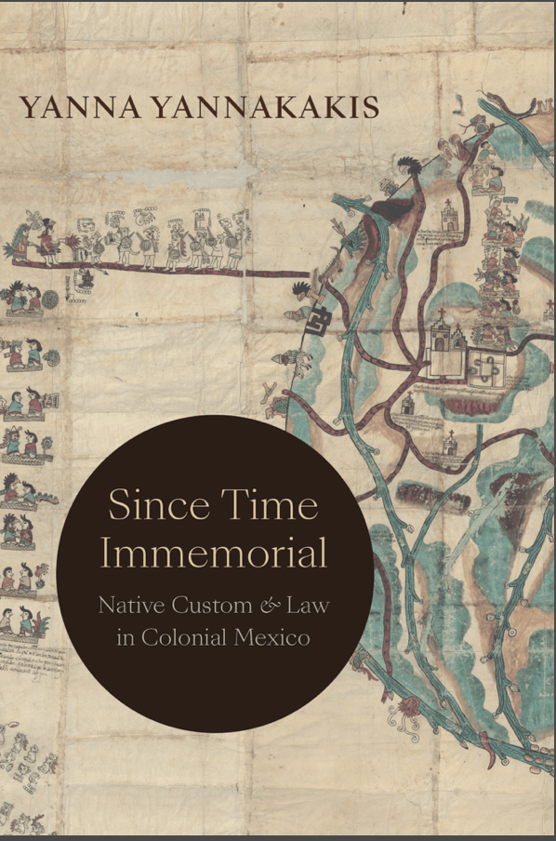
b) The Law

Slide 11
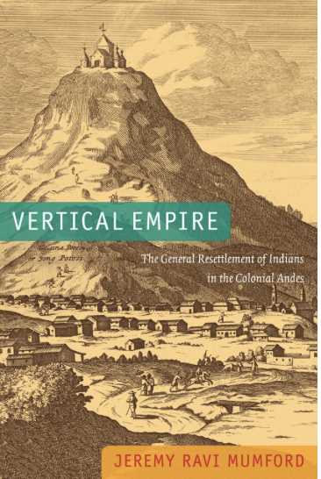
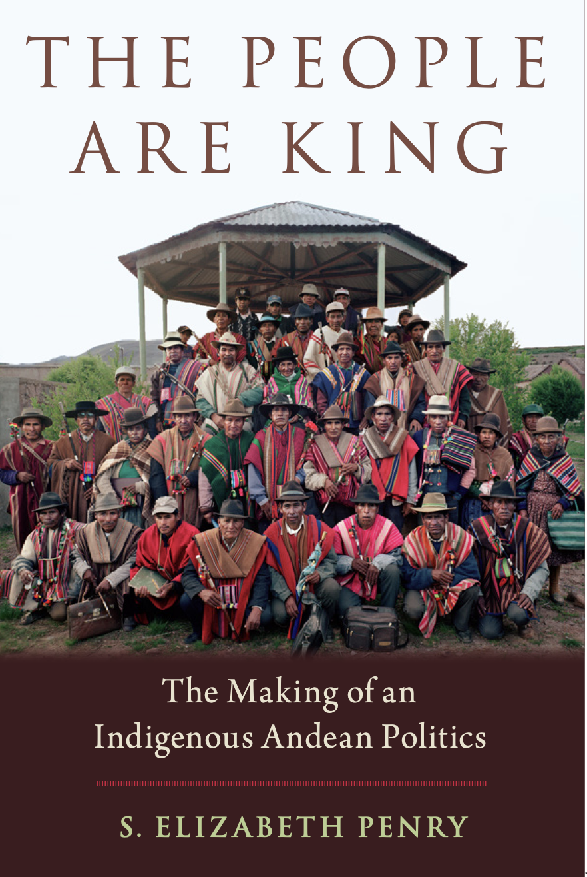
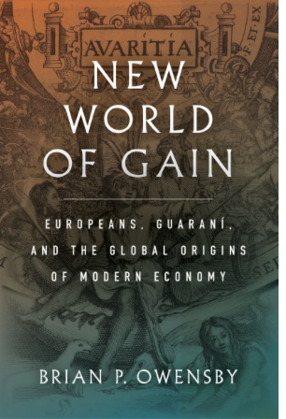
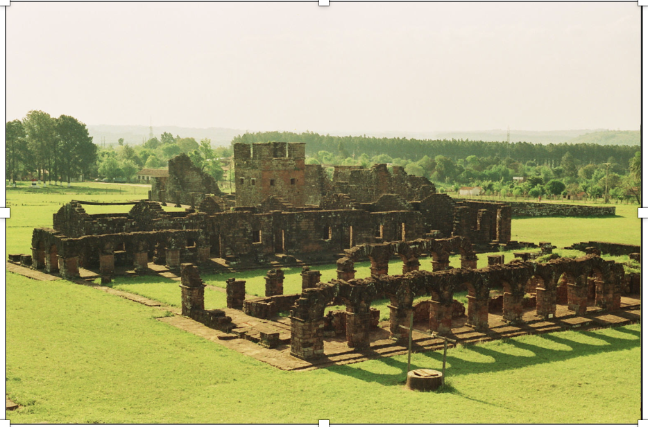
Can this model be extended to South America?

