Slide 1
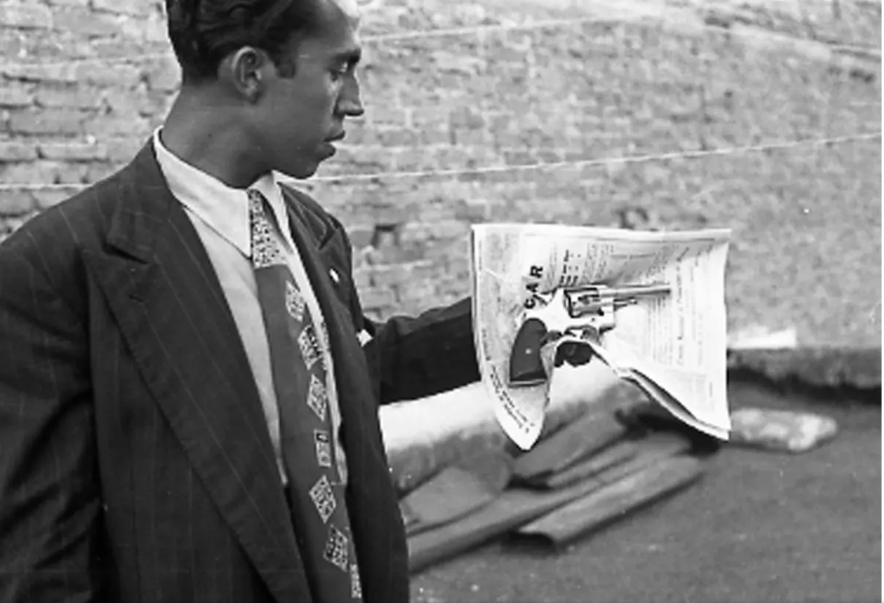
A grassroots history of modern Mexico
Benjamin T. Smith
Professor of Latin American History
University of Warwick

Slide 2
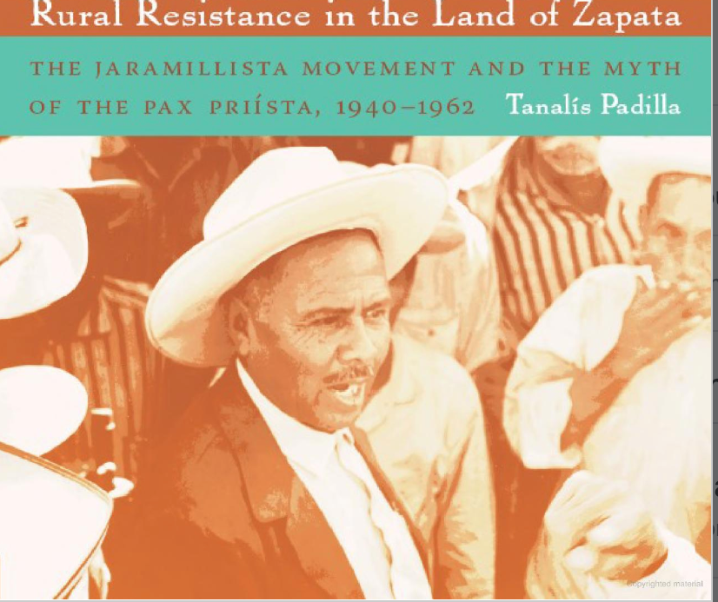
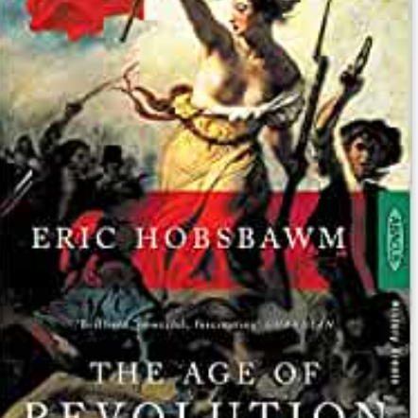
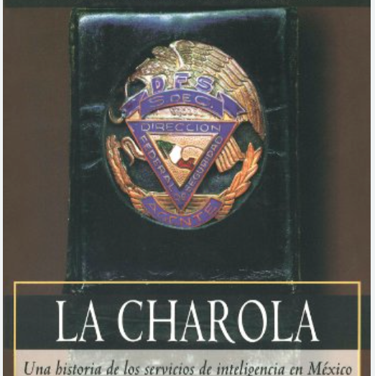
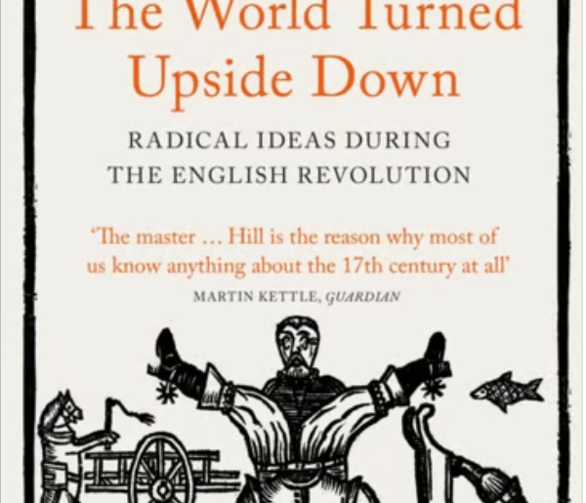
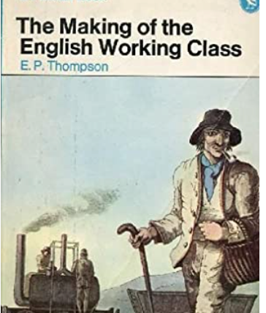
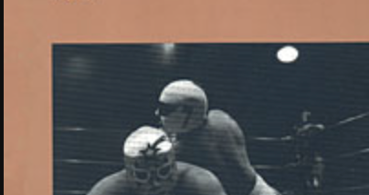
Influences
British Marxist tradition
Latin America’s New Cultural History
Emerging critiques of NCH
Weakness of Mexican state
Force and autonomy of civil society
Importance of the Catholic church
Use of violence in state building

Slide 3
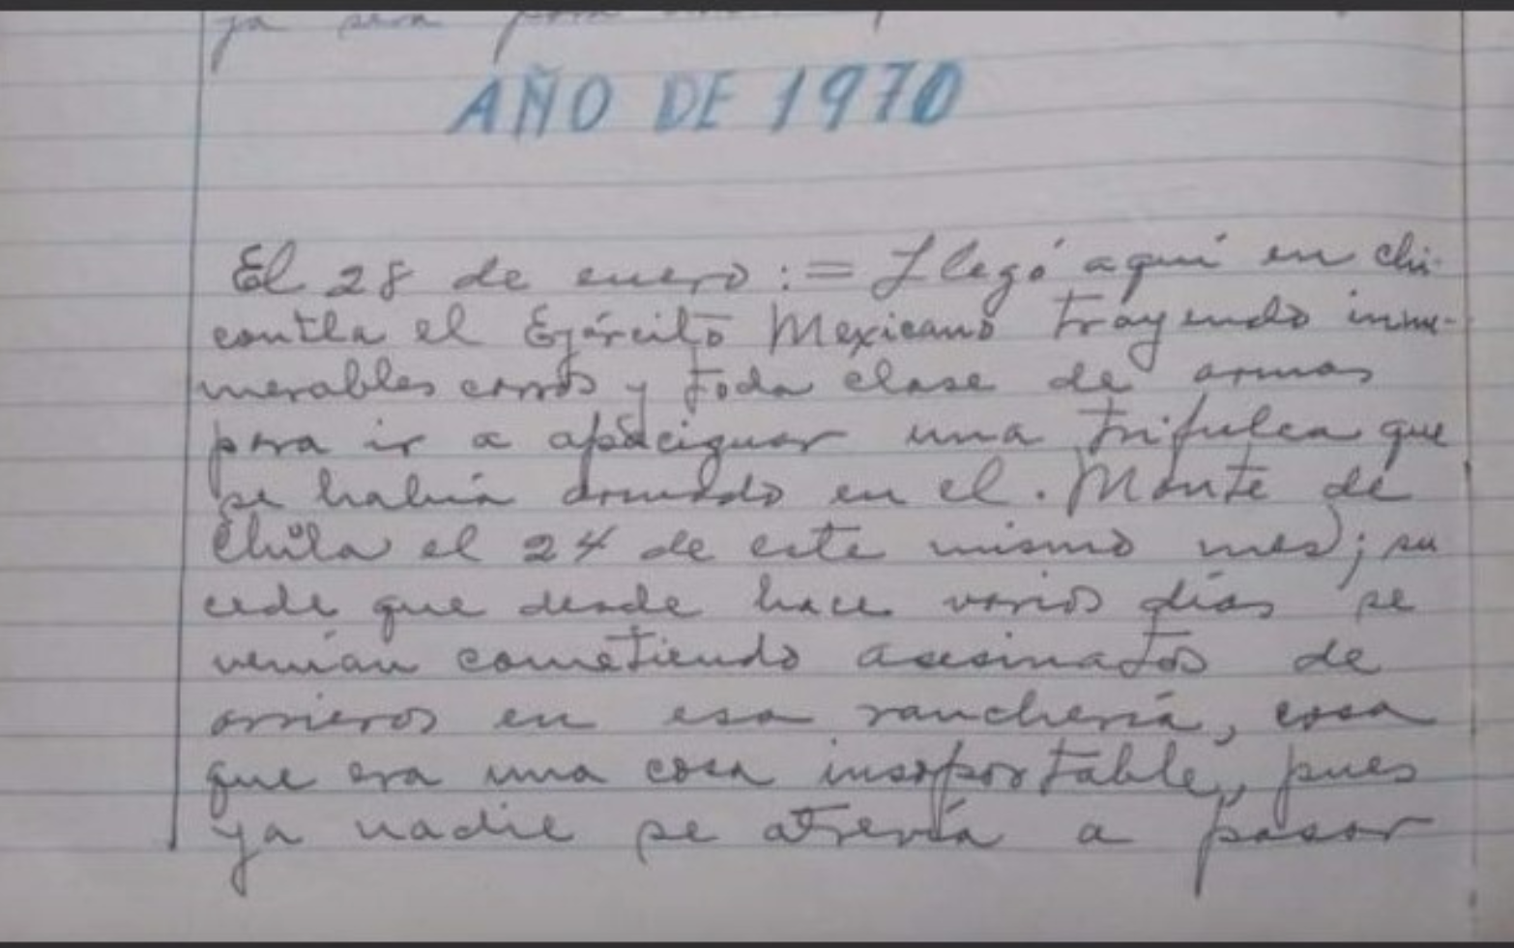
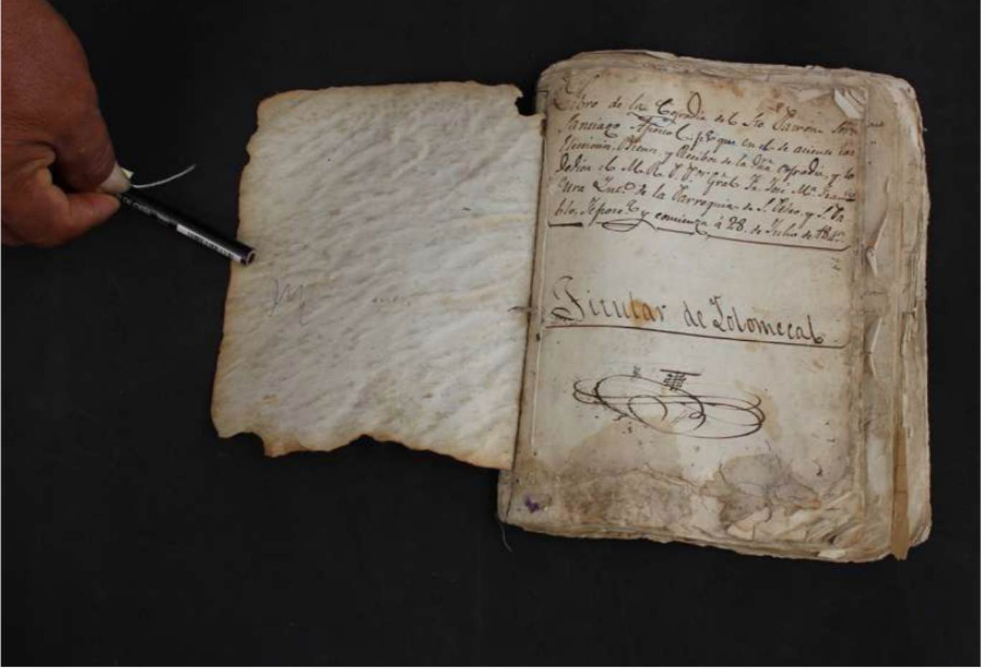
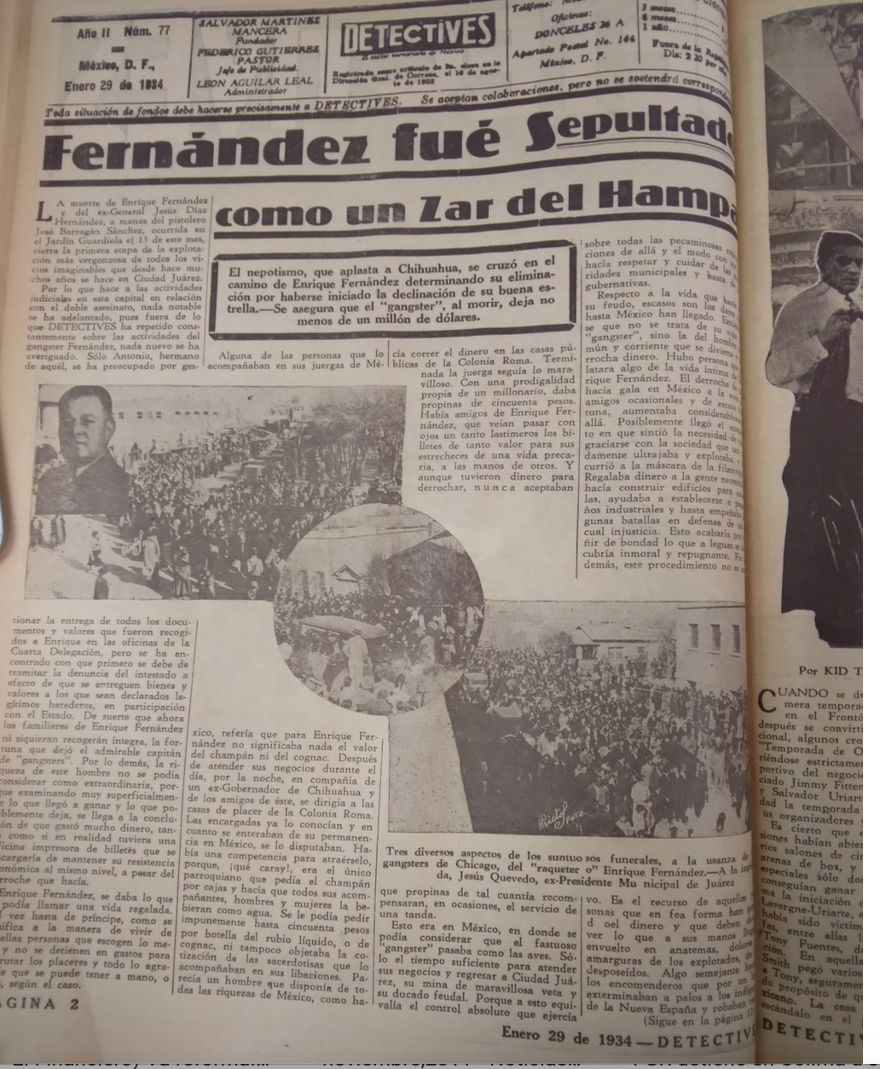
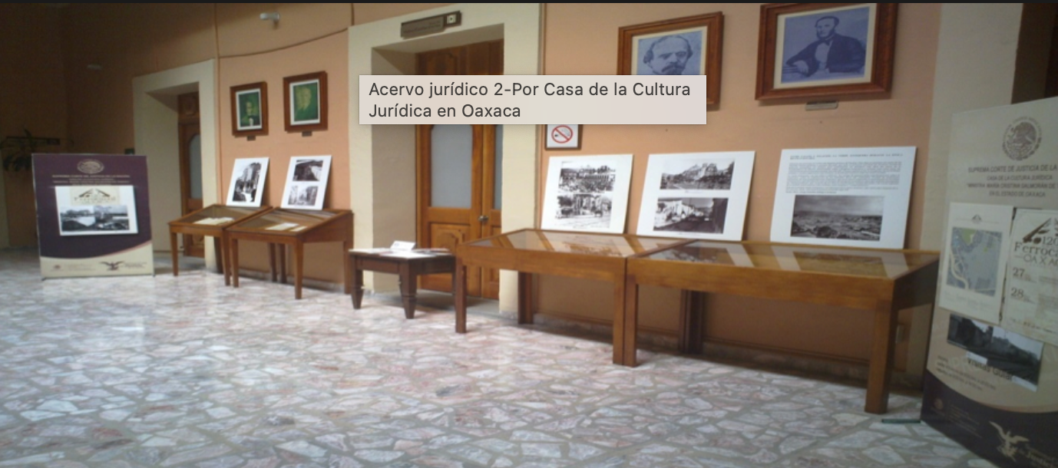
Archives
Most historians of modern Mexico employ a blend of three archives – the U.S. National Archives and Records Administration, the Archivo General de la Nación, and the Hemeroteca Nacional.
But there are hundreds of other archives for modern Mexico.
State archives
Municipal archives
Parish archives
Local newspapers
Judicial archives
Private archives

Slide 4
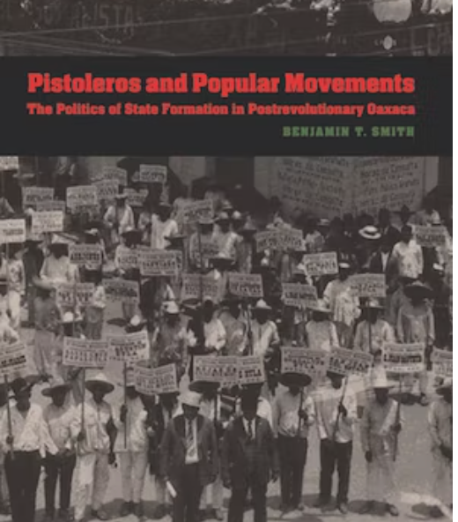
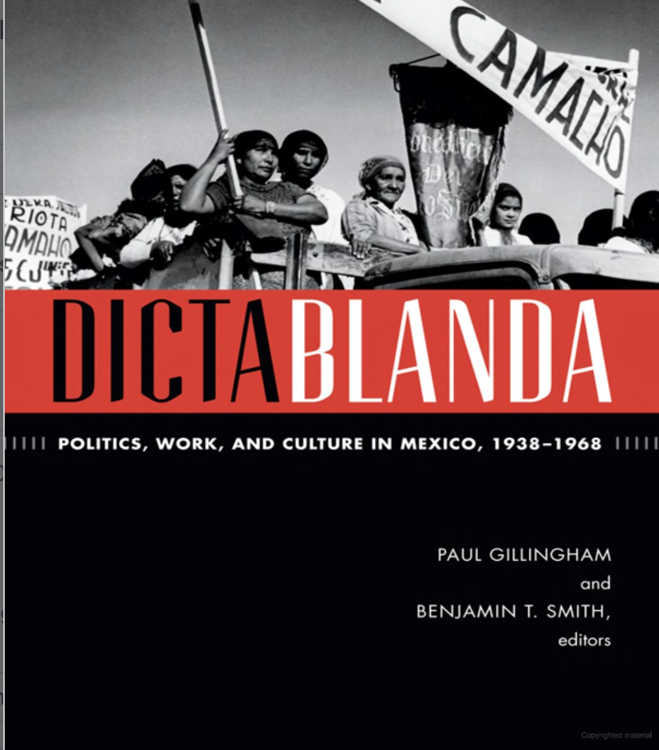
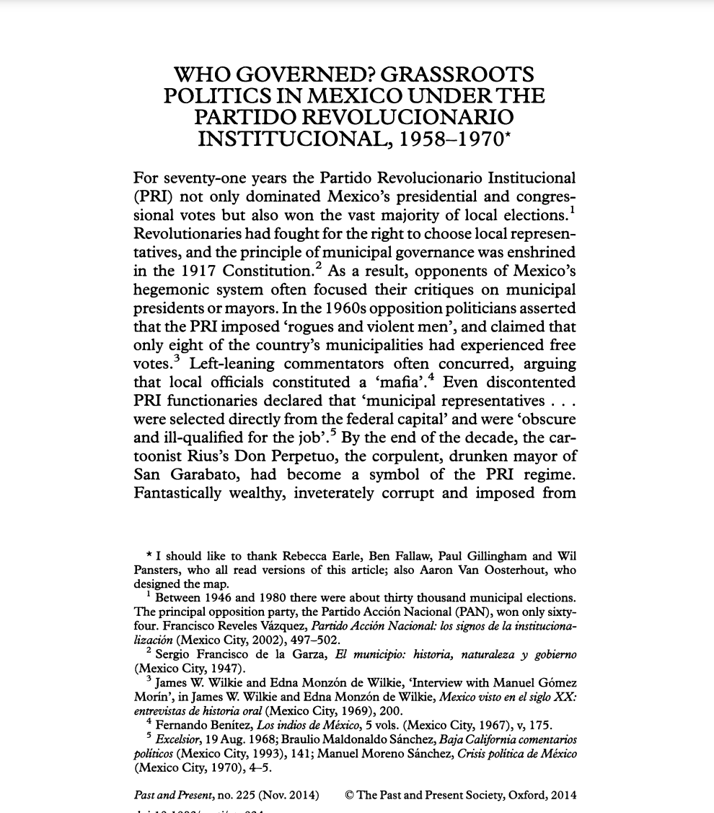
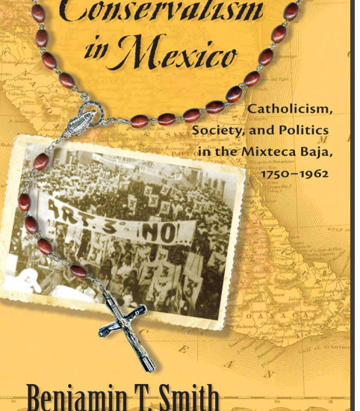
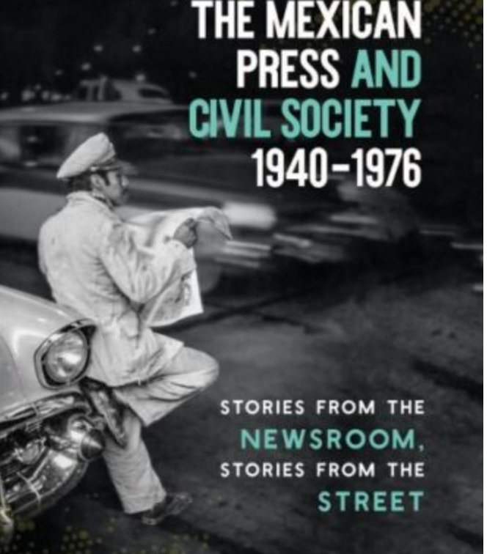
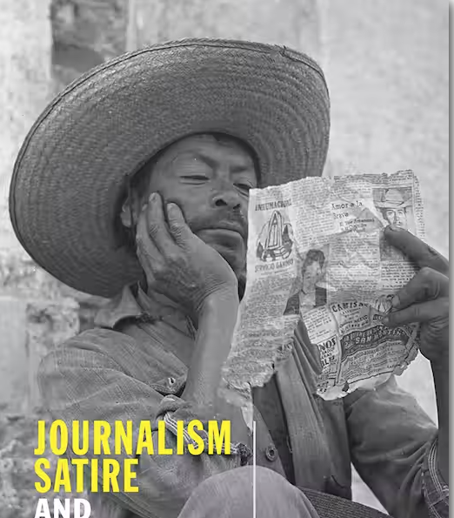
Rethinking Mexican Politics

Slide 5
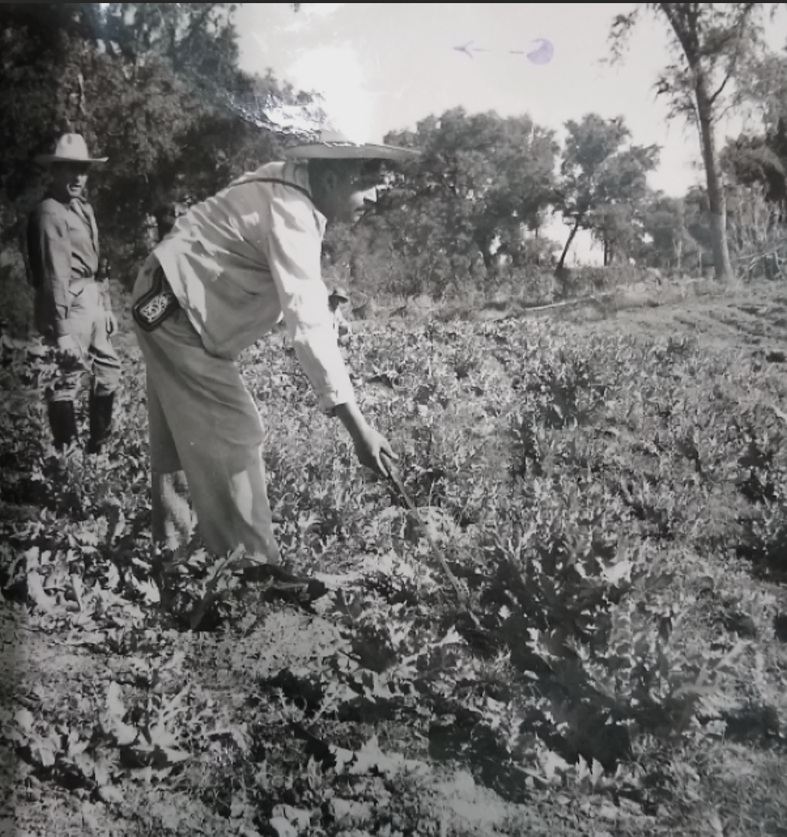
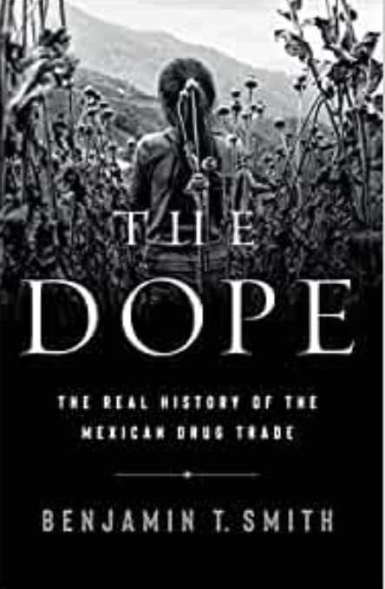
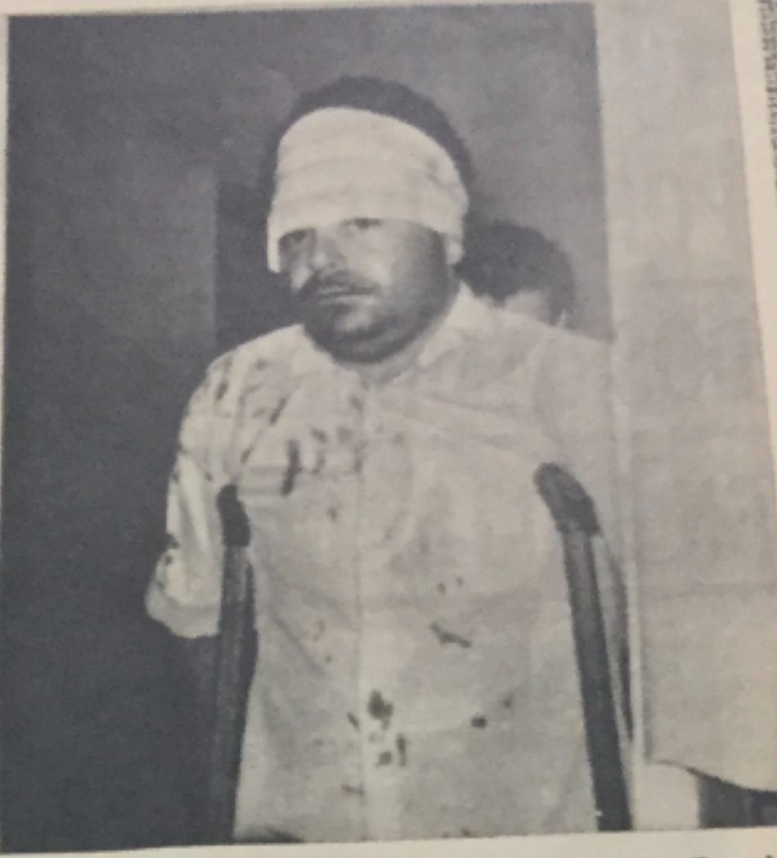
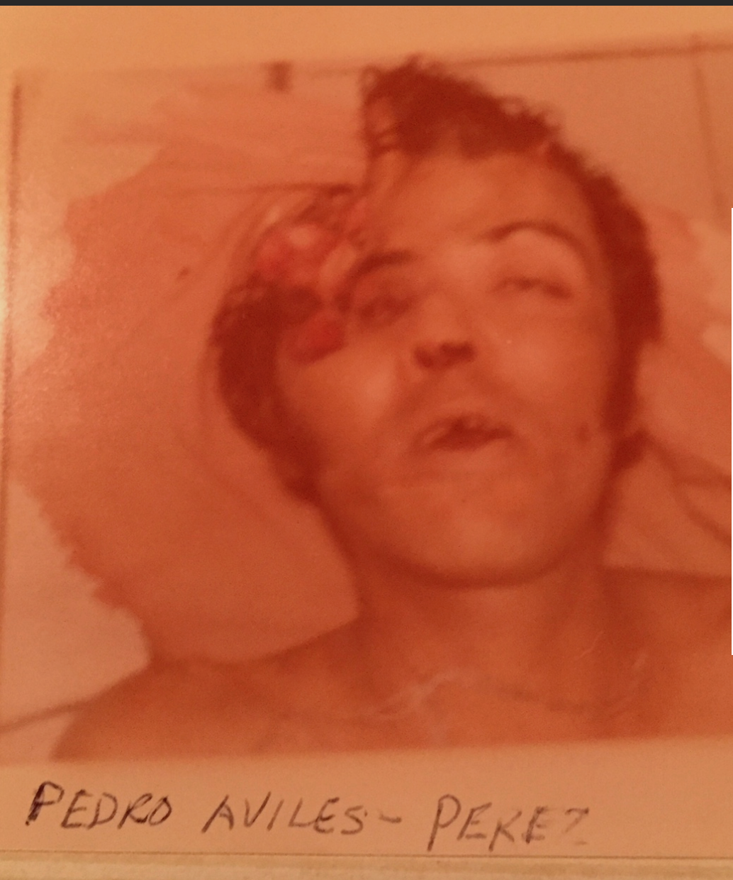
Drugs and counternarcotics policies
Mexican drug trade driven by U.S. demand
State authorities established “protection rackets” which offered traffickers impunity in return for cash.
Violence emerged from a) clashes between authorities over protection rackets and b) increasingly punitive counternarcotics policies

Slide 6
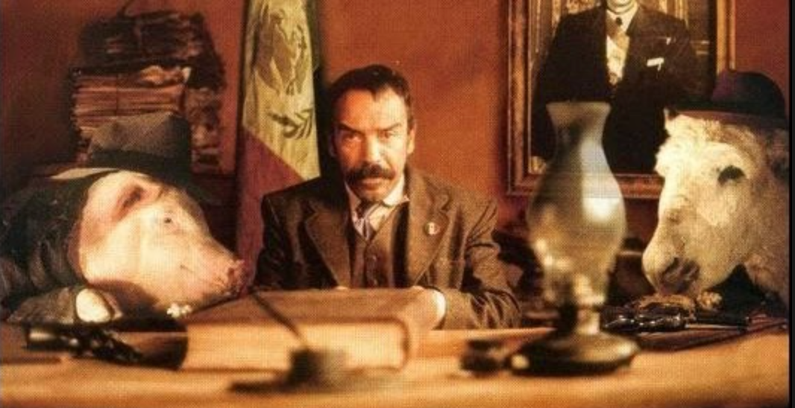
CRIME AND STATE MAKING IN TWENTIETH CENTURY MEXICO

Slide 7
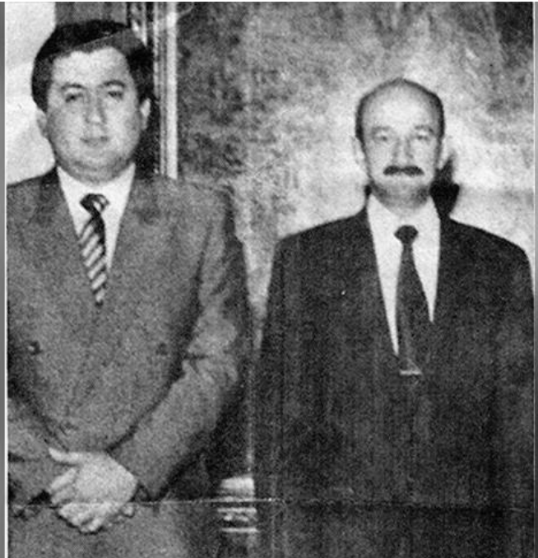
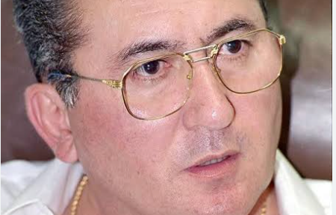
Interview with Guillermo González Calderoni, former head of Mexico’s federal police, 2000
PBS: Why are so many Mexican police commanders corrupt?
GGC: What did you do to turn them into real police officers? Did you give them a budget? Did you give them gas for their trucks? Did you give them better weapons, trucks, vehicles, intelligence, information, technology, than the traffickers had? If you didn't give them any of this, really, what did you give them? You sent them off to become what they became--to take money from drug traffickers in order to fight them. Maybe they take the money from some of the traffickers to fight the other traffickers.

Slide 8
Standard appreciations of the relationship between the Mexican state and organized crime
The Mexican state is “weak” or even “failed” (Valdés Castellanos, Durán-Martínez, Kenny and Serrano)
The Mexican state is “strong”; violence is the result of the policy choices of a cohesive state (Carlsen, Lessing, Flores-Macias and Zarkin, Castillo and Kronick)
The Mexican state is so riddled with corruption, it cannot adequately deploy its capacities. (Benitez Manaut, Chabat, Rosen, Bonner).

Slide 9


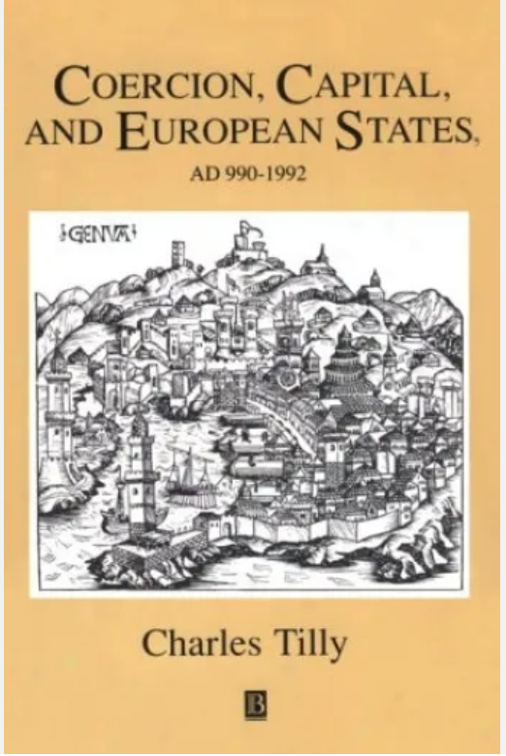
How to reconcile these visions?
By employing insights drawn from Charles Tilly’s work on the state as a protection racket and state-building as organized crime.
Viewing the Mexican (and other states) as essentially not one but TWO protection rackets – one licit and the other illicit.

Slide 10
The Janus-faced state
THE LICIT FACE OF THE STATE
State operates as a protection racket
State extracts tributes (taxes) for the provision of security
This security is both against the state and the state’s rivals
THE ILLCIT FACE OF THE STATE
Illicit economies offer huge potential resources.
These could be exploited by rivals.
So, the state opens a second, sub rosa track of state building.
For the illicit entrepreneurs who pay, the state offers protection.

Slide 11
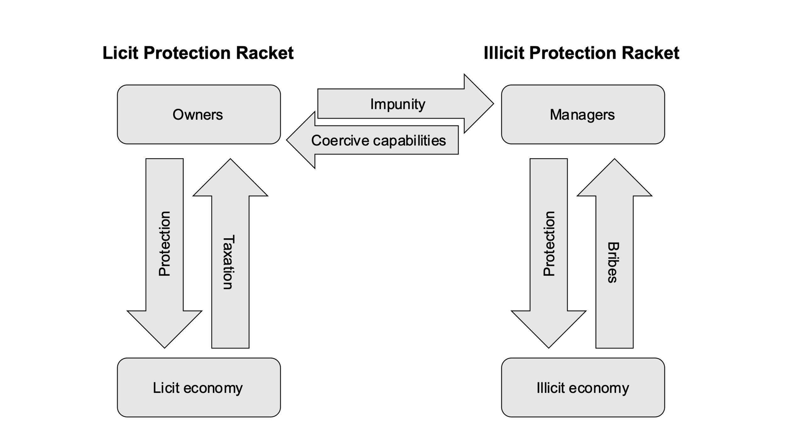
The intertwining of licit and illicit protection rackets

Slide 12
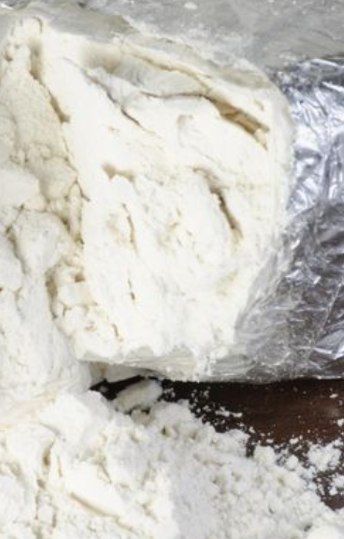
Two key sub-arguments undergird this theory
1) The illicit rackets should not be dismissed as “corruption” but as playing a crucial state- making role.
2) The Janus-faced state endures because international pressures make sure that certain products (especially narcotics) are always:
a) highly priced and
b) dealt in a market with low interpersonal trust.

Slide 13
The Janus-faced state in postrevolutionary Mexico
The licit face of the state has always been weak.
Low taxes
Restricted state capacity
In post-revolutionary Mexico, the state faced multiple internal rivals.
So, it established an illicit face of the state. Here impunity was exchanged for violence work.
To rephrase Weber, “the state did not so much have a monopoly of the legitimate use of force as a monopoly over the proffering of official impunity.”

Slide 14
Early post-revolutionary protection rackets, 1910-1960s
Headed by generals, mayors, caciques and local cops.
Concerned illegal logging, illegal mining, illegal still running, booze smuggling, gambling, prostitution and both the domestic and transnational narcotics businesses
Concentrated at the border.

Slide 15
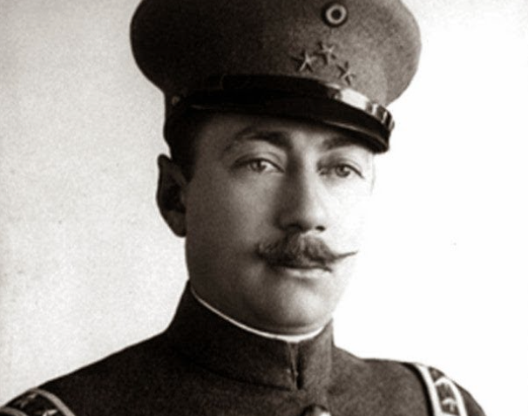
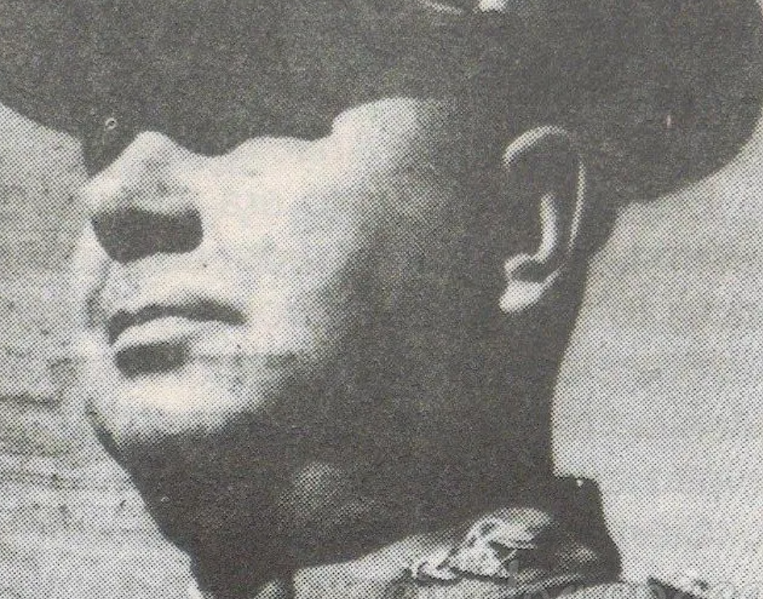
E.g. Estebán Cantú, governor of Baja California, 1915-1920
Extracted protection money from state’s opium importers and processors.
Used money to build schools, roads, and local police
E.g. Pablo Macías Valenzuela, governor of Sinaloa, 1945-1950
State cops extracted money from Sinaloa opium growers
State cops gave money t state tax collectors

Slide 16
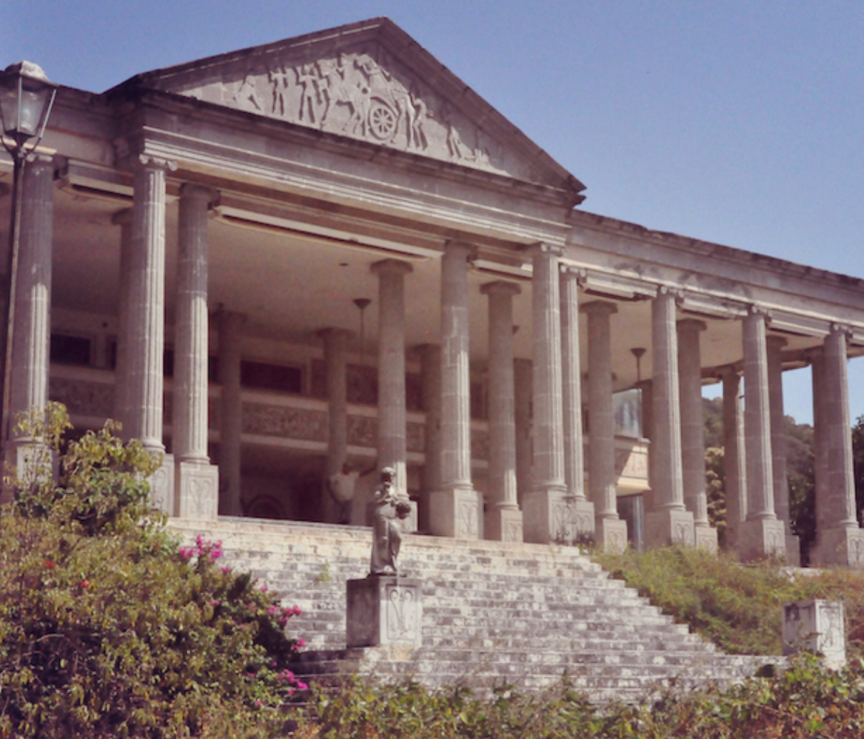
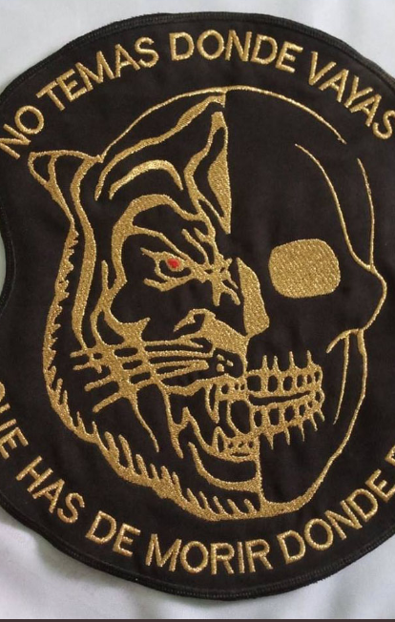
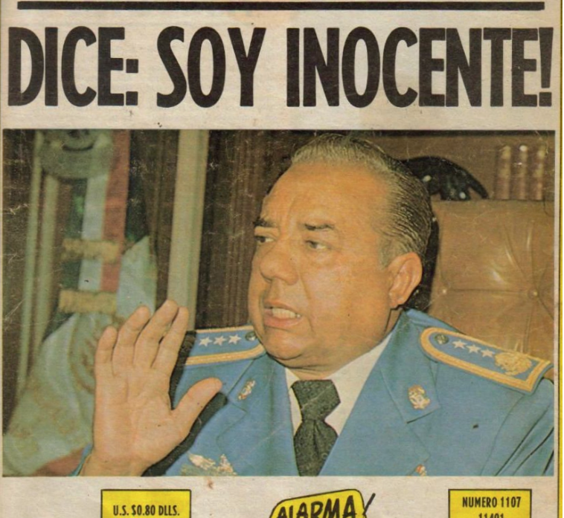
Federalization of the local protection rackets, 1970-1989
Takeover of local protection of drug trade by army, Policia Judicial Federal (PJF) and finally the Dirección Federal de Seguridad (DFS).
Use of drug money and labor to fight dirty war.
Occasional revoking of impunity. E.g Arturo “el Negro” Durazo or Guillermo González Calderoni.

Slide 17
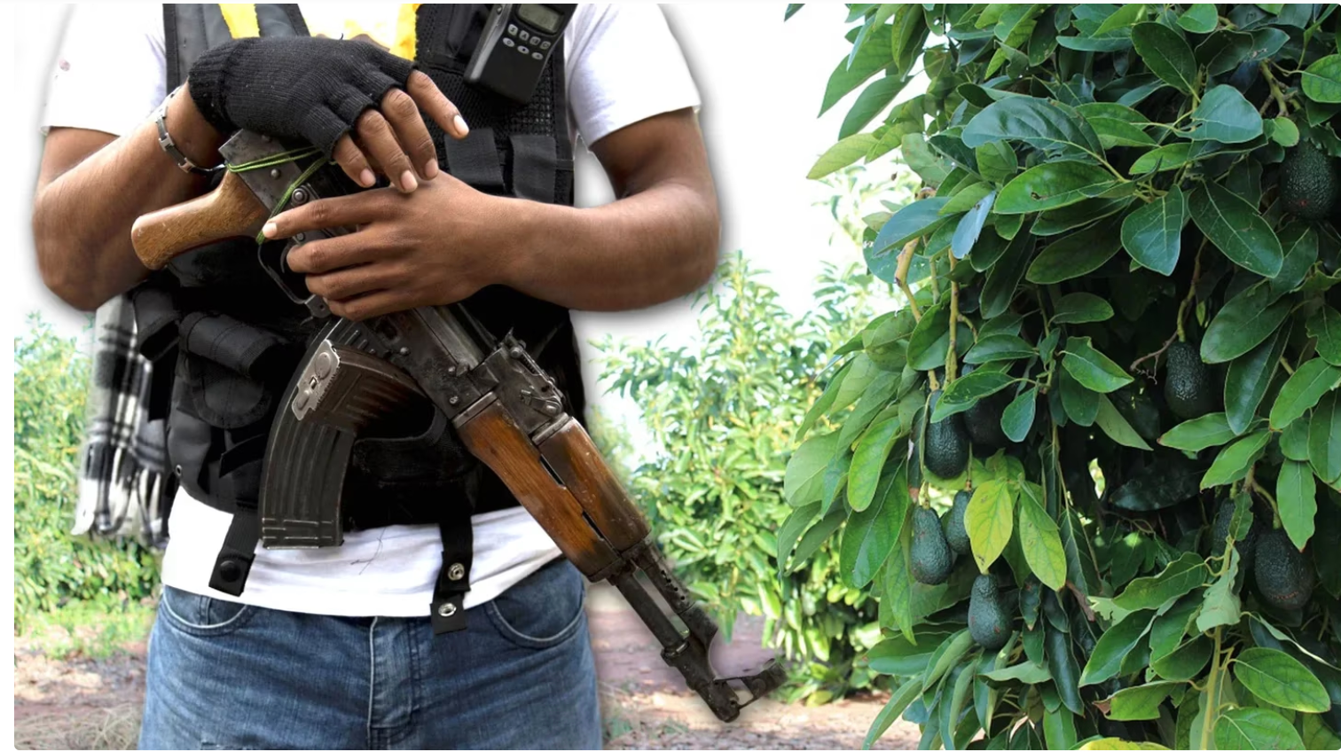
The 1990s
Democratization generates competing authorities offering impunity.
Fragmentation of security apparatus generates multiple agents of coercion.
Neoliberal reforms generate a) new products that need protection b) increase in value of commodities
Protection rackets expanded in focus and scale

Slide 18
Conclusions
Other Janus-faced states – Brazil, Indonesia, Colombia, Argentina
Violent pluralisms (Goldstein and Arias) emerge not from democratization but baked into process of state making.
To what extent can this model be extended to entire “underground” economy which now accounts for 50% of Mexican GDP?

