Slide 1

Surveillance Capitalism

Slide 2
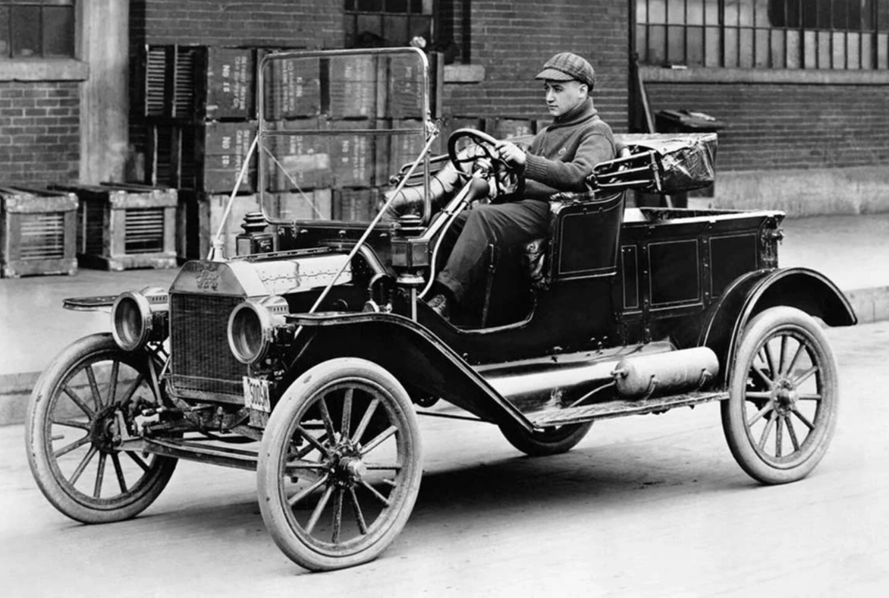
Fordian or Mass Consumer Capitalism
Mass production of standardized, cheap goods. (”any color as long as its black”)
Sale to a mass market
This form of capitalism contained a “reciprocity with the social order”. i.e. Workers paid OK as they were also consumers.
Do we agree with this?

Slide 3
How Mass Consumer Capitalism went wrong
Previously managers were judged according to productivity, profit and relationship to workers. Bad managers caused strikes.
1) Meckling and Jensen argued that managers should be judged according to the “shareholder value” of the company. A strike was no bad thing; you could sack workers; and employ cheaper workers in a different country.
2) This combined with deregulation, which gradually gave corporations more power to do whatever they wanted. i.e. If you were a corporation, you could stop workers joining a union.
3) Individualiization. Growing idea that our identity is individual RATHER THAN based on a group, ethnicity or class.

Slide 4
These changes create a paradox
Zygmunt Bauman, the deepest contradiction of our time, he claimed was the “yawning gap between the right of self assertion and the capacity to control the social settings which render such self assertion feasible. It is from that abysmal gap that the most poisonous effluvia contaminating the lives of contemporary individuals emanate”
What does this mean?

Slide 5

The surveillance capitalism solution
New corporations harvest our private data (often without us knowing).
The good corporations (she gives example of Amazon) are “advocacy-oriented” and basically just help us get what we already want. Amazon suggests books.
The bad corporations try to use data to modify desires and behavior. By doing this they create a “behavioral surplus”

Slide 6

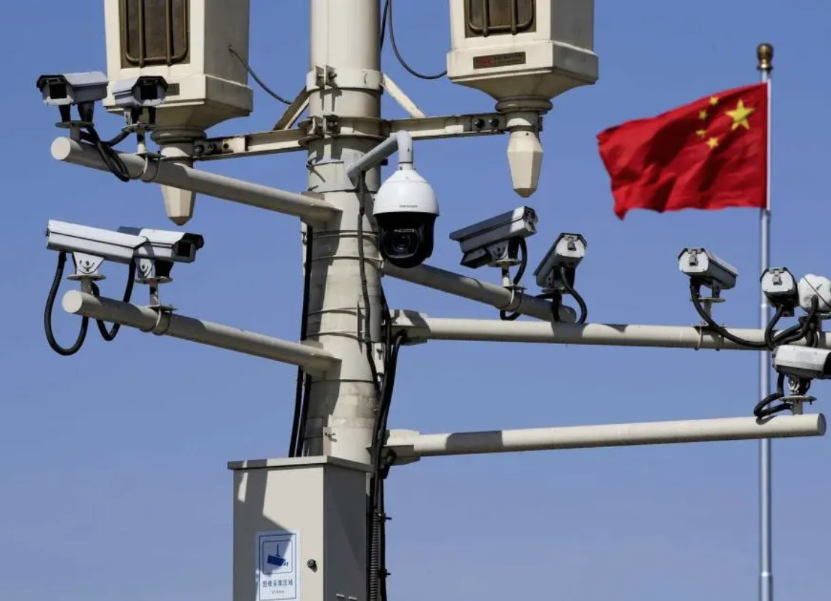
My questions
How is this different from mass surveys and targeted advertising? Advertising has always tried to play on our vulnerabilities and fears to sell us stuff.
How is this different from government spy networks? (e.g. COINTELPRO)
How joined up is all this data collection? My assumption…. not very. Human incompetence has always undermined the efforts of the authoritarian state.
Surely there is a difference between surveillance and control of Uyghurs and surveillance of shoe-purchasers or Strava runners?
https://www.nytimes.com/video/world/asia/100000008314175/china-government-surveillance-data.html
In terms of security, is not surveillance capitalism a relatively cheap solution to the cutting of police, and the rise of impunity?

