Slide 1

Capitalism and High Education

Slide 2
An idiot’s guide to writing a book review
https://warwick.ac.uk/fac/arts/history/students/modules/hi2k1/bookreview/
First paragraph: The problem
Second paragraph: The main argument
Third, Fourth, Fifth paragraphs – break down the arguments
Sixth paragraph – critique
Seventh paragraph – conclusion (short)

Slide 3

Three ways of funding universities
State subsidies
Private/parental income.
Government-backed loans.

Slide 4


The State-subsidized university system
When did it emerge?
Why did it emerge then?
What ideas underpinned it?
What assumptions about class underpinned it?

Slide 5

“Why should a binman subsidize the son of a banker to go to university?”

Slide 6

The privatized model of universities
What are the advantages?
What are the disadvantages?

Slide 7

Why no graduate tax? Or Why saddle students with debt?

Slide 8
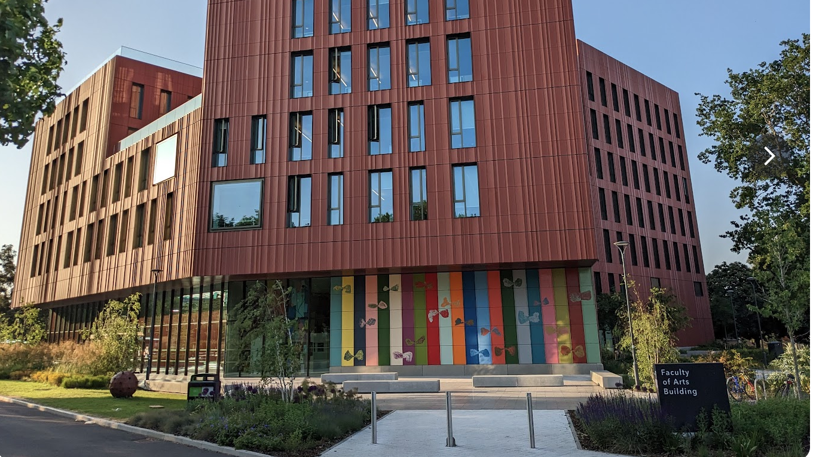
What is the point of Arts & Humanities?

Slide 9

Ways out of the labyrinth?
Academic-student alliances?
Strikes?
Small-scale cooperativism?

