Slide 1
Weaponizing History

Slide 2
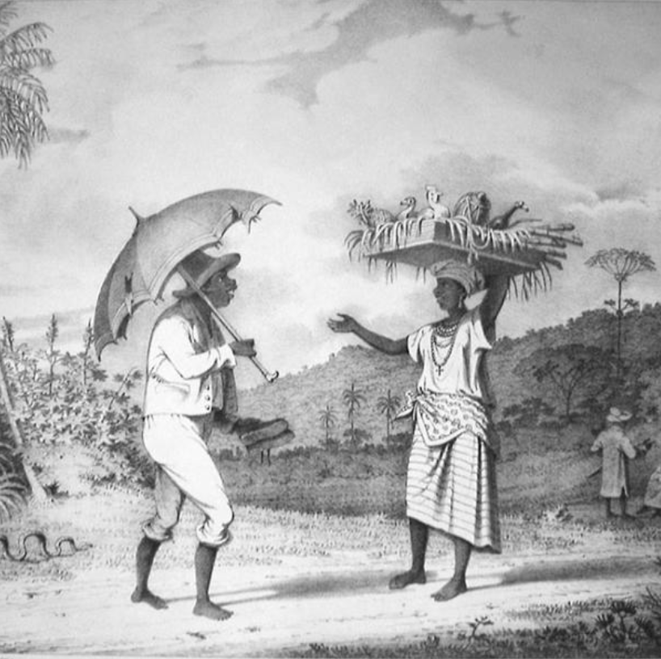
What types of history get weaponized in the UK?

Slide 3
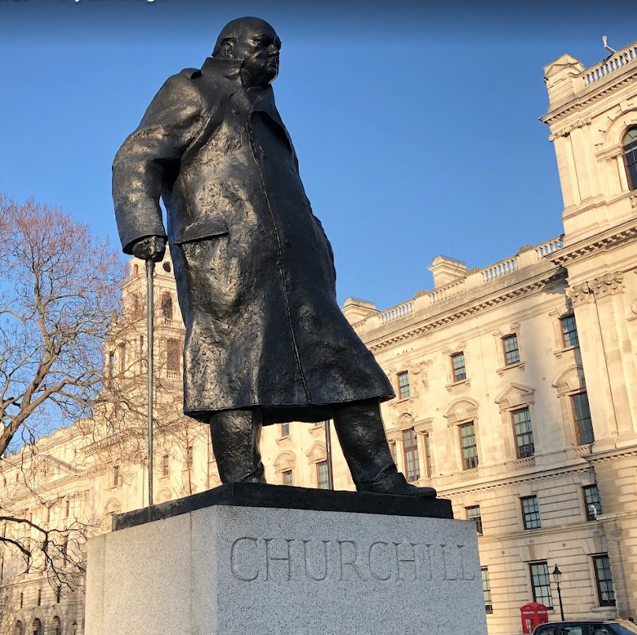
What are we talking about when we are talking about history?

Slide 4
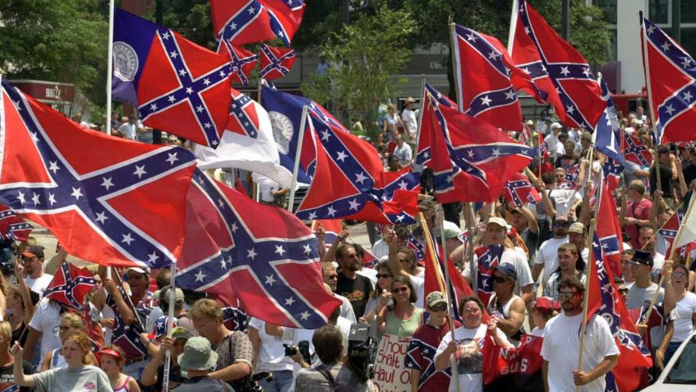
What types of history get weaponized in other countries?

Slide 5
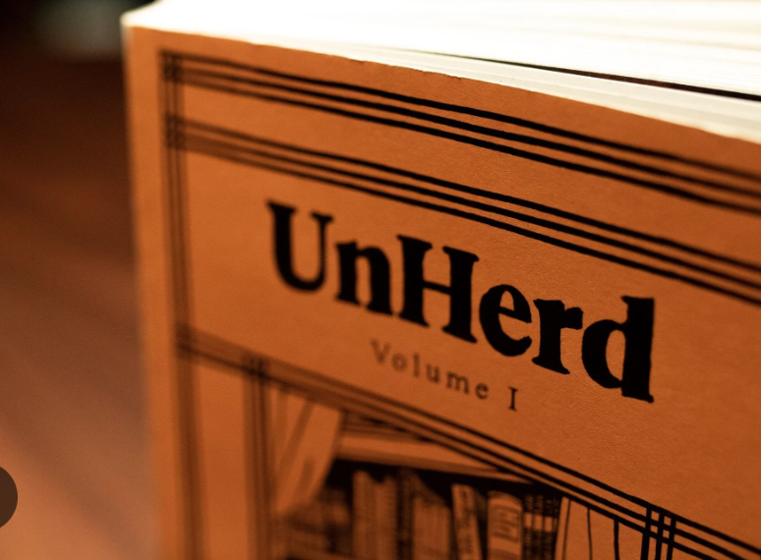
How does economics fit into the weaponization of history?
Who benefits?
Can we talk about a Historical Industrial Complex?

Slide 6
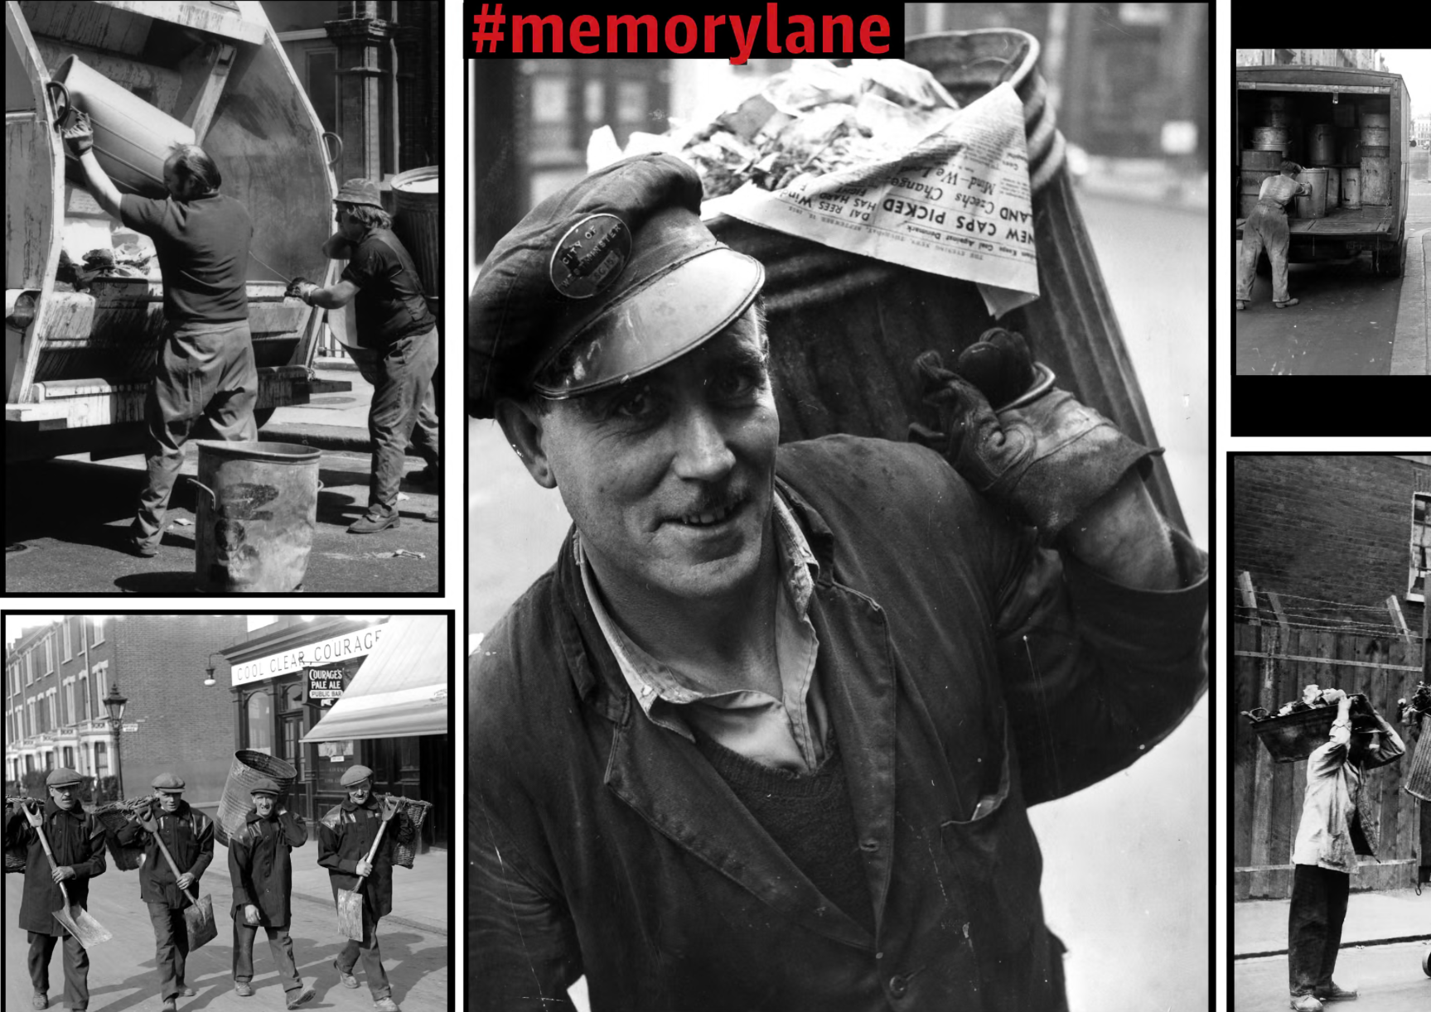
Nostalgia
What function does it play?
Do we live in an era of nostalgia? Or did it always exist?
Is it only the right that indulges in nostalgia?

Slide 7
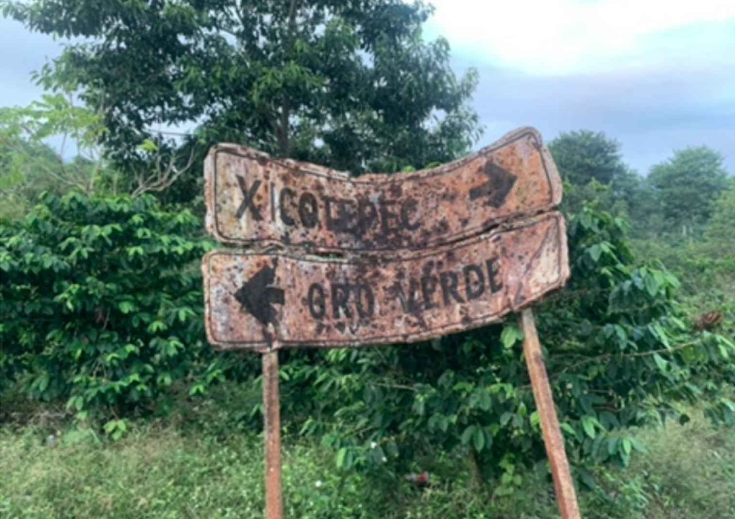
Politics vs ethics in history

