Slide 1

Master’s Info Session
Course overview
Application process
Funding opportunities
Q&A

Slide 2




Course Overview
One MA with 4 different streams:
Modern
Early Modern
Global and Comparative
History of Medicine
Different core modules, but same choice of optional modules
12 months/24 months if part-time

Slide 3
Course Overview
Theory, Skills and Methods
Term 1
Themes in Modern History
Themes in Early Modern History
Themes in Global History
Themes in the History of Medicine
History of Medicine
History of Religion
History of Consumption
Term 2
History of Empire
History of Gender
History of Science
Term 3
Dissertation
Green = core modules; Blue = optional modules

Slide 4

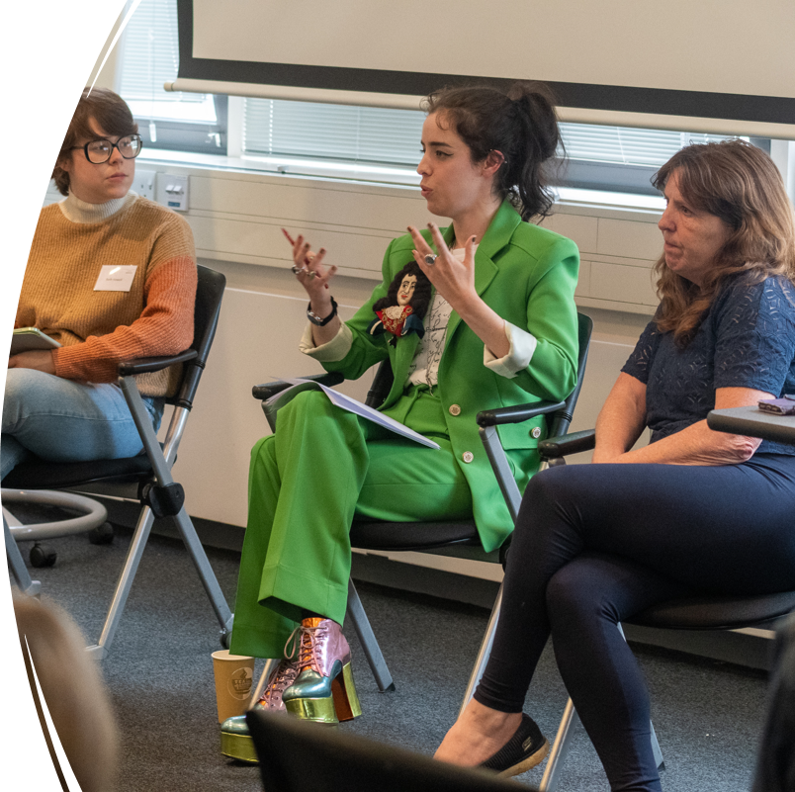
Beyond seminars…
There are lots of opportunities to get involved in the life and research of the department…
PGT Lunch
Research seminars and Research centres
PG Work in Progress
PG Conference

Slide 5
Where can I go next?
The MA is ideal preparation for students considering a PhD and the department is well placed to support you with a PhD application.
You can also do the MA even if you don’t want to do a PhD!
The MA helps you develop skills such as analysis, critical thinking, empathy, presentation and communication skills. We will also support you with careers advice.
Last year’s cohort have gone into a range of fields, including healthcare, academia, hospitality, media and the heritage industry.

Slide 6
How do I apply?
Apply online (£75 fee)
It takes about 6-8 weeks for us to process your application
If you need a visa – apply by 2nd August 2025
Apply up to Aug/Sept – but earlier for funding offers
Entry requirements:
2:1 or above Hons degree in History or a closely related discipline
One satisfactory academic reference
Academic or interim transcript
English Language Qualifications (if appropriate)
One-page personal statement and research proposal

Slide 7
Personal statement
Tell us why you want to do the MA
Show your enthusiasm for History!
Talk about your skills in the subject
Research proposal – give an indication of what you’d like to focus on in your dissertation, don’t worry if it’s not a fully-fledged idea
This should be part of the personal statement, not a separate document.

Slide 8
Finance and funding
Fees for 2025-26
Full time Home: £11,170 | Overseas: £25,120
Part-time Home: £5,585 | Overseas: £12,560
Students are eligible for a government loan
The university offers a 10% alumni discount
The department offers 3 inclusion grants of £1000 each
Warwick Taught Masters Scholarship Scheme (£10, 000)

Slide 9
…Any questions?
Email: pghistoryoffice@warwick.ac.uk

