Slide 1
The (un)forgotten: Looking back in hope at juvenile LWOP offenders in the US
(Un)doing Time and an archaeology of hope in the shadow of prison
Prison and Memory
Warwick University Memory Group
24th January 2017
Dr Evi Girling
e.j.girling@keele.ac.uk
SCHOOL OF SOCIAL SCIENCE AND PUBLIC POLICY
KEELE UNIVERSITY

Slide 2
Lives Unbound
The life (un)limited sentencing for juveniles
Recent genealogies of hope and the juvenile in life limited sentencing.
Roper v. Simmons (2005)
Graham v. Florida (2010)
Miller v. Alabama (2012)
Montgomery v. Louisiana (2016)
Hope and its discontents
Prescribing hope in sentencing: the rare juvenile
Retroactivity: An archaeology/anamnesis of hope and redemption in hopeless places.

Slide 3
Extreme Punishment: ‘in’ and ‘out of’ time
Remembering, forgetting, hope/hopelessness, memoralisation, transformation, redemption, incorrigibility, waiting (to die), mourning, finality, closure.
LWOP – lives and deaths: LWOP as living death, slow death, living dead, buried alive, a ‘slow death’, social death, the ‘forgotten’
Punishment as emplotment and challenges in extreme punishment
  Redemptive scripts (Maruna, 2001)
  Redemption and (Un)grievable lives (Butler, 2009)

Slide 4
Covenants with anger past
Like Odysseus at the mast, who made his men swear that they would ignore his future pleas and keep the covenant, when we sentence to LWOP, we irrevocably pledge at this moment forever: We will never let our rage and disgust disintegrate and deteriorate. LWOP creates a binding commitment now and forever never to think differently, or feel different—when the future becomes the present and the present is now past.
(Blecker, 2010, pp. 12-13)
LWOP as Museum of rage.

Slide 5
LWOP and the creation of ‘ungrievable lives’
“An ungrievable life is one that cannot be mourned because it has never lived, that is, it has never counted as a life at all”
Judith Butler, Frames of War: When Is Life Grievable

Slide 6
Witnessing the (un)forgotten: Disjunctures and the paranoid temporality of infinite containment
Witnessing lives in places of death
Liveable lives in unliveable spaces; Life worthiness and incorrigibility in resentencing vs parole proceedings
The body snatchers: Juveniles in adult bodies
The limits of witnessing the carceral state: Redemption stories and self –fulfilling prophecies.

Slide 7
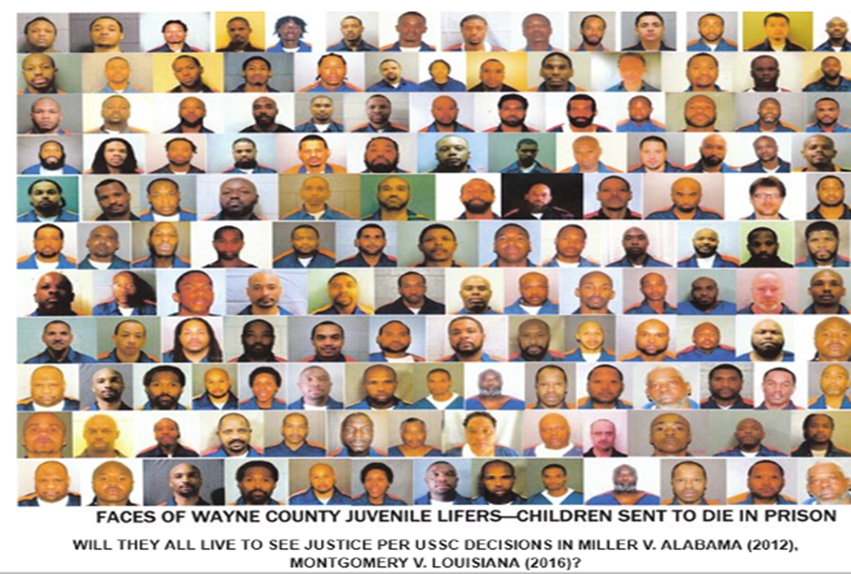
(Un)children

Slide 8
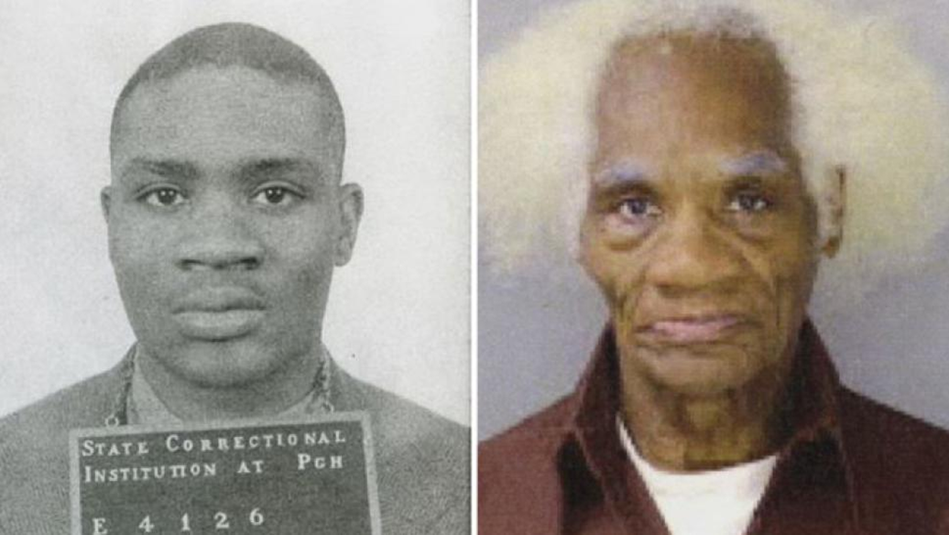
Joseph Ligon, at 15 and now at 80, Pennsylvania
Notes:
Joseph Ligon, at 15 and now at 80, Pennsylvania

Slide 9
During these years of hopelessness
Because I had given up hope a long time ago[,] I was prepared to die behind these walls. I gave up all hope of ever having an opportunity to ever see life outside of these walls. You all have slowly help[ed] to restore that hope. However during these years of hopelessness, I've dug myself in a hole. I have stabbed people, caught additional time in prison for assault on guards. So I now have a minimum of 11 years to serve aside from my life sentence [a]nd I wonder if any of these doors that are opening [after Miller] will benefit me in any way. Is it too late to turn things around or do I have a real shot. This is my question to you[ ] [b]ecause there are those in here with me, that giv[en] the opportunity would do what[ ]ever is required to get out of here and stay out. We have bad prison records, but are not bad people. We just got caught up in this jail house maddness [sic] and had a rougher time than some others. Some people have always held onto hope[;] others such as myself felt it was easier to do my time by letting go of any false hope, [a]nd because of that lack of hope our minds began to deteriorate, and with no rehabilitation taking place for us . .. our stress, anger, confusion, and frustration would lash out. Along with losing all hope, we lost all patience. [We also had to adapt to a violent environment at a young age, and were forced to become a product [sic] of that environment in some way. Either you are the wolf or the sheep in here. And I learned this early on and felt if I have to spend the rest of my life here I refuse to be the sheep. Now I look back and question my decisions over the past 14 2 years. And I feel like all I had to do is be patient, and not give up hope so fast, or so early. I allowed my environment to get the best of me, and it may have cost me my only shot left in getting out of here. But I just wanted to . .. ask, please don't forget about those like myself, that we can't change our past mistakes in here, and hope to still have a chance to benefit from [the Miller decision and] any leg[i]slation that is passed in regards to juvenile lifers.
Letter from Shariff I. to the Juv. Law Ctr. (July 17, 2012) (Pennsylvania)

Slide 10
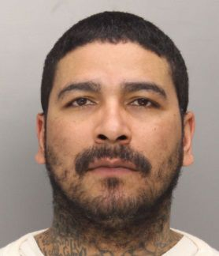
Vignette: Ricardo Cruiz, convicted at 1993 at 14 to JLWOP Resentenced to 25 years to life in Sep 2017 (released in December 17)

Slide 11
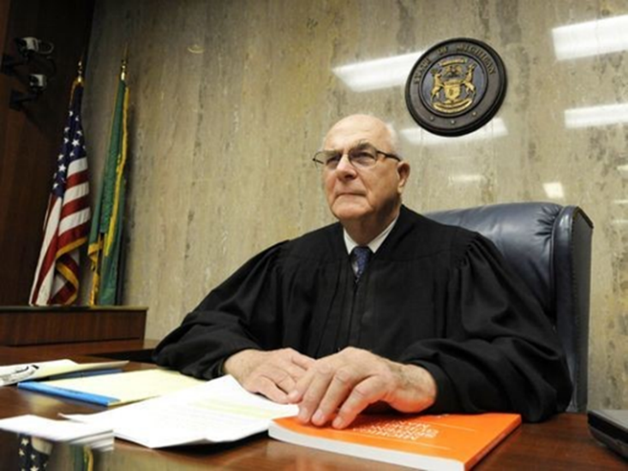
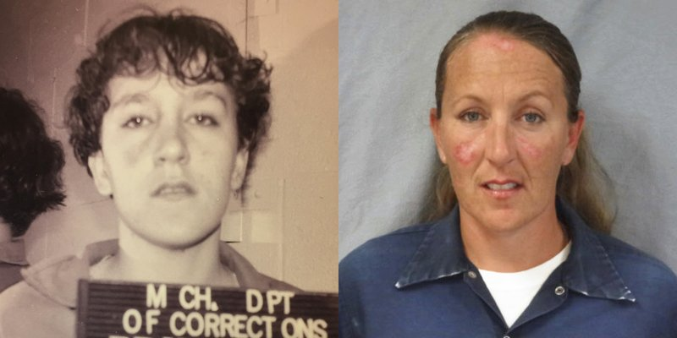
Vignette: Jennifer Pruitt, sentenced to JLWOP in 1992, resentenced in 2016 to 30 -60 years – eligible for parole in 2022
Judge Fred Mester in Waterford, Mich. In a 2016 letter submitted for the resentencing of Jennifer Pruitt’ "As a former judge, I was always hopeful that those who were sentenced before me would take advantage of all the programs offered to rehabilitate inmates. Ms. Pruitt has done just that and more, and I am not sure what more we can ask of her under the rulings of the Supreme Court which recognizes that children are to be given an opportunity for release upon such demonstration of rehabilitation." (Charles V. Tines/Detroit News via AP) (Photo: Charles V. Tines, AP)

