Slide 1
First Year Revision Session
History & Politics SSLC
Julia Ostendorf
Email: Julia.ostendorf@warwick.ac.uk
Facebook: Julia Oliwa

Slide 2
Content
World Politics exam
Introduction to Politics
Some advice on the Making History project
Please speak to me after the presentation! I’m happy to answer any questions

Slide 3
Disclaimer: This Power Point is based on my personal experience as a Fourth year, I’m not a lecturer/tutor so cannot guarantee that this will help but I’m trying to show how I would approach the Politics exams

Slide 4
Grade boundaries
You are graded on 4 criteria
Comprehension: Do you understand the debate and the scholarship?, ‘some familiarity’ to pass
Analysis: Do you answer the question?, ‘very limited understanding’ to pass
Critique: Do you understand the problems/limitations of what you’re analysing?, ‘weak awareness’ to pass
Presentation: Do you use paragraphs and write an introduction, main body and conclusion? Do you use grammar/spelling correctly? ‘little awareness’ to pass
Most common reason why students fail is they don’t answer all 4 questions

Slide 5
http://www2.warwick.ac.uk/fac/soc/pais/currentstudents/undergrad/academic/ughandbook/criteria/
Class | Grade | Comprehension | Analysis | Critique | Presentation
FIRST | 81 Mid 1st | Demonstrates very good command of the subject matter including, where appropriate, methodological, technical and scholarship skills. | Presents a very focused, relevant and well-structured answer with full and accurate development of concepts/theories, and excellent use of evidence. | Understands and evaluates relevant arguments, debates and/or interpretations in a manner that demonstrates a highly developed capacity for independent thought. This may amount to an extension of existing arguments, debates and/or interpretations. | Demonstrates very good deployment of techniques of academic writing with particular reference to structure, referencing/sourcing and spelling/grammar.
 | 74 Low 1st | Demonstrates very good command of the subject matter including, where appropriate, methodological, technical and scholarship skills. | Presents a well-focused, relevant and well-structured answer with full and accurate development of concepts/theories, and excellent use of evidence. | Understands and evaluates relevant arguments, debates and/or interpretations in a manner that demonstrates a strongly developed capacity for independent thought. This may amount to an extension of existing arguments, debates and/or interpretations. | Demonstrates good command of techniques of academic writing with particular reference to structure, referencing/sourcing and spelling/grammar.
UPPER SECOND (2.1) | 68 High 2.1 | Demonstrates very good appreciation of the subject matter including, where appropriate, methodological, technical and scholarship skills. | Presents a coherent and closely-argued answer with good structure, accurate use of concepts/theories, and good use of evidence. | Understands and evaluates relevant arguments, debates and/or interpretations in a manner that demonstrates a capacity for independent thought. | Demonstrates very good use of techniques of academic writing with particular reference to structure, referencing/sourcing and spelling/grammar.
 | 65 Mid 2.1 | Demonstrates considerable appreciation of the subject matter including, where appropriate, methodological, technical and scholarship skills. | Presents a good, reasonably closely-argued answer with good structure, accurate use of concepts/theories, and good use of evidence. | Understands and evaluates relevant arguments, debates and/or interpretations in a manner that demonstrates some capacity for independent thought. | Demonstrates good use of techniques of academic writing with particular reference to structure, referencing/sourcing and spelling/grammar.
 | 62 Low 2.1 | Demonstrates good appreciation of the subject matter including, where appropriate, methodological, technical and scholarship skills. | Presents a cogent answer with good structure, accurate use of concepts/theories, and good use of evidence. | Understands and evaluates relevant arguments, debates and/or interpretations in a manner that demonstrates a limited capacity for independent thought. | Demonstrates satisfactory use of techniques of academic writing with particular reference to structure, referencing/sourcing and spelling/grammar.

Slide 6
To provide some perspective
The marking criteria explicitly state the following: ’Please note that the descriptors should be interpreted as appropriate to the year of study’. This means that no marker will expect first year students to know everything, everything is relative, Dr Marijn Nieuwenhuis said it’s not about reinventing the wheel, you are first year students ☺
Second year module Theories of International relations covers roughly the same as World Politics, but second year students are supposed to be more critical and come up with their own ideas
Third year module Critical Security Studies again goes further in discussing World Politics so remember you are a first year and the same topics will come up again in second/third year with different levels of knowledge
Just an example of what you could do in your final year: I wrote an essay applying Foucault’s biopolitics and postcolonialism to analyse the Western-centric perspective of video games

Slide 7
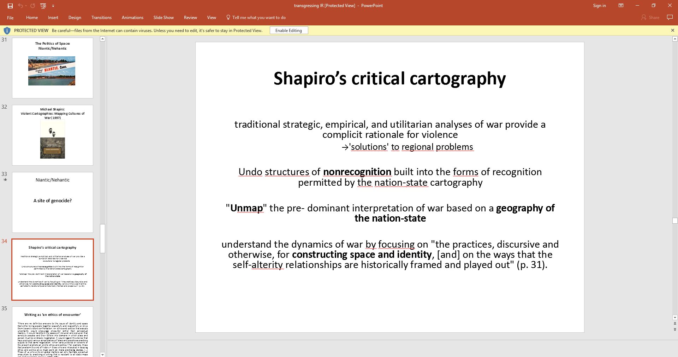
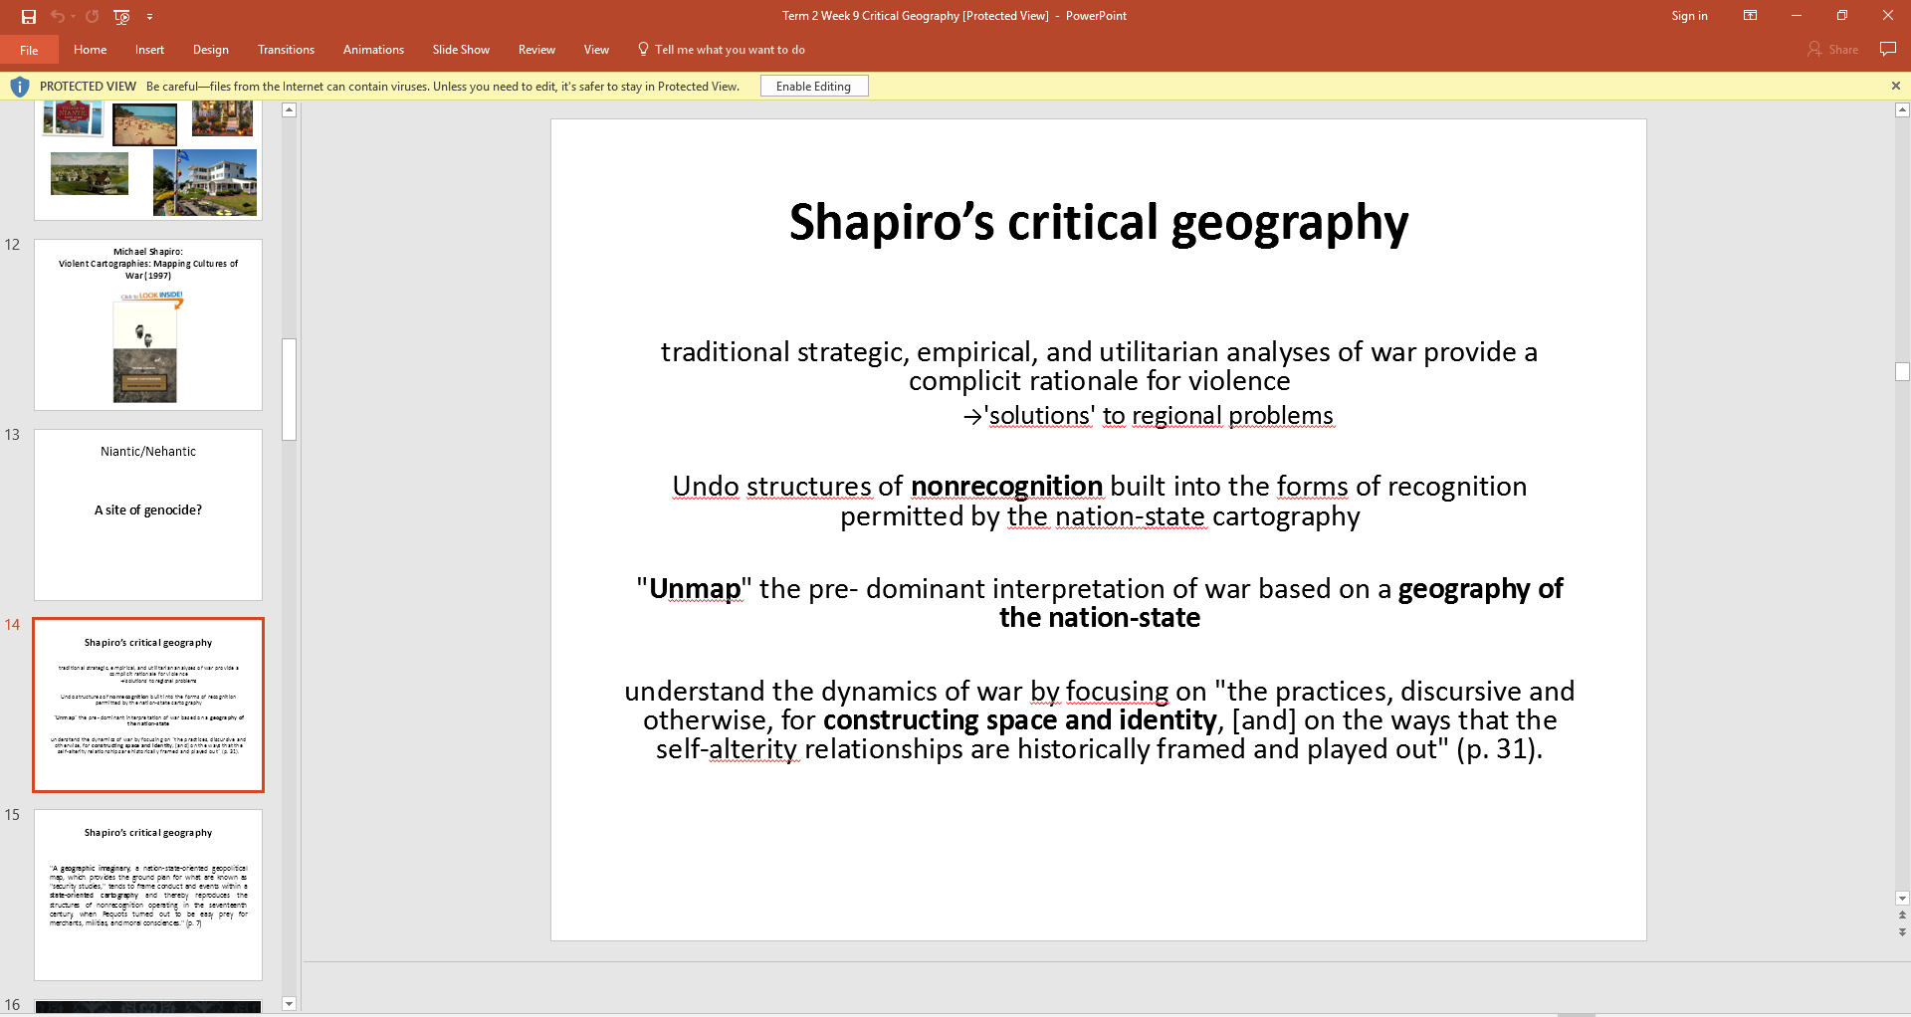
Your ‘transgressing IR lecture’
My final year module Critical Security Studies

Slide 8
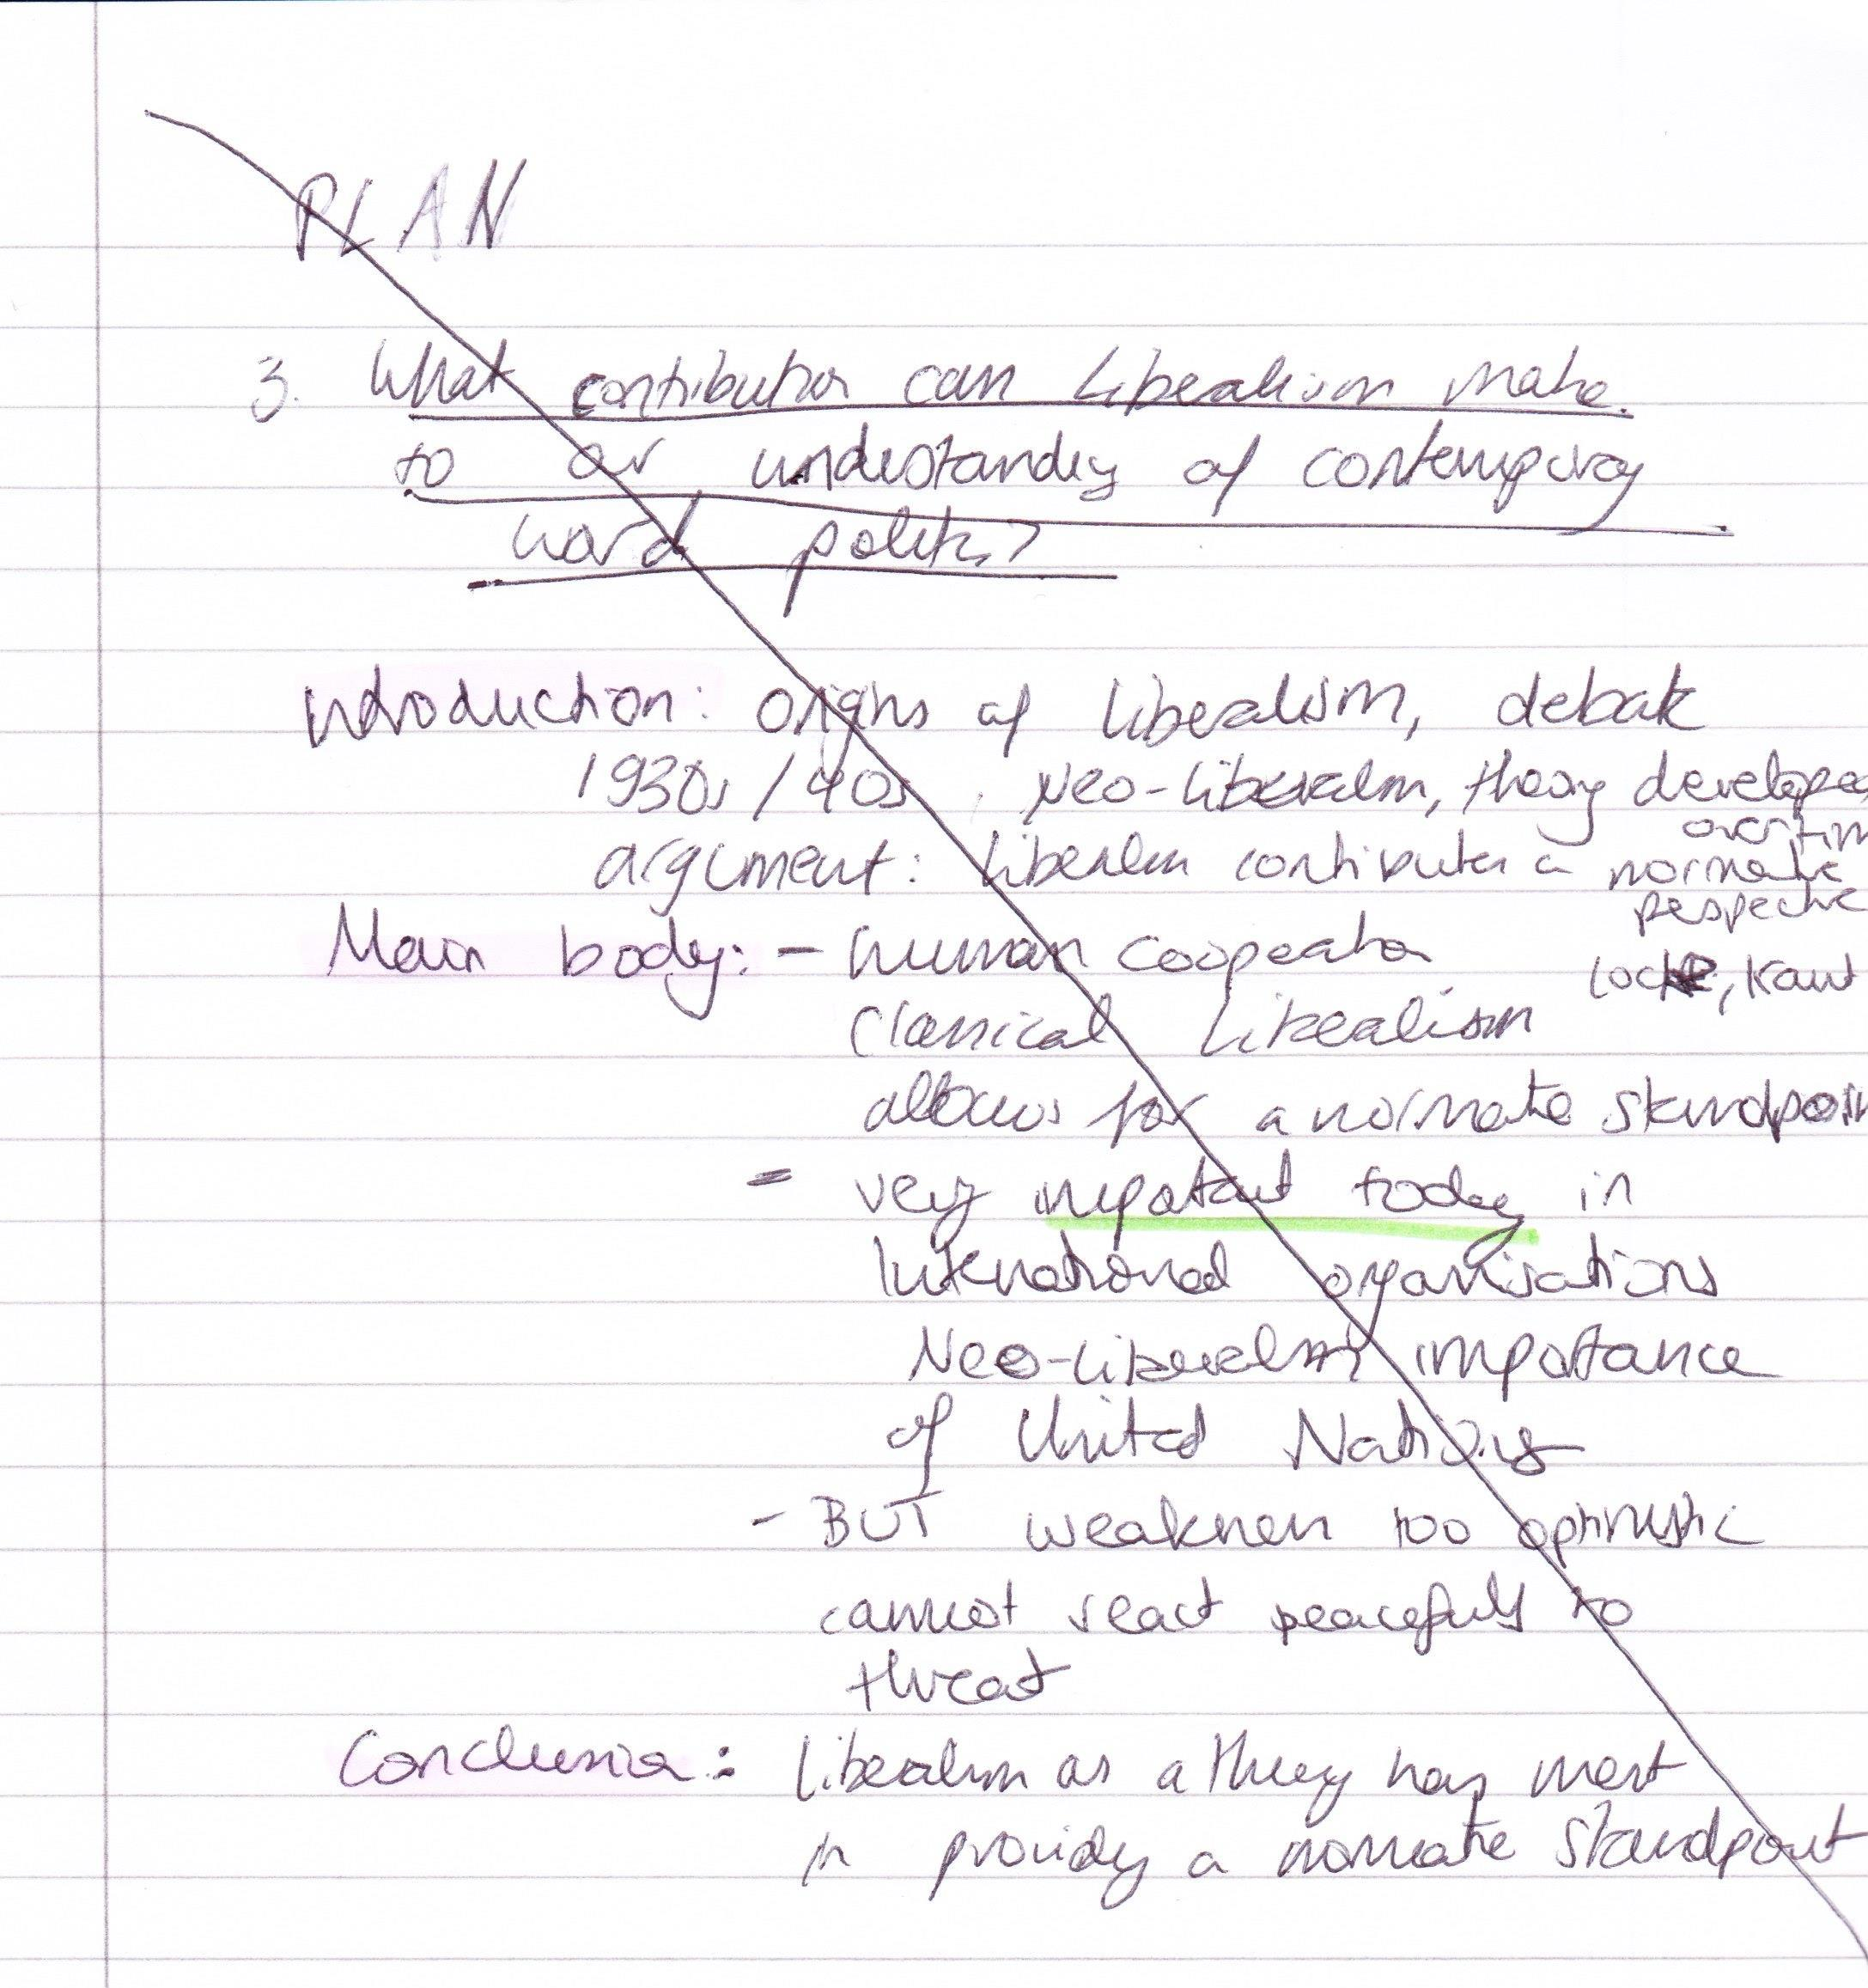
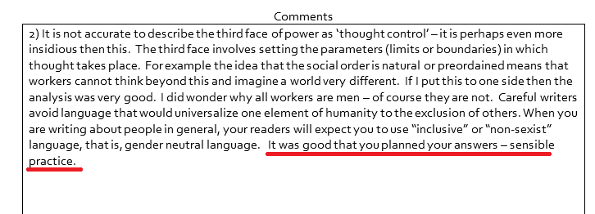
Before you start: Write/Pretend to write a plan
If you naturally write plans, great! But not every human being works the same way so if you’re a person who doesn’t usually write plans, do it anyway, the marker will see (but probably not read) the plan so just write something and add some colours if you’re feeling fancy, you don’t need to 100% stick to the plan, it’s okay to change your mind and don’t spend too much time on it (5 min max) but just write something down and label it as a plan
Remember to cross out your ‘plan’
This is the exam feedback I received for my Intro to Pol exam

Slide 9
2016/2017 Exam
I understand that Dr Marijn Nieuwenhuis said this is a new module and will have new questions
There will be no historical questions about the Cold War and nothing about nuclear weapons
I took the exam in 2014 but as I said, I’ve studied the same theories for 3 years so I know what is expected btw you don’t need to do IR for the rest of your degree, you can do political philosophy etc.!

Slide 10
World Politics: What your answer needs to contain
In the Introduction, state: This essay will argue that ………. (any variation of that sentence) No first person, no we, stick to ‘this essay’ throughout
For any theory, there is a Checklist of concepts & scholarship (See next slide) BUT there’s also specific language which you need to use
Dr Marijn Nieuwenhuis: ‘Do not call these ideologies, call them theories’
In general, (obv where appropriate) say the words ‘lens’ (This essay will apply a Marxist lens to the concept of power) ‘bridge’ (This essay will bridge the theory of Realism with the concept of environmentalism) ‘complement’ (The theory of poststructuralism will be complemented by a case study on European migration) and ‘ontology/epistemology’ (Poststructuralism applies a non-positivist ontology to the study of power and knowledge) if you don’t know the meaning of those words, don’t use them but Marjin has repeated them in nearly every lecture so there should be examples of how to use those words
Include case studies/examples (Paris climate accord 2015, Brexit, Marie Le Pen, Women’s March DC., Trump’s visit to Saudi Arabia etc.)

Slide 11
Checklist
Theory | Context in IR debate | Concept | Scholar
Realism | WW2 | war/conflict, military, sovereign nation states, human nature, anarchy, perpetual fear, self-help | Morgenthau Carr
Neorealism | Nuclear contest in Cold War | Scientific, positivist method, states as rational actors, international structure | Mearsheimer Waltz
Liberalism | WW1 | cooperative human nature, normative framework, positive sum | Wilson, Smith, Locke
Neoliberalism | 1980s/Cold War | Economy, International Organisations, international society, cooperation, liberal democratic principles, free market capitalism, privatisation | Fukuyama, Doyle Friedman Keohane
Marxism | 19th century | Economics, capitalism, worker, bourgeoisie, class, relations of production, consciousness, contradictions, materialist conceptualization of history | Marx, Engels
Critical Theory | Interwar (difficult to specify) | Cultural hegemony/base and superstructure Development/dependency/ World Systems theory | Gramsci, Cox Wallerstein
Postcolonialism | 1950s onwards/Cold War | Race, Historical approach, Self-Other, Orientalism, close to humanities | Said, Fanon, Césaire
Constructivism | Post Cold War | Ideas, Norms, Identities, Imagined Community, Construction of Fear, Danger etc. | Kuhn, Wendt, Weber, Anderson, Weldes
Post-structuralism | Cold War | Deconstruction, Binaries, Power/Knowledge, Subjectivity, Governmentality, Discourse, Panopticon | Derrida, Foucault, Lyotard, Campbell
Feminism | Different waves | ‘add women and stir’ (liberal), economic inequality (Marxism) etc. | Enloe, Butler, Sylvester, Tickner

Slide 12
How not to be descriptive/how to be analytical
Answer the question. It’s as easy as saying ‘this essay will argue that the theory xyz is useful to a high extent’
One of the most important ways how to not be descriptive is presentation. You absolutely need to use paragraphs and make clear where your introduction, main body and conclusion start/end. It’s very useful to signpost and say ‘The next concept that needs analysing is’ or ‘In conclusion’ USE PARAGRAPHS it’s about presenting your knowledge, so in your plan, you can write all the names of the scholars down (vomit your knowledge on the paper) and in the actual answer you can structure it
It’s easy to just say traditional theories (Realism, Liberalism) are useless but it’s about understanding how they relate to other theories (think that all IR theories are debating each other) That’s why it’s really important to say traditional theories have merit BUT have limitations, too. In final year, you can take liberalism apart and write and entire dissertation about why Liberalism doesn’t make sense but in first year you have to ‘appreciate/respect’ the contributions of traditional theories (even better if you can explain the historical context) and then you can say whilst the xyz concept of liberalism is stimulating, there are limitations to this concept which can be complemented by xyz critical theory (so refute traditional theory with critical theory) It’s really good If you can show how a theory has contributed to IR as a whole/as a subject (Literally just state the words: ‘Realism has made a considerable contribution to IR as a whole because…’)

Slide 13
What does it mean to be critical?
Being critical means not accepting things as they are (liberal feminism says everything is good, let’s just add women and stir and nothing more, that’s why its traditional)
Being critical about gender means not accepting gender as a given, for example not saying that all women have vaginas or all men have penises and that gender cannot be changed (that’s very uncritical), instead, being critical means looking at gender as a spectrum, seeing how gender is constructed (on birth certificates) and how we can dismantle gender (for example by not shouting at men who wear lipstick or wear skirts, and stopping femmephobia and taking sexual assault seriously)
Being critical about development means not accepting poverty as a given (don’t just think poor people don’t work hard enough!) but instead look at the relationship between capitalism, postcolonialism, gender and development, ie. women are most hit by austerity measures, austerity is a political choice not natural, or a necessity and examine how active measures such as a higher living wage, corporate tax etc. can help eradicate poverty and analyse how the West continuously exploits ‘underdeveloped/Third World’ countries (see this report: https://www.theguardian.com/global-development/2017/may/24/world-is-plundering-africa-wealth-billions-of-dollars-a-year)

Slide 14
How to answer a question from Term 1
Questions on theory (can be both traditional and critical) [again 2016/17 will be new questions but its still the same theories]
What contribution can Liberalism make to our understanding of contemporary world politics? – 2014/15 or What are the strengths and weaknesses of Classical Realism? – 2013/14 What contribution can Marxism make to our understanding of contemporary world politics? – 2013/14

Slide 15
How would you answer a question on the contributions of Liberalism to world politics? (not a test, I just want to show how you probably already know the answer)

Slide 16
How I would answer the question:
Introduction: Discuss the context in which Liberalism arose (WW1, Wilson) then link this to your argument: This essay will argue that the concept of a cooperative human nature is the most important contribution of Liberalism to World Politics, however, this essay will also discuss the limitations of this contribution
Main Body: Start off by discussing human nature as Locke and Kant understood it and say how this shaped Classical Liberalism, then transition into Neo-Liberalism by saying how the concept of human nature was adopted to looking at nation-states in international organizations (so away from individual human nature but still the theory has an optimistic/normative aspect) then add the case study of the United Nations doing something good in xyz country. Then you can transition into the critique by saying that the UN has a huge child sex abuse problem and how critical theory (for example postcolonialism) can challenge the concept of human nature
Conclusion: Liberalism (and the concept of human nature) has merits but one needs to be aware of its limitations

Slide 17
How to answer a question from Term 2
“What is ‘Othering’, and why is it important for understanding international politics? Provide at least one example.
“Why does terrorism receive more attention than the environment in public, but also in academic debates?” (don’t think this will come up)
Why is there no hyphen (‘-’) in postcolonialism?/ What does the post in postcolonialism stand for?

Slide 18
How would you answer a question on ‘Othering’?

Slide 19
You and the Other
No previous questions – but look where it’s positioned in the syllabus: after Foucault and Derrida!
Identity politics – class, race, gender
About definitions and creating differences, ie. the ‘terrorist’
How I would answer the question “What is ‘Othering’, and why is it important for understanding international politics? Provide at least one example.
Introduction: State that there are many different applications of the concept of ‘Othering’ (can mention Huntington ‘essentialising’ as an example, whichever you remember) This essay will focus on ‘Othering’ in the context of gender (note, you can replace this with any identity)
Main body: Outline/Define ‘Othering’, it is about identity-making, state that identities cannot be taken for granted as static/fixed but need to be critically examined, in this case, by looking at gender
In the case of gender, ‘othering’ creates a binary of genders which is assigned at birth → Judith Butler; case study: Bathroom Bills
Conclusion: ‘Othering’ is a versatile and important concept in international politics as it provides a critical examination of identities that are usually taken for granted, especially in binary genders of ‘men’ and ‘women’ (other answers can also talk about migration!)

Slide 20
Terrorism
About definitions! Who has the authority to define terrorism?
Also a question about security
How I would answer the question: How can a rise in terrorism be explained in international politics? (I made that question up)
Introduction: State that terrorism is not easily definable, also say that rise implies it is more now than it was before (is that really true?), and state that this essay will apply a neoliberal lens to terrorism
Main Body: Look at the Neoliberal approach to terrorism (rule of law, democracy, International Organizations) How do Liberal states define terrorism, how is that definition problematic? Neoliberalism is Western centric (mention postcolonialism) and projects ideals of Western superiority → Liberal Colonialism, can bring in ‘State and Territory’ or ‘Geopolitics’ topic of how non-Western states are seen as illegitimate Case study: Bush says we need to fight the war on terror to defend democracy, ulterior motives, US hegemony, foreign interventions/ can also look how Blair justified the invasion of Iraq based on made up ‘evidence’
Conclusion: Looking at Terrorism through a neoliberal lens can reveal how terrorism is a reaction to the aggressive foreign policy of liberal states (alternative answers can be about ‘Othering’, gender, race etc. etc.)

Slide 21
Space (includes State and Territory, Geopolitics and Migration)
Apply ‘Othering’, Geopolitics, State and Territory
What can migration tell us about world politics? (again, I made this question up) or What can the concept of space contribute to IR (in this case say defining ‘space’ is at central to answering the question)
Postcolonial approach, show how realist perception of a static nation state does not account for migration, add geopolitics (Classical vs. Critical): many nation-states were made up by colonial powers, how can we speak of migration if the concept of statehood and nationality are made up? Maps cannot be taken for granted but are always constructed, this also questions which states are seen as legitimate and illegitimate (also ties in with neoliberalism)
Trick question ahead: Is the narrative on the emergence of the modern state Eurocentric? If so, is this problematic?

Slide 22
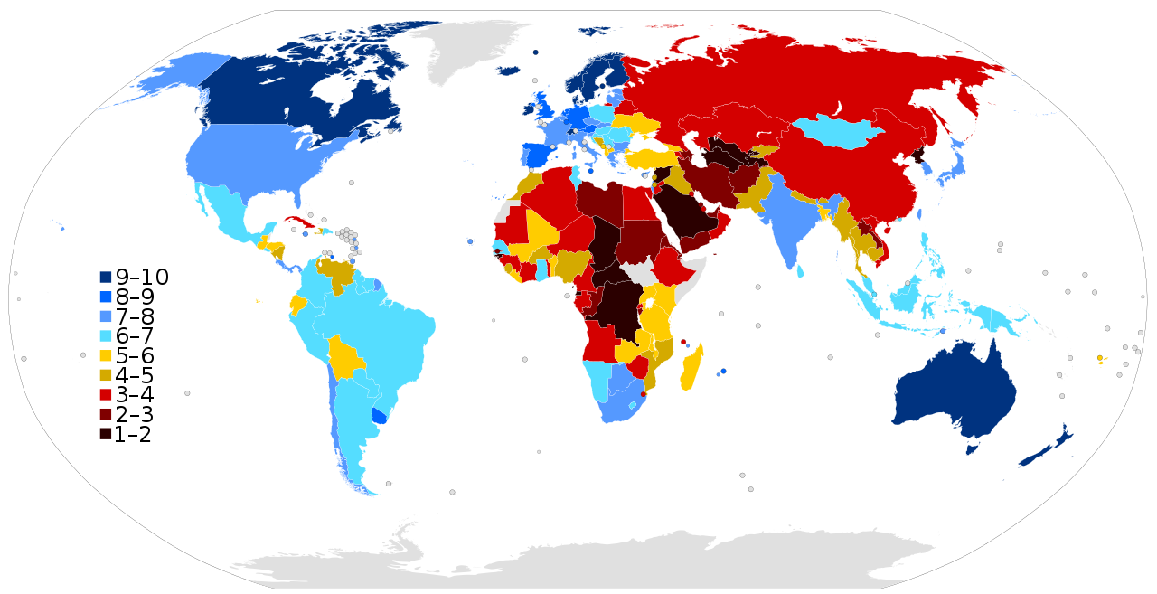
Geopolitics
There is a lot of ways to bring geopolitics into your argument, for example when you discuss neoliberalism and democratization/ the spread of liberal values, you could look at maps which mark continents such as South America, Africa and Asia as ‘undemocratic’ so this also ties to postcolonialism

Slide 23
Bad questions
Did colonialism hamper or encourage development? – 2012/13
There is no way you can write that colonialism encouraged development without being racist
Is the narrative on the emergence of the modern state Eurocentric? If so, is this problematic? (seminar question)
- >Exams aren’t perfect and it can happen that a question cannot be answered but there should be enough choice to avoid the question

Slide 24
What happens if you run out of time?
Dr Marijn Nieuwenhuis: ‘Never run out of time’
Okay, but if you sit in the exam and you realise you spent like 1 hour on one question and now you need to write 3 questions in 2 hours
Focus on completing essays, so its better to write a 4 average essays with conclusions than 3 good answers and one doesn’t have a conclusion
It’s okay to have worse answers, they all weigh equally

Slide 25
Intro to Pol
Why might one be powerful or powerless and not recognise the fact? (65)
It is not accurate to describe the third face of power as ‘thought control’ – it is perhaps even more insidious then this. The third face involves setting the parameters (limits or boundaries) in which thought takes place. For example the idea that the social order is natural or preordained means that workers cannot think beyond this and imagine a world very different. If I put this to one side then the analysis was very good. I did wonder why all workers are men – of course they are not. Careful writers avoid language that would universalize one element of humanity to the exclusion of others. When you are writing about people in general, your readers will expect you to use “inclusive” or “non-sexist” language, that is, gender neutral language. It was good that you planned your answers – sensible practice.

Slide 26
Making History Project
If you are struggling to find a primary source (you need 3), try these:
https://www.cartoons.ac.uk/ (British Cartoon Website, put in any keyword)
http://player.bfi.org.uk/search/ (British Film Institute, again search for keywords)
http://www.britishnewspaperarchive.co.uk/ (British Newspaper Archive)
https://historicengland.org.uk/images-books/photos/ (Historic England, for photos)
http://mrc-catalogue.warwick.ac.uk/ (Modern Records centre, it’s worth a try!)
Remember to 1) explain the historical context of the source 2) analyse the discourse (explain the terms, message) 3) consider the source itself as a historical fact (can it be edited, what were the reactions) 4) Explain how the source fits into understanding of wider historical events

Slide 27
Making History Project
Worst case scenario you have nothing yet, what do you do?
For inspiration, go on the module website (http://www2.warwick.ac.uk/fac/arts/history/students/modules/ug-year-2)
Look at Second Year and Final Year modules, choose a module that sounds interesting and look at which primary sources they use, for example the Cultural History of the NHS has primary sources each week (especially final year Special Subjects have lots of primary sources)
For example, if you literally have nothing you could look at

Slide 28
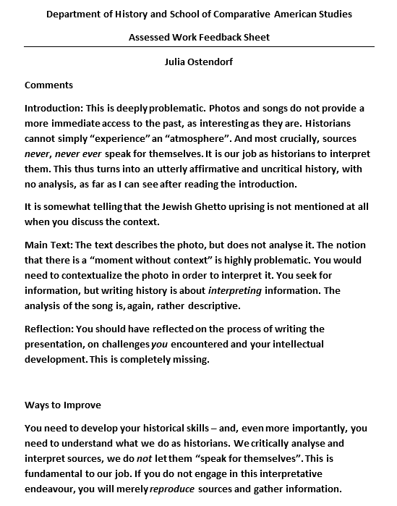
Making History Project
Please don’t take your feedback/grade too seriously

Slide 29
General note on Academia
Warwick PAIS always likes to encourage students to think ‘critically’ and ‘challenge the status quo’, ‘think outside the box’ etc. Students get firsts for being critical – but only in the way Warwick wants them to be.
If you start to challenge Warwick (the institution) itself, it will fight back to defend the status quo.
People of Colour at Warwick Uni are less likely to get a first and more likely to get a 2:2 than white students. When People of Colour challenge the racism of seminar tutors or modules, they are punished, not rewarded with a good grade for being ‘critical’.
For example, how can Warwick grade students on the question ‘Did colonialism hamper or encourage development? – 2012/13’ Academia is not outside of racism, sexism, queerphobia, ableism etc. and the idea that people at university are smarter than say ‘uneducated’, working class people is not true

Slide 30
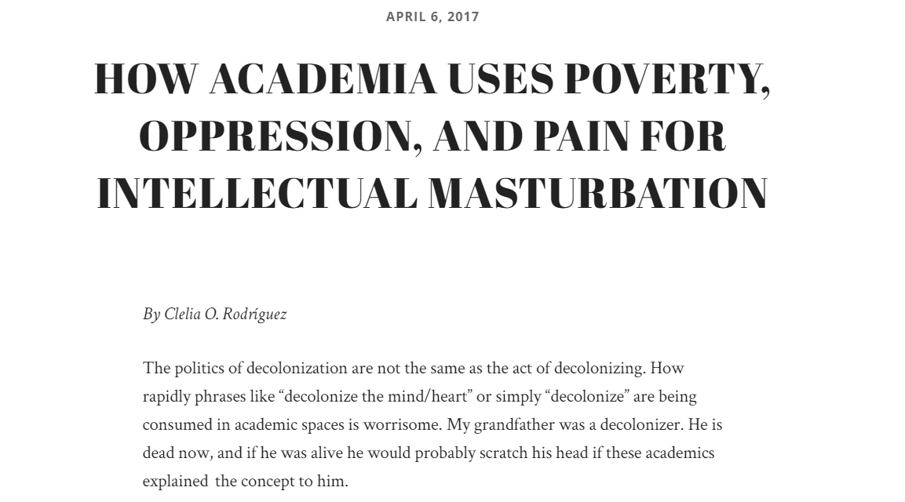

Slide 31
General note on Academia II and neoliberalism
It’s all fun and games when Marijn wants you to critically analyse neoliberalism but don’t forget we’re literally paying £9,000 (and more in the next few years) to be assigned a grade so we can prove we’re employable – it doesn’t have to be this way, if you actually want to think critically IRL, don’t think that the current system cannot be changed
At Warwick, students are treated like customers and all the things Warwick tells you are impossible (transferring to a different degree after your first year, getting deadline extensions, receiving more support) ARE possible but you need to fight for them, there’s academics and then there’s ‘men in suits’ who run the profitability of Warwick and those are the ones you need to convince
My friend in Germany told me how she was struggling with her dissertation and exams and then simply said: ‘It’s okay because I’ll just add another term for more time’, Germany provides free education where you can easily transfer, retake and prolong your degree
Tl;dr: Free education is possible

Slide 32
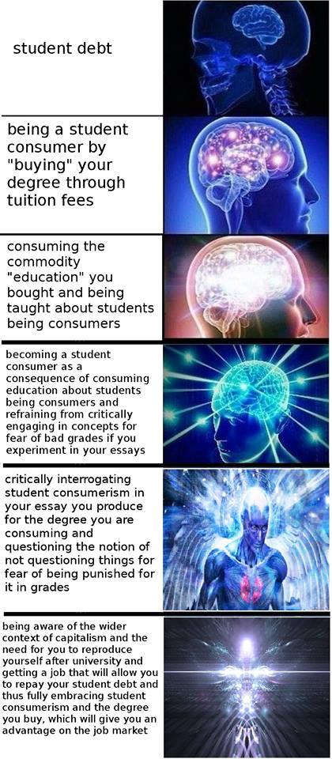

Slide 33
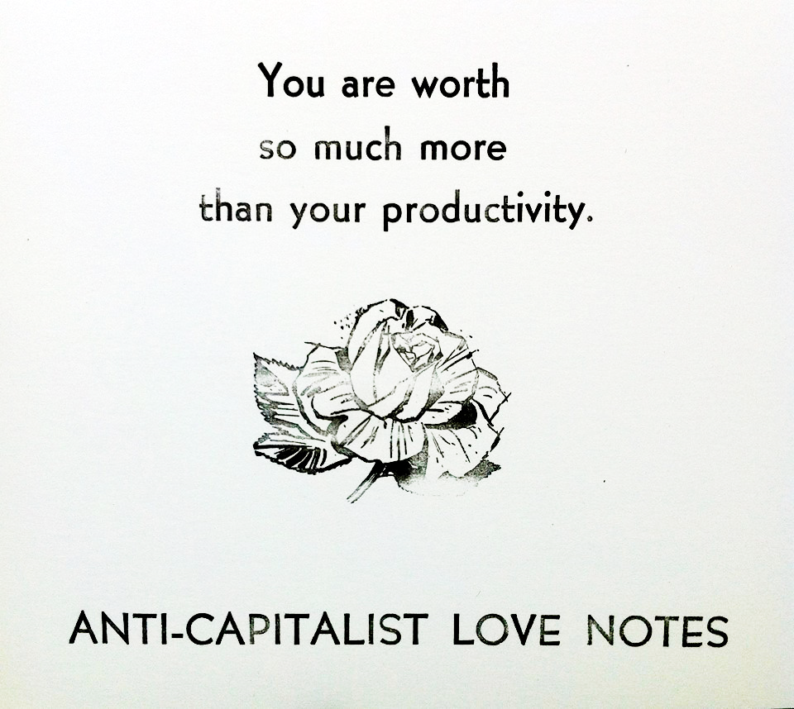
To remember
You all have worth as human beings, no one has the same experiences and thoughts as you do, so whichever grade you get, it won’t define you

Slide 34
Questions?
Drop me an email (Julia.Ostendorf@warwick.ac.uk) add me on facebook (Julia Oliwa, you might have to message me first if we don’t have mutual friends, but I’ll add you, just drop a line or say ‘hi’)

