Slide 1

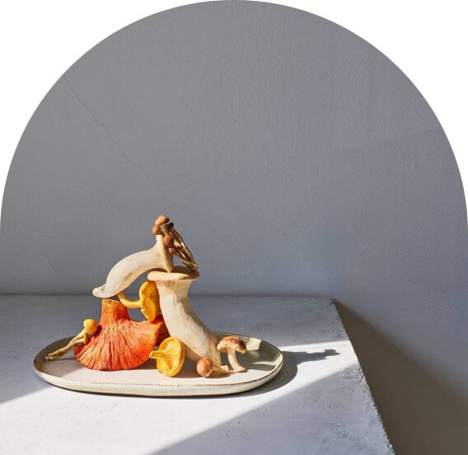
Postgraduate Research
Induction and Welcome
Dr James Poskett
Department of History
All images courtesy of the Modern Records Centre. Warwick at 60.
Notes:
Welcome
Who am I?
Who are you?

Slide 2
Warwick history: core values
We believe that every individual in our University community should be treated with dignity and respect and be part of a working and learning environment that is free from barriers, regardless of age, disability, gender reassignment, race, religion or belief, sex, sexual orientation, marriage or civil partnership and pregnancy or maternity status.
We value our diverse and international community, the pursuit and dissemination of knowledge and research with real impact. At the same time, we are committed to working towards a supportive, accessible and inclusive environment.
We uphold the importance not only of free speech, but also of promoting free speech. We also support academic freedom, a component of free speech. We place great importance on the responsible behaviour of both our students and staff at Warwick.
For more details. See ‘Values and Expectations’.
Notes:
Values
What this means in practice

Slide 3
Key contacts
Director of Postgraduate Research
  James Poskett, FAB3.50
    Email: j.poskett@warwick.ac.uk
Postgraduate History Office
  Rachel Gunn (until 19 October 2026)
  Kay Jones (from 19 October 2026 onwards)
    Email: PGHistoryOffice@warwick.ac.uk
    Phone: 024 7652 4858 (int 24858)
Director of Research
  Penny Roberts, FAB3.06
  Email: Penny.Roberts@warwick.ac.uk
Notes:
Who we are and what we do
Email in the first instance

Slide 4
GET INVOLVED
There’s lots going on in the History Department research-wise. I would highly recommend attending research seminars and reading groups and alike.
These are mainly organised through the Research Centres in the Department:
Centre for the History of Medicine, Science, and Technology
Early Modern and Eighteenth Century Centre
Global History and Culture Centre
European Research Centre
Centre for Global Jewish Studies
Yesu Persaud Centre for Caribbean Studies
For a full list, see Centres and Research Groups.
And don’t forget, the weekly History Department Research Seminar. Highly recommended for all PGRs!
Notes:
Lots going on.
Regularly attend something—not necessarily 100% relevant to your work.
Introduce yourself to the group.
Find your home

Slide 5
Supervision and responsibilities
General principle: communicate and the the initiative.
You
Work independently to develop your project with guidance from supervisors.
Be proactive in terms of planning: travel, literature, sources, archives, ethics.
Take the initiative to request supervision meetings and training.
Deliver materials (such as drafts) on time as agreed by supervisors.
Record meetings on Tabula (or relevant system).
Supervisors
Maintain regular contact and be available for meetings.
Read materials and provide constructive feedback.
Advise on skills, ethics, and careers.
Notes:
Role of student
Role of supervisor

Slide 6

Meetings and records
Meetings with your supervisors should occur at least once a month and in person wherever possible (pro rata for part-time students).
Outside of term, or when you are away on research, these meetings can take place online or via an email exchange.
You must record these meetings on Tabula (or relevant system).
The record can be a short log, as agreed with supervisors.
Notes:
Meetings, Tabula

Slide 7
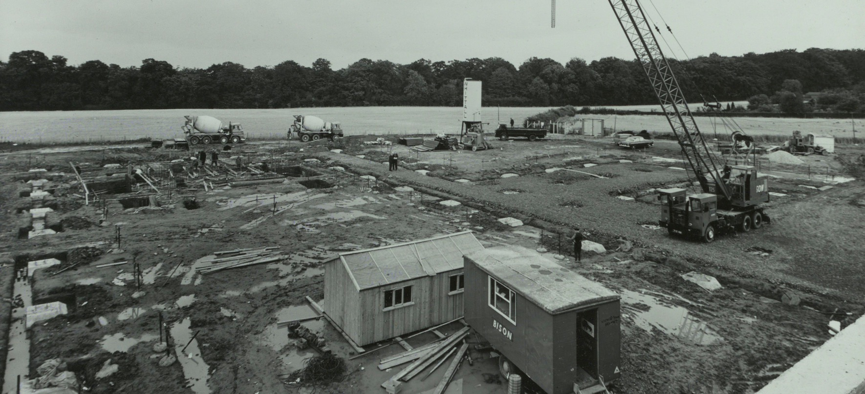
Let’s take a tour!
Notes:
Tour time!

Slide 8
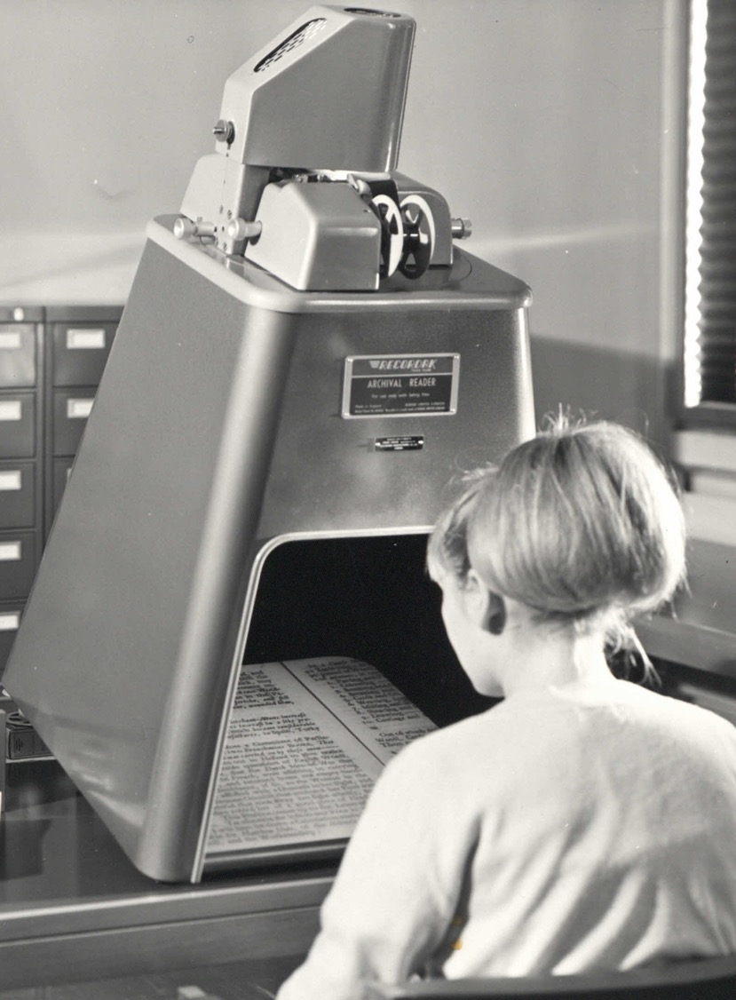
Sources of information
Be prepared for information overload. I recommend you organise your emails with rules and folders through Outlook.
Prioritise emails from:
Your supervisors
The PG History Office
The Director of PGR
Additional information
MS Teams History PGR Channel
History Student Hub
PGR Community Page
Doctoral College
Notes:
Information

Slide 9
SUPPORT and adjustments
General principle: I will endeavour to support, adapt, and advocate for your needs, including (but not limited to) health, disability, and caring responsibilities.
Additional Sources of Support
Centre for Arts Doctoral Research Excellence (CADRE)
Humanities Research Centre
Academic English Enhancement
Careers: Clare Halldron, Senior Careers Consultant (History)
Wellbeing and Student Support
Report and Support
If something is not covered, or not clear, please contact the Director of PGR or the PG History Office.
Notes:
Sources of support
WELLBEING

Slide 10
Temporary withdrawal and extensions
General principle: communicate any difficulties or changes as soon as possible so we can best support you.
Discuss with your supervisor(s) first.
Discuss with the Director of PGR and the PG History Office.
It is an online application process involving the Doctoral College.
Similar processes for extensions and transfer from part-time to full-time (and reverse).
For extensions, these will need to be accompanied by appropriate evidence.
Be aware of potential implications, for example:
  If you’re on an award, funding may stop.
  Visa implications for overseas students.
Further information is available on the Doctoral College website, but in the first instance, simply email me and your supervisors and we can guide you.
Notes:
Temporary withdrawal
Communicate wellbeing

Slide 11
FUNDING
General principle: different funders have different policies, so check in advance, keep receipts, and make all claims and bookings through the approved Warwick system.
If you are as self-funded PhD student, then you can apply for up to £350 per year (pro rata for part-time). This needs to be approved by the Director of PGR and applications are made with an online form.
For the form and additional funding guides, see Postgraduate Research Funding.

Slide 12
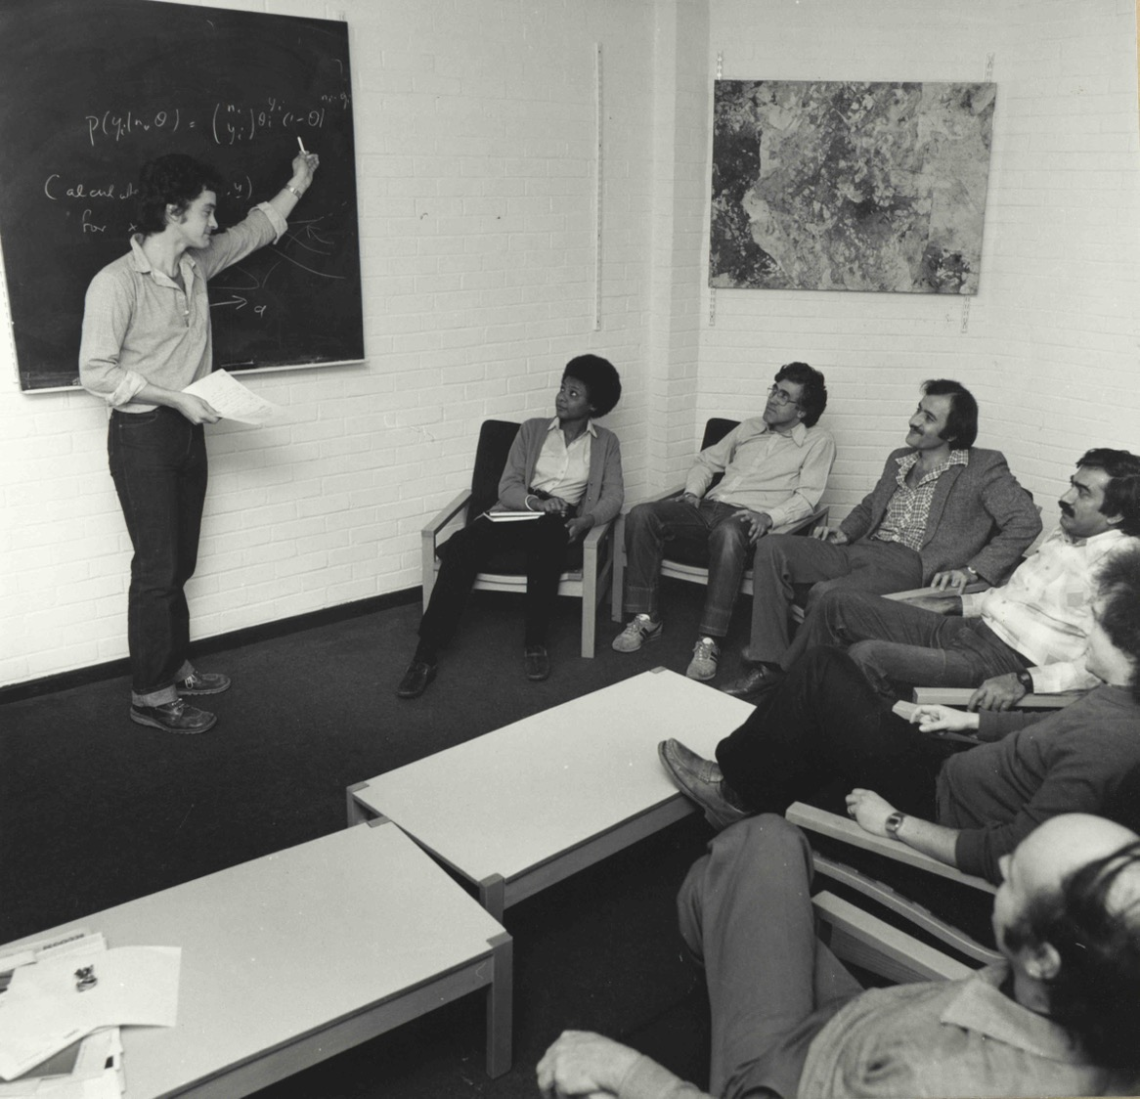
Teaching Opportunities
Graduate Teaching Assistant [GTA] positions are normally available after your first year.
PGRs can apply to teach up to two seminars a week.
There is a module run by the Learning Development Centre: Prepare to Teach.
It is compulsory for anyone wanting to teach—do this in Year One.
Teaching is run by the History Office.
We can’t guarantee teaching but do try to accommodate requests.

Slide 13
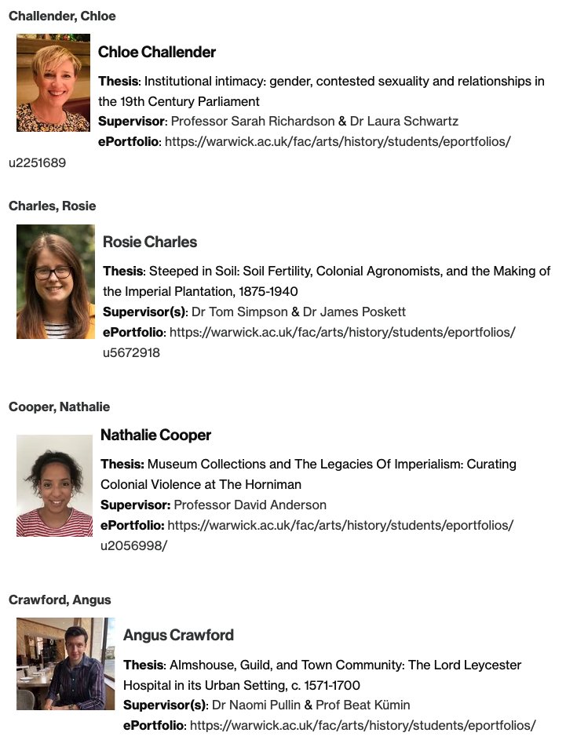
research profiles
Get added to the list of PhD students and develop your online profile.
ePortfolio Request Form
Highly recommended!
That’s it…
Notes:
https://warwick.ac.uk/fac/arts/history/students/eportfolios/

Slide 14
Research integrity
And now, time for some online training. It is compulsory to complete.
The full course of 8 core Research Integrity training modules.
Provided by a company called Epigeum, it focuses on areas such as conflict of interest, safety and health, animal research [?], and intellectual property.
PGR working with human participants additionally need to complete the respective supplementary course.
In the next Graduate Research Forum I will talk more about ethics and research design.
Notes:
Research integrity covers a range of areas - from adhering to policies, standards and protocols, through good research practice (e.g. during field work or interviews), to reporting research findings clearly and transparently.

Slide 15
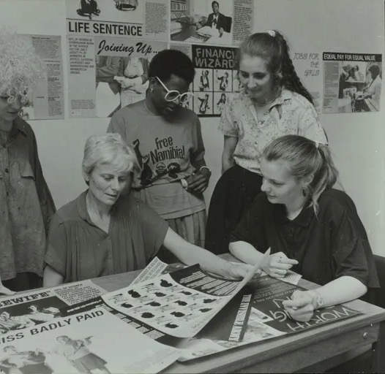
Questions?
And social…
Notes:
Questions

