Slide 1
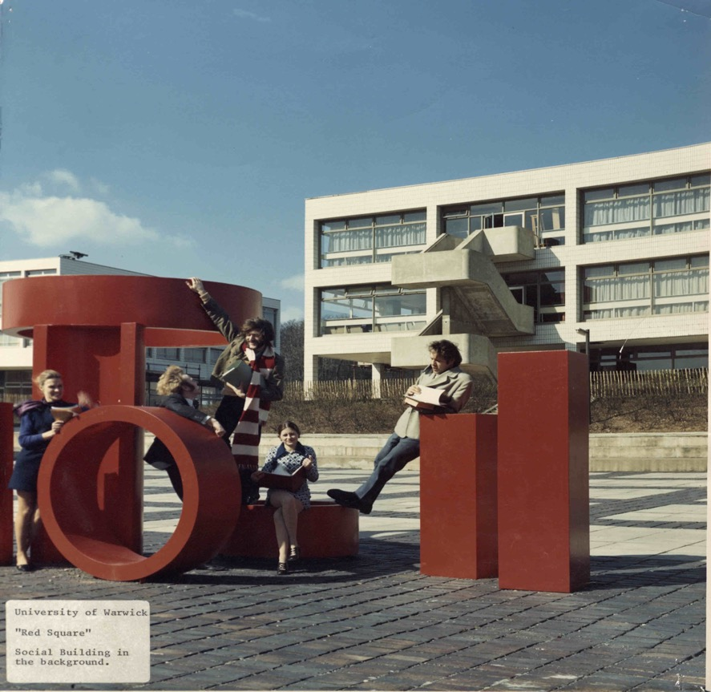
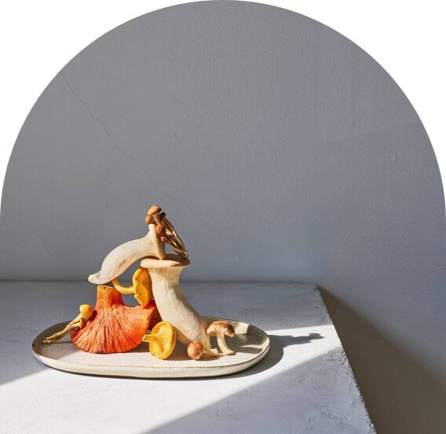
Postgraduate Research
Project Design, Upgrade, and Ethics
Dr James Poskett
Department of History
All images courtesy of the Modern Records Centre. Warwick at 60.
Notes:
Covering: project design, ethics, upgrade.

Slide 2
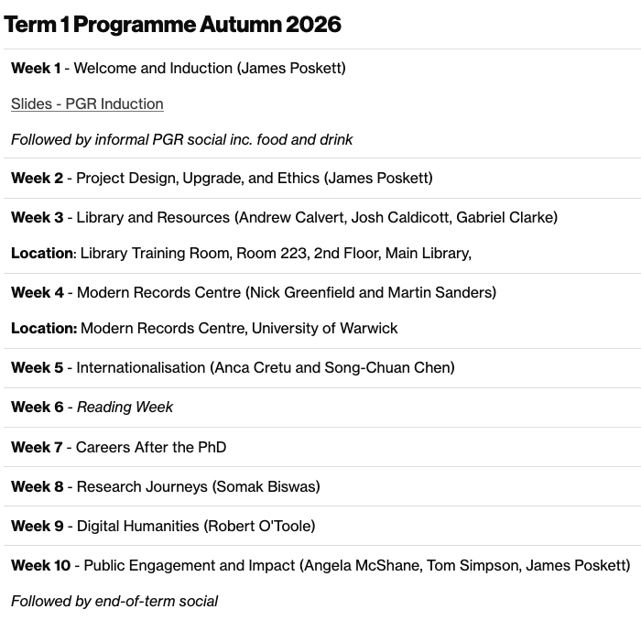
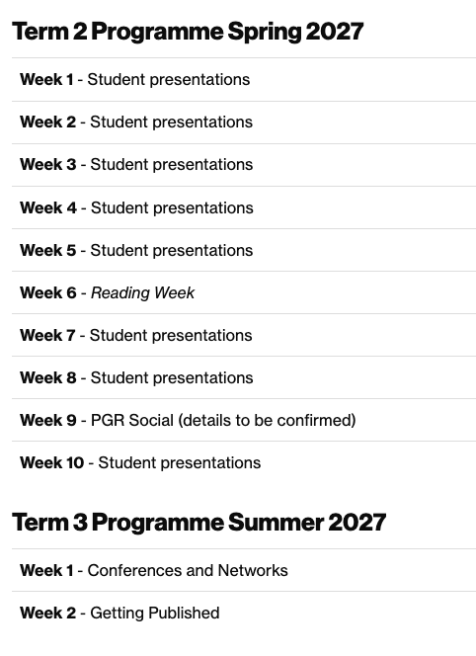
Notes:
Overview of the GRF

Slide 3
Starting at the end: what is a PhD?
The formal requirements for a PhD:
“[a] thesis shall constitute a substantial original contribution to knowledge which is, in principle, worthy of peer-reviewed publication. The thesis shall be clearly and concisely written, well argued, and shall show a satisfactory knowledge of both primary and secondary sources. In addition, it shall contain a full bibliography and, where appropriate, a description of methods and techniques used in the research.”
80,000 words (excluding appendices, footnotes, tables and bibliography)
Completion of viva voce oral examination with one internal and one external examiner.
Completion of any revisions requested by the examiners.

Slide 4
Starting at the end: look at a PhD
The best way to get a sense of what a finished PhD might look like is… to look at one!
I highly recommend at some point in the first few months taking a look at a couple of recent (UK) PhD theses in history: one related to your subfield, another not.
You do not need to read them cover-to-cover. Instead, get a sense of what a PhD thesis does, what the standard is, how it is organised and such like.
How to find PhD theses?
E-Theses Online Service (EThOS)
Warwick History PhD Theses
NB. Some theses will be ‘embargoed’ and so not accessible.

Slide 5
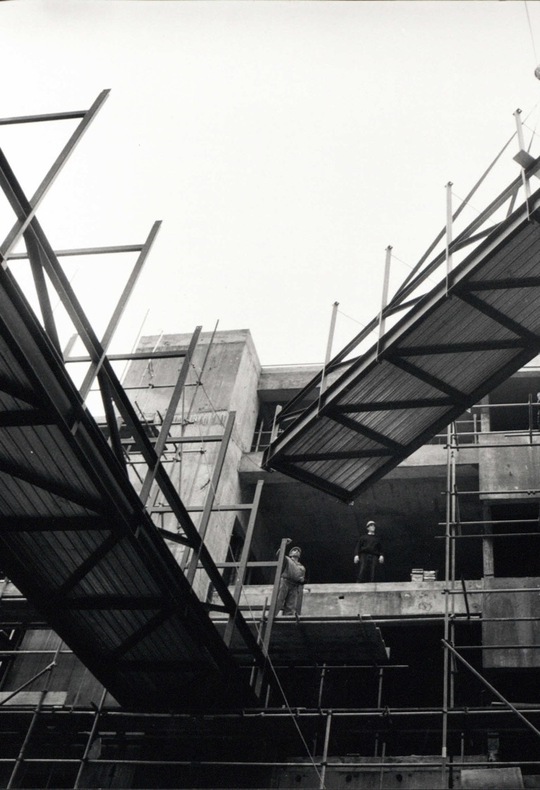
designing your project
What was your experience designing your BA or MA dissertation?
What were the key challenges?
How do you think a PhD might differ?
Discuss in pairs or on your table.

Slide 6
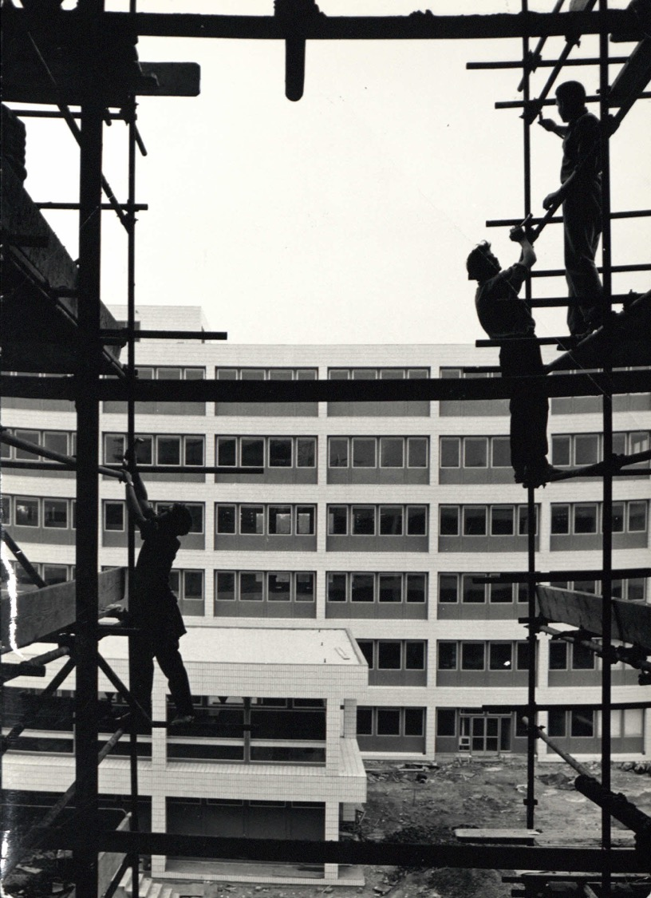
The upgrade process
Each year there is an “annual review” (usually in May).
However, at the end of the first year you will have a formal interview: the’ upgrade’.
Passing this ‘upgrade’ moves you from ‘MPhil’ to ‘PhD’ track.
Usually held in summer term of your first year
  Except for M4C students (in which case, it usually happens in February or March).
  Full details are available here: PGR Progression.

Slide 7
What do you need to submit?
For the upgrade, you should submit the following:
Draft chapter of 5,000–6,000 words in length which might either offer a literature review, or a piece of research, or a combination of the two.
2,500-word Research Proposal.
A chapter plan and timetable for completion of your thesis (max 1500 words)
History PGR Ethical Review form (which includes completion of the required University online Research Integrity Training Programme, Epigeum).

Slide 8
Research proposal
Your overall aim in pursuing this project: what do you hope to achieve?
The central research question(s) you plan to address and what kinds of answers you are anticipating.
A demonstration of your ability to situate your work within the existing scholarship and to show how your research engages with this body of studies, methodologies and ideas.
What methods, theories, or concepts you plan to use, and why.
An outline of your source-base and where you will be consulting these materials.
Could use these points as subheadings i.e. Aims, Research Questions, Historiography, Methodology, Sources, Chapter Structure.

Slide 9
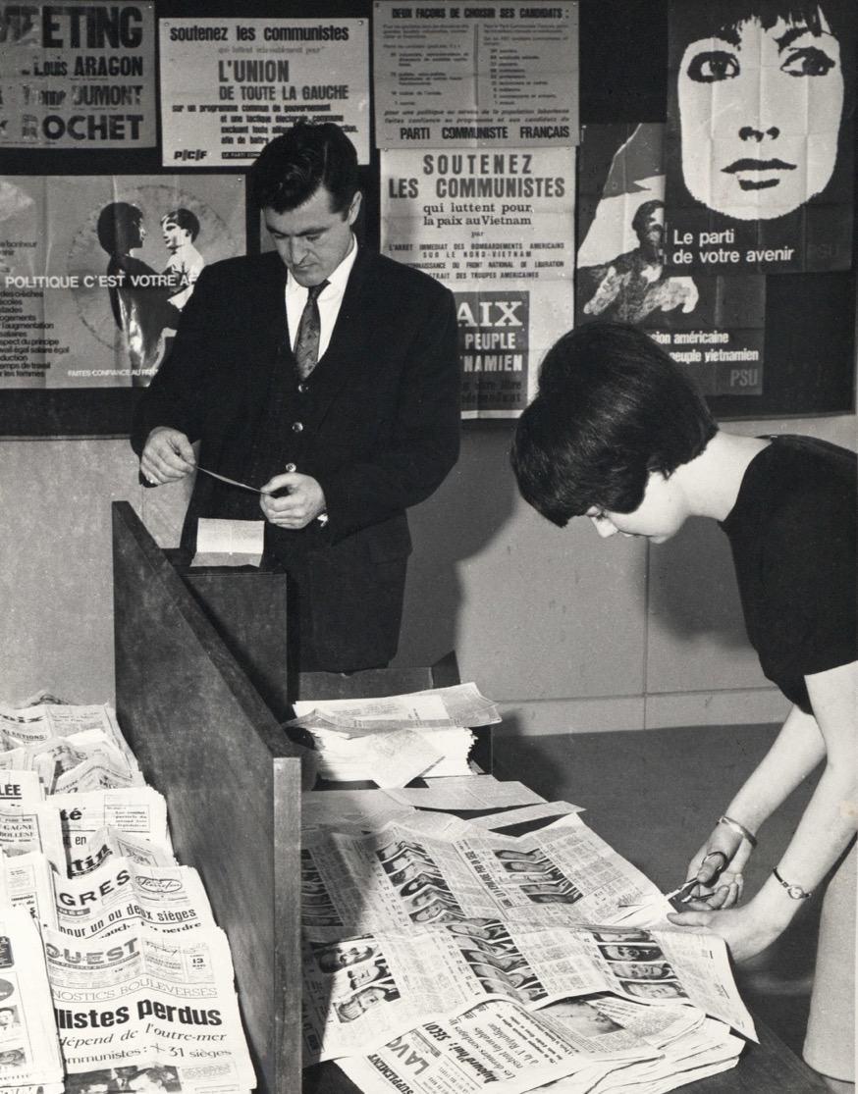
Chapter plan
Useful exercise, but no one is going to hold you to it exactly.
Shows that you have thought about the design of the project and how you will impose a sense of order and argument onto the material.
You have 80,000 words, so, with an introduction (c.10–12k) and conclusion (4–6k), this leaves scope for around 5 or 6 chapters of about 10–12k words, or 4 or 5 longer chapters.
Discuss in pairs or on your table

Slide 10
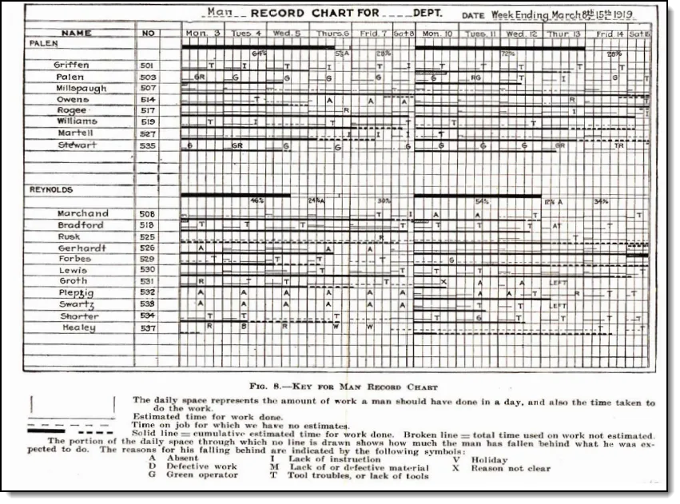
timetable
The timetable helps you plan research trips, chapter writing, publication ambitions, applications for jobs and postdocs.
Some people like to use Gantt charts, but it’s up to you.
You are expected to complete in three years and are registered for a maximum of four.
Unless there are serious mitigating circumstances, you cannot extend beyond the four years.
Wallace Clarke, The Gantt Chart: A Working Tool of Management (1923)

Slide 11
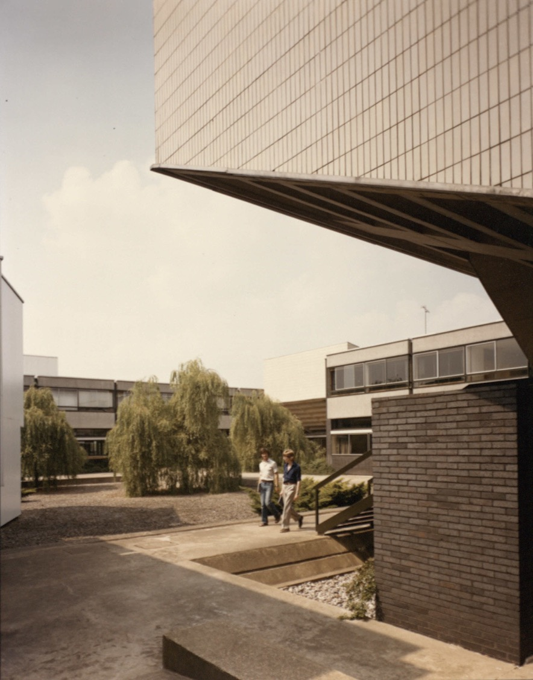
Upgrade interview
Test your ideas with two independent academics (not your supervisors).
Receive constructive feedback from informed scholars to help refine and improve your plans.
Gain experience of a ‘viva’ style of examination
Test your ability to work at doctorate level
The atmosphere is friendly and supportive but be prepared for a serious exploration of your work, which includes critical questioning

Slide 12
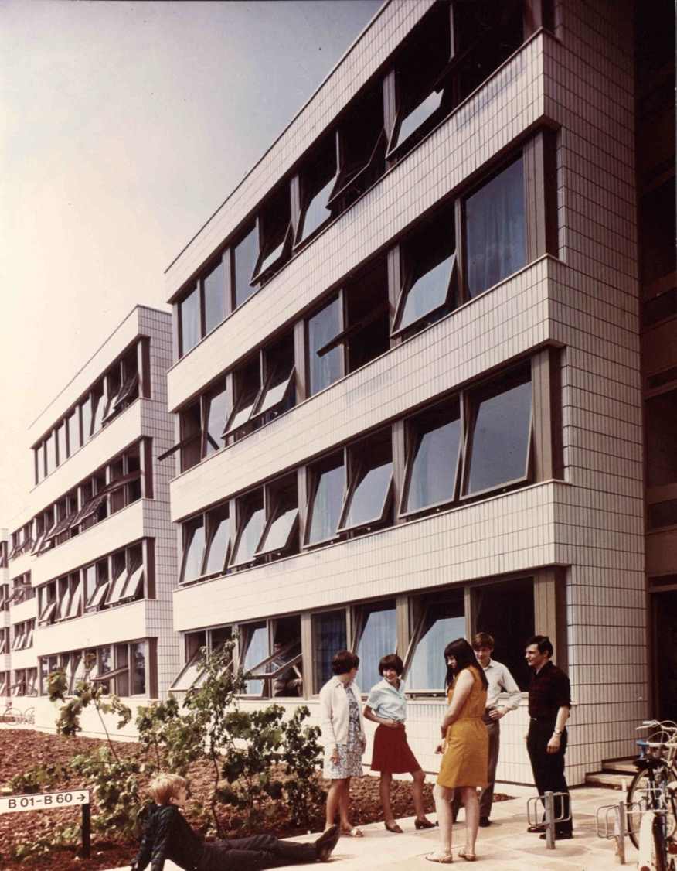
potential issues
Unclear or over-ambitious set of research questions
Vague understanding of relevant sources.
Formulaic presentation of the literature review.
Lack of (or inadequate) research methodology.
Unrealistic (chronological, regional) scope or timetable.
Some conceptual gaps or fuzzy terminology.
Usually, simply a helpful review opportunity.

Slide 13
Upgrade outcomes
In order of most to least common:
1. Upgraded to PhD registration.
2. Required to resubmit your work, or additional information, at a future date, having made any changes required in consultation with your supervisor. A second upgrade interview may be required.
3. Required to continue with your project to completion as an MPhil. Note that your expected end date would be reduced to the standard Period of Study for the MPhil course.
4. Registration as a research student will be discontinued, on the grounds that the planned project will not lead to a research degree. This option will, however, normally only be used after a resubmission and after consultation with the Director of PGR or Head of Department.

Slide 14

M4c… has its own process!
Mid-Year Review and End of Year Report: February–March 2027.
A research statement of 1500–2000 words indicating the scope of your thesis, and outlining the key research questions, research context and methodology.
A 5000-word example of your written work i.e. a short chapter or a section of discursive prose from your thesis, or equivalent output for practice-based PhDs.
For M4C award holders in year one (or part-time equivalent) requests for extended funding can be made where there is a rationale for complex.
Assessment review interview with two assessors from outside of the supervisory team. (NB this does not preclude assessors subsequently acting as internal examiners on final submission of the thesis).

Slide 15
Ethical considerations
Ethics in research
&
ethics of research

Slide 16
1. Ethics in research
Risks to you, participants and institutions. See departmental and university guidance set out on Travel, Do I need Ethical Approval and Applying for Ethics.
Everyone needs to complete an Ethics Review Form as part of the upgrade: in many cases, timely discussion with supervisors and scrutiny by panel is sufficient.
However, research in regions considered dangerous, on topics relating to national security, with sensitive questions may — and everyone working with human participants will — require external approval by the University’s Humanities & Social Sciences Research Ethics Committee (HSSREC).

Slide 17

2. Ethics of research
How to carry out your project—from inception to publication and dissemination—with integrity, transparency and honesty. For example:
Avoiding misconduct and plagiarism.
Avoiding damaging cultural heritage sites or resources.
Avoiding misrepresentation of findings.
Don’t forget to complete full epigeum course of 8 modules. In addition, if you are working with human participants (such as oral history) then complete the supplementary ‘Protecting Human Participants’ module.

Slide 18
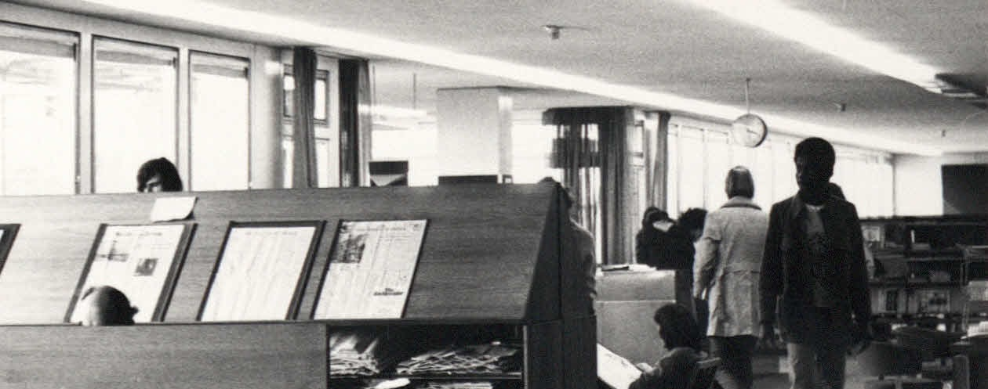
Next week: meet in the library
Library Training Room, Room 223, 2nd Floor, Main Library.
Notes:
Tour time!

Slide 19
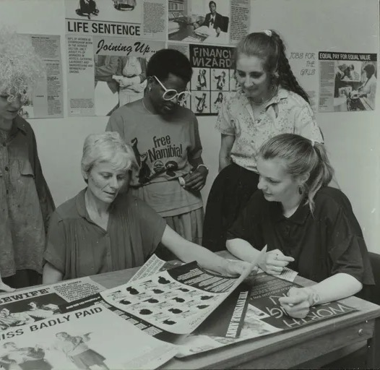
Questions?

