Slide 1

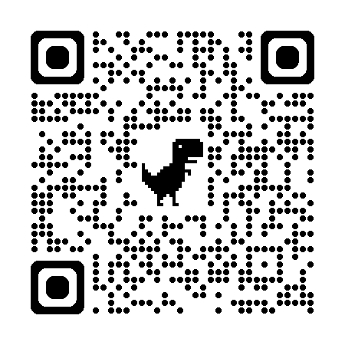
CAREERS,
EMPLOYABILITY
& SKILLS
Clare Halldron
Senior Careers Consultant c.m.halldron@warwick.ac.uk https://warwick.ac.uk/services/careers/

Slide 2
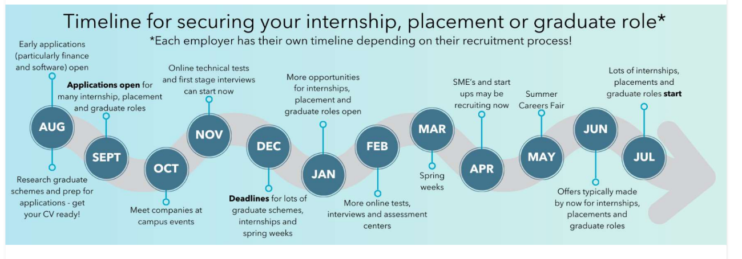
Large recruiters are advertising internships and placements now
We have online resources, advice, events and opportunities to support you at every stage of the recruitment process

Slide 3

You do not need a perfect plan
It is normal to…
What helps…
getting involved in societies, volunteering and/or departmental roles
understanding the skills you are developing
researching your options & attending events
work experience (including volunteering)
asking for advice early on- book a careers appointment
• have several ideas or none at all
• change direction
• learn by trying things
Small actions now will create more choices and opportunities after graduation
3

Slide 4
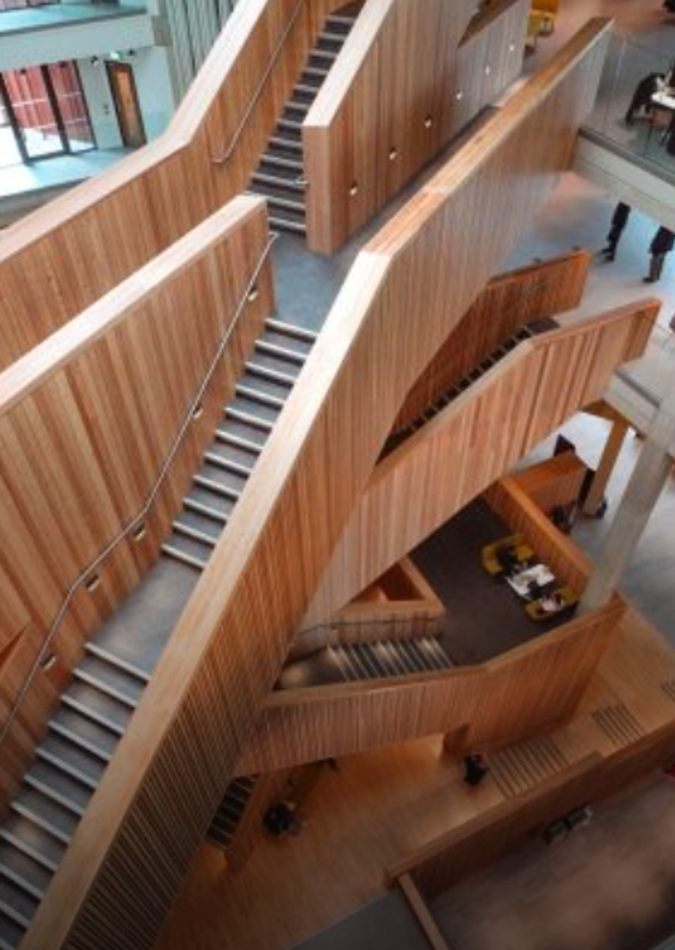
CAREERS SUPPORT AVAILABLE
CAREERS GUIDANCE & MOCK INTERVIEWS
You don’t need to have specific career ideas to book an appointment
- Online/in-person Mon- Friday- book through myAdvantage
- FAB Careers drop- inTuesdays 11 am- 1 pm FAB 1.37
IMPROVE YOUR APPLICATIONS
- Careerset- NEW RESOURCE- 24/7 CV, Cover Letter & LinkedIn feedback
- Psychometric test practice
RESEARCH CAREERS & DEVELOP EXPERIENCE
- online resources on our website (see below)
- career events
- Warwick Volunteers, TeamWork, URSS, Warwick Award- (all develop relevant skills- full details on the website)
1 to 1 careers support
myAdvantage.warwick.ac.uk
warwick.ac.uk/services/careers/
Appointments • events • vacancies

Slide 5
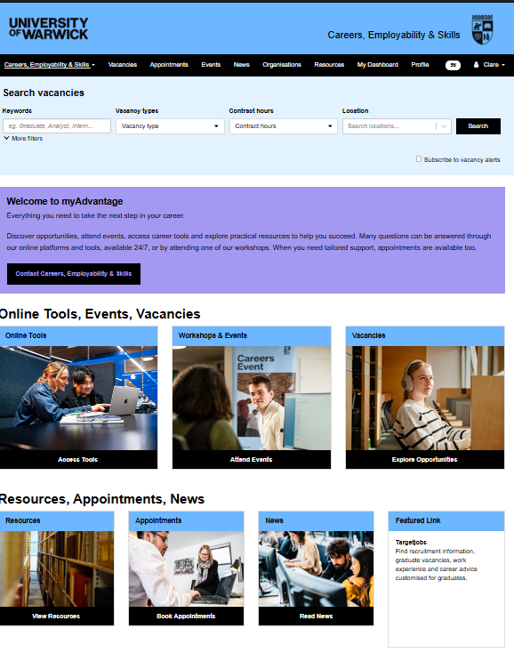
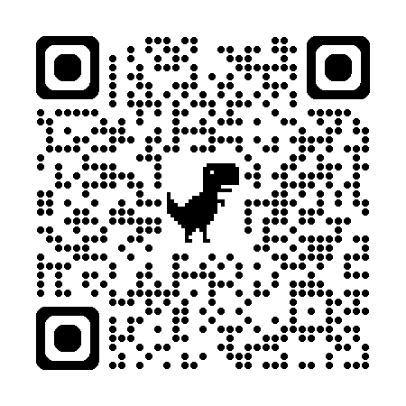
Accessing careers support
Log on to myAdvantage.warwick.ac.uk
Here you can:
Book events & workshops
Access online resources & tools
Search for vacancies
Book Careers appointments

Slide 6

SOME OF OUR UPCOMING AUTUMN EVENTS
MEET THE PROFESSIONALS (IN-PERSON & ONLINE)
Careers in the Public Sector- Mon 12th Oct- 3 pm- 5 pm
Careers in HR and Recruitment- Mon 19th Oct- 6 pm- 7.30 pm
Careers in Marketing- Tues 20th Oct- 6.15 pm- 7.45 pm
Careers with Global Brands- Tues 27th Oct- 5 pm-7.30 pm
Careers in Film & TV- Mon 2nd Nov 6.00 pm- 7.30 pm
Careers in Museums & Culture- Tues 3rd Nov 6 pm-7.30 pm
Careers in Publishing- Tues 17th November- 6.15 pm- 7.45 pm
Careers in Diplomacy TBC
7.00pm
CAREERS FAIRS (Panorama, Rootes Building)
Autumn Careers Fair- Tues 13th Oct- 11am-4pm
Economics, Finance & Consultancy- Thurs 15th Oct- 11am- 3pm
Law Fair- Weds 21st Oct- 11am- 3pm
CAREERS WORKSHOPS THROUGHOUT THE TERM. For example……
Your Application Toolkit, Breaking into the Job Market: What Every Student Should Know, TeachFirst, Internal Communications.

