Slide 1
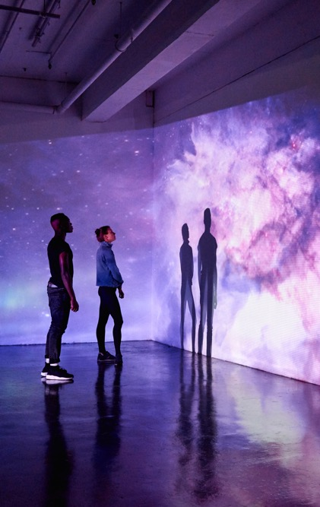
Welcome to your second year in History!
Dr Camillia Cowling (Director for Intermediate Year, History)
C.cowling@warwick.ac.uk

Slide 2
For (almost) everything, please check:
The new-look History UG Student Hub!
htps://warwick.ac.uk/fac/arts/history/students/undergraduate
For year 2 events & info, see:
Year 2 UG page: https://warwick.ac.uk/fac/arts/history/studenthub/ugcourseinformation/intermediate/
These slides will be posted there!
(Check this page for upcoming Year 2 Study Cafes!)

Slide 3
New this year…
Always bring your university card to tap in for attendance at seminars:
https://warwick.ac.uk/fac/arts/history/studenthub/attendance/
New Academic Integrity Moodle: complete by end of week 2 (this is a monitoring point)
https://warwick.ac.uk/fac/arts/history/studenthub/assessment/integrity/

Slide 4
Useful contacts
Dr Camillia Cowling: Year 2 Director of Studies
Dr Song-Chuan Chen: Senior Tutor
Dr Claire Shaw: History-based joint degrees; coordinator for Historical Research
Dr Simon Peplow & Student Voice Reps: Student Voice
Claire Halldron: Careers

Slide 5
Make wellbeing your top priority!
Prioritise your wellbeing and a healthy work-life balance
Recognise it’s not always going to be easy – and that’s normal.
Talk to your Personal Tutor! https://warwick.ac.uk/fac/arts/history/students/undergraduate/support-personaltutors
Let us know about ongoing or new difficulties as they arise – they are easier to fix if we know sooner
Get support: Wellbeing Portal: wellbeing.warwick.ac.uk
Report + Support - Report + Support - University of Warwick
The Warwick Community Respect programme:
https://warwick.ac.uk/services/wss/students/communityrespect

Slide 6
Student-Staff Liaison Committee (SSLC)
Student Voice Ambassadors (SVAs)
Student-Staff Liaison Committee (SSLC)
Student-led, vital forum for collecting feedback and ensures that
your student voice is integral to decision-making in our department!
SSLC Meetings 2026-27 (open to ALL students!):
  Term 1 – Wednesday 04/11/2026, 13:00 - 14:00 (OC1.08)
  Term 2 – Wednesday 10/02/2027, 13:00 - 14:00 (FAB5.01)
  Term 3 – Wednesday 05/05/2027, 13:00 - 14:00 (FAB5.01)
Student Voice Ambassadors (SVAs)
Paid position – gather feedback, lead SSLC,
and represent students at our departmental Education Committee.
Applications open NOW for 2026/27 SVAs, deadline Friday 9 October.
For more info, check your emails and/or email Simon.Peplow@Warwick.ac.uk

Slide 7
Personal Tutoring
Your personal tutor will:
Provide academic advice and support.
Signpost support and development resources and opportunities.
Advise on course regulations and mitigating circumstances.
Provide references.
For more on the role of the personal tutor, see https://warwick.ac.uk/fac/arts/history/students/undergraduate/support-personaltutors

Slide 8
Wellbeing Useful Contacts
Wellbeing Support Services: https://warwick.ac.uk/services/wss
Health Centre: https://www.uwhc.org.uk/
SU Advice Centre: https://www.warwicksu.com/help-support/
Chaplaincy: https://warwick.ac.uk/services/chaplaincy
Residential Life Team: https://warwick.ac.uk/services/residentiallife
Campus Security: https://warwick.ac.uk/services/campus-security (Tel: 024 7652 2222)
Report and Support: https://reportandsupport.warwick.ac.uk/
Together All https://togetherall.com/en-gb/

Slide 9
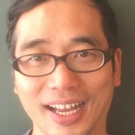
Intermediate Year Senior Tutor:
Dr Song-Chuan Chen
Role:
Overall responsibility for personal tutoring arrangements in History
Part of the History department Pastoral Team
Helping support students and signpost relevant University resources/services
Email me: S.Chen.64@warwick.ac.uk
Find me: FAB3.76 (B cluster)

Slide 10
What do Student Voice Ambassadors do?
SVAs are representatives of the History student cohort. The role can involve various responsibilities, including:
Organising and attending SSLC meetings (Staff-Student Liaison Committee)
Representing student opinion at other department committees on education and diversity
Raising issues that students have and work with staff towards finding solutions to them
Providing feedback on new department policies and modules
Notes:
These are the typical responsibilities that SVAs have, but we have also been involved in other opportunities through this role, such as:
Contributed to an article about Student Voice published in the Student Engagement in Higher Education Journal
Sat in on and provided feedback for interviews for new academic staff
Attended educational

Slide 11
What impact have they had?
Helped develop a skills training module for first-year students to help them with the transition to university
Represented student opinion during the 2022-2023 UCU strike and marking boycott
Worked to remove restrictions on referencing to avoid joint honours students having to learn and use two different styles
Advocated for further support for study abroad students
Notes:
These are the typical responsibilities that SVAs have, but we have also been involved in other opportunities through this role, such as:
Contributed to an article about Student Voice published in the Student Engagement in Higher Education Journal
Sat in on and provided feedback for interviews for new academic staff
Attended educational

Slide 12
Student Research & Engagement
Dr Tara Morton (tara.morton.1@warwick.ac.uk)
Student Research & Engagement Officer

Slide 13
History SR & E Overview
URSS Undergraduate Research Support Scheme
BCUR British Conference Undergraduate Research
ICUR International Conference of Undergraduate Research
Publications Reinvention Journal (IATL) : Rewind (student-led)
History Groups & Activities

Slide 14

URSS
Undergraduate Research Support Scheme enables undergraduate students to carry out a non-assessed, self-directed research project
Project should be between 6-10 weeks, and you will receive supervision from a Warwick academic
URSS projects are usually carried out over the summer between July and September.
You can apply for a bursary of up to £1500 to contribute to your living expenses and other associated costs whilst carrying out your project
Opens 6 October closes 6 February 2026
https://warwick.ac.uk/services/skills/urss/
https://warwick.ac.uk/fac/arts/history/urss/
Come to student showcase Wednesday 12 November 2025, 12-4pm, Panorama Suite, Rootes Building

Slide 15

BCUR (IATL)
BCUR is the largest conference in the UK dedicated exclusively to undergraduate research.
Previous conferences have seen over 500 delegates from 70 different institutions over the two days presenting their research work on a diverse range of topics.
Undergraduates of all levels are invited to submit papers, posters, workshops and performances to the conference.
Abstracts are peer-reviewed and those accepted will be invited to attend the conference.
Limited travel bursaries available
2026 University of Glasgow (April) TBC
https://warwick.ac.uk/fac/cross_fac/iatl/research/present/bcur
Let’s get History students represented!!!

Slide 16

ICUR (IATL)
Annual, two-day academic conference showcasing excellence in undergraduate research from around the world.
Unique opportunity for history students to present to interdisciplinary audiences internationally in real-time, video-linked sessions
Supports Warwick students to present their research from the Oculus, central campus, on the global stage.
A year-round programme of training and support from abstract submission through to presentation
Opportunity to network with like-minded undergraduates all over the world.
Supportive yet rigorous research experience, helping develop confidence and skills in communication, presentation, and engagement.
https://www.icurportal.com/icur-2026/
Let’s get our history students brilliant work included!!!

Slide 17

Thinking of publishing?
Reinvention
International Journal of Undergraduate Research
An established journal publishing quality peer-reviewed student research with a student led editorial bord
https://reinventionjournal.org/
Rewind
Student led
Blogs & Articles
https://www.warwickrewind.com/

Slide 18
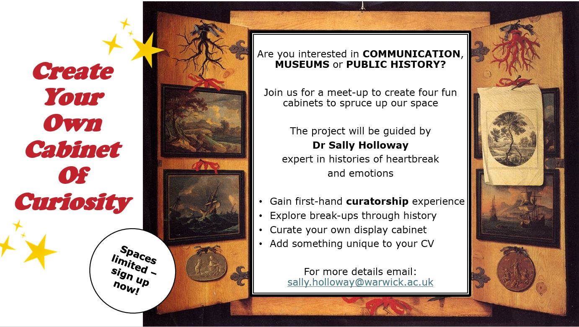


Warwick History Hour
https://warwick.ac.uk/fac/arts/history/outreach/radio1
Cabinets of Curiosity
https://warwick.ac.uk/fac/arts/history/students/research_opportunities/cabinets_of_curiosity
Warwick History Society
https://www.warwicksu.com/societies-sports/societies/historySoc/
Rewind
https://www.warwickrewind.com/

Slide 19

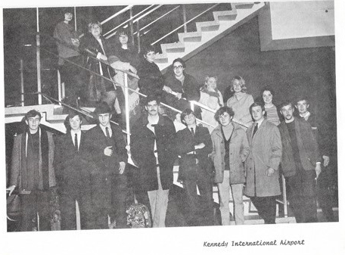
Study Abroad
Warwick History Study Abroad students, December 1968

Slide 20
Venice https://warwick.ac.uk/fac/arts/history/ students/international/veniceprogramme/
Study the history of Florence and Venice in the Renaissance while living in it, accompanied and taught by Warwick History Department staff.
Guided tours of the major monuments
of the city are a key part of the module.
If you’re planning a Venice term: bear in mind new post-Brexit Schengen rules: don’t book a long holiday in Europe over the summer before, unless you have a European passport (you can now only spend 90 days in Europe; Venice is approx. 75).

Slide 21
Year Abroad https://warwick.ac.uk/fac/arts/history/students/international/yearabroad/
All single/joint-honours (non-language) can apply.
3rd year will be Year Abroad, returning to
spend 4th final year studying at Warwick.
Eligibility: average grade of 60 (2.1) or above for
Year 2, with good attendance record (mitigating circumstances will be taken into consideration).
For full information regarding fees, finances,
and the application process, please see the university study abroad webpages!

Slide 22
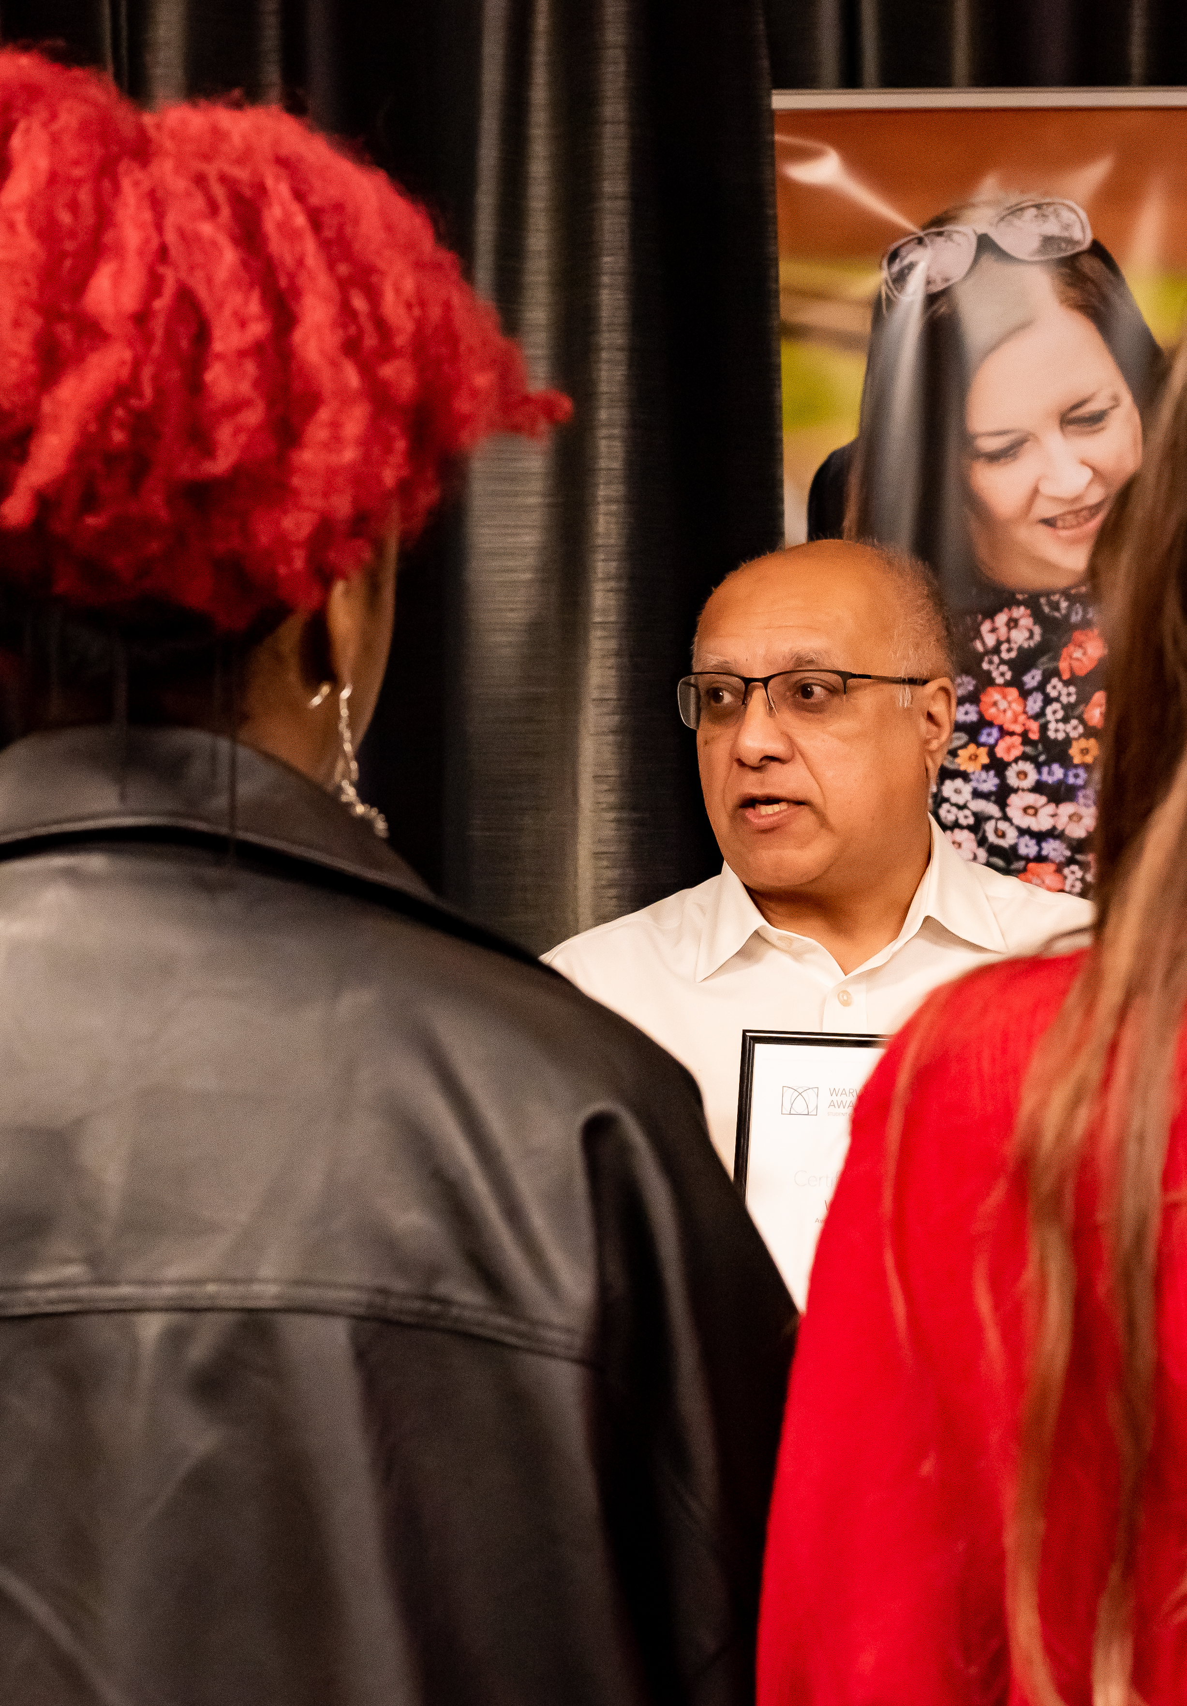

The Warwick Award,
Core Skills, and History
Dr Steven J Burke, Skills Developer
E: steven.burke@warwick.ac.uk

Slide 23
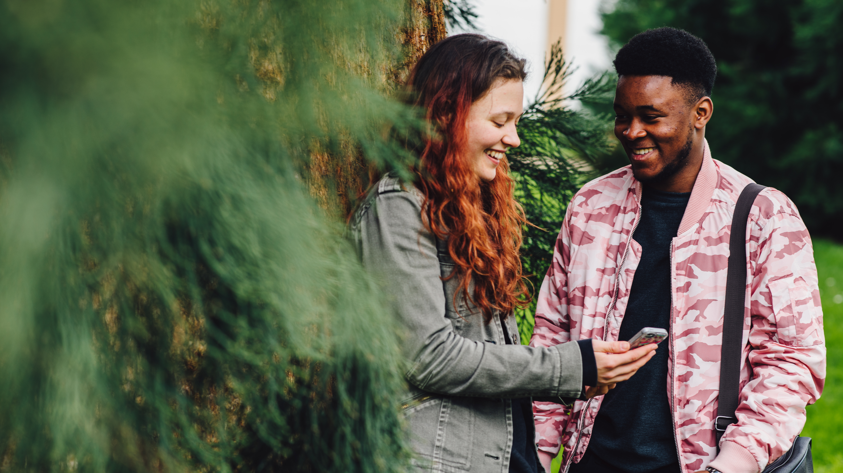

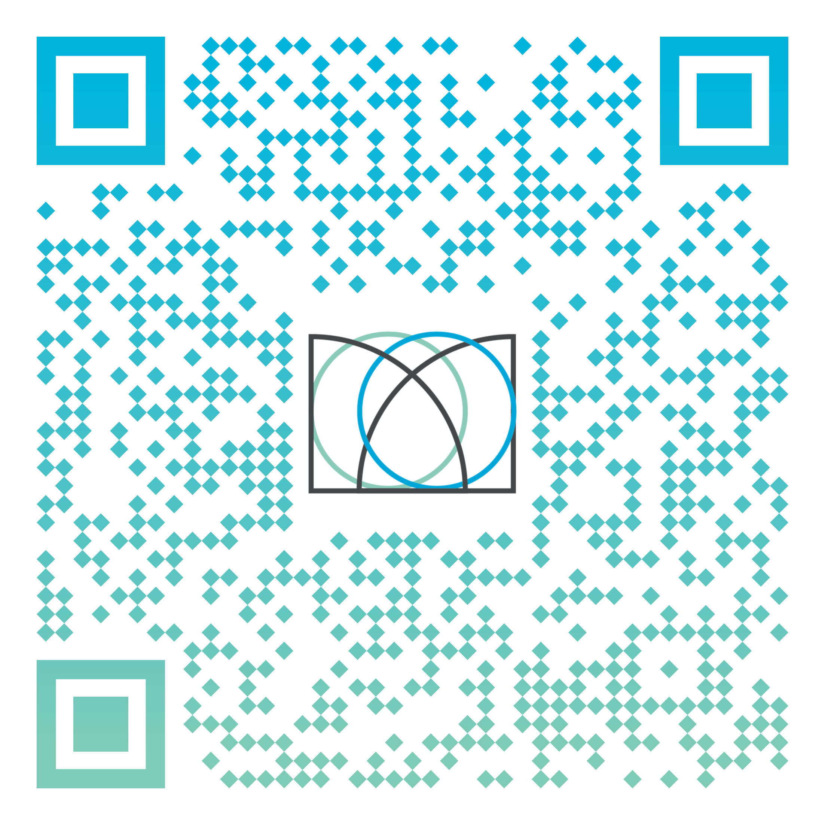
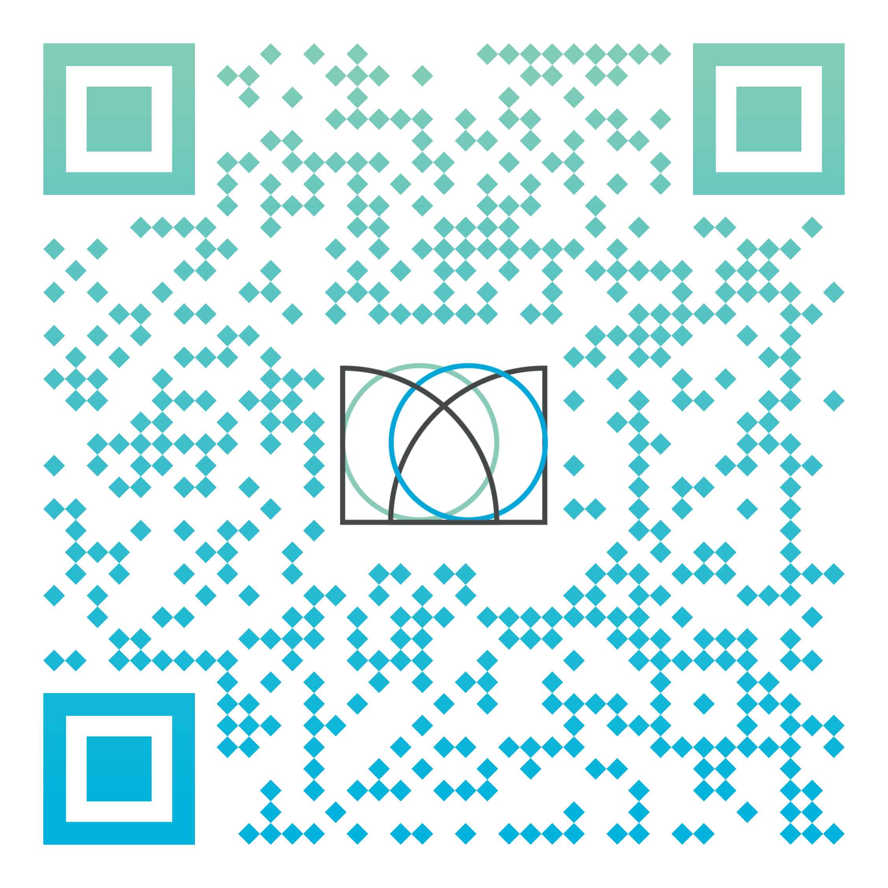
Go to the Warwick Award website to find out more about signing up
Go straight to the Gradintelligence platform to log in
Notes:
QR code takes students straight to GI - *not* our webpage

Slide 24


What is The Warwick Award?
A programme for recognising Core Skills development through your experiences while a student at Warwick
A process of reflective practice on those experiences
A portfolio of activity and reflections recorded on your personal profile that you can keep after you graduate
Evidence of transferable skills from your course, student life, and other personal experiences
A way of recording examples of skills in action for your employability, career, and personal development
An official digital certificate and digital badge from the University of Warwick, proving you have practised these skills
Gold Award
60 Core Skills Points
Silver Award
30 Core Skills Points

