Slide 1


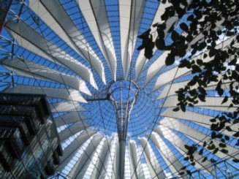
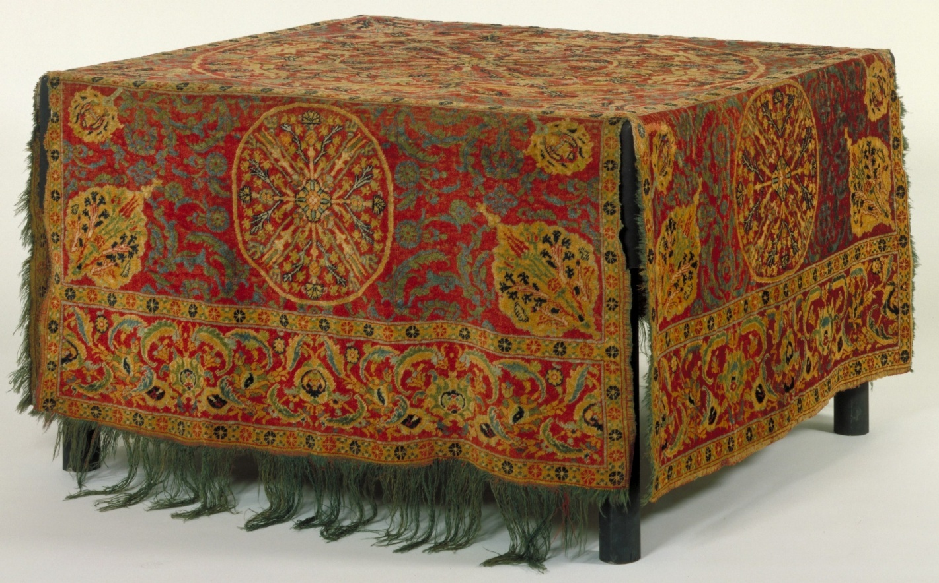
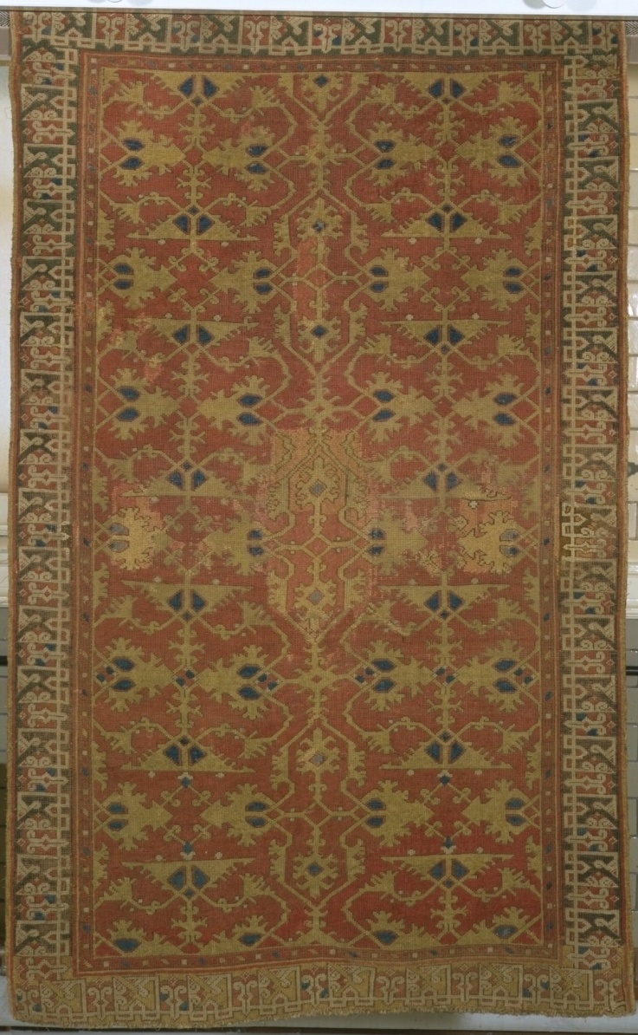
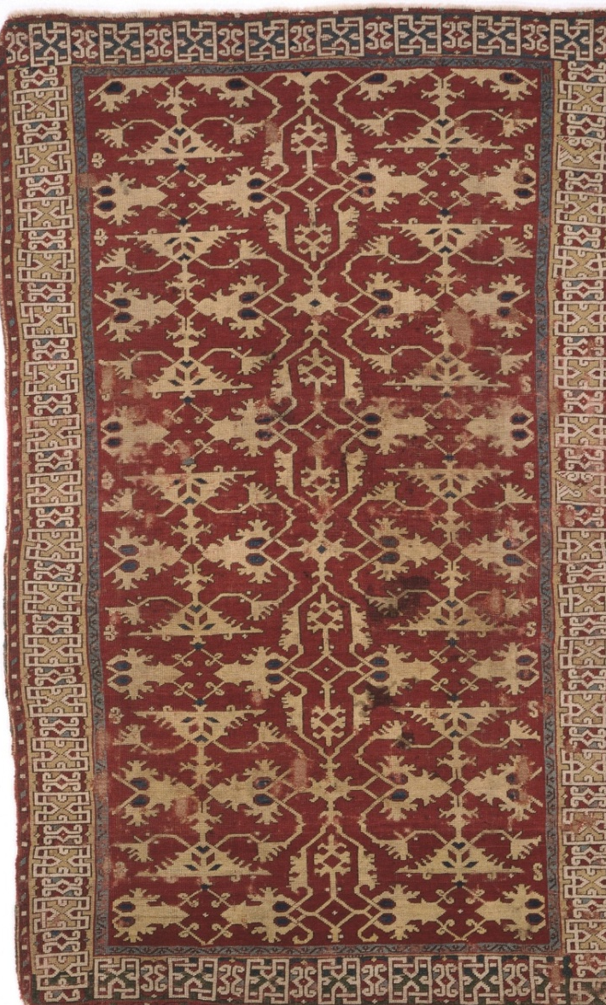
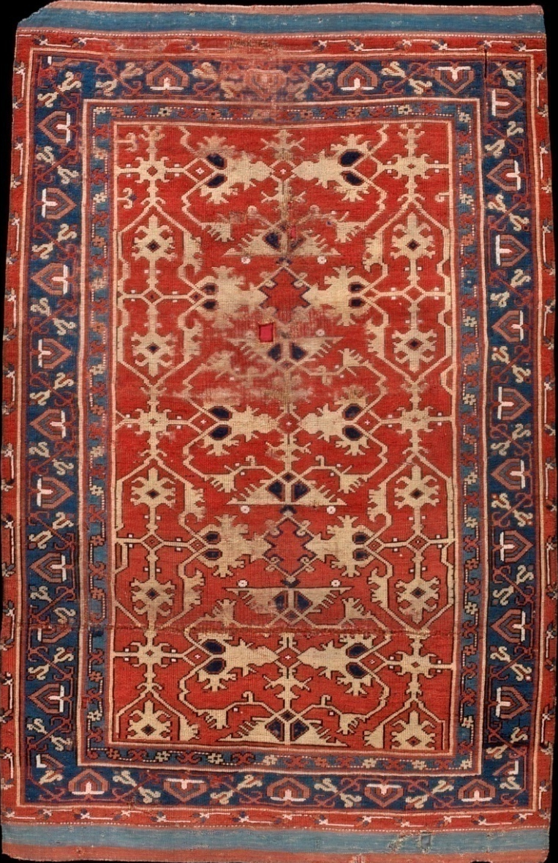
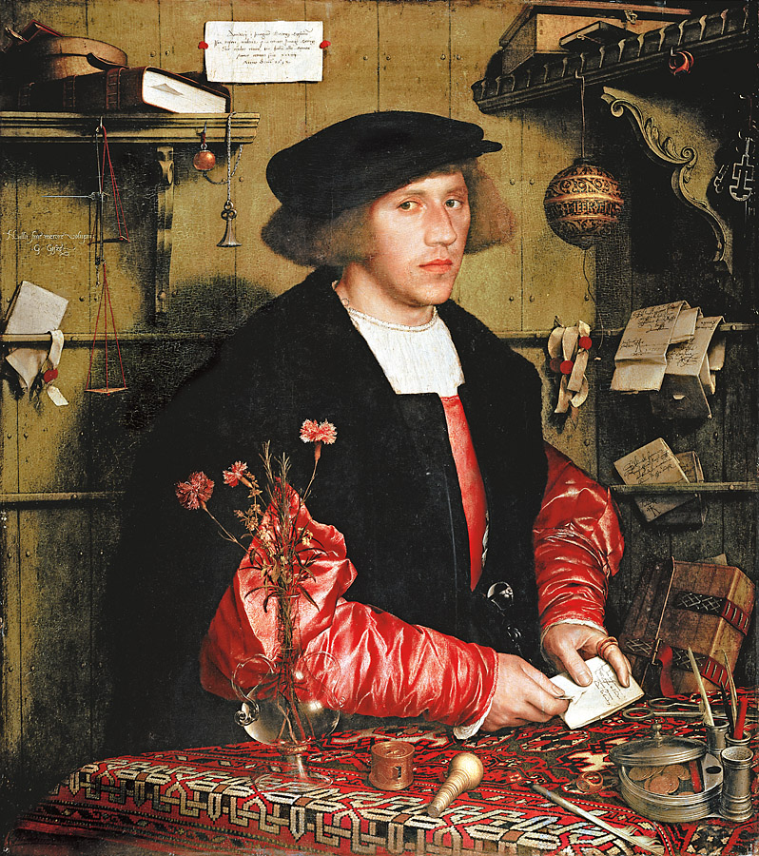
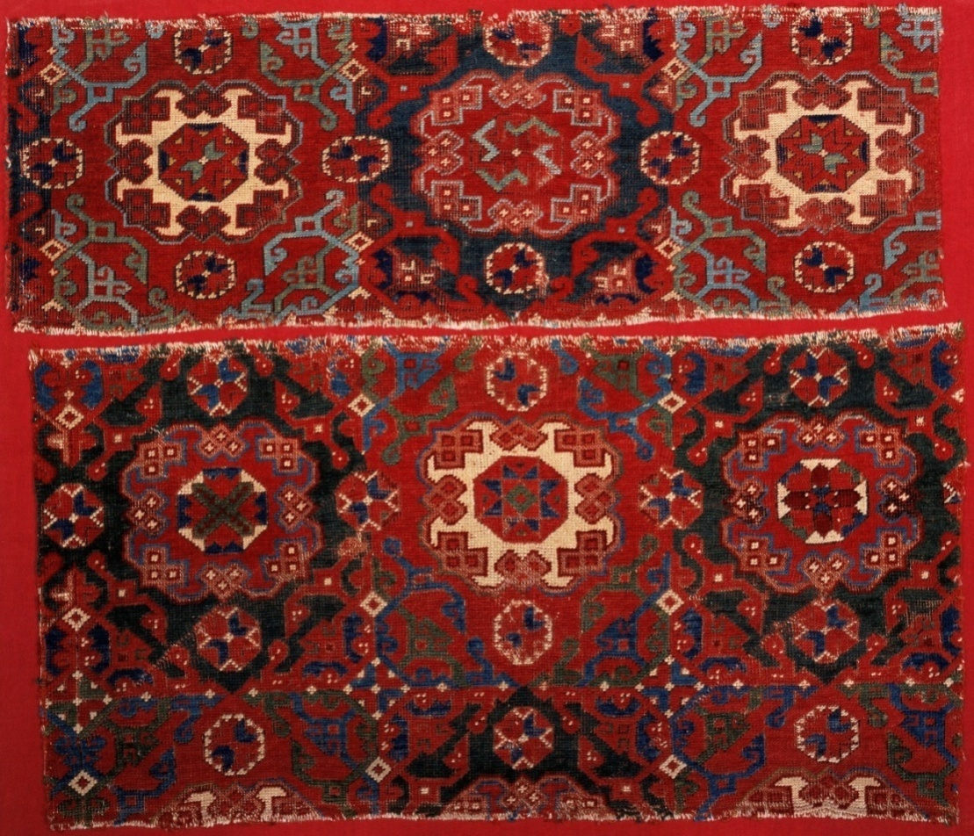
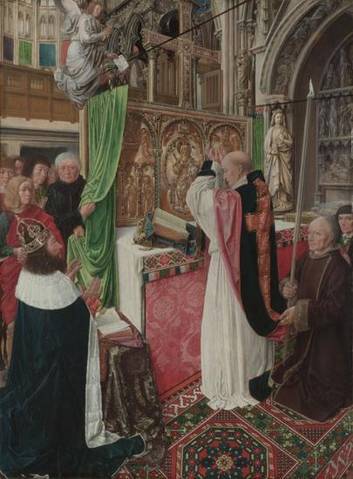
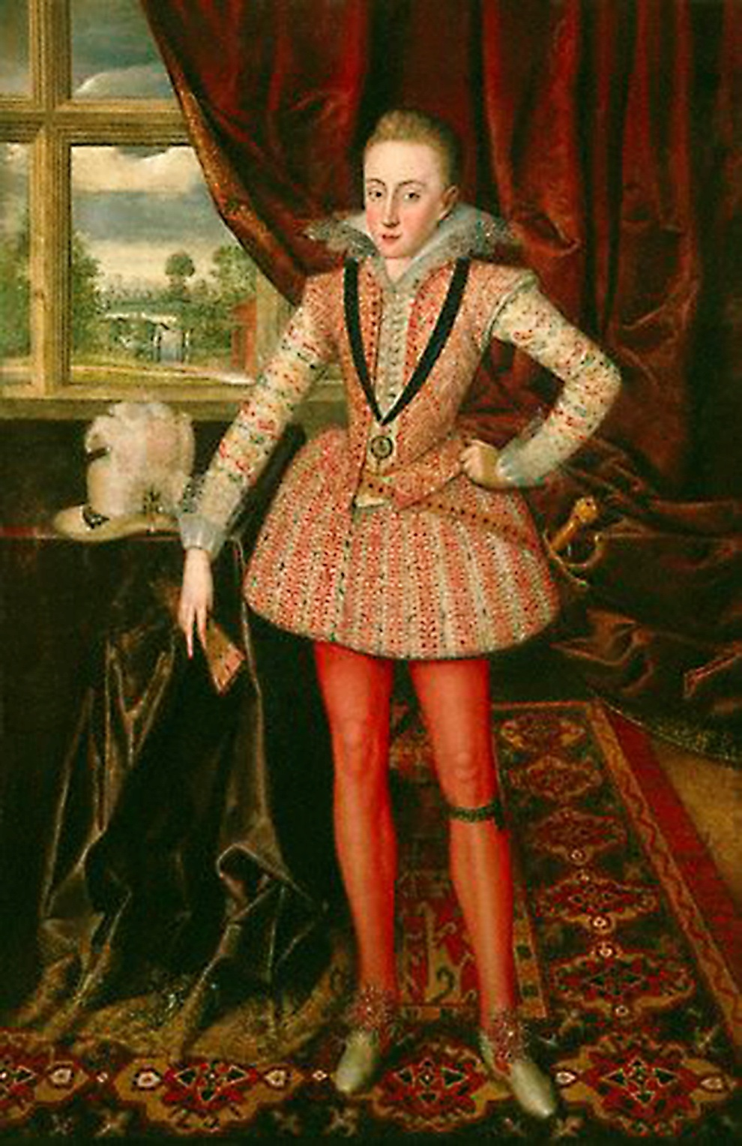
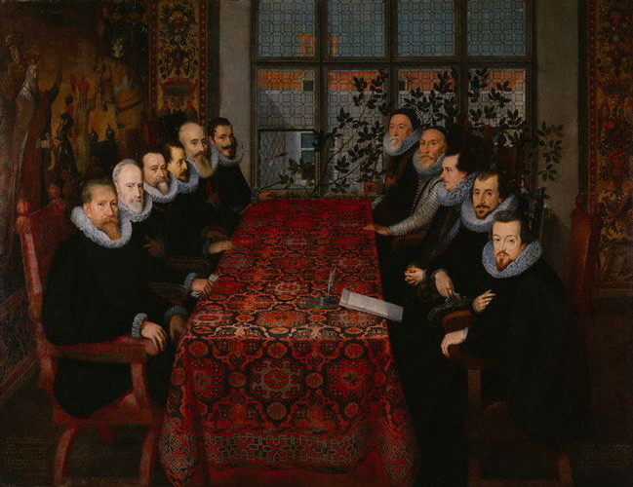
Flying Carpets?
Material Culture and the Global Trade of Turkish Carpets, c. 1400-1700
Rebecca Unsworth, History Department R.A.Unsworth@warwick.ac.uk
http://www2.warwick.ac.uk/fac/arts/history/postgraduate/eportfolios/hyuieo
Carpets like this must have been commissioned specially for a European audience, as the Turks did not use carpets on top of furniture.
Artefacts
A database of surviving carpets was created as part of this project, alongside a bibliography on early modern Turkish carpets, by collecting information from online and printed catalogues of museum collections. By comparing the carpets featured in the database to paintings and written sources, it was revealed that:
while a huge number of carpets must have perished, there are a reasonable number still existing
there were differences in the popularity of different patterns, sometimes between different European countries
there is a correlation between numbers of surviving carpets and painted representations for some carpet patterns, but not others
← Table Carpet, c. 1500
Introduction
The frequent occurrence of Turkish carpets in early modern European paintings shows that they were a popular global commodity at that time. This project aimed to examine Europe’s relationship with the Turkish carpet.
Paintings
The Most Popular Carpets
Lotto carpets emerged as seemingly the most popular type of carpet in Europe, with the largest number of both surviving examples and representations in paintings.
The Naming of Carpets
The relative lack of surviving Turkish carpets has led to a reliance on representations of carpets in European paintings. Because of this, many carpet patterns have been named after the artists who represented them; the carpet design below is known as a “Small Pattern Holbein” carpet.
Lotto Carpets, 16th – 17th Century ↑
↑ Small Pattern Holbein Carpet Fragments, c.1500
← Hans Holbein, George Gisze, 1532
Similarities Between Europe and Anatolia
The existence of a Large Pattern Holbein carpet like the one in this painting in the Vakiflar Carpet Museum in Istanbul shows that carpets were used to decorate religious spaces in both Europe and Anatolia, and that the same carpet patterns were consumed in both places.
The Problems with Paintings
Paintings do not always give the most reliable picture. Rather than representing a Turkish carpet pattern for which there are no surviving carpets, the carpet in the right-hand painting was probably either made in Europe or a work of the artist’s imagination, while an old carpet is depicted in the painting below, making the dating of that pattern difficult.
Master of Saint Giles, The Mass of Saint Giles, c. 1500 →
Conclusion
This project has shown the value of using actual carpets alongside paintings and written documents. Artefacts can also reveal information which the other sources cannot, such as the differences between the carpets which were exported to Europe and those which were used in Anatolia.
My Experience
This project has given me a taster of what independent academic research is like, and has confirmed to me that I want to continue with further study.
↑ Robert Peake, Henry Prince of Wales, c. 1610
← The Somerset House Conference, 1604
Project Supervised by Dr Giorgio Riello and Dr Anne Gerritsen, Global History and Culture Centre

