Slide 1
Matters of Life and Death:
An Introduction
Roberta Bivins
Department of History
University of Warwick
r.bivins@warwick.ac.uk

Slide 2
Welcome to ‘Matters of Life and Death’
Social Context, Historical Moment, Personal Experiences, Values and Interests
Question formation
Research
Source and research methods selection
Interpretation,
narration,
argument
Presentation and audiences
Let’s start with a question.
How (and why) do historians create and curate historical meaning?
Historical Subject

Slide 3
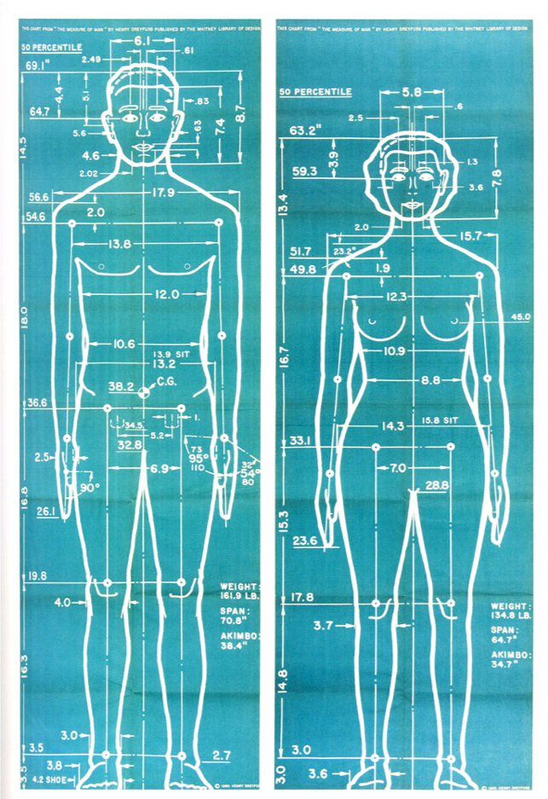
What’s ‘medical’ and what’s ‘historical’ about the history of medicine?
Why do historians need to read beyond their own specific sub-field and historical ‘object’?
HOW do historians read and write ‘outside the box’ (or just build a better/bigger box?
‘Joe and Josephine’: average – not perfect – Americans
in Henry Dreyfuss, Designing for People, 1955
See also this Working Paper and this fun website.

Slide 4
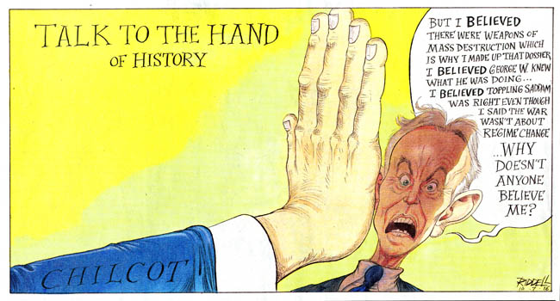
Navigating the module
The Interviews
Personalising the interview
Why interview historians?
How to make the authors ‘useful’?
How to learn from asking questions?
How does this text relate to my dissertation?
What are my personal interests?
What is hard for me in constructing historical analysis?
What do I want to learn?

Slide 5
Navigating the module: Using the Format
Part 1: Using the Team
Part 2: Using the Readings
Share your interests
Pool your skills
Choose leaders for each session
Establish your contribution to each session
How to use readings on topics close to your interests
How to use readings on topics far from your interests

Slide 6

The Structured Essay: Building on Critical Discussion
The readings
Choosing your pathway through the texts: the ‘theme’
Writing ‘in depth critical review of key historical works’
Developing ‘broader examination of the chosen theme’
Drawing on your conversations in the essay
Your Dissertation
Topic
The readings
Your interviews with the authors
Your interviews with the authors
The readings
Your Dissertation
Topic
Your Dissertation
Topic
The readings
Your interviews with the authors

Slide 7
Writing History in the Age of Biomedicine
Why this book?
A historian in conversation with himself
Curating a ‘body of work’ (or ‘article to book and back again’)
Theory, methodology, and YOU
Twists and ‘Turns’
Establishing the context of historical scholarship
Methods for(historical) moments – and/or for historical scholars

