Slide 1
Europe in the Making, 1450-1800 (HI113)
Early Modern Cosmologies
Dr Sophie Mann (s.mann.2@warwick.ac.uk)

Slide 2
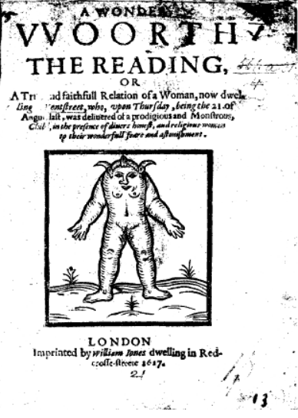
A Wonder Woorth Reading or A true and faithfull relation of a woman, now dwelling in Kentstreet who … deliuered of a prodigious and monstrous child (London, 1617)
“after long travel [labour], [the woman] was deliuered of a Female child with a halfe forehead, without any scull, hauing a faire proportioned body from the brest downward: the said child had its mouth & eyes miraculously placed in the sayd halfe forhead neere vpon the breast, vpon the said halfe fore-head lay a peece of flesh of two fingers thicke round about, the flesh being wonderfully curled like Gentlewomens attire… the eyes being very bigg staring and very firy red, which greatly terrifyed the midwife and all that were present”

Slide 3
A Wonder Woorth Reading or A true and faithfull relation of a woman, now dwelling in Kentstreet who … deliuered of a prodigious and monstrous child (London, 1617)
“How many warning peeces of his displeasure hath he discharged vpon thee (O England) … What blazing Comets, what Apparitions, What miraculous, Monstrous, and Prodigious births haue beene presented to our eyes … God, I say, who created all of nothing, can as easily diuert the vsuall and orderly course of procreation, into dreadfull and hideous deformitie”.
“euery honest heart, to apply this to his owne conscience, and seriously to weigh and consider the sinnes of the land in a holy consideration? then shall he clearely discerne this monstrous production, to be a mercifull message sent from the Almightie, for our further admonition and instruction… send out thy prayers & repentance to stop the violence of the Lords just anger breaking foorth against thee”

Slide 4
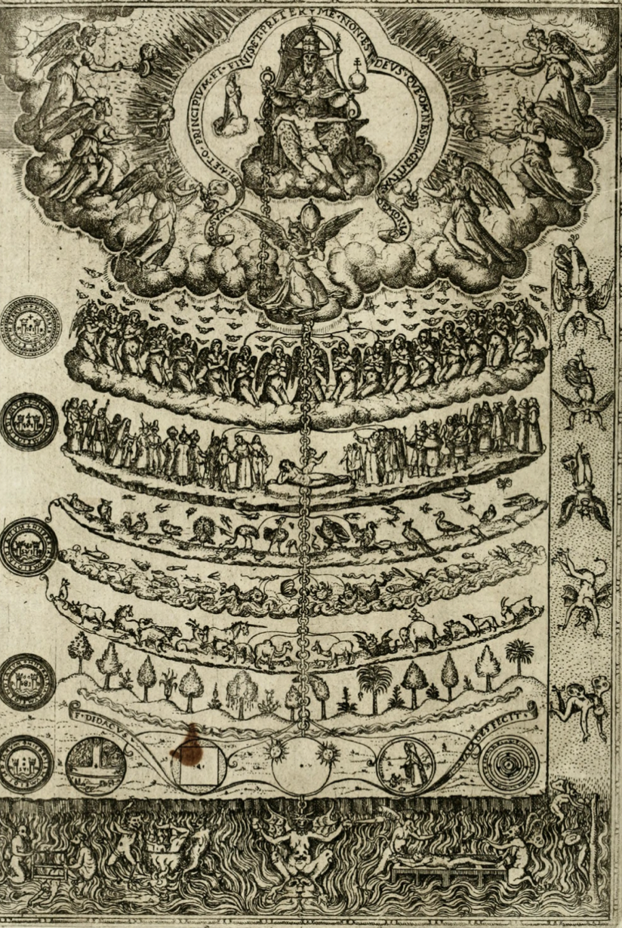
The Great Chain of Being, 1579

Slide 5
Definitions
“Natural”
The sublunary, material, physical world.
“Preternatural”
Used to refer to events that were extraordinary and not easily explicable by humans, but nevertheless possible according to the laws of nature. These events were often termed ‘wonders’, ‘marvels’ or ‘providences’, rather than miracles. Theologians commonly argued that wonders might be attributed to the agency of angels, the devil or demons, who were able to manipulate the forces of nature in ways that were beyond human capability.

Slide 6
Definitions
“Supernatural”
Constituted the work of genuine miracles. Only God could do this, only God could intervene supernaturally in the physical world and human affairs – that is, work above and beyond the realm of nature and natural law.
NB: while theologians worked to enforce these distinctions, the term ‘supernatural’ could be employed by early modern men and women to mean anything that had origins outside of the realm of human understanding and/or of being outside and beyond the workings of ‘natural causes’.

Slide 7
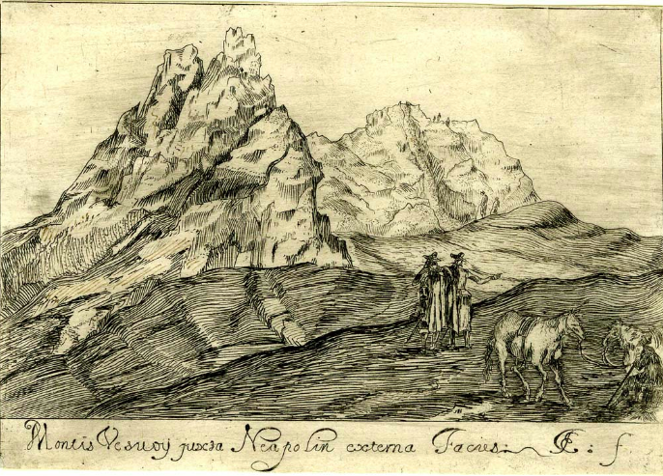
The Physical Environment
Print made by John Evelyn, ‘Twin Peaks of Mount Vesuvius’, 1649

Slide 8
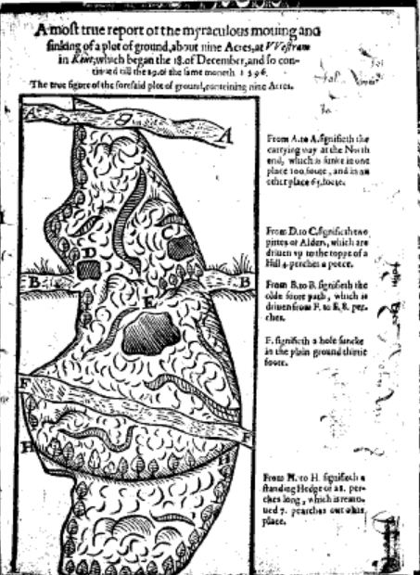
John Chapman, A most true report of the miraculous moving and sinking of a plot of ground … at Westram in Kent (London, 1597)
The displacement and sinking of this plot of ground was described as ‘a sensible testimony of His more certaine being’.
The supernatural event was to be regarded as a ‘heedfull document’ delivered by God to warn against ‘blasphemous contempt’ and impiety’.
4,000 people travelled from London to visit the site, and meditated on this ‘great opening of the earth’ which ‘stirres up in us a more strong and fruitfull impression of the great deitie’.

Slide 9
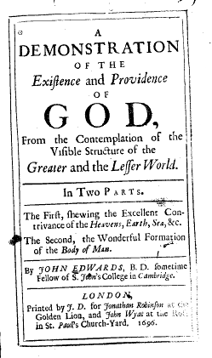
John Edwards, A Demonstration of the Existence and Providence of God from the Contemplation of the Visible Structure of the Greater and the Lesser World (London, 1696), pp. 144-54.
On Earthquakes:
‘There is a Supernatural Cause to be assigned… It should lead us directly to the acknowledgment of a Supream and All-Wise Agent, to whom only we can attribute such strange Effects’.
While the ‘Supernatural Cause’ was the ‘First Cause’, the Almighty worked through secondary ‘Physical Causes’.
These secondary ‘Physical Causes’ included ‘Heat’ and ‘Inundations of the Sea’, which cause ‘Commotion and disorder in the Earth’.

Slide 10
John Edwards, A Demonstration of the Existence and Providence of God from the Contemplation of the Visible Structure of the Greater and the Lesser World (London, 1696), pp.151-4.
“Though Earthquakes are thus resolved into Physical Causes, yet they are to be look'd upon as remarkable Testimonies of the Divine Power and Greatness …
This unusual Exertment of Divine Providence we of this Nation (as well as others) have lately felt with Surprise and Astonishment … Earthquakes, and the lesser Tendencies to them, as Tremblings of the Earth, are the Product of Natural Causes, yet it is as true that the God of Nature, when he is provoked by the Sinful Enormities of a People, may and oftentimes doth turn these Natural Effects into Punishments and Iudgments. So that both Philosophy and Divinity are concern'd here, and they are very well consistent”.

Slide 11
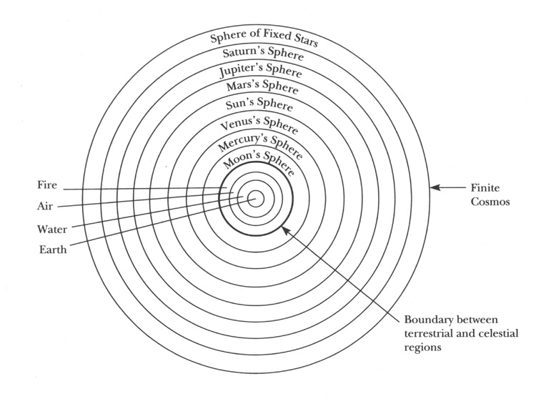
Aristotelian cosmos

Slide 12
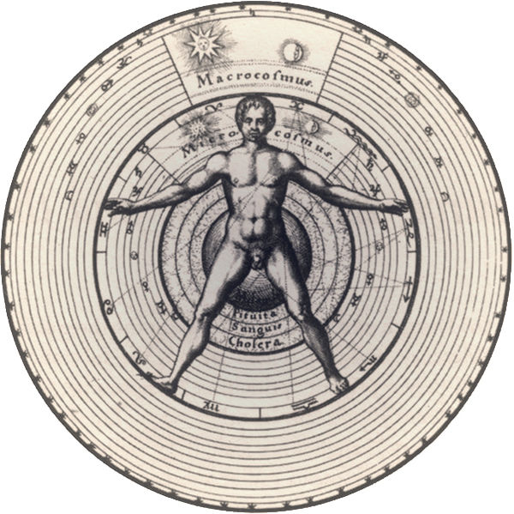
Micro-Macrocosm – Man as the mirror of the wider cosmos

Slide 13
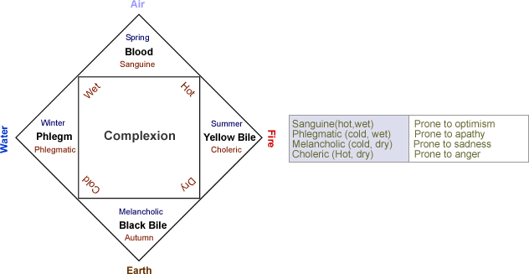

Slide 14
the six-non naturals: air, food and drink, sleeping and waking, motion and rest,
excretions and retentions, and the passions of the soul

Slide 15
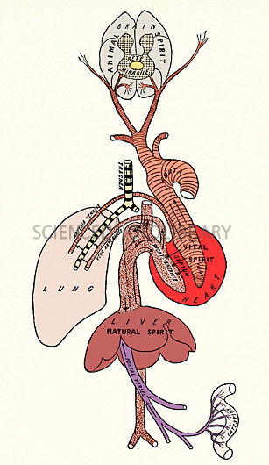
Spiritus: a subtle vapour produced in the blood and disseminated throughout the body by the arteries and nerves. It was considered to be the central source of activity in the living body.
Three forms:
1. natural spirit: resided in the liver, the center of
nutrition and metabolism
2. vital spirit was located in the heart, the center of
blood flow regulation and body temperature,
3. animal spirit was animal spirit was created in the
brain, the center of sensory perceptions and
movement.

Slide 16
the six-non naturals: air, food and drink, sleeping and waking, motion and rest,
excretions and retentions, and the passions of the soul

Slide 17
Religion, Morality and the Maternal Body
Early modern concepts of the cosmos, the natural world and the human body, were bound up inseparably with beliefs about God’s governorship.
In this context, the creation, the nourishment and the perfection of the foetus was divinely managed.
Childbirth pain was commonly interpreted through the lens of Genesis.
The pregnant woman as “God’s Workshop”.
Conduct literature and spiritual manuals emphasised that successful pregnancy and healthy babies depended on the social and moral behaviour of the mother-to-be.

Slide 18
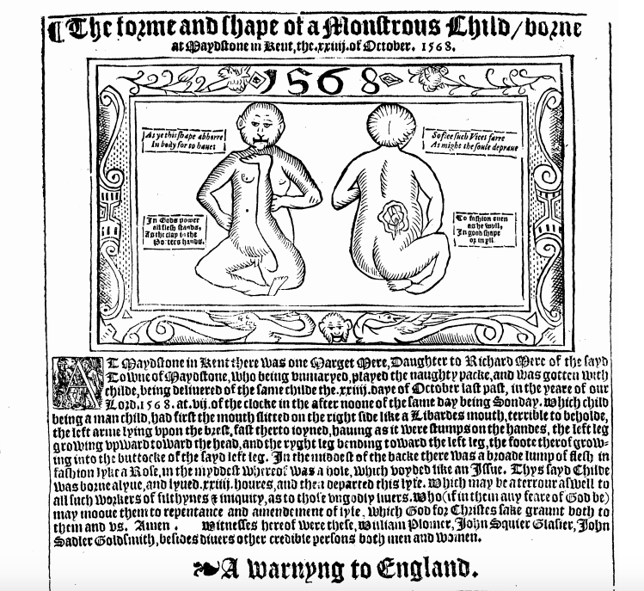

Slide 19
“In Gods power
all flesh stands,
As the clay to the
Potters hands.
To fashion euen
as he wyll
Jn good shape
or in yll”.
Margaret Mere “being unmarried, played the naughty pack and was gotten with child”
The gaping mouth “doth full well declare” human greed. The lack of fingers signified the sin of idleness.

Slide 20
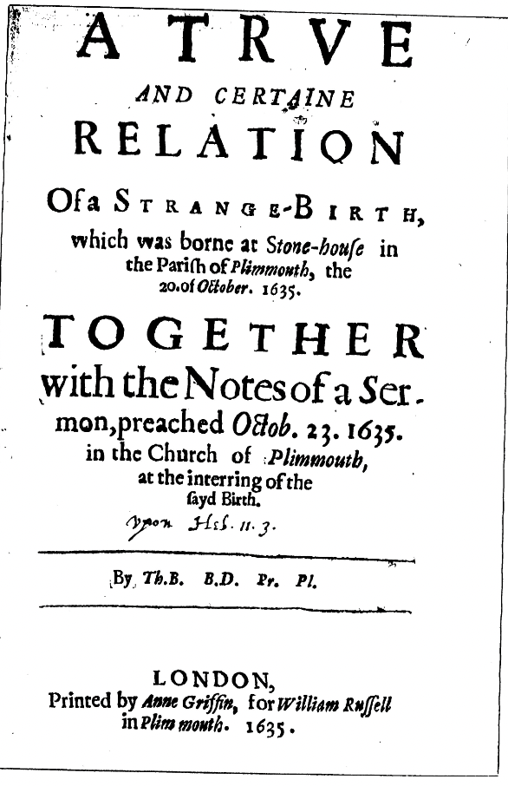
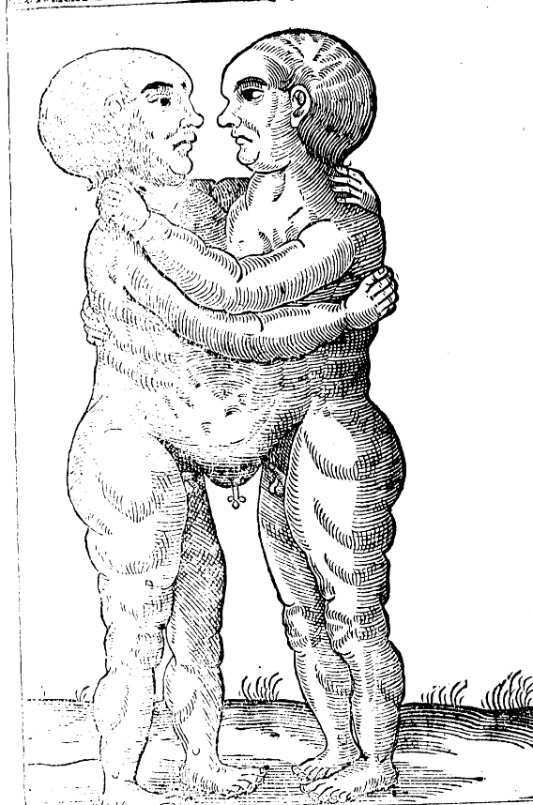

Slide 21
“Monsters and mishapen births”…
“It is the finger of God that hath beene here, and manifested his presence by hindering the common and ordinary course of Nature in the Birth of the Wombe.”
“For when any birth of ours is brought into the world misformed, and mis-featured … If God hath laid the black-finger of Deformity upon the body, Hath God written in great Letters the guilt of Sin, and in a deformed body drawn a resemblance of the Soules deformity”.

Slide 22
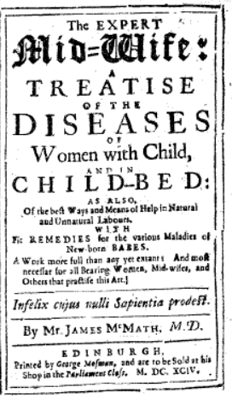
James MacMath, M.D., The Expert Midwife: A Treatise of the Diseases of Women with Child, and in Child-Bed (London, 1694), pp. 27-8.
‘Of the Infants Formation’:
‘All joyntly grows together into a compleat Child, an entire perfect System of the whole … finished and trimmed up by the most Skilful Hands of our great Creator’
‘The soul … infused thereinto (the fit time and minute none knows exactly, but God alone its Creator) by which the Motions of the Corporeal Soul, are thenceforth determined, ruled and tempered: And all the Constitutions, Concoctions and Elaborations of the Body, fixed as by Gods own Hand, and doing … The Finger of God, or Divine Power, the first Efficient Cause of all things’.

Slide 23
James MacMath, M.D., The Expert Midwife: A Treatise of the Diseases of Women with Child, and in Child-Bed (London, 1694), pp. 27-8.
‘On Monstrous Conceptions’:
First Cause:
‘remarkable Instances of Divine Vengeance, or Manifestations of the Works of God’…
The physician then moved from first causes (supernatural), to second causes. In particular, he reflected on the impact of the mother’s imagination, which was able to affect the physical body via the intermediary spirits.
‘the Embryo receives the ailment of its Monstrosity from the Ineptitude or Excess Inordination of the Animal Spirits: and their inusual Emotions and Determinations, from the Mothers strong Imaginations … marking upon it, (as it were Wax) things exactly represented in the Brain, and impressed upon the Animal Spirits, and Arterious Blood, and therewith conveyed to the Womb’.

Slide 24
How to approach unfamiliar belief systems as historians?
The beliefs and case studies reviewed in this lecture would have once been used to illustrate past ignorance and superstition. Is the assumption of ignorance a helpful starting point?
Today, historians take past belief systems on their own terms, they work to assess them in their own social and cultural context, and work to comprehend what made certain belief systems possible, truthful and rational at particular moments in time.
Knowledge produced about the human body, including scientific and medical knowledge, does not stand apart from the society and culture it inhabits.

